Slide 1
Management of 1st stage of labour

Slide 2


Prof. Umar’s Model of Teaching Strategy
Self Directed Learning Assessment Program
First Ten Minutes
Objectives :
To cultivate critical thinking, analytical reasoning, and problem-
solving competencies.
To instill a culture of self-directed learning, fostering lifelong
learning habits and autonomy.
How to Assess?
➢
Ten randomly selected students will be evaluated within the first 10 minutes of the lecture through 10 multiple-choice questions (MCQs) based on the PowerPoint presentation shared on Students Official WhatsApp group, one day before the teaching session.
➢
The number of MCQs from the components of the lecture will follow
the guidelines outlined in the Prof. Umar model of Integrated Lecture.
Component of LGIS
Core Know ledge
Horizontal Integration
Vertical Integration
Spiral Integration
No of MCQs
6-7
1-2
1
1

Slide 3
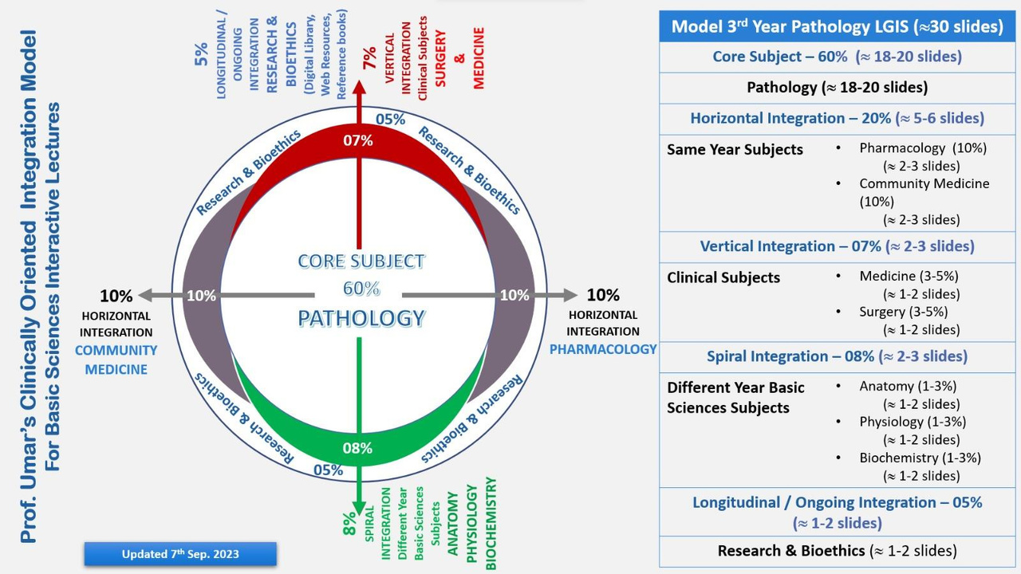
Professor Umar Model of Integrated Lecture
3

Slide 4
University Motto, Vision, Values & Goals
MISSION STATEMENT
To impart evidence-based research-oriented health professional education
Best possible patient care
Mutual respect, ethical practice of healthcare and social accountability.
VISION AND VALUES
Highly recognized and accredited centre of excellence in Medical Education, using evidence-based training techniques for development of highly competent health professionals, who are lifelong experiential learner and are socially accountable.
GOALS
The Undergraduate Integrated Learning Program is geared to provide you with quality medical education in an environment designed to.

Slide 5
SEQUENCE OF LGIS
Learning objectives
Management of First Stage of Labour
(Core concept = 70%)
Related anatomy of genital tract (Horizontal integration 15%)
Related clinical findings (vertical integration – 10%)
Research article related to topic (3%)
Ethics (2%)

Slide 6
LEARNING OBJECTIVES
At The End Of This Lecture Students Shall Be Able To Learn:
Stages of labour
Mechanism of labour
Plotting partogram
Interpretation of CTG

Slide 7
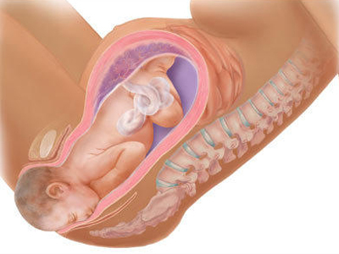
Labour
Definition
Presence of strong, regular uterine contraction resulting in diltation of cervix

Slide 8
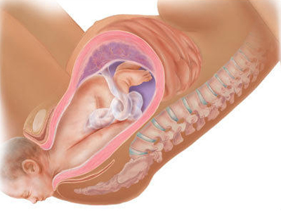
1st stage of labour
Time From diagnosis of labour to full dilatation of cervix(10cm)
Latent phase
Active phase

Slide 9
Latent phase
From onset of regular uterine contractions to 3-4cm dilatation of cervix
Duration 3-8hours in nullipara
Cervix becomes fully effaced

Slide 10
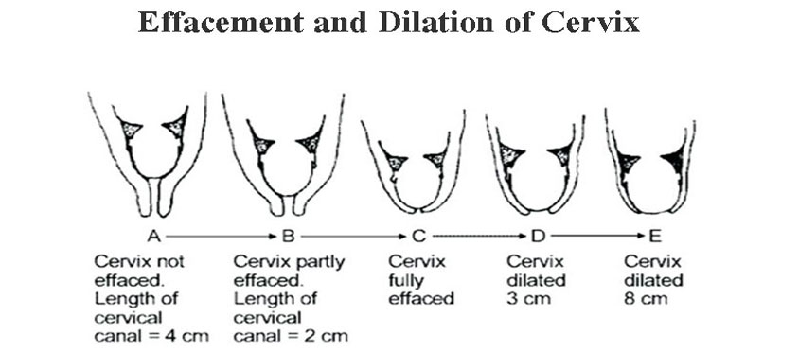
What is effacement
Shortening of cervical lentgth
Cevix gets in corporated in lower uterine segment
Consecutive event in nulliparous women and can occur simultaneously in multipara

Slide 11


Active phase
From the end of latent phase to full dilatation of cervix that is 10cm
Duration 2-6hours
Dilatation occurs at 1cm/hr

Slide 12
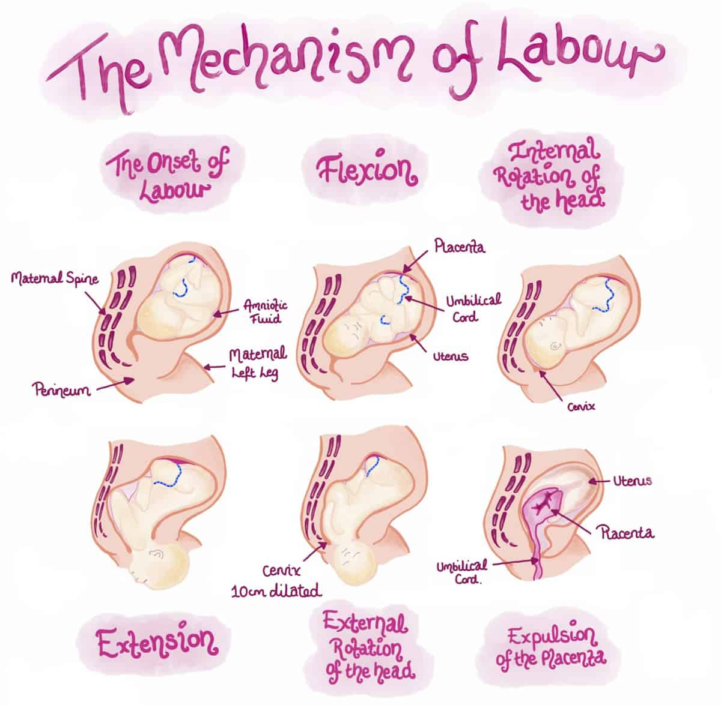
Physiology of labour
Changes in uterus
From a state of relaxation to an active state of regular , strong, frequent contractions which are
Coordinated
Followed by period of relaxation
Involuntary
Frequency of 2-4 per min
Duration of 30-60 sec
Amplitude of 30-60mmhg

Slide 13
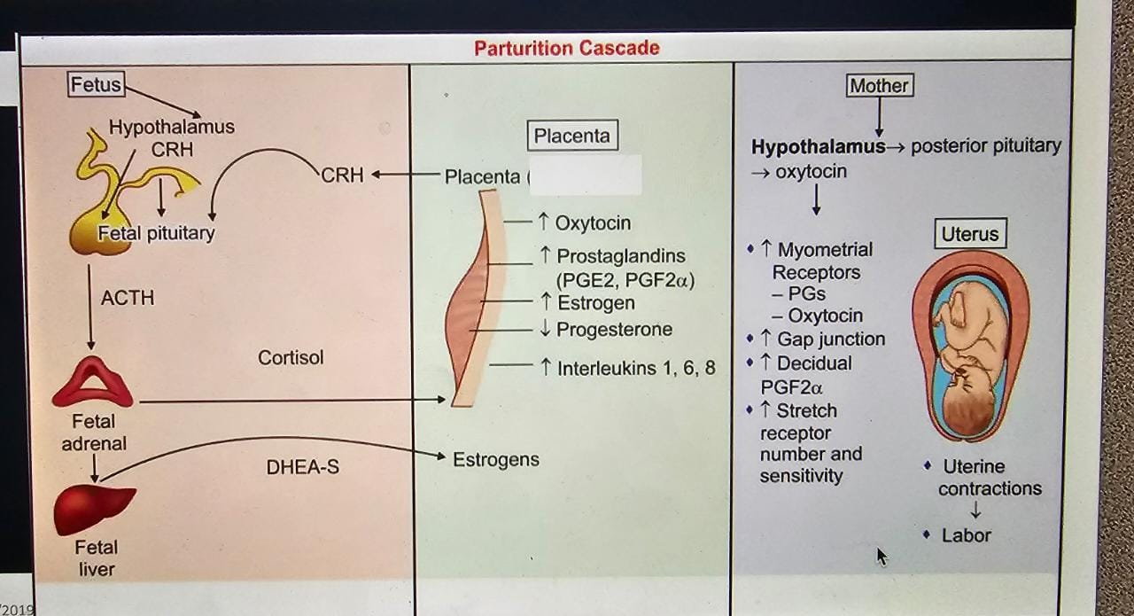
Hormonal factors
Progesterone
Estrogen
Prostaglandins
Cortisol
Oxytocin

Slide 14

progesterone
Increased fetal production of dehydro epiandrosterone sulphate (DHEA-S) and cortisol inhibits the conversion of fetal pregnenolone to progesterone
Progesterone levels therefore fall before labour.
It is the alteration in the oestrogen:progesterone ratio rather than the fall in the absolute concentration of progesterone which is linked with the prostaglandin synthesis.

Slide 15
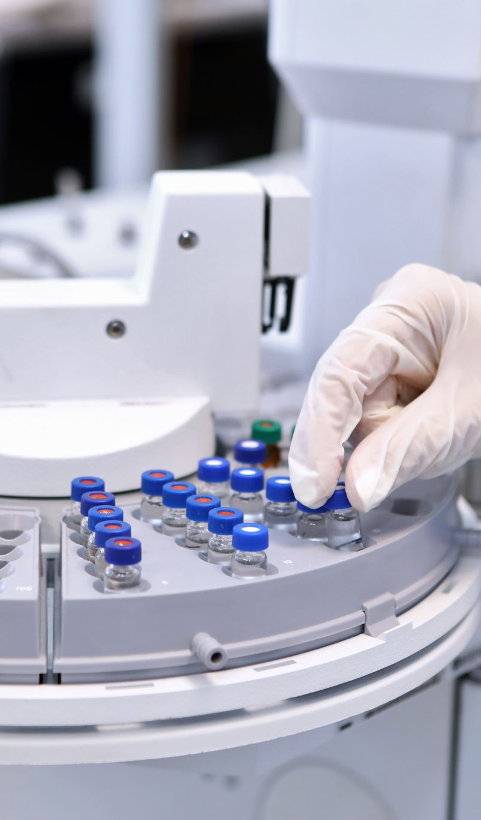
Prostaglandins
Prostaglandins are the important factor which initiate and maintain labour
The major sites of synthesis of prostaglandins are --
  Amnion, chorion, decidual cells and myometrium
Synthesis is triggered by -rise in oestrogen level, glucocorticoids, mechanical stretching in the late pregnancy, increase in cytokines, infection, vaginal examination, separation or rupture of membrane

Slide 16
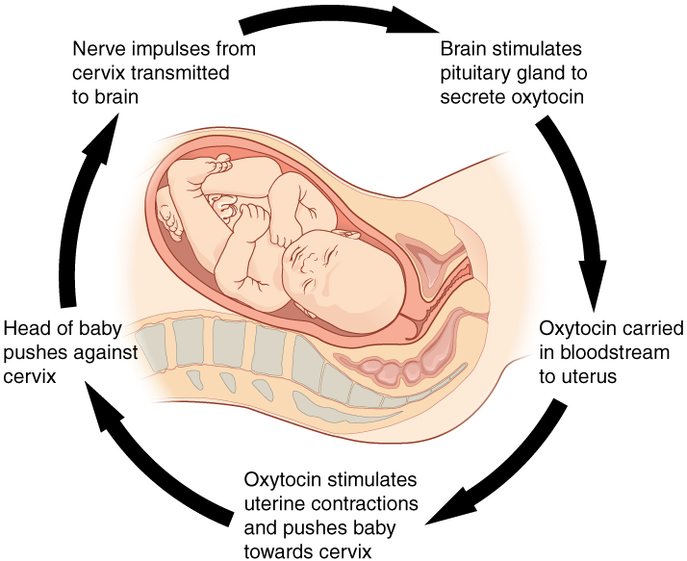
Oxytocin
Oxytocin receptors are increased in the uterus with the onset of labour.
Oxytocin promotes the release of prostaglandins from the decidua
Oxytocin synthesis is increased in the decidua and in the placenta
Vaginal examination and amniotomy cause rise in maternal plasma oxytocin level (ferguson reflex)

Slide 17

Neurological factors
Both beta and alpha adrenergic resceptors are present in myometrium; oestrogen causing the alpha receptors andprogesterone the beta receptoors to function predominantly.
The contractile response is initiated through the alpha receptors of the post ganglionic nerve fibres in and around the cervix and the lower part of the uterus.

Slide 18

Management of labour
History
Gpe
Abdominal examination
  Lie , scar, contractions

Slide 19
Vaginal examination
Cervix position , length ,effacement ,consistency, dilatation and application of presenting part
Position of fetal head, station,caput or moulding
Condition of membranes
Frequency of examination
Pulse hourly BP and temp 4hourly
Uterine contractions every 30mins
Vaginal examination 4 hourly

Slide 20
Fetal assessment
During uterine contractions blood flow to fetus decreases
May lead to metabolic acidosis
FHR monitoring should be done by
  Pinard stethoscope for 1 min after every contraction or after 15 mins in first stage of labour
  Continuous FHR monitoring by CTG if Meconium stained liquor, maternal pyrexia , PVB, augmentation of labour, maternal request

Slide 21

Management of 1st stage of labour
Latent phase
Should be managed away from labour suite
Clean and safe environment
Encouragement and reassurance
Avoid intervention unless risk factors are present
Do not restrict food and drinks
IV hydration if patient is dehydrated
Mild analgesic should be given
One to one care
Bladder and bowel

Slide 22
Examination
  Cervical dilatation
  Descent
  Membranes
  Matenal and fetal assessment

Slide 23
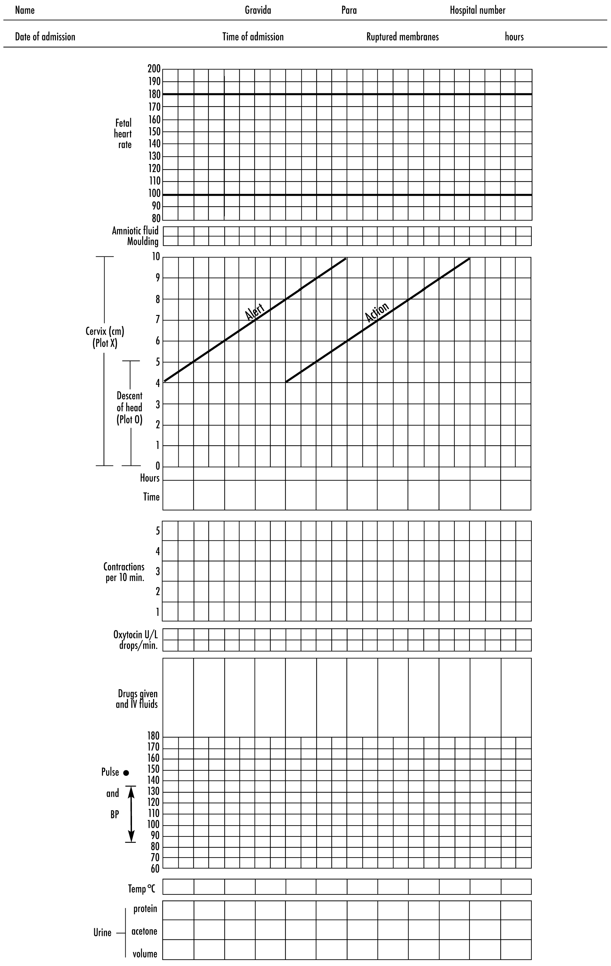
Partogram
Graphical record of progress of labour , maternal and fetal wellbeing and treatment administration
Benefits
Provides instant visual assessment of progress of labour based on cervical dilatation
Gives clear picture of normal and abnormal progress so that appropriate intervention can be done

Slide 24
Who recommends partogram for every labouring patient
Exclusion
  Prematurity
  Cervical dilatation 9-10cm on admission
  Elective C/S
  Fetal distress
  Pre eclampsia
  Diagnosed Cpd
  Malpresentation

Slide 25

Principles
Latent phase should not last longer than 8hours
Latent phase end and active phase starts when cervix is 4cm dilated
During active phase cervix should not dilate less than 1cm per hour
A lag time if 4hours is usually acceptable which is the distance between action line and alert line

Slide 26
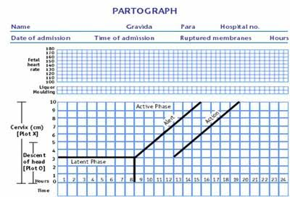

Slide 27
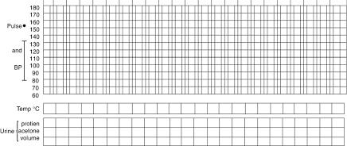
Recording the condition of mother
Bp,pulse, temperature
Urinary data
Volume
Proteins
ketones

Slide 28
Recording condition of fetus
FHR
Baseline FHR
Presence or absence of decelerations and if present whether early or late

Slide 29
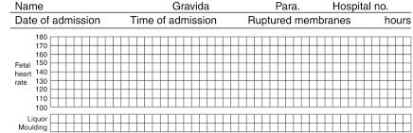

Slide 30
Liqour findings
I=intact membranes
C=clear liqour draining
M=meconium stained liquor draining
This should be recorded on each vaginal examination and when a change is noticed

Slide 31
Position of fetal head
By marking “o” with anterior fontanelle and sagital suture
Moulding of fetal head
Degree of moulding from 0 to +3
Duration of contractions
Stippled if contractions last less than 20sec
Stripped if between 20-40sec
Colour in complete if contraction last for more than 40 secs

Slide 32
Frequency of contractions
Occuring in 10mins is Recorded bymarking Of
1 block for each contraction
2 blocks marked off equals 2 contractions in 10 mins
5 block marked off if 5 or more than 5 contractions in 10mins

Slide 33
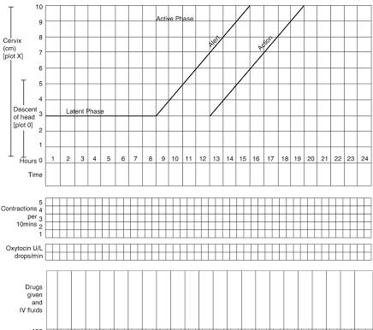

Slide 34
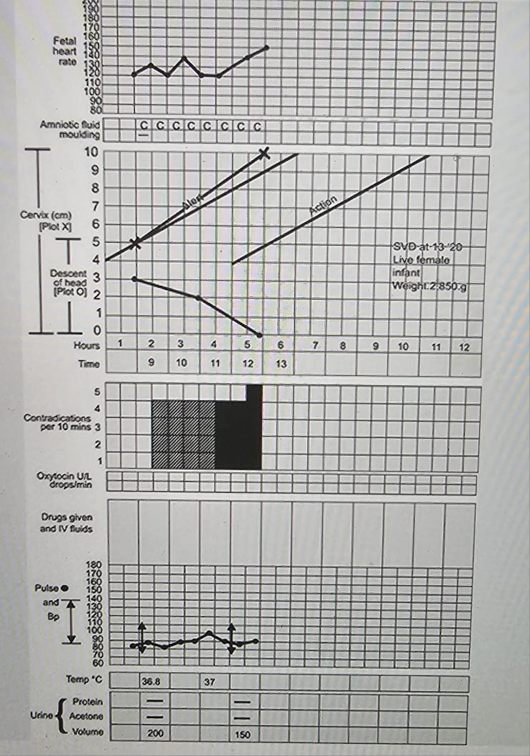

Slide 35
Drugs an IV fluids given during labour
The aim of drug
Dose of drug given
The time when the drug was given
Type ,time ,rate and amount of fluid given

Slide 36
Cardiotocography
Cardiotocography is a technique used to monitor fetal heart rate and uterine contractions during pregnancy and labour.
Primary purpose of fetal surveillance by CTG is to prevent adverse fetal outcomes.

Slide 37
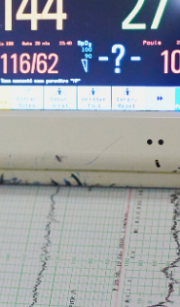
Components
Baseline fetal heart rate
Baseline variability
Accelerations
Decelerations

Slide 38

Baseline Fetal Heart Rate
Fetal heart rate (FHR) is the mean FHR when this is stable, excluding accelerations and decelerations.It is determined over a time period of 5- 10 minutes, expressed as beats per minute(bpm).
Range 110-160 b/m
Preterm fetuses tend to have values towards the upper end of the normal range.

Slide 39
Baseline Variability
It is the minor fluctuation in baseline FHR.
It is assessed by estimating the difference in bpm the highest peak and lowest trough of fluctuation in one minute segment of the trace.
Normal vriability 6-25 beats per minute.
Reduced variability 3-5 beats per minute.
Absent variability < 3 beats per minute.
Increased variability >25 beats per minute.

Slide 40
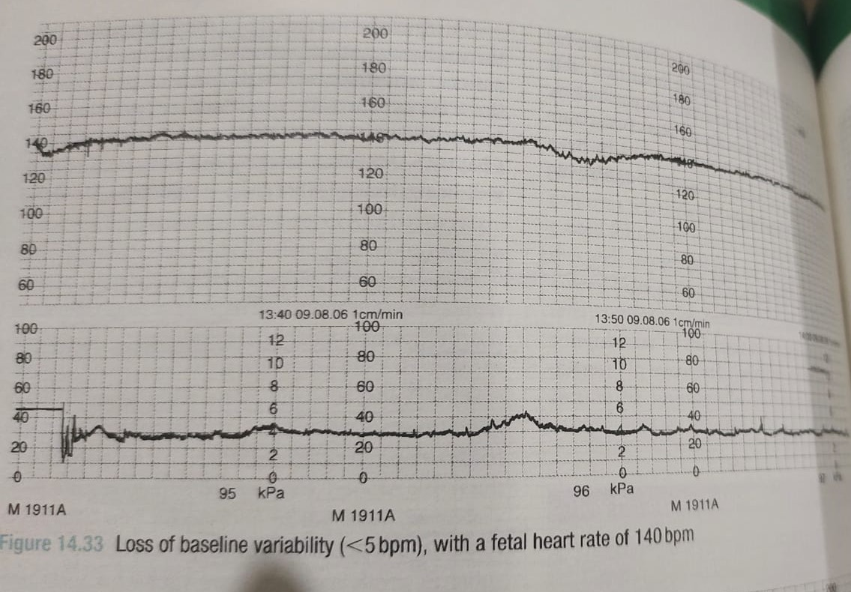

Slide 41
Acceleration
Accelerations are transient increases in FHR of 15 bpm or more above the baseline and lasting 15 seconds.
Accelerations in preterm fetuses may be of lesser amplitude and shorter duration.

Slide 42
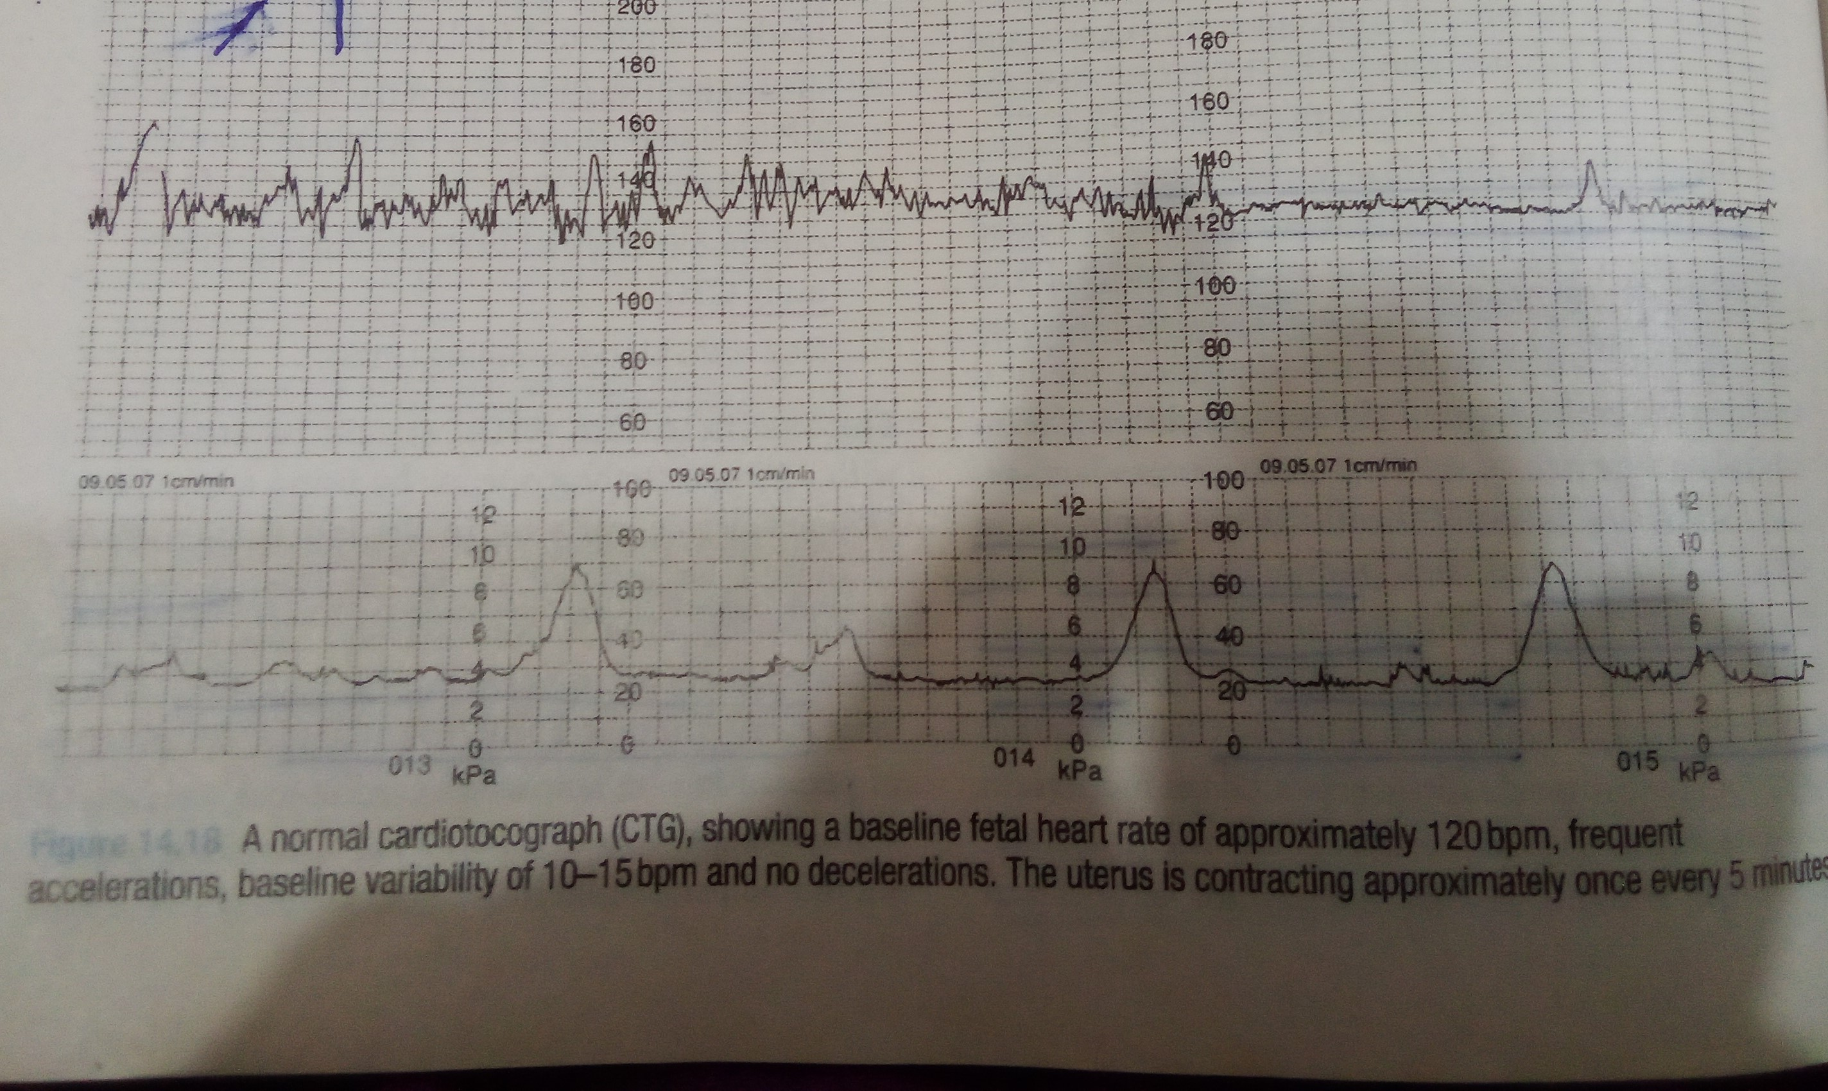

Slide 43
Decelerations
Decelerations are transient episodes of decrease of FHR below the baseline of more than 15 bpm lasting at least 15 seconds.
The fetus will not decelerate its heart rate without physiological provocation.
Uterine activity even in its mildest form will result in deceleration s in a fetus whose oxygenation is already compromised

Slide 44
Early Decelerations
These are benign and associated
Often occur when cervical dilatation is 4-8 cm
In general, these are normal physiological response to a mild increase in intracranial pressure.
Caused by head compression.
They are uniform in shape.
Start and finish with contractiions.

Slide 45
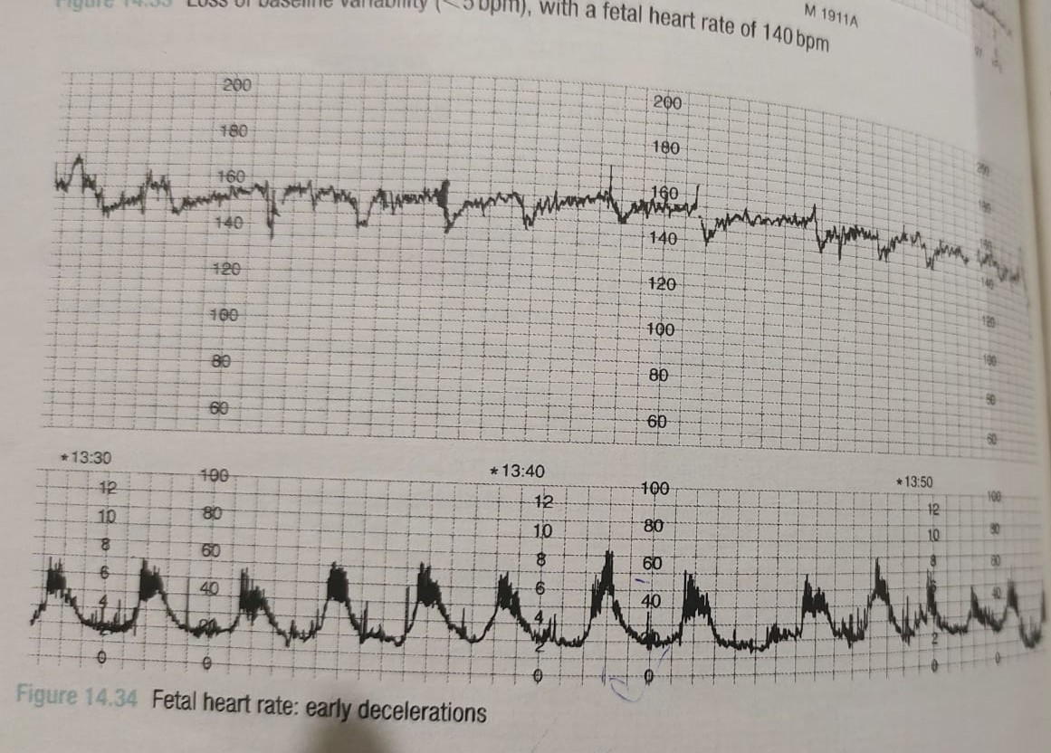

Slide 46
Variable Decelerations
These are a repetitive or intermittent decreasing of FHR with rapid onset and recovery.
Time relationship with contraction cycle may be variable but most commonly occur simultaneously with contractions.
Slow return to baseline heart rate after the end of contraction.

Slide 47
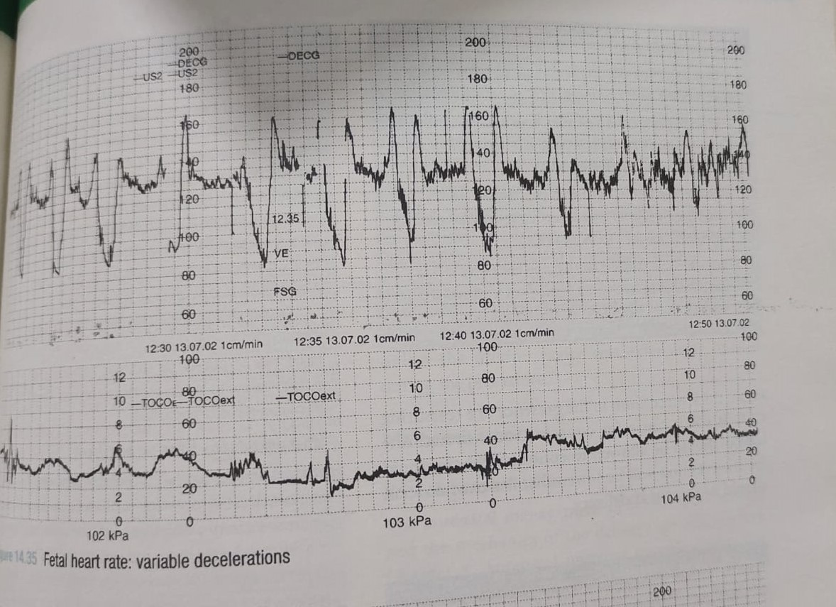

Slide 48
Late Deceleration
Late decelerations are defined as uniform, repetitive decreasing of FHR with, usually, slow onset mid to end of the contraction and lasting more than 20 seconds after the peak of the contraction and ending after the contraction.
Late decelerations are caused by contractions in the presence of hypoxia. This means that they will occur with each contraction and the fetus is already hypoxic.
They start after the start of the contraction and importantly, they return to the baseline after the contraction has finished.

Slide 49
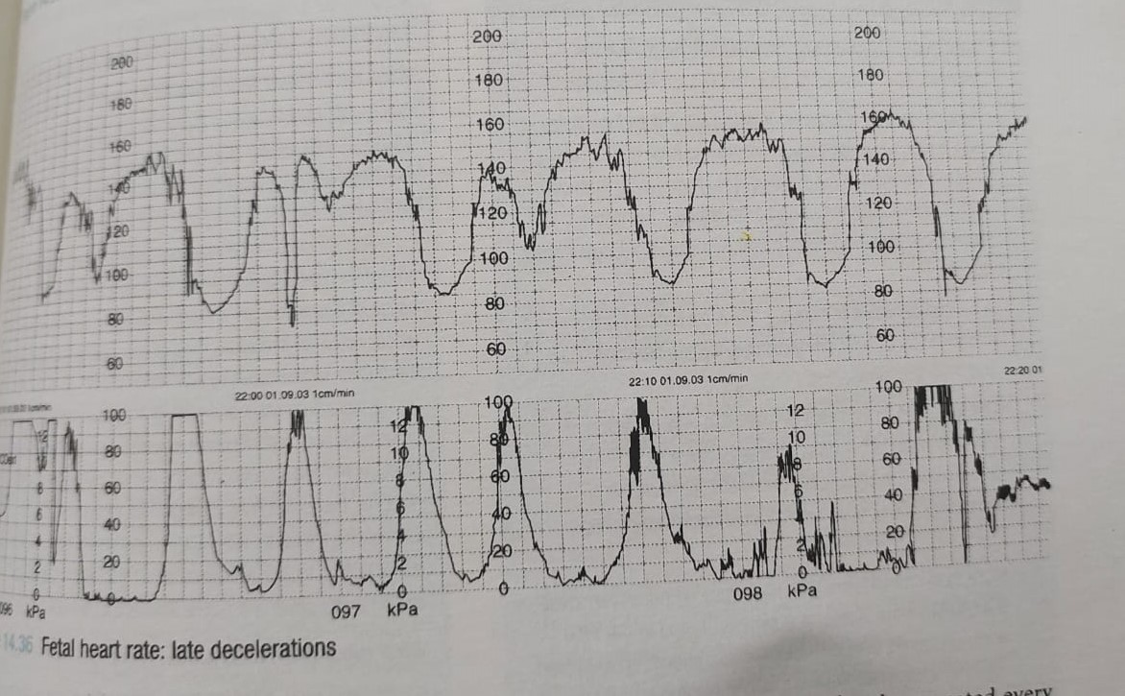

Slide 50
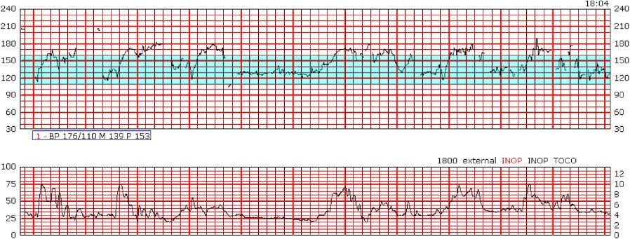
Normal reactive CTG
Baseline FHR 110-160
Variability of 5-25 bpm
Prescence of acceleration
Absence of decelerations

Slide 51
Interpretation of CTG During Labour
Each can be described as reassuring, non reassuring and abnormal.
Normal CTG
If all four features are reassuring , then CTG is considered as normal
Suspicious CTG
If one feature is non reassuring and other three are reassuring
Pathological CTG
If there are two or more non reassuring features or ay abnormal feature

Slide 52
Bioethics
autonomy and informed consent
healthcare providers must act in the best interest of both the mother and fetus, ensuring optimal conditions for a safe and healthy delivery.
avoiding unnecessary interventions that may cause harm, such as overuse of oxytocin, routine episiotomy, or prolonged continuous monitoring that limits mobility.
balancing risks of medical intervention versus expectant management is crucial to preventing unnecessary medicalization of labour.
access to quality maternity care should be equitable, regardless of socioeconomic status, race, or geographic location.
ethical concerns arise in resource-limited settings where access to pain relief, skilled birth attendants, and emergency obstetric care may be inadequate.
4. ethical use of pain management
5. medicalization vs. natural birth ethics
respecting individual preferences while ensuring safety.
the overuse of interventions, such as continuous fetal monitoring and elective inductions, must be weighed against the potential harms of an overly medicalized approach.
healthcare providers should respect and accommodate cultural birthing practices whenever they do not compromise safety.

Slide 53
Future RESEARCH
pasquale J, Chamillard M, Diaz V, Gialdini C, Bonet M, Oladapo OT, Abalos E, Algorithms Working Group FT, Ciabati L, De Oliveira LL, Browne J. Clinical algorithms for identification and management of delay in the progression of first and second stage of labour. BJOG: An International Journal of Obstetrics & Gynaecology. 2024 Aug;131:28-36.
Kogner L, Lundborg L, Liu X, Ladfors LV, Ahlberg M, Stephansson O, Sandström A. Duration of the active first stage of labour and severe perineal lacerations and maternal postpartum complications: a population‐based cohort study. BJOG: An International Journal of Obstetrics & Gynaecology. 2024 May;131(6):832-42.

Slide 54
Family medicine
Family physicians should know the Definition and Phases of the First Stage of Labour
Continuity of Care and Patient-Centered Approach
Low-Intervention Philosophy with Readiness for Escalation
Community and Rural Healthcare Considerations
Maternal and fetal Monitoring
Supportive Care and Comfort Measures
Pain Management
Management of Slow or Prolonged Labour
Recognition of Complications and Referral Criteria

Slide 55


