Slide 1
Eye lids
Dr Muhammad Rizwan Khan
MBBS,FCPS,FICS(USA)
Fellow in Paediatric Ophthalmology and Strabismus(K.E)
Senior Registrar/Consultant Holy Family Hospital,RMC
For Feedback Email:balochrizwan37@yahoo,com
03326379565

Slide 3
LEARNING OBJECTIVES
ALREADY DISCUSSED IN PREVIOUS LECTURE
PTOSIS
CHALAZION
STYE
DERMATOCHALASIS
CAPPILARY HAMANGIOMA

Slide 4
Topics to be discussed
Malignant Tumors
Disorders of Eyelid margins
Viral Infections

Slide 5
EYELID TUMORS
MOST TUMORS ARE OF CUTANEOUS ORIGIN
MOSTLY EPIDERMAL WHICH CAN BE DIVIDED INTO EPITHELIAL AND MELANOCYTIC
BENIGN EPITHELIAL LESIONS, CYSTIC LESIONS AND BENIGN MELANOCYTIC LESIONS ARE VERY COMMON.

Slide 6
Malignant tumors
Basal cell carcinoma:
BCC is the most common human malignancy.90% of the cases occours in head and neck and about 10% of these involve eyelids.
It Most frequently arise from the lower eyelid,followed in relative frequency by Medial canthus,upper eyelid and lateral canthus

Slide 7
The tumor is slowly growing but non METASTASIZING.
Typically affects OLD age groups
Most important Risks factors are
i-Fair skin
ii-Inability to Tan
iii-Chronic exposure to sunlight

Slide 8
Clinical features
Eyelid BCC generally conforms to one of the morphological pattern below
i-Nodular BCC:
Shiny,Firm,pearly nodule
Growth is slow and it may take the tumor 1-2 years to reach the diameter of 0.5cm.
ii-Noduloulcerative BCC(Rodent Ulcer):
Centrally ulcerated with pearly raised ROLLED EDGES,with time it may erode a large portion of eyelid.

Slide 9
Basal cell carcinoma

Slide 10
Sclerosing BCC(Morphoeic):
Less common,difficult to diagnose because it infiltrates laterally beneath the epidermis as indurated plaques.The lesion tends to be more extensive on palpation than inspection.

Slide 11
Squamous Cell Carcinoma
Less common but more aggressive tumor with METASTASIS to regional lymph nodes in 20% of the cases.
The tumor is most common in old age group with fair skin and chronic sun exposure.
It has predilection for lower eyelid and lid margin.
It may exhibit PERINURAL spread to intracranial cavity via orbit.
It may arise de novo or from pre existing actinic keratosis or carcinoma in situ(bowen disease,intraepidermal carcinoma)

Slide 12
Clinical features
The tumor may be indintinguishable clinically from BCC but the Growth is rapid and hyperkeratosis is more common.
Nodular SCC:
Hyper keratotic nodule that may develop crusting,erosions and fissures.
Ulcerating SCC:
it has a red base and sharply defined,indurated and everted borders.
Cutaneous horn:with underlying invasive SCC.

Slide 14
Treatment
Biopsy i- Incisional
ii-Excisional
Surgical excision:
Surgical excision aims to remove the entire tumor with preservation of as much normal tissue as possible. Smaller tumors can be removed via excision biopsy and the defect closed directly.

Slide 15
Reconstruction:
The techniques depends on the extent of tissue removed.
Smaller defects:
involving less than 1/3 of the lid can usually be closed directly. If necessary then a lateral cantholysis can be performed for increased mobilization.
Moderate size defects:
involving ½ of the eyelid may require a flap(Tenzel semicircular flap) for closure.

Slide 16
Direct clousure

Slide 17
Tenzel flap

Slide 18
Large defects:
involving more than half of the eyelid may be closed
posterior lamellar reconstruction may involve buccal mucosa membrane,upper lid free tarsal graft or hard palate graft.
Anterior lamellar reconstruction may involve skin adjustment,a local skin flap or a free skin graft.
Radiotherapy
Cryotherapy

Slide 19
For larger defects:

Slide 20
Disorders of Eyelids Margins.
Ectropion
It is a condition in which lid margin rolls outwards.
Types :
Involutional ectropion
Cicatricial ectropion
Paralytic ectropion/fascial nerve palsy
Mechanical ectropion

Slide 21
Involutional Ectrpion:
Involutional(Age-related)ectropion affects the lower lid of elderly pts.
Causes Epiphora(tear over flow) and may exacerbate ocular surface diseases. In long standing cases the tarsal conjuctiva may become thickened and keratinized

Slide 22
Involutional ectropion

Slide 23
Aetiological factors include:
i-Horizontal lid laxity.
ii-Lateral canthal tendon laxity.
iii-Medial canthal tendon laxity

Slide 24
Treatment :
The approach to repair depends on apparent causation and the dominant location of ectropion.
Generalized:
it is treated with the repair of horizontal lid laxity.Which is achieved with lateral tarsal strip procedure.

Slide 25
Excision of tarsoconjuctival pentagon is an Alternative that can be placed to excise an area of misdirected lashes or keratinized conjuctiva.
Medial ectropion,if mild,may be treated with medial spindle procedure though must often be combined with tarsal strip or lateral canthal sling procedure

Slide 26
Excision of Tarsoconjuctival pentagon

Slide 27
Medial canthal tendon laxity:
if marked,requires stabilization prior to horizontal shortening to avoid excessive dragging of punctum laterally.
Cicatricial ectropion:
This is caused by scarring or contracture of the skin and underlying tissues,which pulls the eyelids away from the globe.

Slide 29
Depending on the cause both lids may be involved
The defects may be local e.g. Trauma
It may be generalized e.g. burns,dermatitis,ichthyosis
Mild localized cases are treated with procedures that lenghtens vertical skin deficiency e.g Z-plasty
Severe cases can require transposition flaps or free skin grafts

Slide 30
Z-plasty

Slide 31
Mechanical ectropion
is caused by tumors on or near the lid margin the mechanically evert the lid.
Traetment: Involves removal of the cause if possible and correction of horizontal lid laxity.

Slide 33
Paralytic ectropion/fascial nerve palsy
It is caused by ipsilateral facial nerve palsy and associated with retraction of the upper and lower lids.
Complications: exposure keratopathy,watering.

Slide 34
Treatment:
Temporary measures may be instituted to protect the cornea in anticipation of spontaneous recovery of facial nerve function.
i-lubrication with tear substitute during day and ointment and taping of lids during night.
ii-botulinum toxin injection into levator to induce temporary ptosis.
iii-temporary tarsoraphy may be necessary

Slide 35
Permanent treatment should be considered when there is irreversible damage to the facial nerve as may occour following removal of Acoustic neuroma or when no further improvement has occoured for 6-12 months
i-Medial canthoplasty
ii-Lateral canthal sling or tarsal strip
iii-upperlid lowering Levator disinsertion.
iv-Gold weight implantation can assist clousre
v-A small lateral tarsorraphy is cosmetically acceptable.

Slide 36
Medial canthoplasty & lat canthal sling

Slide 37
Lateral canthal strip procedure

Slide 38
Weight implantation

Slide 39
Entropion:
It is a condition in which lid margin rolls inward.
Types
i- Involutional Entropion
ii-Cicatricial Entropion

Slide 40
Involutional entropion:
It effects mainly the lower lid.
Constant rubbing of the lashes on cornea in long standing entropion may cause irritation ,corneal punctate epithelial erosion
In severe cases,pannus formation and ulceration.

Slide 42
Aetiological factors include
Horizontal lid laxity: caused by stretching of the canthal tendon and tarsal plate
Vertical lid instability: caused by attenuation,dehiscence or disinsertion of lower lid retractors.
Over-riding of the pretarsal by the preseptal orbicularis during lid closure tends to move the lower border of tarsal plate anteriorly,thus

Slide 43
tipping the lid inwards.
Orbital septum laxity with prolapse of orbital fat into lower lid.
Treatment
Temporary protection must be short term
Options include lubricants,taping,soft bandges,contact lenses and orbicularischemodenervation with botulinum toxin injection.

Slide 44
Surgical treatment aims to correct the underlying problem as follows.
Over riding:
i-Transverse everting sutures
ii-Weis procedure(full thickness horizontal lid spiltting and insertion of everting sutures)
iii-Lower lid retractor reinsertion

Slide 45
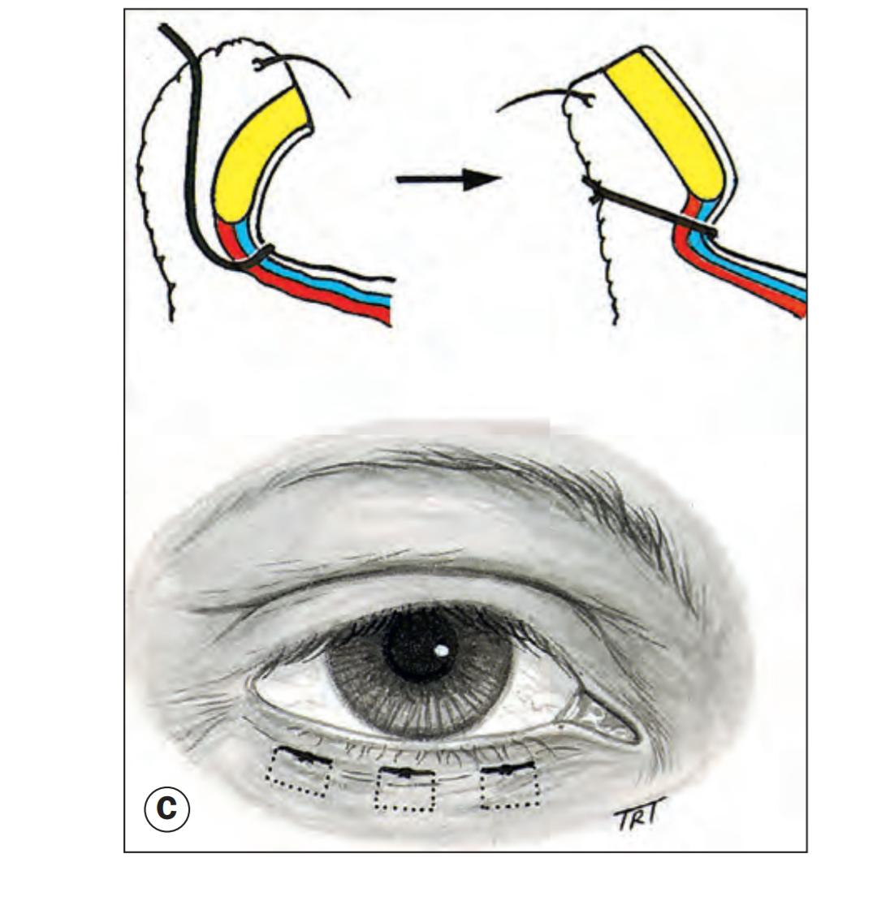
Transverse Everting sutures

Slide 46
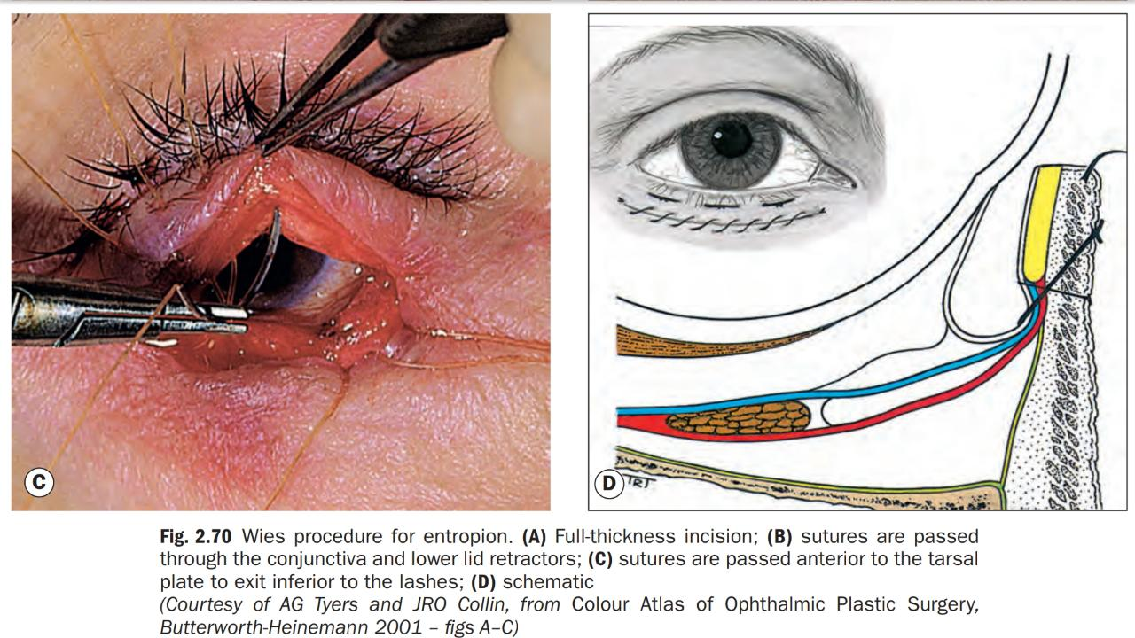
Weis procedure

Slide 47
Horizontal lid laxity:
Can be corrected with a lateral canthal sling(tarsal strip) or a full thickness lateral pentagon excision.

Slide 48
Cicatricial entropion:
Scarring of the palpebral conjuctiva can rotate the upper or lower lid margin towards the globe
Causes: cicatrizing conjuctivitis,trachoma,trauma and chemical injuries.

Slide 49
Definitive surgical treatment
Mild cases: by tarsal fracture(transverse tarsotomy) with anterior rotation of lid margin.
Severe cases: Treatment of severe cases is difficult and is directed at replacing deficient or keratinized conjuctiva and replacing the contracted tarsal plate with composite grafts.

Slide 50
Blephiritis:
It is chronic Inflamation of the lid margin.
Aetiology:
i- It follows chronic conjuctivitis due to staphylococcous aureus in childern who are living in poor hygienic conditions.
ii- Some parasites can also cause blephiritis e.g. Demodex folliculorum,phthiriasis palpabram,crab louse

Slide 52
Types
Squamous blephiritis:
It is due to abnormal metabolism and seborrhea.it is usually assosiated with dandraff of the scalp.
Numerous white coloured small scale accumulate among the eyelashes.
The eyelashes fallout readily but are replaced without distortion.
On removal of scales,the underlying surface is hyperamic

Slide 53
Ulcerative blepharitis:
it is an infective condition. The yellow crustglue the lashes together
On removing the crust there are small ulcers seen around the bases of the lashes. These ulcers bleed easily.
The eyelashes fall out and is replaced by misdirected lashes.

Slide 54
Diagnosis:
Involvement is usually bilateral and symemetrical.
Symptoms: are caused by disruption of normal occular surface functionand reduction in tear stability. Burning,grittines,mild photopobia and crusting of the lid margins with remissions and exacerbations are charateristic.

Slide 55
Sequelae:
Trichiasis-this condition due to misdirected lashes
tylosis-thickening or hypertrophy of lid margin.
Madarosis-absence of or scanty eyelashes as a result of destruction of hair roots
Ectropion-Eversion of the lid margin
Epiphora-constant watering of eyes

Slide 56
Treatment
Lid hygiene can be carried out once or twice daily initially.
Antibiotics
Plant and fish oil supplements
Topical steroids
Tear substitues

Slide 57
Trichiasis
It is a condition where eye lashes are misdirected backwards rubbing against the cornea. A few lashes or whole lid margin may be involve.
Aetiology
Entropion due to cicatrization in trachoma
Spastic entropion in old people or due to tight bandge.
Blephiritis specially ulcerative.

Slide 59
It may occur after recurrent stye.
Scars of lid following burn,injury or operation may cause trichiasis.
Diagnosis
symptoms: Forigen body sensations
Photophobia,irritation,pain,alcrimation, conjuctival congestion
Signs:
Reflex blepharospasm and photophobia
Superficial corneal opacities are often present.

Slide 60
Complications:
recurrent errosion and corneal ulcer are common complications
Treatment:
Isolated cilia
i-epilation of misdirected lashes is repeated every few weeks.
ii-Electrolysis:causes destruction of hair follicle
Whole lid margin involved –operative procedures as for entropion.

Slide 62
Viral Infections
Herpes zoster virus:
Herpes zoster is common and has been astimated the one in three people will develop the condition in lifetime.
Pathogenesis
herper zoster ophthalmicus is the term used for shinglesinvolving the dermatome supplied by the ophthalmic division of 5th cranial nerve(trigeminal)nerve. Occular involvment can also occour when the disease affects the Maxillary Division alone

Slide 64
The virus may travel in a retrograde manner to the dorsal root and cranial nerve sensory ganglia,where it may remain dormant for decades,with reactivation is thought to occour after specific cell mediated immunity has faded.
Mechanism of occular involvement
Direct viral involvment may lead to conjuctivitis and epithelial keratitis.
Secondary Inflamation may cause episcleritis ,scleritis,keratitis,uveitis,optic neuritis and cranial nerve palsies,post herpetic neuralgias.

Slide 65
Reactivation causes necrosis and inflamation in the affected ganglia,causing corneal anastheia that may result in neurotrophic keratopathy.
Risk of occular involvment
Hutchinson sign: describes vesicles in the skin supplied by external nasal nerve.Vesicles involving side and tip of the nose may preccede to ophthalmic herpes zoster.
Age : HZO most frequently occours in 5thor 6th decades,in elderly sign and symptoms are tend to be more severe.

Slide 66
AIDS: These pts tend to have more severe disease and shingles can be an early indicator of HIV.
Acute shingles
General features:
A prodromal phase preccedes the appearance of rash.it lasts 3-5 days and is charaterized by tiredness,fever,malaise and headache. Symptoms involving the affected dermatome vary from itching,tingling or burning sensation to a severe boring or lancing pain.

Slide 67
Skin leisions:
Painful erythemaous areas with maculopapular rash develop.
Group of vesicles appear within 24 hrs and these become more confluent over 2-4 days. Vesicles often pass through a pustular phase before they crust and dry 2-weeks.
Lesion heal to leave a residual skin destruction and depigmented scars.

Slide 68
Dessiminated zoster:
Involving multiple Dermatomes and organ systems may develop in immunodeficiency.
INVESTIGATION:
Vesicular fluid can be sent for PCR or immunomicroscopy.
PCR of plasma for VZV DNA may be positive(40%).IgM antibodies to VZV are found only in a minority of early stage patients.
vz

Slide 69
Treatment
Oral antiviral Treatment:
optimally given within 72 hrs of rash onset,reduces the severity and duration of the acute episode and risk of post herpetic neuralgia.
patients presenting after 72 hours but still at the vesicular stage also derive benefit for treatment.Aciclovir 800mg five times daily for 7-10 days has been the mainstay of treatment.

Slide 70
Newer agents valaciclovir 1g thrice daily or famiciclovir 250-500mg three times daily have more convinient regimens are better tolerated and atleast as effective as aciclovir.
Intravenous aciclovir 5-10mg/kg three times daily is generally indicated for severe disease.
Systemic steroids commonly used in moderate-severe disease,particularly for neurological complains.

Slide 71
Symptomatic treatment for skin leisions is by drying,antisepsis and cold compressors.
Patients with shingles can transmit chickenpox so that contact with people not known to be immune and immunodeficient individuals should be avoided atleast until crusting is complete.

Slide 72
Prevention
Vaccination against herpes zoster reduces the incidence of HZO. Two vaccines are available and approved for individuals over the age of 5o years
Zoster vaccine live
Recombinant zoster vaccine

Slide 73
Herpes simplex
Herpes simplex skin rash results from either primary infection or reactivation of herpes simplex virus previously dormant in trigeminal ganglion.
Prodormal facial and lid tingling lasting about 24hrs is followed by eyelid and periocular skin vesicles that breakdown over 48hrs.

Slide 75
Typically confiened to a single dermatome.
Commonly associated pappillary conjuctivitis,lid swelling and discharge.
Dendritic corneal ulcers can develop,especially in atopic pts in whom skin involment (eczema herpeticum) can be extensive and very severe.

Slide 76
Treatment
Inflamation will gradually settle without treatment over about a week.
If necessary a topical or oral antiviral agent can be used.
Antibiotics may also require in pts with secondry infection. Particularly common in eczema herpeticim.

Slide 77
COMMUNITY MEDICINE
EDUCATING REGARDING LID HYGIENE (TRACHOMA, BLEPHRITIS, STYE, HERPES)
SCHOOL HEALTH NUTRITION PROGRAMS IN EVERY UNION COUNCIL OF PUNJAB FOR SCREENING PURPOSES ARE ALREADY FUNCTIONAL.

Slide 78
RESEARCH AND ETHICS
https://pubmed.ncbi.nlm.nih.gov/32843744/
https://pubmed.ncbi.nlm.nih.gov/31567695/

