Slide 1


Slide 2
Eye Lids
Dr Muhammad Rizwan Khan
MBBS,FCPS,FICS(USA)
Fellow in Paediatric Ophthalmology and Strabismus(K.E)
Senior Registrar/Consultant Holy Family Hospital,RMC
For Feedback Email:balochrizwan37@yahoo,com
03326379565

Slide 3
Topics to be discuss
Anatomy
Ptosis
Non Neoplastic Lesions
Benign Tumors

Slide 4
LEARNING OBJECTIVES
Drescribe the infective lesions of lid-stye/blepharitis and their treatment
Enlist the inflammatory lesions of lid like chalazion and their treatment
Discuss the common lid tumors and their clinical presentations
Discuss the Eye - Lash abnormalities.
Describe the pathologies like Trichiasis ,ectropion / entropion and ptosis

Slide 5
Applied Anatomy
The eyelids are two moveable folds of tissues infront of the eye,the eyelashes situated on their free edges.The layers of the tissues which form eyelids are
Thin covering of skin
Thin sheet of areolar tissues
Three muscles(the orbicularis oculi,levatorpalpebrae superioris,
Muller’s musclr)

Slide 6
A sheet of dense connective tissue(tarsal plate)
A lining of palpebral conjuctiva
Glands of eyelids
Meibomian glands
Glands of Zeis
Glands of Moll

Slide 7
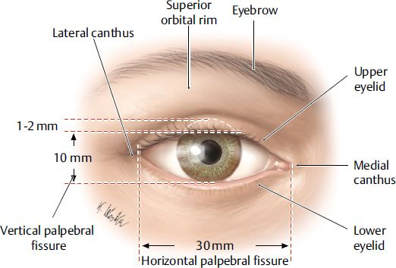

Slide 8
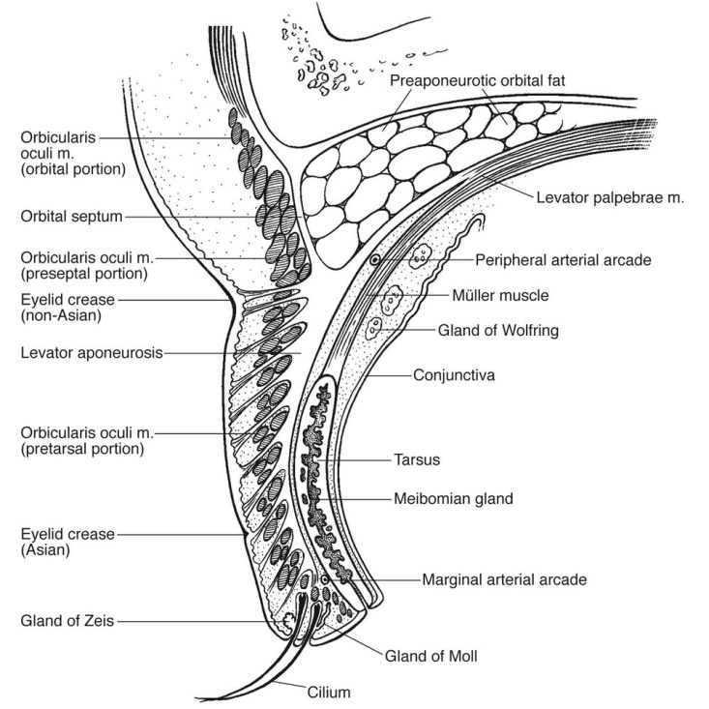

Slide 9
Blood supply
it is supplied by ophthalmic and lacrimal arteries.
Nerve supply
the 7th cranial nerve supplies the orbicularis oculi muscle
the 3rd nerve supply levator palpaberae superioris
sympathetic nerve supply muller muscle
Sensory supply is by ophthalmic division of 5th nerve

Slide 10
Ptosis
Classification
May be congenital or acquired
i-Neurogenic (3rd nerve paresis and horner syndrome)
ii-Myogenic (myopathy of levator muscle,impairment of transmission of impulses at NMJ)
iii-Aponeurotic or involutional (defect in levator aponeurosis)
iv-Mechanical (grvitational effect of mass )

Slide 11
PATHOPHYSIOLOGY
PHYSIOLOGY.
  PROTECTION
  ADEQUATE TEAR FILM DISTRIBUTION AND DRAINAGE
  GLANDS SECRETE LUBRICATIONG FLUID
PATHOLOGY.
  INVOLUTIONAL (AGE RELATED)
  EYELID DISORDERS (LOSS OF MUSCLE TONE)
  DERMATOCHALESIS AND APONEUROTIC PTOSIS

Slide 12
Clinical Evaluation
The age of onset and its duration.
Its important to enquire about symptoms of underlying systemic disease such as associated diplopia,variability during day and excessive fatigue

Slide 13
Pseudoptosis
A false imperssion of ptosis may b caused by following.
i-Lack of support by the globe (artificial eye,pthisis bulbi,enophthalmos)
ii-Contralateral lid retraction
iii-Ipsilateral hypotropia causes pseudo ptosis
iv-Brow ptosis(excessive skin or seventh nerve palsy)
v-Dermatochalasis

Slide 14
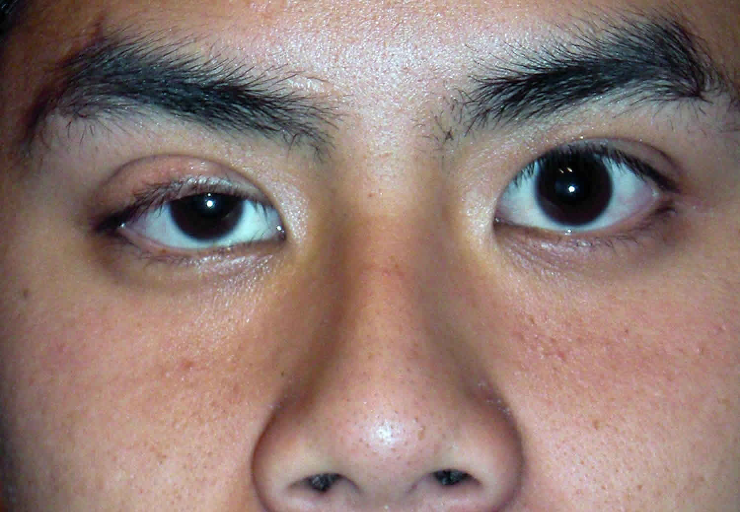
Pseudoptosis in pthisis bulbi

Slide 15
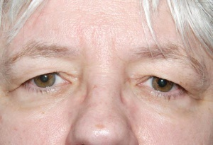
Dermatochalasis

Slide 16
Ptosis Measurements
Margin-reflex distance
it’s the distance b/w the upper lid margin and the corneal reflection of pen torch held by the examiner on which pt fixate.
The normal measurement is 4-5mm.

Slide 17
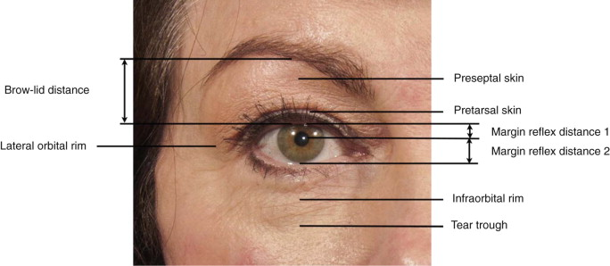
MRD

Slide 18
Palpebral fissure height
it’s the distance b/w the upper and lower lid margins,measured in the pupillary plane.
The measurement is shorter in males(7-10mm) than in females(8-12mm)
Ptosis can be graded as
i-Mild upto 2mm
ii-Moderate upto 3mm
iii-Severe upto 4mm or more

Slide 19
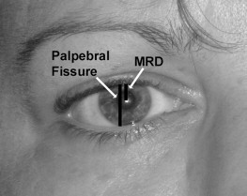

Slide 20
Levator function
measured by placing a thumb firmly against the pt’s Brow to negate the action of FRONTALIS muscle with downward gaze.
The amount of excursion is measured .
The Levator function is graded as
i-Normal 15mm or more
ii-Good 12-14mm
iii-Fair 5-11mm
iv-Poor 4mm or less

Slide 21
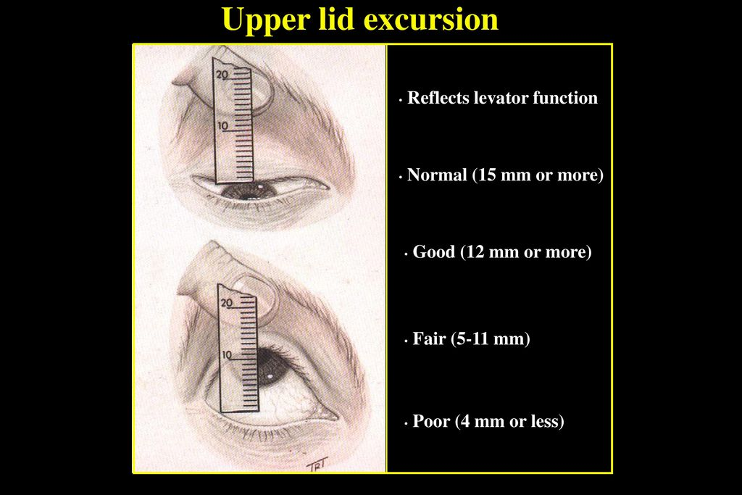

Slide 22
Upper lid crease
Vertical distance b/w the lid margin and the lid crease in downgaze.
In females it is about 10mm and in males it is about 8mm.
Absence of crease with congenital ptosis is evidence of poor Levator function.

Slide 23
Associated signs
Pupillary signs(for horner or pupil involving 3rd nerve palsy)
Fatigability (myasthetic ptosis)
Occular motility defect(particularly for SR)
Jaw winking(Marcus Gunn jaw winking syndrome)
The Bells phenomenon(the up and outwards rolling up of eye during sleep or forcily closure of lids)

Slide 24
Treatment
Principle
i-If levator muscle action is good,it may be shortened.
ii- If the levator muscle is paralysed,the superior muscle is used to lift the lid.
iii-If both levator and superior rectus muscles are paralysed,the action of frontalis muscle is utilized.

Slide 25
Surgical techniques
Levator advacement(resection)
Brow (frontalis)suspension
Conjuctiva-Muller resection

Slide 26
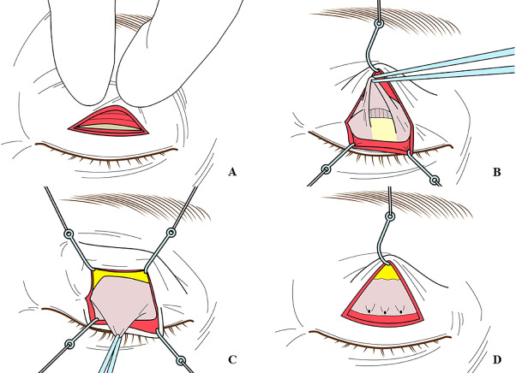
Levator resection

Slide 27
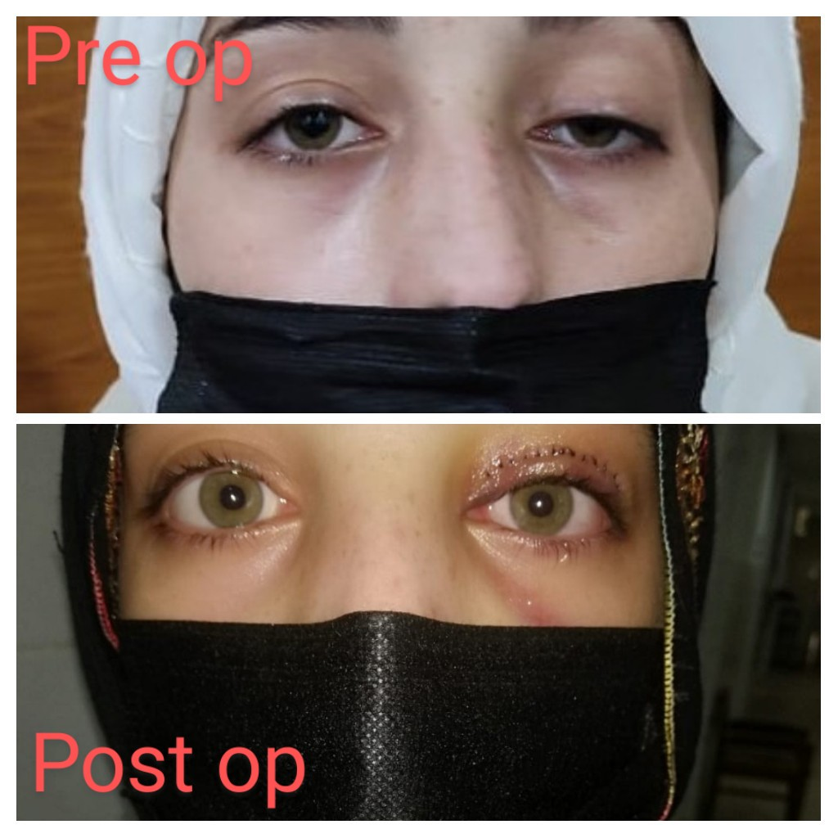
Case of levator resection

Slide 28
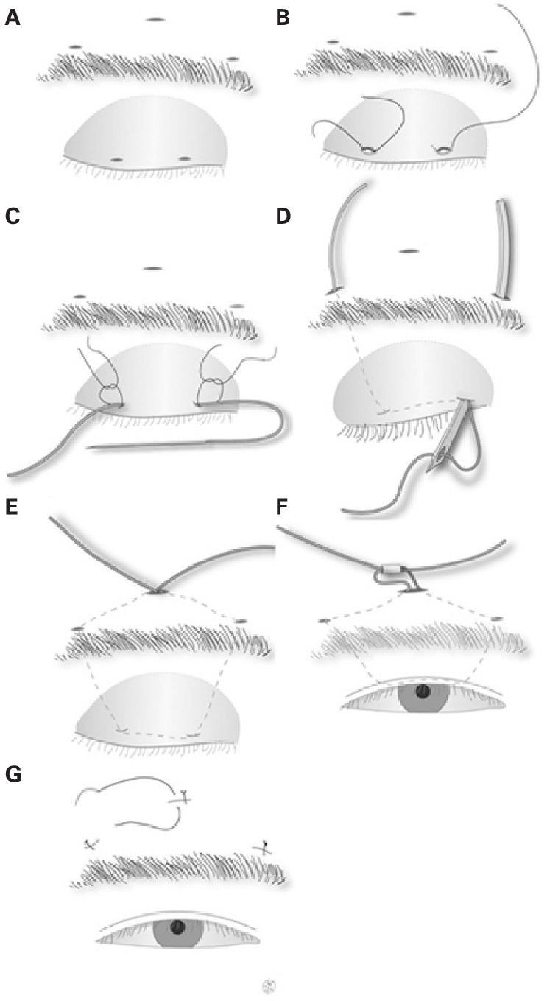
Brow suspension

Slide 29
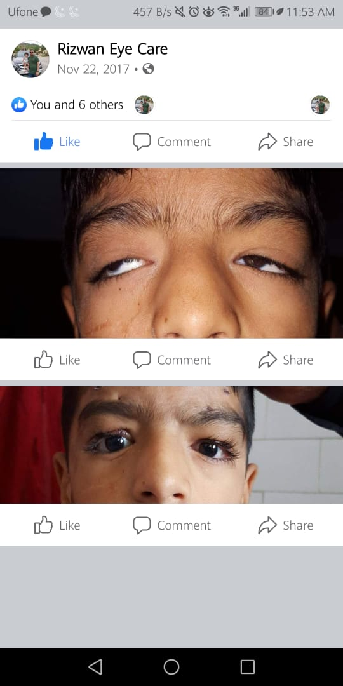
Case of brow suspension

Slide 30
Non Neoplastic lesions
Chalazion
A chalazion(meibomian cyst)is a sterile chronic granulomatous inflamatory lesion of meibomian gland.
Symptoms:
Gradually enlarging Painless rounded nodule
It may be single or multiple
Secondarily infected meibomian gland is refferd to as Internal hordeolum.

Slide 31
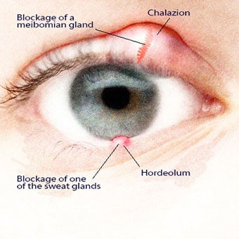

Slide 32
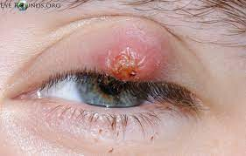
Internal hordeolum

Slide 33
Signs
A nodule within the tarsal plate sometimes associated with inflamation.
The conjuctiva over the swelling is red or purple and it may be yellow when secondariliy infected
A lesion at the anterior lid margin(marginal chalazion)may be connected to a typical chalazion deeper in the lid

Slide 34
Treatment
Conservative
Hot compressors
Expression
Oral antibiotics(for significant bacterial infection not for sterile inflamation)
Steroid injection
Surgery

Slide 35
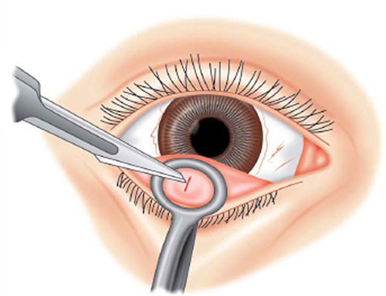
surgery

Slide 36
Stye(External Hordeolum)
It is an acute staphylococcal abcess of a lash follicle & is associated with glands of Zeis
Symptoms
Acute pain and swelling at the lid margin
Signs
Localised tender swelling at lid margin,usually with lash at its apex

Slide 37
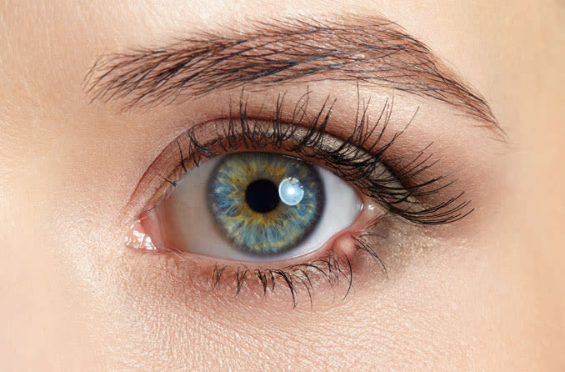

Slide 38
Treatment
Hot compressors
Epilation of the associated lash
Topical(occasionally oral)Antibiotics

Slide 39
Non Neoplastic tumors
Capillary hemangioma(strawberry naevus)
It is the most common tumours of infancy.
Girls are affected more than boys 3:1
It may present as a small isolated lesion or as a large disfiguring mass that can cause visual impairment and systemic complications.

Slide 40
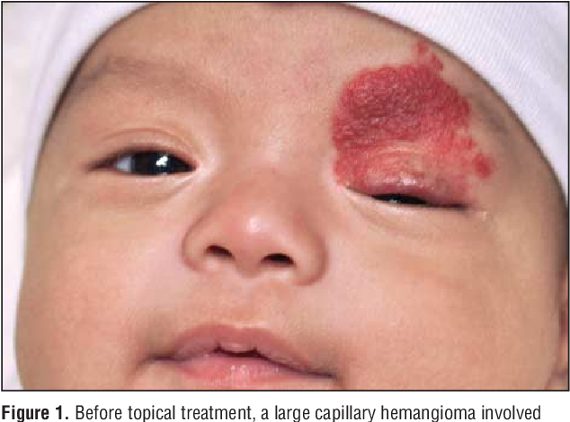

Slide 41
Large or multiple lesions may have visceral involvement,which can lead to serious complications such as
Thrombocytopenis(Kasabach-Merritt syndrome)
High out put cardiac failure
so systemic investigations should be considered.

Slide 42
Symptoms
The lesion is usually noticed in the 1st few months of life,approximately 30% are present at birth
Signs
Extensive underlying orbital involvment should always be ruled out
Superficial cutaneous lesions are bright red,deeper lesions appear purplish.

Slide 43
Usually present in the upper lid
The lesion blanches on pressure and may swell on crying or straining but both pulsations and a bruit are absent
Deep orbital tumors give rise to unilateral ptosis
Heamangiomatous involvment of palpebral or forniceal conjuctiva is common

Slide 44
Investigation
Ultrasound shows medium internal reflectivity
MRI or CT scan shows a soft tissue mass in the anterior orbit or extraconal mass with finger like poterior expansion

Slide 45
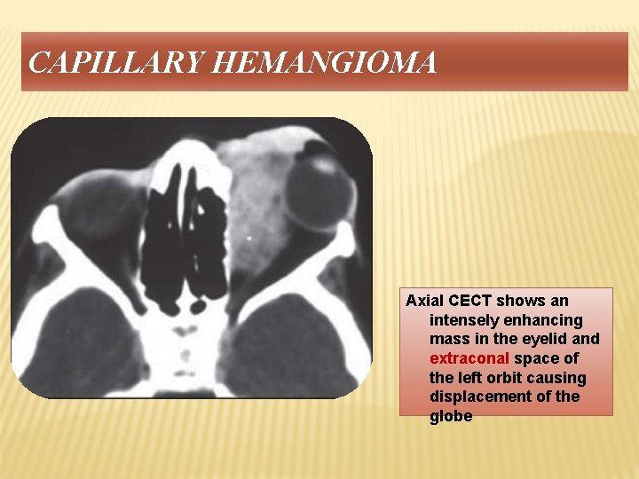

Slide 46
Treatment
Natural course:
Rapid growth for 3-6 months after diagnosis
Followed by slower phase of natural resolution(30% of lesion resolve by the age of 3 yrs and about 75% by the age of 7)
The treatment is indicated principally for amblyopia 2ndry to astigmatism,anisometropia or strabismus.

Slide 47
Betablockers
i-Oral propanolol
ii-Topical preparations including Timolol
Steriods
i-Injection of triamcinolone or betamethasone into a cutaneous orpreseptal tumor
ii-Topical high potency steroids(clobetasol propionate cream)

Slide 48
iii-systemic steriods
Laser
Interferon alfa-2a and Vincristine (for steroid resistant sight threatening lesions)
Local resection with cutting cautery or carbon dioxide laser

Slide 49
COMMUNITY MEDICINE
EDUCATING REGARDING LID HYGIENE (TRACHOMA, BLEPHRITIS, STYE, HERPES)
SCHOOL HEALTH NUTRITION PROGRAMS IN EVERY UNION COUNCIL OF PUNJAB FOR SCREENING PURPOSES ARE ALREADY FUNCTIONAL.

Slide 50
ETHICS AND RESEARCH
https://pubmed.ncbi.nlm.nih.gov/12925861/

Slide 51


