Slide 1
Ethics and Islamic Teachings Regarding Assisted Reproductive Techniques
بسم الله الرحمن الرحيم
Dr. Mohammad Akram Randhawa
MBBS (KE), M. Phil (Pb), PhD (QU)
Fellowship Clinical Pharmacology (UK)
Professor Emeritus, Pharmacology Department
& HOD Biomedical Ethics
Rawalpindi Medical University

Slide 2
Introduction
Allah Almighty by His mercy has created human spouses.
Primary aims for creation of spouses, mentioned in Quran Karim, are:
Proliferation of race and achievement of pleasure:
يَا أَيُّهَا النَّاسُ اتَّقُوا رَبَّكُمُ الَّذِي خَلَقَكُم مِّن نَّفْسٍ وَاحِدَةٍ وَخَلَقَ مِنْهَا زَوْجَهَا وَبَثَّ مِنْهُمَا رِجَالًا كَثِيرًا وَنِسَاءً ۚ وَاتَّقُوا اللَّهَ الَّذِي تَسَاءَلُونَ بِهِ وَالْأَرْحَامَ ۚ إِنَّ اللَّهَ كَانَ عَلَيْكُمْ رَقِيبًا ۚ
Translation: " O mankind! Be dutiful to your Lord, Who created you from a single person (‘Adam’), and from him (Adam) He created his wife [‘Hawwa’ (Eve)], and from them both He created many men & women and fear Allah through Whom you demand your mutual (rights), and (do not cut the relations of) the wombs (kinship). Surely, Allah is Ever an All-Watcher over you. " (Chapter 4, verse 1) [1].

Slide 3
Introduction (Cont.)
وَمِنْ ءَايَـٰتِهِۦٓ أَنْ خَلَقَ لَكُم مِّنْ أَنفُسِكُمْ أَزْوَٰجًۭا لِّتَسْكُنُوٓا۟ إِلَيْهَا وَجَعَلَ بَيْنَكُم مَّوَدَّةًۭ وَرَحْمَةً ۚ إِنَّ فِى ذَٰلِكَ لَـَٔايَـٰتٍۢ لِّقَوْمٍۢ يَتَفَكَّرُونَ ۚ
Translation: "And one of His signs is that He created for you spouses from among yourselves so that you may find comfort in them. And He has placed between you compassion and mercy. Surely in this are signs for people who reflect" (Chapter 31, verse 21) [2].
To achieve these aims humans genders must have some abilities, i.e.
Fertility: Ability to produce enough healthy sperms (♂)/ or ovum) (♀)
Competency: Ability to place sperms at proper place (♂) & receive (♀)
Leading to fertilization & implantation of fertilized ovum in uterus
Then growth of fetus during pregnancy, & delivery of baby [3].
Competency, both in (♂) & (♀) is also associated with pleasure.

Slide 4
Introduction (Cont.)
May seem simple to have children to those who can produce children.
Assisted Reproductive Techniques (ARTs) is of great hope for those who are infertile or incompetent to produce children.
Most common mode of ART is In Vito Fertilization (IVF).
Steps involved in IVF [4]:
Stimulation of ova formation during follicular phase of menstrual cycle by Gonadotropin (hMG or follitropin) & GnRH agonist (Leuprolide).
Oocytes are taken from ovary, kept in test-tube or frozen for later use.
Maturation of oocytes is achieved with addition of hCG in test tube.
Sperms are obtained from male, used fresh, or frozen for future use.

Slide 5
Introduction (Cont.)
Sperm are added in test tube & allowed to fertilize to an oocyte.
Zygote formed is allowed to grow to an embryo in test-tube.
Now a days, fertilization is preferred with Intra-Cytoplasmic Sperm Injection (ICSI), under microscope.
Embryo is transferred into uterus of the woman.
Embryo gets implanted in uterus, & pregnancy is said to occur
Can be confirmed with pregnancy test after about 2 weeks.
Progesterone &/or hCG is given for luteal support, till placenta starts producing its own progesterone.
Then pregnancy is allowed to continue till birth.

Slide 6
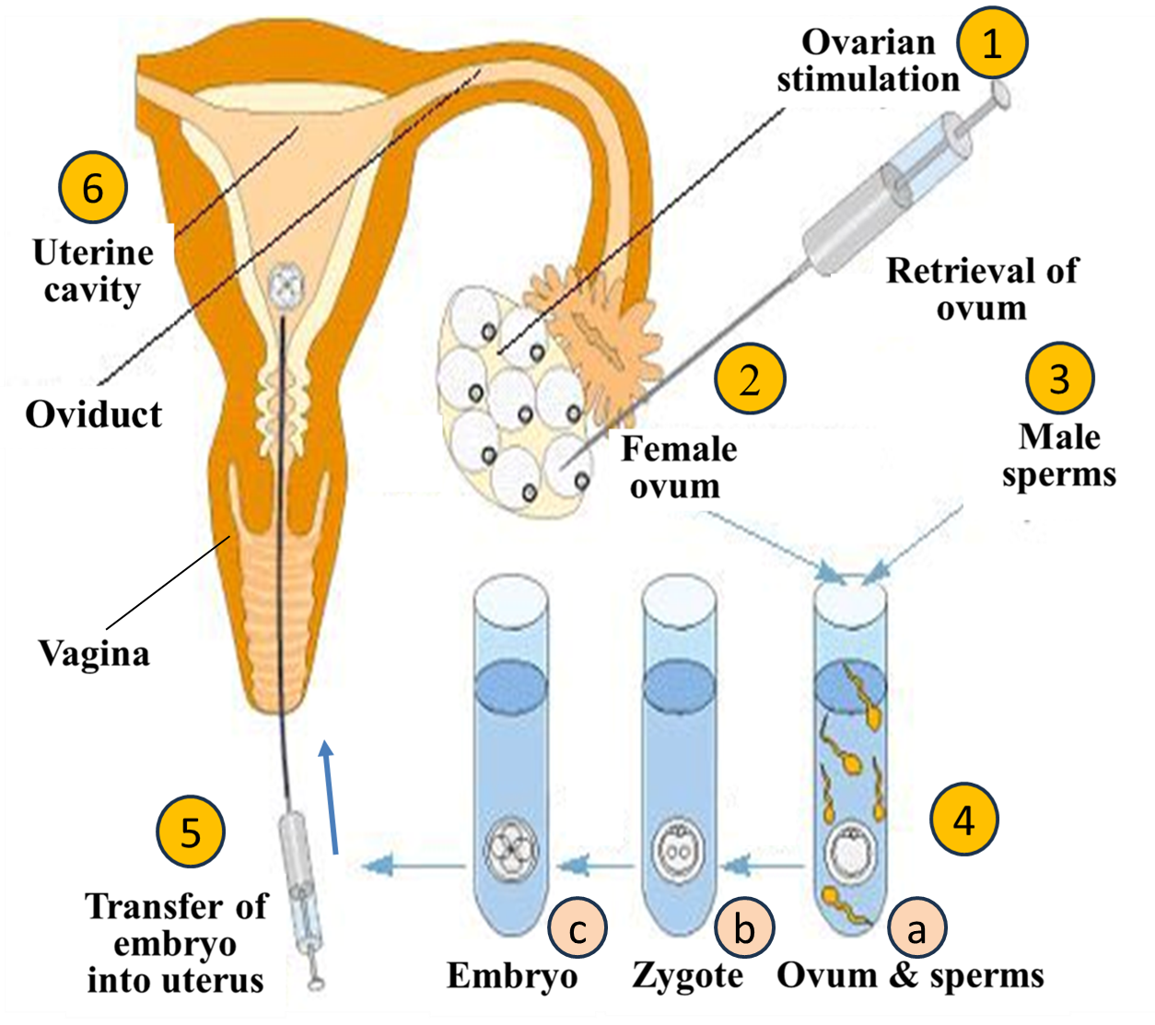
Steps involved in IVF
Fertilization

Slide 7
Ethical concerns relevant to ARTs
ARTs are linked to: Gametes from Spouses (sperms & oocytes), Embryos, and Donor Sperms (or Third-Party Reproduction).
A. Ethics Related to Gametes
Considering ‘Autonomy’, a basic principle of medical ethics, it can be argued that gametes are person’s own property, & has right to decide how, when and where to utilize them.
Gametes can be preserved via cryopreservation & used for obtaining baby
Thus, infertile people, e.g. due to cancer of testis or ovaries, can have children by cryopreservation of their gametes.

Slide 8
Ethical concerns relevant to ARTs (Cont.)
While we should honor a person’s will to decide (‘Autonomy’), we must consider ‘Beneficence’ of next generation.
Consider case of a 30-year-old female who decides to cryopreserve her oocytes, then at 65 years, use them to have a child (‘Autonomy’)
Weighing lady’s autonomy with baby’s ‘Beneficence’
Child has right:
To have a mother who could live till he/she becomes adul
To see his/her father
Get share from father’s property.

Slide 9
Ethical concerns relevant to ARTs (Cont.)
Consider another case of 35-years lady whose husband dies, she desires to get her husband’s sperms retrieved & cryopreserved in an ART clinic and then use to obtain a child (‘Autonomy’).
Ethical issues in this case could be:
Consent of husband
Child’s share from father’s inheritance
Child is deprived of father.

Slide 10
Ethical concerns relevant to ARTs (Cont.)
Cryopreservation of gametes may provide children to infertile couples
But involves important ethical issues:
Deprivation of children’s rights (Non-maleficence): Psychological trauma of loss of mother &/or father, & loss of inheritance from one or both parents.
Sale of gametes to ART clinics, their storage on payment & need of “surrogate” uterus in some cases.
Low success rate of getting children from cryopreserved gametes, 1.8-5.6%.

Slide 11
Ethical concerns relevant to ARTs (Cont.)
Cryopreserved sperms remain more fertile & their increased demand can lead to sale at high cost (Coercion).
Physical & mental health of children born via ARTs is not known.
Medical organizations discourage cryopreservation of oocytes for routine use.
Allow only for patients undergoing chemotherapy or surgery.

Slide 12
Ethical concerns relevant to ARTs (Cont.)
B. Ethics Related to Embryos:
After fertilization, early developing human being up to 8 weeks is called as “embryo”.
Then, till birth is named as “fetus”.
Ethics Committee of American Society of Reproductive Medicine (ASRM) declares that ART with a partner’s sperm (or husband’s sperm) or donor sperm (Third party reproduction) is ethically acceptable, provided that medical specialists follow particular guidelines.
Because ART could provide an opportunity of parenthood to childless parents.

Slide 13
Ethical concerns relevant to ARTs (Cont.)
Ethics of unused and unclaimed (abandoned) embryos:
Problem may arise when individuals leave cryopreserved embryos in ART centers unused and unclaimed (abandoned).
ASRM Ethics Committee recommends that every ART Centers should addresses this issue in consent forms before gamete retrieval,
& give written instructions to patients regarding fate of their cryopreserved embryos in case of death, divorce, separation, failure to pay storage fees, & inability to agree on disposition, etc.
ASRM Ethics Committee allows ART centers to discard these embryos after an appropriate length of time (five years).
However, it is unethical to donate these cells kept for disposal to other couples or use for research.

Slide 14
Ethical concerns relevant to ARTs (Cont.)
C. Ethics Related to Donor Sperms (or Third-Party Reproduction):
Semen donor should undergo proper screening & selection, to reduce risk of psychological & health problems, before use of donor sperms in a patient.
Ethical issues increase when donated sperms come from family members.
Because reproduction between two closely related individuals can increase risk of psychological problems & genetically transmitted diseases.
Sperm donor may find it difficult to detach himself from offspring.
Child born via donor sperm may like to identify sperm donor to get genetic information for health reasons.
When child is not informed & by chance comes to know about family link, could be more damaging.
Proper record of sperm donors & number of off-spring produced must be maintained [6].

Slide 15
Islamic Perspective of Assisted Reproductive Techniques
A. Islam and Fertility:
Children are a blessing, expressed in Quran Karim as:
ٱلْمَالُ وَٱلْبَنُونَ زِينَةُ ٱلْحَيَوٰةِ ٱلدُّنْيَا ۖ وَٱلْبَـٰقِيَـٰتُ ٱلصَّـٰلِحَـٰتُ خَيْرٌ عِندَ رَبِّكَ ثَوَابًۭا وَخَيْرٌ أَمَلًۭا
Translation: “Wealth and children are the adornment of this worldly life, but the everlasting good deeds are far better with your Lord in reward and in hope” (Chapter 18, Al-Kahf, verse 46) [7].
A prayer described in Quran Karim:
وَٱلَّذِينَ يَقُولُونَ رَبَّنَا هَبْ لَنَا مِنْ أَزْوَٰجِنَا وَذُرِّيَّـٰتِنَا قُرَّةَ أَعْيُنٍۢ وَٱجْعَلْنَا لِلْمُتَّقِينَ إِمَامًا
Translation: “O, Lord, grant us spouses and offspring who will be the comfort of our eyes.” (Chapter 25, Al-Furqan, verse 74) [8].
Therefore, seeking cure for infertility is permissible & appropriate.

Slide 16
Islamic Perspective of ARTs (Cont.)
Allah Almighty has narrated examples of two Prophets, Hazrat Ibrahim & Hazrat Zakaria (Blessings be upon them) in Quran Karim,
which help us to get insight into problem of infertility.
Story of Hazrat Ibrahim & his wife Sara (Blessings be upon them):
قَالُوا۟ لَا تَخَفْ وَبَشَّرُوهُ بِغُلَٰمٍ عَلِيمٍ ۖ فَأَقْبَلَتِ ٱمْرَأَتُهُۥ فِى صَرَّةٍ فَصَكَّتْ وَجْهَهَا وَقَالَتْ عَجُوزٌ عَقِيمٌ ۖ قَالُوا۟ كَذَٰلِكِ قَالَ رَبُّكِ ۖ إِنَّهُۥ هُوَ ٱلْحَكِيمُ ٱلْعَلِيمُ ۖ
Translation: “They (angles) said, ‘don’t be afraid, And they gave him (Ibrahim, Peace be upon him) glad tidings of a son endowed with knowledge. But his wife came forward clamoring, she smote her forehead and said: A barren old woman! They said: Even so has Thy Lord spoken and He is full of wisdom and knowledge” (Chapter 51, verses 28-30) [9].
Allah Almighty blessed them with a child, Ishaq.

Slide 17
Islamic Perspective of ARTs (Cont.)
Example of Hazrat Zakaria (Blessings be upon him):
وَزَكَرِيَّا إِذْ نَادَىٰ رَبَّهُ رَبِّ لَا تَذَرْنِي فَرْدًا وَأَنتَ خَيْرُ الْوَارِثِينَ (89) فَاسْتَجَبْنَا لَهُ وَوَهَبْنَا لَهُ يَحْيَىٰ وَأَصْلَحْنَا لَهُ زَوْجَهُ ۚ إِنَّهُمْ كَانُوا يُسَارِعُونَ فِي الْخَيْرَاتِ وَيَدْعُونَنَا رَغَبًا وَرَهَبًا ۖ وَكَانُوا لَنَا خَاشِعِينَ (90)
Translation: “And (remember) Zakaria, when he cried to his Lord: ‘O my Lord! Leave me not without offspring, though Thou are the best of inheritors.’ So We listened to him and granted him Yahya (John). We cured his wife for him. They were ever quick in emulation in good works; they used to call on us with love and reverence, and humble themselves before Us” (Chapter 21, verses 89-90) [10].

Slide 18
Islamic Perspective of ARTs (Cont.)
B. Islam, marriage and ARTs:
Teachings of Quran Karim and Hadiths of Prophet Mohammad (Peace & blessings be upon him) emphasize vital role of marriage & family structure.
Allah Almighty says in Quran Karim:
وَٱللَّهُ جَعَلَ لَكُم مِّنۡ أَنفُسِكُمۡ أَزۡوَ ٰجࣰوَجَعَلَ لَكُم مِّنۡ أَزۡوَ ٰجِكُم بَنِینَ وَحَفَدَةࣰ وَرَزَقَكُم مِّنَ ٱلطَّیِّبَـٰتِۚ أَفَبِٱلۡبَـٰطِلِ یُؤۡمِنُونَ وَبِنِعۡمَتِ ٱللَّهِ هُمۡ یَكۡفُرُونَ
Translation: “And Allah has made for you spouses of your own kind, and given you through your spouse children and grand children. And He has granted you good, lawful provisions. Are they then faithful to falsehood and ungrateful for Allah’s favors?” (Chapter 16: verse 72) [12].

Slide 19
Islamic Perspective of ARTs (Cont.)
Assisted reproductive technologies are permitted in Islam
Provided: Semen source, ovum source, & uterus come from legally married husband & wife during their marriage span.
Concept of marriage & family is also emphasized in other religions:
In Holy Bible, it is narrated, "Let marriage be held in honor among all, and let marriage bed be undefiled, for God will judge sexually immoral and adulterous" (Hebrews 13:4).
In Judaism, marriage is an important event and avoiding from it is considered as unnatural.
In Buddhism & Hinduism also, marriage is a sacred ceremony & life-long commitment between wife and husband [13].

Slide 20
Islamic Perspective of ARTs (Cont.)
C. Islam and Third-Party Reproduction:
Involvement of a third person in family (Wife and husband) is not acceptable in Islam, whether in form of sperm, ovum, embryo, or uterus.
Therefore, practices involved in ART linked to sperm, ovum, & embryo donation & “rental” of uterus is not compatible with Islamic teachings.
Frozen embryos belonging to legally married couple & transplanted in wife’s uterus when marriage still exists (Not dissolved by death or divorce) are allowed [14].

Slide 21
Summary of Islamic teachings on ARTs [14]
Assisted insemination with husband’s semen is allowed, & resulting child is legal offspring of couple.
IVF of an egg from wife with sperm of her husband followed by transfer of fertilized embryo(s) back to wife’s uterus is allowed, Provided:
Process is indicated for a medical reason & carried out by an expert team.
Intrusion of third party into marital functions of sex and procreation is prohibited, because marriage must be respected.
Similarly, third-party donor is not allowed, whether providing sperm, eggs, embryos, or a uterus.
If marriage does not continued because of divorce or death of husband, medically assisted conception not allowed on ex-wife even if sperm comes from former husband.

Slide 22
Summary of Islamic teachings on ARTs (Cont.)
Cryopreservation of excess fertilized embryos is allowed, however, frozen embryos are property of couple alone.
May be transferred to same wife in a successive cycle, but only when marriage exists.
All forms of surrogacy are forbidden.
Establishment of sperm or egg banks, for use outside marriage limits, strictly forbidden,
Because such practices threaten concepts of marriage & family.
According to Islam, a man’s or woman’s infertility should be accepted if it is beyond cure.

Slide 23
Summary of Islamic teachings on ARTs (Cont.)
Surrogacy is prohibited in Islam in relevance to a verse from Quran Karim:
الَّذِينَ يُظَاهِرُونَ مِنكُم مِّن نِّسَائِهِم مَّا هُنَّ أُمَّهَاتِهِمْ ۖ إِنْ أُمَّهَاتُهُمْ إِلَّا اللَّائِي وَلَدْنَهُمْ ۚ وَإِنَّهُمْ لَيَقُولُونَ مُنكَرًا مِّنَ الْقَوْلِ وَزُورًا ۚ وَإِنَّ اللَّهَ لَعَفُوٌّ غَفُورٌ﴾
Translation: “If any men among you divorce their wives by Zihar (calling them mothers), they cannot be their mothers: None can be their mothers except those who gave them birth. And in fact, they use words (both) iniquitous and false; but truly Allah is one that blots out (sins), and forgives (again and again).” (Chapter 58, verse 2) [15].
Which means ‘birth mother is the “real” mother’.

Slide 24
Thanks a lot ألف شكر

