Slide 2
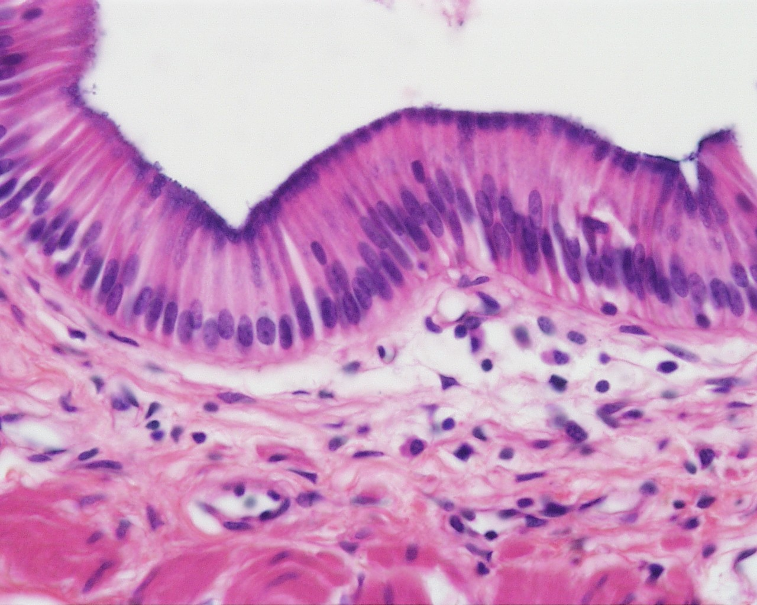
Foundation Module 1st Year MBBS(LGIS) Epithelial Tissue
Presenter: Dr. Mohtasham Hina Date: 23-01-25
(Associate Professor)

Slide 3
Vision; The Dream/Tomorrow
Motto
To impart evidence based research oriented medical education
To provide best possible patient care
To inculcate the values of mutual respect and ethical practice of medicine
Wisdom
Truth
Service

Slide 4
Professor Umar Model of Integrated Lecture

Slide 5
Learning Objectives
At the end of lecture 1st year students should be able to
Define epithelium
Classify epithelium
Explain histological structure of simple and stratified epithelium
Location and functions of epithelia
correlate clinical aspects of epithelia
To understand bio-physiological aspect of different types of epithelia
Read a research article
Use digital library

Slide 6
Interactive Session
A 55-year-old male smoker with a 30-year history presents with chronic cough, occasional blood-streaked sputum, and hoarseness. Examination reveals scattered wheezes on auscultation. Chest X-ray shows a right upper lobe opacity. Bronchoscopy with biopsy confirms squamous metaplasia of the bronchial epithelium, a precursor lesion in chronic smokers due to persistent irritation and inflammation.

Slide 7
Basic Tissues Of Body
Core Knowledge

Slide 8
Epithelium
Core Knowledge
Definition
Collection of closely packed cells with very small amount of intercellular substance

Slide 9
Characteristic Features of Epithelial Cells
Core Knowledge
Specific shape
Nuclear shape corresponds to cell shape
Axis of nuclei
Basal lamina/ basement membrane
Indistinct cell boundaries
Rests on lamina propria
Papillae
Polarity
avascular

Slide 10
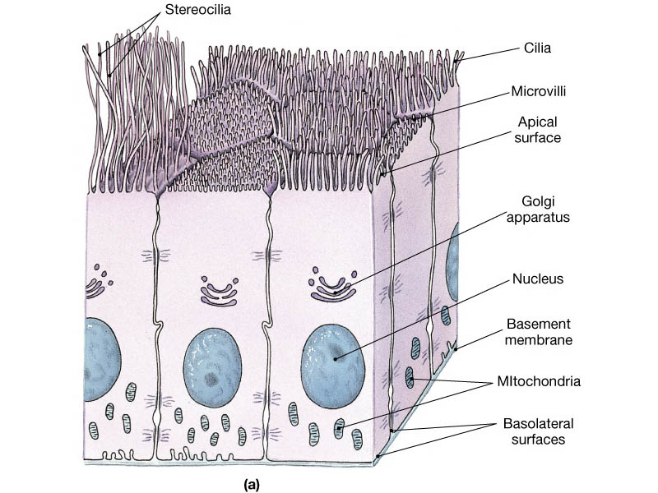
Cell Polarity
Core Knowledge
Apical domain
Microvilli
Sterocilia
cilia
Lateral domain
Junctional complexes
plica
Basal domain
Basement membrane
Cell-to-extracellular matrix junctions
Basal cell membrane infoldings

Slide 11
Plica
Core Knowledge

Slide 12
Basal Lamina (20-100nm)
Core Knowledge
Collagen
type IV collagen
Laminins
Entactin
Proteoglycans

Slide 13
Basement Membrane
Core Knowledge

Slide 14
Basal lamina
Core Knowledge
20-100nm
Lamina lucida: fibronectin, laminin receptors

Slide 15
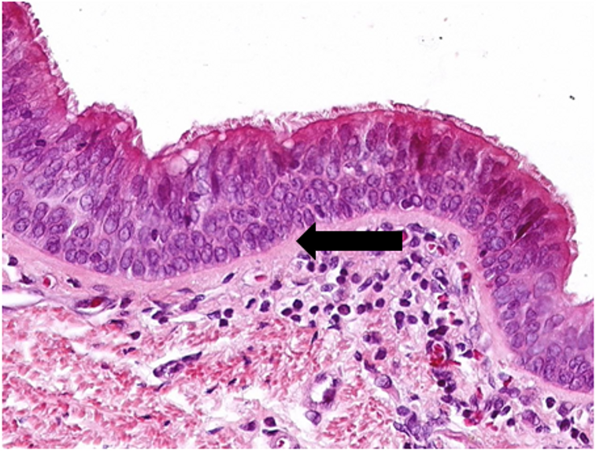
Basement Membrane
Core Knowledge
Basal lamina Reticular lamina basement membrane

Slide 16
Basement Membrane
Core Knowledge

Slide 17
Basement Membrane
Core Knowledge
Functions
Structural attachment.
Compartmentalization.
Filtration.
Regulation and signaling

Slide 18
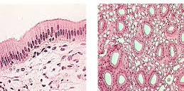
Types of Epithelia
Core Knowledge
Covering
Glandular

Slide 19
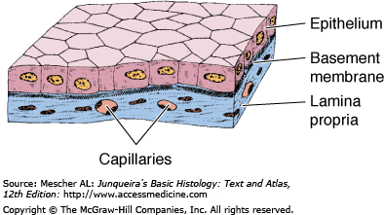
Covering Epithelia
Core Knowledge
Simple Epithelium
Stratified Epithelium

Slide 20
Simple Epithelia
Core Knowledge

Slide 21
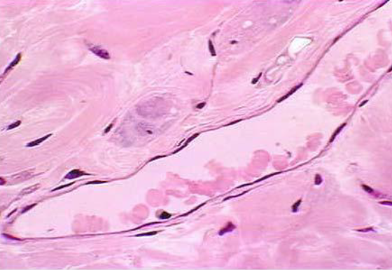
Simple Squamous
Core Knowledge

Slide 22
Simple Cuboidal
Core Knowledge

Slide 23
Simple Cuboidal Epithelium
Core Knowledge

Slide 24
Simple Columnar
Core Knowledge

Slide 25
Simple Columnar Epithelium
Core Knowledge

Slide 26
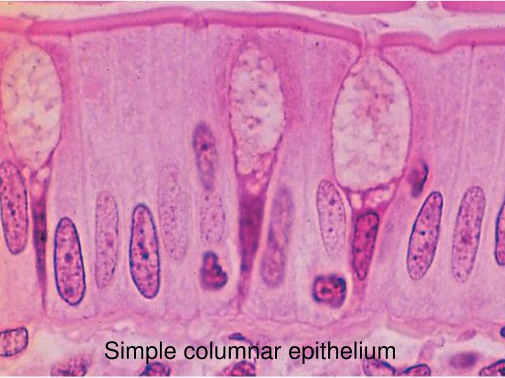
Core Knowledge

Slide 27
Pseudostratified Columnar
Core Knowledge

Slide 28
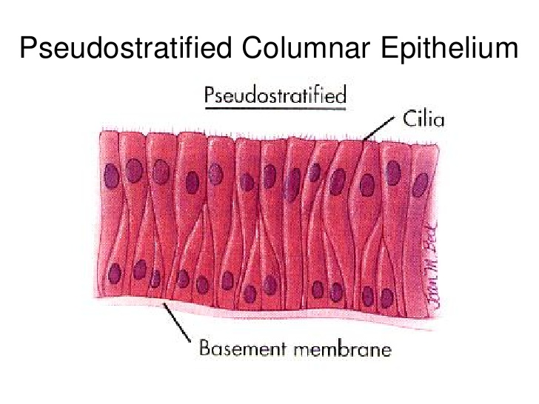
Core Knowledge

Slide 29
Core Knowledge

Slide 30
Stratified Epithelium
Core Knowledge

Slide 31
Stratified Squamous
Core Knowledge

Slide 32
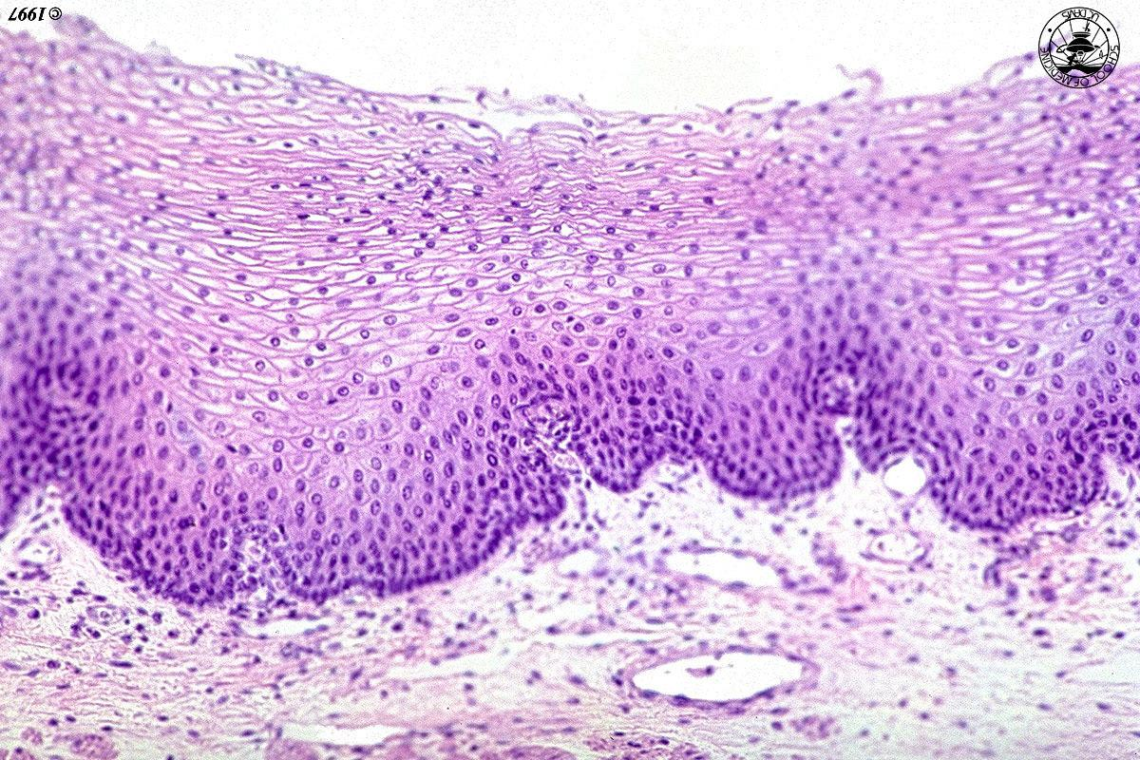
Stratified Squamous Epithelium
Core Knowledge

Slide 33
Stratified Cuboidal Epithelium
Core Knowledge

Slide 34
Stratified Columnar Epithelium
Core Knowledge

Slide 35
Urothelium
Core Knowledge

Slide 36
Urothelium
Core Knowledge

Slide 37
Bio-physiological Aspects of Epithelium
Horizontal Integration
Epithelium is an avascular tissue
cell junctions
free surface or apical domain, a lateral domain, and a basal domain
Epithelium creates a selective barrier between the external environment and the underlying connective tissue

Slide 38
Interactive Session
Vertical Integration
Epithelial metaplasia
conversion of one epithelial type to another in response to stimuli
Adaptive response to stimuli or stress
squamous metaplasia frequently occurs in the pseudostratified respiratory epithelium of the trachea and bronchi in response to prolonged exposure to cigarette smoke

Slide 39
Bioethical Principals Related To Pulmonary Metaplasia
Spiral Integration
Bioethics
Informed Consent: Patients diagnosed with pulmonary metaplasia should be fully informed about the condition
Autonomy: Patients have the right to make decisions about their care, including whether to undergo interventions.
Non-Maleficence: Clinicians must avoid harm by ensuring accurate diagnosis and recommending interventions that prevent further damage to lung tissue, such as lifestyle changes or medications.
Public Health Responsibility: Given the link between smoking and metaplasia, there is a duty to advocate for tobacco control policies and education to reduce exposure and prevent disease at a population level.

Slide 40
Spiral Integration
Artificial Intelligence
Role of AI in Pulmonary Metaplasia
AI can potentially aid in enhancing diagnostic accuracy and efficiency.
AI-powered decision support systems can also help clinicians in selecting appropriate treatment modalities
AI-driven predictive models may help anticipate the risk of Pulmonary Metaplasia in susceptible populations

Slide 41
Squamous Metaplasia Is Increased in the Bronchial Epithelium of Smokers with Chronic Obstructive Pulmonary Disease
Spiral Integration
Research
Helen M. Rigden,¹ Ahmad Alias,¹ Thomas Havelock,^{1,2} Rory O'Donnell,¹ Ratko Djukanovic,^{1,2} Donna E. Davies,^{1,2} and Susan J. Wilson
https://pubmed.ncbi.nlm.nih.gov/?term=Wilson%20SJ%5BAuthor%5D
The extent of squamous metaplasia was significantly increased in both COPD1 and COPD2 compared to healthy smokers and healthy non-smokers. The amount of fully differentiated squamous epithelium was also increased in COPD1 and COPD2 compared to healthy non-smokers, as was the expression of carcinoembryonic antigen

Slide 42
How To Access Digital Library
Steps to Access HEC Digital Library
Go to the website of HEC National Digital Library
On Home Page, click on the INSTITUTES
A page will appear showing the universities from Public and Private Sector and other Institutes which have access to HEC National Digital Library HNDL
Select your desired Institute
A page will appear showing the resources of the institution
Journals and Researches will appear
You can find a Journal by clicking on JOURNALS AND DATABASE and enter a keyword to search for your desired journal

Slide 43
Learning Resources
Junqueira’s Basic Histology 12th Edition, Chapter 4
Histology , A text and Atlas by Michael H.Ross 7th Edition, Chapter 5
DiFiore's Atlas of Histology with Functional Correlations 11th Edition, Chapter 2
Google scholar

