Slide 1
Gram Negative Enteric Rods (Enterobacteriaceae Family) Microbe Module 3rd Year MBBS
By: Dr. Kiran Fatima
Pathology Department
Rawalpindi Medical University

Slide 4
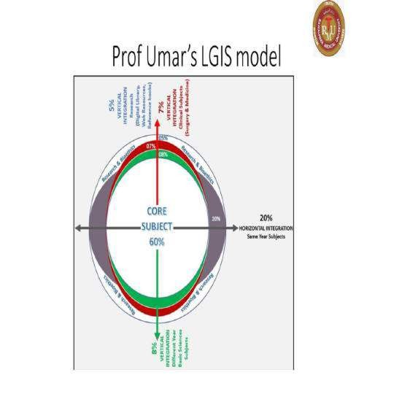

Slide 5
Learning outcomes
Classification of Gram negative enteric rods
Classification of Enterobacteriaceae family
Differentiation of Lactose fermenters & Non Lactose fermenters
Sites of infection by Enterobacteriaceae family
Escherichia coli
Yersinia species

Slide 6
Enterobacteracae
Core
Normal Flora: Many Enterobacteriaceae, such as Escherichia coli, are part of the normal gut microbiota. They play roles in nutrient absorption, production of vitamins (e.g., vitamin K), and protection against pathogenic microbes.
These bacteria can ascend from the urethra to the bladder and kidneys, leading to cystitis and pyelonephritis.
Nosocomial Infections: In healthcare settings, Enterobacteriaceae can cause respiratory tract infections, particularly in immunocompromised patients or those with invasive devices like ventilators. Klebsiella pneumoniae is a notable pathogen causing pneumonia.
Sepsis: Enterobacteriaceae can invade the bloodstream, leading to sepsis, a life-threatening condition characterized by systemic inflammation and organ dysfunction
Knowledge of how Enterobacteriaceae interact with different anatomical sites helps in developing prevention strategies, such as proper catheter care to prevent UTIs and stringent aseptic techniques to avoid surgical site infections.

Slide 7
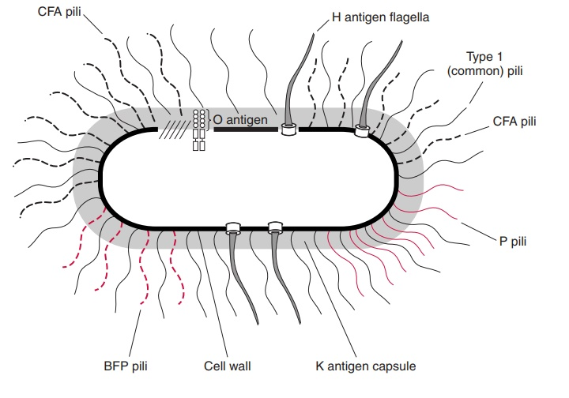
Spiral

Slide 8
Classification - enterobacteriacea family
CORE

Slide 9
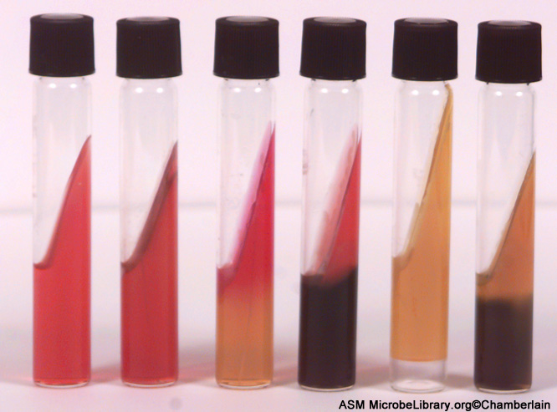
Important characteristics of enterobacteriacea family
CORE
Facultative anaerobes
Catalase positive
Ferments glucose
Oxidase negative
Reduces nitrates to nitrites

Slide 10
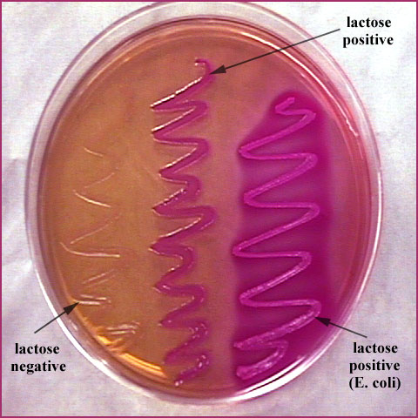
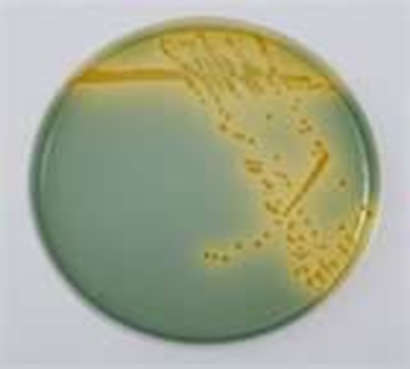
Classification based upon lactose fermentation
CORE
Slow lactose fermenters
Lactose fermenters
E.coli
Klebsiella spp.
Enterobacter spp.
Citrobacter spp.
Serratia spp.
Providencia spp.
Arizona spp.
Non- lactose fermenters
Pseudomonas spp.
Proteus spp.
Salmonella spp.
Shigella spp.
Mac Conkey’s Agar
CLED

Slide 11
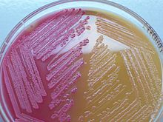
CORE
Lactose fermenting (LF)

Slide 12
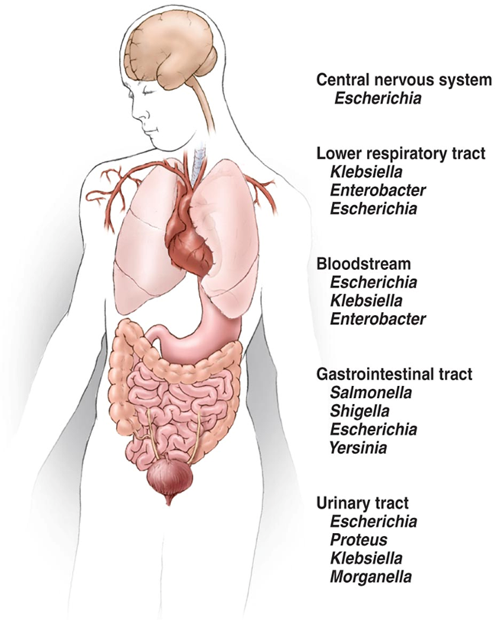
Sites of infection by enterobacteriacea
VERTICAL

Slide 13
Escherichia coli
CORE
Member of enterobacteriaceae family.
Morphology: Gram negative enteric Lactose fermenting rods
Mode of transmission: Fecal contamination
05 strains :
Entero toxigenic E. Coli (ETEC)-
Entero pathogenic E. Coli (EPEC)
Entero invasive E. Coli (EIEC)
4. Entero aggregative E. Coli (eaggec)
5. Entero hemorrhagic E. Coli (EHEC)

Slide 14
Sr No. | Strains of E.coli | Abbre-viation | Syndrome | Management
1. | Entero Toxigenic E. coli | ETEC | Travellers Diarrhea (watery) | Antibiotics may be useful (Non invasive diarrhea)
2. | Entero Pathogenic E. coli | EPEC | Watery diarrhea | Antibiotics may be useful (Non invasive diarrhea)
3. | Entero Invasive E. coli | EIEC | Severe Dysentery (like Shigellosis) | Rehydration required with electrolytes
4. | Entero Aggregative E. coli | EAEC | Watery diarrhea (in children & immunosuppressed pts.) | Rehydration required with electrolytes
5. | Entero Hemorrhagic E. coli | EHEC | Hemolytic uremic syndrome [HUS]- Due to renal toxic effects | Antibiotics should be avoided (because of worsening effects)

Slide 15
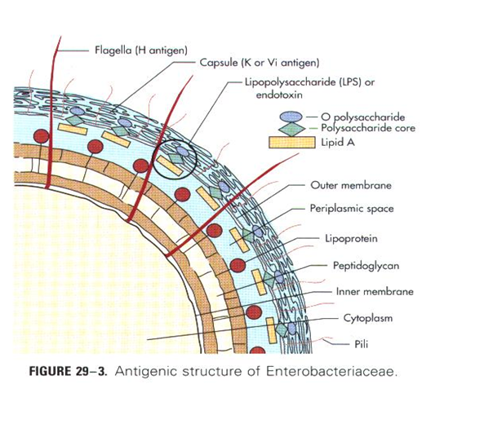
Pathogenesis and immunity
CORE
A. VIRULENT FACTORS
Capsule (some strains)
Endotoxin (fever, DIC)
Presence of Antigens –
[Somatic ‘0’, Flagellar ‘H’ &
Capsular ‘k’]
B.ENZYME PRODUCTION
Beta lactamases destroys penicillin ring of antibiotics → efficacy of penicillin group of antibiotics reduces → results in Drug resistance pattern to all penicillin group of antibiotics (EXTENDED SPECTRUM BETA LACTAMASES producing E.coli)
Carbapenams & high potency combination therapy required in such cases → but chances of complications more

Slide 16
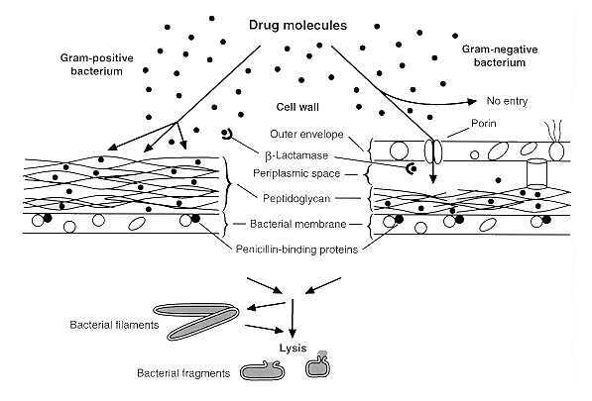
Mode of action of beta lactam drugs
CORE

Slide 17
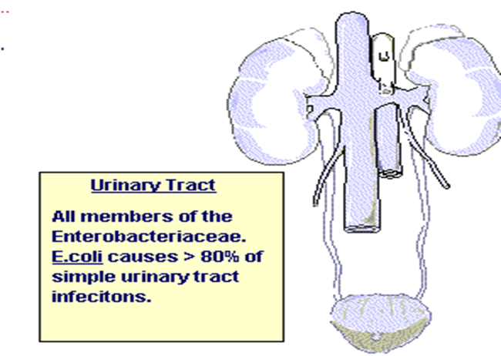
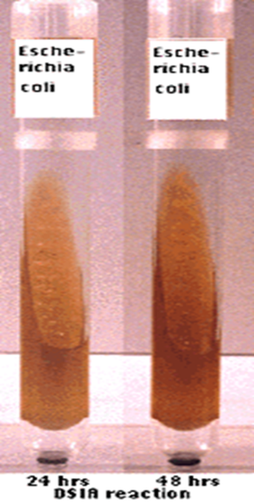
Diseases caused by eschericia coli
CORE
VERTICAL
UTI- 80% cases
Diarrhea/ dysentery
Neonatal sepsis
Meningitis
Pneumonia
Nosocomial infections
IMVIC (Indole, Methyl Red, Voges Prausker, Citrate)
E. coli ----------- IMViC (+ + - - )
Enterobacter --- IMViC (- - + + ).
Other tests: TSI Reactions
Treatment: Based upon C/S

Slide 18
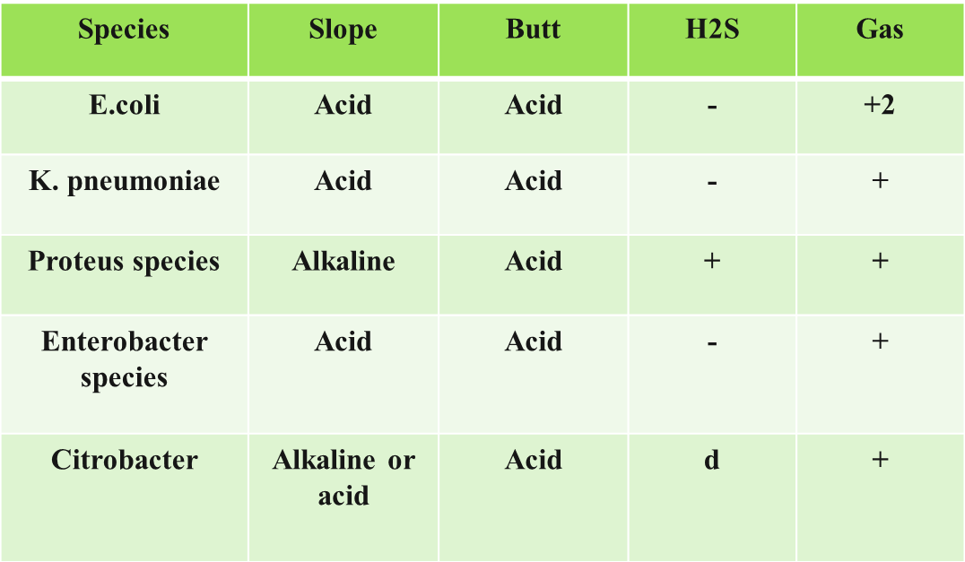
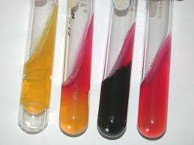
Triple sugar iron (tsi ) agar reaction
Composition of TSI: 0.1 % glucose ,1 % sucrose 1 % lactose , Ferrous sulphate ( for detection of H2S, production ) and a pH indicator ( phenol red ).
If only glucose is fermented --------------- Alkaline Reaction ( RED).
If lactose or sucrose are fermented ------ Acidic Reaction (YELLOW).

Slide 19
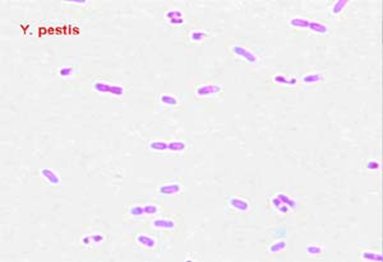
Yersinia species
CORE
03 Species:
Yersina enterocolitica
Yersinia pestis
Yersina pseudotuberculosis

Slide 20
CORE
Morphology: Gram-negative rods or coccobacilli
Important Characteristics:
Facultative intracellular anaerobes
Bipolar staining.
Yersinia pestis is nonmotile.
Other species are nonmotile at 98.6°F (37°C)
But motile at temperatures < 86°F (30°C) by means of peritrichous flagella.

Slide 21
1. Yersinia enterocolitica:
CORE
Reservoirs: Rodents, cattle, sheep, pigs, cats and dogs
Transmission: Fecal oral
Diseases:Gastroenteritis & Mesenteric lymphadenitis
Virulent factors & Pathogenies: *Adhesin & Effector proteins → Invades and damages mucosal cells → Diarrhea → Spread of infection to mesenteric lymph nodes → bacteremia
Diagnosis:
Stool C/S (MacConkey or Selective agar i.e CIN – Cefsulodin irgasan novobiocin agar)
NLF colonies
Catalase & Urease positive
Oxidase negative

Slide 22
HORIZONTAL CM
2. Yersina pseudotuberculosis:
Reservoirs: rodents, birds and farm animals
Transmission: Aerosol transmission/ Direct contact with animal excreta
Disease: Mesenteric lymphadenitis, & pseudo appendicitis
3. Yersina pestis:
Reservoirs: rodents, birds and farm animals
Transmission: Aerosol transmission/ Direct contact with animal excreta
Diseases:
* Bubonic Plague: Potentially fatal
* Pneumonic Plague: Highly contagious & fatal

Slide 23
Diagnosis of yersinia infection
CORE PATHOLOGY
HORIZONTAL
SPECIMENS:
Peripheral blood, sputum, lymph node aspirate, bronchial or tracheal washings.
SEROLOGICAL TESTS; Antibodies detection (If culture is negative)
STAINS: Bipolar staining
Gram, Wright, Giemsa, or Wayson's stain (staining will be negative in early course of infection)
CULTURE MEDIA: MacConkeys or CIN agar (cefsoludin irgasan novobiocin)
TREATMENT: Aminoglycosides or Tetracyclines

Slide 24
Research in therapeutics
HORIZONTAL
Novel Therapeutics
To combat antibiotic-resistant Enterobacteriaceae, researchers are exploring new therapeutic options, including:
Phage Therapy: Using bacteriophages to target and kill specific bacterial strains.
Antimicrobial Peptides (AMPs): Developing AMPs that can bypass traditional resistance mechanisms.
CRISPR-Cas Systems: Utilizing CRISPR technology to specifically target and disrupt resistance genes.

Slide 25
AI and automation for lab diagnosis
Automated Culture Systems: BACTEC or BacT/ALERT systems, detect microbial growth based on changes in the environment, such as gas production or changes in the pH, and alert technicians when growth is detected.
Automated Inoculation and Streaking: Robotic systems can automate the inoculation and streaking of TSI agar plates. reduces human error and increases throughput.
Automated Incubation and Reading:automated reading systems, such as the VITEK 2 or BD Phoenix systems, can interpret the results.
Lab Information Management Systems (LIMS)

Slide 26
Thank you

