Slide 2
Entamoeba Histolytica
GASTROINTESTINAL HEPATOBILIARY & PARASITOLOGY II Module
3rd year MBBS
Dr. Kiran Fatima
Department of Pathology
Rawalpindi Medical University

Slide 3
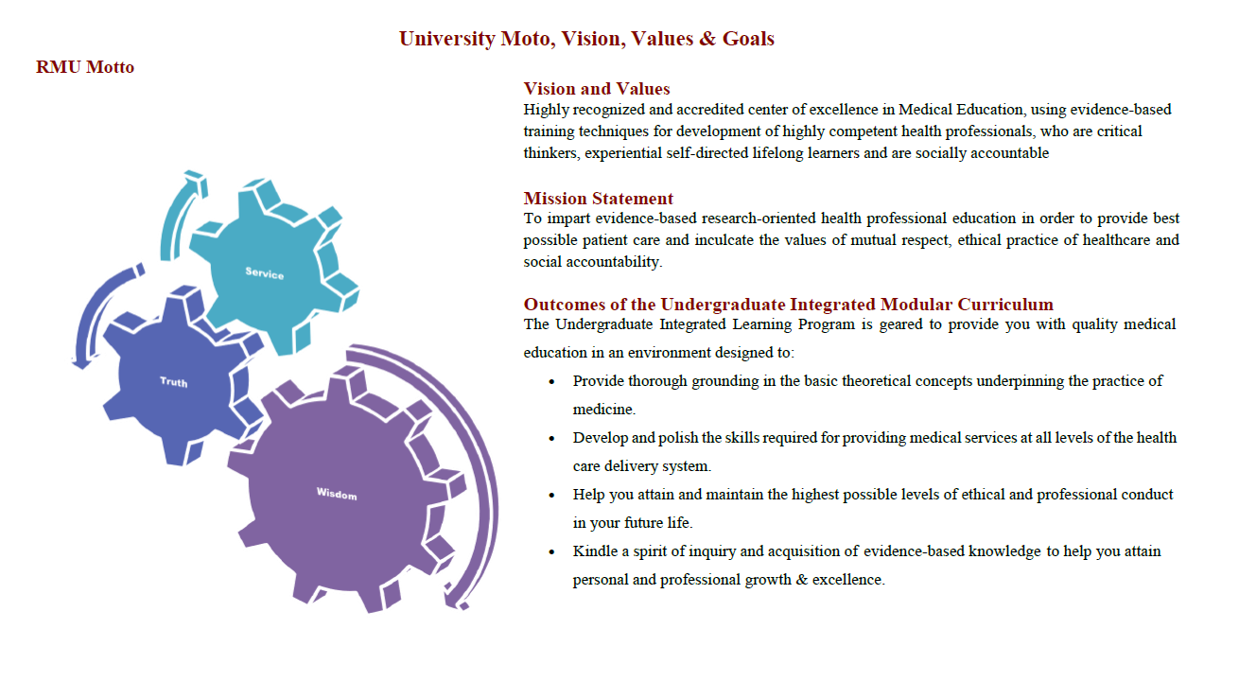

Slide 4
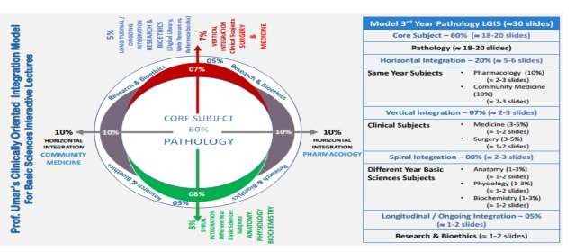

Slide 5
Learning Objectives
Classification and Characteristics of Entamoeba histolytica
Global Distribution of Amoebiasis
Clinical Manifestations: Amoebic Colitis & Liver Abscess
Pathophysiology of Liver Abscess
Diagnostic Methods for Entamoeba histolytica
Treatment of Amoebiasis
Learning Resources: Robbins & Cotran Pathologic Basis Of Disease 10th Edition

Slide 6
Introduction
VERTICAL PATHOLOGY
Protozoan Parasite: Entamoeba histolytica
Worldwide Distribution: Affects regions globally, especially in areas with poor sanitation
Amoebic Colitis: Inflammation of the colon caused by the parasite
Liver Abscess: Potential extraintestinal complication leading to abscess formation in the liver

Slide 7
Classification
VERTICAL PATHOLOGY
Entamoeba histolytica: Pathogenic
Entamoeba dispar: Non-pathogenic
Entamoeba hartmanni
Entamoeba polecki
Entamoeba coli
Entamoeba gingivalis

Slide 8
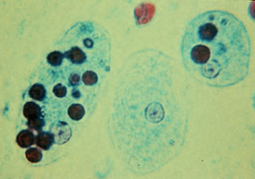
Morphology Trophozoite
CORE PATHOLOGY
Size: 20-40 µm
Cytoplasm: Clear ectoplasm, granular endoplasm
Ingested Red Cells: Present
Glycogen: Rich in glycogen
Chromatoid Bodies: Present
Nucleus: Single, chromatin granules lining the nuclear membrane, central karyosome
Locomotion: Rapid, gliding, explosive with a single pseudopodium

Slide 9
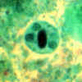
Morphology
CORE PATHOLOGY
Cysts
Shape: Spherical
Size: 10-16 µm
Nuclei: Four
Glycogen Vacuole: Present
Chromatoid Bodies: Present
Sensitivity: Killed by desiccation or boiling

Slide 10
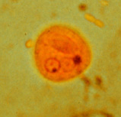
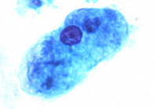
life Cycle
CORE PATHOLOGY
Excretion in faeces
Ingestion by humans
Cyst
Excystation in small intestine
Encystation in colon
Trophozoites
Liver abscess
Asymptomatic colonization
Amoebic colitis

Slide 11
Pathogenesis
CORE PATHOLOGY
Invasive
Mucosal Necrosis
Ulceration
Dysentery
Ulcer Enlargement
Colitis
Peritonitis
Ameboma
Metastasis (Extra-intestinal disease)
Dissemination via portal vein to liver
Non-invasive
Asymptomatic Colonization
Non-dysenteric Diarrhea
Cramps
Abdominal Discomfort

Slide 12
Colonic Mucosal Biopsy
CORE PATHOLOGY
Histopathological Findings of Amebic Colitis:
Diffuse, nonspecific mucosal thickening with or without ulceration
Classic flask-shaped lesions with ulceration extending through the mucosa and muscularis mucosa into the submucosa
Necrosis and perforation of the intestinal wall
Rare presence of amebae in the mucinous exudate or diffusely inflamed mucosal layer

Slide 13
Clinical Syndromes
VERTICAL INTEGRATION
Intestinal Disease:
Asymptomatic Infection
Symptomatic Non-invasive Infection
Acute Rectocolitis
Fulminant Colitis with Perforation
Toxic Megacolon
Ameboma
Perianal Ulceration
Extra-intestinal Disease: Clinical Manifestations
Liver Abscess
Peritonitis
Empyema
Pericarditis
Lung Abscess
Brain Abscess
Genitourinary Disease

Slide 14
Lab Findings
CORE PATHOLOGY
Diagnostic Findings in Amebic Liver Abscess
Leukocytosis, Anemia
↑ ALT and Normal ALP: Acute amoebic liver abscess
Normal ALT and Raised ALP: Chronic amoebic liver abscess
USG Liver and CT Scan or MRI Abdomen: Excellent for detecting liver mass, but not specific for amoebic liver abscess
Detection of Parasite Antigen in Stool: Positive in < 50% of cases
Serum Anti-amoebic Antibodies: Present in 70-80% of patients
PCR: Used for molecular detection
Fluid Aspiration: Ameba may be visualized in abscess fluid

Slide 15
Treatment
VERTICAL HORIZONTAL
INTEGRATION
Treatment of Amebiasis
Medication:
Metronidazole + Paromomycin/Diloxanide Furoate
± Emetine
Needle Aspiration: For large abscesses
Open Surgical Drainage: If needle aspiration is not possible
Perforation/Peritonitis:
Anti-protozoal drugs + Antibacterial drugs
Peritoneal Drainage

Slide 16
Prevention
FAMILY MEDICINE
Prevention and Control of Amebiasis
Boiling of Drinking Water
Adequate Water Purification: Low level of chlorine does not kill cysts
Treating Vegetables: Wash with strong detergent soap, then soak in acetic acid for 5-10 minutes
Proper Waste Disposal
Immunization: Currently under trial

Slide 17
Difference
CORE PATHOLOGY
BACILLARY | AMOEBIC
HIGH FREQUENCY | LOW FREQUENCY
BLOOD & MUCUS | BLOOD & MUCUS MIXED WITH STOOLS
STICKY | NOT STICKY
ALKALINE | ACIDIC
PUS CELLS / RBCs | PUS CELLS / RBCs
MACROPHAGES | TROPHOZOITES OF E. HISTOLYTICA

Slide 18
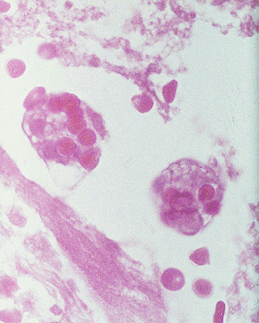
Amoebic colitis –dysentery stool (small volume, blood & mucus)
CORE PATHOLOGY
E. Histolytica with ingested RBCs –H&E stain

Slide 19
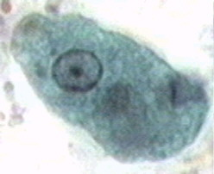
E. Histolytica (trophozoites)
CORE PATHOLOGY
Trichrome stain
Gomori's trichrome
PAS
Invasive trophozoites contain erythrocytes and bacteria (H&E stain)

Slide 20
Cyst & Trophozoite of E. histolytica
CORE PATHOLOGY

Slide 21
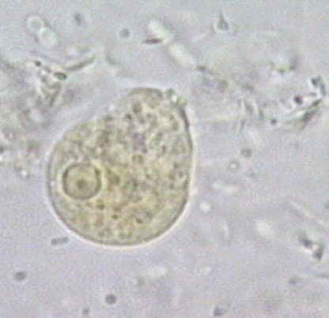
Cyst & Trophozoite of E. histolytica
CORE PATHOLOGY
Differential Diagnosis of E. histolytica Trophozoite
Differential diagnosis from other intestinal amoebae is based on:
Size, shape, and morphology of nuclei
Chromatin and karyosome characteristics
The characteristics of the single nucleus can be observed after iodine stain.

Slide 22
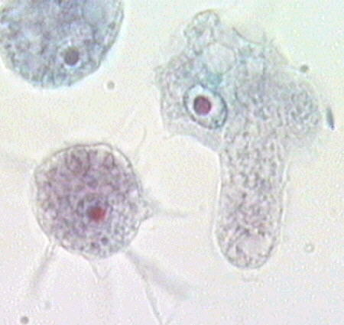
Acanthamoeba spp. Clinical Syndromes
CORE PATHOLOGY
Free-living amoebae of the Acanthamoeba genus cause two clinical syndromes:
Granulomatous amoebic encephalitis (GAE)
Subacute and chronic amoebic keratitis
A disseminated form of GAE has been described in individuals with Acquired Immunodeficiency Syndrome (AIDS).
Acanthamoeba spp
(Trophozoites, trichrome stain)

Slide 23
Giardia Lamblia
CORE PATHOLOGY
Intestinal flagellate infections are associated with contaminated water.
Commonly seen in:
Day care centers
Campers
Male homosexuals
Compromised patients at higher risk include those with:
Hypogammaglobulinemia
Malnutrition
Gastrectomy
HLA-B12
Gastric achlorhydria
Blood group A
Ig deficiencies
Reduced IgA levels in the gut

Slide 24
Giardia Lamblia
CORE PATHOLOGY
Incubation period (IP):
Ranges from a few days to several weeks
Average: 9 days
Signs & Symptoms (S&S):
Nausea
Upper intestinal cramping or pain
Malaise
Explosive watery diarrhea
Foul-smelling stools
Flatulence
Abdominal distension
Belching
Heartburn
S&S may mimic:
Peptic ulcer disease
Gallbladder disease

Slide 25
Giardia Lamblia- Morphology
CORE PATHOLOGY
Giardia lamblia consists of two forms:
Trophozoite:
Rounded anterior and pointed posterior end
Pear-shaped or racket-shaped
Two nuclei and four pairs of flagella
Ventral surface has a sucking disc
Cyst:
Oval in shape with a tough hyaline wall
Young cyst has two nuclei
Mature cyst has four nuclei at one end
Encystation occurs in the colon

Slide 26
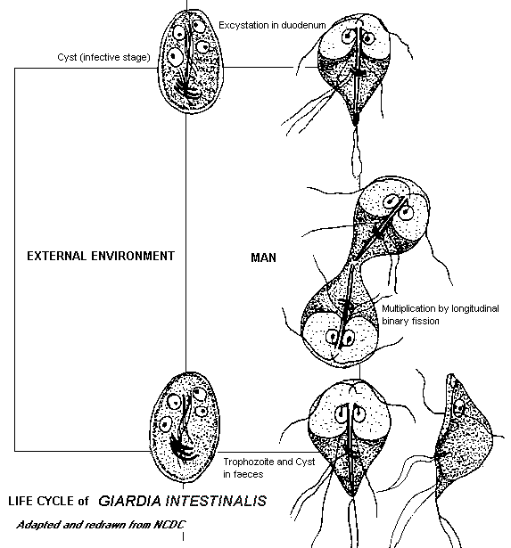
CORE PATHOLOGY

Slide 27
Giardia Lamblia
CORE PATHOLOGY
Diagnosis:
Demonstration of cysts or trophozoites in feces:
Examine three stool specimens
Trophozoites in duodenal contents:
Obtained by string test, aspiration, or biopsy
Identification of trophozoites:
Characteristic falling leaf or tumbling motion in saline mount

Slide 28
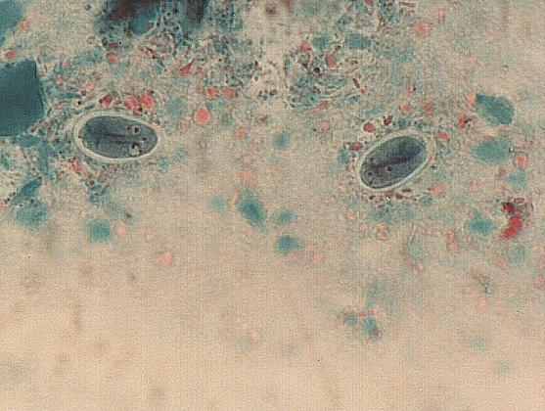
CORE PATHOLOGY
Giardia cysts stained with Trichrome stain

Slide 29
Giardia Lamblia -Trophozoites & cyst
CORE PATHOLOGY

Slide 30
Research
LONGITUDINAL PATHOLOGY
https://www.ncbi.nlm.nih.gov/books/NBK557718/
Objectives:
Identify the etiology of Entamoeba histolytica medical conditions and emergencies
Describe components of evaluation in the work-up for Entamoeba histolytica
Summarize the management options available for Entamoeba histolytica
Outline interprofessional team strategies for improving care coordination and communication to advance Entamoeba histolytica care and improve outcomes

Slide 31
AI In Microbiology
LONGITUDINAL PATHOLOGY

Slide 32
CORE PATHOLOGY

