Slide 1
LUTS/Benign Prostate Hyperplasia Renal Module 4th Year MBBS
Dr Kiran Fatima
Pathology Department
Rawalpindi Medical University

Slide 2
MOTTO OF RMU
Wisdom
Truth
Service

Slide 3
VISION OF RMU THE DREAM/ TOMORROW
To impart evidence based research oriented medical education
To provide best possible patient care
To inculcate the values of mutual respect and ethical practice of medicine

Slide 4
PROF UMAR’S LGIS MODEL

Slide 5
How to use HEC digital library
Steps to Access HEC Digital Library
Go to the website of HEC National Digital Library.
On Home Page, click on the INSTITUTES.
A page will appear showing the universities from Public and Private Sector and other Institutes which have access to HEC National Digital Library (HNDL).

Slide 6
4. Select your desired Institute.
5. A page will appear showing the resources of the institution
6. Journals and Researches will appear
7. You can find a Journal by clicking on JOURNALS AND DATABASE and enter a keyword to search for your desired journal.

Slide 7
Objectives
Describe the lower urinary tract symptoms (LUTS) found in men with BPH.
Outline the investigations required when evaluating a man with LUTS.
Describe the medical treatments of BPH.
Describe the indications for surgical treatment of BPH.

Slide 8
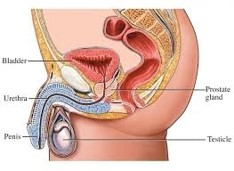
Spiral
Anatomy
The prostrate gland

Slide 9
Benign prostatic hyperplasia
Core Content
Commonly associated with “voiding” & urinary “storage” symptoms
Epidemiology
Extremely common with 70% of men in their 70’s describing voiding symptoms

Slide 10
Benign prostatic hyperplasia: pathophysiology
Core Content
Pathophysiology
Prostate volume increases from puberty
Androgen dependent
Symptoms correlate with gland size, but not strongly
Glandular volume
Smooth muscle component of prostate

Slide 11
Lower urinary tract symptoms (LUTS)
Core Content
Storage symptoms
Frequency
Urgency ± urge incontinence
Nocturia
Voiding symptoms
Hesitency
Decreased stream
intermittency
Straining to void
Incomplete emptying
Urinary retention
Overflow incontinence

Slide 12
Evaluation: medical history
Integration Vertical
Medical history
Should focus on:
Urinary tract symptoms
UTI, Hematuria
Previous surgery
Family history of prostate carcinoma
Co-morbidities/general health issues
Medications
(Anti-cholinergics & sympathomimetics)
Voiding diary (optional)

Slide 13
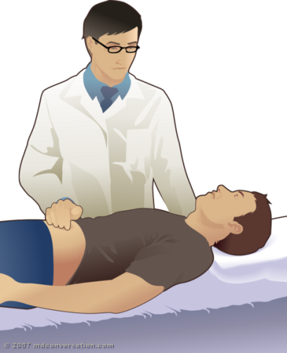
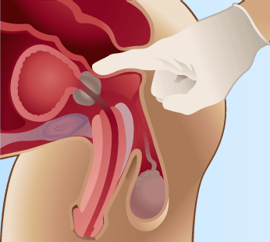
Evaluation: physical examination
Integration Vertical
Physical examination
Complete exam including:
Abdomen (assess bladder)
External genitalia
Focused neurological exam
Digital Rectal Examination (DRE)
(Assess for concurrent

Slide 14
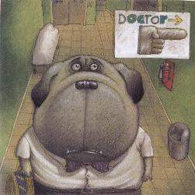
BPH: Recommended investigations
Integration Vertical
Urinalysis and culture
Prostate Specific Antigen (PSA)(if appropriate)
International Prostate Symptom Index (or AUA symptom index)
Serum Creatinine (optional)

Slide 15
LUTS: Optional investigations
Core Content
Cystoscopy (only if):
If urinalysis abnormal (hematuria or pyuria)
Patient <50 years old
Renal ultrasound (only if):
If serum Cr elevated
PVR urine/Uroflow (optional)

Slide 16
LUTS: Treatment options
Integration Horizontal
Lifestyle Measures
Watchful Waiting
Medical Management
Alpha blockers
5-alpha reductase inhibitors (5 ARI’s)
Surgical Management

Slide 17
1. Treatment options: lifestyle measures
Integration Vertical
Fluid modification
Reduce fluid intake in the evening
Avoid caffeine, alcohol
Timed voiding
Regular timed voiding of the bladder
Modify medications
I.e: change time of dosing diuretics
Avoid cold remedies (anti-histamines)
Avoid anti-cholinergics
Avoid alpha-agonists (i.e. decongestants)

Slide 18
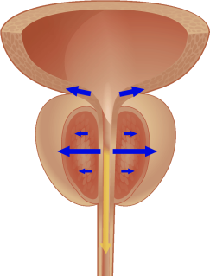
3a. Medical treatment: long-acting non-selective α₁-blockers
Integration Vertical
Dosage is increased in a stepwise fashion at weekly intervals
Does not affect PSA
Acts to relax prostatic/bladder neck smooth muscle (& vascular smooth muscle - non selective)
Doxazosin (Cardura)
Dosage: 1-2 mg qDay, titrate up to 4-8 mg OD
Terazosin (Hytrin)
Dosage: 1 mg OD, titrate up to 2, 5, or 10

Slide 19
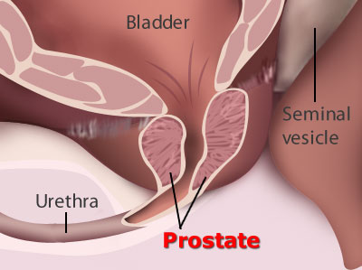
3a. Medical management: long-acting selective α_{1a}-blockers
Integration Vertical
Long-acting selective α₁-blockers
Specifically relaxes the smooth muscle of the prostate and bladder neck
Does not interfere with bladder contractility
Does not affect PSA
Alfuzosin (Xatral)
Dosage: 10 mg qDay
Tamsulosin (Flomax)
Dosage: 0.4 mg qDay
Silodosin (Rapaflo)
Dosage: 8mg qDay

Slide 20
α₁-blockers: side effects
Integration Vertical
5 known side effects of alpha blockade for LUTS
Asthenia
Hypotension
Retrograde ejaculation
Dizziness
Flu-like syndrome

Slide 21
3b. Medical management: the 5-α-reductase inhibitors
Integration Vertical
5-α-reductase inhibitors:
Regulate androgen available to prostate by blocking conversion of testosterone to dihydrotestosterone (DHT)
Slow the rate of prostate enlargement
Reduce prostate volume and relives “static” compression by BPH
Reduce PSA by ~50%
Takes 3-6 months to exert clinical effect

Slide 22
5-α-reductase inhibitors
Integration Vertical
Men with larger prostates (> 40 g) respond most favorably
Finasteride (Proscar)
Dosage: 5 mg OD – type II inhibitor
Dutasteride (Avodart)
Dosage: 0.5 mg OD – type I and II inhibitor

Slide 23
4. LUTS: Indications for surgery
Integration Horizontal
Bothersome symptoms despite treatment
BPH-related complications
Urinary Retention (inability to void)
Bladder calculi
Recurrent UTI
Recurrent hematuria from the prostate
Upper tract dysfunction (hydronephrosis, renal dysfunction)
Surgical approach will depend on:
Patient’s prostate size
Surgeon’s judgment
Patient’s co-morbidities

Slide 24
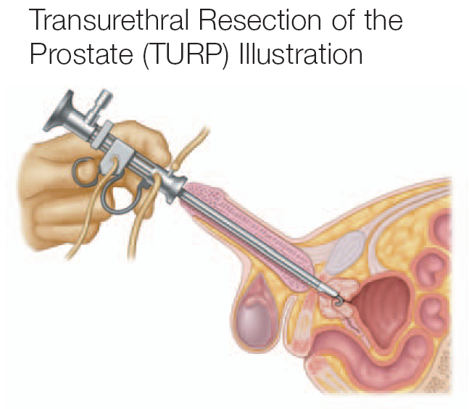
BPH Surgery: transurethral resection of prostate (turp) is the most common surgery for BPH
Integration Horizontal
Transurethral resection of the prostate (TURP)
Standard of care
Uses electrosurgery to “core” out the obstructive tissue

Slide 25
LUTS: Surgical techniques
Integration Horizontal
TURP - Transurethral Resection of Prostate
Gold standard for surgical treatment of BPH if prostate has moderate size
Minimally invasive surgeries
Numerous laser vapourization techniques
Open prostatectomy to remove the central/transtion zone when prostate is very large (>100cc)

Slide 26
Complications: TURP
Integration Vertical
Retrograde ejaculation (very common>90%)
Incontinence (1-2%)
Erectile Dysfunction (rare)
Bladder neck Contracture/Urethral Stricture (1-10%)
Bleeding (~5% need a transfusion)
Risks of any Operation

Slide 27
Research https://www.ncbi.nlm.nih.gov/books/NBK558920/
Benign Prostatic Hyperplasia
Michael Ng; Stephen W. Leslie; Krishna M. Baradhi.
Author Information and Affiliations
Last Update: October 20, 2024.
Continuing Education Activity
Benign prostatic hyperplasia is a common condition encountered in aging men and a common cause of lower urinary tract symptoms. Histological prevalence is common, and disease progression is associated with bladder outflow obstruction. This may present clinically in both the emergency surgical and outpatient clinical settings. This activity reviews the natural history of benign prostatic hyperplasia and highlights the role of the interprofessional healthcare team in evaluating and managing these patients.
Participants will explore the definitions of benign prostatic hyperplasia, benign prostatic enlargement, and bladder outlet obstruction, gaining clarity on the terminology used to describe the various aspects of the condition. They will acquire a thorough understanding of benign prostatic hyperplasia, its clinical implications, and evidence-based approaches to its evaluation and management. This knowledge will equip healthcare professionals and interprofessional team members with the tools necessary to enhance patient care and outcomes in affected individuals.

Slide 28
Take home message
An enlarged prostate, also known as benign prostatic hyperplasia (BPH), is a common condition that affects men as they age.
Symptoms of an enlarged prostate can include frequent urination, difficulty starting or stopping urination, a weak urine stream, and nocturia (the need to wake up at night to urinate).
Treatment for an enlarged prostate may include medication, minimally invasive procedures, or surgery.

Slide 29
Family Medicine
Scenario:
A 65-year-old man, Mr. Ahmed, visits his doctor for his annual check-up. He's been feeling generally well but mentions experiencing some increased frequency in urination, especially at night. He also reports occasionally feeling a slight burning sensation during urination. He's not overly concerned, attributing it to "getting older," but his wife has encouraged him to discuss it with his doctor. His family history includes his father being diagnosed with prostate cancer at age 78.
Based on Mr. Ahmed's symptoms and family history, what is the MOST appropriate next step the doctor should take in evaluating his condition?
A) Immediately schedule a prostate biopsy to rule out cancer. B) Reassure Mr. Ahmed that his symptoms are likely age-related and no further investigation is needed at this time. C) Perform a digital rectal exam (DRE) and discuss the pros and cons of prostate-specific antigen (PSA) testing with Mr. Ahmed. D) Prescribe antibiotics for a presumed urinary tract infection, as burning during urination is a common symptom.
Correct answer: C) Perform a digital rectal exam (DRE) and discuss the pros and cons of prostate-specific antigen (PSA) testing with Mr. Ahmed.

