Slide 2
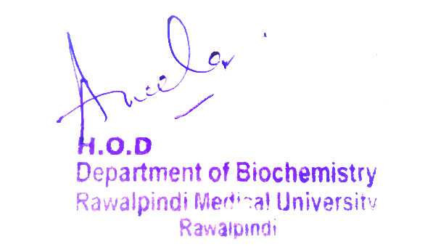
Endocrinology Module 2nd Year MBBS(LGIS) Physicochemical Aspects
Presenter: Dr Uzma Zafar Date: 01-02-25
Dept of Biochemistry
RMU

Slide 3
Motto, Vision, Dream
To impart evidence based research oriented medical education
To provide best possible patient care
To inculcate the values of mutual respect and ethical practice of medicine
Wisdom
Truth
Service

Slide 4
Professor Umar Model of Integrated Lecture

Slide 5
Learning Objectives
At the end of this session students should be able toUnderstand synthesis of parathyroid and calcitonin hormone
Discuss MOA of parathyroid & calcitonin hormone
Explain regulation of parathyroid along with calcitonin
Integrate anatomical and physiological aspects
Associate clinicopathological conditions

Slide 6
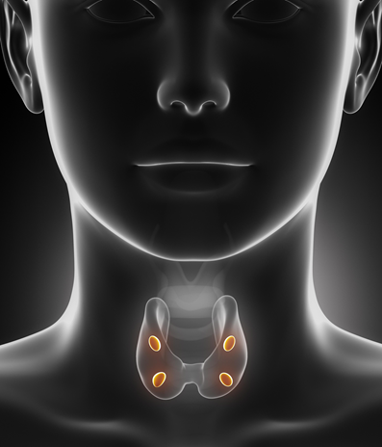
Core Knowledge
Parathyroid hormone
Parathyroid hormone provides a powerful mechanism for controlling extracellular calcium and phosphate
concentrations by regulating intestinal reabsorption, renal excretion, and exchange between the extracellular fluid and bone of these ion

Slide 7
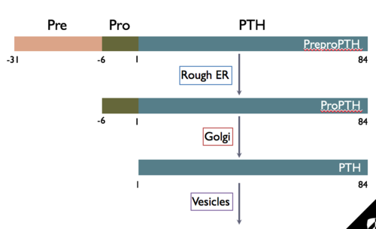
Chemistry of parathyroid hormone
Core Knowledge
PTHis first synthesized as preprohormone, a polypeptide chain of 110 amino acids
This is cleaved first to a prohormone with 90 amino acids
PTH itself with 84 amino acids
110 amino acids
90 amino acids
84 amino acids

Slide 8
Chemistry of parathyroid hormone
Core Knowledge
PTH is first synthesized on the ribosomes in the form of a preprohormone, a polypeptide chain of 110 amino acids
This is cleaved first to a prohormone with 90 amino acids, then to the hormone itself with 84 amino acids by the endoplasmic reticulum and Golgi apparatus, and finally is packaged in secretory granules in the cytoplasm of the cells
Smaller compounds with as few as 34 amino acids adjacent to the N terminus of the molecule have also been isolated from the parathyroid glands that exhibit full PTH activity

Slide 9
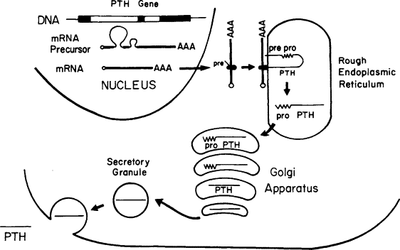
Synthesis of parathyroid hormone
Core Knowledge

Slide 10
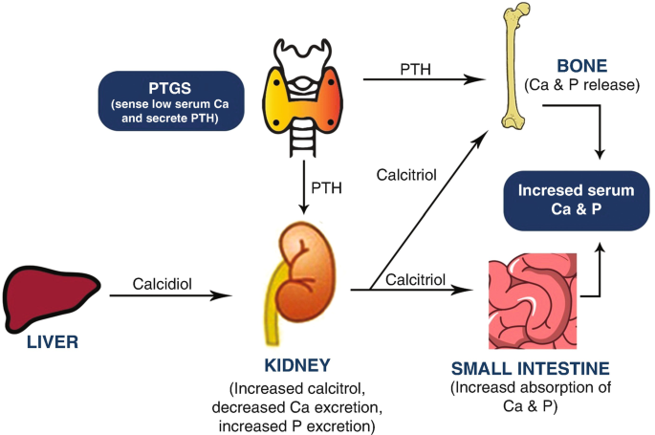
Core Knowledge
Effect of PTH on calcium and phosphate concentrations

Slide 11
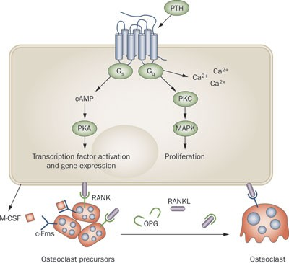
Core Knowledge
Mechanism of action of parathyroid hormone

Slide 12
Core Knowledge
Mechanism of action of parathyroid hormone
Osteoclasts do not have receptors for parathyroid hormones (PTH). However, PTH can indirectly stimulate osteoclast activity by acting on osteoblasts.
Osteoblasts have receptors for PTH, they are bone-forming cells that also produce a variety of signaling molecules, including receptor activator of nuclear factor kappa-b ligand (RANKL) and osteoprotegerin (inhibits bone resorption and binds with strong affinity to its ligand cytokine). RANKL is a cytokine that stimulates osteoclast differentiation and activity

Slide 13
Mechanism of action of parathyroid hormone
Core Knowledge
PTH binding to its receptor on osteoblasts increases cytokine expression and decreases osteoprotegerin expression
Overall, PTH stimulates osteoclast activity by acting on osteoblasts, but it does not directly interact with osteoclasts
In addition, PTH can stimulate osteoblast production of other factors that promote osteoclast activity, such as macrophage colony-stimulating factor (M-CSF)
M-CSF is a cytokine that is essential for osteoclast differentiation and survival

Slide 14
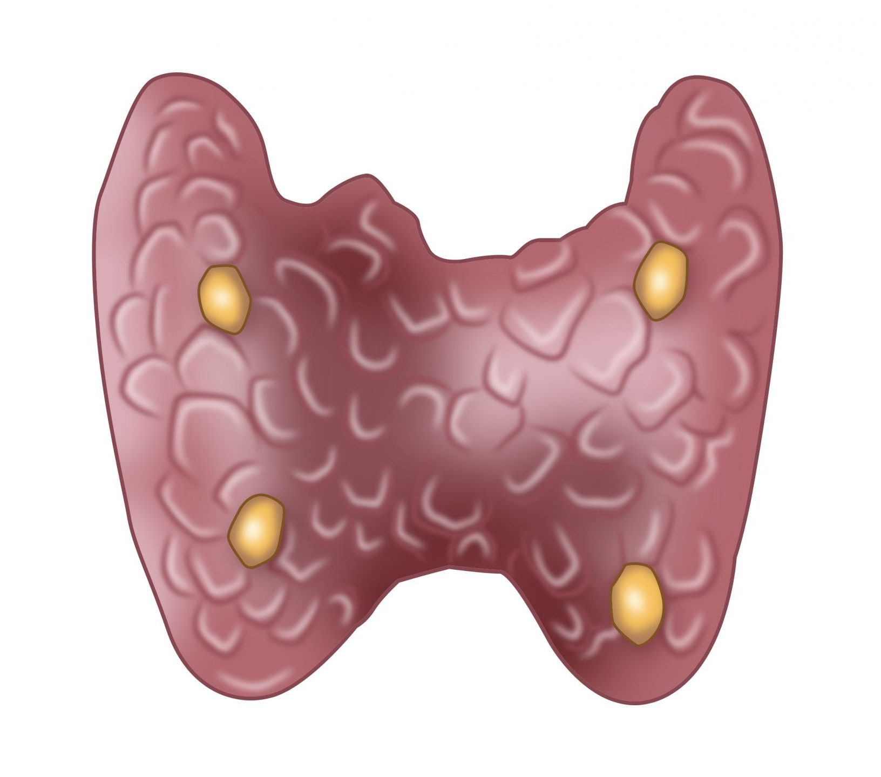
Core Knowledge
Regulation of parathyroid hormone
Hypocalcaemia
Hyperphosphatemia
Hypomagnesemia
Stimulation
Inhibition
Hypercalcaemia
Hypophosphatemia
Hypercalcaemia
Calcitriol

Slide 15
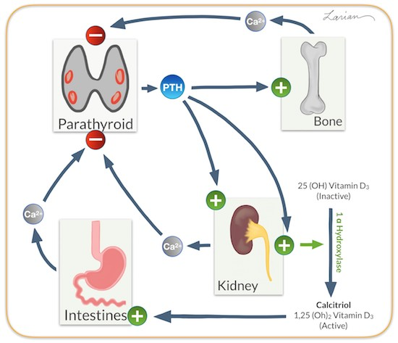
Core Knowledge
Regulation of parathyroid hormone

Slide 16
Core Knowledge
Cont……
Even the slightest decrease in calcium ion concentration in the extracellular fluid causes the parathyroid glands to increase their rate of secretion within minutes if the decreased calcium concentration persists, the glands will hypertrophy, sometimes fivefold or more
The parathyroid glands become greatly enlarged in rickets also in pregnancy and during lactation because calcium is used for milk formation
Conversely, conditions that increase the calcium ion concentration above normal cause decreased activity and reduced size of the parathyroid glands:
Excess quantities of calcium in the diet
Increased vitamin D in the diet

Slide 17
Core Knowledge
Calcitonin Hormone
Calcitonin, a peptide hormone secreted by the thyroid gland, tends to decrease plasma calcium concentration and, in general, has effects opposite to those of PTH.
Calcitonin is a 32-amino acid peptide with a molecular weight of about 3400.
Synthesis and secretion of calcitonin occur in the parafollicular cells, or C cells, lying in the interstitial fluid between the follicles of the thyroid gland.
These cells constitute only about 0.1 percent of the human thyroid gland and are the remnants of the ultimobranchial glands of lower animals, such as fish, amphibians, reptiles, and birds.

Slide 18
Core Knowledge
Calcitonin Decreases Plasma Calcium Concentration
Calcitonin decreases blood calcium ion concentration rapidly, beginning within minutes after injection of the calcitonin, in at least two
ways.
The immediate effect is to decrease the absorptive activities of the osteoclasts and possibly the osteolytic effect of the osteocytic membrane throughout the bone, thus shifting the balance in favor of deposition of calcium in the exchangeable bone calcium salts.
The second and more prolonged effect of calcitonin is to decrease the formation of new osteoclasts. Also, because osteoclastic resorption of bone leads secondarily to osteoblastic activity, decreased numbers

Slide 19
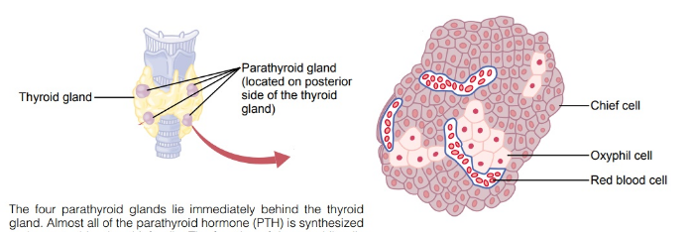
Anatomy of Parathyroid Gland
Horizontal Integration

Slide 20
Physiology of PTH & Calcitonin
Horizontal Integration
PTH stimulates osteoclast activity, leading to bone resorption (breakdown of bone tissue), which releases calcium and phosphate into the bloodstream.
PTH increases calcium reabsorption in the renal tubules, reducing calcium excretion in the urine.
Calcitonin inhibits osteoclast activity, reducing bone resorption and preventing the release of calcium into the bloodstream.
Calcitonin promotes renal excretion of calcium and phosphate, though this effect is less significant compared to PTH.

Slide 21
Horizontal Integration
Parathyroid diseases
Hypoparathyroidism
Hyperparathyroidism
PTH- independent hypercalcemia
Primary
hyperparathyroidism
Latent tetany
Secondary
hyperparathyroidism
Latent tetany

Slide 22
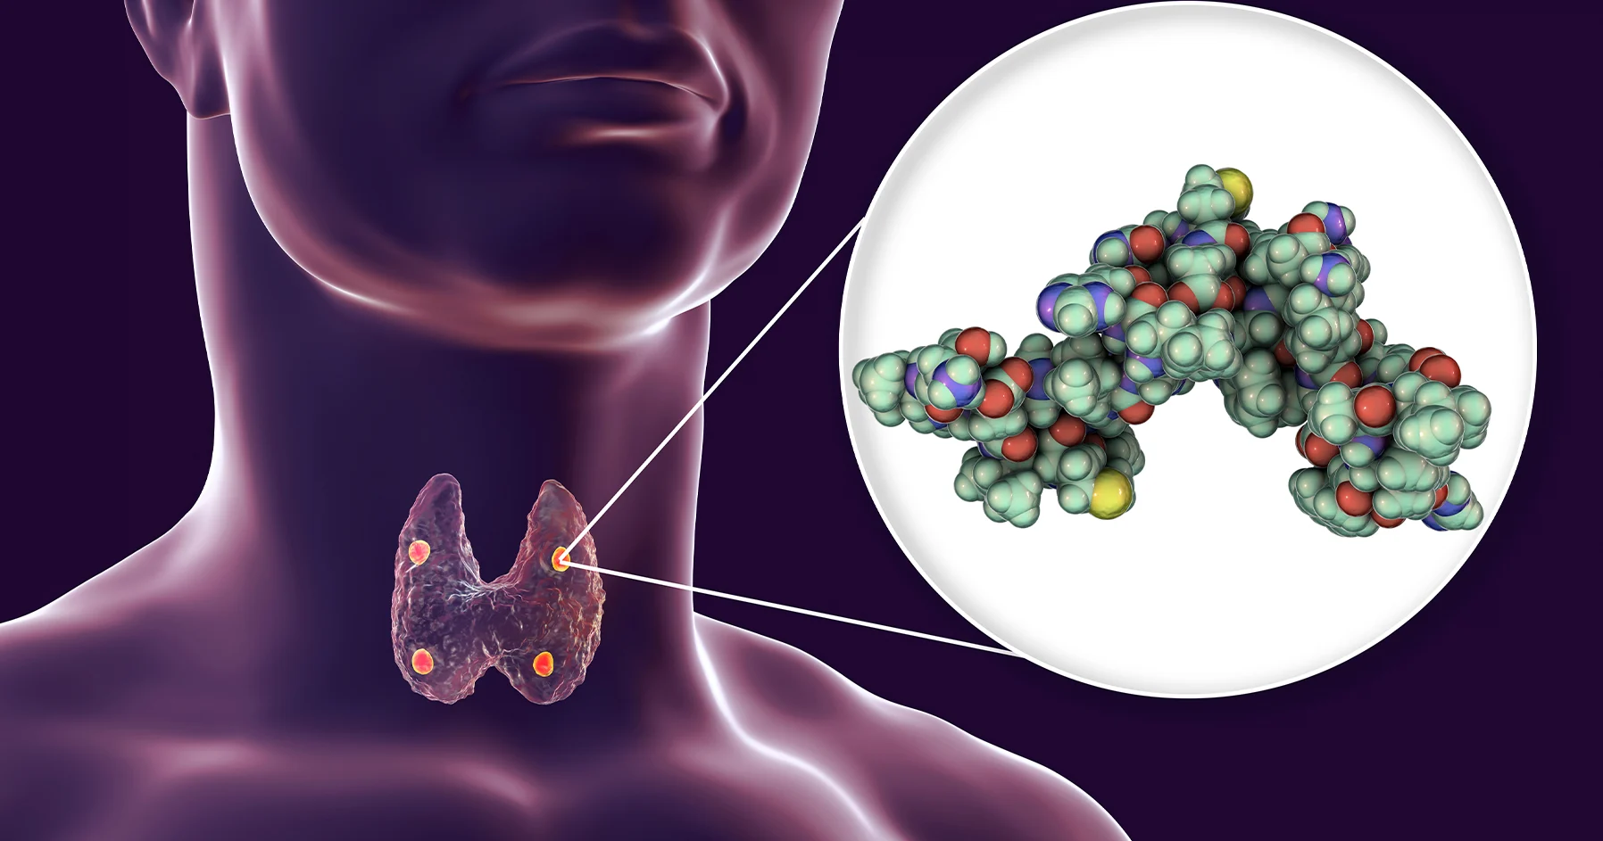
Vertical Integration
Hypoparathyroidism
Injury
(during thyroid or neck surgery)
Autoimmune attack
Hypomagnesemia

Slide 23
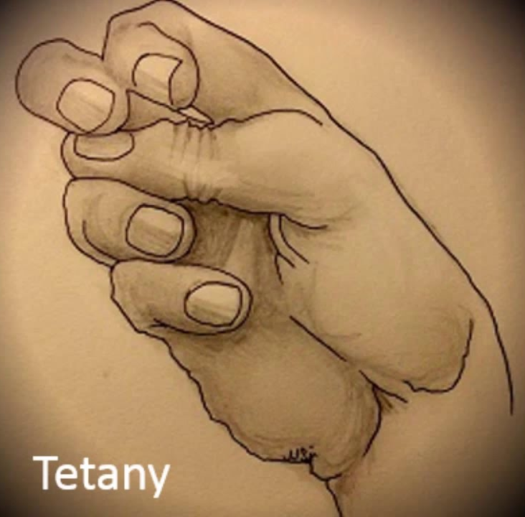
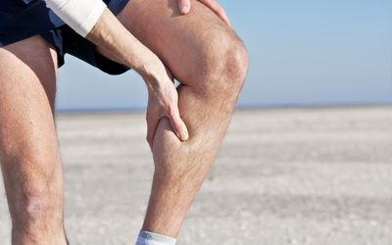
Vertical Integration
Clinical manifestation of hypoparathyroidism
Notes:
Thickening of the superficial layer of the epithelium due to increased keratinization.
Destruction or atrophy of the finger-like projections on the dorsal surface of the tongue.
Increased proliferation of epithelial cells in response to the inflammatory process.
Invasion of fungal elements, such as hyphae and spores, within the superficial layers of the epithelium.

Slide 24
Spiral Integration
Family Medicine
Family Medicine plays important role in following manner:
Diagnosis
Education
Dietary Guidance
Monitoring
Refer to Specialists

Slide 25
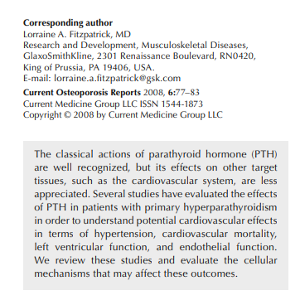
Suggested research articles
https://link.springer.com/article/10.1007/s11914-008-0014-8

Slide 26
Spiral Integration
Bioethics
Ethical Considerations
From an ethical standpoint, the scenario raises considerations regarding patient autonomy, informed consent, and confidentiality
The physician must ensure that patient fully understands her diagnosis, treatment options, and potential implications
Discuss the necessity of a healthy lifestyle & treatment plan. This requires clear communication and understanding of risks and benefits.
Additionally, the physician must respect patient’s privacy and confidentiality throughout the diagnostic and treatment process

Slide 27
Spiral Integration
Artificial Intelligence
Role of AI in Management
AI can potentially aid in enhancing diagnostic accuracy and efficiency.
AI-powered decision support systems can also help clinicians in selecting appropriate treatment modalities
AI-driven predictive models may help anticipate the risk of complications of the Disease in susceptible populations

Slide 28
Learning Resources
GUYTON & HALL chap no: 80, Pg no: 991
Google Images
Google Scholars

