Slide 1
Ectopic pregnancy Gestational Trophoblastic Disease
Dr. Maliha Sadaf
Gynae unit II
Holy Family Hospital

Slide 2
University Motto, Vision, Values & Goals
Mission Statement
To impart evidence-based research-oriented health professional education
Best possible patient care
Mutual respect, ethical practice of healthcare and social accountability.
Vision and Values
Highly recognized and accredited center of excellence in Medical Education, using evidence-based training techniques for development of highly competent health professionals, who are lifelong experiential learner and are socially accountable.
Goals
The Undergraduate Integrated Learning Program is geared to provide you with quality medical education in an environment designed to.

Slide 3
SEQUENCE OF LGIS
Learning objectives
Ectopic pregnancy ,Gestational trophoblastic disease (core concept = 70%)
Related anatomy (horizontal integration 15%)
Related clinical findings (vertical integration – 10%)
Research article related to topic (3%)
Ethics (2%)

Slide 4
PROF UMER MODEL OF INTEGRATED LECTURE

Slide 5
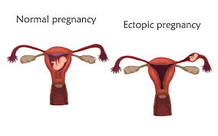
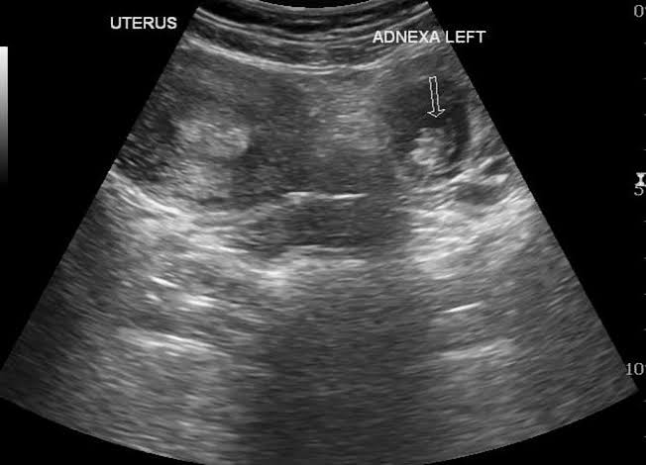
ECTOPIC PREGNANCY
Understanding of definition, Identify clinical features of ectopic pregnancy
Enlist investigations required to diagnose ectopic pregnancy
Formulate a management plan including treatment for ectopic pregnancy and follow up plan after treatment.

Slide 6
ECTOPIC PREGNANCY
An ectopic pregnancy is any pregnancy implanted outside of the endometrial cavity
when fertilized egg attaches itself in a place other than inside the uterus.
The incidence of ectopic pregnancy is 2-3%
account for 9-13% of maternal death in western world
10-30% in low resource countries

Slide 8
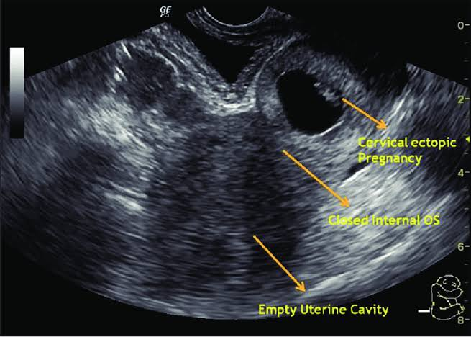
Implantation sites
Fallopian tubes( Tubal, Ampulla, isthmus, interstitial, infundibulum)
Ovary
Cervix
abdominal cavity
Caesarean section scars

Slide 11
ACUTE ECTOPIC PREGNANCY
Severe abdominal pain
amenorrhea with scanty dark vaginal bleeding
nausea,vomiting,fainting and syncope attack
On examination: patient is pale with cold clammy skin, tachycardia, hypotension
Abdomen is tense and tender
mostly as rupture ectopic pregnancy

Slide 12
CHRONIC ECTOPIC PREGNANCY
Diagnosed by high clinical suspicion.
had previous attack of acute lower abdominal pain
amenorrhea, vaginal bleeding, dull lower abdominal pain and urinary complaints, no feature of shock.
abdominal examination: may be tenderness

Slide 13
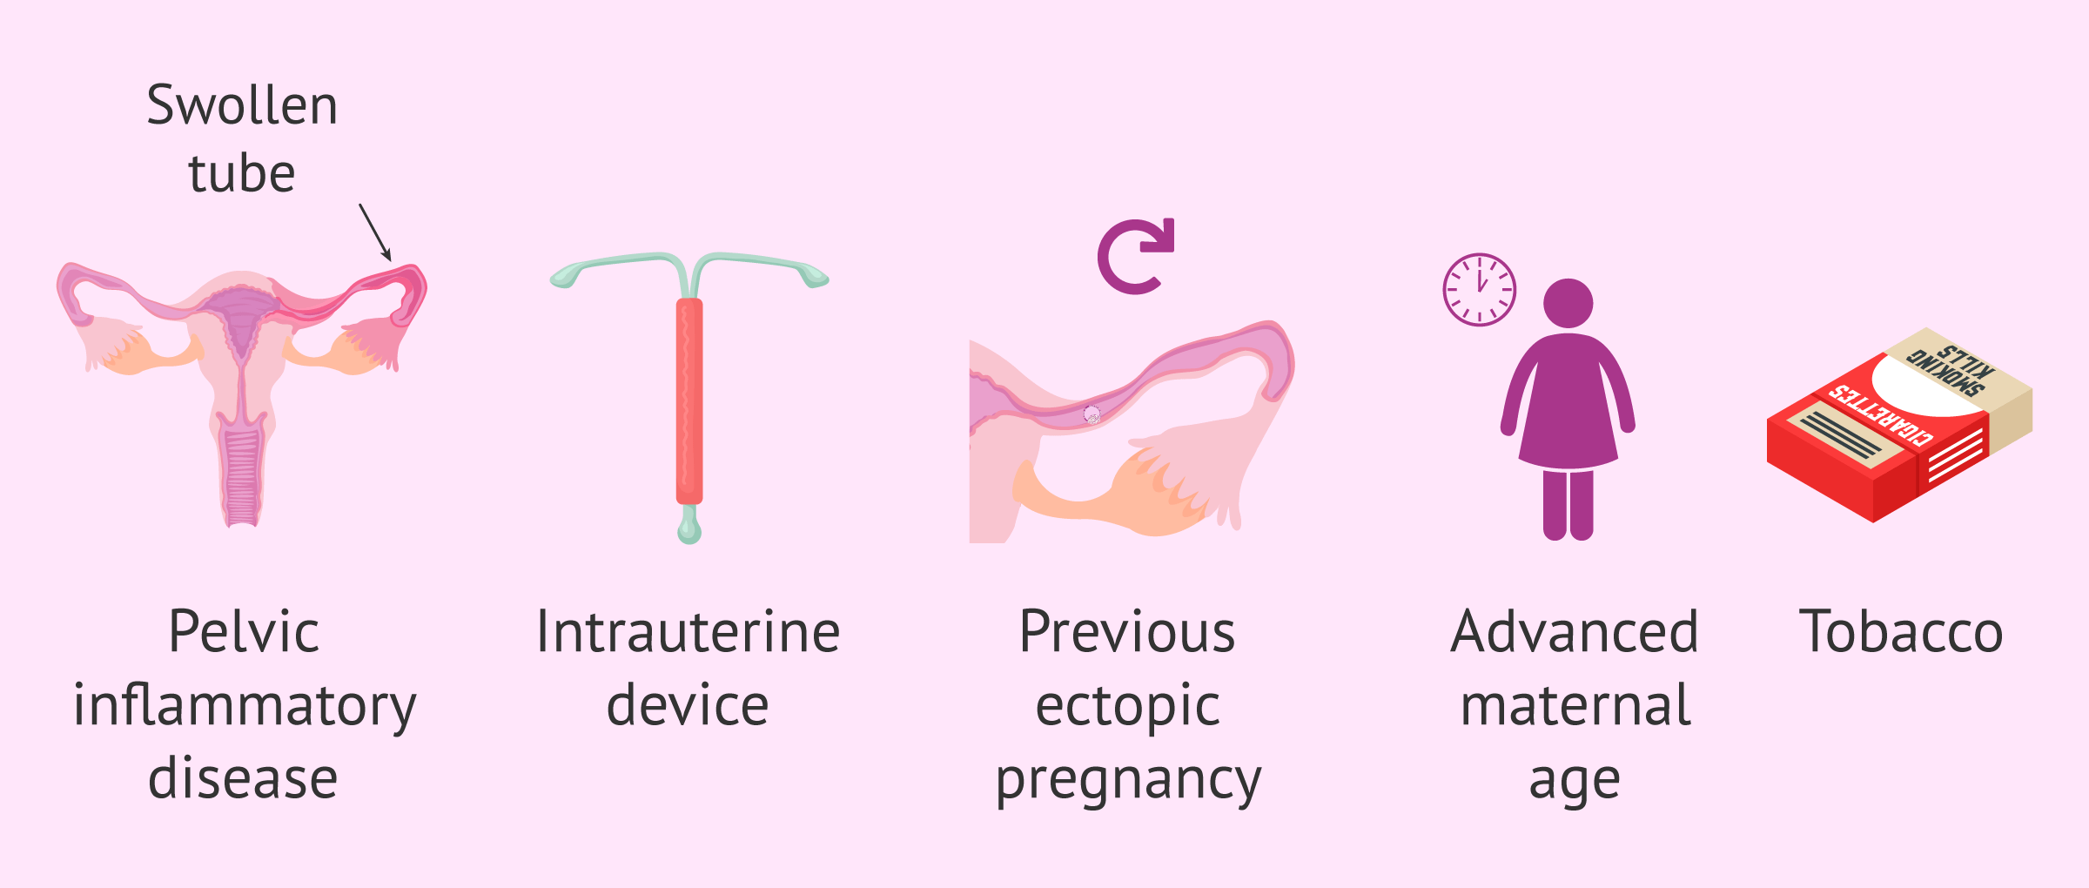
RISK FACTORS
Subfertility
IVF
previous abdominal surgery
smoking
Endometriosis
use of IUCD
Conception on oral contraceptive pills

Slide 14
HETEROTOPIC PREGNANCY
Is simultaneous development of two pregnancies
one within uterine cavity and one outside uterine cavity

Slide 16
DIFFERENTIAL DIAGNOSIS
Rupture corpus luteum cyst
ovarian cyst accident
torsion or degeneration of pedunculated fibroid
incomplete miscarriage
acute appendicitis
renal colic

Slide 17
Assessment and Diagnosis
history collection: amenorrhoea, vaginal bleeding, vomiting, shoulder tip pain, hx of previous surgery
Physical examination: tenderness, mass, uterus normal in size.
Radiological Investigation: transvaginal ultrasound empty uterus with adnexal mass, presence of free fluid rupture ectopic pregnancy
biochemical investigation: serum beta human chorionic gonadotropin level rise is suboptimal .
Blood Grouping and cross match

Slide 18
TREATMENT
EXPECTANT MANAGEMNT
Hemodynamically stable patient
Asymptomatic
Live in close proximity to hospital
Ultrasound: small<3cm mass of non rupture ectopic pregnancy
Serial Beta hCG levels until undetectable
MEDICAL MANAGEMENT
Criteria: minimal symptoms
Adnexal mass <40mm
Serum beta hCG <3000IU/L
USG: No fetal cardiac activity
No hemoperitoneum
INJECTION METHOTREXATE 50mg/m2
IM
Serum beta hCG on day 4,7,11 then weekly until undetectable
SURGICAL MANAGEMENT
Standard treatment of choice: Laparoscopy
2: Laparotomy :severe compromised patients
3: Salpingectomy: removal of fallopian tube and EP within
4: Salpingostomy: EP extracted through opening.
Recommended if contralateral tube is absent

Slide 22
IMPORTANT POINTS TO REMEMBER
Avoid intercourse and conceiving for 3 months during and after methotrexate
Contraindication to methotrexate: chronic liver, renal and blood disorder, acute infection, immunodeficiency
RH negative women who have undergone surgery should be offered anti –D 250 IU injection as soon as possible or within 72 hour of surgery

Slide 23
GESTATIONAL TROPHOBLASTIC DISEASE

Slide 24
LEARNING OUTCOME
Classify gestational trophoblastic disease
Identify clinical features of gestational trophoblastic disease
Enlist investigations required to diagnose GTD
Formulate a management plan including treatment for GTD and follow up plan after treatment.
Identify features of gestational trophoblastic neoplasia during follow up after treatment for premalignant GTD
Categorise patients requiring chemotherapy into low risk and high risk group
Devise a follow up plan after chemotherapy

Slide 25
Gestational trophoblastic disease
Gestational trophoblastic disease (GTD) consists of a range of pregnancy-related disorders derived from disordered proliferation of the placental trophoblast.
GTD has distinctive morphological, histopathological and genetic characteristics that enable subdivision into benign and malignant GTD.

Slide 26
How do you classify gestational trophoblastic disease?

Slide 27
GESTATIONAL TROPHOBLASTIC DISEASE
1.Premalignant disorders
Complete hydatidiform mole.
Partial hydatidiform mole.
2. Gestational trophoblastic neoplasia (GTN)
Invasive mole
Choriocarcinoma
Placental-site trophoblastic tumor.
GTN can progress, invade, metastasize, and lead to death if left untreated.

Slide 28
ORIGIN AND GENETICS
An abnormal pregnancy characterized by varying degrees of trophoblastic proliferation (both cytotrophoblast and syncytiotrophoblast) and vesicular swelling of placental villi (villous hydrops) associated with an absent or an abnormal fetus/embryo.
Pathophysiology

Slide 29
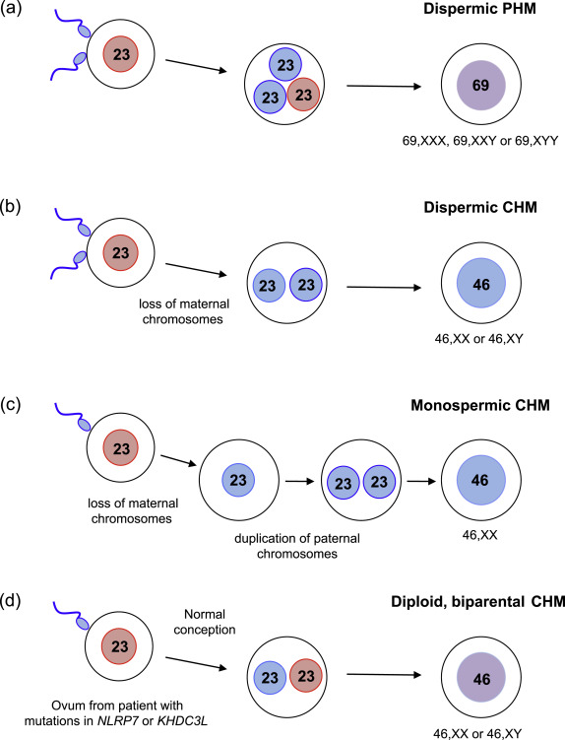

Slide 30
RISK FACTORS
More common in women of Asian than non-Asian ethnicity
Advanced or very young maternal age
Previous molar pregnancy (risk of recurrence after one or two moles is 2% and 20% respectively; recurrence risk is not altered if there is a change in male partner)
Potential but low Increased risk of malignant transformation of CHM/PHM if using combined oral contraceptive pill while hCG levels remain elevated
Familial/sporadic clusters of complete hydatidiform mole (autosomal recessive)

Slide 31
 | Complete (CHM)+ | Partial (PHM)
Origin | Monospermic or dispermic fertilisation of ‘empty’ ovum | Dispermic fertilisation of ovum
Karyotype | All diploid and of paternal origin | Paternal and maternal origin
Prevalence | 1 per 1000 pregnancies | 3 per 1000 pregnancies
Fetal tissue and fetal red blood cells | Absent | Present, fetus is abnormal
Histopathology | Diffuse villous hydrops Diffuse trophoblast hyperplasia Macroscopically, the cystic villi have the appearance of ‘clusters of grapes’ | Focal villous hydrops with scattered abnormally sized/scalloped villi Focal trophoblast hyperplasia Trophoblastic pseudoinclusions Identifiable fetal tissues
Risk of requiring chemotherapy for persisting GTD/GTN | 15% | 0.5%

Slide 32
Macroscopic histopathology Complete mole

Slide 33
CASE SCENARIO
Mrs XY reported with irregular vaginal spotting at 10 weeks gestation, on evaluation you are suspecting molar pregnancy
Enlist the clinical features that will help in diagnosis of GTD?
Enlist the investigations you will advise her

Slide 34
Clinical presentation and assessment
Clinical features
Common presentation is vaginal bleeding in early pregnancy.
Uterus may be larger than dates
Hyperemesis gravidarum

Slide 35
INVESTIGATIONS
Full blood count, blood group and rhesus antibody serology
Serum human chorionic gonadotrophin (hCG) [hCG levels are often > 100 000 iu/l with complete hydatidiform mole (CHM) but not partial hydatidiform mole (PHM)]
Pelvic ultrasound e.g snow storm appearance and bilateral theca luteal cyst in CHM , focal cystic spaces within the placenta,
Histopathological analysis of products of conception (POC)

Slide 36
Pelvic ultrasound of CHM

Slide 37
What is the treatment option for this patient ?

Slide 38
TREATMENT
Surgical evacuation
The preferred treatment for women with suspected molar pregnancy is surgical evacuation of the uterus using suction curettage.
Medical termination
Where possible, medical termination of molar pregnancies, including prostaglandin cervical preparations, should be avoided. This is due to the mainly theoretical risk of increasing trophoblastic embolization by inducing uterine contractions.
Oxytocic agents, if required, should ideally only be commenced after completing uterine evacuation.

Slide 39
CASE SCENARIO
Mrs XY is diagnosed to have molar pregnancy , for which suction evacuation was done
Devise a follow up plan for her

Slide 40
FOLLOW-UP
Follow up to detect persistent gestational trophoblastic disease (GTD) or GTN (invasive mole, choriocarcinoma, placental site trophoblastic tumor
Avoid pregnancy during follow up period
Reliable contraception( avoid intrauterine device)
Two-weekly serum and urine samples until hCG concentrations are normal (non-elevated) range
Once HCG is normalized:
If this occurred ≤56 days after evacuation, measure urine concentrations monthly for 6 months from the date of evacuation
If this occurred >56 days after evacuation, measure urine concentrations monthly for 6 months from the date hCG became normalized.

Slide 41
PERSISTANT GTN/GTD
SYMPTOMS
Irregular bleeding following evacuation of a hydatidiform mole.
Acute respiratory, abdominal or neurological symptoms after any pregnancy. For example:
Pulmonary metastases: dyspnea, cough and chest pain
Gastrointestinal tract metastases: abdominal pain, hemoptysis, malena
Brain metastases: evidence of increased intracranial pressure, intracerebral hemorrhage, headaches, seizures.
Signs suggestive of post-molar GTN include:
An enlarged, irregular uterus
Persistent, bilateral ovarian enlargement
Elevated hCG.
Systemic involvement

Slide 42
Enlist indications of chemotherapy for persistent gestational trophoblastic disease/ gestational trophoblastic neoplasia

Slide 43
INDICATIONS FOR CHEMOTHERAPY
Rising hCG concentration after evacuation
Histological diagnosis of choriocarcinoma
Evidence of metastases in the brain, liver, gastrointestinal tract or lung (radiological opacities >2 cm on chest radiograph)

Slide 44
FIGO scoring system for GTN
Parameter | FIGO prognostic score
 | 0 | 1 | 2 | 4
Age (years) | <40 | ≥40 | – | –
Antecedent pregnancy | Mole | Abortion | Term pregnancy | –
Interval (months) from index pregnancy to chemotherapy | <4 | 4–<﻿7 | 7–<﻿13 | >13
Pretreatment hCG (IU/l) | <10³ | 10³–<﻿10⁴ | 10⁴–<﻿10⁵ | >10⁵
Largest tumour size | <﻿ | 3–<﻿5 cm | ≥﻿5 cm | –
Site of metastases | Lung | Spleen, kidney | Gastrointestinal tract | Brain, liver
Number of metastases | 0 | 1–4 | 5–8 | >8
Previous chemotherapy | – | – | Single drug | Two or more drugs

Slide 45
CHEMOTHERAPY
Low-risk (prognostic score ≤6)
monotherapy e.g. Methotrexate with folinic acid rescue
survival rate 100 %
High-risk high risk (prognostic score more than 7)
The etoposide, methotrexate, and dactinomycin (EMA)-cyclophosphamide and vincristine (CO) regimen is recommended
5 year survival is 75 to 90 %
The treatment causes reversible alopecia and is myelosuppressive.

Slide 46
FOLLOW-UP AFTER CHEMOTHERAPY
Beta hCG follow up for 5 years
Patients are advised not to become pregnant until 12 months after completion of chemotherapy
Neither low- or high-risk treatment affects fertility or congenital abnormality rates in subsequent pregnancies.

Slide 47
CASE SCENARIO
A 40 years old P1 has reported to OPD at 14 weeks of pregnancy with complaints of irregular vaginal bleeding and excessive vomiting. On examination uterus id 18 week size.
How will you investigate her?
What are the treatment options if she is diagnosed as GTD?

Slide 48
RESEARCH
Gestational Trophoblastic Disease at Sultan Qaboos University Hospital: Prevalence, Risk Factors, Histological Features, Sonographic Findings and Outcomes. Oman Med J. 2019 May; 34(3): 202-204
Imaging in Gestational Trophoblastic Disease. 2019 Aug; 40(4): 332-349(PubMed)

Slide 49
BIOMEDICAL ETHICS
Gestational Trophoblastic Disease is curable
Follow up and early referral to oncology department is mandatory for good prognosis

Slide 50
FAMILY MEDICINE
Family Physicians should be educated about proper follow-up and referral of these cases.

