Slide 1
Dr Arslan Ahmad Assistant Professor Medicine RMU/HFH
EPILEPSY IN PREGNANCY

Slide 2
Mission Statement: To impart evidence based research oriented health professional education in order to provide best possible patient care and inculcate the values of mutual respect, ethical practice of healthcare and social accountability. Vision: Highly recognized and accredited centre of excellence in Medical Education, using evidence-based training techniques for development of highly competent health professionals, who are lifelong experiential learner and are socially accountable. Values: Merit ,Pursuit of Excellence, Integrity ,Diversity & Inclusivity ,Social Impact MOTO: Service Truth Wisdom

Slide 3
SEQUENCE OF LGIS
Learning Objectives
Introduction, Epidemiology and prevalence of Epilepsy in pregnancy(Core Concept)
Related Pathophysiology(Horizontal Integration)
Clinical presentation and diagnosis(Core Concept)
Management of Epilepsy in Pregnancy (Core Concept)
Complications and Prognosis (Vertical Integration)
Family Medicine/Research/MDM/Ethics

Slide 4
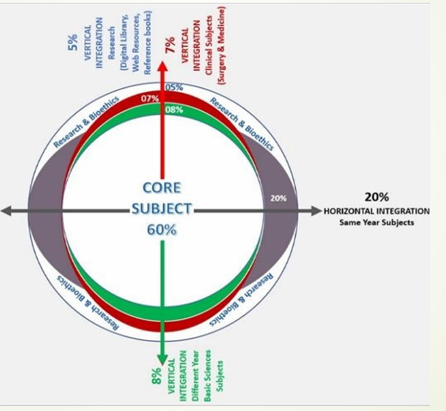
Prof Umer Model of Integrated Lecture

Slide 5
LEARNING OBJECTIVES
CORE CONCEPT
How does Epilepsy effects pregnancy
Understand the Pathophysiology and Basic Science Concepts
Identify common seizure types and their manifestations in pregnancy
Review appropriate AED choices and safety considerations
Outline the Principles of Management and Treatment
Identify Potential Complications and Prognosis
Discuss pre-conception counselling and risk assessment
Identify Public Health Strategies for Early Detection and Management of Epilepsy in Pregnancy

Slide 6
WHAT IS EPILEPSY ?
CORE CONCEPT
Epilepsy is a chronic noncommunicable disease of the brain that affects around 50 million people worldwide.
One seizure does not signify epilepsy (up to 10% of people worldwide have one seizure during theirlifetime).
It is characterized by recurrent seizures, which are brief episodes of involuntary movement that may involve a part of the body (partial) or the entire body (generalized) and are sometimes accompanied by loss of consciousness and control of bowel or bladder function.
Epilepsy is defined as having two or more unprovoked seizures.

Slide 7
Introduction and background epidemiology HORIZONATL INTEGRATION
Epilepsy is one of the most common neurological conditions in pregnancy with a prevalence of 0.5–1%.
An estimated 2500 infants are born to WWE every year in the UK and one-third of WWE are in the reproductive age group.
The risk of death is increased ten-fold in pregnant WWE compared with those without the condition.
Maternal concerns regarding the effects of AEDs on the baby may lead to discontinuation or reduction in the dose of the AEDs thereby increasing the woman's risk of seizures and SUDEP(sudden unexpected death in epilepsy).

Slide 8
CLINICAL PRESENTATION OF SEIZURES AND THEIR EFFECTS ON MOTHER AND BABY VERTICAL INTEGRATION
The manifestation of epilepsy is highly varied.
Classification of the epilepsy syndrome is required to choose the appropriate AED.
To determine prognosis in pregnancy.
To identify and prevent the factors of seizure deterioration.

Slide 9
CLINICAL PRESENTATION OF SEIZURES AND THEIR EFFECTS ON MOTHER AND BABY CORE/VERTICAL CONCEPT
TONIC CLONIC SEIZURES:
PRESENTATION:
Dramatic events with stiffening, then bilateral jerking and a post seizure state of confusion and sleepiness.
EFFECTS ON MOTHER AND BABY:
Sudden loss of consciousness
Uncontrolled fall,without warning.
Associated with variable period of fetal hypoxia.
Highest risk of Sudden unexpected death in epilespy

Slide 10
CLINICAL PRESENTATION OF SEIZURES AND THEIR EFFECTS ON MOTHER AND BABY CORE/VERTICAL CONCEPT
FOCAL SEIZURES:
PRESENTATION:
Symptoms are variable , depending on Areas of the brain affected.
May impair consciousness.
EFFECTS ON MOTHER AND BABY:
Impairment of consciousness increases risk of injury (fracture, injury, burns)
Have “epileptic aura” while remaining conscious
Can be associated with a variable period of hypoxia
Risk of sudden unexpected death in epilespy

Slide 11
CLINICAL PRESENTATION OF SEIZURES AND THEIR EFFECTS ON MOTHER AND BABY CORE/VERTICAL CONCEPT
JUVENILE MYOCLONIC EPILEPSY:
PRESENTATION:
Myoclonic jerks (sudden unpredictable movements) often precede a generalised tonic clonic convulsion.
EFFECTS ON MOTHER AND BABY:
Occurs more frequently after sleep deprivation, tiredness and soon after awakening.
Sudden jerky movements may lead to falls or to dropping of objects including the baby.
ABSENCE SEIZURES:
PRESENTATION:
Generalised seizures that consist of brief blank spells associated with unresponsiveness, followed by rapid recovery.
EFFECTS ON MOTHER AND BABY:
Effects mediated through brief loss of awareness of surroundings (like a burning flame).

Slide 12
EFFECTS OF ANTIEPILEPTIC DRUGS ON PREGNANCY VERTICAL INTEGRATION
VAPLROATE:
Valproate exposure in utero is associated with the development of neural tube-like defects (eg, spina bifida aperta, open lumbosacral myelocele) in 1 to 2 percent of fetuses, which represents a 10- to 20- fold increase over the general population
Percentage of specific malformations are:
Spina bifida (12.7)
Atrial septal defect (2.5)
Cleft palate (5.2)
Hypospadias (4.8)
Polydactyly (2.2)
Craniosynostosis (6.8).

Slide 13
EFFECTS OF ANTIEPILEPTIC DRUGS ON PREGNANCY VERTICAL INTEGRATION
PHENYTOIN:
The overall rates of major congenital malformations among pregnancies exposed to phenytoin monotherapy are 2.9 to 7 percent.
Orofacial clefts
Cardiac malformations
Genitourinary defects are the major malformations described with phenytoin

Slide 14
EFFECTS OF ANTIEPILEPTIC DRUGS ON PREGNANCY VERTICAL INTEGRATION
CARBAMAZEPINE:
Carbamazepine is associated with a relatively modest rate of major malformations overall but the increased rates include neural tube defects .
As much as 0.9 percent of fetuses exposed in utero to carbamazepine have neural tube defects (a sevenfold increase compared with the general population).
In the United Kingdom Epilepsy and Pregnancy Registry compared with other AEDs carbamazepine was associated with the lowest rate of major malformations 2.2 percent of 900 pregnancies.

Slide 15
EFFECTS OF ANTIEPILEPTIC DRUGS ON PREGNANCY VERTICAL INTEGRATION
TOPIRAMATE:
Across multiple studies, the estimated absolute risk of oral clefts in a topiramate-exposed pregnancy has ranged from approximately 4 to 29 per 1000 births compared with an expected unexposed risk in the background population of 1 to 2 per 1000 births.
The increased risk of oral clefts associated with use of topiramate early in pregnancy Is more pronounced in women with epilepsy who used higher doses and is another example of a dose-dependent risk for a major malformation

Slide 16
EFFECTS OF ANTIEPILEPTIC DRUGS ON PREGNANCY VERTICAL INTEGRATION
LAMOTRIGINE:
Data on lamotrigine exposure are mostly reassuring with fairly good consistency across studies from different parts of the world.
Three registries reported a 1.9 to 3.2 percent incidence of major malformations after first-trimester exposure to lamotrigine monotherapy .
The International Lamotrigine Pregnancy Registry found no effect of lamotrigine dose up to 400 mg/day on the incidence of major malformations.
The United Kingdom Epilepsy and Pregnancy Registry observe a dose relationship and suggested that doses higher than 200 mg/day might present a risk similar to that of valporate.

Slide 17
EFFECTS OF ANTIEPILEPTIC DRUGS ON PREGNANCY VERTICAL INTEGRATION
LEVETIRACETAM:
Its use in pregnancy appears to be associated with a low risk of major malformations when used as monotherapy.
The largest body of data is from EURAP ( the prevalence of major congenital malformations among 599 pregnancies exposed to levetiracetam monotherapy was (2.8 percent).
Higher rates have been reported in pregnancies exposed to levetiracetam as part of a polytherapy regimen.
Limited data suggest that intrauterine exposure to levetiracetam monotherapy does not adversely affect early developmental outcomes in contrast with drugs such as valproate

Slide 18
EFFECTS OF ANTIEPILEPTIC DRUGS ON PREGNANCY VERTICAL INTEGRATION
PHENOBARBITAL:
Malformations of the heart, orofacial, and urogenital structures occur with increased frequency with phenobarbital.
A study from the North American Antiepileptic Drug Pregnancy Registry reported a 5.5 percent incidence of major malformations among 199 pregnancies associated with phenobarbital use.
This rate is somewhat higher than for unexposed pregnancies and for those exposed to Lamotrigine.
The use of PREGABALIN was associated with major congenital anomalies when used during the first trimester.
The gabapentin-exposed group had higher rates of preterm births and low birth weight <2500 g.

Slide 19
MANAGEMENT OF EPILEPSY IN PREGNANCY CORE CONCEPT
Women with epilepsy were once counseled to avoid pregnancy but epilepsy is no longer considered a contraindication to pregnancy.
Over 90 percent of women with epilepsy will have good outcomes.
WWE who are planning their pregnancy should have a clinician competent in the management of epilepsy take responsibility for sharing decisions around choice and dose of AEDs based on the risk to the fetus and control of seizures.
WWE should be reassured that most mothers have normal healthy babies and the risk of congenital malformations is low if they are not exposed to AEDs in the periconception period.
Women should be informed that the risk of congenital abnormalities in the fetus is dependent on the type number and dose of AEDs.

Slide 20
HORIZONTAL INTEGRATION
What effect do maternal epilepsy and seizures have on the course of pregnancy?
Women with epilepsy are at increased risk for a range of perinatal complications compared with the general population.
Preclampsia
Premature delivery
Hemorrhage
Fetal growth restriction
Still birth
Dramatically increased risk Of maternal mortality
Cesarean delivery is also more common among women with epilepsy.

Slide 21
VERTICAL INTEGRATION
What effect does pregnancy have on seizure risk?
At least half of women with epilepsy will have no alteration of their seizure pattern during pregnancy.
Some women experience seizure worsening compared with their baseline.
Possible riskrisk factors for increased seizures during pregnancy include:
Baseline Seizure frequency before pregnancy
Underlying Localisation related (focal) Epilespy
AED polytherapy
Patient adherence
Altered pharmacokinetics of AEDs during pregnancy

Slide 22
CORE CONCEPT
Necessity for antiepileptic drugs :
We have to see whether the diagnosis of eplilepsy is well established.
Psychogenic nonepileptic seizures (PNES) are commonly mistaken for epilepsy seizures.
Other mimics include syncope and movement disorders.
If a woman has been seizure free for a satisfactory period and she meets the general criteria for consideration of discontinuing medications it is suggest doing so at least 6 to12 months prior to becoming pregnant as the risk of seizure recurrence after withdrawal is highest during this period.

Slide 23
CHOICE OF AED VERTICAL INTEGRATION
Choice of antiepileptic drug:
For women with epilepsy of childbearing age who are planning pregnancy lamotrigine or levetiracetam monotherapy are preferred as first line treatment.
Valproate should be avoided in all situations with the rare exception that it may be used as a last resort when other AEDs have been tried and have failed to provide adequate control of seizures.
Some AEDs have moderately elevated risk for malformations, intrauterine growth retardation, and/or adverse neurodevelopmental effects (phenytoin, phenobarbital, topiramate).
Others have modestly elevated risk (carbamazepine, oxcarbazepine, zonisamide)

Slide 24
Antiepileptic Drug Dosing At Conception CORE CONCEPT
AEDs should be administered at the lowest effective dose to control seizures to the optimal level for each individual woman.
Data from the International Registry of Antiepileptic Drugs and Pregnancy (EURAP) show that the risk for major congenital malformations varies with the type and daily dose at conception .
Folic acid supplementation:
Folic acid 1mg is used for all women of childbearing potential who are taking AEDs beginning prior to conception and continued through pregnancy.
For women taking carbamazepine or valproate or those with a previous pregnancy affected by a neural tube defect or with a neural tube defect affecting either parent start at higher folic acid dose of 4 mg daily.

Slide 25
MANAGEMENT DURINGPREGNANCY:
VERTICAL INTEGRATION
During pregnancy and the intrapartum period women are more likely to be exposed to potential seizure triggers that include
Sleep deprivation
Increased emotional stress
Nausea and vomiting affecting medication levels.
Continued Folic acid supplementation : Preconceptional doses of folic acid should
be continued throughout pregnancy.

Slide 26
MONITORING OF AED CORE CONCEPT
Because of the changes in volume of distribution and the increased renal clearance and hepatic metabolism of antiepileptic drugs (AEDs) associated with pregnancy blood levels of AEDs should be followed at regular intervals.
Routinely at four-week intervals throughout pregnancy and beginning when pregnancy is reported
Once at the six-week postpartum visit
Immediately if the patient reports or presents with increased seizure activity or worsened seizure severity
Immediately if the patient experiences dizziness, blurred vision, or other common complaints associated with AED medication toxicity

Slide 27
DOSE ADJUSTMENT CORE CONCEPT
It is reasonable to increase the AED dose after the first trimester for women with epilepsy when the following conditions apply
The treatment involves AEDs that are prone to marked changes in clearance (lamotrigine, levetiracetam, and oxcarbazepine) with pregnancy
The seizures include focal to bilateral or generalized tonic-clonic seizures
The seizure control was sensitive to changes in AED levels before pregnancy
The patient entered pregnancy on the lowest effective AED dose

Slide 28
SCREENING FOR MALFORMATIONS VERTICAL INTEGRATION
Ultrasound screening for morphologic anomalies in the fetus is undertaken at 17 to 20 weeks gestation
The finding of normal posterior fossa and fetal spine will typically adequately exclude the presence of a neural tube defect.
If additional reassurance is desired:
Measurement of the serum alpha-fetoprotein (AFP) concentration or amniocentesis for amniotic fluid AFP levels should be performed between at or after 16 weeks especially in women treated with valproate and carbamazepine

Slide 29
APPROACH TO A FIRST SEIZURE IN
PREGNANCY
VERTICAL INTEGRATION
Occasionally a woman presents with a first seizure in pregnancy.
The approach to diagnosis and management of a first seizure is the same as in a nonpregnant individual.
Additional considerations in a pregnant woman include:
Diagnostic considerations for new seizures must include exclusion of possible pregnancy-associated conditions such as eclampsia and cerebral venous thrombosis.

Slide 30
Choice of antiepileptic drug (AED) treatment VERTICAL INTEGRATION
The evidence linking valproate to fetal malformations and neurodevelopmental disorders is sufficiently convincing to recommend avoiding its initiation in pregnancy.
Lamotrigine Is a favorable choice during preconceptional planning.
Not a good choice for initiation during pregnancy due to the higher risk of rash with accelerated titration and difficulty in achieving therapeutic concentration due to the enhanced clearance.
Levetiracetam: Is a medication with a favorable reproductive safety profile and can be started at a therapeutic dose immediately and has a broad spectrum of action across multiple seizure types.
Carbamazepine:For focal and begin seizures carbamazepine is another option after 1st Trimester

Slide 31
MANAGEMENT AT DELIVERY:
VERTICAL INTEGRATION
Most women with epilepsy have a normal vaginal delivery
The labor and delivery room environment should be optimized for the woman with epilepsy
With an appropriately dosed epidural many women can nap or sleep during the first stage of labor and thereby minimize the potential consequences of sleep deprivation as well as minimize pain-associated stress.
Lighting can be lowered to encourage sleep at appropriate intervals.

Slide 32
Managing seizures during labor and Delivery VERTICAL INTEGRATION
Convulsive seizures during labor and delivery should be treated promptly with intravenous (IV) Benzodiazepines
Lorazepam is considered the drug of choice
Indications of caesarean section:
Breech presentation
Failure of progression of labour
Asphyxia
Rupture of placenta

Slide 33
PRECONCEPTION MANAGEMENTVERTICAL INTEGRATION ROLE OF FAMILY MEDICINE
Preconception Counselling Early Diagnosis & Risk Assessment
Medication Adherence & Safety Mental Health & Support Systems
COUNSELING:
Birth control.
The potential of antiepileptic drugs (AEDs) to cause contraceptive failure.
Contraceptive efficacy considering the AED prescribed.
The risks of AEDs on pregnancy outcomes.
Possible changes needed to optimize the AED regimen.
The importance of folic acid supplementation to prevent neural tube defects.

Slide 34
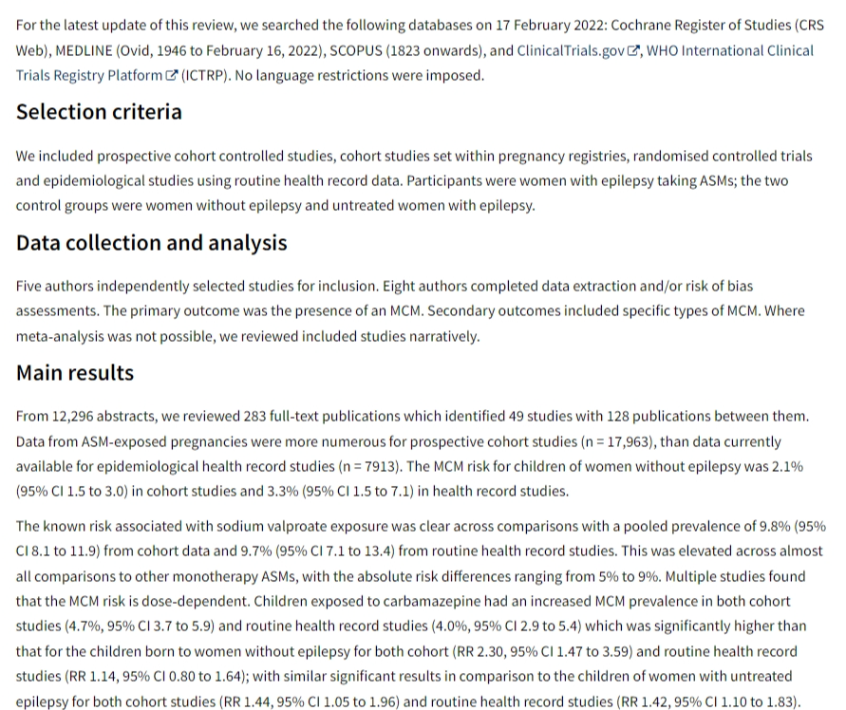
RESEARCH ARTICLE TO READ
Monotherapy treatment of epilepsy in pregnancy: congenital malformation outcomes in the child(Systemic Review)
www.cochranelibrary.com/cdsr/doi/10.1002/14651858.CD010224.pub3

Slide 35
MULTIDISCIPLINARY APPROACH VERTICAL/HORIZONTAL INTEGRATION
The management of epilepsy in pregnancy requires a vertically integrated, multidisciplinary approach, beginning with an understanding of the underlying pathophysiology ,risk factors, and diagnosis.
Effective management involves collaboration among obstetricians, neurologist, neonatologist, and internal medicine specialists along with the integration of lifestyle modifications, pharmacological treatment, and obstetric monitoring.
Additionally, postpartum follow-up and public health interventions play a crucial role in preventing long-term complications for both the mother and child.

Slide 36
Resources/References
MEDSCAPE
RCOG Guidelines
RMU Portal

