Slide 1
CLINICAL AUDIT ( january 2020 TO december 2020)
DEPARTMENT OF ENT AND HEAD AND NECK SURGERY, HOLY FAMILY HOSPITAL

Slide 2
ROADMAP
Introduction to department faculty.
Working Schedule.
Number of OPD cases.
Number of admissions/discharges.
Procedures conducted in department.
Total number of deaths.

Slide 3
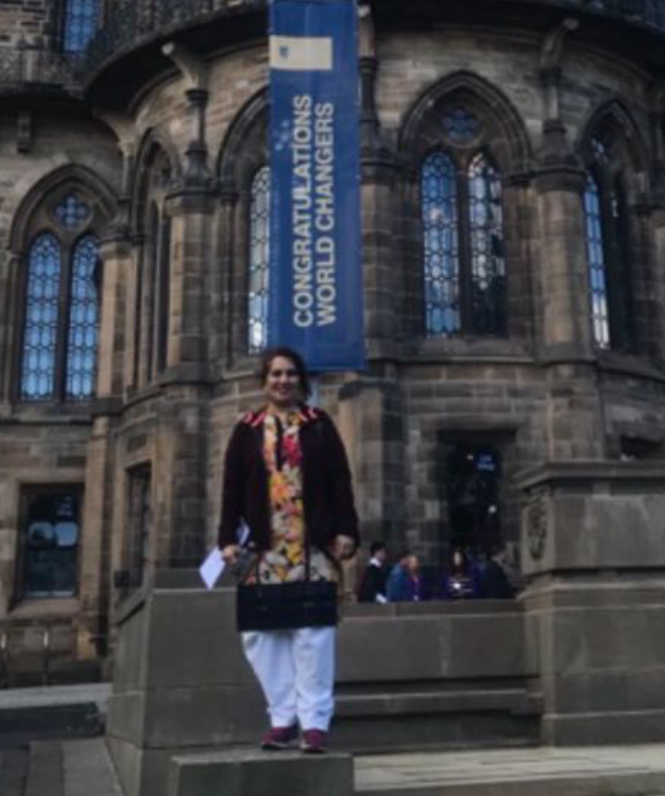
FACULTY
HEAD OF DEPARTMENT: DR. NOUSHEEN QURESHI ( ASSOCIATE PROFESSOR )

Slide 4
Assistant Professors: DR. NAYYER AYUB
DR. HAITHAM AKAASH
PGTS:
MS: 5
FCPS: 6
House Officers: 6

Slide 5
WORKING SCHEDULE
NO. OF OPDS: 6 PER WEEK
NO. OF OT DAYS: 3 PER WEEK
Minor OT: Every Wednesday

Slide 6
NUMBER OF OPD CASES
 | TOTAL | MALES | FEMALES
January | 3614 | 1842 | 1772
February | 4837 | 2483 | 2354
March | 3215 | 1628 | 1587
April | 261 | 147 | 114
May | 610 | 353 | 257
June | 1015 | 569 | 446
July | 1595 | 868 | 727
August | 2341 | 1228 | 1113
September | 4053 | 2098 | 1955
October | 2904 | 1508 | 1396
November | 2745 | 1406 | 1339
December | 2783 | 1444 | 1339
TOTAL | 29973 | 15574 | 14399

Slide 7
Opd cases distribution
 | TOTAL | Ear | Nose | Throat
January | 3614 | 1567 | 1005 | 1042
February | 4837 | 1764 | 1342 | 1731
March | 3215 | 989 | 1471 | 755
April | 261 | 98 | 74 | 89
May | 610 | 231 | 167 | 212
June | 1015 | 487 | 391 | 137
July | 1595 | 734 | 525 | 209
August | 2341 | 945 | 845 | 551
September | 4053 | 850 | 1150 | 2053
October | 2904 | 950 | 1050 | 904
November | 2745 | 820 | 780 | 1145
December | 2783 | 790 | 1110 | 883
TOTAL | 29973 | 10225 | 9910 | 9838

Slide 8
DISTRIBUTION OF OPD’s per month

Slide 9
TOTAL NUMBER OF ADMISSIONS AND MORTALITIES
 | ADMISSIONS | MORTALITIES
January | 117 | 0
February | 90 | 1
March | 82 | 0
April | 11 | 0
May | 10 | 0
June | 22 | 0
July | 29 | 1
August | 44 | 1
September | 90 | 2
October | 77 | 1
November | 66 | 0
December | 78 | 1
TOTAL | 716 | 7

Slide 10
Emergency opd cases distribution
Month | Total | Ear | Nose | Throat
January | 454 | 165 | 126 | 163
February | 397 | 156 | 138 | 103
March | 413 | 123 | 122 | 167
April | 165 | 50 | 50 | 65
May | 134 | 44 | 50 | 40
June | 228 | 68 | 70 | 80
July | 296 | 85 | 86 | 125
August | 341 | 185 | 98 | 58
September | 268 | 175 | 93 | 82
October | 432 | 156 | 216 | 60
November | 344 | 206 | 138 | 68
December | 401 | 214 | 187 | 27
TOTAL | 3873 | 1627 | 1374 | 872

Slide 11
Emergency operative cases
Month | Total | General anaesthesia | Local anaesthesia
January | 9 | 8 | 1
February | 11 | 7 | 4
March | 8 | 5 | 3
April | 22 | 13 | 9
May | 16 | 8 | 8
June | 9 | 5 | 4
July | 11 | 8 | 3
August | 14 | 7 | 7
September | 9 | 2 | 7
October | 6 | 3 | 3
November | 9 | 6 | 3
December | 13 | 9 | 4
TOTAL | 137 | 81 | 56

Slide 12
Emergency operative cases distribution
Month | Total | Esophagoscopy | bronchoscopy | tracheostomy | Other cases
January | 9 | 1 | 2 | 5 | 1
February | 11 | 2 | 0 | 7 | 3
March | 8 | 1 | 0 | 5 | 2
April | 22 | 3 | 1 | 15 | 3
May | 16 | 3 | 0 | 9 | 4
June | 9 | 1 | 0 | 5 | 3
July | 11 | 2 | 0 | 6 | 3
August | 14 | 5 | 0 | 7 | 2
September | 9 | 2 | 0 | 7 | 0
October | 6 | 1 | 1 | 3 | 1
November | 9 | 4 | 1 | 3 | 1
December | 13 | 6 | 0 | 4 | 3
TOTAL | 137 | 31 | 5 | 76 | 26

Slide 13
Emergency procedures

Slide 14
Elective operative cases
Month | Total | General Anaesthesia | Local Anaesthesia
January | 127 | 93 | 34
February | 123 | 87 | 36
March | 95 | 64 | 31
April | 19 | 15 | 4
May | 9 | 9 | 0
June | 16 | 15 | 1
July | 45 | 36 | 9
August | 69 | 33 | 36
September | 100 | 69 | 31
October | 76 | 57 | 19
November | 60 | 48 | 12
December | 86 | 56 | 30
Total | 825 | 582 | 243

Slide 15
Elective operative cases distribution
 | Mastoid exploration | Tympanoplasty | FESS | thyroidectomy | Septo- rhinoplasty | Tonsillect omy | septoplasty
January | 5 | 0 | 6 | 1 | 2 | 23 | 8
February | 2 | 2 | 6 | 0 | 1 | 15 | 12
March | 0 | 1 | 5 | 0 | 1 | 19 | 9
April | 1 | 0 | 0 | 0 | 0 | 0 | 0
May | 0 | 0 | 1 | 0 | 0 | 0 | 0
June | 0 | 0 | 1 | 0 | 0 | 3 | 1
July | 0 | 0 | 0 | 0 | 0 | 2 | 3
August | 0 | 0 | 3 | 1 | 0 | 4 | 6
September | 2 | 3 | 4 | 1 | 0 | 26 | 9
October | 1 | 0 | 8 | 1 | 1 | 11 | 9
November | 2 | 0 | 5 | 3 | 0 | 6 | 12
December | 6 | 0 | 3 | 0 | 1 | 11 | 3
Total | 19 | 3 | 42 | 7 | 6 | 120 | 72

Slide 16
OT CASES DISTRIBUTION

Slide 17
HIGHLIGHT CASES DONE IN DEPARTMENT
SCC Left nasal alae excision with flap rotation.
Endoscopic Tympanoplasty
Total laryngectomy
Brachial cyst excision
Septorhinoplasty
Nasal angiofibroma + external carotid embolization
Cystic hygroma excision
Primary tracheal repair
Buccal carcinoma excision
Microscopic thyroidectomy
Microscopic parotidectomy

Slide 18
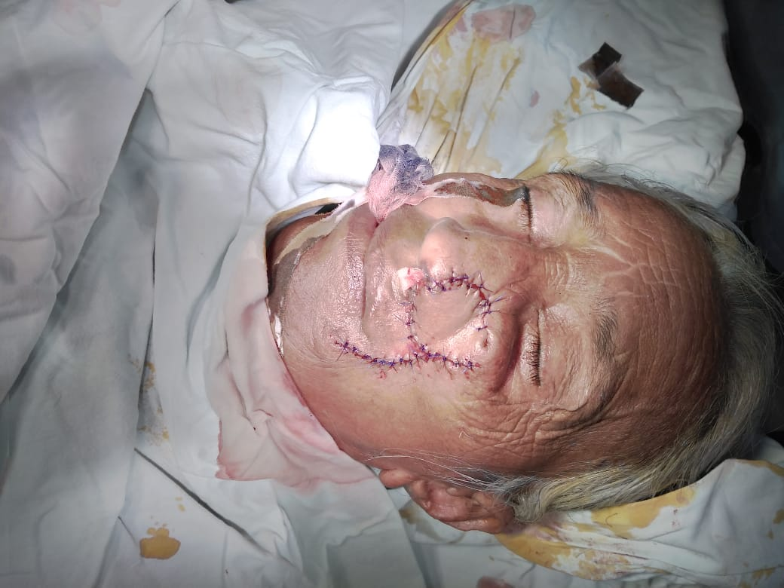
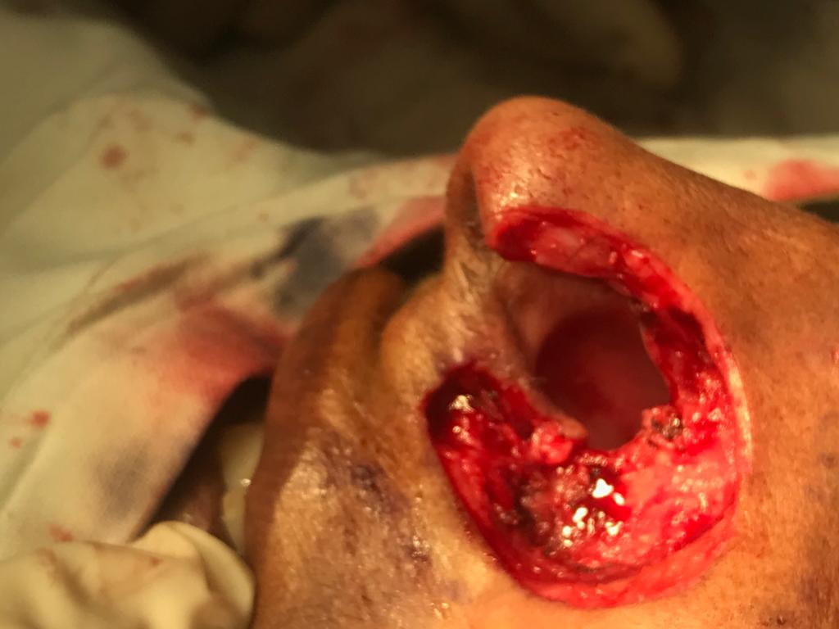
SCC LEFT NASAL ALAE EXCISION AND RECONSTRUCTION (FLAP ROTATION)

Slide 19
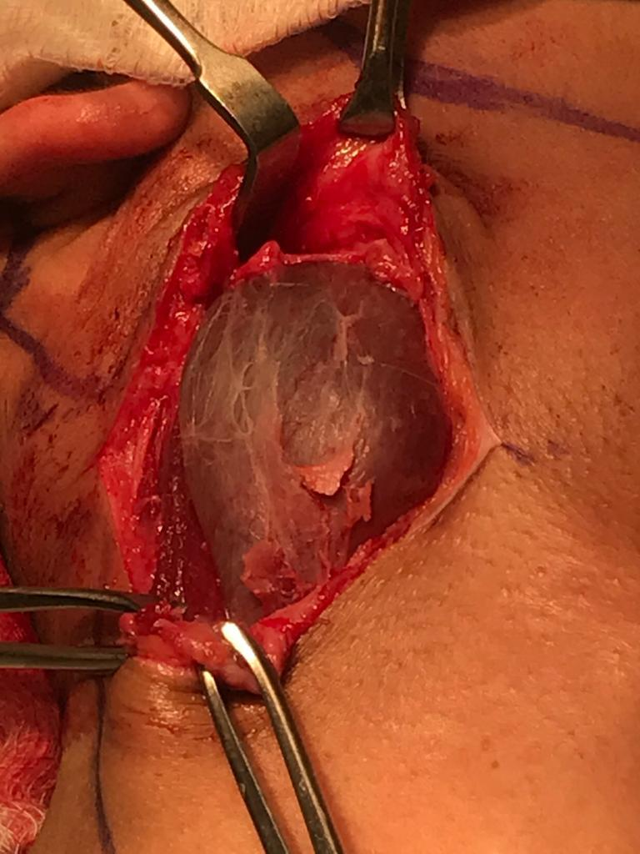
BRANCHIAL CYST EXCISION

Slide 20
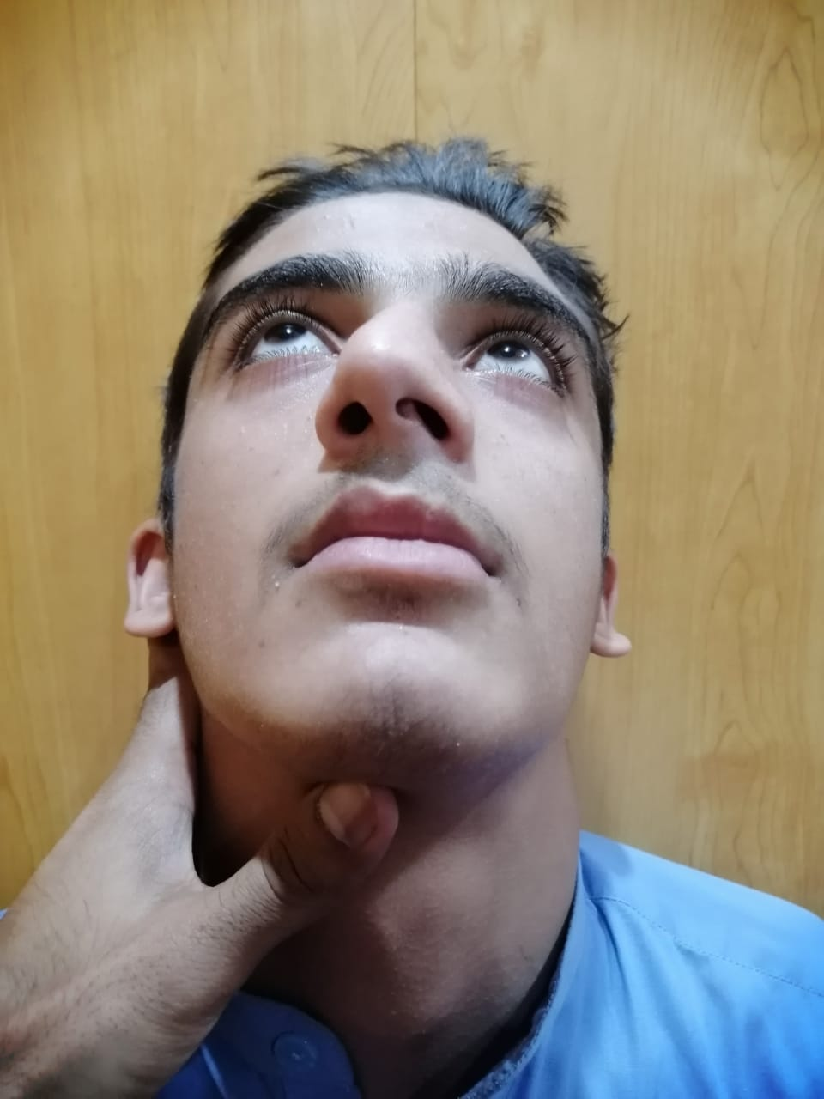
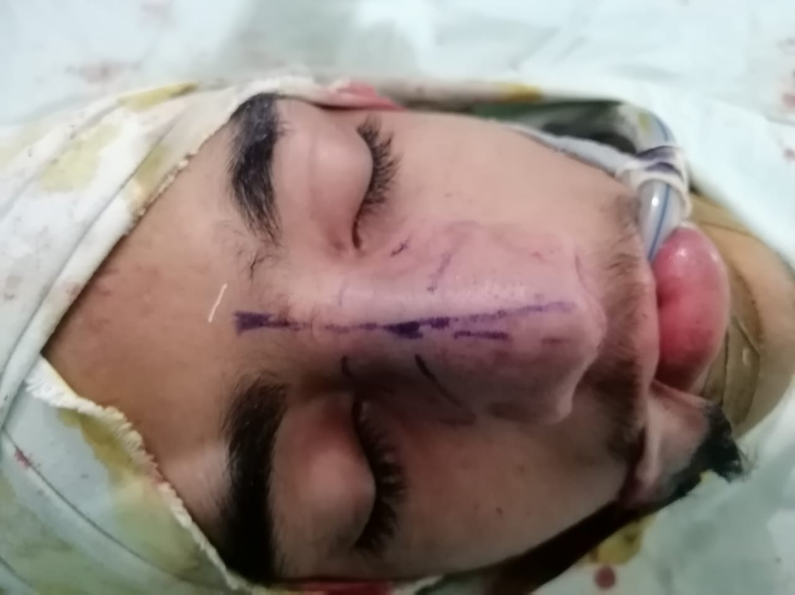
SEPTORHINOPLASTY

Slide 21
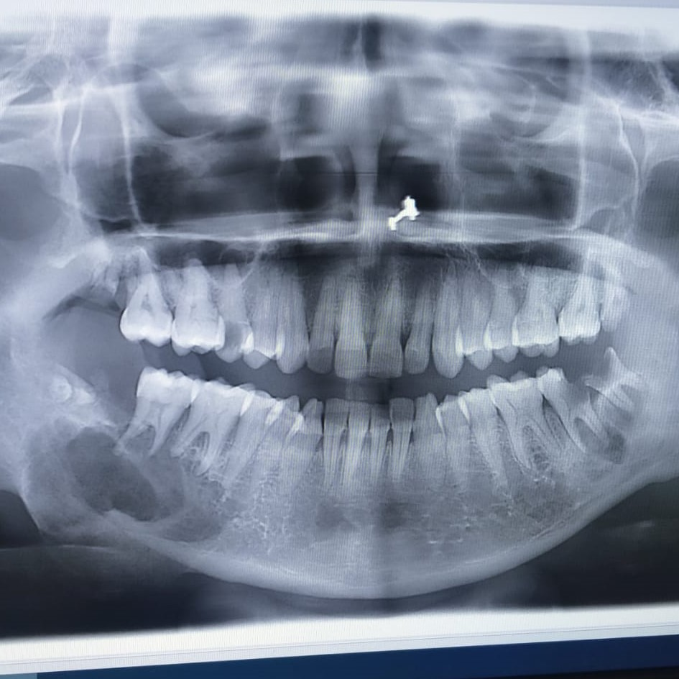
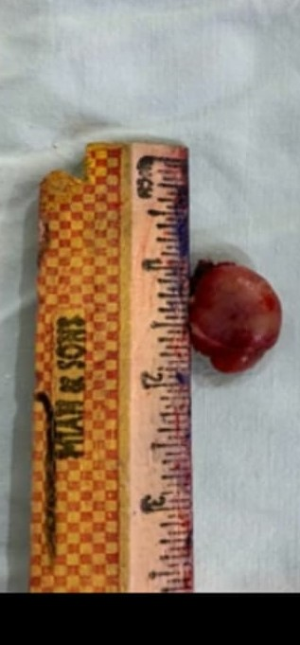
Parathyroid adenoma with giant cell granuloma

Slide 22
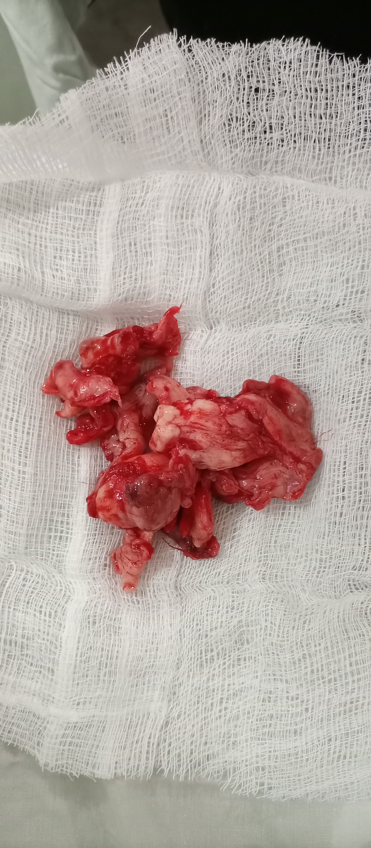
Nasal angiofibroma excision (in October 2020)

Slide 23
Endoscopic tympanoplasty

Slide 24
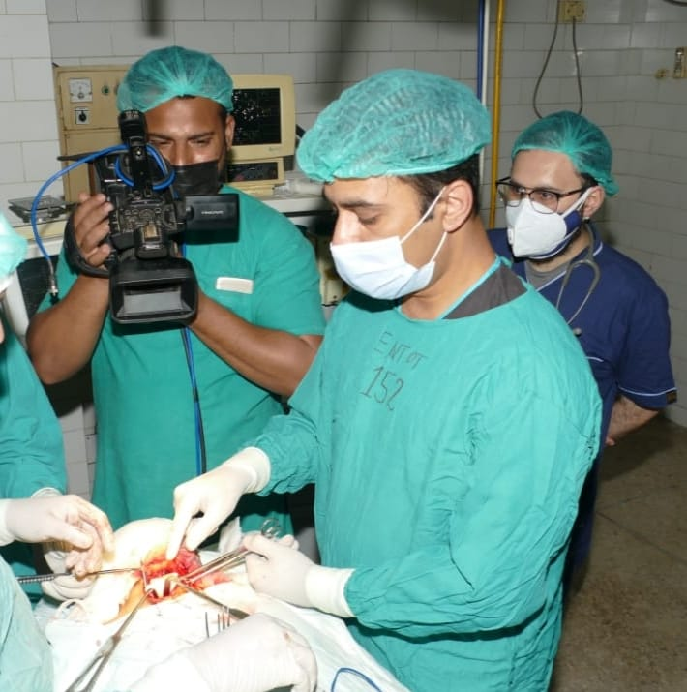
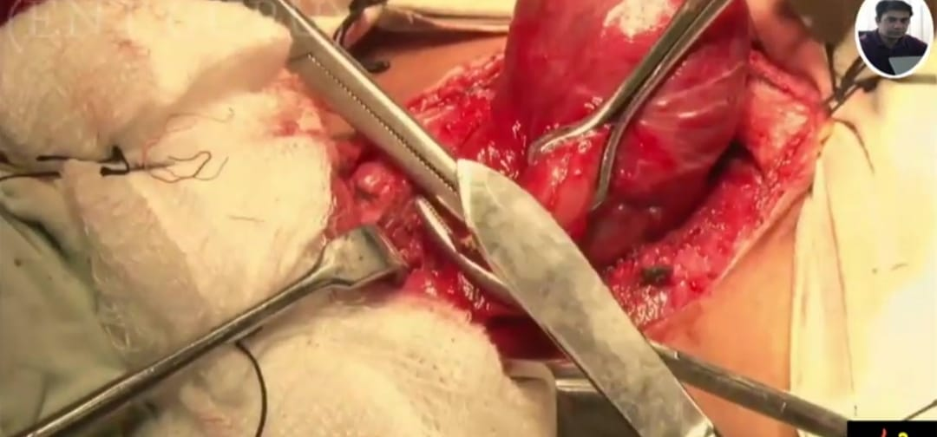
WORKSHOPS
Microscopic Thyroidectomy On 15th Nov 2020.

Slide 25
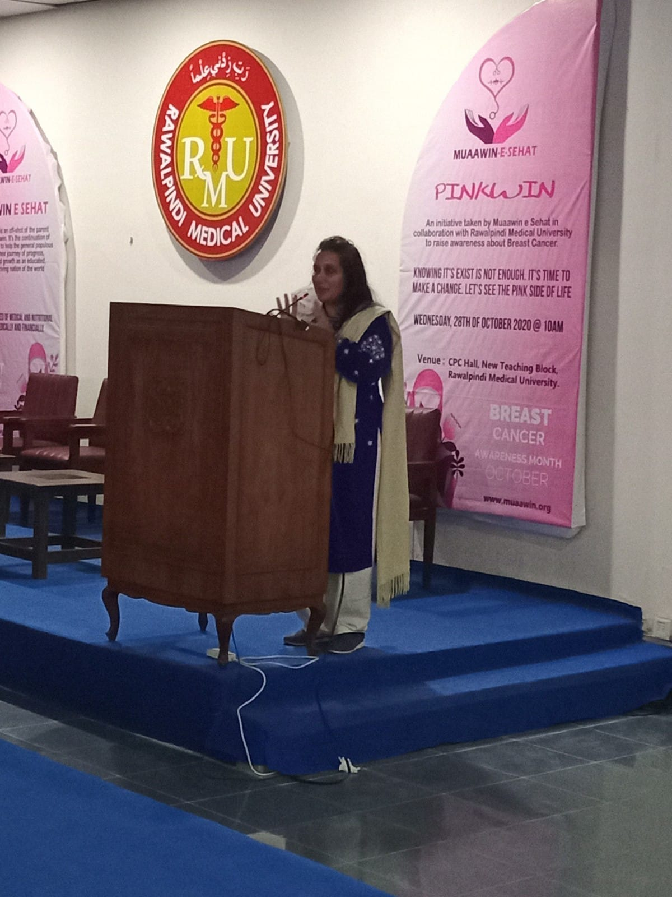
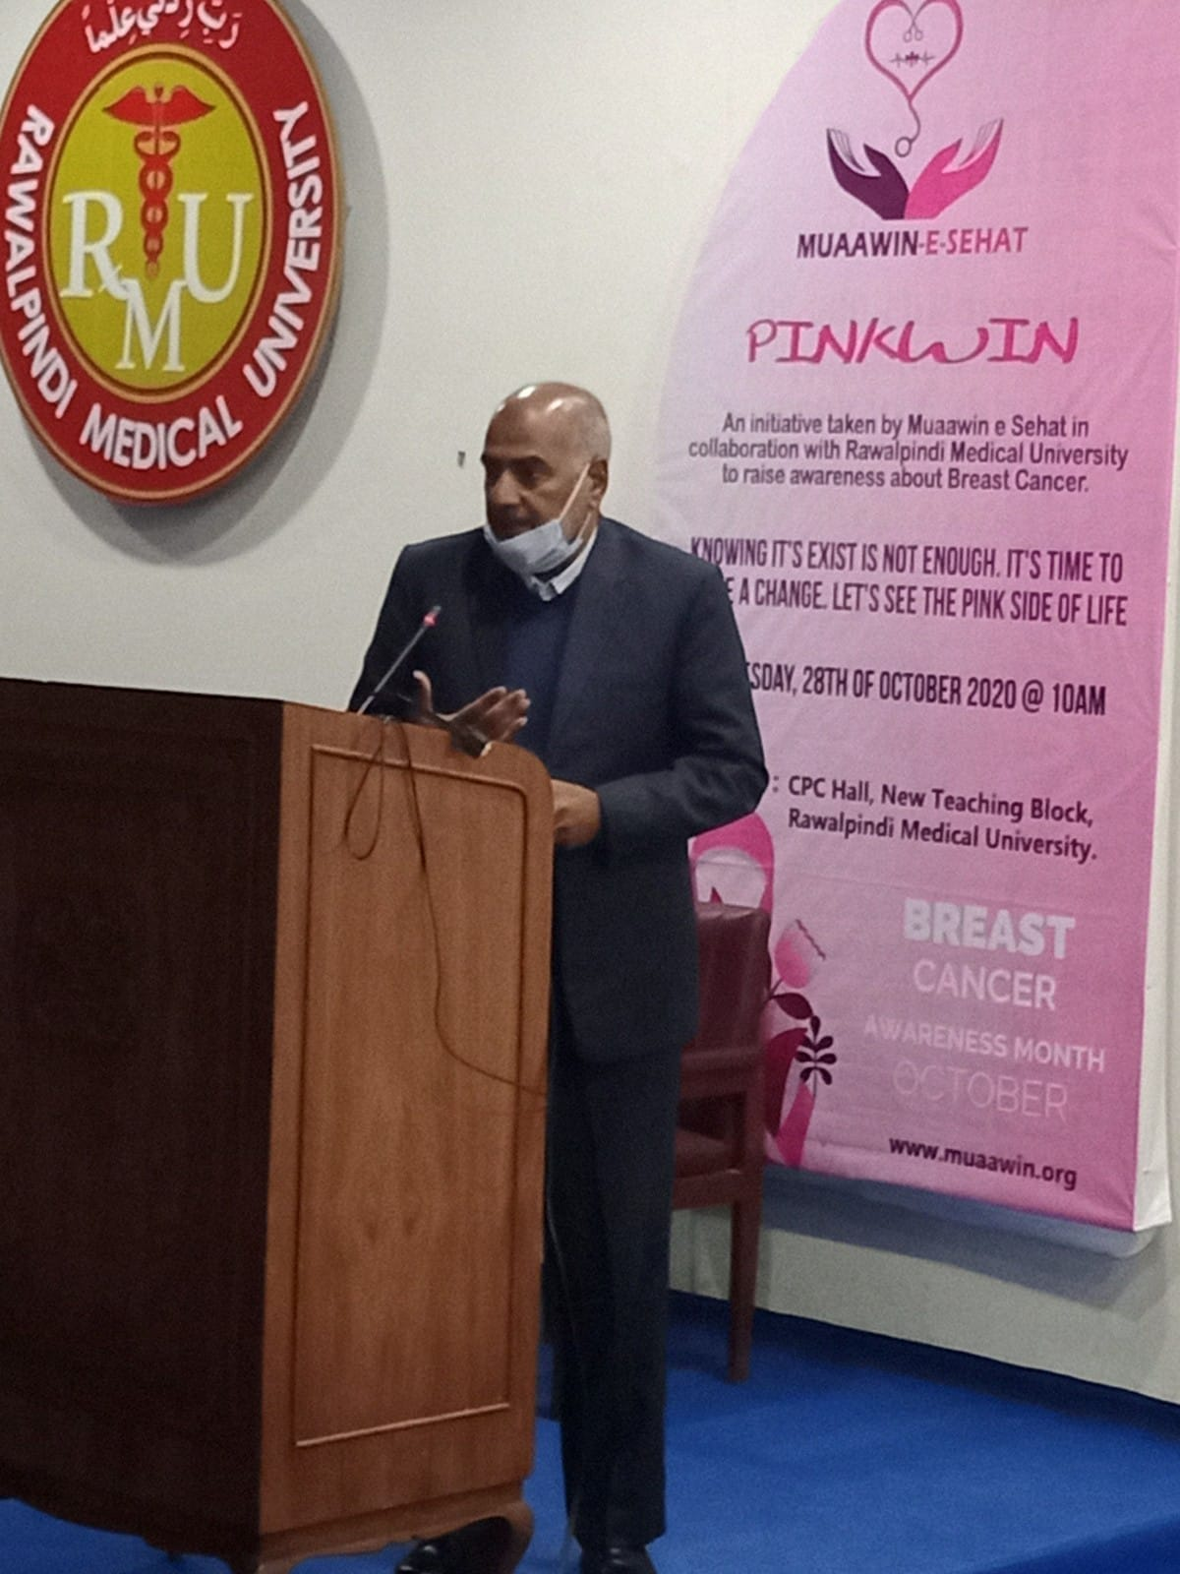
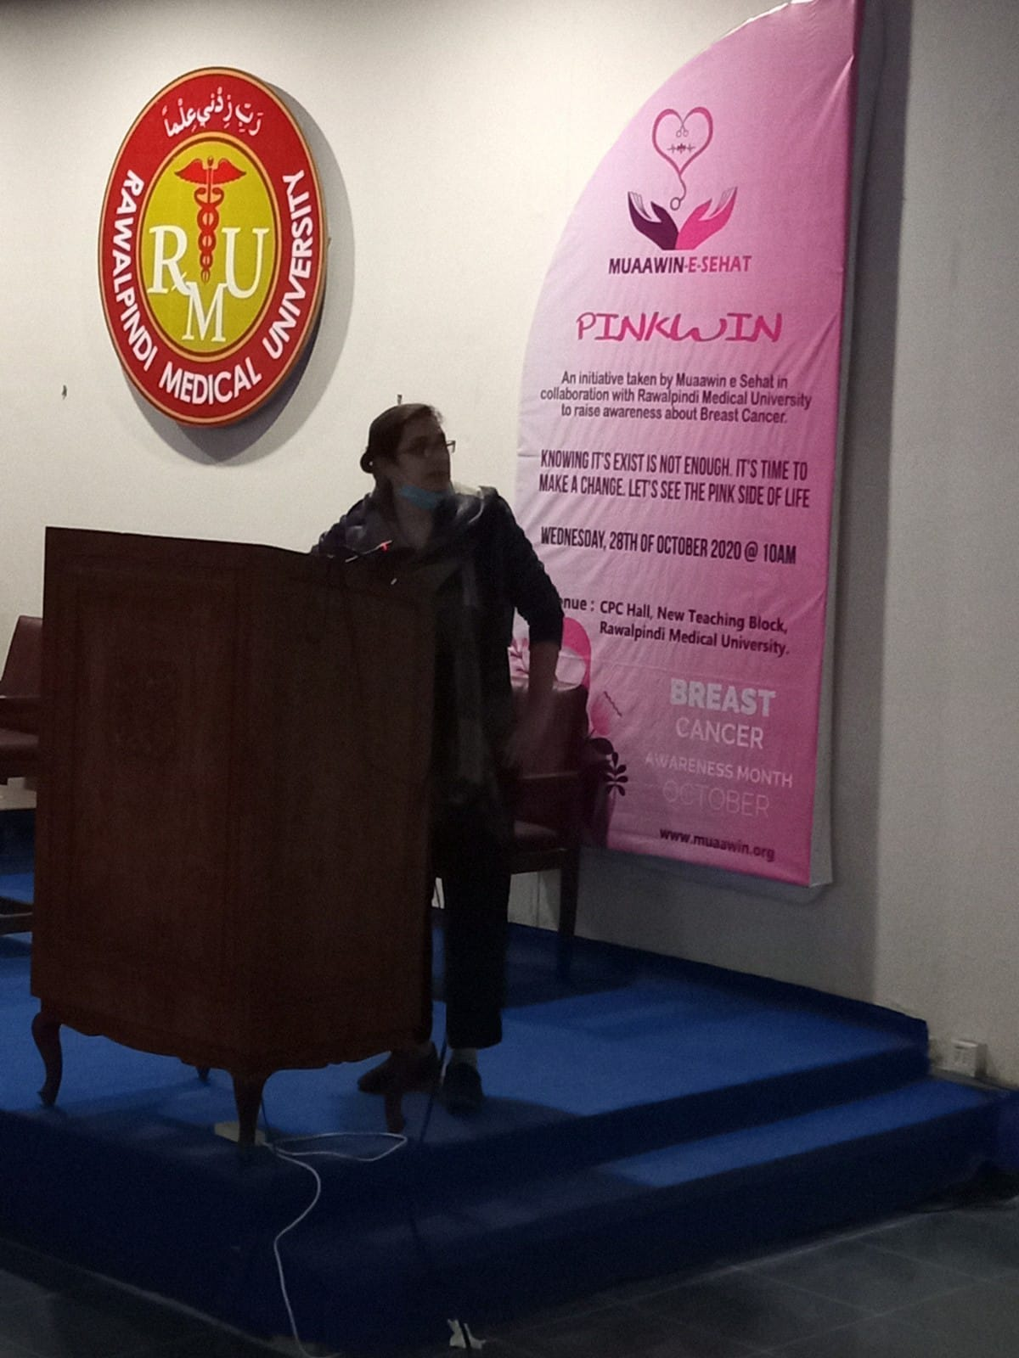
symposium
Paediatric airway management on 30th November 2020

Slide 26
INNOVATIVE PROCEDURES
Endoscopic tympanoplasty
Microscopic thyroidectomy

Slide 27
ACADEMIC TEACHING:
Under graduate training: Online class lectures, ward classes
Post graduate training: Attending online webinars

Slide 28
No. of ACADEMIC sessions OF PGTS:
40 presentations given by post graduate trainees regarding the basic topic, its surgical management and recent most advances.
20 case presentations by PGT’s
3 Ward Tests conducted of PGT’s

Slide 29
No. of ongoing research projects and their status
3 research articles accepted by journal and awaiting publication.
2 research articles submitted and under review for publication.
1 research article submitted and under review for international publication.
2 research proposal regarding COVID-19 pandemic published
3 research articles in process of acceptance.
2 dissertations submitted and awaiting approval.

Slide 30
THANK YOU!!

