Slide 3
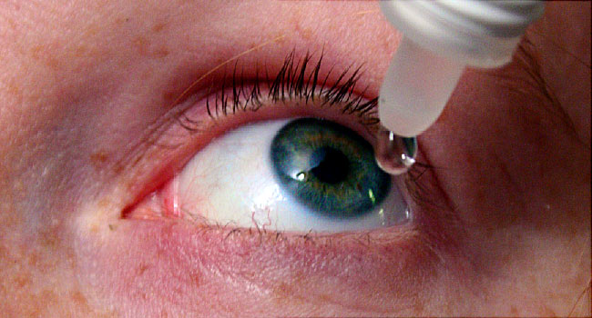
Dry Eyes

Slide 4
Sequence of lecture
Core subject
Spiral integration
Vertical integration
EOLA end of lecture assessment
Digital library references
(Research , bioethics, artificial intelligence)

Slide 5
Lecture Objectives
At the end of this lecture you should be able to
Describe etiology, pathophysiology of dry eyes
Interpret common Eye clinical signs and symptoms of dry eyes.
Advise correct diagnostics & management plan

Slide 6
Spiral Integration Anatomy and Physiology of Tear Film

Slide 7
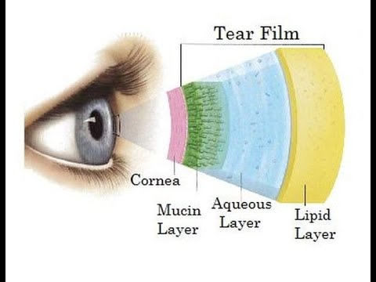
Tear Film
It has three layers:
Lipid Layer: secreted by meibomian glands
Prevent evaporation of aqueous layer
Aqueous Layer: secreted by lacrimal glands
Provides oxygen and wash away debris, antibacterial activity.
Mucous Layer: by conjunctival goblet cells
convert the hydrophobic cornea to hydrophilic surface, lubrication

Slide 9
Core Subject

Slide 10
When there is inadequate tear volume or function, resulting in unstable tear film and ocular surface disease
Keratoconjunctivitis Sicca: an eye with some degree of dryness.
Xerophthalmia: dry eye associated with vitamin A deficiency.
Xerosis: extreme ocular dryness and keratinization in eyes with severe conjunctival cicatrization
Sjogren Syndrome: autoimmune inflammatory disease, dry eye is a feature.

Slide 11
Mechanism
Four mechanisms are responsible for manifestation of dry eye.
Tear instability
Tear hyperosmolarity
Inflammation
Ocular surface damage
Horizontal integration

Slide 12
Classification
Dry Eye
Aqueous deficient
Sjogren syndrome
Non-sjogren Syndrome
Evaporative
Intrinsic
Extrinsic
Lacrimal deficiency
Lacrimal gland duct obstruction
Reflex hyposecretion
Meibomian gland deficiency
Disorders of lid aperture
Low blink rate
Drugs
Vit A def
Topical drugs
Contact lens
Ocular surface disease

Slide 13
Symptoms
Feeling of dryness, grittiness and burning
Stringy discharge
Transient blurring of vision
Redness
Crusting of the lids
Lack of emotional or reflex tearing

Slide 16
Signs
Posterior blepharitis
Conjunctival redness
Staining with fluorescein or rose bengal
Keratinization of conjunctiva
Conjunctivochalasis
Punctate epithelial erosions on cornea
Mucous plaques on cornea

Slide 18
Keratiniaztion of cornea and conjunctiva

Slide 19
Conjunctivochalasis

Slide 20
Punctate epithelial Keratitis

Slide 21
Mucous plaques

Slide 22
Complications
Epithelial breakdown of cornea
Melting of cornea
Perforation of cornea
Bacterial keratitis

Slide 23
Epithelial breakdown of cornea

Slide 24
Melting of cornea

Slide 25
Perforation of cornea

Slide 26
Bacterial keratitis

Slide 27
Investigations
Tear film break up time
Schirmer test
Ocular surface staining
Fluorescein clearance test
Tear film osmolarity
Tear meniscometry
Phenol red thread test
Impression cytology

Slide 28
Tear film break up time

Slide 29
Schirmer test

Slide 30
Tear meniscometry

Slide 31
Phenol red thread test

Slide 32
Treatment
Level 1
Level 2
Level 3
Level 4

Slide 33
Level 1
Education and environmental/Dietary modifications
Systemic medication review
Artificial tear substitutes
Lid hygiene and lid reparative surgery
Horizontal Integration

Slide 34
Level 2
Pharmacological Intervention
Non preserved tear substitutes
Anti-inflammatory agents
Tetracyclines
Punctal plugs
Scretagogues e.g. pilocarpine, rebamipide
Moisture chamber spectacles and spectacle side shields
HORIZONTAL INTEGRATION

Slide 36
Punctal plugs

Slide 37
Level 3
Pharmacological Intervention
Serum eye drops
Contact lenses
Permanent punctal occlusion
HORIZONTAL INTEGRATION

Slide 38
Level 4
Systemic anti-inflammatory agents
Tarsorrhaphy
Salivary gland autotransplantation
Mucous membrane or amniotic membrane transplantation

Slide 39
Tarsorrhaphy
Vertical Integration

Slide 40
Amniotic membrane transplantation
Vertical Integration

Slide 41
Sjogren Syndrome

Slide 42
Sjogren Syndrome
Autoimmune disorder characterized by lymphocytic inflammation and destruction of lacrimal and salivary glands and other exocrine organs.
The condition involves a cell-mediated delayed hypersensitivity reaction, usually related to drug exposure.
Affects females more frequently.

Slide 43
Classical clinical triad:
Dry eyes,
Dry mouth,
Parotid gland enlargement.
Primary: when occurs in isolation
Secondary: associated with another disease e.g. Rheumatoid Arthritis

Slide 45
etiology
A wide range of medications have been incriminated, including:
Antibiotics (especially sulfonamides and trimethoprim),
Analgesics including paracetamol (acetaminophen),
Nevirapine (widely prescribed as a part of combination therapy for HIV infection),
Cold remedies and anticonvulsants.
Infections due to microorganisms such as Mycoplasma pneumoniae and HSV.

Slide 46
Criteria for diagnosis
Positive antiSSA or anti SSB antibodies
Positive Rheumatoid factor
Positive anti nuclear antibodies
Ocular surface staining
Focal lymphatic sialadenitis

Slide 47
Ocular features
Acute signs
Haemorrhagic crusting of the lid margins is characteristic.
Skin lesions may be confluent and it is often difficult for an examiner to open the eyes without causing marked discomfort.
Papillary conjunctivitis, which can range from mild, transient and self-limiting to severe.
Conjunctival membranes and pseudomembranes, severe hyperaemia, haemorrhages, blisters and patchy infarction.
Keratopathy: a spectrum of lesions from punctate erosions to large epithelial defects, secondary bacterial keratitis and occasionally perforation.

Slide 48
Ocular Features
Late signs
Conjunctival cicatrization with forniceal shortening and symblepharon formation.
Keratinization of the conjunctiva and lid margin, sometimes with abrasive plaque formation.
Eyelid complications include cicatricial entropion and ectropion, trichiasis, metaplastic lashes and ankyloblepharon.
Keratopathy including scarring, vascularization and keratinization as a result of the primary inflammation and/or infection, as well as cicatricial entropion and aberrant lashes.
Watery eyes due to fibrosis of the lacrimal puncta.
Dry eyes may also occur as a result of fibrosis of lacrimal gland ductules and conjunctival metaplasia with loss of goblet cells.

Slide 49
symblephron

Slide 50
Forniceal shortening

Slide 51
ankyloblephron

Slide 52
Treatment
Pharmacological Intervention
Salivary stimulants e.g. pilocarpine
Immunosuppression
Biological blockers e.g. rituximab.
HORIZONTAL INTEGRATION

Slide 53
Treatment
Pharmacological Intervention
Acute disease:
Daily review is advisable initially in most patients to check the corneas and exclude symblepharon formation.
Topical lubricants are used as frequently as necessary, e.g. hypromellose 0.3% preservative-free up to hourly, high viscosity ointment during sleep.
Prevention of corneal exposure, e.g. moisture chambers, gel pads if mechanically ventilated.
Topical steroids may be used for iritis and for conjunctival inflammation, though a benefit for the latter has not been demonstrated conclusively.
Topical cycloplegia (e.g. atropine 1% once or twice daily) may improve comfort.
Lysis of developing symblephara with a sterile glass rod or damp cotton bud.
A scleral ring, consisting of a large haptic lens, may help to prevent symblepharon formation.
HORIZONTAL INTEGRATION

Slide 54
Treatment
Chronic disease
Adequate lubrication, including punctal occlusion if required.
Topical transretinoic acid 0.01% or 0.025% may reverse keratinization.
Treatment of aberrant lashes.
Bandage contact lenses (typically gas permeable scleral lenses) to maintain surface moisture, protect the cornea rom aberrant lashes and address irregular astigmatism.
Mucous membrane grafting (e.g. buccal mucosa autograft) for forniceal reconstruction.
Corneal rehabilitation may involve superficial keratectomy for keratinization, lamellar corneal grafting for superficial scarring (preferred to penetrating keratoplasty), amniotic membrane grafting, limbal stem cell transplantation and keratoprosthesis implantation in end-stage disease.

Slide 55
Scenario
A 47 years old female came to eye opd with presenting complaints of painfull decrease vision in both eyes for the last few months.On S/L examination Conjunctiva was congested B/l.In her right eye there were punctate epithelial erosions which stained on fluoroscene along with filaments on the cornea.While in the left eye there was corneal ulcer with abcess.Her systemic history suggested she was suffering from rheumatoid arthritis.Considering this clinical scenario
Q 1) What is the provisional diagnosis ?
Q 2) What are the sight threatening complication of this disease?
Q 3) What are the ocular investigation for this disease ?
Q 4) What is the treatment ?

Slide 56
research
The pathophysiology, diagnosis, and treatment of dry eye disease
Dtsch Arztebl Int. 2015 Jan 30;112(5):71-81; quiz 82. doi: 10.3238/arztebl.2015.0071.

Slide 57
Bioethics
DED is associated with substantial reductions in both physical and mental Health Related –Quality of Life, also after correction for associated comorbidities. Not having a diagnosis is associated with worse mental HR-QoL in subjects with severe DED. Our results underline the importance of recognizing dry eye as a serious disorder.

Slide 58
Bioethics
From a bioethical perspective, the management of dry eyes raises several important issues. Here are some of them:
Access to Treatment: One bioethical concern is ensuring that people with dry eyes have access to effective treatments. This includes making sure that medications and procedures are affordable and available to those who need them.
Informed Consent: Another issue is ensuring that patients receive accurate and complete information about the risks and benefits of various treatments for dry eyes. This includes disclosing any potential side effects or complications of treatment, and allowing patients to make informed decisions about their care.
Patient Autonomy: Finally, there is a bioethical consideration around patient autonomy, or the right of patients to make decisions about their own care. This includes respecting patients' decisions about whether to pursue treatment for dry eyes, and ensuring that patients are involved in decisions about their care.

Slide 59
Artificial Intelligence
AI can also be used to develop new treatments for dry eyes. For example, researchers are exploring the use of machine learning to identify new drug targets for dry eye disease. By analyzing large amounts of data, AI can help researchers identify molecular pathways and potential drug targets that may not have been discovered through traditional research methods.

Slide 60
Artificial Intelligence
Advances in dry eye disease treatment
Abstract
Purpose of review: The prevalence and burden of dry eye disease continues to grow at a rapid pace, creating an increased need for new therapies. This review summarizes the various treatment options available to clinicians treating complex dry eye disease patients.
Recent findings: As we better understand the multifactorial mechanisms leading to dry eye disease, treatments increasingly focus on the amelioration of the underlying deficiencies and inflammation, rather than on transient symptomatic relief alone. Most topical medications seek to replace deficient growth factors and/or decrease inflammation on the ocular surface. The majority of new devices and procedures seek to treat meibomian gland dysfunction, with one new device stimulating tear production through utilizing the nasolacrimal reflex pathway.
Summary: Clinicians have more options at their disposal in the treatment of dry eye disease than ever before, including topical medications and devices.

