Slide 2
Diseases Of Pancreas
GASTROINTESTINAL HEPATOBILIARY & PARASITOLOGY II Module
3rd year MBBS
Dr. Mudassira Zahid
Associate Professor
Department of Pathology
Rawalpindi Medical University

Slide 3
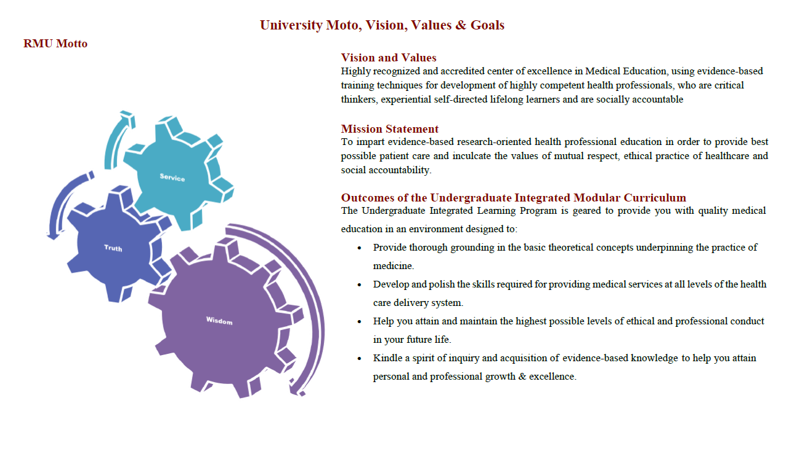

Slide 4
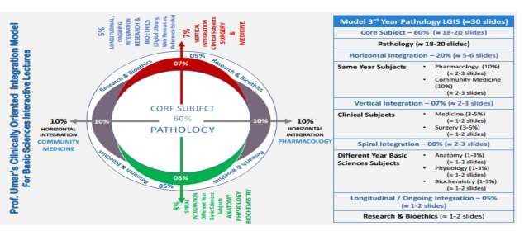

Slide 5
Learning Objectives
Enlist the types of pancreatitis.
Enlist the causes of acute and chronic pancreatitis.
Describe the pathogenesis of acute and chronic pancreatitis.
Describe the morphological findings of acute and chronic pancreatitis.
Enumerate the clinical features of acute and chronic pancreatitis.
Describe the lab investigations of acute and chronic pancreatitis.
Learning Resources: Robbins & Cotran Pathologic Basis Of Disease 10th Edition

Slide 6
Pancreatitis
CORE PATHOLOGY
Definition:
Pancreatitis is inflammation of the pancreas, occurring when digestive enzymes begin to digest the pancreas itself.
Two Types:
Acute Pancreatitis (Duration: < 3 weeks)
Chronic Pancreatitis (Duration: > 3 weeks)

Slide 7
Acute Pancreatitis

Slide 8
Acute Pancreatitis
CORE PATHOLOGY
HORIZONTAL INTEGRATION
Acute Pancreatitis
Definition: Acute pancreatitis is characterized by inflammation and reversible parenchymal damage, ranging from focal edema to fat necrosis.
Prevalence:
Most common in men.
Idiopathic pancreatitis occurs in 10-20% of cases.
Gallstones are present in 35% to 60% of cases.
Approximately 80% of cases are due to biliary tract disease or alcoholism.

Slide 9
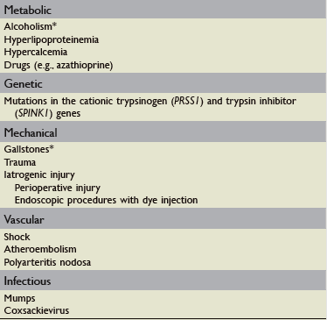
Causes Of Acute Pancreatitis

Slide 10
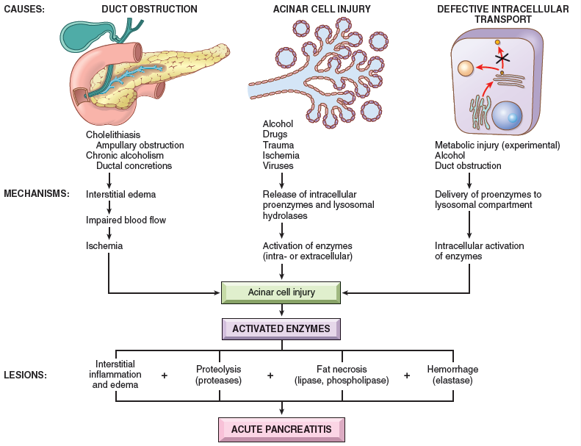
Three Pathways For Pathogenesis Of Acute Pancreatitis

Slide 11
What Are The Causes Of Acute Pancreatitis

Slide 12
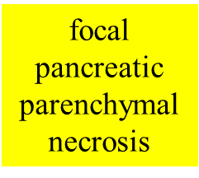
Morphology
CORE PATHOLOGY
Gross Appearance
Microscopically

Slide 13
Clinical Presentation
VERTICAL INTEGRATION
Clinical Features of Acute Pancreatitis:
Epigastric or abdominal pain radiating to the back (especially to the left side).
Abdominal guarding (tensing of the abdominal wall muscles).
Absence of bowel sounds.

Slide 14
Lab Investigation Of Acute Pancreatitis
CORE PATHOLOGY
Laboratory Investigations of Acute Pancreatitis:
Leukocytosis (elevated white blood cell count).
Markedly elevated serum amylase during the first 24 hours, followed by a rise in serum lipase levels.
Hypocalcemia (due to precipitation of calcium in areas of fat necrosis).
Enlarged inflamed pancreas can be visualized by CT or MRI.

Slide 15
Complications of Acute Pancreatitis
CORE PATHOLOGY
Local Complications:
Abscess
Pseudocyst
Ascites
Systemic Complications:
Pulmonary: Pleural effusions and ARDS.
Cardiovascular: Hemorrhage and hypovolemia.
Metabolic: Hypocalcemia, hyperglycemia, and hyperlipidemia.
Fat necrosis.
Disseminated intravascular coagulation (DIC).

Slide 16
Treatment
VERTICAL INTEGRATION
HORIZONTAL INTEGRATION
The patient is kept NPO (nil per os — nothing by mouth).
Intravenous (IV) fluid hydration is provided.
Analgesics are administered for pain relief.
Antibiotics are generally not indicated.
Future Aspects:
Inflammatory cytokines (TNF antagonists) may be used to decrease the systemic inflammatory response.

Slide 17
Chronic Pancreatitis

Slide 18
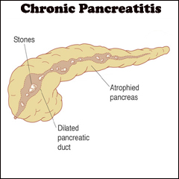
Chronic Pancreatitis
CORE PATHOLOGY
Definition: Chronic pancreatitis is characterized by irreversible parenchymal damage and scar formation.
Clinical Presentations:
Chronic malabsorption
Diabetes mellitus

Slide 19
Common Causes of Chronic Pancreatitis:
HORIZONTAL INTEGRATION
Long-term alcohol abuse.
Middle-aged men.
Less Common Causes:
Long-standing pancreatic duct obstruction (e.g., by pseudocysts, calculi, neoplasms).
Hereditary pancreatitis due to gene mutations.
Tropical pancreatitis, seen in Africa and Asia.
25% to 30% of patients have "idiopathic" origin.

Slide 20
Theories of Chronic Pancreatitis Pathogenesis:
CORE PATHOLOGY
Ductal obstruction by concretions.
Oxidative stress.

Slide 21
Pathogenesis
CORE PATHOLOGY
1st Theory: Ductal Obstruction by Concretions
Example: Alcohol-induced damage.
Alcohol increases the protein concentration of pancreatic secretions, forming ductal plugs.
This causes direct damage to acinar cells, leading to lipid accumulation.
Eventually, this results in parenchymal fibrosis.

Slide 22
Pathogenesis
CORE PATHOLOGY
2nd Theory: Oxidative Stress
Alcohol-induced oxidative stress may generate free radicals in acinar cells, leading to membrane damage.
This damage results in the subsequent expression of chemokines such as:
Interleukin-8 (IL-8)
Transforming growth factor-β (TGF-β)
Connective tissue growth factor
Platelet-derived growth factor

Slide 23
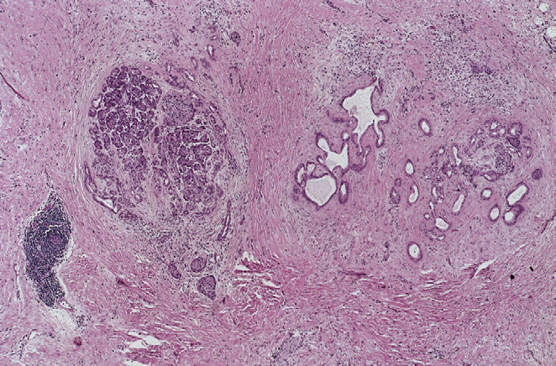
Morphology
CORE PATHOLOGY
Gross Appearance:
The gland is hard, sometimes with extremely dilated ducts and visible calcified concretions.
Microscopic Appearance:
Parenchymal fibrosis.
Reduced number and size of acini (glands).
Variable dilation of the pancreatic ducts.

Slide 24
Clinical Features of Chronic Pancreatitis:
VERTICAL INTEGRATION
Nausea
Vomiting
Weight loss
Edema
Jaundice
Persistent or recurrent abdominal pain radiating to the back
50% mortality rate over 20 to 25 years

Slide 25
Laboratory Investigations of Chronic Pancreatitis:
CORE PATHOLOGY
Elevations of serum amylase and serum alkaline phosphatase.
Calcifications within the pancreas visible by CT or ultrasonography.
Complication:
40% risk of developing pancreatic cancer.

Slide 26
Assessment
A 45-year-old obese female was diagnosed with acute cholecystitis due to numerous gallstones. What is the most likely complication in this patient if not treated?
Appendicitis
Gastritis
Colitis
Pancreatitis

Slide 27
Classification Of Pancreatic Tumors

Slide 28
Summary
Recurrent acute pancreatitis can result in chronic pancreatitis.
Ductal obstruction and long-term alcohol abuse are the most common causes in both forms.
Inappropriate activation of pancreatic digestive enzymes (due to mutations in genes encoding trypsinogen or trypsin inhibitors).
Primary acinar injury (due to toxins, infections, ischemia, or trauma) also causes pancreatitis.

