Slide 1
DIABETES INSPIDUS
Dr Shehzad Manzoor,Associate Professor, Internal Medicine,
HOD,Medical Unit 1, BBH, Rawalpindi.

Slide 3
Learning Outcomes:
Definition of Diabetes Inspidus
Different Types of DI
Pathogenesis Of DI
Symptoms and Signs Of DI
Management Of Central and Nephrogenic DI
Drugs ,modes of action and side effects
Etiological Evaluation of DI

Slide 4
Clinical Case Scenario:
A 35-year-old female presents to the emergency department with excessive thirst, polyuria, and fatigue. She reports having to urinate frequently throughout the day and night.

Slide 5
EXAMINATION
On examination, she appears dehydrated, with dry mucous membranes and tachycardia. Laboratory investigations reveal hypernatremia and a low urine specific gravity. Which of the following is the most likely diagnosis?

Slide 6
DIAGNOSIS
DIABETES INSIPIDUS

Slide 7
DIABETES INSPIDUS:
Core subject
Diabetes insipidus (DI) is a disorder characterized by excessive thirst and excretion of large amounts of diluted urine.
It's caused by either insufficient production of antidiuretic hormone (ADH), also known as vasopressin, or by the kidneys' inability to respond effectively to ADH.

Slide 8
TYPES OF DIABETES INSIPIDUS:
Core subject
There are two types of DI;
A) Central Diabetes Insipidus ( AVP-D)
B) Nephrogenic Diabetes Insipidus (AVP-R)

Slide 9
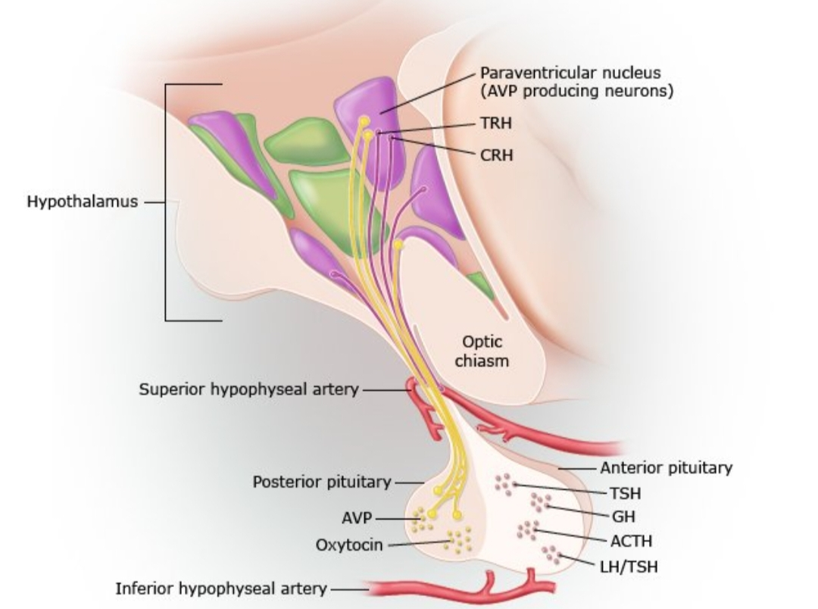
PATHOPHYSIOLOGY:
Figure;

Slide 10
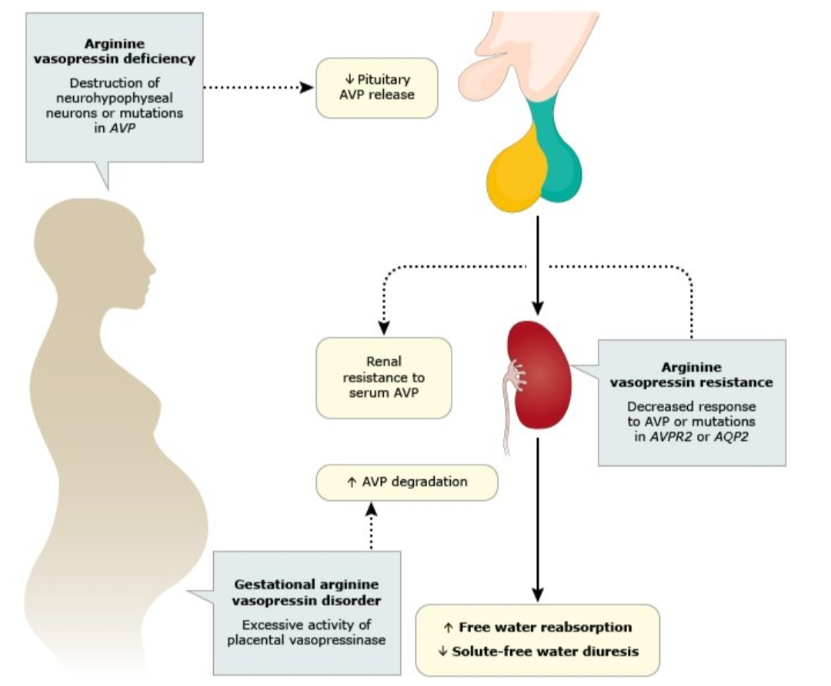
Vertical Integration

Slide 11
CENTRAL DIABETES INSIPIDUS;
Core subject
Loss of Vasopressin producing cells
Causing deficiency in ADH synthesis or release
Deficiency in ADH, resulting in an inability to conserve water
Leading to extreme polyuria and polydipsia

Slide 12
Etiology of Central DI
Core subject
Idiopathic:
a.Dominant ( Mutations in AVP gene)
b.Recessive ( DIDMOAD syndrome)
Neurosurgery:
a. Craniopharyngioma
b. Transphenoidal Surgery

Slide 13
CONTT.
Vertical Integration
Head Trauma
Hypoxic or ischemic encephalopathy:
a. Cardiopulmonary arrest
b. Shock
Neoplastic:
a. Primary: Craniopharyngioma , Cyst, Pinealoma
b. Metastatic : Breast, Lung

Slide 14
Nephrogenic DI;
Vertical Integration
Depression of aldosterone
Decrease in urinary concentrating ability that results from ADH resistance
Resistance at the ADH site of action in the collecting tubules.
interference with the countercurrent mechanism due to medullary injury

Slide 15
ETIOLOGY OF Nephrogenic DI;
Vertical Integration
Congenital
V2 receptor mutation
Aquaporin-2 mutation
Metabolic
Hypercalcemia
Hypokalemia
Drugs
a. Lithium
b. Demeclocycline

Slide 16
CONTT.
Horizontal Integration
Poisoning
Heavy metals
Chronic kidney disease
Polycystic kidney disease
Sickle-cell anemia
Infiltrative disease

Slide 17
SIGNS AND SYMPTOMS;
Core subject
-Polyuria with urine output of 5 –15 L/day.
-Polydipsia.
-Marked Dehydration as evidenced by dry mucous membranes, dry skin and weight loss.
-Nocturia
-Anorexia
-Epigastric fullness

Slide 18
INVESTIGATIONS ;
Core subject
~ GENERAL:
Serum Electrolytes
Urea levels
Creatinine levels
Serum Osmolality
Urine Osmolality
Urine R/E
~ SPECIFIC:
ADH Levels
Water Depriviation Test

Slide 19
Diagnostic test results;
Core subject
High serum osmolality, >300 mOsm/kg of water.
Low urine osmolality, usually 50~200 mOsm/kg of water.
Low urine specific gravity of less than 1.005
Increased creatinine nd blood urea nitrogen (BUN) levels resulting from dehydration.
Positive response to Water Depriviation Test

Slide 20
WATER DEPRIVATION TEST;
Core subject
Protocol;
-Record body weight, urine volume, plasma and urine osmolality every 2 hourly.
-Stop test if patient loses 3% body weight
-If plasma osmolality reaches >300mOmol/kg and urine osmolality reaches >600mOmol/kg, administer DDAVP .

Slide 21
DIAGNOSIS OF CENTRAL AND NEPHROGENIC DI
FLOW CHART

Slide 22
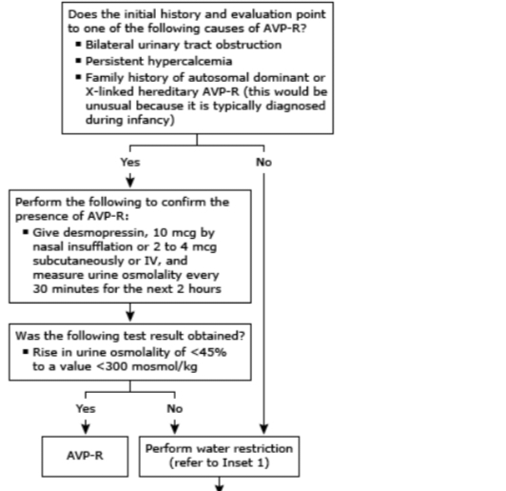
Core subject

Slide 23
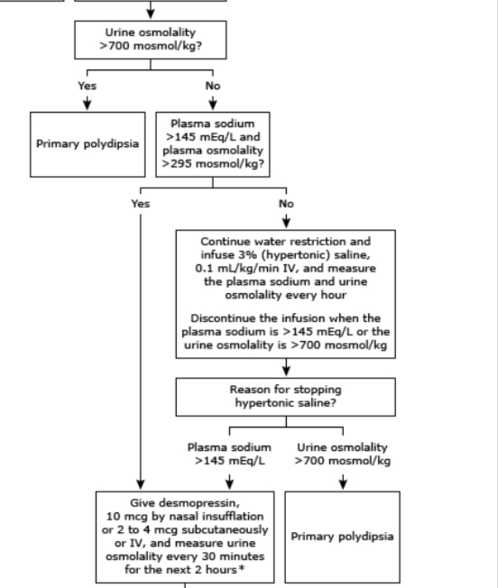
Core subject

Slide 24
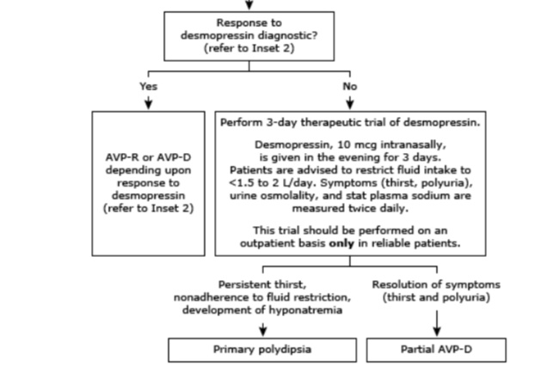

Slide 25
GOALS OF MANAGEMENT ;
Core subject
The objectives of therapy are:
-To replace ADH
-To Ensure adequate fluid replacement
-To identify and correct the underlying cause

Slide 26
MANAGEMENT OF CENTRAL DI

Slide 27
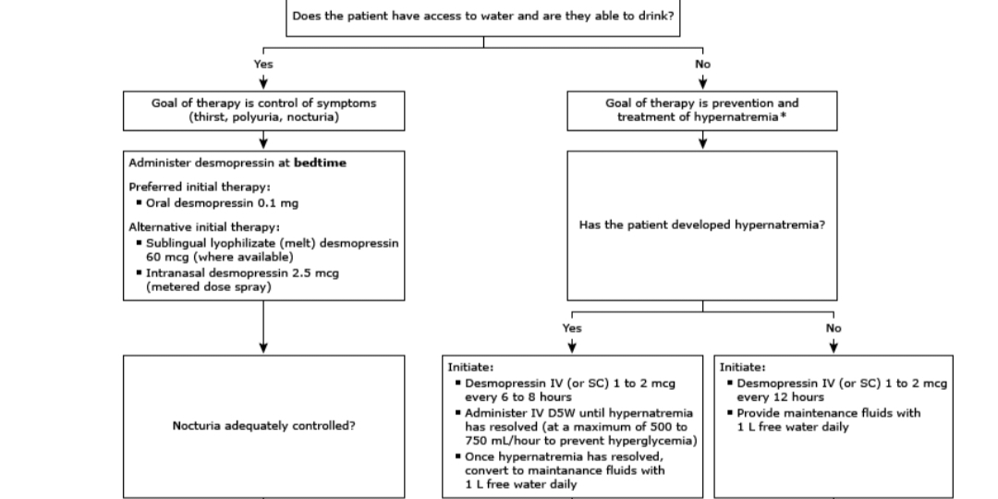

Slide 28
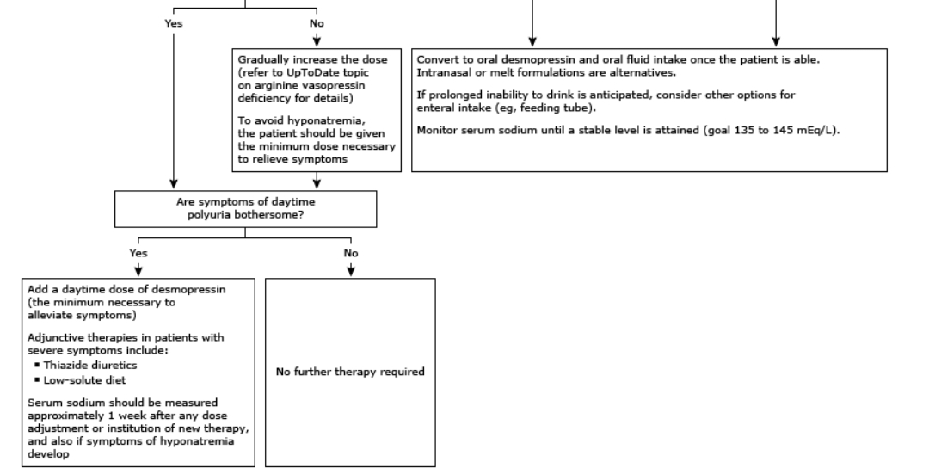
Vertical Integration

Slide 29
Management of NephrogenicDI;
Vertical Integration
-Low sodium, low protein diet.
-Thiazide diuretics.(To deplete Sodium and increased renal water reabsorption)
-Amiloride, K+ sparing diuretics.
-NSAIDS (Indomethacin)

Slide 30
MCQ1
Which of following is a key indicator of DI?
a)Urine specific gravity greater than 1.005
b)Urine specific gravity less than 1.005
c)Urine osmolality greater than 200 mosm/kg
d)Urine osmolality less than 200mosm/kg
e)Increased urine output

Slide 31
Answer 1
Option d

Slide 32
MCQ 2
A patient with diabetes insipidus is given a water depriviation test,after with holding water,urine osmolality remains low.what is next step in management?
a) Administer desmopressin(DDAVP)
b) Increased fluid intake
c) Perform Ctscan of brain
d) Measure serum sodium levels
e) Start thiazide diuretics

Slide 33
Answer 2
a

Slide 34
Researchers and References
Vertical integration
https://emedicine.medscape.com/article/117853-overview
https://pubmed.ncbi.nlm.nih.gov/31855345/
https://www.uptodate.com/contents/table-of-contents/endocrinology-and-diabetes/diabetes-mellitus
https://www.nice.org.uk/guidance/ng3
Davidson’s Principles and Practice of Medicine
The Oxford Textbook of Medicine
Medical Diagnosis and Treatment 2022
Harrison’s Principles of Internal Medicine

Slide 35
THANKYOU

