Slide 1
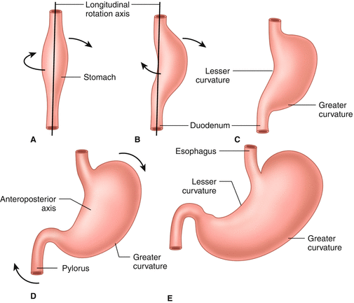
Gastrointestinal Tract (GIT) Module 2nd Year MBBS(LGIS) Development of Stomach
Presenter: Prof.Dr. Ifra Saeed Date: 07-03-25

Slide 2
Prof. Umar’s Model of Teaching Strategy Self Directed Learning (SDL) Assessment Program Objectives :To cultivate critical thinking, analytical reasoning, and problem-solving competencies. To instill a culture of self-directed learning, fostering lifelong learning habits and autonomy.
First Ten Minutes
How to Assess?
Ten randomly selected students will be evaluated within the first 10 minutes of the lecture through 10 multiple-choice questions (MCQs) based on the PowerPoint presentation shared on Students Official WhatsApp group, one day before the teaching session.
The number of MCQs from the components of the lecture will follow the guidelines outlined in the Prof. Umar model of Integrated Lecture.
Component of LGIS | Core Knowledge | Horizontal Integration | Vertical Integration | Spiral Integration
No of MCQs | 6-7 | 1-2 | 1 | 1

Slide 3
Professor Umar Model of Integrated Lecture

Slide 4
Sequence Of LGIS
Development of Stomach (Core concept=70%)
Related Physiology and Biochemistry (Horizontal Integration-10%)
Related clinical/congenital abnormalities (Vertical integration- 10%)
Research article related to topic (3%)
Ethics (2%)
Family Medicine (3%)
Artificial Intelligence (2%)

Slide 5
Learning Objectives
At the end of the lecture, students will be able to
Describe different stages of development of stomach with special reference to rotation of stomach
Integrate physiology of Stomach with its development
Explain associated congenital abnormalities
Appreciate term Beneficence in Bioethics
Correlate and build core knowledge on the basis of latest research

Slide 6
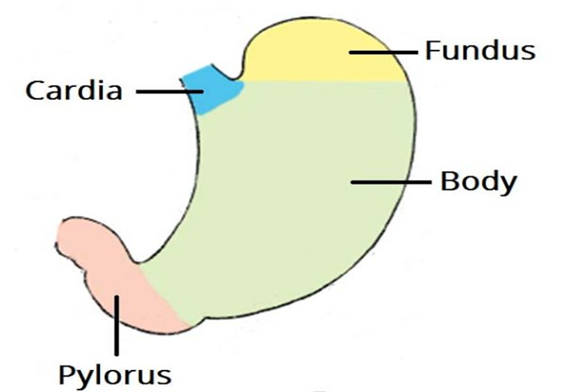
Gross Anatomy
The stomach, is an intraperitoneal digestive organ located between the esophagus and the duodenum.
It is ‘J’ shaped,
lesser and greater curvature.
The anterior and posterior surfaces are smoothly rounded with a peritoneal covering.
Four divisions
Core Knowledge

Slide 7
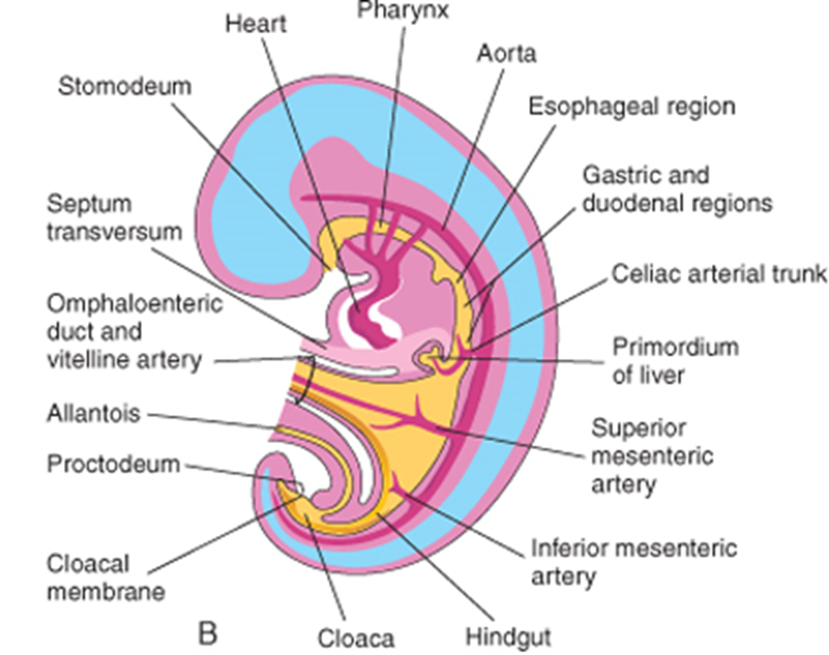
Development of Primitive Gut

Slide 8
Development of Stomach
Below the diaphragm, the gut tube begins to dilate and expands into a fusiform (spindle-shaped) structure by week 4.
In week 5, its dorsal border starts to grow faster forming greater curvature dorsally and the lesser curvature ventrally.
Continued growth forms the fundus and cardiac incisure .

Slide 9
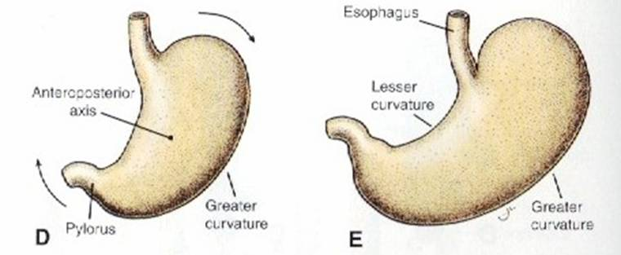
Development Of Stomach

Slide 10
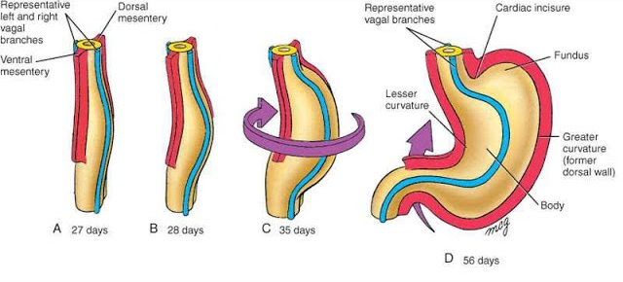
Rotation Of Stomach
As the stomach enlarges and acquires its final shape, it slowly rotates 90 degrees in a clockwise direction (viewed from the cranial end) around its longitudinal axis. The ventral border (lesser curvature) moves to the right and the dorsal border (greater curvature) moves to the left. The original left side becomes the ventral surface and the original right side becomes the dorsal surface.
.

Slide 11
Results Of Rotation
Before rotation ?????
its cranial region moves to the left and slightly inferiorly, and its caudal region moves to the right and superiorly
The rotation and growth of the stomach explain why the left vagus nerve supplies the anterior wall of the adult stomach and the right vagus nerve innervates its posterior wall.

Slide 12
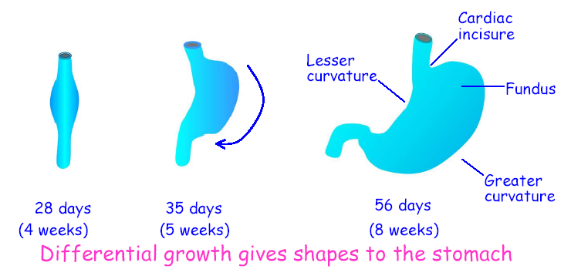

Slide 13
Formation Of Omental Bursa
The rotation of the stomach along its longitudinal axis pulls the dorsal mesogastrium to the right, creating a space behind the stomach called the omental bursa (or lesser sac).

Slide 14
Video Recap

Slide 15
Physiological And Biochemical Aspects
Gastric acid secretion,
peristaltic propulsion, and
other physiologic functions of the stomach
are finely controlled by the integration of the enteric nervous system, parasympathetic nervous system, and the secretion of various neurohormonal molecules (i.e., gastrin, HCl acid, intrinsic factor, bicarbonate, mucus
Horizontal integration

Slide 16
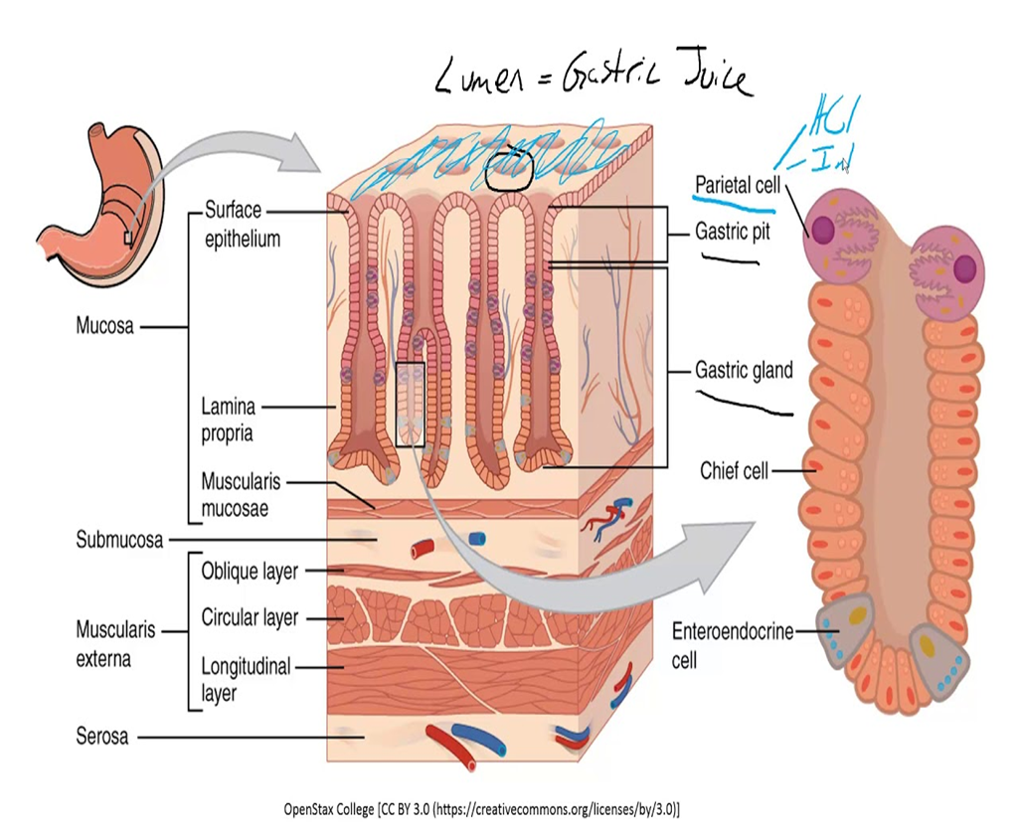
Physiological and Biochemical Aspects

Slide 17
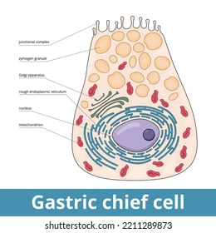
Physiological and Biochemical Aspects
Chief cells found at the base of the gastric glands within the fundus of the stomach that secrete the zymogen called pepsinogen.
Pepsinogen is the inactive form of a proteolytic enzyme called pepsin, which is needed to digest proteins into small units called polypeptides. .

Slide 18
Physiological and Biochemical Aspects
Surface mucus cells primarily line the gastric mucosa. They secrete mucus which acts as a barrier to the corrosive nature of the gastric acid.
Parietal cells secrete gastric acid (HCl formation)
Also secrete a protein called intrinsic factor. necessary for the absorption of vitamin B12

Slide 19
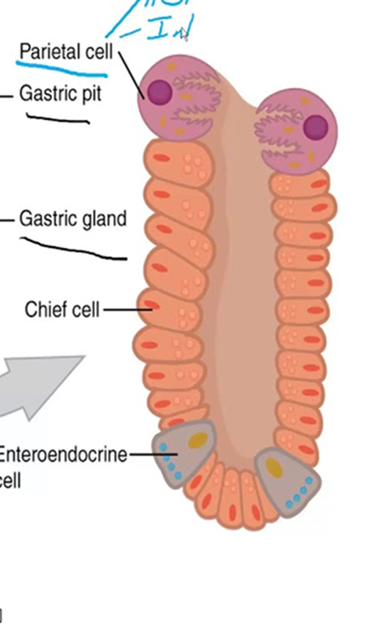
Physiological and Biochemical Aspects Neuroendocrine cells
are also found in the gastric glands
G-cells are located in the pylorus region of the stomach, produce the gastrin, capable of increasing HCl production
D-cells are located in the pylorus of the stomach, and secrete an inhibitory molecule called Somatostatin.

Slide 21
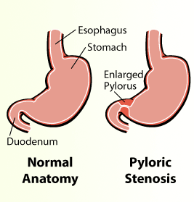
Congenital Hypertrophic Pyloric Stenosis
Anomalies of the stomach are uncommon except for hypertrophic pyloric stenosis. This anomaly affects one in every 150 males and one in every 750 females. In infants with this anomaly, there is a marked muscular thickening of the pylorus, the distal sphincteric region of the stomach . The circular and, to a lesser degree, the longitudinal muscles in the pyloric region are hypertrophied. stenosis of the pyloric canal and obstruction of the passage of food. the stomach becomes markedly distended (projectile vomiting). (pyloromyotomy) is the usual treatment..
Vertical integration

Slide 22
Development of the submucosa and musculature in the human fetal stomach: A microscopic study
Roy N, Roy S. Development of the submucosa and musculature in the human fetal stomach: A microscopic study. National Journal of Clinical Anatomy. 2023 Jan 1;12(1):9-14.
ABSTRACT
The findings of the present study about the time of appearance and further development of MM and ME and the thickness and formation of SM of the human fetal stomach are quite comprehensive.
These findings are expected to aid in the knowledge of histogenesis of the stomach in the human fetuses and help in the diagnosis and treatment of various congenital anomalies and clinical conditions involving gastric connective tissue and musculature.
Questions from article next time
Spiral Integration
Research

Slide 23
Approach to patient of pyloric stenosis
Approaching a patient with pyloric stenosis involves recognizing symptoms like projectile vomiting in infants 2-8 weeks old, conducting a physical exam for an "olive" mass in the abdomen, and confirming diagnosis via ultrasound showing pyloric muscle thickening.
Initial treatment
correcting dehydration and electrolyte imbalances, surgical pyloromyotomy.
The prognosis after surgery is excellent, with rapid symptom improvement.
Family Medicine

Slide 24
Bioethics related to patient of pyloric stenosis
In the treatment of pyloric stenosis, bioethical considerations emphasize informed consent from parents, ensuring decisions are in the infant's best interest, and providing equitable access to care.
Ethical care involves clearly explaining the condition, treatment options, and outcomes to caregivers, prioritizing the infant's health while respecting family values and decisions.
Healthcare providers must balance medical urgency with ethical sensitivity to guide families through the decision-making process, ensuring every infant receives timely and appropriate intervention.
Bioethics

Slide 25
Role of Artificial Intelligence
AI algorithms, especially those based on deep learning, are being used to analyze endoscopic images and videos to identify various gastric issues, including ulcers, cancer, and polyps, with high accuracy.
AI can analyze data from a patient's medical history, genetic information, and lifestyle factors to tailor treatment plans for stomach diseases,
Artificial Intelligence

Slide 26
Role of Artificial Intelligence
AI models can predict disease progression and outcomes in stomach diseases, helping in early intervention and better management of conditions like gastric cancer.
Surgical Assistance: AI and robotics are used to enhance the precision and safety of procedures, reducing recovery times and improving outcomes.
Treatment Response Monitoring: AI tools can analyze data over time to assess how well a patient is responding to treatment

