Slide 1


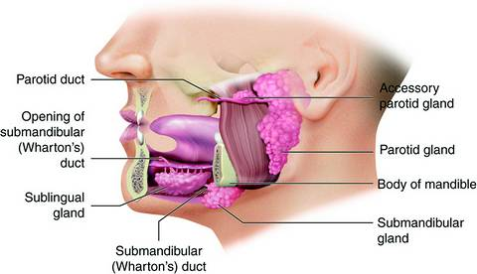
Gastrointestinal Tract (GIT)-I Module
2nd Year MBBS(LGIS)
Development of Salivary Glands
Presenter: Prof. Dr. Ifra Saeed Date: 27-02-25

Slide 2
Motto Vision; The Dream/Tomorrow
To impart evidence based research oriented medical education
To provide best possible patient care
To inculcate the values of mutual respect and ethical practice of medicine
Wisdom
Truth
Service

Slide 3
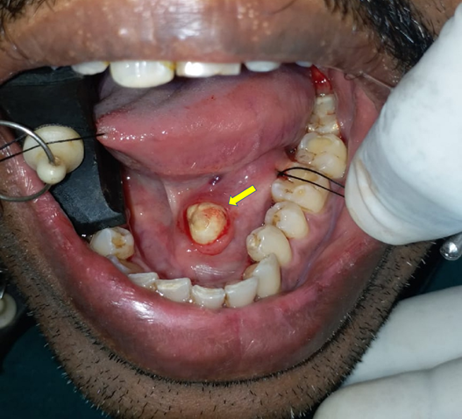
Clinical Scenario
Interactive Session

Slide 4
Learning Objectives
At the end of the lecture, students will be able to
Describe embryogenesis and different stages of development of salivary glands
Integrate physiological and biochemical aspects of saliva
Explain associated congenital abnormalities
Correlate and build core knowledge on the basis of latest research, associated Family Medicine and Bioethics

Slide 5

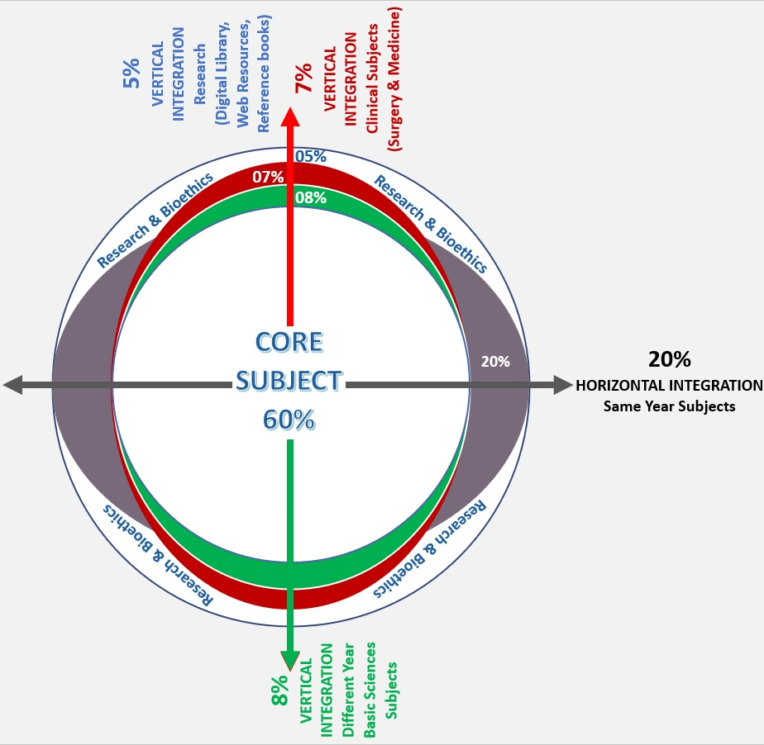
Professor Umar Model of Integrated Lecture
60%
CORE SUBJECT
20%
HORIZONTAL
INTEGRATION
Physiology
biochemistry
8%
VERTICAL INTEGRATION
Pathology
pharmacology
7%
VERTICAL INTEGRATION
Clinical integration
8%
Spiral integration Research, professionalism
Ethics
Digital library

Slide 6

Gross Anatomy
The Major Salivary Glands are paired glands with long ducts that empty into the oral cavity. The major salivary glands, consist of the paired
Parotid,
Submandibular, and
Sublingual glands.

Slide 7
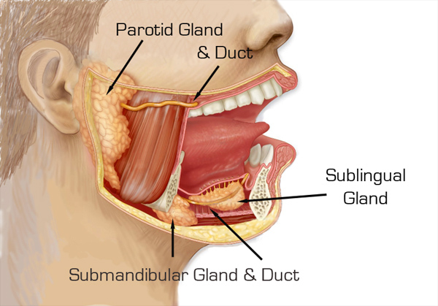
Location Of Salivary Glands
The parotid and the submandibular glands are actually located outside the oral cavity; their secretions reach the cavity by ducts.
The parotid gland is located subcutaneously, below and in front of the ear in the space between the ramus of the mandible and the styloid process of the temporal bone.
The submandibular gland is located under the floor of the mouth, in the submandibular triangle of the neck.
The sublingual gland is located in the floor of the mouth anterior to the submandibular gland.

Slide 8
The Minor Salivary Glands
are located in the submucosa of different parts of the oral cavity. They include the
lingual,
labial,
buccal,
molar, and
palatine glands.

Slide 9
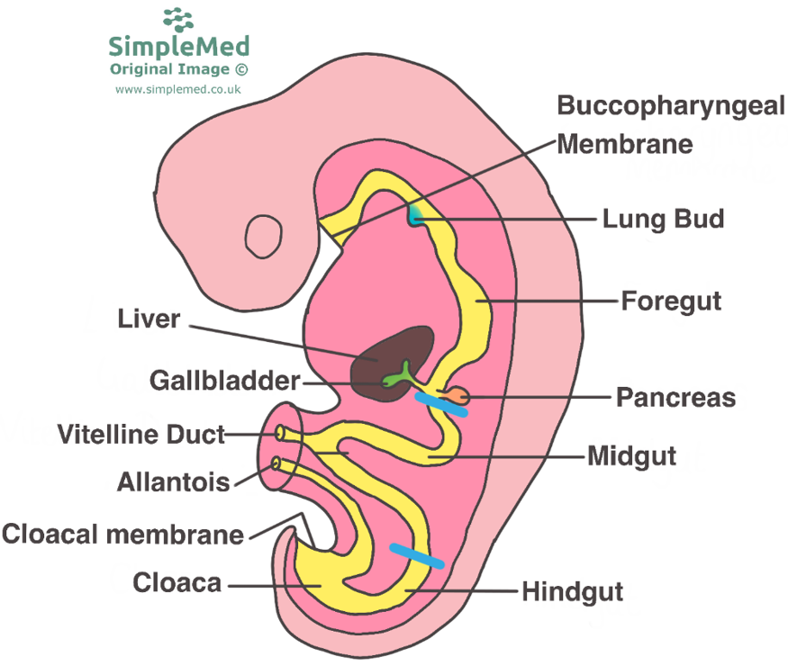

Slide 10
In humans, the parotid gland appear first, between the fourth and sixth embryonic weeks, as solid epithelial placodes.
The placodes for the submandibular glands appear later in the sixth embryonic week in the medial paralingual sulcus.
During the seventh to eighth embryonic weeks, the sublingual gland arise from multiple epithelial placodes, lateral to the submandibular glands,
and finally the minor salivary glands develop late in the 12th fetal week .

Slide 11
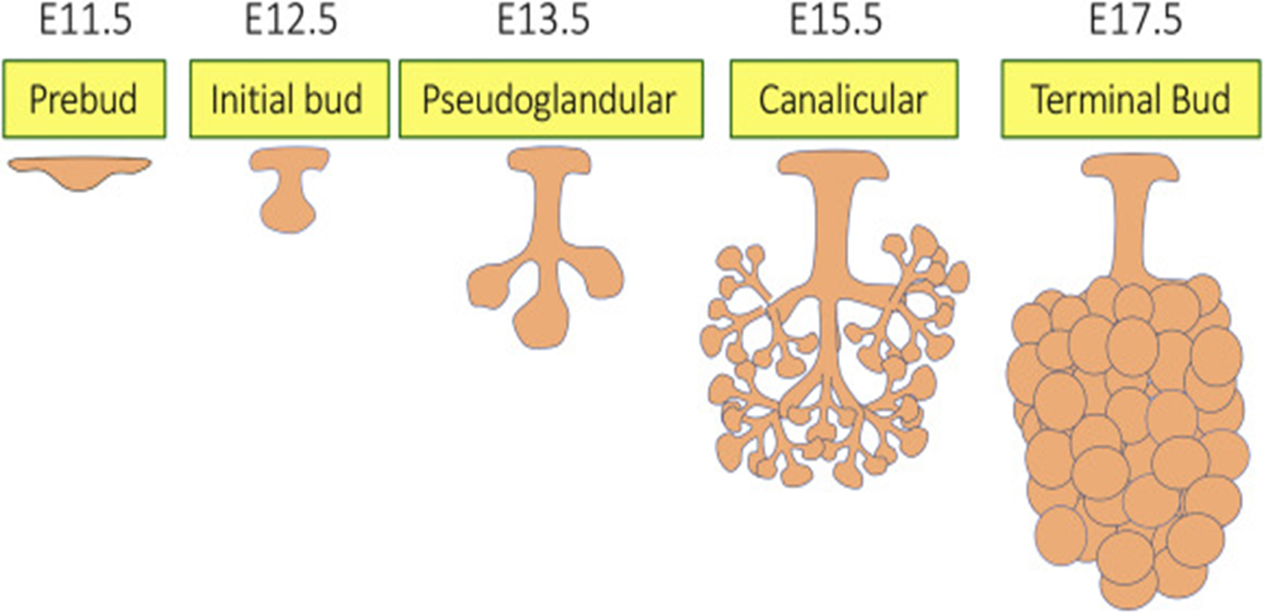
Stages Of Salivary Gland Development:
Pre Bud Stage
Initial bud stage
Pseudoglandular stage
Canalicular stage
Terminal Differentiation Stage

Slide 12
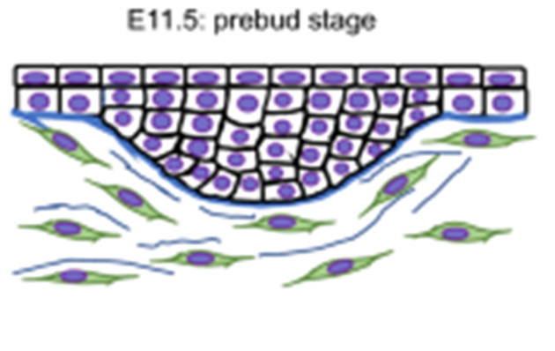
Pre bud stage
The mesenchyme underlying the oral epithelium induces the proliferation in the epithelium which results in tissue thickening
The first sign of salivary gland development consists of a thickening of the oral epithelium, known as the placode or prebud stage

Slide 13
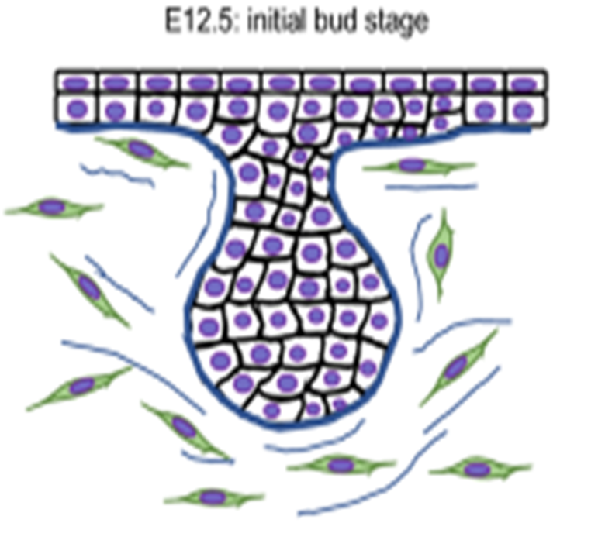
The prebud stage is followed by an invagination of the thickened epithelium into the underlying mesenchyme, which leads to the formation of a spherical bud connected to the oral epithelium through a thick solid epithelial stalk.
The epithelial stalk will give rise to the main salivary duct, whereas the terminal bulb constitutes the primordium of the intralobular parenchyma
Surrounding mesenchymal cells become the capsule of the gland. This stage is known as the initial bud stage.
INITIAL BUD STAGE

Slide 14
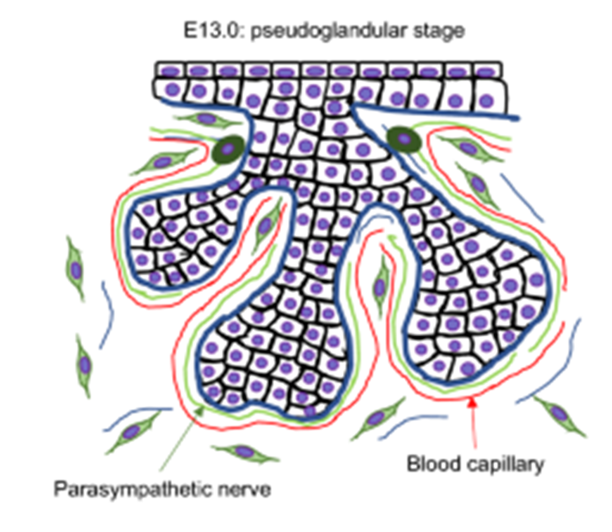
Psuedoglandular Stage
A solid cord of cells forms from the epithelial bud through cell proliferation. Condensation and proliferation occur in the surrounding mesenchyme which is closely associated with the epithelial cord.
The basal lamina plays a role in influencing morphogenesis and differentiation of the salivary glands throughout the development .The arborization of the salivary gland epithelium is produced by branching morphogenesis.

Slide 15
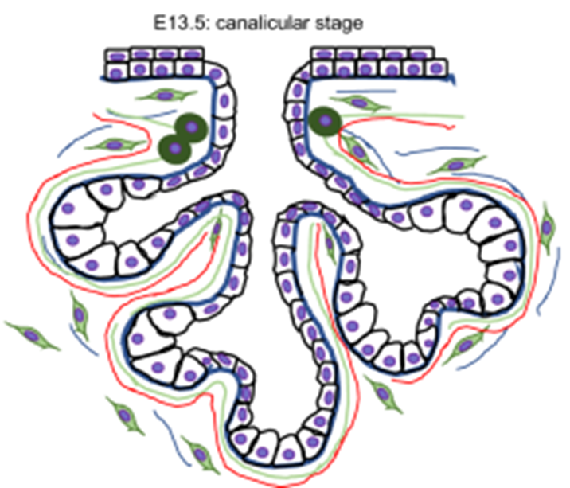
Canalicular stage
Canalization of the epithelial cord, with the formation of a hollow tube or duct, usually occurs by the sixth month in all the major salivary glands. The epithelial tree of the developing salivary glands is initially formed by solid cords of epithelial cells.
The two main theories to explain the mechanism of canalization are: •
Different rates of cell proliferation between the outer and inner layers of the epithelial cord.
Fluid secretion by the duct cells which increases the hydrostatic pressure and produces a lumen within the cord..

Slide 16
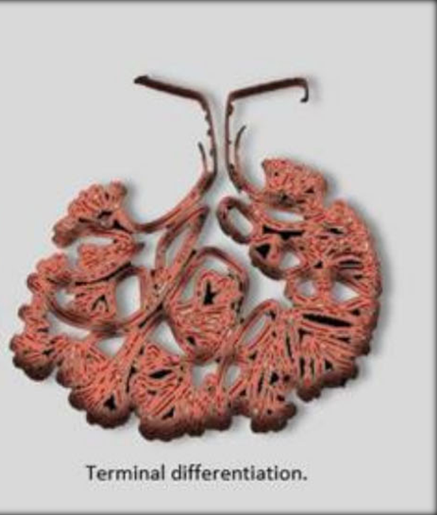
Terminal differentiation stage
When the ducts and acini are finally hollowed out, the terminal differentiation stage starts . During this stage, the epithelial cells lining the ducts, tubules, and acini proceed to differentiate both morphologically and functionally.
Throughout the glands, the ducts will differentiate into excretory, striated, and intercalated types,
whereas the cells within the acini differentiate into serous or mucous secretory cells as well as myoepithelial cells.

Slide 17
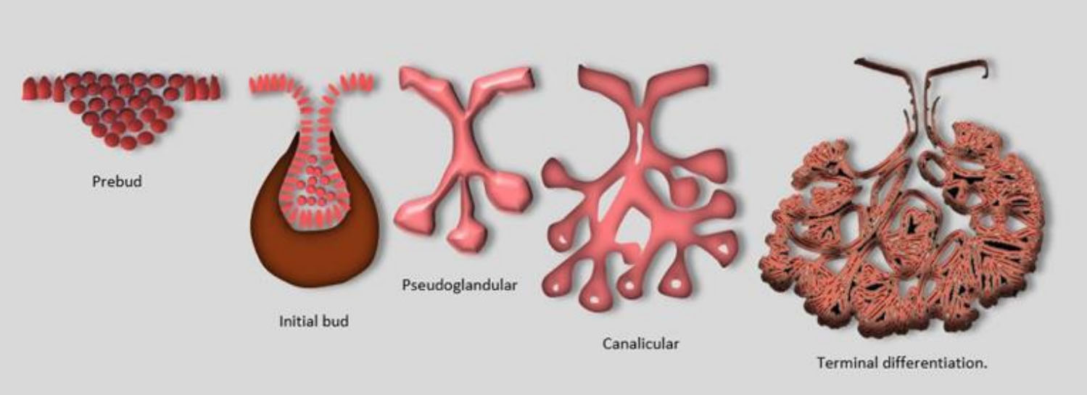

Slide 18


Slide 19
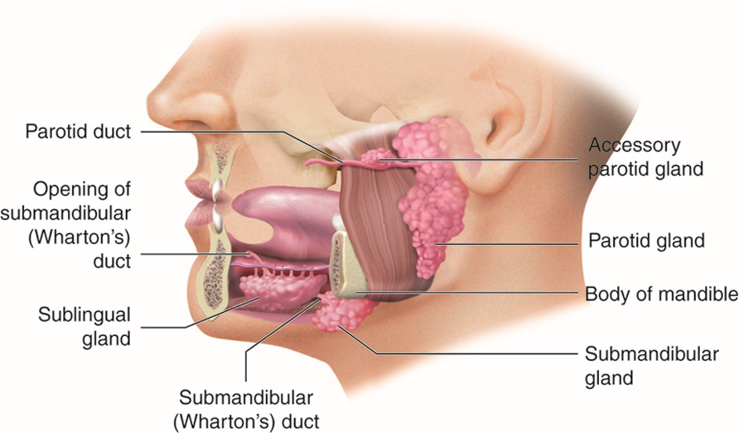
Parotid Gland
The parotid glands are the first to appear (early in the sixth week). They develop from buds that arise from the oral ectodermal lining near the angles of the stomodeum.
Elongation of the jaws causes lengthening of the parotid duct, with the gland remaining close to its site of origin. Later the cords canalize-develop lumina-and become ducts by approximately 10 weeks.
The rounded ends of the cords differentiate into acini. Secretions commence at 18 weeks. The capsule and connective tissue develop from the surrounding mesenchyme.

Slide 20
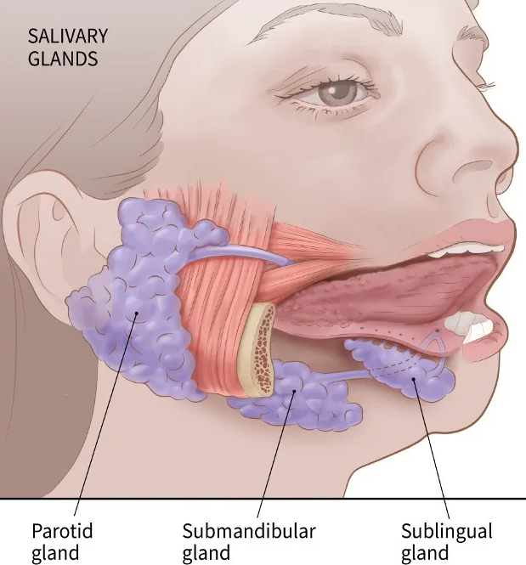
Submandibular Gland
The submandibular glands appear late in the sixth week. They develop from endodermal buds in the floor of the stomodeum. Solid cellular processes grow posteriorly, lateral to the developing tongue. Later they branch and differentiate.
Acini begin to form at 12 weeks and secretory activity begins at 16 weeks.
Growth of the submandibular glands continues after birth with the formation of mucous acini. Lateral to the tongue, a linear groove forms that soon closes over to form the submandibular duct.

Slide 21
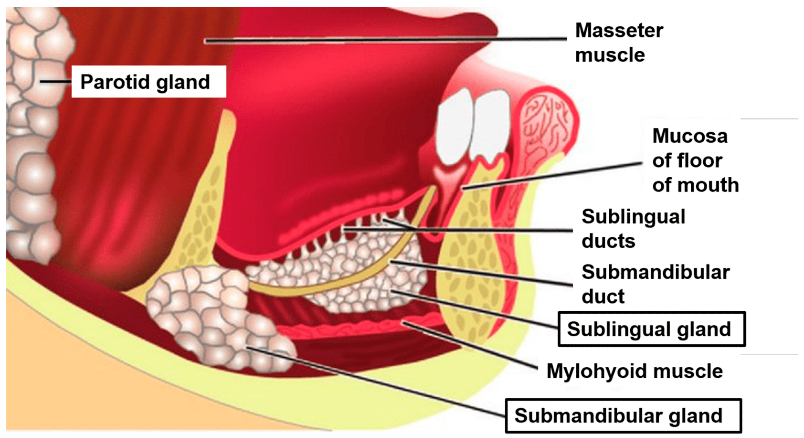
Sublingual Gland
The sublingual glands appear in the eighth week, approximately 2 weeks later than the other salivary glands They develop from multiple endodermal epithelial buds in the paralingual sulcus.
These buds branch and canalize to form 10 to 12 ducts that open independently into the floor of the mouth.

Slide 22

Saliva
Saliva, a thick, colourless, opalescent fluid that is constantly present in the mouth of humans and other vertebrates.
It is composed of water, mucus, proteins, mineral salts, and amylase.
As saliva circulates in the mouth cavity it picks up food debris, bacterial cells, and white blood cells.
One to two litres of fluid are excreted daily into the human mouth..

Slide 23
Types of Saliva
Parotid gland – Purely Serous, Watery, 25%
Sub Mandibular: Mixed with Serous units predominating, semi viscous, 71%
Sub Lingual: Mixed with mucus units predominating, Viscous, 3-4%
Palatine & Glossopalatine: Purely mucous Trace
Glands of Blandin & Nuhn: Chiefly mucous Trace
Von Ebner glands: Purely serous Trace

Slide 24
Composition Of Saliva
Water: 99.5%
Electrolytes:
  2–21 mmol/L sodium (lower than blood plasma)
  10–36 mmol/L potassium (higher than plasma)
  1.2–2.8 mmol/L calcium (similar to plasma)
  0.08–0.5 mmol/L magnesium
  5–40 mmol/L chloride (lower than plasma)
  25 mmol/L bicarbonate (higher than plasma)
  1.4–39 mmol/L phosphate
  Iodine (mmol/L concentration is usually higher than plasma, but dependent variable according to dietary iodine intake)
Mucus (mucus in saliva mainly consists of mucopolysaccharides and glycoproteins)
Antibacterial compounds (thiocyanate, hydrogen peroxide, and secretory immunoglobulin A)

Slide 25
Flow of saliva
On average, unstimulated flow rate is 0.3 mL/min, with the average total for 16 hours of unstimulated flow (during waking hours) being 300 mL. Salivary flow during sleep is nearly zero.
Stimulated flow rate is, at maximum, 7 mL/min. Stimulated saliva is reported to contribute as much as 80% to 90% of the average daily salivary production.

Slide 26
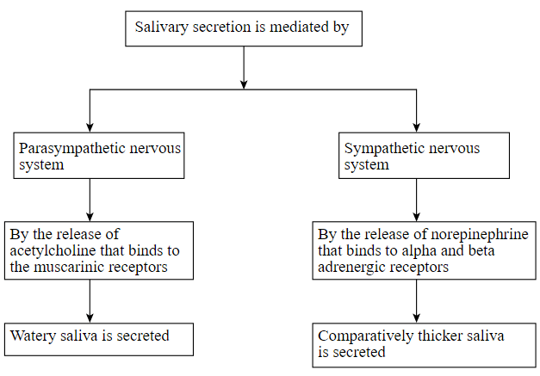


Slide 27
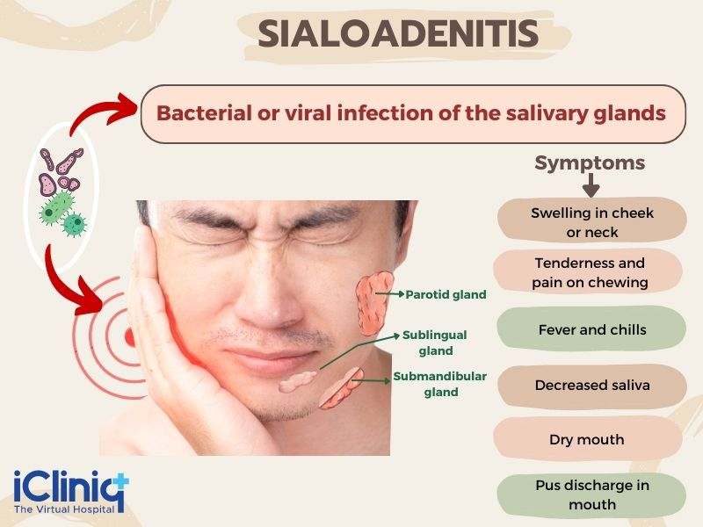
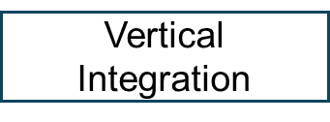
Clinical Conditions Associated With Parotid Gland
The most frequently diagnosed salivary gland disease is salivary gland infections,
Salivary gland infections are usually of bacterial or viral etiology
divided into acute and chronic type
result from obstruction of the salivary duct, an autoimmmune disease or cancer therapy.

Slide 28

Sialolithiasis
Sialolithiasis is characterized by the development of calcified structures in the salivary glands, especially in the submandibular gland.
Cause
Sialoliths are generally attributed to retention of saliva and are usually accompanied by swelling and pain when a salivary stimulus is applied.

Slide 29
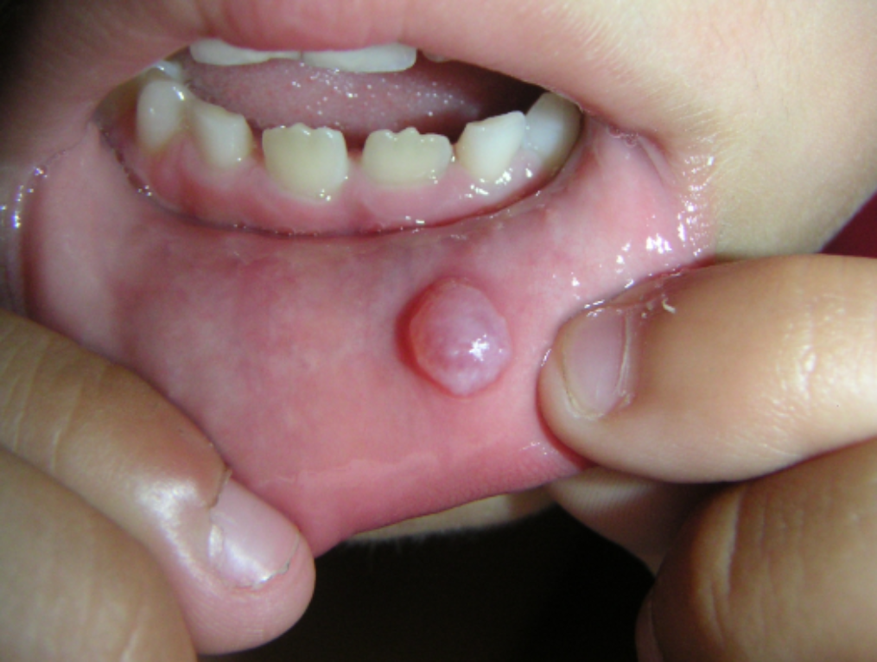
Mucoceles
Mucoceles can be differentiated into mucus extravasation phenomenon or mucus escape reaction, mucus retention cysts and ranulas.
They result from extravasation of saliva into the surrounding soft tissues or from retention of saliva within the duct

Slide 30
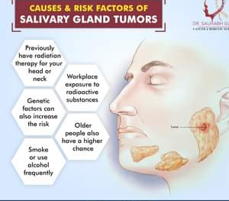
Carcinoma of salivary gland
Salivary gland cancer is a rare disease in which malignant (cancer) cells form in the tissues of the salivary glands.
Being exposed to certain types of radiation may increase the risk of salivary cancer. Signs of salivary gland cancer include a lump or trouble swallowing.

Slide 31

Suggested Research Article
The evolving definition of salivary gland stem cells
Cecilia Rocchi, Lara Barazzuol & Rob P. Coppes
npj Regenerative Medicine volume 6, Article number: 4 (2021)
In studies to elucidate salivary gland regenerative mechanisms, more and more evidence suggests that salivary gland stem/progenitor cell behavior, does not follow that of the hard-wired professional stem cells of the hematopoietic system.
In this review, study provide evidence showing that several cell types within the salivary gland epithelium can serve as stem/progenitor-like cells.
Spiral Integration

Slide 32
How To Access Digital Library
Steps to Access HEC Digital Library
Go to the website of HEC National Digital Library.
On Home Page, click on the INSTITUTES.
A page will appear showing the universities from Public and Private Sector and other Institutes which have access to HEC National Digital Library HNDL.
Select your desired Institute.
5. A page will appear showing the resources of the institution
6. Journals and Researches will appear
7. You can find a Journal by clicking on JOURNALS AND DATABASE and enter a keyword to search for your desired journal.

Slide 33


Common Characteristics and Clinical Management Recommendations for Juvenile Recurrent Parotitis:
A 10-Year Tertiary Center Experience
Juvenile recurrent parotitis (JRP) is a rare disease that may adversely affect normal development and quality of life. The objective of this study was to report on the demographics, characteristics, and treatment outcomes of JRP and to offer evidence-based management recommendations.
Study Design
Retrospective review.
https://doi.org/10.1177/2473974X221077874/2022

Slide 34


Is keeping my child from getting the MMR vaccine unethical? Bioethical arguments for informed decision-making https://doi.org/10.1016/j.bioet.2020.03.00
A brief review is presented on the Measles Mumps Rubella (MMR) vaccine and recent outbreaks, with special attention to the role of anti-vaccine movements. Diverse bioethical perspectives are discussed to answer this issue. Informed consent is advised for all settings and mandatory vaccination is suggested for high risk children and vulnerable groups, based on the bioethical analysis

