Slide 1
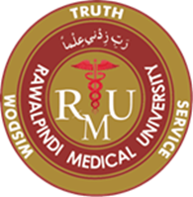
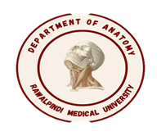
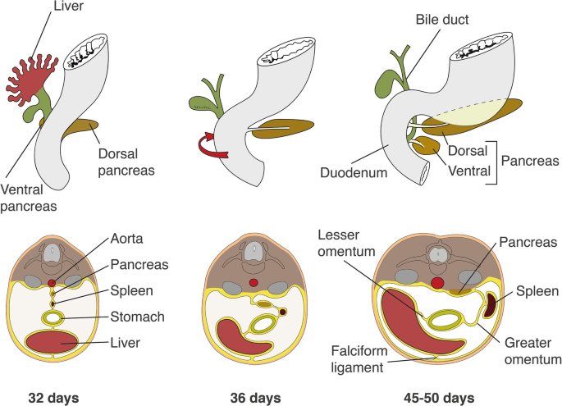
Gastrointestinal Tract (GIT) Module 2nd Year MBBS(LGIS) Development of Liver & Biliary Apparatus
Presenter: Prof.Dr. Ifra Saeed Date: 11-03-25

Slide 2
Prof. Umar’s Model of Teaching Strategy Self Directed Learning Assessment Program Objectives :To cultivate critical thinking, analytical reasoning, and problem-solving competencies. To instill a culture of self-directed learning, fostering lifelong learning habits and autonomy.
First Ten Minutes
How to Assess?
Ten randomly selected students will be evaluated within the first 10 minutes of the lecture through 10 multiple-choice questions (MCQs) based on the PowerPoint presentation shared on Students Official WhatsApp group, one day before the teaching session.
The number of MCQs from the components of the lecture will follow the guidelines outlined in the Prof. Umar model of Integrated Lecture.
Component of LGIS | Core Knowledge | Horizontal Integration | Vertical Integration | Spiral Integration
No of MCQs | 6-7 | 1-2 | 1 | 1

Slide 3
Professor Umar Model of Integrated Lecture

Slide 4
Motto Vision; The Dream/Tomorrow
To impart evidence based research oriented medical education
To provide best possible patient care
To inculcate the values of mutual respect and ethical practice of medicine
Wisdom
Truth
Service

Slide 5
Learning Objectives
At the end of the lecture, students will be able to
Describe formation of hepatic diverticulum and histogenesis of liver during intrauterine life
Describe development of Biliary apparatus
Correlate bio physiological knowledge
Discuss congenital abnormalities of Liver and Biliary apparatus
Correlate and build core knowledge on the basis of latest research, Bioethics, Family Medicine, Artificial Intelligence

Slide 6
DEVELOPMENT OF FOREGUT
ESOPHAGUS
STOMACH
DUODENUM
LIVER & GALLBLADDER
PANCREAS

Slide 7
Gross Anatomy

Slide 8
Key Points
Endoderm forms the epithelial lining of digestive tract and give rise to specific cells of glands (hepatocytes)
Stroma is derived from splanchnic mesoderm
Muscles, connective tissue and peritoneal component of the wall of the gut are derived from splanchnic mesoderm

Slide 9
Early Liver Development
The liver, gallbladder, and biliary duct system arise as a ventral outgrowth-hepatic diverticulum-from the caudal or distal part of the foregut early in the fourth week

Slide 10
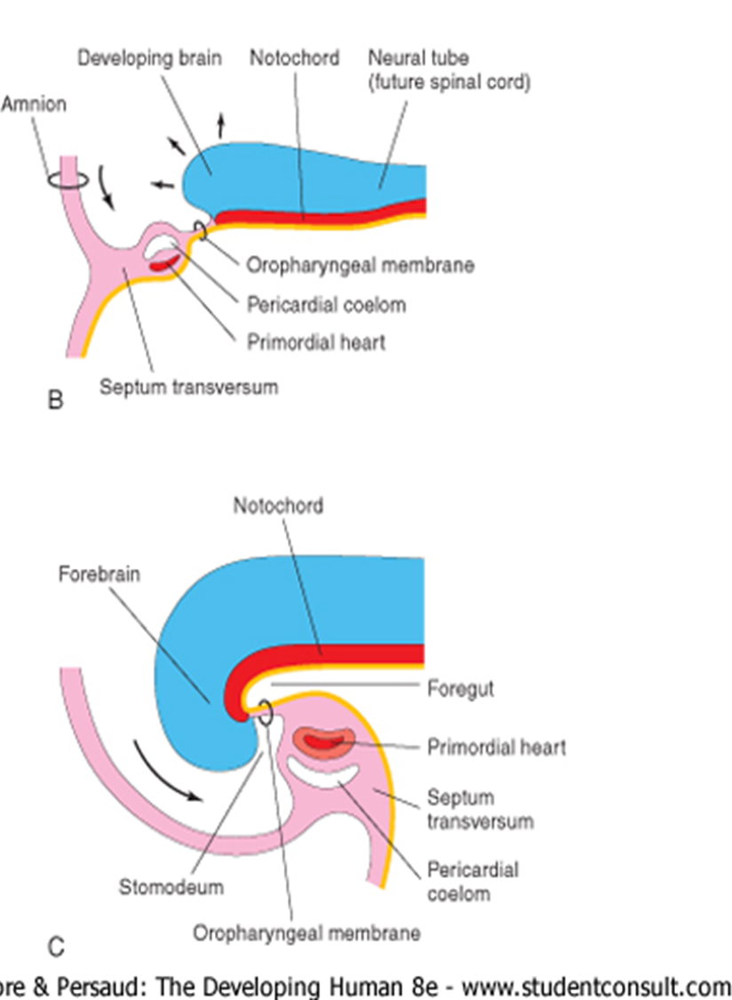
Early liver development
As the head fold and early intraembryonic coelom form, the ventral parietal wall of the pericardial cavity gives rise to populations of cells termed precardiac or cardiac mesenchyme. Hepatic endoderm is induced to proliferate by this mesenchyme.

Slide 11
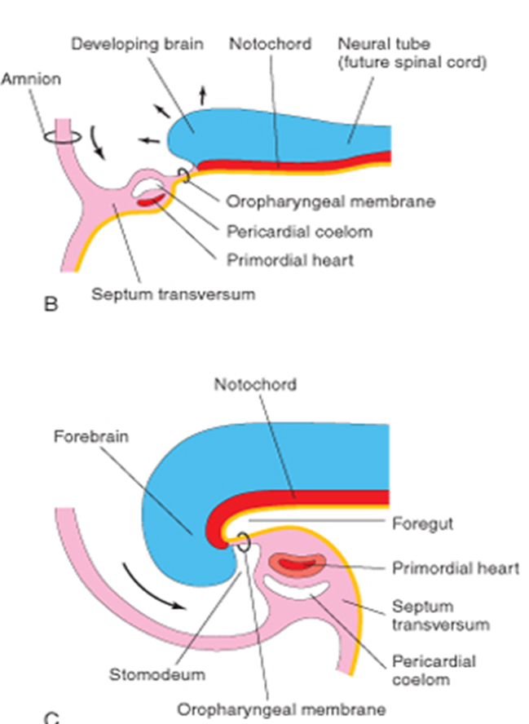
Formation of Septum Transversum
As the heart and foregut become separated by the accumulation of the cardiac mesenchyme, the mesenchyme itself is renamed septum transversum. It is seen as a ventral mass, caudal to the heart.
The majority of the cells within the septum transversum are destined to become hepatic mesenchyme.

Slide 12
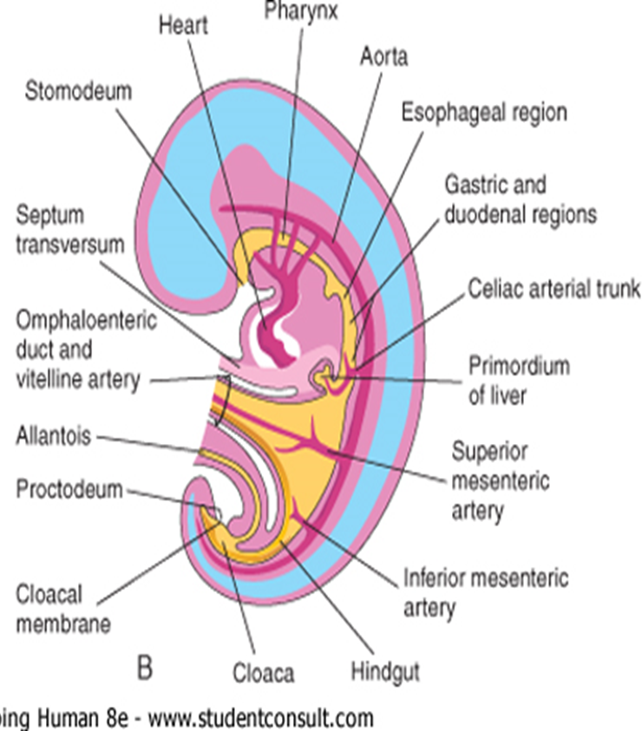
Formation of Hepatic Diverticulum
FGFs, secreted by the developing heart, induce formation of the hepatic diverticulum
The diverticulum extends into the septum transversum, a mass of splanchnic mesoderm between the developing heart, foregut and midgut.

Slide 13
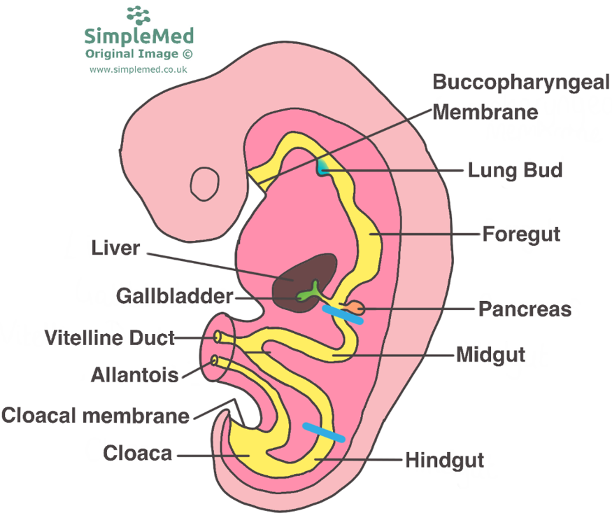

Slide 14
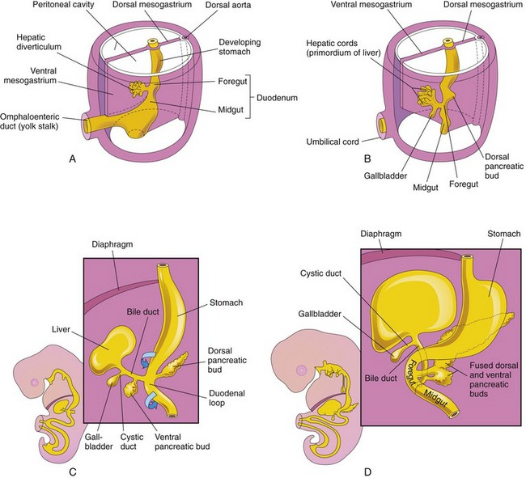
Primordium of Liver
The hepatic diverticulum enlarges rapidly and divides into two parts as it grows between the layers of the ventral mesogastrium
The larger cranial part of the hepatic diverticulum is the primordium of the liver.

Slide 15
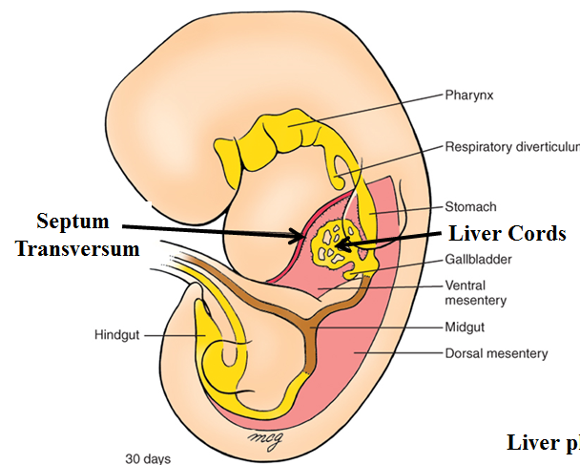
Development of Hepatocytes, Hepatic Cords
The proliferating endodermal cells give rise to interlacing cords of hepatocytes and to the epithelial lining of the intrahepatic part of the biliary apparatus.
The hepatic cords anastomose around endothelium-lined spaces, the primordia of the hepatic sinusoids.
The fibrous and hematopoietic tissue and Kupffer cells of the liver are derived from mesenchyme in the septum transversum.

Slide 16
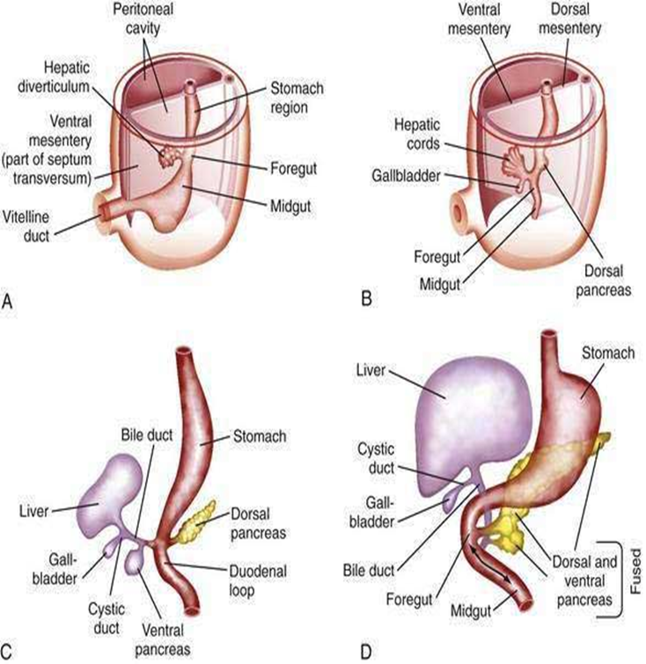
Development of Gall Bladder The small caudal part of the hepatic diverticulum becomes the gallbladder, and the stalk of the diverticulum forms the cystic duct Initially, the extrahepatic biliary apparatus is occluded with epithelial cells, but it is later canalized because of vacuolation resulting from degeneration of these cells.

Slide 17
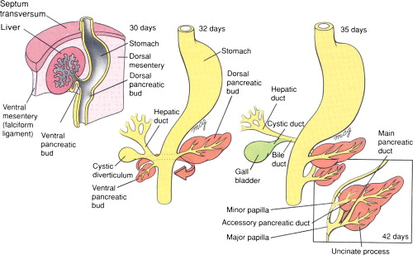
Development of Bile Duct
The stalk connecting the hepatic and cystic ducts to the duodenum becomes the bile duct.
Effect of rotation on bile duct entry into duodenum

Slide 19
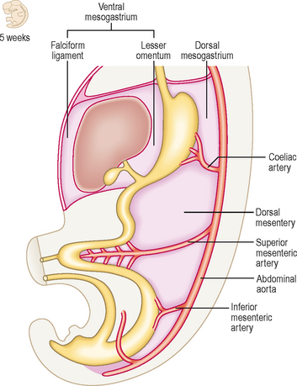
Ventral Mesentery
This thin, double-layered membrane gives rise to:
The lesser omentum, passing from the liver to the lesser curvature of the stomach (hepatogastric ligament) and from the liver to the duodenum (hepatoduodenal ligament)
The falciform ligament, extending from the liver to the ventral abdominal wall

Slide 20
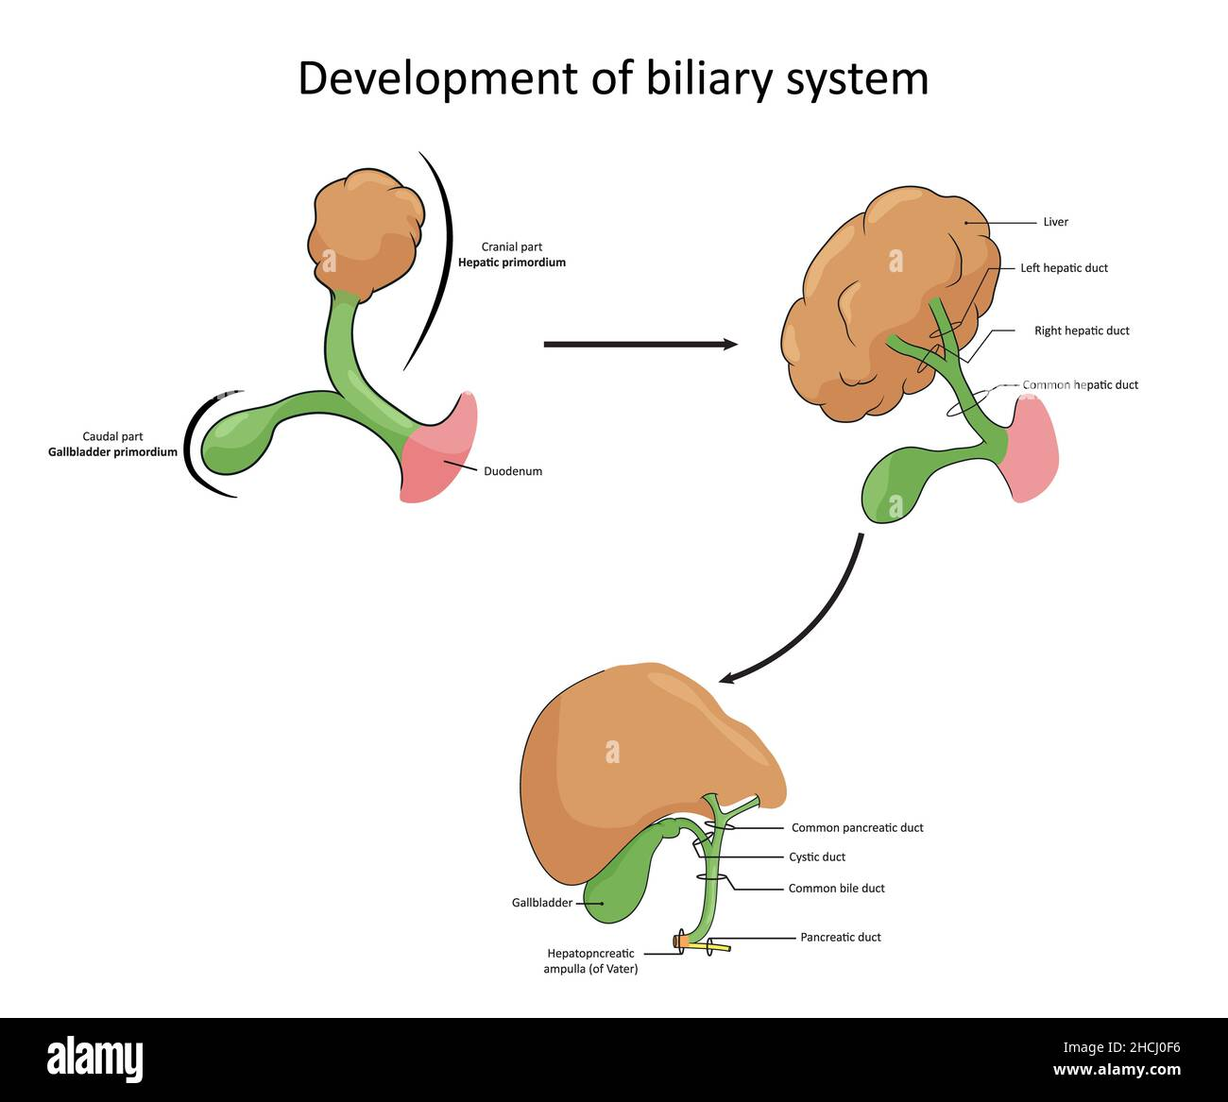
Development of Biliary Apparatus

Slide 21
Bile (composition)
Bile digests fat by breaking it down into fatty acids and dispersing it throughout the digestive tract for digestive enzymes to process.
Bile consists of 95% water in which are dissolved a number of endogenous solid constituents including
bile salts,
bilirubin phospholipid, cholesterol, amino acids,
steroids, enzymes, porphyrins, vitamins, and heavy metals, as well as exogenous drugs, xenobiotics and environmental

Slide 22
Functions of Bile
Aids in the digestion of fat via fat emulsification.
Absorption of fat and fat-soluble vitamins.
Excretion of bilirubin and excess cholesterol.
Provides an alkaline fluid in the duodenum to neutralize the acidic pH of the chyme that comes from the stomach.

Slide 23
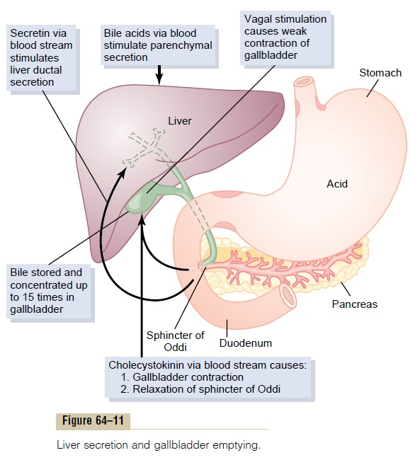
Liver secretion and Gall bladder emptying

Slide 24
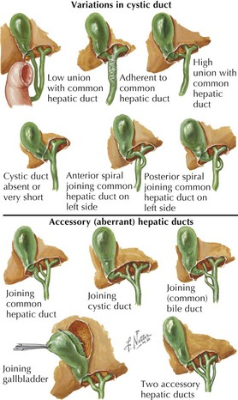
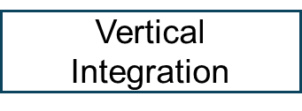
Variation in Cystic Duct

Slide 26
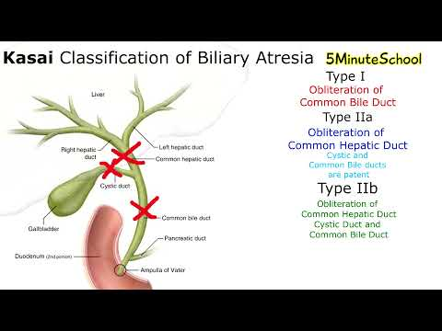
KLM (Blue box ) Page no 221 Extrahepatic biliary atresia

Slide 27
An adipocentric perspective on the development and progression of non-alcoholic fatty liver disease
Eunyoung Lee 1 2, Hannelie Korf 3, Antonio Vidal-Puig
Journal of Hepatology Volume 78, Issue 5, May 2023, Pages 1048-106
https://doi.org/10.1016/j.jhep.2023.01.024
Abstract
Adipose tissues and the liver are relatively resilient and can adapt to an energy surplus by facilitating triglyceride (TG) storage up to a certain threshold level without significant metabolic disturbances.
Factors contributing to hepatic lipid overload include lipids released from WAT, dietary fat intake, and enhanced de novo lipogenesis.
Initially, hepatocytes preferentially accumulate TG species leading to a relatively “benign” non-alcoholic fatty liver. However, with time, inflammatory responses ensue, progressing into more severe conditions such as non-alcoholic steatohepatitis, cirrhosis, and hepatocellular carcinoma
Research

Slide 28
Ethical Dilemmas --- Liver Transplant
LDLT may become an option for patients who are ineligible for or unlikely to receive DDLT
Although the benefit of DDLT is clear, LDLT presents ethical challenges regarding honoring principles of medical ethics
The transplant team must balance the patient’s mortality without transplantation and the serious medical risks to the healthy living donor versus the potential lifesaving benefits to the patient and the lack of any direct medical benefit to the donor.
Organ Procurement and Transplant Network Policy outlines informed consent requirements for living donors.
Bioethics

Slide 29
Family Medicine
A diagnosis of liver disease usually can be made accurately by careful elicitation of the patient’s history, physical examination, and application of a few laboratory tests. In some circumstances, radiologic examinations are helpful or, indeed, diagnostic.
Liver biopsy is considered the criterion standard in evaluation of liver disease
Non-invasive means of assessing fibrosis stage have become increasingly helpful and may allow for avoidance of biopsy in a proportion of patients.
Family Medicine

Slide 30
Artificial Intelligence
Liver cancers are the fourth leading cause of cancer-related mortality worldwide.
A growing body of recent studies have evaluated machine learning (ML) and deep learning (DL) algorithms for pre-screening, diagnosis and management of liver cancer patients through diagnostic image analysis, biomarker discovery and predicting personalized clinical outcomes.
Advances in computer-aided automation for HCC diagnosis through CT, MRI and histology scans increases efficiency with quicker patient diagnosis, care and decrease in potential adverse impacts on their clinical outcomes
This has been developed over the years through high-performance algorithms for liver cancer diagnosis
Spiral Integration
Artificial Intelligence

