Slide 1
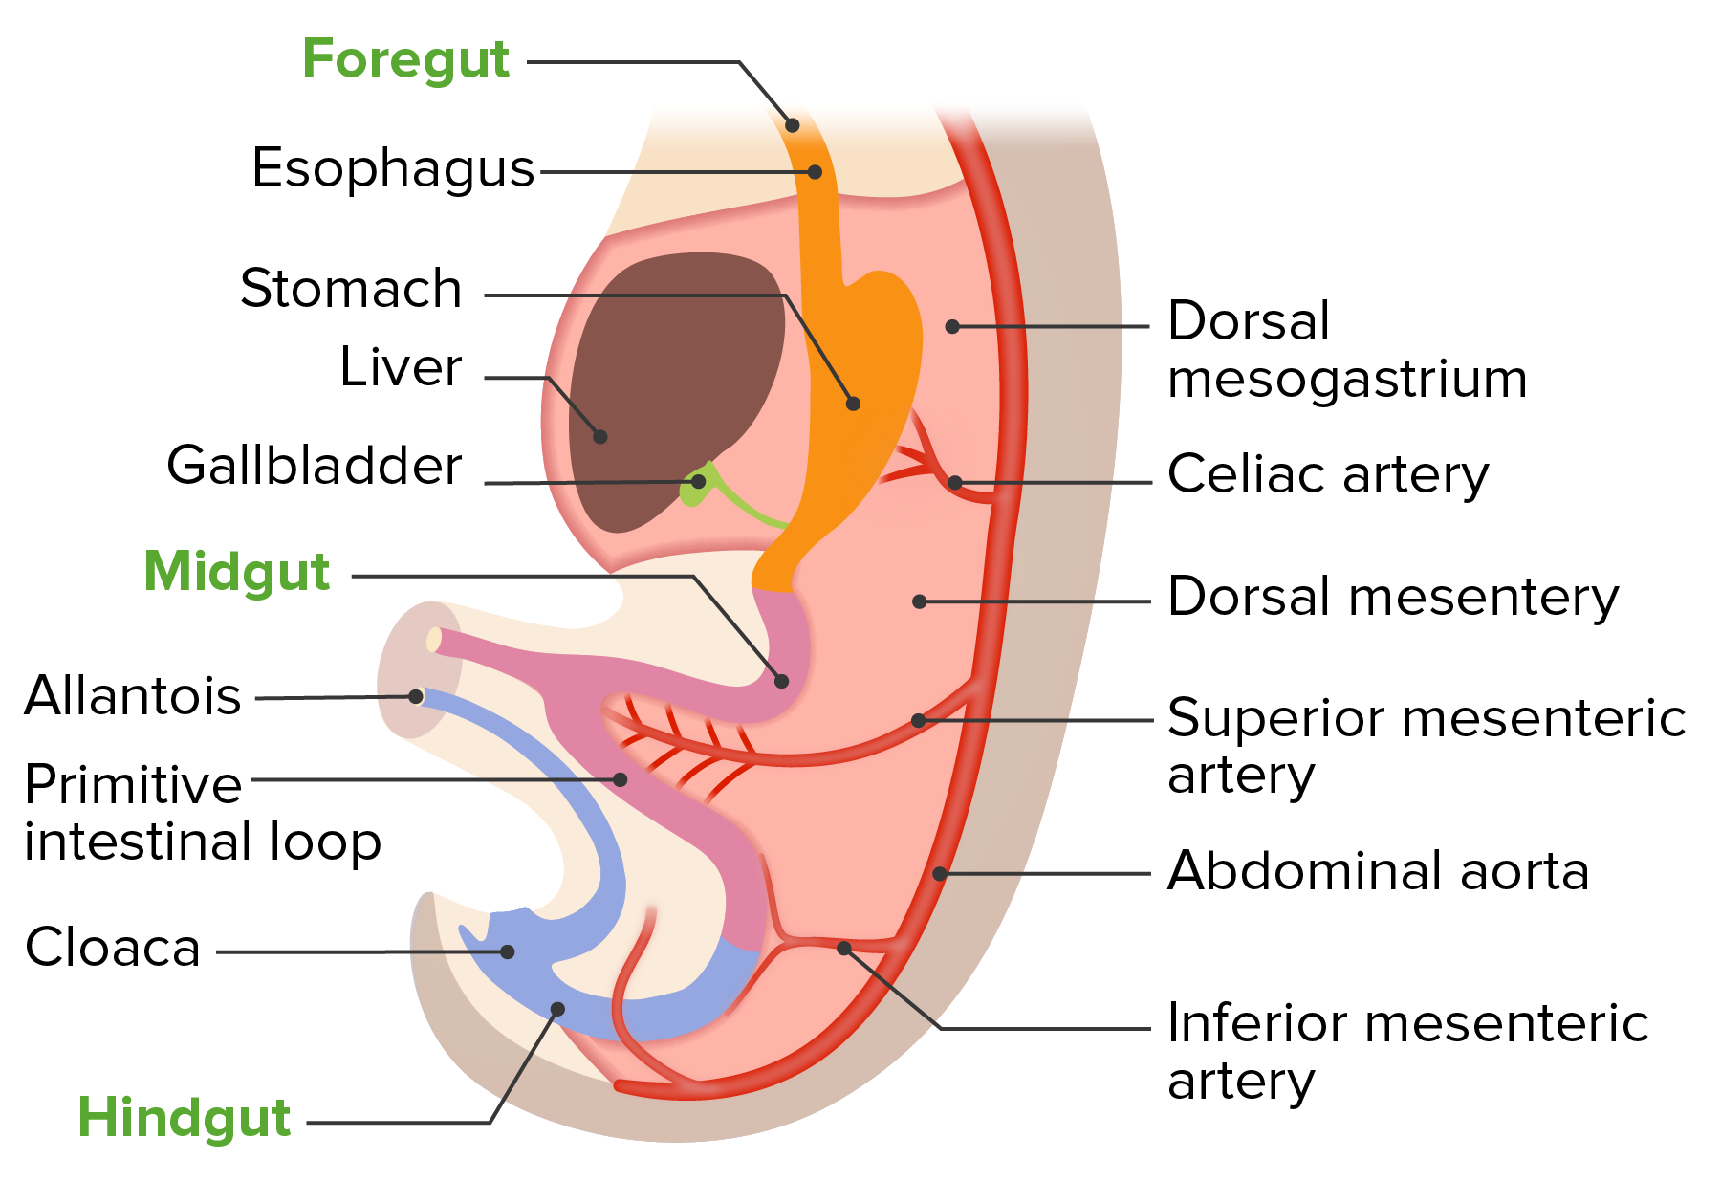
Gastrointestinal Tract (GIT) Module 2nd Year MBBS(LGIS) Development of Esophagus
Presenter: Prof. Dr. Ifra Saeed
Date: 04-03-25

Slide 2
Learning Objectives
At the end of the lecture, students will be able to
Enlist derivatives of Foregut, Mid gut and Hind gut
Describe different stages of development of Esophagus
Integrate physiology of esophagus with its development
Explain associated congenital abnormalities
Correlate and build core knowledge on the basis of latest research

Slide 3
Professor Umar Model of Integrated Lecture
60%
CORE SUBJECT
20%
HORIZONTAL
INTEGRATION
Physiology
biochemistry
8%
VERTICAL INTEGRATION
Pathology
pharmacology
7%
VERTICAL INTEGRATION
Clinical integration
5%
VERTICAL INTEGRATION
Research, professionalism
Ethics
Digital library

Slide 4
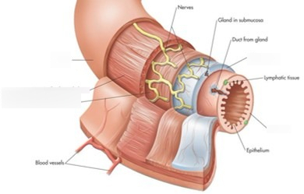
Introduction
Endoderm forms the epithelial lining of digestive tract and give rise to specific cells of glands (hepatocytes)
Stroma is derived from splanchnic mesoderm
Muscles, connective tissue and peritoneal component of the wall of the gut are derived from splanchnic mesoderm
Core Knowledge

Slide 5
Interactive session
A 2-hour-old male neonate was brought to the pediatric emergency department.
The neonate exhibited episodes of coughing and choking, especially when attempting the first feed.
The baby turned cyanotic during these episodes.
the neonate appears well-developed but is tachypneic.
An attempt to pass a nasogastric tube meets resistance at approximately 10 cm from the nares

Slide 6
Formation of Primitive Gut
Core Knowledge

Slide 7
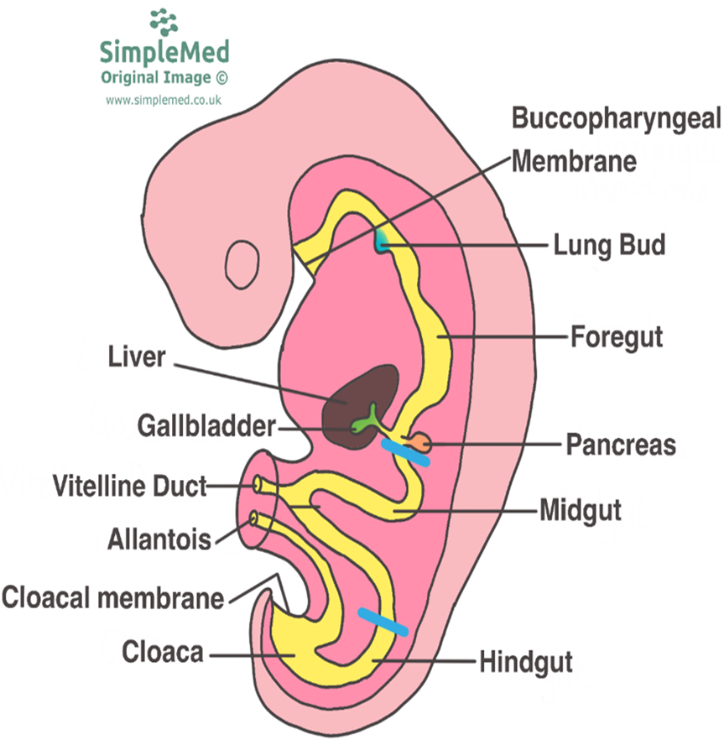
The development of the primitive gut and its derivatives are generally divided into four sections:
The proximal foregut (pharyngeal gut)
The distal foregut
The midgut
The hindgut

Slide 8
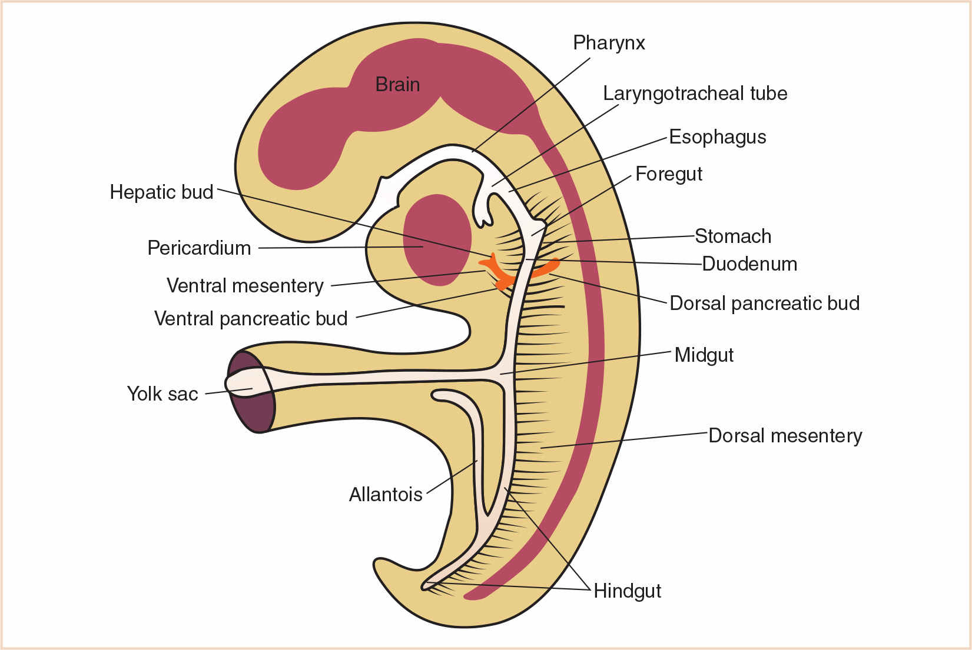
Derivatives of Foregut
Forms the
pharynx,
esophagus,
stomach and
the duodenum down to the level of the major duodenal papilla lungs and trachea
Liver, pancreas, gallbladder and their associated ducts
Core knowledge

Slide 9
Derivatives of Mid Gut
Forms the
duodenum distal to the major duodenal papilla
the jejunum,
iliem,
caecum,
appendix,
ascending colon and
the right 2/3 of the transverse colon.
It remains connected to the yolk sac by the vitelline duct and is supplied by the superior mesenteric artery.
Core knowledge

Slide 10
The Hind Gut
Forms the left 1/3 of the transverse colon,
the descending colon,
the sigmoid colon,
the rectum and
part of the anal canal.
It also gives rise to the urogenital sinus and its derivatives.
Blood supply is from the inferior mesenteric artery.

Slide 11
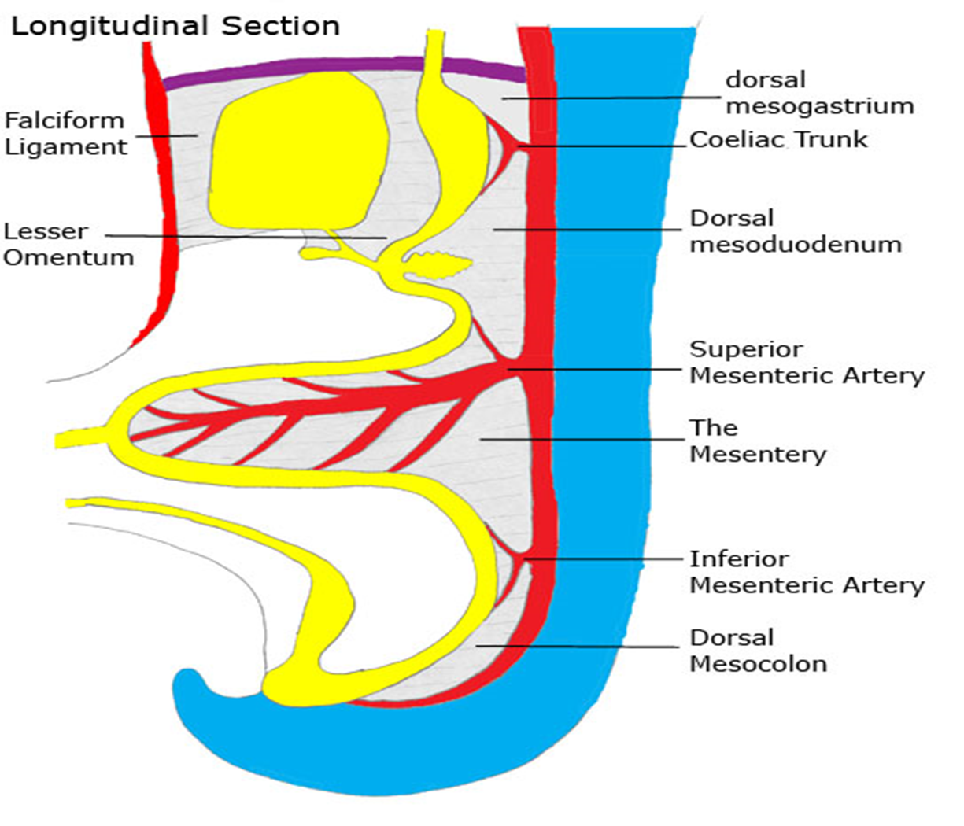
The Dorsal Mesentery
Suspends the gut tube from the posterior abdominal wall, running from the lower end of the oesophagus right to the end of the gut tube at the cloacal membrane and give rise to
The dorsal mesogastruim
The dorsal mesoduodenum
The mesentery proper (that connect to the ileum and jejunum)
The dorsal mesocolon (transverse and sigmoid mesocolons)

Slide 12
The Ventral Mesentery
Exists only in the region of the terminal oesophagus, stomach and upper duodenum, being derived from the septum transversum.
The growth of the liver later divides it into lesser omentum posteriorly and falciform ligament anteriorly

Slide 13
Development Of Foregut
ESOPHAGUS
STOMACH
DUODENUM
LIVER & GALLBLADDER
PANCREAS

Slide 14
Esophagus
Anatomy
The esophagus is a 25 cm long muscular tube that connects the pharynx to the stomach.
The length of the esophagus at birth varies between 8 and 10 cm and measures about 19 cm at the age of 15 years.
The esophagus in adults typically measures between 23 and 37 cm in length and about 1-2 cm in diameter
Extent
The esophagus extends from the lower border of the cricoid cartilage (at the level of the sixth cervical vertebra) to the cardiac orifice of the stomach at the side of the body of the 11th thoracic vertebra.
The upper limit in newborn infants is found at the level of the fourth or fifth cervical vertebra, and it ends higher, at the level of the ninth thoracic vertebra.

Slide 15
Oesophagus
develops from foregut immediately caudal to the pharynx.
Initially short, it lengthens rapidly due to the descent of the heart and the growth of the lungs, reaching its final relative length at 7 weeks.
The respiratory diverticulum 4th week
partitioned by the tracheoesophageal septum into respiratory primordium and oesophagus.

Slide 16
Development Of Esophagus

Slide 18
The esophagus continues to grow with elongation and thickening at postnatal period. It is approximately 8-10 cm at term,
12.5 cm at the end of the first year,
16 cm at the end of the 5th year,
and 19 cm at the end of the 15th year.

Slide 19
Its diameter is 5 mm at term and becomes 15 mm within the 5th year.
Just after the delivery, within the first 4 weeks, the lumen of the esophagus rapidly enlarges, and thickening of the mucosa is obvious.
The proportion of the thicknesses of the mucosa/submucosa increases until the end of the 2nd week

Slide 20
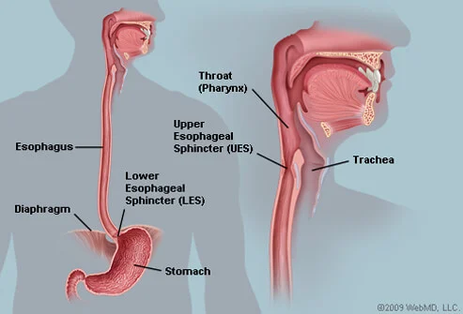
Functions of esophagus
The upper esophageal sphincter
Location
Composition
The unique composition also allows the sphincter to maintain the capacity to open wide in response to a stimulus.
Horizontal integration

Slide 21
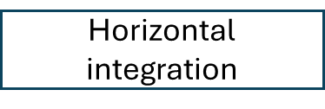
Food bolus in oropharynx, stimulates sensory receptors. The receptors transmit the signal to the swallowing center in the brainstem
In turn, the brainstem processes the message and sends efferent fibers to UES.
Efferent signals also stimulate the hyoid muscle to contract, leading to elevation of the hyoid.
Together, with the propulsion force of the bolus, three forces allow the food bolus to overcome the pressure in the UES region and pass into the esophagus

Slide 22
As the food bolus enters the esophagus, it triggers primary peristalsis.
Primary peristalsis refers to bolus-induced esophageal contractions. In contrast, secondary peristalsis refers to distension-induced contractions.
In peristalsis, the area ahead of the bolus relaxes, and the area behind it contracts, enabling the bolus to propel forward.

Slide 23
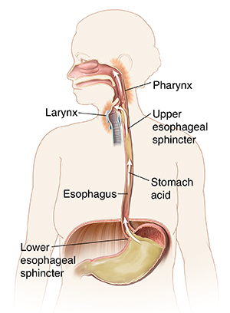
Lower esophageal sphincter
Bolus pass through the LES to reach the stomach.
The LES and the crural diaphragm constitute a high-pressure zone.
They function as an anti-reflux barrier
They also allow for the passage of the bolus into the stomach.

Slide 24
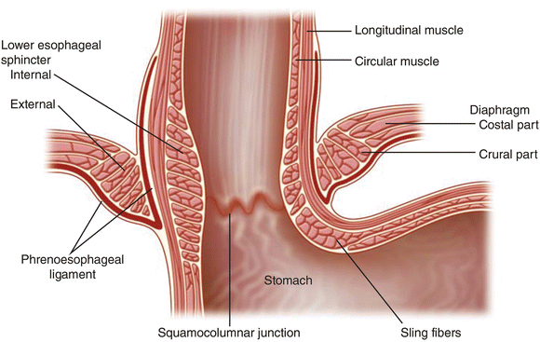
The LES consists of smooth muscles that help keep the sphincter tightly closed.
In response to direct inhibitory signals, the smooth muscles in the LES relax, allowing the sphincter to open
The LES does not posses any dilator muscles

Slide 25
ESOPHAGEAL ABNORMALITIES Tracheo-esophageal fistula

Slide 26
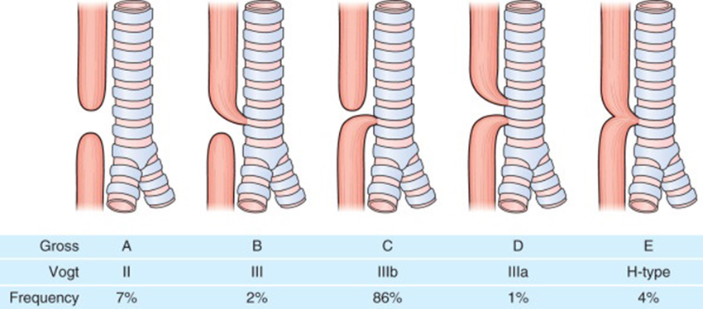
Vertical Integration

Slide 27
Esophageal Atresia
Blockage of the esophagus occurs with an incidence of 1 in 3000 to 4500 live births. Approximately one third of affected infants are born prematurely. Esophageal atresia is associated with tracheoesophageal fistula in more than 85% of cases Atresia may occur as a separate anomaly, but this is less common. Cause : the atresia results from failure of recanalization of the esophagus during the eighth week of development. The cause of this arrest of development is thought to result from defective growth of endodermal cells.

Slide 28
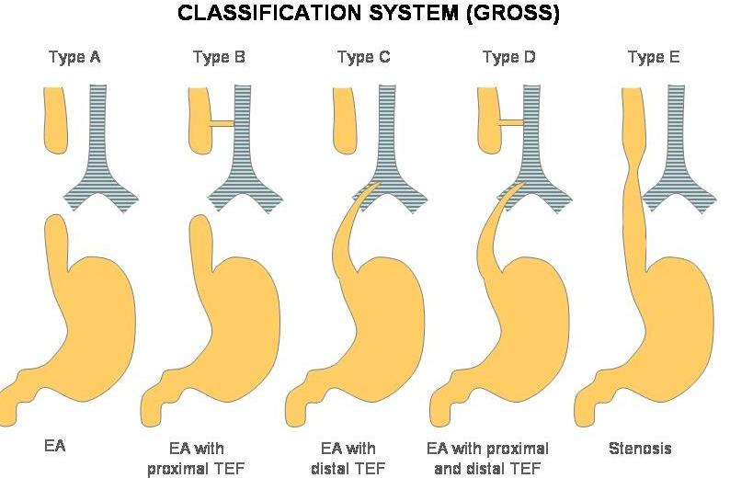

Slide 29
A fetus with esophageal atresia is unable to swallow amniotic fluid; consequently, this fluid cannot pass to the intestine for absorption and transfer through the placenta to the maternal blood for disposal. This results in polyhydramnios, the accumulation of an excessive amount of amniotic fluid.

Slide 30
Sign and symptoms
Newborn infants with esophageal atresia usually appear healthy
Excessive drooling
the infant fails oral feeding with immediate regurgitation and coughing.
DIAGNOSIS
Inability to pass a catheter
A radiographic examination demonstrates the anomaly by imaging the nasogastric tube arrested in the proximal esophageal pouch.
TREATMENT: Surgical repair of esophageal atresia now results in survival rates of more than 85%.

Slide 31
Esophageal Stenosis
can be anywhere along the esophagus, but it usually occurs in its distal third, either as a web or as a long segment of esophagus with a threadlike lumen. results from incomplete recanalization of the esophagus during the eighth week, or it may result from a failure of esophageal blood vessels to develop in the affected area..

Slide 32
Suggested Research Article
Mapping the adult human esophagus in vivo and in vitro
D Ferrer-Torres, JH Wu, CJ Zhan Development (2022) 149 (20): dev200614.
https://doi.org/10.1242/dev.20061 journals.biologists.com
Abstract
Many esophageal diseases can arise during development or throughout life. Therefore, well-characterized in vitro models and detailed methods are essential for studying human esophageal development, homeostasis and disease.
Spiral integration
Research

Slide 33
Approach to patient of esophageal atresia
Once EA is diagnosed, the infant should be intubated to control the airway and help prevent further aspiration. If not already, a catheter should be gently placed to suction oropharyngeal secretions.
The infant should be given antibiotics, intravenous fluids, and given nothing by mouth (NPO). Total parenteral nutrition (TPN) should be considered for the infant as NPO status may last several weeks. Once the neonate is stabilized from a hemodynamic and airway standpoint, a pediatric surgeon should be consulted.
Family Medicine

Slide 34
Artificial intelligence technique in detection of early esophageal cancer
World J Gastroenterol. 2020 Oct 21; 26(39): 5959–5969.
Published online 2020 Oct 21. doi: 10.3748/wjg.v26.i39.
Lu-Ming Huang, Wen-Juan Yang, Zhi-Yin Huang, Cheng-Wei Tang, and Jing
Abstract
When AI technique comes to the pathological diagnosis, borderline lesions that are difficult to determine may become easier than before.
In gene diagnosis, due to the lack of tissue specificity of gene diagnostic markers, they can only be used as supplementary measures at present. In predicting the risk of cancer, there is still a lack of prospective clinical research to confirm the accuracy of the risk stratification model.
Artificial Intelligence

