Slide 1
Rawalian Burn & Reconstructive Surgery Department
RB&RSD Holy Family Hospital, Rawalpindi
CPC
2024

Slide 2
A CASE OF AMBIGUOUS GENITALIA
Rawalian Burn & Reconstructive Surgery Department Holy Family Hospital, Rawalpindi

Slide 3
Learning Objectives
What is Ambiguous Genetalia
Examination
Investigation
Management Plan
Surgical Procedure and Post Operative Care

Slide 4
CASE SUMMARY
Dr. Sania Khalid PGT Plastic Surgery

Slide 5
History
Name: X.Y.Z
Age/Gender: 13 yrs old Child
Residence: Rawalpindi
Profession: student of 5th grade
Family: Sibling with CAH
Co-morbidities: Congenital Adrenal Hyperplasia

Slide 6
History
PRESENTATION
Presented to OPD in the dept of Pediatric Medicine HFH with history of:
Cyclical abdominal pain
Abdominal swelling for the last 1.5 years.

Slide 7
History
PRESENTATION
Previously, diagnosed as
Congenital Adrenal Hyperplasia at the age of 1.5 month

Slide 8
History
PRESENTATION
Past Medical History: Taking Hydrocortisone and Fludrocortisone
Past Surgical History: Clitoral Recession and creation of Labial folds in 2017 from PIMS hospital

Slide 9
History
There was no history of
Fever
No history of any allergies (Food, Drug or environmental)
Nonsmoker, non alcoholic
No family history of similar problems

Slide 10
Examination (Local)

Slide 11
Examination (Local)
Clitoral Hypertrophy Clitoris was split and scarred due to previous surgery
Urethral opening below Clitoris
No vaginal opening
Scrotal skin present instead of Labia Majora
Absent Testis

Slide 12
Examination (Abdominopelvic)
Inspection
Mildly distended abdomen
Palpation
Soft smooth swelling from umbilicus to pubic bone
Mildly tender
No inguinal lymphadenopathy

Slide 13
Examination (Secondary Sexual Characters)
Tanner Stage III of puberty
Breast elevation
Sexual hair at pubic area

Slide 14
Examination (Systemic)
Well oriented in time space and person, sitting comfortably in bed, with
CNS – GCS 15/15
CVS – No added sound
Resp – Normal vesicular breathing

Slide 15
Investigations
Dr. Shamail Zara PGT Plastic Surgery

Slide 16
Investigations
Required Investigations.
Hematological
Serum Electrolytes.
Blood Sugar
Hormonal Studies
Karyotyping

Slide 17
Investigations
Required Investigations.
Ultrasonography or MRI
To internal sexual organs
To visualize adrenal glands (CAH)
To see Associated malformations in kidneys, ureter, bladder

Slide 18
Investigations
All BLI,s of the patient was within normal range Pre Op.

Slide 19
Investigations
Karyotyping
Karyotyping showed 46XX

Slide 20
Investigations
Ultrasound (02-02-2024)
Heamatocolpos
Minimal Ascites
Rt. Renal Lithiasis

Slide 21
Investigations
MRI (02-02-2024)
Visualization of female internal reproductive structures.
Grossly distended fluid filled endometrial cavity and endo-cervical canal extending into the lower abdominal cavity with hydrometrocolpos.
Inferior bulging of lower end of cervix with significantly foreshortened vagina.

Slide 22
Investigations
Cystoscopy
Normal uretheral opening, normal uretheral tract.
No vaginal opening

Slide 23
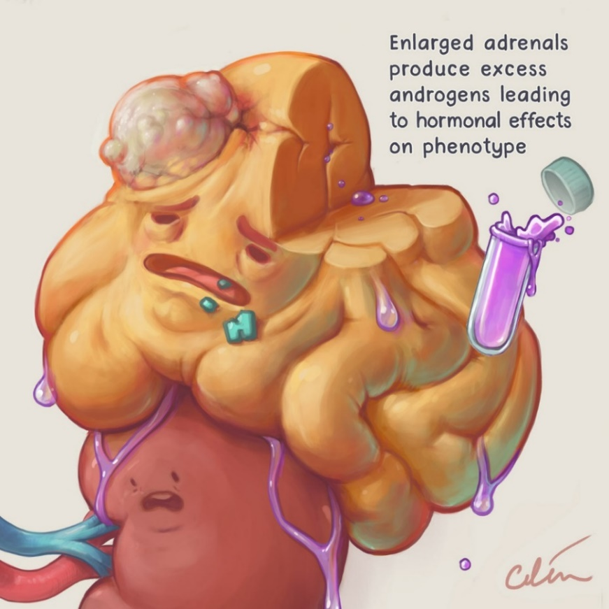
Provisional Diagnosis
Congenital Adrenal Hyperplasia

Slide 24
Ambiguous Genetalia
Dr. Muhammad Ahmad PGT Plastic Surgery

Slide 25
Ambiguous Genetalia
Disorders of sex development
Also known as disorder of sexual determination
Atypical development of genetic, gonadal and phenotypic sex
Includes disorders grouped under 4 major headings
46,XX virilized female
46,XY undervirilized male
Gonadal differentiation and chromosomal disorders
Syndromes associated with ambiguous genitalia

Slide 26
Classification
European Society for Paediatric Endocrinology

Slide 27
Ambiguous Genetalia
Pathophysiology
Chromosomal sex determines gonadal sex
Gonadal sex determines phenotypic sex.
Phenotype determines by müllerian and wolffian ducts

Slide 28
Ambiguous Genetalia
Gonadal Differentiation
During the second month of fetal life
Fetal ovaries develop by absence of TDF gene.

Slide 29
Ambiguous Genetalia
Gonadal Differentiation
Male (requires DHT):
Labioscrotal fold = Scrotum
Urethral Fold / Groove = Urethra & Penile Shaft
Genital Tubercle = Glans Penis

Slide 30
Ambiguous Genetalia
Gonadal Differentiation
Female (requires nil):
Labioscrotal Fold = Labia Majora
Urethral Fold = Labia Minora
Genital Tubercle = Glans Clitoris

Slide 31
Ambiguous Genetalia
Clinical Manifestation in Adults
Psychosexual issues
Fertility in Females
Fertility in Males
Metabolic Abnormalities
Bone Mineral Density.

Slide 32
Ambiguous Genetalia
Sex Determination
Infants born with ambiguous or abnormal genitalia may have indeterminate phenotypic sex
DSDs, formerly termed intersex conditions, are classified on the basis of genetics and the state of the gonads
DSDs may be caused by
virilization of a child with 46,XX
or under virilization of a child with 46,XY

Slide 33
Ambiguous Genetalia
Congenital Adrenal Hyperplasia
CAH is autosomal Recessive disorder
21-Hydroxylase deficiency
Required for cortisol synthesis
No Cortisol leads to ACTH

Slide 34
Ambiguous Genetalia
Clinical Manifestation in Children
Classic 21 hydroxylase deficiency detected in 1:16000 births
Salt wasting
Ambiguous genitalia
Postnatal virilization
Growth

Slide 35
Ambiguous Genetalia
Patient with congenital adrenal hyperplasia (CAH; 46,XX DSD).
Masculinized appearance of genitalia
Enlarged phallus
Scrotal appearance of labia

Slide 36
Ambiguous Genetalia
Patient with congenital adrenal hyperplasia (CAH; 46,XX DSD).
Note phallus like clitoris
empty scrotal appearance of labia majora

Slide 37
Ambiguous Genetalia
Patient with congenital adrenal hyperplasia (CAH; 46,XX DSD).
After feminizing genitoplasty surgery.
Three components of surgery:
Clitoroplasty,
Labiaplasty.
Vaginoplasty.

Slide 38
MANAGEMENT
DR. MUHAMMAD AUSAF SALEEM
PGT Plastic Surgery

Slide 39
MANAGEMENT
Muti Disciplinary Team Approach
Pediatrician
Medical Geneticist
Pediatric Urologist
Pediatric Endocrinologist
Plastic Surgeon
Gynecologist
Pediatric Psychologist
Cytogeneticist
Social Worker

Slide 40
MANAGEMENT
THREE MAIN DOMAINS;
Initial Stabilization,
Accurate Diagnosis,
Decisions on the gender of rearing and planning of surgical intervention and hormonal treatment

Slide 41
MANAGEMENT
Initial Stabilization
Congenital adrenal hyperplasia, can present as life-threatening salt-wasting crises.
Prompt diagnosis and treatment with glucocorticoids should be instituted

Slide 42
MANAGEMENT
Accurate Diagnosis
In some cases, diagnosis may be obvious;
Transfer cases to a center experienced in the management of Disorders of Sexual Differentiation.
Discussion with the parents regarding the delay of gender assignment.

Slide 43
MANAGEMENT
Gender Assignment Considerations
Type of Disorder of Sexual Differentiation
Prenatal androgen exposure
Possibility of fertility and Sexual functionality
Psychosocial factors/Desires of Family

Slide 44
MANAGEMENT
Gender Assignment
In cases which can not be fertile, gender assignment will depend on:
The appearance of the external genitalia
The potential for unambiguous appearance
The potential for normal sexual functioning

Slide 45
MANAGEMENT
Gender Assignment
Great care should be taken in declaring a male sex considering:
Potential for reconstructive surgery
Probability for pubertal virilization
Response of the external genitalia to exogenous & endogenous Testosterone
Patients with small phallus & poor response to androgens may be reared as Female

Slide 46
MANAGEMENT
Timing of Gender Assignment
Assign complete genital reconstruction after birth to avoid conflicts
Delay gender assignment until puberty, allowing individual participation

Slide 47
MANAGEMENT
Treatment Options
Reconstructive Surgery
Hormone Therapy

Slide 48
MANAGEMENT
For Female
Uncovering vagina hidden under skin
Removing excess masculine tissue around the clitoris(clitoral reduction) – done once hormone replacement therapy has begun
Testis should be removed soon after birth if female sex of rearing is decided

Slide 49
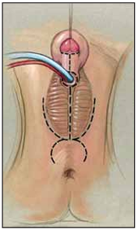
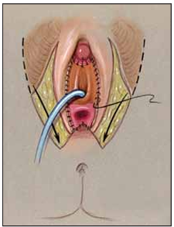
MANAGEMENT
Genital surgery for Female
Three basic components to feminizing genitoplasty:
Clitoroplasty,
Labioplasty,
Vaginoplasty.

Slide 50
MANAGEMENT
Principles of Surgery
Ensure the best cosmetic results
Preserve sexual functioning
Preserve fertility if possible,
Decrease the risk of malignancy in the dysgenetic gonad

Slide 51
MANAGEMENT
Surgery is aimed to restore
Vaginal and urethral position
Correct the fistula between the vagina and urogenital sinus.
Preservation of clitoral function is another important consideration.

Slide 52
SURGICAL PROCEDURE POST OPERATIVE CARE
Dr. AYESHA BAHAR HASHMI
PGT Plastic Surgery

Slide 53
Surgical Procedure
We opted for
Introitoplasty
Labioplasty

Slide 54
Steps of Surgery
Anesthesia
Position
Marking
Incision
Raising flaps

Slide 55
Steps of Surgery
Per Op Findings
Repair of Urethrovaginal Fistula
Labioplasty
9. Introitoplasty
10. Skin closure

Slide 56
Planning
General Anesthesia
Position: Lithotomy

Slide 57
Preop

Slide 58
Marking

Slide 59
Incision

Slide 60
Raising Flap

Slide 61
Flap Dissection

Slide 62
Perop Findings
Blind Vagina
Urethrovaginal Fistula
300ml haematocolpus drained

Slide 63
Vaginal Reconstruction

Slide 64
Skin Closure
Insetting of flaps for Labioplasty

Slide 65
Skin Closure
Labia Majora Reconstruction

Slide 66
Immediate Postop

Slide 67
Postop Care
IV antibiotics were started
Drain output monitoring was done
Patient was mobilized on first post operative day

Slide 68
Postop Care
Postop period was uneventful
Drain was removed on third day
Patient was advised daily wound wash for wound care.
Foley’s removed on 14th POD with urological consult

Slide 69
5th Postop Day

Slide 70
Comparison

Slide 71
Complications
No complications were reported in the post operative period

Slide 72
THANK YOU

