Slide 1
Neurogenic Bladder – breaking new barriers
Department of Urology & Kidney Transplant
Benazir Bhutto Hospital
Rawalpindi Medical University

Slide 2
Case Presentation
NAME : Mehwish
AGE : 12yrs
SEX : F
ADDRESS : Village Pindi Gheb, Attock
MOD : OPD

Slide 3
Presenting Complains
Urinary Incontinence – 5yrs
RT flank pain for 2 months

Slide 4
History of Present Illness
Frequency +ve
Nocturia +ve
Urgency with urge incontinence +ve
Dysuria +ve
RT flank pain +ve
Hematuria -ve
Voiding LUTs -ve
No associated nausea, vomiting, weight loss or decreased apetite

Slide 5
Past History
History of Ano-Rectal Malformation with Recto-vaginal Fistula – Posterior sagital anorectoplasty – PIMS – 01-04-2013
Recurrent Urinary Tract Infections
Frequent catheterizations for incontinence
No history of spinal trauma or surgery

Slide 6
Family History - Unremarkable
Personal History – Unremarkable
Drug History – No known drug allergy

Slide 7
General Physical Examination
PULSE : 88bpm
BP : 100/60 mmHg
TEMP : 98.6 °F
R/R : 20 / MIN
Jaundice
Anemia
Cyanosis
Clubbing
Koilonychia
Lymph Nodes
Edema
Thyroid
NAD

Slide 8
Abdominal Examination
Soft, non-tender, non-distended abdomen
RT Kidney palpable with bimanual examination
External Genitalia – Perineal scar seen
DRE –
Anal Tone – increased
Rest of examination was normal

Slide 9
Investigations
Blood CP –
TLC – 8.6k
Hb- 11.2
Hct – 37.1
PLT – 296k
Renal Function Tests –
S. Creat. – 0.6
Urea - 24

Slide 10
Urine R/E –
Turbidity – 3+
Deposits – 3+
Pus Cells – 24-26
RBCs – 4-6
Urine C/S –
E. coli sensitive to Sulbactam + Cefoperazone

Slide 11
Ultrasound Abd/Pelvis–
RT Kidney with moderate hydronephrosis and cortical cysts
Thick walled urinary bladder wall with floating echoes

Slide 12
CT KUB Plain –
Marked RT Hydronephroureter with paper thin cortex

Slide 13
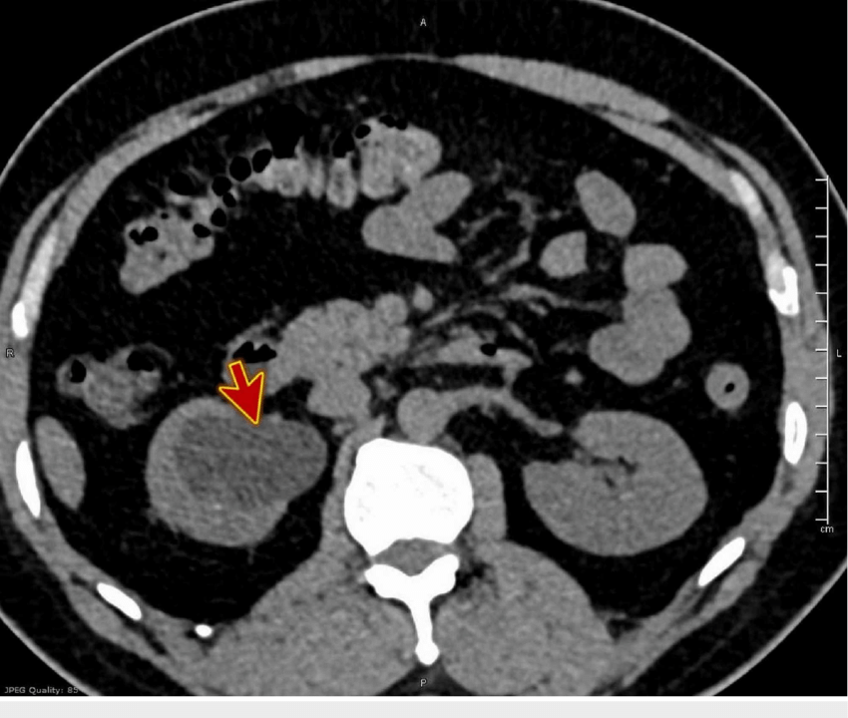

Slide 14
MCUG –
Urinary bladder shows irregular thickened walls and abnormal shape of bladder
Short capacity urinary bladder
RT grade 5 VUR

Slide 15
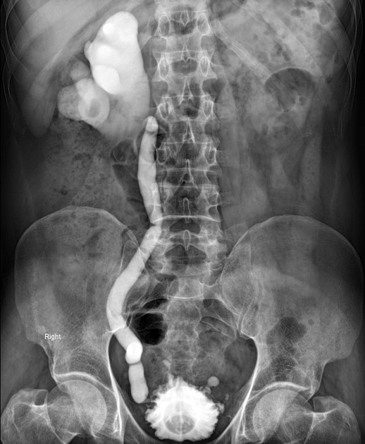

Slide 16
Renal Scan (DTPA)-
LT – 76.85ml/min
RT – 23.54ml/min

Slide 17
Urodynamics –
Small capacity bladder
High Detrusor pressure

Slide 18
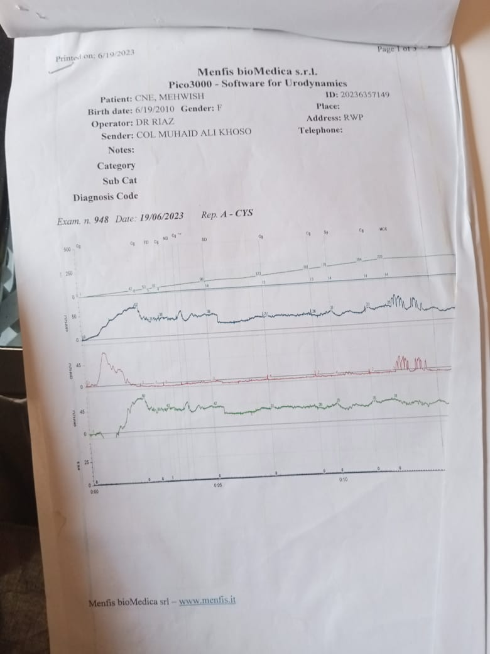

Slide 19
Cystoscopy-
B/L ureteric orifices identified
Short capacity bladder
No other abnormality found

Slide 20
Diagnosis
Neurogenic Bladder (Spastic)

Slide 21
Management
UTI managed with long term antibiotics
Once urine was sterile, patient was proceeded with Augmentation Cystoplasty

Slide 22
Literature Review

Slide 23
Neurogenic Bladder
It refers to dysfunction of the urinary bladder due to disease of Central nervous system, or peripheral nerves involved in control of micturition

Slide 24
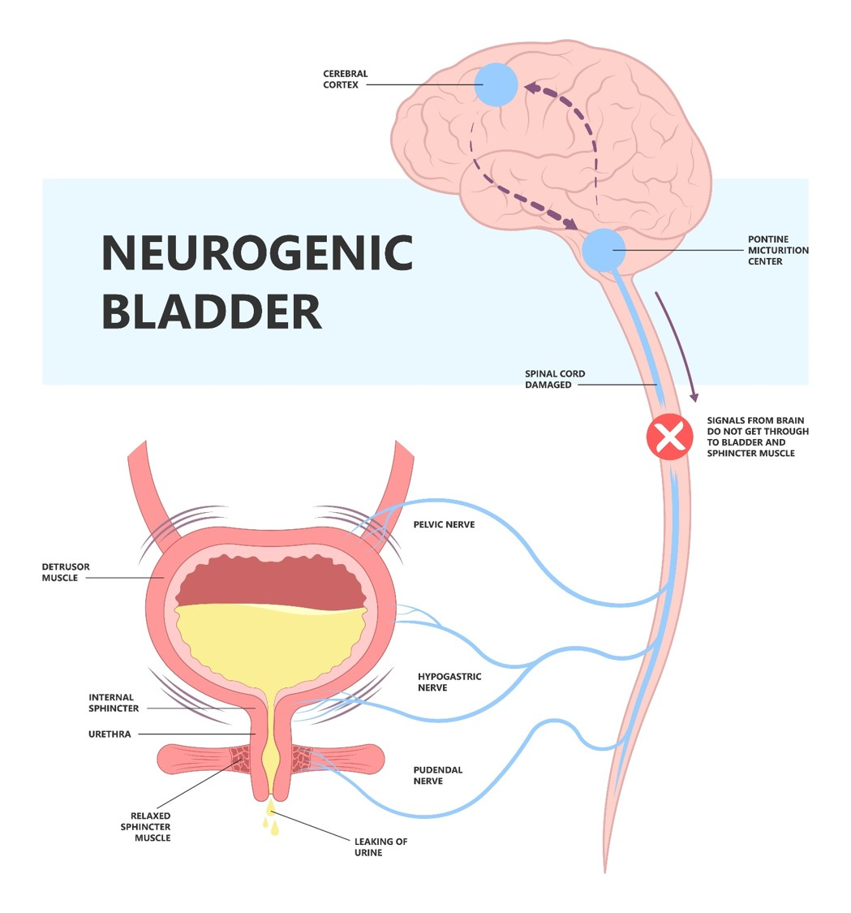

Slide 25
Types
Flaccid/Atonic Bladder
A flaccid or hypotonic bladder ceases to contract fully causing urine to dribble out of bladder as a result of overflow incontinence
Spastic/Overactive Bladder
A spastic bladder occurs when the volume of urine is normal or small but there are involuntary contractions of detrusor muscle causing involuntary leakage of urine

Slide 26
Etiology
Supra pontine
Pontine
Suprasacral
Infrasacral

Slide 27
Central Nervous System causes
Stroke
Brain tumors
Multiple sclerosis
Parkinson's disease
Multiple system atrophy

Slide 28
Peripheral causes
Diabetes
Alcoholism
Vitamin B12 deficiency
Spinal cord injury
Pelvic surgeries
Transverse Myelitis

Slide 29
Diagnosis
History & Physical examination
Ultrasound
MCUG
Cystoscopy
Urodynamic studies
Renal functions
Urine C/S

Slide 30
Management
Flaccid neurogenic bladder
Main aim is to keep bladder empty either by CISC or via permanent indwelling catheter
Drugs – Bethanechol (Muscarinic Agonist)
Neuromodulation & sacral nerve stimulation – emerging techniques

Slide 31
Spastic Neurogenic Bladder
Non-surgical Management –
Fluid modification & behavioral therapy
Drugs –
Antibiotics according to urine culture
Antimuscarinics, like Oxybutinin, Solifenacin, etc
Beta-3 Agonist like Mirabegron

Slide 32
Surgical Management –
Intravesical Botox
Augmentation Cystoplasty

Slide 33
Augmentation Cystoplasty
Segment of intestine is used to increase the capacity of the bladder
This surgery is indicated in patients who have low capacity, poorly compliant, and overactive bladder that is refractory to medical treatment

Slide 34
Ileocystoplasty
A segment of small intestine (ileum) is isolated and disconnected from the rest of the bowel
The rest of the bowel is reconnected
The removed segment is opened up and is attached to the bladder to increase bladder capacity
Detrusorectomy
part of the detrusor muscle of the bladder is stripped away from the bladder to increase capacity

Slide 35
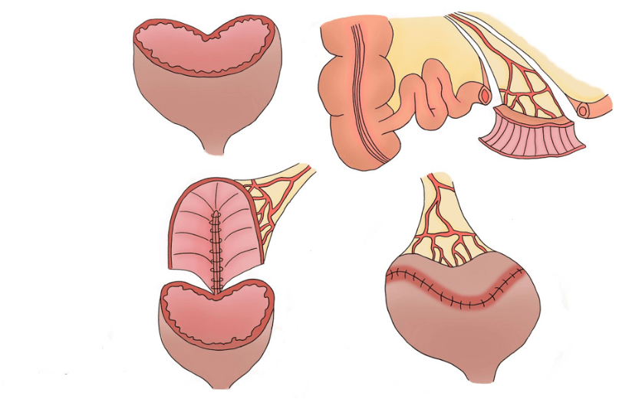

Slide 36
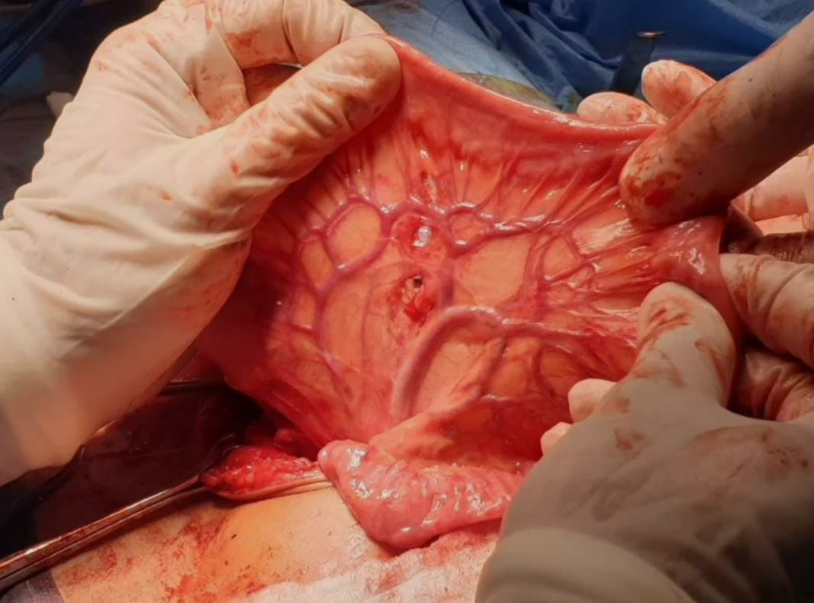

Slide 37
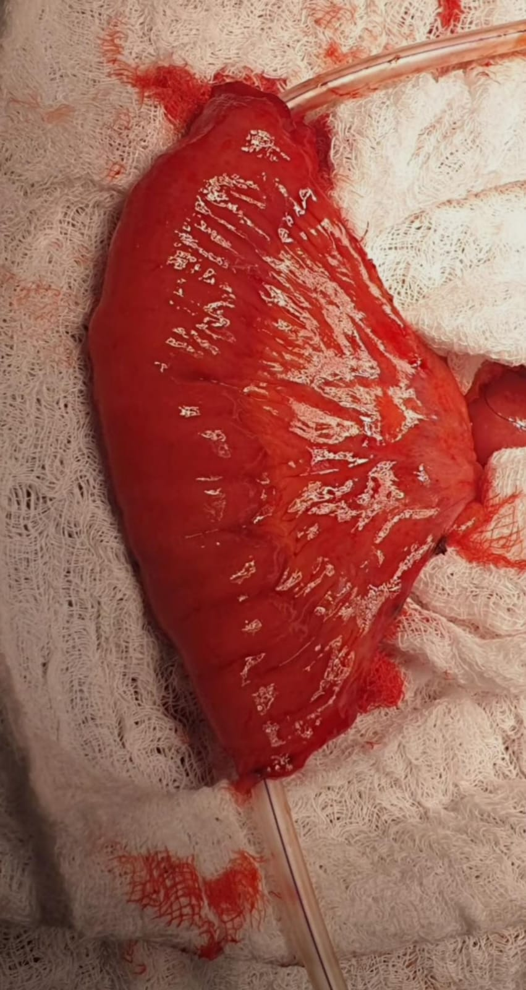

Slide 38
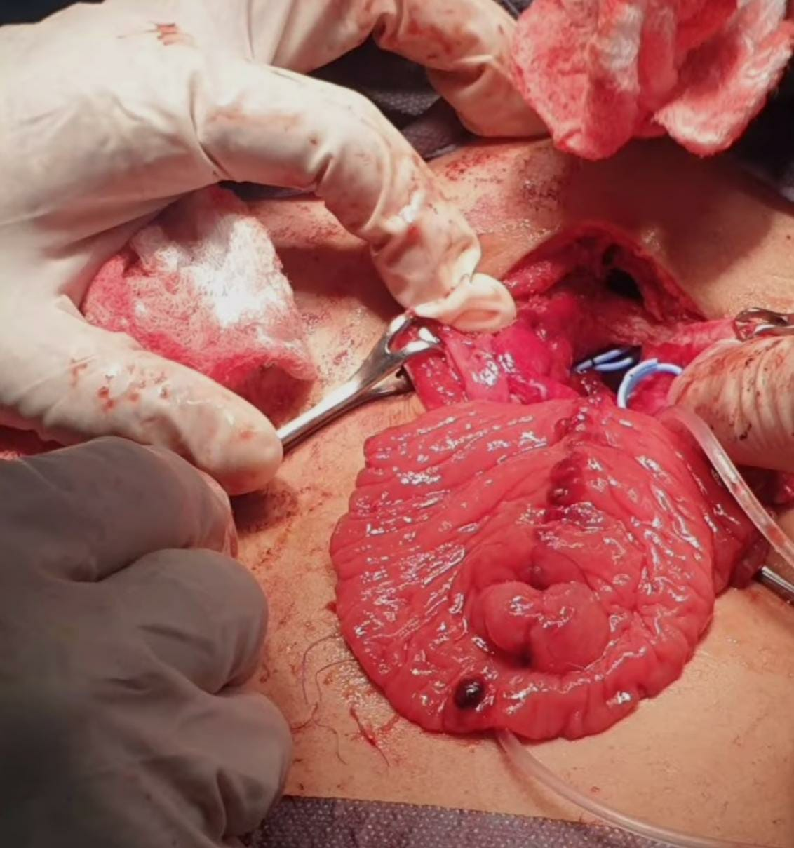

Slide 39
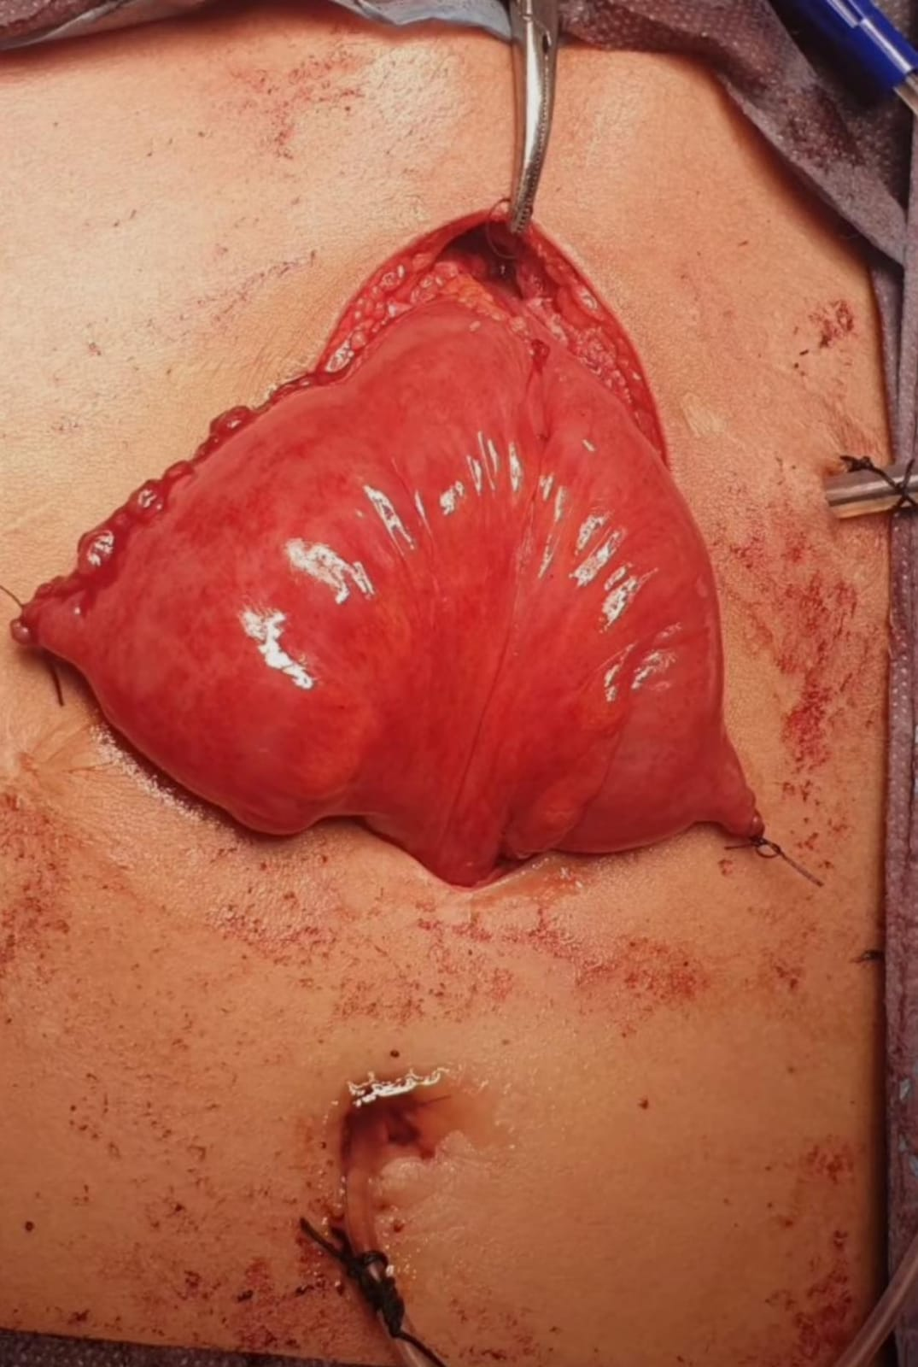

Slide 40
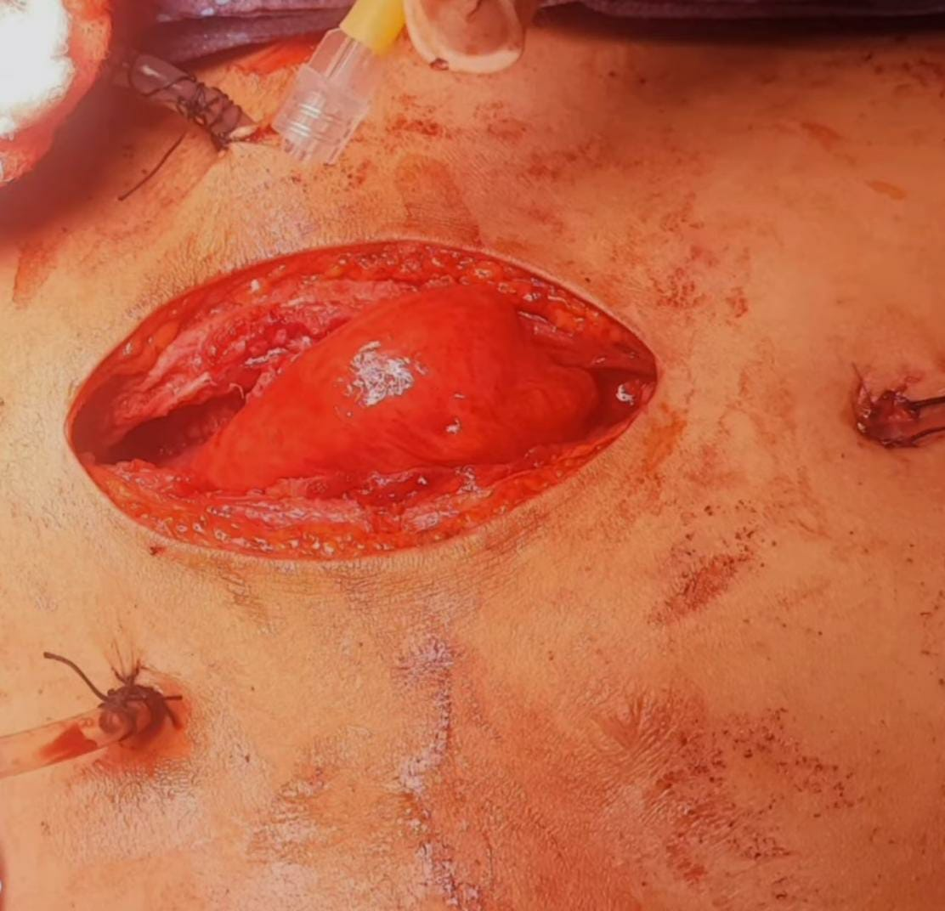

Slide 41
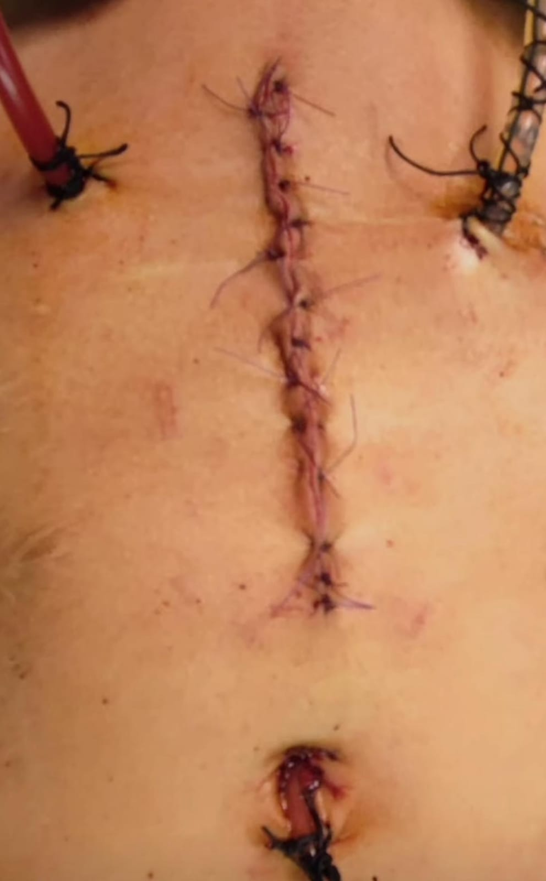

Slide 42
Take home message
Always thoroughly investigate a patient with recurrent UTIs
Rule-out the cause of incontinence before starting treatment, especially neurological causes

Slide 43
THANK YOU

