Slide 4
"Radiological Insights into a Rare Gynecological Complication In Post Bladder Exstrophy Repair” By RADIOLOGY DEPARTMENT HOLY FAMILY HOSPITAL

Slide 5
Components
Recitation of Holy Quran
Case presentation
Imaging Findings and Radiological Diagnosis
Gynecological Management
Literature Review of Case
Advance Imaging techniques
Dr Muntazir (PGT Radiology)
Dr Muqadas Munir (PGT Radiology)
Dr Riffat Raja (AP Radiology)
Dr Sobia Nawaz (Associate Professor, GU 1)
Dr Beenish Nadeem(AP Radiology)
Prof Dr Nasir Khan (Dean Diagnostics, RMU)

Slide 6
CASE PRESENTATION
DR MUQADAS MUNIR
PGT RADIOLOGY

Slide 7
CASE DEMOGRAPHICS
Name
Miss xyz
Marital Status
unmarried
Educational Status
Primary
Female
Age
21 years
Residential Status
Kashmir

Slide 8
PAST SURGICAL HISTORY
Surgery for bladder exstrophy at 4 years of age from CMH in 2010, Record not available

Slide 9
PRESENTING COMPLAINTS:
Presented for reconstruction of external genitalia to plastic surgery department due to scarring from previous surgery for bladder exstrophy
No active gynecological issue. Normal menstrual cycle.

Slide 10
EXAMINATION FINDINGS:
Scarring of external genitalia extending from pubis to clitoris
Per Vaginal:
Not done as patient was unmarried

Slide 11
VITALS:
Investigations | Results
Heart Rate | 86pulse/min
Blood Pressure | 120/80mmhg
Respiratory Rate | 23/min
Temperature | 98.6 F
SpO2 | 94%

Slide 12
LAB INVESTIGATIONS
Investigations | Results
Blood group | O+
Haemoglobin | 11.5 g/dl
Liver function tests | Normal
Renal function test | Normal
Hepatitis profile | Non-reactive

Slide 13
IMAGING FINDINGS AND RADIOLOGICAL DIAGNOSIS
By
DR RIFFAT RAJA
ASSISTANT PROFESSOR
RADIOLOGY

Slide 14
Notes:
When we performed an MRI on a patient suspected of having vaginal stenosis, shows a mildly lobulated urinary bladder (arrow), from previous bladder reconstructive surgery, we identified a large oval shaped T1- and T2-hypointense structure in the anatomical location of the vagina. However, we were unable to determine whether it was situated within the vaginal canal or outside it, as we could not accurately assess the extent of vaginal stenosis or dysgenesis.

Slide 15
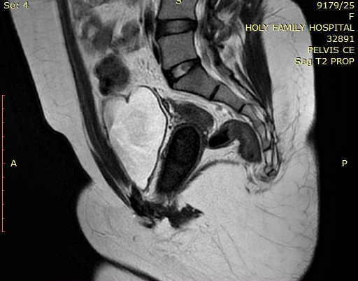
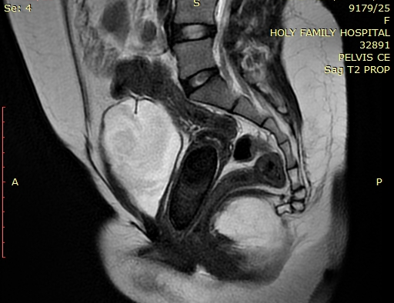
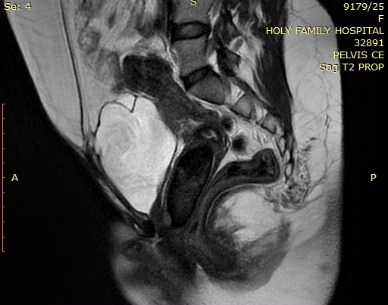
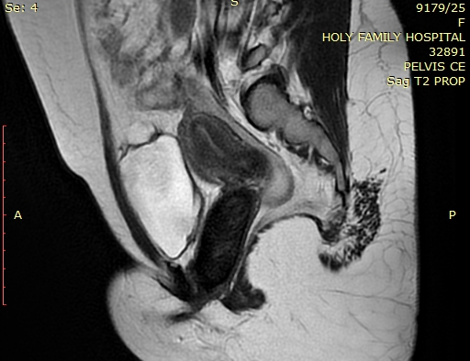
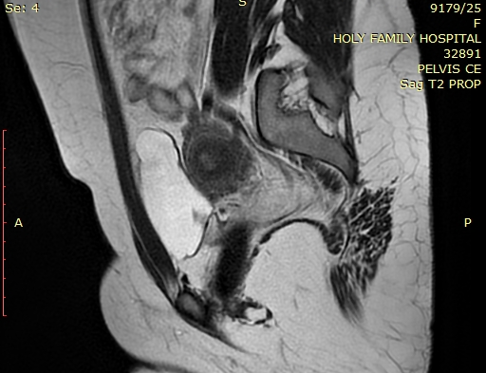
Notes:
Fibrous or Scar Tissue
Calcifications
Air or Gas
Blood Products (Chronic Hemorrhage)
Certain Masses or Foreign Bodies –

Slide 16
DIFFERENTIAL DIAGNOSIS
Based on imaging appearance and signal characteristics, our key differentials were:
Calculus/ calcification
Chronic hematoma
Foreign body (considering the patient's history of previous surgery)
Prolapsing cervical fibroid
Notes:
I will present the imaging appearances of pathologies from our differential list, emphasizing their overlapping features on MRI.

Slide 17
CHRONIC HEMATOMA IN VAGINAL OUTLET OBSTRUCTION
Notes:
A- Sagittal T2WI of patient with complete vaginal agenesis of lower one third of vagina resulting in vaginal outlet obstruction with a large chronic hematoma seen in superior vagina

Slide 18
FOREIGN BODY IN VAGINA
Notes:
Foreign body in a 5-year-old girl who presented with orange vaginal discharge. Sagittal T1-W MR image shows a well-delineated, hypointense, cylindrical structure within the vagina. An orange crayon was found on vaginoscopy.

Slide 19
PROLAPSING CERVICAL FIBROID

Slide 20
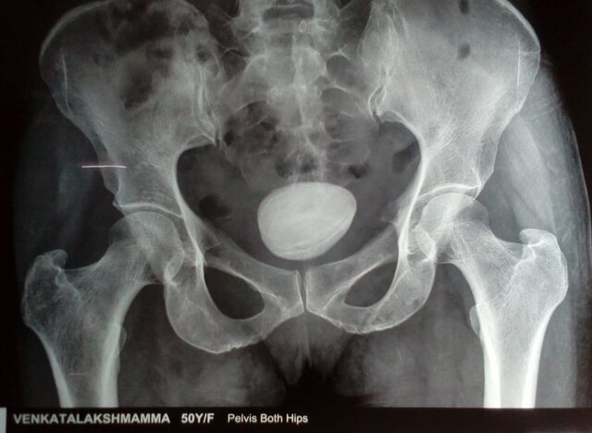
VAGINOLITH
Notes:
T2 sagittal and axial T1 MRI showing a hypointense round to oval structure in vagina which was actually a vaginolith

Slide 21
Key Imaging Questions & Further Evaluation
❓Could it represent calcification, a chronic hematoma, a foreign body or cervical fibroid?
❓Is the structure actually lying within the vaginal canal?
❓Is there an element of associated vaginal dysgenesis / stenosis?

Slide 22
🔍 To address these concerns, we performed:
✅ Complimentary plain CT scan
✅ T2-weighted sagittal and axial MRI sequences with insertion of sonogel into the vaginal canal to enhance delineation of anatomical structures

Slide 23
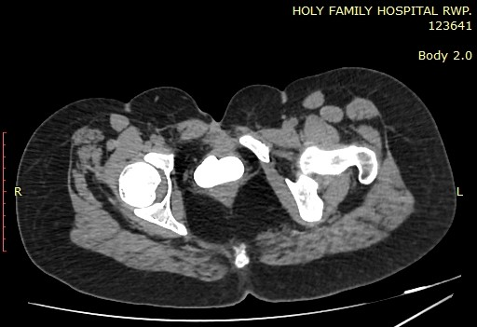
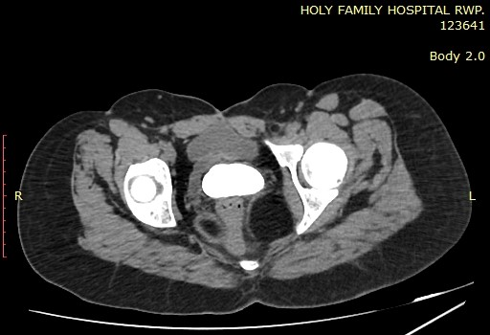
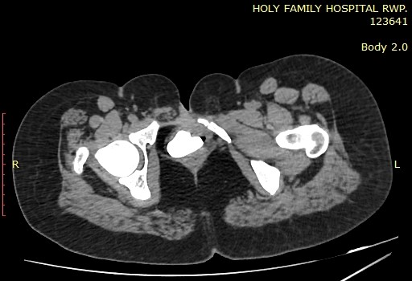
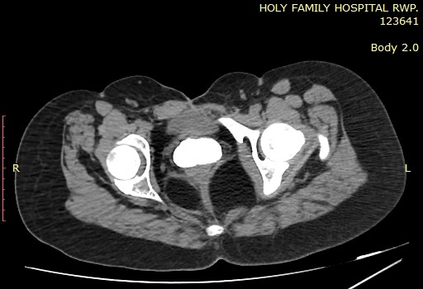
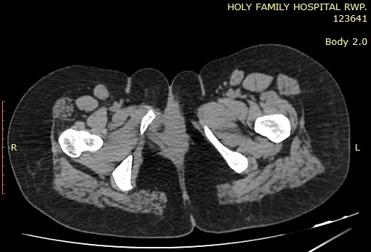
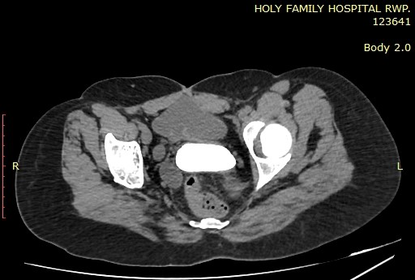
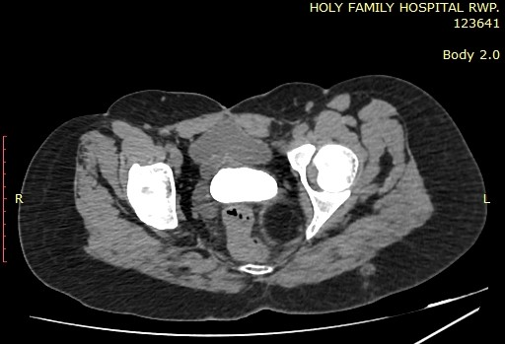
Notes:
CT scan confirmed that the structure is a large calculus.

Slide 24
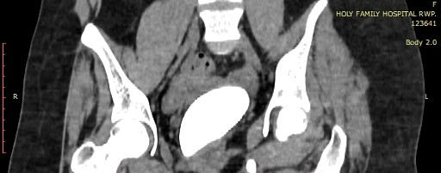
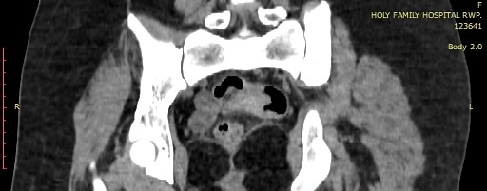
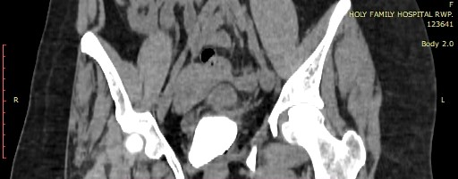
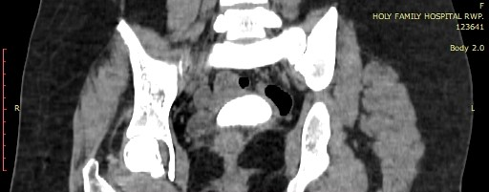
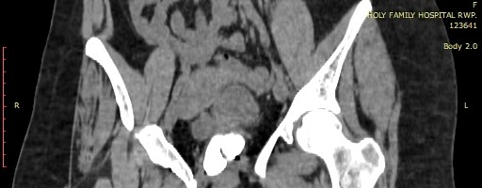

Slide 25
UTERUS
URINARY BLADDER
CALCULUS
B
CALCULUS
R

Slide 26
Notes:
3D volume rendered image of CT pelvis showing a large calculus in the pelvis. We can appreciate pubic diastasis as well which is an associated finding of bladder exstrophy

Slide 27
Notes:
these are sagittal T2 weighted mr sequences of the patient with the insertion of sonogel which is seen as hyperintense fluid filling the vaginal canal and outlining this calculus confirming its presence inside the vaginal canal. Moreover we can appreciate that the vagina is well formed excluding possibility of vaginal stenosis/ dysgenesis.
Another reason of performing these MR sequences with insertion of sonogel was to look for any vesicovaginal or urethrovaginal fistula which is the commonest cause of primary vaginal calculiforming due to pooling and stasis of urine within the vagina. We were unable to find any fistulous tract in our study

Slide 28
Notes:
However what we identified in our study was a High and posteriorly positioned urethral opening lying in very close proximity to vaginal opening → Constant urine reflux into the vagina → stone formation

Slide 30
FINAL DIAGNOSIS
PRIMARY VAGINAL CALCULUS (VAGINOLITH)
CT scan revealing a large calcified structure in the vaginal canal
MRI (T1 & T2): Hypointense structure, confirming calcification
Underlying Cause in This Case:
High and posteriorly positioned urethral opening → Constant urine reflux into the vagina → Chronic mineral deposition → Stone formation

Slide 31
GYNECOLOGICAL MANAGEMENT
By
DR SOBIA NAWAZ
ASSOCIATE PROFESSOR
GYNAE UNIT 1, HFH

Slide 32
EXAMINATION
Her external genitalia; normal, and hymen was absent
A stony hard mass was found within the vagina.
There was a 8 cm × 8 cm × 6 cm mass compressing the rectum and the bladder and adherent to posterior vaginal wall; therefore, we suspected that the stone was inside the vagina
Vaginal discharge was mucoid, yellowish-gray, and had an unpleasant odor.

Slide 33
DIFFERENTIAL DIAGNOSIS
Primary vaginal stone: result from urine stasis in the vagina
Secondary vaginal stones form as urine crystallizes around foreign bodies in the vagina

Slide 35
Struvite ; magnesium ammonium phosphate. It is formed by two factors: decreased urine volume and infection with bacterial species such as Proteus, Staphylococcus, Pseudomonas, and Klebsiella, which increase the urine pH by producing urease
Ureolysis caused by urease increases ammonia and bicarbonate, thus a supersaturated state and resulting in struvite crystal formation
Reduced bladder capacity; dissonance between contraction of the bladder detrusor muscle and the urethral sphincter and leads to urine leakage.
Leaked urine passes through the vaginal wall and stagnates in the vaginal cavity, thus leading to bacterial colonization in the stagnant urine.

Slide 36
Urologist consultation
Surgical consultation
Examination under anesthesia and proceed
Margins of the calculus identified; blunt dissection done to mobilize the calculus
Half of stone was removed in pieces
Introitus was narrow, right medio-lateral episiotomy incision was given to facilitate removal of calculus, rest of calculus removed with the help of vaginal retractors
Digital rectal examination was done, integrity of bladder was ensured

Slide 37
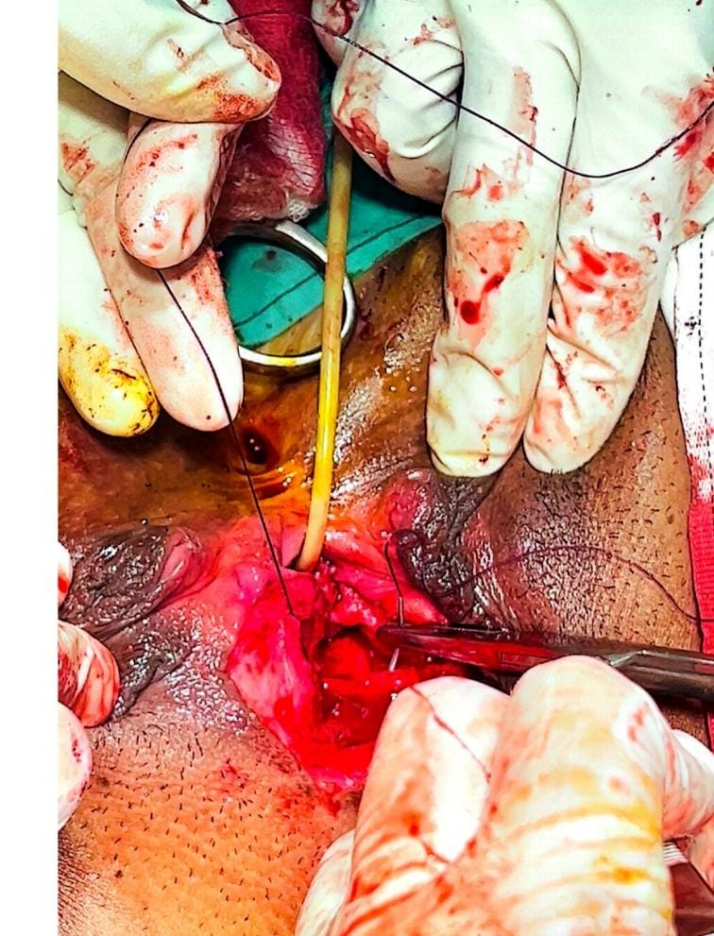
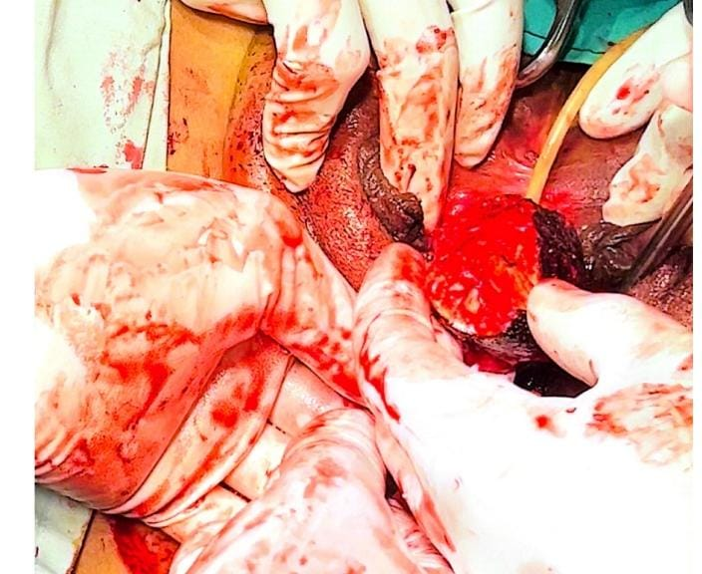
Notes:
25 case s reported so far since 2000. 14 were associated with urogental tract anatomical defects, 14 were struvite. 3 were extracted transperitonealy, One case ended in hysterectomy.

Slide 38
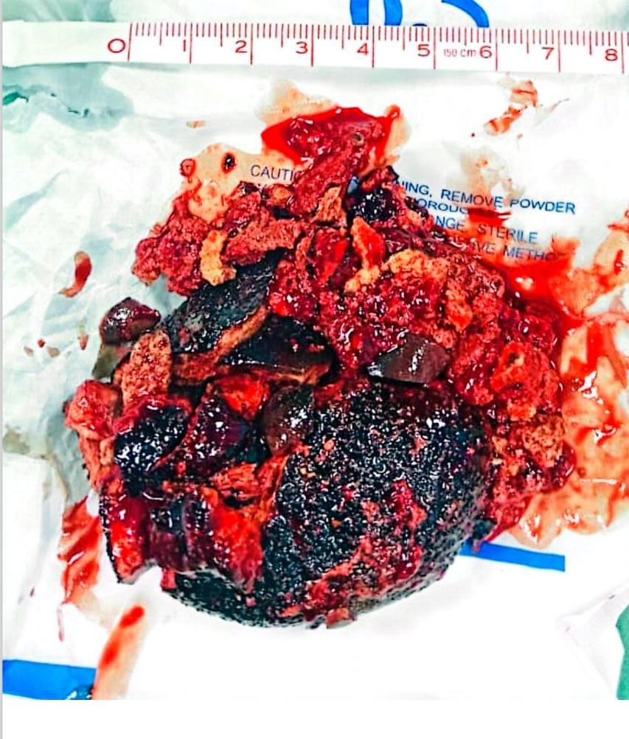

Slide 39
STONE ANALYSIS

Slide 40
LITERATURE REVIEW
By
DR BEENISH NADEEM
ASSISTANT PROFESSOR
RADIOLOGY

Slide 41
INTRODUCTION
Definition: A vaginolith is a rare calcified mass found within the vaginal canal. It may form due to calcification of foreign bodies, retained material, or dystrophic changes in infected or necrotic tissue.
Importance in Radiology: Often an incidental finding and can mimic other pelvic pathologies like bladder stones, ureteric calculi, or even pelvic tumors.

Slide 42
INCIDENCE
rare pathology with a few cases reported in literature.
originates after urinary stasis in the vagina and concomitant infection
1st case of vaginal calculus was reported by Halban in 1900 in patient with vaginal cystocele.

Slide 43
EPIDEMIOLOGY
most commonly associated with;
Foreign body retention (tampons, contraceptive devices, surgical sutures).
Congenital vaginal obstruction (imperforate hymen, vaginal septa).
Chronic infections (e.g., tuberculosis, schistosomiasis).

Slide 44
SYMPTOMS & CLINICAL PRESENTATION
Asymptomatic (incidental finding).
Symptomatic cases may present with:
Chronic vaginal discharge.
Pelvic pain or discomfort.
Dysuria or dyspareunia.
Sensation of a mass in the vaginal canal.

Slide 45
CLASSIFICATION
Primary Vaginal Calculus | Secondary Vaginal Calculus
More frequent | Less Frequent
are formed due to stasis of urine in the vagina secondary to constant urinary leakage | formed by crystallization of urinary salts around a foreign body
Vesicovaginal fistula is the commonest underlying cause, while urethrovaginal fistula and ectopic ureteric insertion being rare ones | A retained surgical suture or gauze or less commonly migration of vesical calculus through perforation of vesicovaginal septum

Slide 46
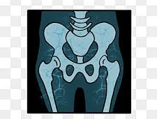
RADIOLOGICAL APPROACH & INVESTIGATION
Step 1: Clinical History & Physical Exam
Ask about foreign body insertion, infections, surgeries, or congenital anomalies.
Step 2: Imaging Modalities
1) X-ray (Pelvis & Abdomen)
✅ Quick and cost-effective. ✅ Shows a radio-opaque calcified mass in pelvis ❌ Cannot exactly determine the exact location of calculus.

Slide 47
2) Ultrasound (Transabdominal/Transvaginal)
Identifies the location, size, and composition of the lesion.
Helps rule out adjacent pathologies (ovarian, bladder, or rectal masses).
Limitations
false diagnosis of bladder calculi.
dense posterior shadowing make it difficult to evaluate the vaginal details.

Slide 48
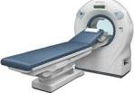
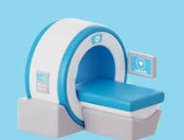
3) CT Scan (Preferred Investigation for Diagnosis)
Provides detailed anatomical location and relationship with adjacent structures.
Helps differentiating vaginolith from bladder calculi, foreign bodies, or pelvic tumors.
4) MRI (For Complex Cases)
Useful in pediatric patients, congenital anomalies, or suspected malignancies.
Shows soft tissue details

Slide 49
LITERATURE REVIEW
14/24 | vesicovaginal fistula, urethrovaginal fistula, and vaginal outlet obstruction
10/24 | patients were bedridden with paraplegia or tetraplegia
22/24 | urine stagnation was the main cause of vaginal stone
14/24 | composition of the vaginal stones was reported as struvite. Other reported components of the stones were carbonate, apatite, calcium phosphate, oxalate, and hemosiderin.
3/24 | vaginal stones were removed transperitoneally; in the remaining 21 case reports, episiotomy or hymenectomy was performed to remove the stones vaginally.
Search Engines: PubMed and EMBASE.
The search was limited to articles published from January 2000 to July 2022
We primarily focused on primary vaginal stones and the ages of the patients ranged between 4 to 69 years.

Slide 50
"Let’s Analyze: Interesting Case Reports in Literature"

Slide 51
Case Report 1
A giant dumb-bell vaginolith: Is only radiograph or ultrasound good enough? - A case report
Dr Vipula Goswami¹, Dr Anil Vasoya ², Dr Zalak J Panchal³
^{EuroRad in July 2017}

Slide 52
A 35-year-old female patient presented with chief complaints of urinary incontinence and perineal discomfort for two years .She had H/O an obstructed labor followed by uterine perforation and surgery in a private nursing home.
Her pelvic ultrasound was done on a partially filled bladder that showed an echogenic area in pelvis with dense posterior acoustic shadowing. Next, She was referred for X ray pelvis.

Slide 53
Notes:
Her pelvic ultrasound was done on a partially filled bladder that showed an echogenic area in pelvis with dense posterior acoustic shadowing.
Xray pelvis confirmed it to be a huge calculus

Slide 54
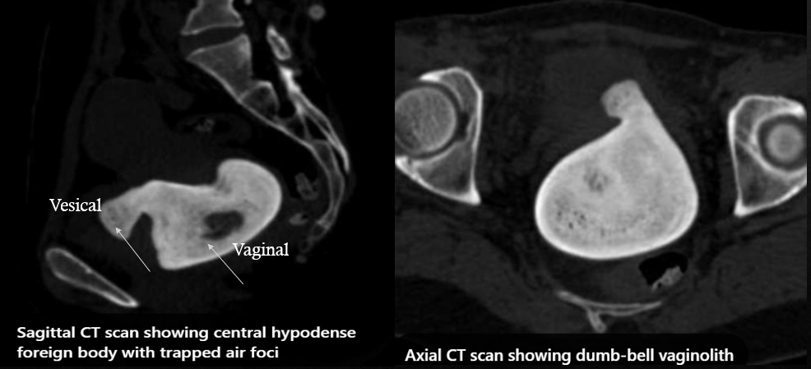
Vaginal
Notes:
CT revealed a giant dumbbell-shaped calculus with smaller vesical component and larger vaginal component connected by a waist through vesico-vaginal fistula.

Slide 55
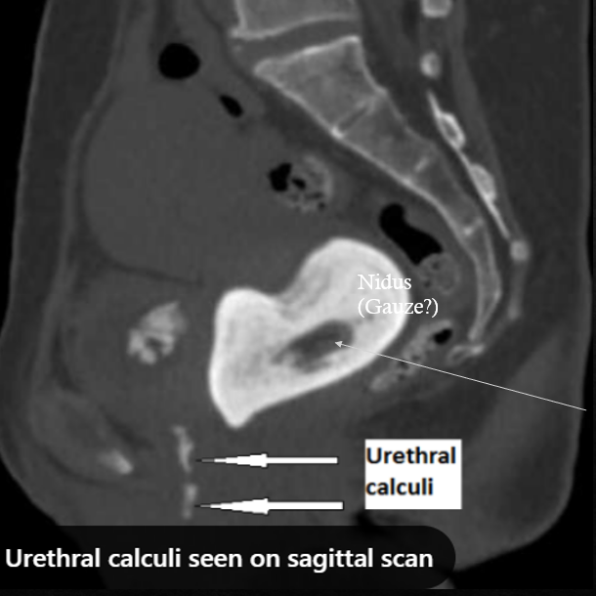
Nidus
(Gauze?)
Notes:
The core of the vaginal component appeared hypodense, having soft tissue density with presence of few air foci within. The possibility of retained surgical gauze acting as nidus for the stone formation was suggested.
In addition to that CT also revealed presence of urethral calculi.

Slide 56
Case Report 2
A rare case of vaginolith & vesical calculus with vesicovaginal fistula in adolescent female
Poonam Raikwar1, Ramsharan Raikwar2, Brijesh Tiwari2*
International Surgery Journal in 2016

Slide 57
A 15-year-old female presented to the surgery outpatient department with complaints of lower abdomen pain and continuous dribbling of urine for the past 1 year. She had attained menarche at age of 12 years.
Based on the history and clinical examination, a provisional clinical diagnosis of vesical calculus was made and the patient was referred to the radiology department for ultrasound and CT KUB.

Slide 59
Notes:
This was followed by MRI which showed a fibrosed bladder .
A fistulous tract communication was seen with bladder neck and proximal urethra to vaginal orifice.
Separate distal urethral opening was not appreciated.

Slide 60
Case Report 3
Huge vaginal stone: Case report and review of the literature
Jae Yoon et al
Frontiers 2022

Slide 61
28-year-old woman with spastic quadriplegia who had been bedridden for most of her life presented to the emergency department with abdominal distension and fever. She had chronic constipation, recurrent urinary tract infections (UTIs) and vaginal discharge.
After initial baseline investigations she was referred for CECT.

Slide 62
Bladder
Notes:
After initial investigations she was referred for CECT which showed a large mass compressing the rectum between the bladder and colon suspected to in vagina.; therefore, it Surgical findings revealed that this calculus was adherent enough that it could not be removed through vaginal approach hence hysterectomy was done later for complete evacuation.

Slide 63
Case Report 4
Neglected vaginal foreign body leading to vaginolith, vesicovaginal fistula and vesical calculus formation in an adolescent girl .
Mukesh et al
British Institute of Radiology in 2016

Slide 64
A 12-year-old female child presented with complaints of continuous dribbling of urine for the past 6 months. She had not attained menarche and had a history of fall and pelvic injury 3 years back. On local examination ,there was marked excoriation of the vulval skin. Foul smelling urine was observed coming out of the vaginal opening.
Based on the history and clinical examination, a provisional clinical diagnosis of post-traumatic vesicovaginal fistula (VVF) was made.

Slide 65
Bladder
Vagina
Notes:
USG was performed showed an echogenic focus within the lumen of the partially distended urinary bladder.
Another echogenic shadow was seen between the urinary bladder and the rectum, raising suspicion of a vaginal foreign body .When enquired, the patient and her parents denied the insertion of any foreign body into the vagina.

Slide 66
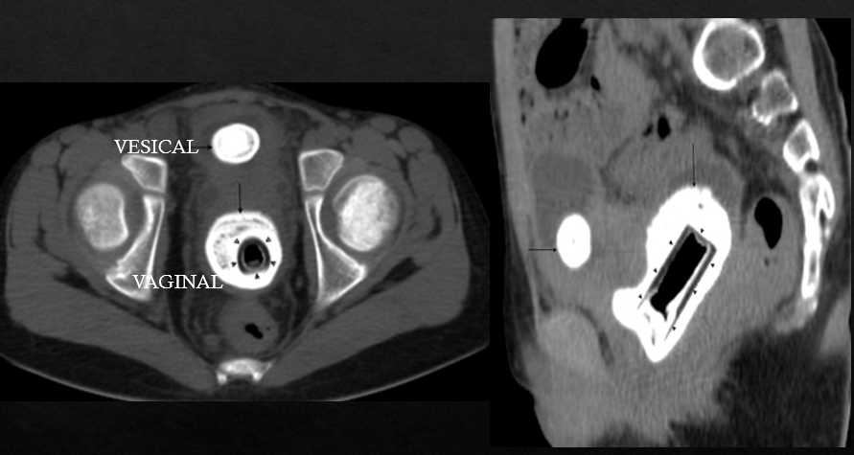
Notes:
Urgent non-contrast CT scan of the pelvis was performed which revealed a vesical and vaginal calculus.
Additionally well-defined rectangular hypodense central area was also noted within vaginolith. The patient was again asked about the vaginal foreign body and she admitted to inserting the plastic cap of a nail colour into her vagina about a year back.

Slide 67
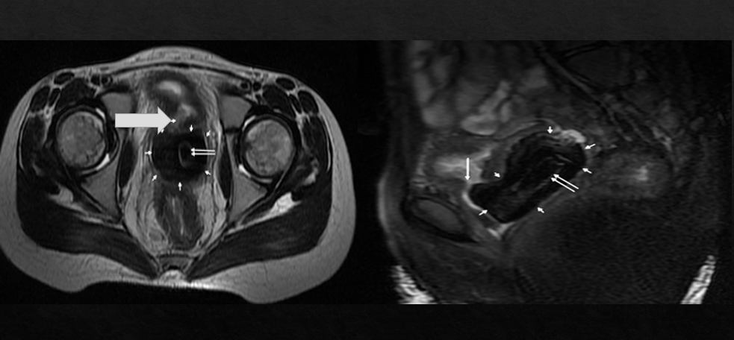
Notes:
She was then referred for MRI which further revealed a defect in the posterior wall of the urinary bladder, with free passage of urine into the vagina .
Based on the radiological findings and history, a diagnosis of vaginal foreign body with secondary vaginolith with vesical calculus with VVF was made.

Slide 68
ADVANCE IMAGING TECHNIQUES AND ROLE OF ARTIFICIAL INTELLIGENCE
By
DR NASIR KHAN
DEAN DIAGNOSTICS
RMU AND ALLIED HOSPITALS

Slide 69
ADVANCE IMAGING TECHNIQUES
High-Resolution Ultrasound (HRUS)
Advanced CT and Dual-Energy CT (DECT)

Slide 70
High-Resolution Ultrasound (HRUS)
Modern high-frequency transvaginal ultrasound (TVUS) provides superior soft-tissue resolution.
Elastography can differentiate calcified lesions (vaginoliths) from soft tissue masses.
Contrast enhanced ultrasound helps detect abscesses, fistulas, or inflammatory enhancement.

Slide 71
Notes:
CC ІІB stage. A) MRI scan: tumor invasion outside the cervix into the uterus left wall; B) right and back contours of the cervix was preserved. On elastography There was a clear border line between dark-blue tumor and green-colored unchanged stroma; C) typical image of preserved green stroma and red paracervical tissue was absent at the left side - tumor invades outside the organ.

Slide 72
Notes:
Trans-intrauterine contrast-enhanced ultrasound (CEUS). SonoVue in the uterine cavity was sprayed into the bladder cavity, clearly showing the hyperechoic fistula tract delineated by SonoVue between the lower anterior uterine wall and the posterior bladder wall (arrow)

Slide 73
Advanced CT and Dual-Energy CT (DECT)
Dual-Energy CT differentiates between different types of calcifications, helping confirm a diagnosis.
3D CT reconstruction enhances anatomical visualization for surgical planning.

Slide 74
Notes:
The color-coded dual-source dual-energy computed tomography (DSDECT) image showing an example of mixed renal hydroxyapatite (HA)-calcium oxalate (CaOx) stone. A, The HA part is color-coded in blue (white arrow), and the CaOx part is color-coded in red (red arrow) in the axial image of mixed stone; B, Sagittal image of the mixed stone;

Slide 75
Notes:
3D CT reconstruction showing a large calculus in vaginal cavity enhancing anatomical visualization for surgical planning.

Slide 76
TAKE HOME MESSAGE
Vaginoliths, though rare, should not be overlooked in chronic gynecological complaints.
Radiology plays a key role in diagnosis, and recent advances in imaging and minimally invasive techniques are improving patient outcomes.
A “multidisciplinary approach” remains essential for effective management."

Slide 78
THANK YOU

