Slide 3
REDEFINING DIAGNOSTICS IN IMAGING RENAL SPECTRUM
Department of Radiology, BBH

Slide 4
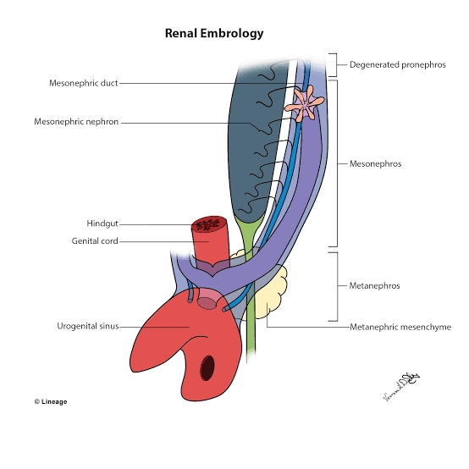
Embryology of kidneys

Slide 5
Anatomy

Slide 6
Radiology (ULTRASOUND)

Slide 7
CT Urography

Slide 8
Right Retrocaval ureter with Left ectopic mal-rotated kidney
Non-contrast Coronal image
Right kidney in anatomical location
Right hydronephrosis
Left ectopic ( pelvic) mal-rotated kidney

Slide 9
Right Retrocaval ureter with Left ectopic mal-rotated kidney
Dilated right ureter crossing medial to pedicle of L3 vertebra with a tapered narrowing & circumscribing posterior medial aspect of IVC
A streak of contrast opacifying the lumen of ureter as it crosses behind the IVC

Slide 10
Right Retrocaval ureter with Left ectopic mal-rotated kidney
Dilated right ureter crossing medial to pedicle of L3 vertebra with a tapered narrowing giving Fish Hook Deformity
Type 1 (low loop type variety) right Retrocaval ureter

Slide 11
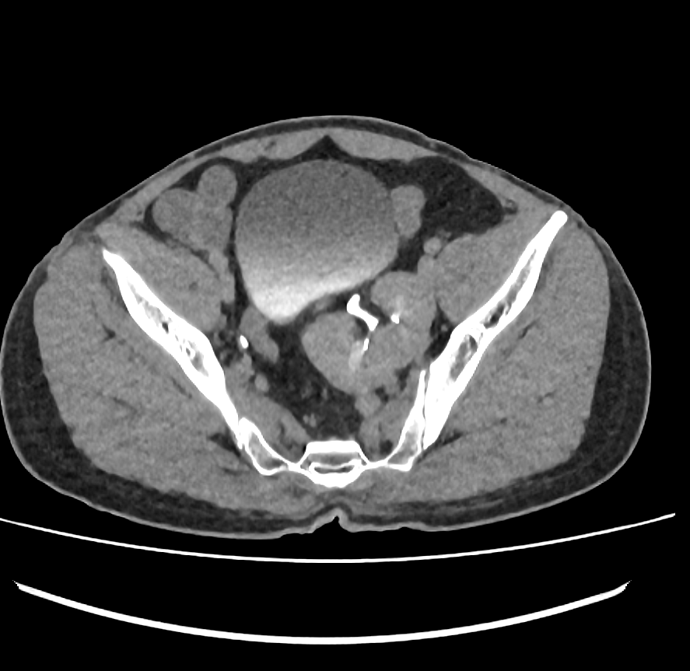
Right Retrocaval ureter with Left ectopic mal-rotated kidney
15 minutes delayed excretory image
Normal excretion of contrast on both sides

Slide 12
Angiographic patterns/vascular variations in 2 cases of crossed fused renal ectopia

Slide 13
CROSSED FUSED RENAL ECTOPIA WITH CALCULUS
Fused mal-rotated kidneys in right renal fossa
Calculus in lower moiety

Slide 14
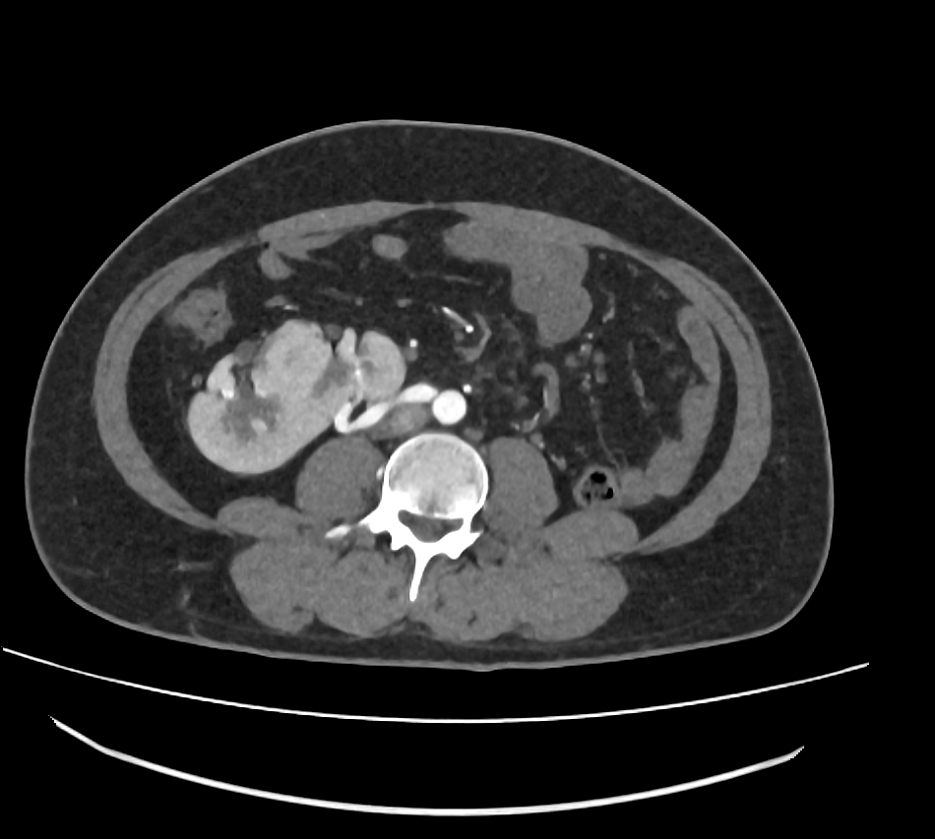
CROSSED FUSED RENAL ECTOPIA WITH CALCULUS

Slide 15
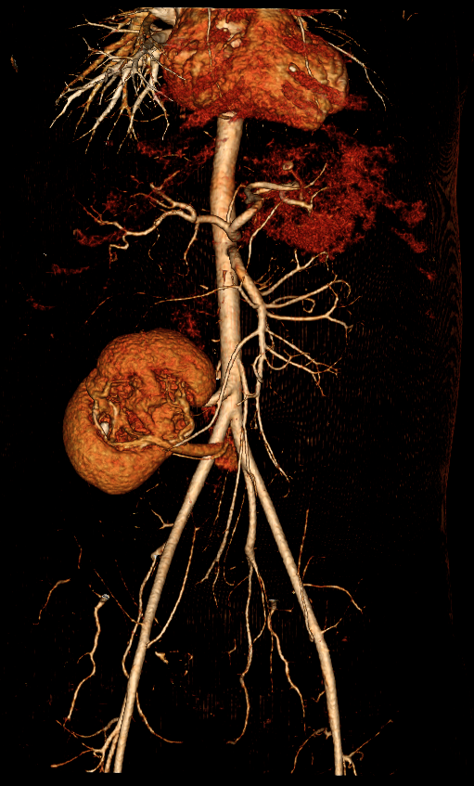
CROSSED FUSED RENAL ECTOPIA WITH CALCULUS
Low lying right renal artery arising from aorta after origin of IMA
One small artery arising at bifurcation of abdominal aorta and supplying the lower moiety
Single draining right renal vein
Single draining ureter

Slide 16
Crossed fused renal ectopia
Fused mal-rotated kidneys in right renal fossa
Over distended urinary bladder

Slide 17
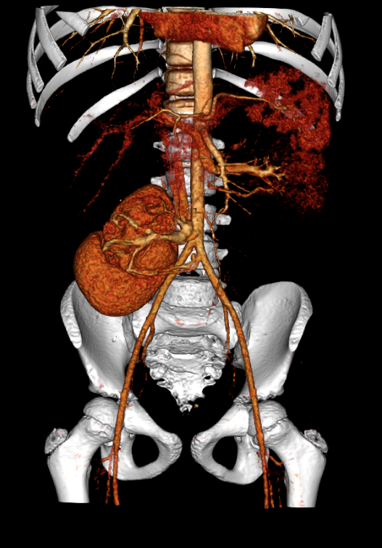
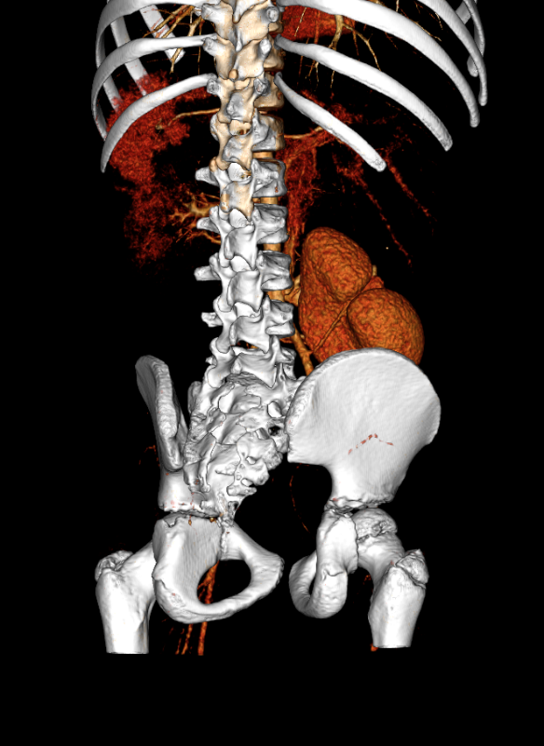
Crossed fused renal ectopia
4 arteries supplying the fused renal tissue
Low lying right renal artery just before bifurcation of aorta
2 arteries from left common iliac artery
One artery from right common iliac artery going to posterior notch
Single draining right renal vein

Slide 18
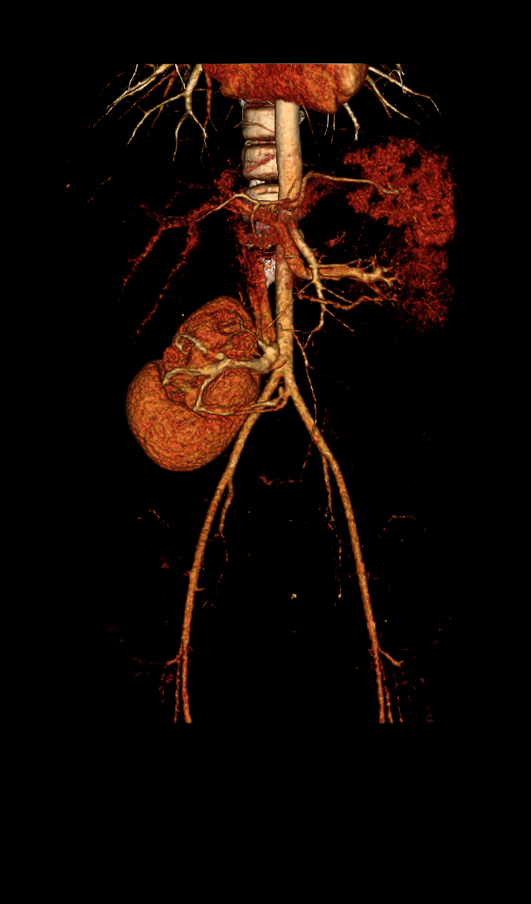
Crossed fused renal ectopia

Slide 19
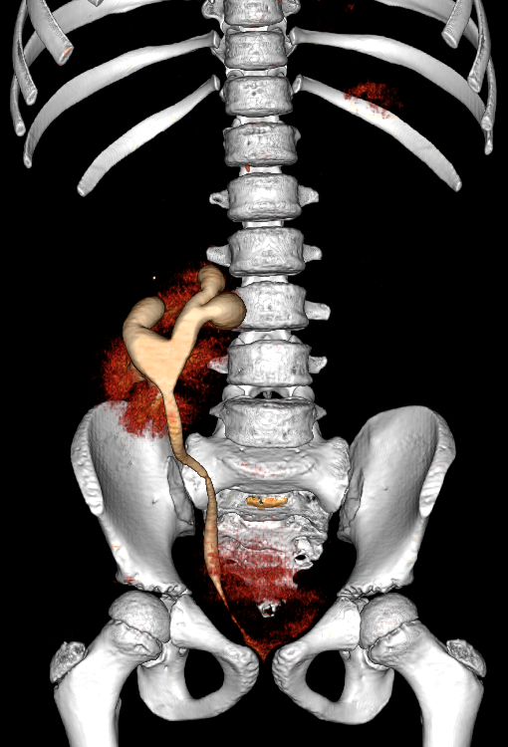
Crossed fused renal ectopia
Single draining right ureter seen on excretory phase

Slide 20
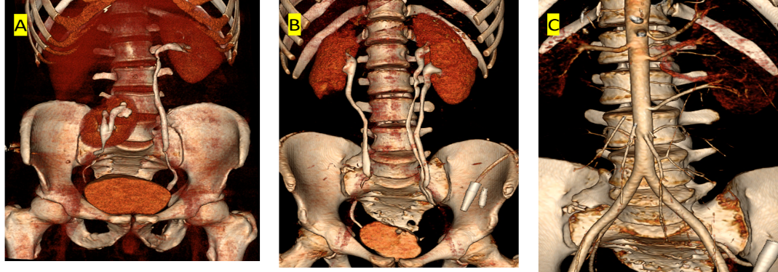
Aberrations in collecting system
Aberrations in collecting system. A: Right pelvic kidney with duplex collecting system. B-C: Left duplex collecting system with bifid ureter. Accessory left renal arteries.

Slide 21
Horseshoe kidney with nephrolithiasis and emphysematous pyelonephritis
Fusion of medial poles of bilateral kidneys at L2-L3 IVD space

Slide 22
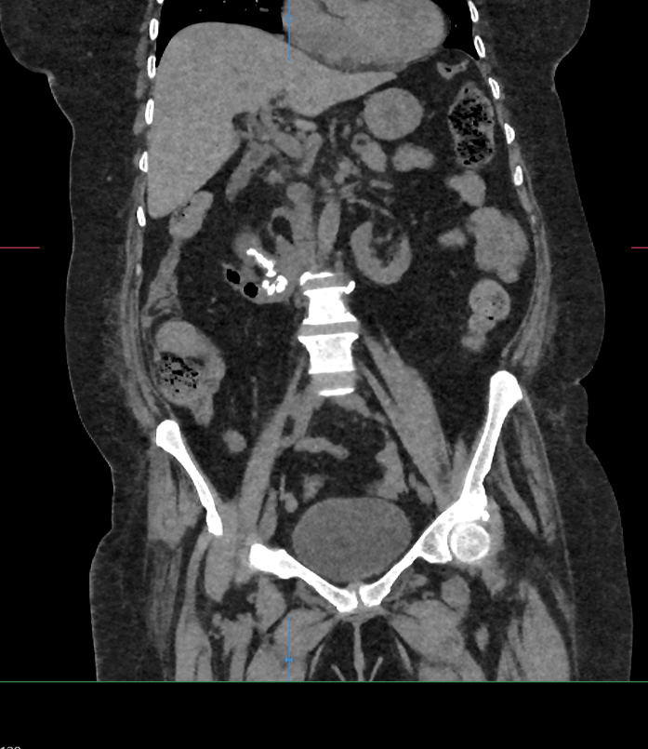
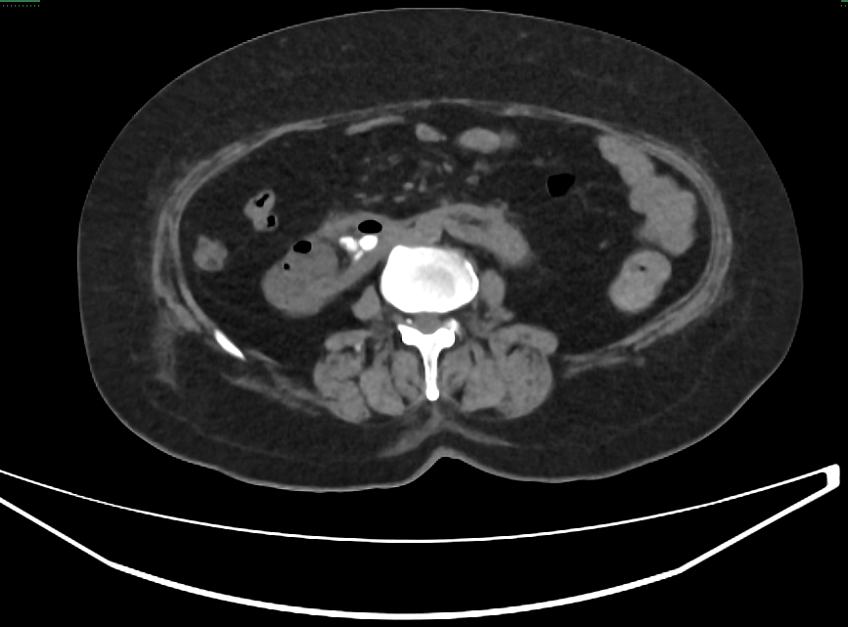
Horseshoe kidney with nephrolithiasis and emphysematous pyelonephritis
Multiple calculi right kidney
Specs of air – right kidney
Moderate right hydronephrosis

Slide 23
Horseshoe kidney with nephrolithiasis and emphysematous pyelonephritis

Slide 24
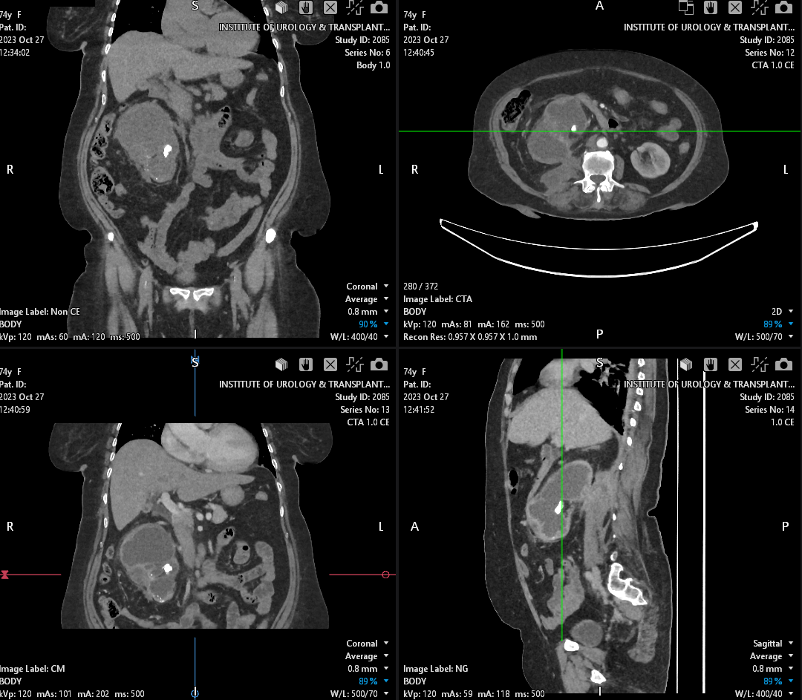
Xanthogranulomatous pyelonephritis
Enlarged right kidney
Multiple right renal calculi
Bear paw appearance on right
Right peri-nephric collections

Slide 25
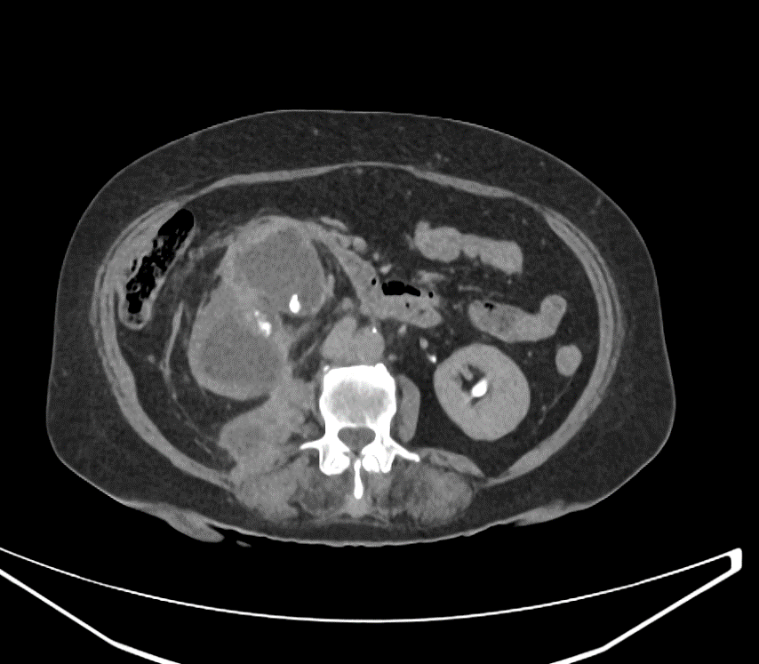
Xanthogranulomatous pyelonephritis
Multiple right sided calculi
Extension of right peri-nephric inflammatory changes to psoas & Quadratus lumborum muscles
Non-contrast
Excretory phase

Slide 26
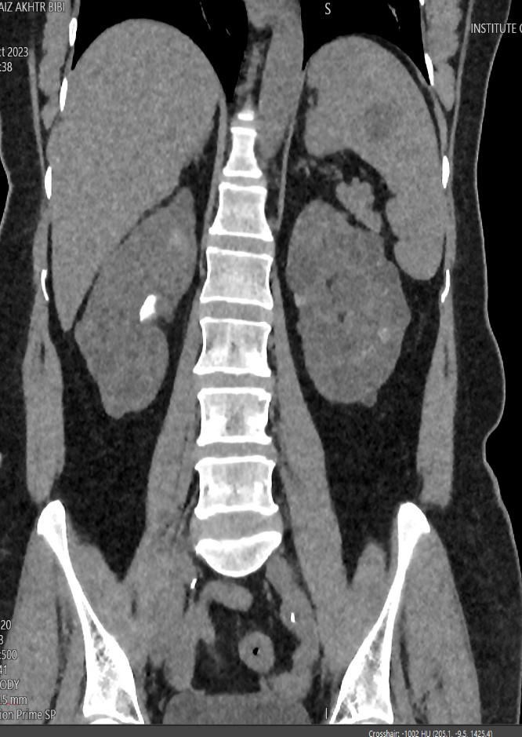
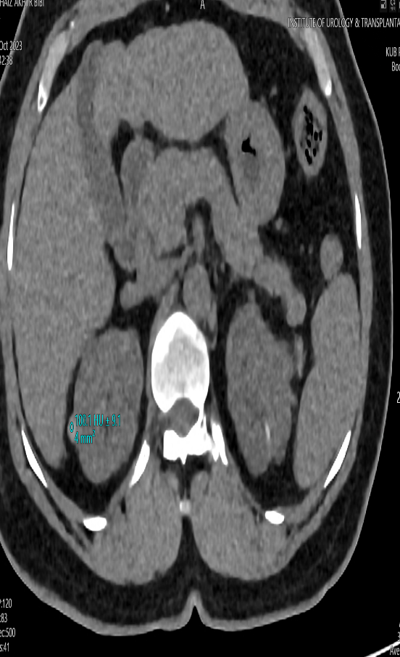
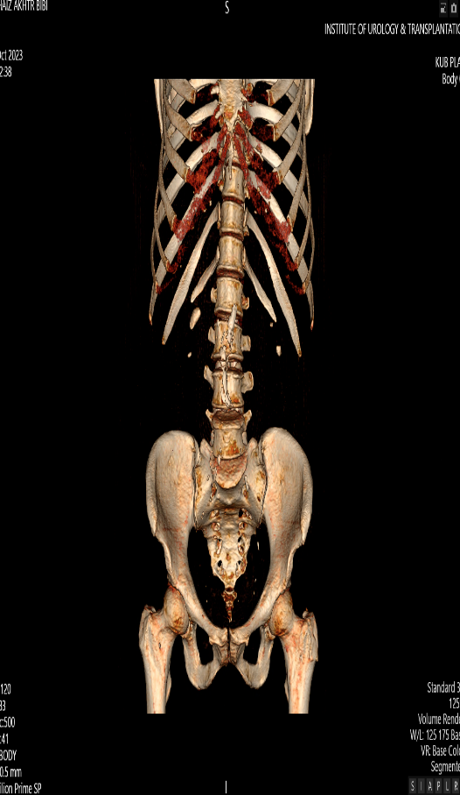
APCKD ASSOCIATED WITH PULMONARY CYSTS

Slide 27
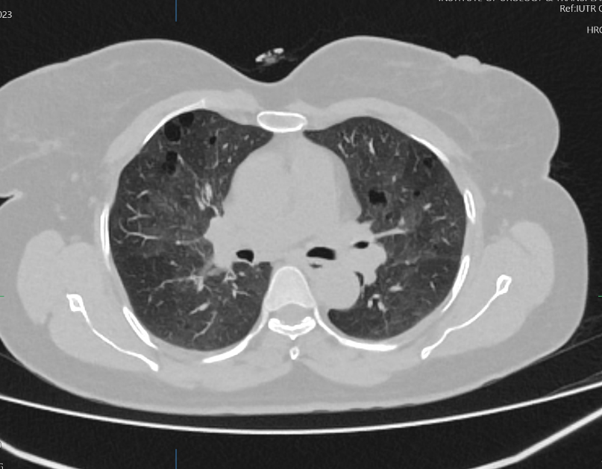
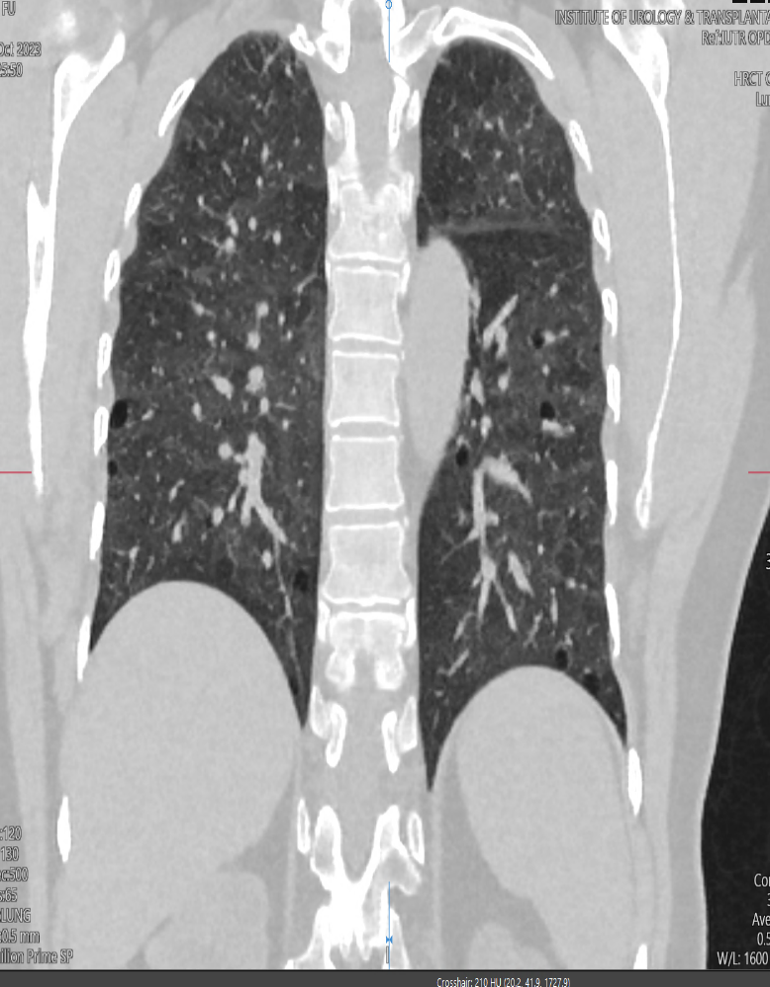
APCKD ASSOCIATED WITH PULMONARY CYSTS

Slide 28
Renal lesion ? Rcc vs hemangioma
Non-contrast
CM Phase
NG Phase
10 mins delay

Slide 29
Renal lesion ? Rcc vs hemangioma

Slide 30
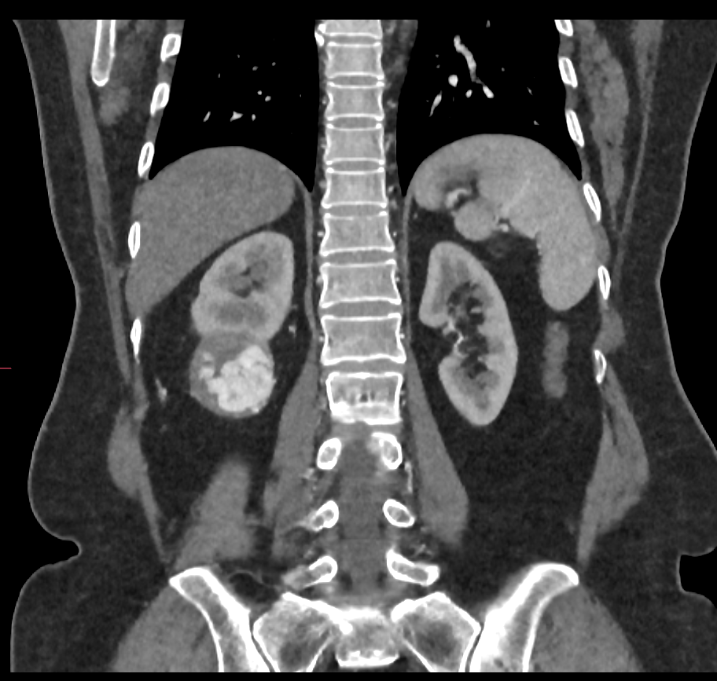
Renal lesion ? Rcc vs hemangioma
Rounded predominantly hypodense
Exophytic
Heterogeneously enhancing
Following blood pool on all phases
Vascular renal lesion
RCC vs hemangioma

Slide 31
Conclusion
Evolving Paradigms in Diagnostics
Importance of Multidisciplinary Collaboration
Personalized Treatment Pathways
Improving Patient Outcomes
Addressing Challenges in Implementation

Slide 32
ANY QUESTIONS?

Slide 33
Thank you

