Slide 1
RMU ClinicoPathological Conference A YOUNG MOTHER WITH BEHAVIOURAL DISTURBANCES
Institute of Psychiatry
Rawalpindi Medical University
Department of Liaison Psychiatry

Slide 2
PROGRAM
Introduction | Dr. Maryam Javed Resident Year 4 IOP
Recitation | Dr. Ibrahim Rashid House Officer IOP
Case Presentation | Dr. Mehvish Batool Resident Year 4 IOP
Gynae and Obstetrics Perspective | Dr. Sadia Khan HOD Gynae & Obs BBH
Medical Perspective | Dr. Arshad Rabbani HOD Medical Unit II BBH
Radiology Perspective | Dr. Hina Hanif HOD Radiology BBH
Evidence based Literature Review | Dr. Sara Afzal Consultant Psychiatrist IOP
Liaison Psychiatric Services at RMU | Prof. Asad Nizami Prof & Chairman IOP

Slide 4
Surah AL AHQAF ayah 15

Slide 6
Case Presentation
Dr Mehvish Batool
Post Graduate Resident
Institute of Psychiatry

Slide 7
Demographics
Mrs. XYZ, 25 years
MPhil Chemistry, teacher,
Mother of one child
Resident of Dera Ismail Khan
Referred to Institute of Psychiatry on 15th March, 2024, by Emergency Department.

Slide 8
Presentation
Increased and irrelevant talk
Fearfulness
Grandiosity
Visual hallucinations
Decreased sleep and appetite
For 17 Days

Slide 9
Course of Current Illness
The patient had an uncomplicated vaginal delivery at a local set-up in Dera Ismail Khan 20 days earlier; healthy baby delivered
Behavioral disturbances started along with 104 °F fever on the 3rd postnatal day
Though fever settled with symptomatic management but behavioral disturbances persisted
Referred to IOP and was admitted to in-patient department

Slide 10
Physical Examination
General Physical Examination:
Unremarkable
Vitals
BP: 110/70 mmhg
Pulse: 82/min
RR: 18/min
Afebrile
Systemic examination:
Non-tender distended bladder, which was relieved after passing Foley's catheter.
Otherwise unremarkable

Slide 11
Mental State Examination
Appearance and Behavior:
Psychomotor agitation was noted
Making fleeting eye contact, difficult to engage in interview
Speech: increase rate and volume, irrelevant and incoherent
Mood: subjectively and objectively elated

Slide 12
Mental State Examination
Thought:
Flight of ideas
Persecutory and grandiose delusions
مجھے باتیں پتہ چل جاتی ہیں،میرے سسرال والے مجھے مارنا چاھتے ہیں مجھے فرشتے خدا کے پیغامات پہنچاتے ہیں
Perception: Visual hallucinations
مجھے خلیفہ نظر آتے ہیں
Cognition: Disoriented in time and place
Insight: Absent

Slide 13
Investigations
Biological Investigations
Baseline Investigations
Fundoscopy
ECG
Psychosocial Investigations
BPRS: 28 (significant; mild symptoms)
Normal

Slide 14
Differential Diagnosis
Mental and Behavioral disturbances due to pregnancy, childbirth and puerperium with psychotic features ?
b) Delirium secondary to puerperal sepsis ?
c) Encephalitis with psychotic presentation ?

Slide 15
Initial Management
Rapid tranquilization: Injection Haloperidol 5mg + Injection Promethazine 25mg I/M stat given
Started on Tablet Olanzapine 15mg in divided doses

Slide 16
Liaison With Gynaecology & Obstetrics Department
Gynaecological consultation was done to rule out puerperal sepsis and other possible obstetric complications
Speculum examination: unremarkable
Ultrasound Abdomen Pelvis: unremarkable
Obstetric complications were ruled out

Slide 17
Liaison With Medical Department
Medical department was consulted due to suspicion of central nervous system infection
History of fever
Visual hallucinations
Disorientation
Advice:
CT Brain with contrast
Lumber Puncture for CSF complete examination

Slide 18
CT Brain Result
Mild Meningeal enhancement along right ambient cistern and left temporal lobe adjacent to crural cistern in favor of meningitis/encephalitis.

Slide 19
CSF Result
Suggestive of Viral Encephalitis
Neutrophils 0%
Lymphocytes 100%
Protein 73mg/dl
Glucose 54mg/dl
ZN stain negative for AFB

Slide 20
Management of Viral Encephalitis by Medical Department
Immediately patient was shifted to medical ward
She was started on Injection Acyclovir thrice a day along with supportive treatment.
Patient remain admitted there for 18 days.
Constant liaison was maintained during her stay at the medical ward.
Her physical symptoms were settled but behavioral and mood symptoms persisted

Slide 21
Final Diagnosis
a) Mental and Behavioral disturbances due to pregnancy, childbirth and puerperium with psychotic features
b) With Co morbid Viral Encephalitis

Slide 22
Follow up Management by Institute of Psychiatry
Patient was shifted back on 4th April 2024 to Institute of Psychiatry after completion of antiviral medication.
At IOP she was managed for elated mood and grandiose ideas
BIOLOGICAL MANAGEMENT
Started on tablet Sodium Valproate 1000mg in divided doses along with tablet Olanzapine 15mg.

Slide 23
Management by Institute of Psychiatry
PSYCHOSOCIAL MANAGEMENT
We mobilized social support and advised attendants to engage her in healthy activities appropriate for her age.
Therapeutic alliance
Provided informational care to family
Counseling provided regarding family planning
Importance of drug compliance and regular follow up in OPD.
Notes:
Family planning due to valproate

Slide 24
Management by Institute of Psychiatry
DISCHARGE & FOLLOW UP
After 1 week on outpatient follow up patient was significantly improved.
Biological functions improved
Grandiose ideas settled on mental state examination

Slide 25
Gynaecological and Obstetric Perspective
Assoc Prof Dr Sadia Khan
Head of Gynaecology and Obstetrics Department BBH

Slide 26
Postpartum Period: A High Risk State
High Risk to develop various conditions like
Infections: Puerperal Sepsis
Psychiatric disorders Postpartum Depression and Psychosis
Electrolyte abnormalities and vitamin deficiencies
Autoimmune diseases (hyperthyroidism, SLE,autoimmune encephalitis) can be triggered during the postpartum period and present with psychosis.
Notes:
Overlap between symptoms presentations

Slide 27
Obstetric Factors for Development of Postpartum Psychosis
Primigravida
Preeclampsia
Prolonged labour
Obstetric complications
Perinatal infant mortality
Sleep deprivation
Increased environmental stress

Slide 28
Medical Perspective
Assoc Prof Dr Arshad Rabbani
Head of Medical Unit II BBH

Slide 29
Encephalitis in Postpartum Period
Significant overlap between symptoms of encephalitis and psychosis
Viral and autoimmune encephalitis reported in 4% cases
Most common viral encephalitis agents are herpesviruses 1 and 2 (HSV-1 and HSV-2)

Slide 30
Diagnostic Criterion for Viral Encephalitis
Patients presenting to medical attention with any of these symptoms
Altered mental status
Lethargy
Personality change
Documented fever ≥38 ºC
New onset generalized or partial seizures
New onset of focal neurologic findings
lasting ≥24Hour with no alternative cause identified

Slide 31
Diagnostic Criterion for Viral Encephalitis
Investigations:
CSF R/E
leukocyte count ≥5 mm3
Proteins raised
Glucose within normal range
Abnormality of brain parenchyma on neuroimaging suggestive of encephalitis
Notes:
Costa BK, Sato DK. Viral encephalitis: a practical review on diagnostic approach and treatment. Jornal de pediatria. 2020 Apr 17;96:12-9

Slide 32
Radiological Perspective
Assoc Prof Dr Hina Hanif
Head of Radiology Department BBH

Slide 33
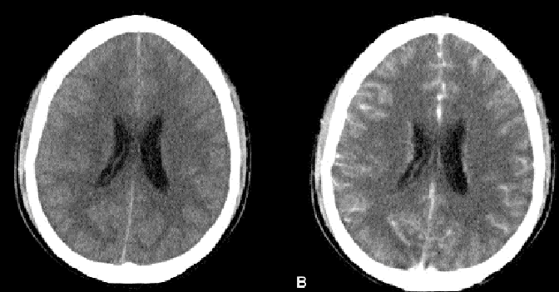

Slide 34
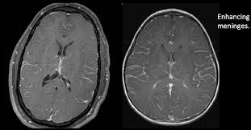

Slide 35
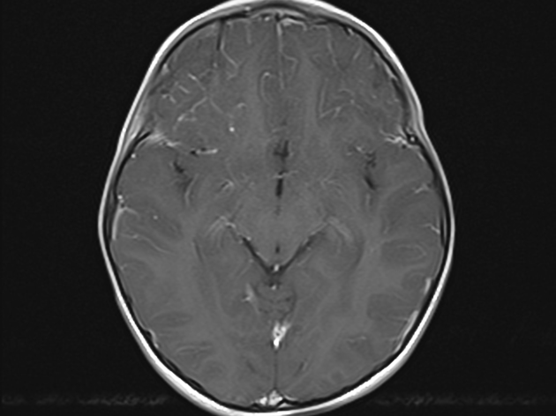
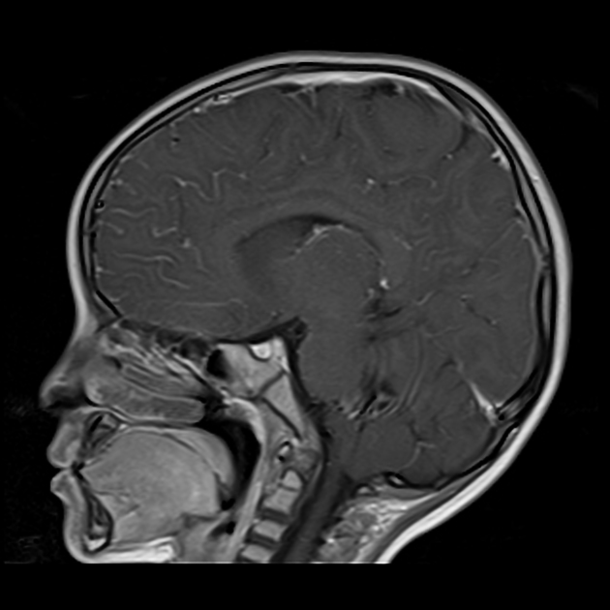
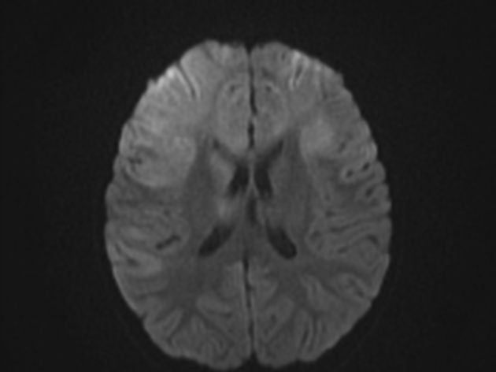
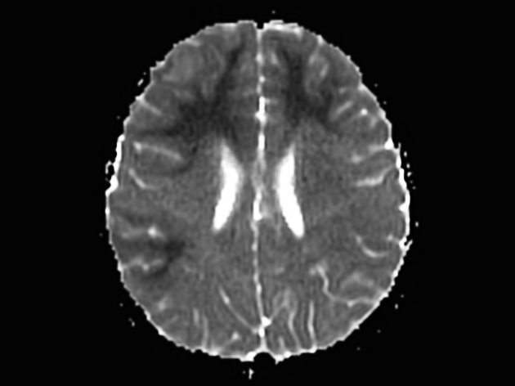

Slide 36
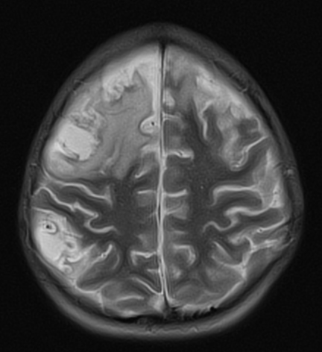

Slide 37
Evidence-Based Recent Advances & Literature
Dr Sara Afzal
Consultant Psychiatrist
Institute of Psychiatry

Slide 38
Mental or Behavioral Disorders Associated with Pregnancy, Childbirth or the Puerperium
Without psychotic symptoms (postpartum depression)
With psychotic symptoms (postpartum psychosis)
Onset within 6 weeks following delivery
Functional impairment
Not explained by other medical conditions
Notes:
Depression: depression, anxiety, obsessions
Psychosis: Delusions, hallucinations, disorientation, suicide (20% of postpartum deaths), infanticide

Slide 39
Incidence of Psychiatric Disorders during Pregnancy and Postpartum Period
International Data
(in %)
National Data
Psychosis: less than 1%
Depression:
37% perinatal
30% postnatal
Anxiety disorders: 5%
Abdelhafez et al. 2023
Atif et al. 2021, Qamar et al. 2022
Notes:
Blues ½ to 2/3rd. Depression: 5 – 19%. Psychosis: 1 – 2/ 1000. Anxiety: 9%
Abdelhafez, M.A.; Ahmed, K.M.; Ahmed, N.M.; Ismail, M.; Daud, M.N.B.M.; Ping, N.P.T.; Eldiasty, A.; Amri, M.F.B.; Jeffree, M.S.; Kadir, F.; et al. Psychiatric illness and pregnancy: A literature review. Heliyon 2023, 9, e20958
Atif M, Halaki M, Raynes‐Greenow C, Chow CM. Perinatal depression in Pakistan: A systematic review and meta‐analysis. Birth. 2021 Jun;48(2):149-63.
Yadav T, Shams R, Khan AF, Azam H, Anwar M, Anwar T, Siddiqui C, Abbas K, Mahnoor Sukaina II, Ghazanfar S. Postpartum depression: prevalence and associated risk factors among women in Sindh, Pakistan. Cureus. 2020 Dec;12(12).
Qamar N, Ali MA, Bashir K, Asif R, Naveed N, Zafar K. Prevalence of postpartum depression and its risk factors among Pakistani females. MedERA-Journal of CMH LMC and IOD. 2022;4(2).

Slide 40
Etiology of Post Partum Psychosis
Genetics
Multiple alleles of small effect
Folate-metabolizing gene (MTHFR C677T) of folate metabolism
Stress:
High cortisol levels
Obstetric factors
Rapidly declining estrogen levels postpartum
Immune system Dysfuction
(Friedman 2023)
Notes:
Friedman SH, Reed E, Ross NE. Postpartum psychosis. Current psychiatry reports. 2023 Feb;25(2):65-72.

Slide 41
Health Burden
Less likely to breastfeed
Difficulties with maternal-infant attachment
Financial losses
Marital difficulties
Children at high risk for developmental delays in speech and social domains
Maternal suicide
Infanticide
(Morehead et al. 2020)

Slide 42
Management of Postpartum Psychosis
Pharmacological
Antipsychotics
Mood stabilizers
Antidepressants
Newer agents
Brexanolone
Zuranolone
Non Pharmacological
Electroconvulsive therapy
Cognitive Behavioral Therapy
Thinking Healthy Program
Psychosocial support
Notes:
NHS
The Thinking Healthy Programme (THP) aimed to reduce perinatal depression in low socioeconomic settings and to improve health outcomes in their children through the adaptation and integration of Cognitive Behavior Therapy (CBT) into the routine work of community health workers. Healthy Programme has been tried successfully in various settings across South Asia and has been adopted by the World Health Organization for global dissemination.
ZULRESSO (Brexanolone) is a novel FDA-approved treatment for moderate-to-severe postpartum depression. The efficacy of brexanolone suggests that neurosteroids such as allopregnanolone are important to treat PPD. Allopregnanolone is a hormone derived from progesterone which rises during pregnancy, begins to fall during the third trimester, and drops precipitously after delivery. IV 60 hour infusion.

Slide 43
Prognosis
Full recovery in 75% cases of puerperal psychosis
Severe symptoms persist for 2-12 weeks
Complete recovery may take 6-12 months
Relapse rates high
35% in the next delivery
70% may have a non-puerperal recurrence, usually of bipolar disorder
(NHS, Harrison et al. 2017)

Slide 44
Liaison Services at Institute of Psychiatry
Prof Dr Asad Tamizuddin Nizami
Chairman Institute of Psychiatry

Slide 45
Audit of Liaison cases presenting to Institute of Psychiatry
A longitudinal descriptive survey of the cases presenting to the consultation-liaison psychiatry service was evaluated
Data was collected for 1131 referrals.
There was 45% increase in referrals from the first to the second year (463 to 668).
96% of all referrals came from the Benazir Bhutto Hospital.
Emergency departments were the main source of referrals, providing 80% of the present study population

Slide 46
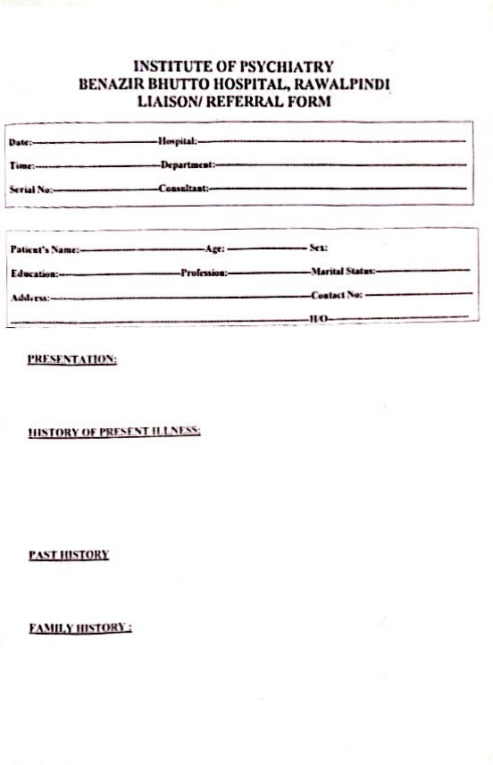
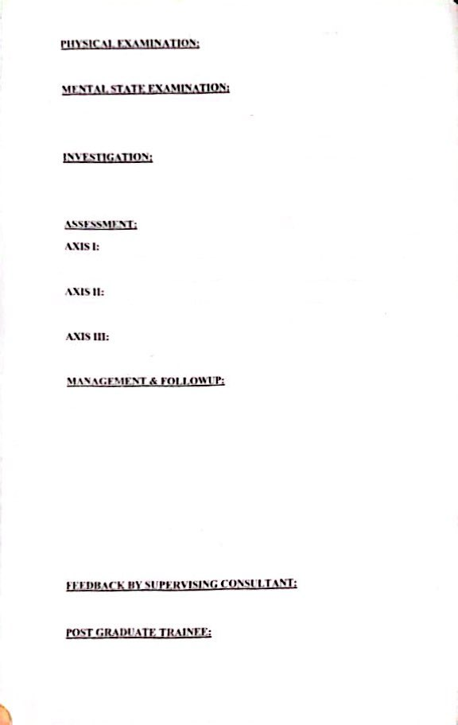
Liaison Register at Institute of Psychiatry

Slide 47
DIAGNOSIS OF REFERRED CASES IN TWO YEARS 2022-2023
DIAGNOSIS | FREQUENCY | PERCENTAGE
Depression | 258 | 27.1
Dissociative/Conversion Disorder | 127 | 13.4
Delirium | 98 | 10.3
Bipolar Affective Disorder | 97 | 10.2
Other Neurosis | 73 | 7.7
Organic | 61 | 6.4
Substance Abuse | 53 | 5.6
Schizophrenia | 44 | 4.6
Self harm | 11 | 1.2
Other | 113 | 11.9
No Psychiatric Diagnoses | 16 | 1.7
TOTAL | 1131

Slide 48
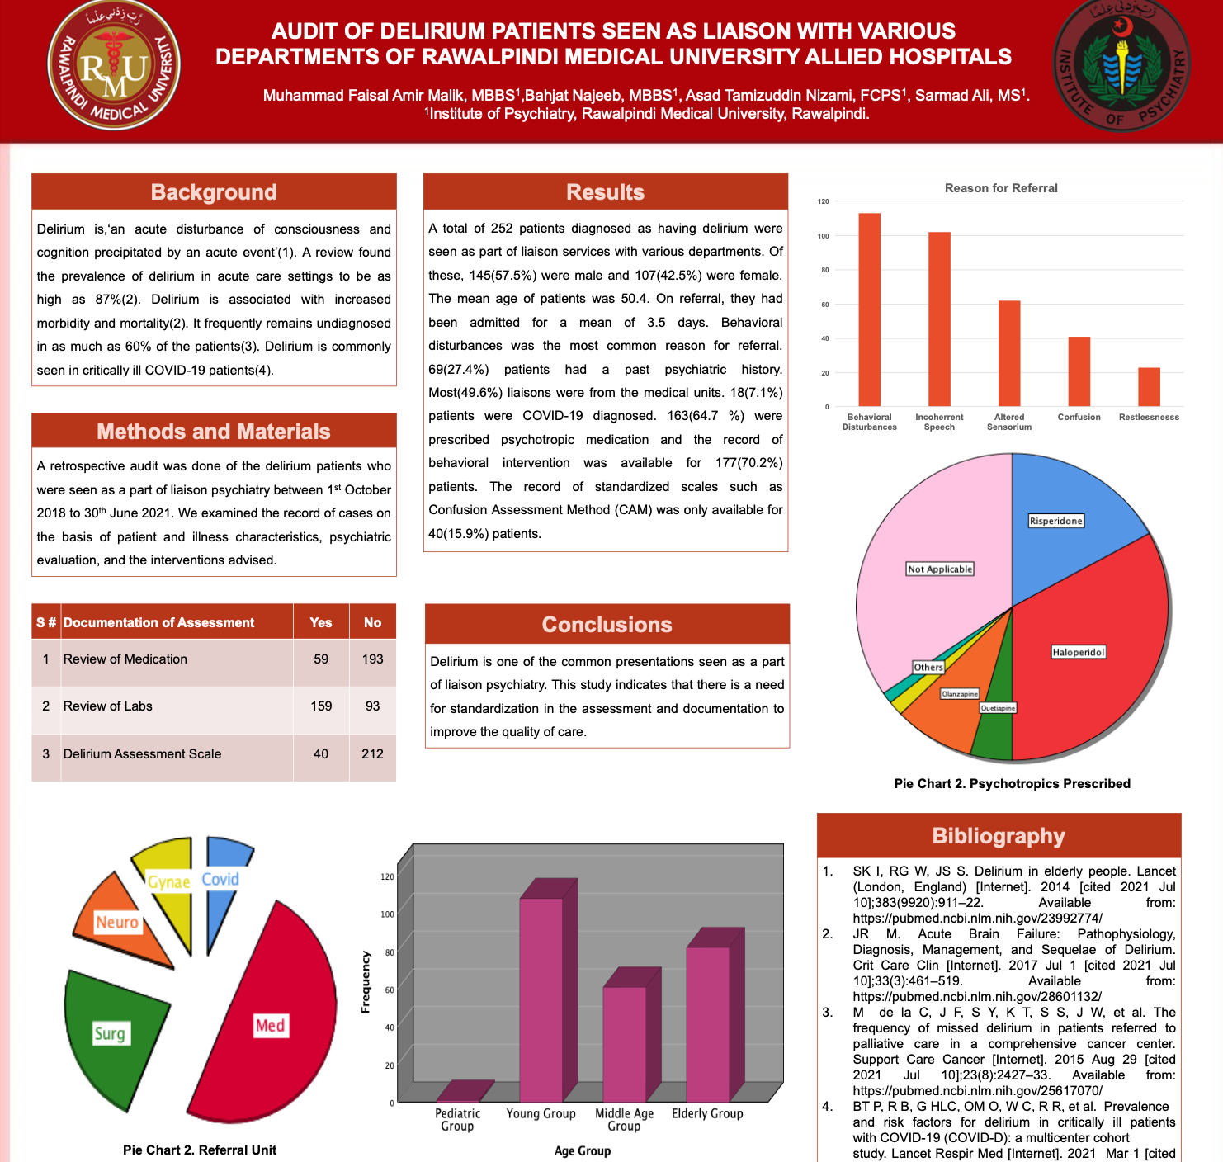

Slide 49
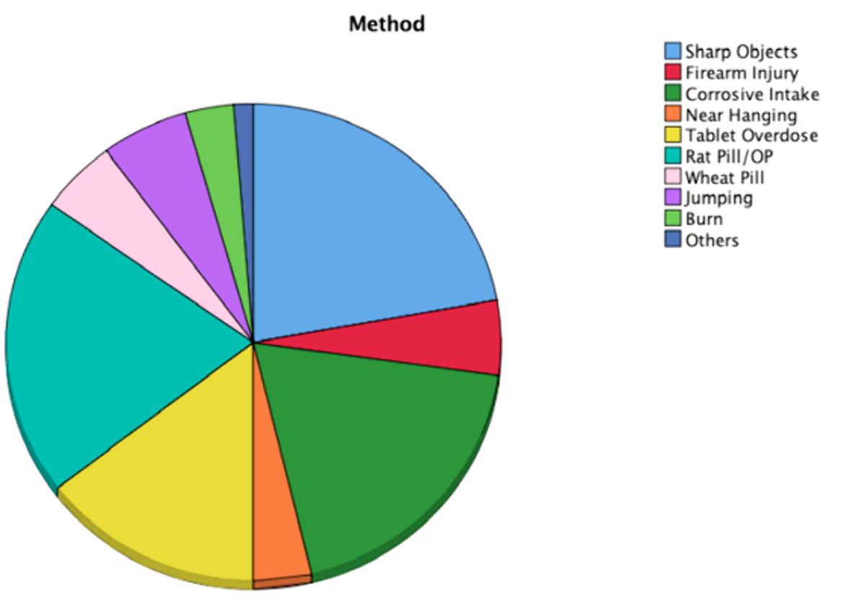
Patients with Self Harm seen as Liaison Psychiatry

Slide 50
Why to establish Liaison Psychiatric Services ?
Train general physicians to manage psychiatric emergencies/ presentations
Exposure of psychiatry residents to medical co-morbidities and vice versa
Development of curriculum for physicians on liaison psychiatry rotation in IOP
Set-up Tele Psychiatric Services to get consultations for patients admitted in other units of RMU Allied Hospitals

Slide 51
Establishment of Liaison Service at Institute of Psychiatry
Workshops were conducted to establish and improve Liaison Department at IOP facilitated by
Prof Dr Tayyab Tahir
Outline standard operational procedures for much broader collaborative scope inclusive of all other medical specialties at the Allied Hospitals of Rawalpindi Medical University
Department of Liaison Psychiatry
University of Wales, Cardiff
Royal College of Psychiatrists London

Slide 52
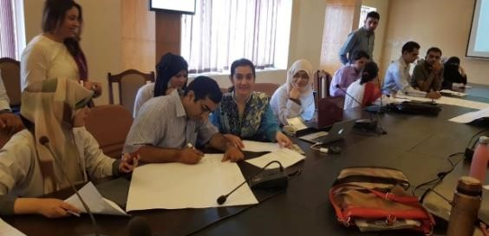
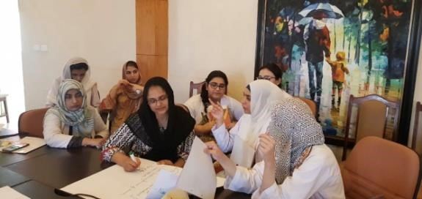
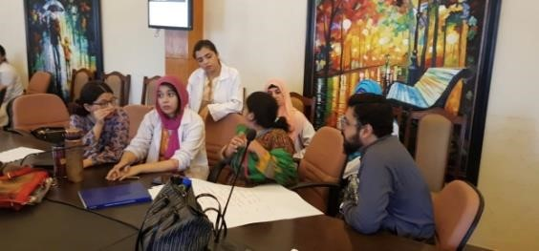
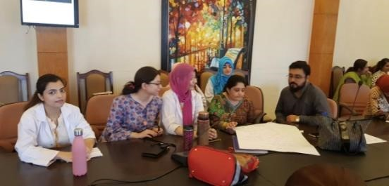
Workshops for establishment of Liaison Psychiatric Services

Slide 53
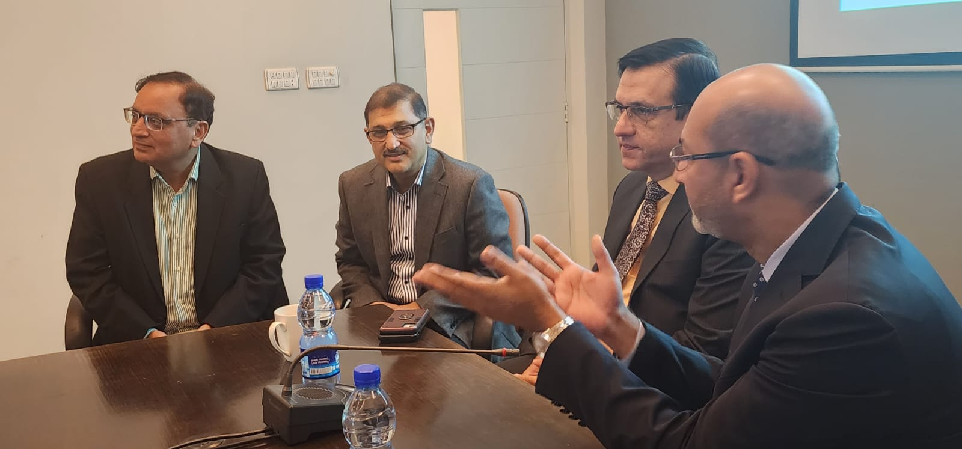
Collaboration with Medical and Surgical Departments

Slide 54
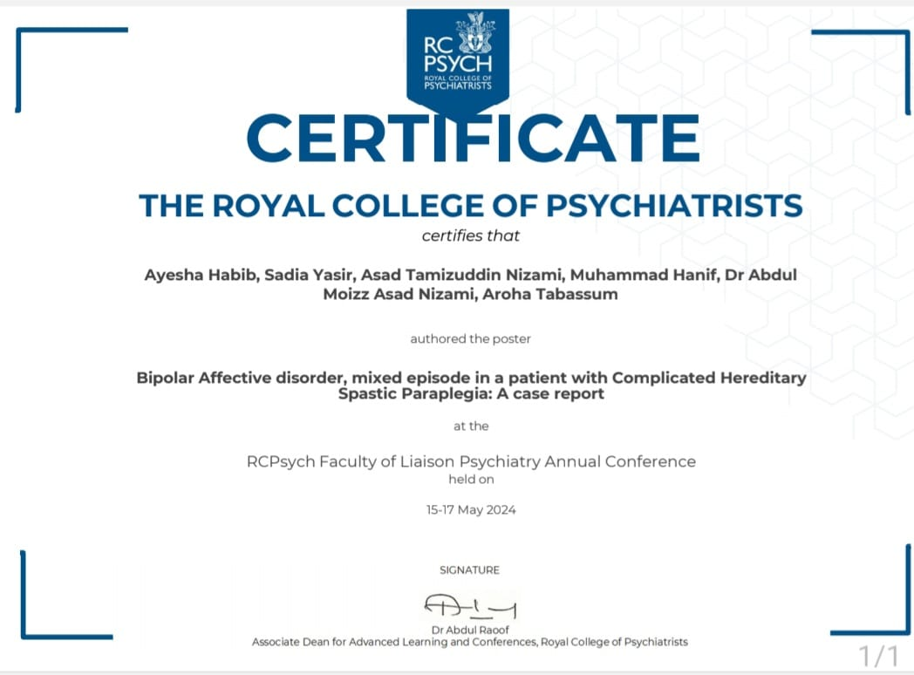
Poster presentation of Liaison Cases at
Royal College of Psychiatrists

Slide 55
Pakistan Psychiatry Society Recommendations

Slide 56
Meeting for People Living with HIV in Pakistan - May 28th,2024
APLHIV has identified 9 Centres in Pakistan where both ART and Psychiatric Services are available in the same hospital.
Train 2 early career psychiatrists for 2 days in June 2024 regarding cultural competence for People living with HIV.
One focal person from Institute of Psychiatry will
liaison between ART Clinic and Mental Health Services

Slide 57
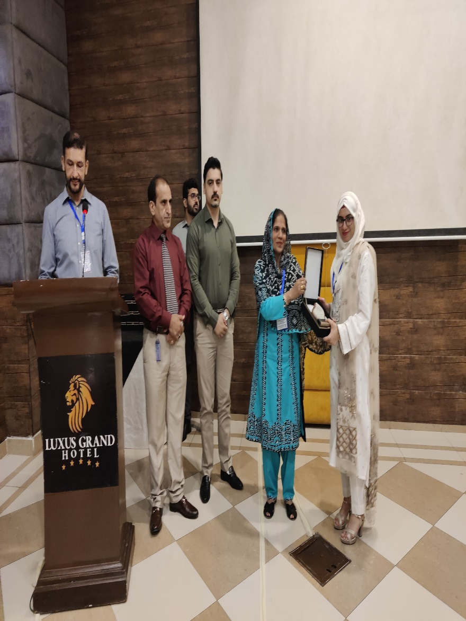
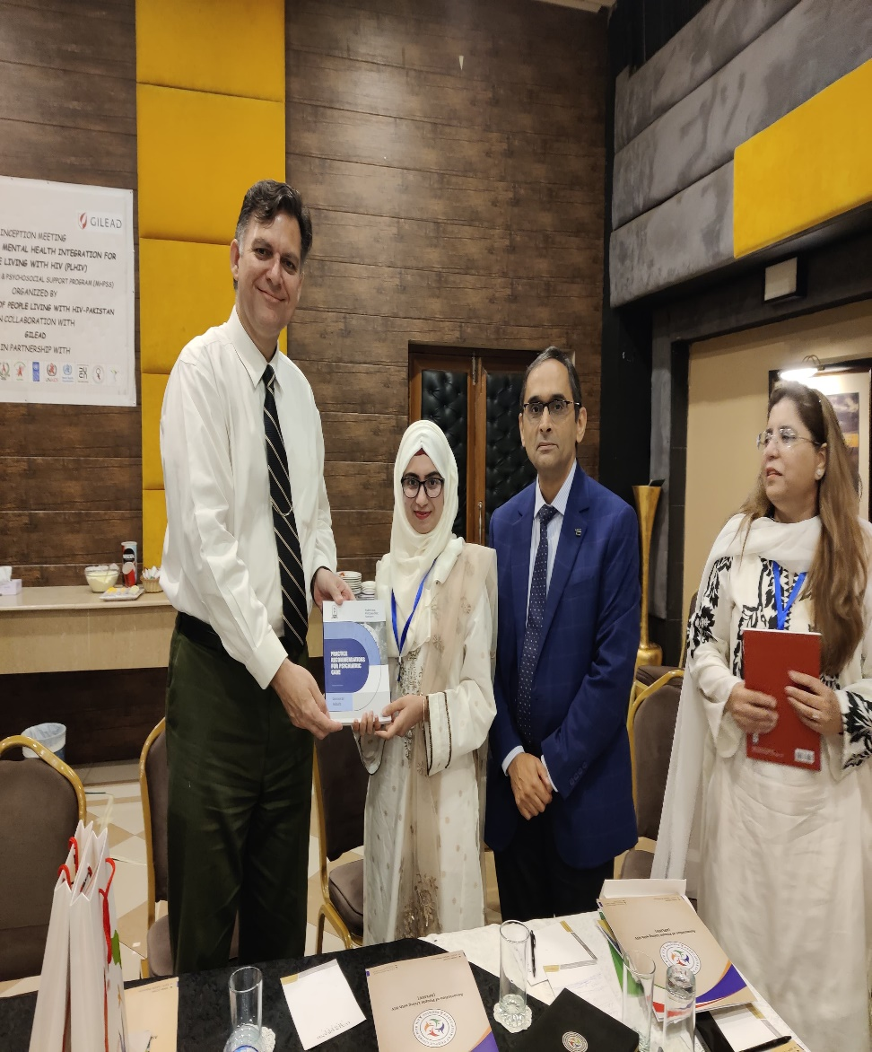

Slide 58
Institute of Psychiatry ioprmu@gmail.com
THANK YOU

