Slide 3
BURKITT’S LYMPHOMA
Dr Sadaf Ijaz
Senior Registrar, Pediatric Medicine
Benazir Bhutto Hospital Rawalpindi.

Slide 4
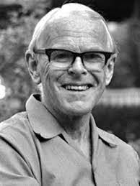
BURKITT’S LYMPHOMA
Discovered by Dennis Burkitt, a British surgeon who was working in Uganda (AFRICA).

Slide 5
NHL is classified into 03 types:
Lymphoblastic lymphoma(LBL)
Anaplastic large cell lymphoma (ALCL)
Mature B-cell lymphoma
Burkitt lymphoma (BL)
Diffuse large B-cell lymphoma (DLBCL)

Slide 6
NON HODGKIN LYMPHOMA
Pediatric NHL is mostly (> 95%) a high-grade tumor.
Constitutes 6-8% of all malignancies in patients under 20 years of age
Median age of presentation is 10 years.
Association: EBV, human immunodeficiency virus (HIV) and possible link to human T-cell lymphotropic virus.

Slide 7
Chromosomal translocation that involves the MYC gene is the hallmark of Burkitt's lymphoma diagnosis

Slide 8
Types of Burkitt’s lymphoma
Endemic type
Sporadic type
Immunodefficiency related

Slide 9
CLINICAL FEATURES
Approximately 70% of children present with
Advanced-stage disease, including
extranodal disease with gastrointestinal,
bone marrow and
CNS involvement.
Diffuse leukemia
Massive abdominal, head and neck, tumor and
can metastasize to the bone marrow or CNS.

Slide 10
Primary gastrointestinal involvement occurs in about 30% (usually Burkitt histology), commonly presenting as an abdominal mass with “acute abdomen”.
Involvement of the bone marrow occurs at diagnosis in 10-30% of patients with BL.
CNS involvement at diagnosis is not common but is mostly seen in children with advanced-stage BL.

Slide 11
Thrombophilic state
Lymphomas are among the neoplasias at high risk for Venous Thromboembolism.
Aggressive lymphomas have about a 10–15% incidence rate of VTE in the first year.
Extensive disease , Immobility, the positioning of CVC, and administration of chemotherapy with anthracyclines all contribute to the VTE risk.
Previous episodes of VTE is also a risk factor.

Slide 12
COMPLICATIONS
Tumor lysis syndrome
Superior vena cava syndrome
Oppurtunistic infections
Chemotherapy complications
Complications related to thrombohilia

Slide 13
DIAGNOSIS

Slide 14
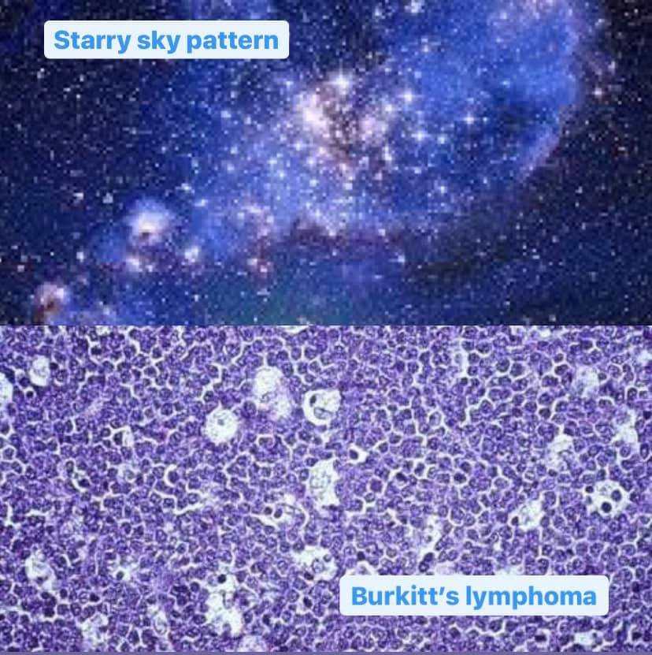
Histopathology
It is the Hallmark of diagnosis
Histology must be done before chemotherapy.
Findings:
Closely packed hyperchromatic monomorphic lymphoid cells interspersed with phagocytic histiocytes.
This is described as “STARRY SKY appearance”

Slide 15
RADIOLOGICAL INVESTIGATIONS
Chest x-ray and abdominal ultrasound as initial investigations
Neck, chest, abdomen and pelvis cross-sectional imaging (CT or MRI) are required for staging
Bone scan if clinically applicable (if no PET-CT available) and x-ray or MRI of suspect areas
Cranial and/or spinal MRI

Slide 16
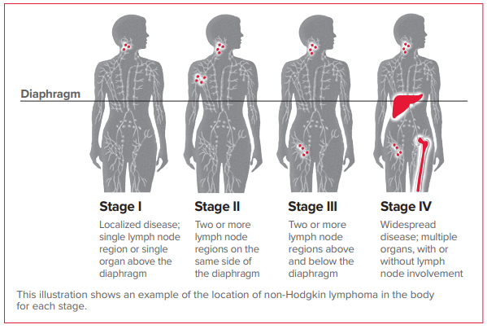

Slide 17
LABORATORY INVESTIGATIONS (for complications & pre chemotherapy)
Full blood count with differential and blood film morphology
Coagulation profile
Electrolytes, urea, creatinine, uric acid, calcium, phosphate,
Albumin, ALT, ALP, γGT, bilirubin
LDH – determine if >2ULN value
HIV screen
Hepatitis B screening (pre-rituximab)
Bilateral bone marrow aspirate and trephine biopsy
Lumbar puncture for blast cells CSF CYTOSPIN

Slide 18
MANAGEMENT
Chemotherapy/Chemo-immunotherapy- Depending upon stage of disease.
Surgical therapy-surgical biopsy, Evaluation of residual mass. Otherwise limited role in treatment

Slide 19
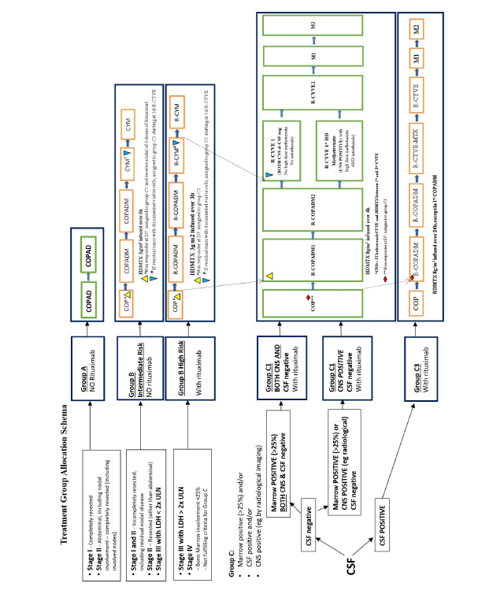

Slide 20
MANAGEMENT OF COMPLICATIONS
Tumor lysis syndrome
Pneumocystis Carnii prophylaxis
Febrile neutropenia

Slide 21
FOLLOW UP
Patient is seen monthly during the first year.
Clinical examination
Abdominal ultrasound and Chest x-ray.
Routine use of CT, MRI or PET-CT imaging in follow up in the absence of symptoms or signs of relapse is not recommended

Slide 22
LITERATURE REVIEW

