Slide 9
CASE PRESENTATION
DR. Hina Gulzar
MEDICAL UNIT 2
BENAZIR BHUTTO HOSPITAL
RAWALPINDI

Slide 10
DEMOGRAPHIC PROFILE
NAME | XYZ
AGE/gender | 28y/o Female
ADDRESS | Chakwal
OCCUPATION | Home maker
DATE OF ADMISSION | February 28th, 2023
MODE OF ADMISSION | ER

Slide 11
PREMORBIDS
Nil

Slide 12
PRESENTING COMPLAINTS
Headache -- 5 days
Multiple episodes of generalized tonic clonic fits – 2 days
Altered level of consciousness along with left sided weakness - 1 day

Slide 13
HISTORY OF PRESENTING COMPLAINTS
My patient was in usual state of health 5 days back she developed Headache
Sudden in onset, worst on awakening.
Moderate to severe in intensity, spreading diffusely over the cranium
Throbbing in nature, radiating to back of head
Exacerbated on coughing, sneezing, exertion, and recumbency
Relieved partially by analgesics
Associated with nausea and vomiting.

Slide 14
CONTINUED…
Not associated with aura, earache, tinnitus, aural fullness/ discharge, toothache, rhinorrhea
No history of head trauma in the recent past.

Slide 15
CONTINUED….
Generalized tonic colonic fits,
Unprovoked, episodic, with each episode lasting for 2-3mins, and culminating spontaneously.
Bilateral, symmetrical, causing tonic posturing of limbs with
no tongue bite followed by myoclonic jerky movements
along with up rolling of eyes and frothing from mouth.
Preceding aura was absent .

Slide 16
CONTINUED…
Fits were followed by post-ictal confusional state.
No history of fever, trauma to head, sleep disturbance, substance abuse, infection with measles in the past.
No history of similar episodes in the past

Slide 17
CONTINUED…
Attendants also complained of depressed level of consciousness with difficulty to arouse
Irritability, impaired judgement and loss of self-recognition were noted.
Decreased attention span, and poor orientation of surroundings were reported by attendants
No association with memory impairment, and such event in the past

Slide 18
CONTINUED…
Altered conscious level associated with weakness
Involving left side of the body.
Sudden in onset ,non progressive and symmetrical involving left upper and lower limb along with confused and irrelevant talk.
No history of drooping of face, difficulty in swallowing and urinary and fecal incontinence
No history of stroke in past.

Slide 19
PAST MEDICAL /SURGICAL HISTORY :
Past Medical History :
Old treated pulmonary TB – 15 years back with no sequalae/ complications –record not available.
Past surgical history :
History of emergency lower segment caesarean section – 9 days back, at a private health facility in Chakwal due to grade 3 meconium leading to foetal distress.

Slide 20
Drug History/ ALLERGIES HISTORY :
Nil

Slide 21
GYNAECOLOGICAL AND OBS HISTORY
Menarche – 13 years
Cycle – 7/28 days
Blood flow – normal (no history of Menorrhagia)
Married for last 3 years, with 2 alive issues
Age | Gender | Gestational age | Mode of delivery | Complication | place of delivery
2 years | female | 38 weeks | SVD | nil | Private hospital, Chakwal
9 days | male | 38 weeks | EM-LSCS | Meconium grade 3, fetal distress | Private hospital Chakwal

Slide 22
PERSONAL HISTORY
Immunized completely according to EPI Schedule.
No history of addictions, normal bowel and bladder habits
No sleep disturbances

Slide 23
FAMILY HISTORY
Family comprises of Husband and 2 offsprings.
No history of consanguinity in parents
No history of similar symptoms in any other family member noted.
No family history of Diabetes Mellitus, Hypertension, Malignancies , Ischemic heart disease , Tuberculosis or any other disease.

Slide 24
SOCIOECONOMIC HISTORY
She belongs to low socioeconomic class .
Living in her own house, which comprises of 1 bedroom and 1 bathroom, shared by 4 family members.
Using tap water for drinking
Depends on husband for financial support
Monthly income 25 - 35 thousands

Slide 25
SYSTEMIC INQUIRY
GENERAL | Fatigue + No history of malaise, fever, weight loss and sleep disturbances.
CENTRAL NERVOUS SYSTEM | History of headache, fits, behavioural abnormalities, and limb weakness present.
GASTROINTESTINAL SYSTEM | No history of abdominal pain, constipation, melena, hematemesis.
CARDIOVASCULAR SYSTEM | No history of chest pain ,pedal edema

Slide 26
Continued…
RESPIRATORY SYSTEM | No history of chest pain, cough ,shortness of breath and wheeze
MUSCULOSKELETAL SYSTEM | Nil
DERMATOLOGICAL SYSTEM | Nil

Slide 27
GENERAL PHYSICAL EXAMINATION
young female of average height and built
VITALS
PULSE | 70 bpm
BLOOD PRESSURE | 140/80 mmHg
TEMPERATURE | 98 F
RESPIRATORY RATE | 18/min
SPO2 | 96% at room air in supine position.
BSR | 125mg/dl

Slide 28
CENTRAL NERVOUS SYSTEM
Examination was limited due to poor cooperation of the patient
HIGHER MENTAL FUNCTION:
GCS 13/15 E4V4M5
Not oriented in time, place and person
2, SPEECH: confused with irrelevant talk

Slide 29
CONTINUED….
3. MOOD & BEHAVIOUR: irritable
4. SIGNS OF MENINGEAL IRRITATION: absent
5. CRANIAL NERVES:
Pupils: BL equally reactive to light, light reflex
and eye movements normal.
Fundoscopy: B/L elevated and blurred disc margins ,findings suggestive of Grade 3 papillary oedema
Gag reflex: intact

Slide 30
CONTINUED…
6. MOTOR SYSTEM:
Power: 4/5 in Left upper and lower limb
5/5 in Right upper and lower limb
Tone: normal
No muscle wasting or fasciculation noted
Gait- could not be assessed as patient was non-ambulatory.
Involuntary movements: nil
Tremors, tics, chorea, myoclonus were absent.

Slide 31
CONTINUED…
7. REFLEXES: all superficial reflexes intact
all deep tendon reflexes intact
Planter: Left sided withdrawal response
Right sided flexor response
8. SPINE EXAMINATION: unremarkable
9. CO-ORDINATION: could not be assessed due to poor cooperation of patient .

Slide 32
GASTROINTESTINAL SYSTEM
ABDOMEN: normal shape with central, inverted umbilicus, healthy cesarian scar with healing edges. No oozing of pus noted.
No visceromegaly
Liver and Spleen not palpable
Fluid thrill/ shifting dullness : absent
Bowel sounds: audible

Slide 33
RESPIRATORY SYSTEM
TRACHEA CENTRAL
NORMAL PERCUSSION NOTE IN ALL ZONES
VOCAL RESONANCE NORMAL
NORMAL VESICULAR BREATHING IN ALL LUNG FIELDS

Slide 34
CARDIOVASCULAR SYSTEM
APEX BEAT IN LEFT 5TH INTERCOSTAL SPACE MEDIAL TO MIDCLAVICULAR LINE
NORMAL HEART SOUNDS
NO MURMUR OR BRUIT

Slide 35
SUMMARY
A 28 years old post partum female presented through ER with complaints of
HEADACHE
GENERALIZED TONIC CLONIC FITS
ALTERED CONSIOUS LEVEL ALONG WITH LEFT SIDED WEAKNESS
History of Emergency lower segment cesarian section due fetal distress 9 days back
Rest of systemic inquiry insignificant
No history of fever, trauma, substance abuse ,PIH and pre-eclampsia
Vitally stable with B.P 140/80mm
GCS 13/15 with irritability ,irrelevant talk and power 4/5 in left upper and lower limb having L planter’s withdrawal response with no SOMI .
Rest of systemic examination unremarkable

Slide 36
Provisional Diagnosis
CEREBROVASCULAR ACCIDENT.
CNS INFECTIONS (MENINGIOENCEPHALITIS)
DEMYLELINATING DISEASE.
SOL BRAIN.

Slide 37
INVESTIGATIONS
BLOOD CP
ESR | 10mm/hr.
Hb | 12.2g/dl
WBC | 8.0*10^3 /micro liter
PLT | 325,000/micro liter
MCV | 74.7 Fl
Neutrophils | 66.6%
lymphocytes | 27.2%

Slide 38
CONTINUED…
RBC PERIPHERAL FILM
Normocytic normochromic picture
Retics count 1.0%

Slide 39
CONTINUED…
RFTS AND ELECTROLYTES
UREA | 44
CREATININE | 0.3
SODIUM | 138
CHLORIDE | 104
POTASSIUM | 4.7

Slide 40
CONTINUIED…
LFTs
ALT | 26
AST | 32
ALP | 69
T.BIL | 0.9

Slide 41
CONTINUED…
Uric acid | 4.6mg/dl
Urine R/E
Proteins | Negative
Pus cells | 1-2/HPF

Slide 42
CONTINUED…
Ultrasound abdomen and pelvis
liver: normal size (11 CM)
gallbladder: normal wall thickness, no mass or calculi seen.
spleen: normal in size 9.5cm, no focal solid or cystic mass seen.
KUB ;Normal study
Uterus: postpartum with normal endometrial walls thickness. No free fluid noted.
Impression: Normal stud
B/L LOWER LIMB;ARTERIAL AND VENOUS DOPPLER USG
Unremarkable study with no evidence of significant stenosis/occlusion noted

Slide 43
CONTINUED….
ECHOCARDIOGRAPHY;
EF 60%
Normal size LV ,with normal systolic function
No segmental wall motion abnormalities noted
No valvular abnormality noted
Normal size RA and RV with normal function
Impression
Normal size heart chambers with good LV systolic function.
EF 60%

Slide 44
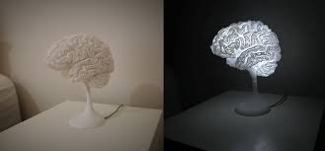
CT +MRI + MRV BRAIN
DR HINA HANIF MUGHAL
ASSOCIATE PROFESSOR RADIOLOGY,
HEAD OF RADIOLOGY DEPARTMENT
BENAZIR BHUTTO HOSPITAL

Slide 45
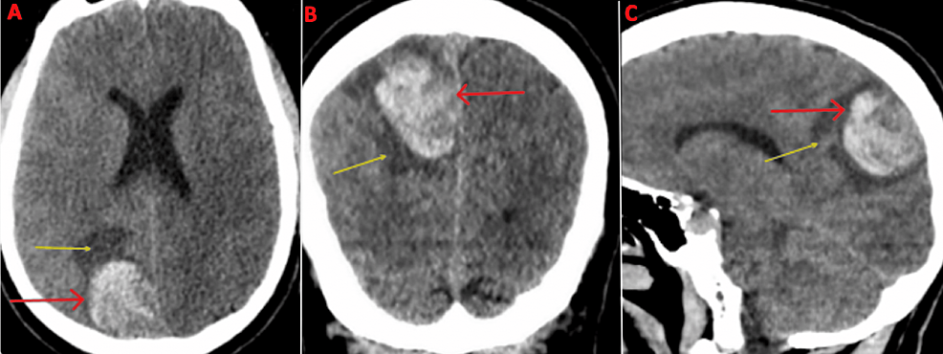
CT BRAIN PLAIN

Slide 46
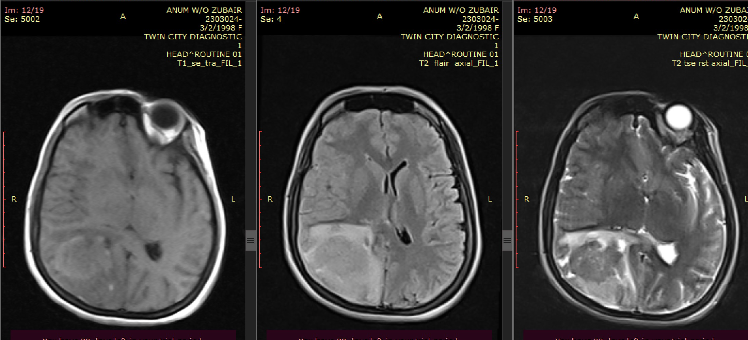
MAGNETIC RESONANCE IMAGING BRAIN

Slide 47
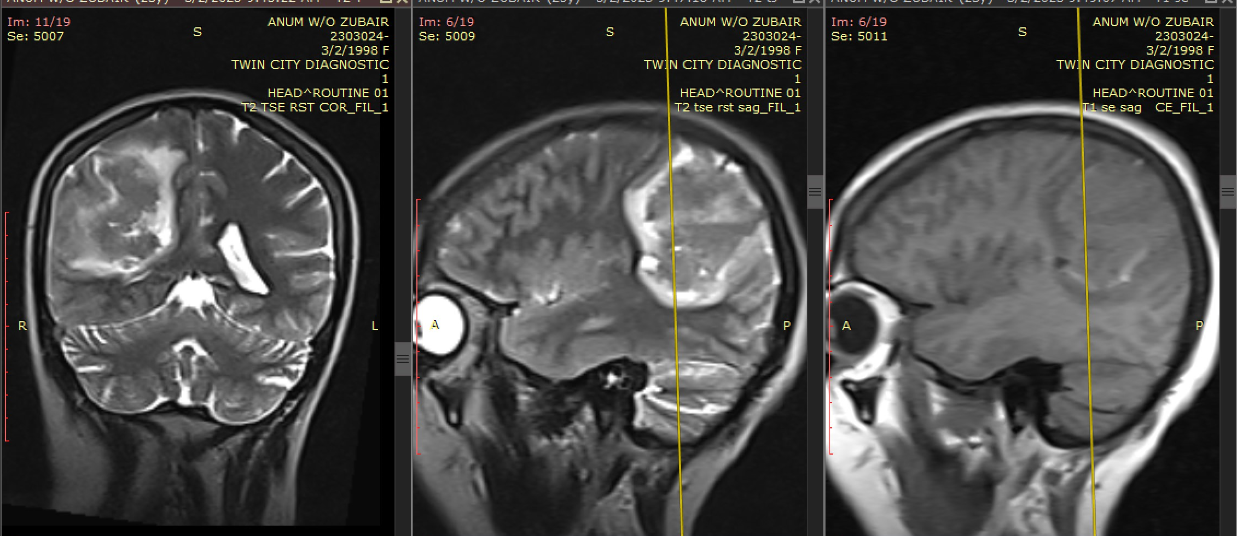
MAGNETIC RESONANCE IMAGING BRAIN

Slide 48
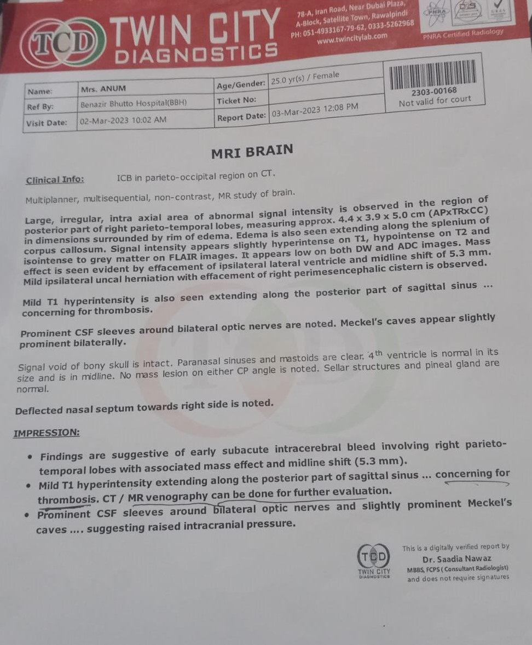

Slide 49
MAGNETIC REASONANCE VENOGRAPHY BRAIN

Slide 50
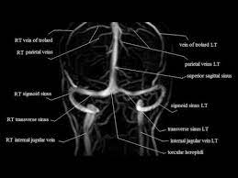
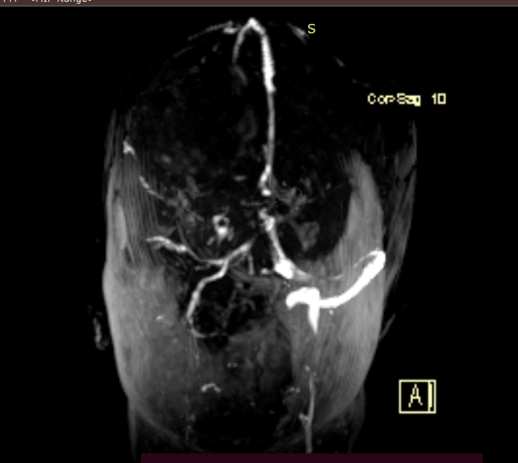
MRV

Slide 51
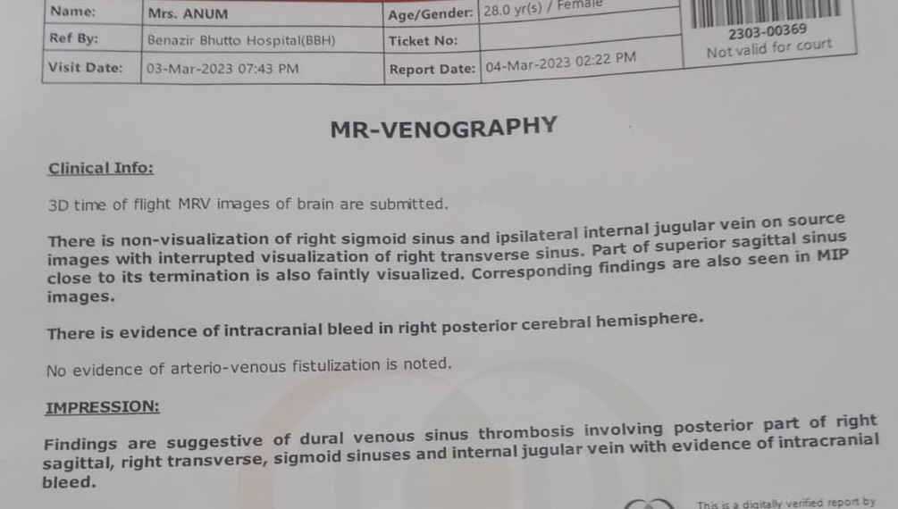

Slide 52
CONTINUED….
ANA | NEG
D-Dimer | 0.3 mg/L FEU
APLA antibodies | NEG
Anti cardiolipin antibodies | NEG
Protein S | WNL
Protein C | WNL
Anti-thrombin III | WNL
P-ANCA | NEG
C-ANCA | NEG

Slide 53
CONTINUED…
FASTING LIPID PROFILE
TOTAL CHOLESTEROL | 160mg/dl
Triglycerides | 100mg/dl
HDL | 52mg/dl
LDL | 77mg/dl
VLDL | 21mg/dl
Cholesterol : HDL | 3.0

Slide 54
FINAL DIAGNOSIS
POST PARTUM CEREBRAL VENOUS SINUS THROMBOSIS.

Slide 55
MANAGEMENT
Injection Mannitol iv BD
Injection Levetiracetam 500mg iv BD
Analgesics
Physiotherapy
Direct oral anticoagulants (DOACS) Tab Rivaroxaban 15mg BD
Iv antibiotics

Slide 56
FOLLOW UP
Patient discharged on DOACS tab rivaroxaban 15mg bd for 3 weeks .
After 3 weeks rivaroxaban 20mg OD for 6 months
Anti epileptics for 3 months and than tapered off.
Follow up for assessment of improvement of neurological deficit .
Counselled regarding prophylactic use of anticoagulants in future pregnancies and specialist consult.

