Slide 4
The Most Compassionate
taught the Quran,
created humanity,
˹and˺ taught them speech.
The sun and the moon ˹travel˺ with precision.
The stars and the trees bow down ˹in submission˺.
As for the sky, He raised it ˹high˺, and set the balance ˹of justice˺
so that you do not defraud the scales.
Weigh with justice, and do not give short measure.
He laid out the earth for all beings.
In it are fruit, palm trees with date stalks,
and grain with husks, and aromatic plants.
Then which of your Lord’s favours will you ˹humans and jinn˺ both deny?

Slide 5
CLINICO-PATHOLOGICAL CONFERENCE
DROOPING DILEMMA
DR.HASEEB AHMED
POST GRADUATE RESIDENT MEDICINE UNIT-1
HOLY FAMILY HOSPITAL

Slide 6
DEMOGRAPHIC DETAILS
Name: ABC
Age: 34 years Female
Marital status: Married for 13 years
Residence: Punjab
Homemaker
Date of admission: 10/09/2023
Mode of admission: OPD

Slide 7
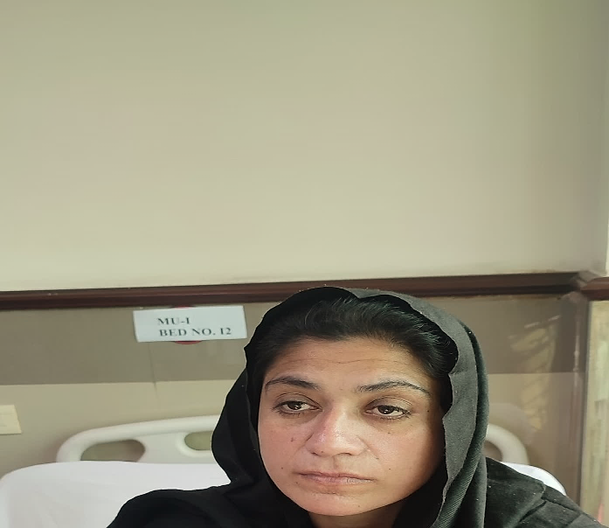
PRESENTING COMPLAINTS
Low grade fever – 12 months
Left sided chest pain-2 months
Drooping of both eyelids- 1 week
PICTURE TAKEN WITH PATIENT’S CONSENT

Slide 8
HISTORY OF PRESENTING ILLNESS
Patient was in optimal state of health one year ago when she started having low grade intermittent fever, insidious onset , not associated with rigors and chills or night sweats,no diurnal variation, no aggravating factors .Temperature was temporarily relieved by anti-pyretics. It was associated with fatigue and undocumented weight loss.
She had an episode of abdominal pain one year ago. It was acute in onset, intermittent, without any aggravating or relieving factors. It was generalized, non colicky , not associated with vomiting, diarrhea, jaundice , constipation , hematemesis, melena or any urinary complaints. She was investigated in a hospital which revealed ascites. On the basis of Ascitic fluid RE and CT abdomen, she was diagnosed and treated as case of abdominal tuberculosis. However, ATT was stopped after two months due to absence of clinical response.

Slide 9
HISTORY OF PRESENTING ILLNESS (contd.)
She also complained of lumps in inguinal region for which she underwent lymph node FNAC and excisional biopsy which revealed only reactive hyperplasia.
She was repeatedly investigated for cause of fever however no cause was found.

Slide 10
HISTORY OF PRESENTING ILLNESS (contd.)
She presented to Medical unit 1 OPD with history of chest pain for past two months. It was acute in onset, intermittent, retrosternal, non radiating , relieved on sitting up and worse on deep inspiration. Chest pain was was not associated with cough, sputum ,fever, shortness of breath, sweating or apprehension.
She started having drooping of both eyelids for past one week. It was acute in onset, more in evening, associated with double vision , improved after rest and aggravated in morning. No history of head or eye trauma, thyroid surgery, visual disturbances, color desaturation, lower limb weakness ,headache, exopthalmous or proptosis.

Slide 11
SYSTEMIC ENQUIRY
There is history of Generalized weakness and lethargy, decreased appetite ,weight loss- upto 8 kg in one year.
History of photosensitive Rash involving face.
Polyuria, periorbital puffiness, pedal edema and frothy urine for past six months.
History of significant hair loss in last one year with previous history of loss of lateral eyebrows.
On and off history of self resolving joint pains involving knee joints, small joints of hands, wrist, elbow and shoulder joints.

Slide 12
SYSTEMIC ENQUIRY (contd.)
History of cervical and axillary swellings from one year
She had Menorrhagia and irregular menstrual cycles from one year
There was history of color changes of hands and feet upon cold exposure, white to blue to red (Raynaud phenomena positive)
Constipation was off and on, relieved by itself, not associated with vomiting or alternating bowel habits.

Slide 13
PAST MEDICAL HISTORY
Took alternative medications 4 years back for joint pains.
History of hospital admission for severe abdominal pain, discharged and labelled as abdominal TB
Received Multiple antibiotic regimes in last 4 years.
Gynecological visits for menstrual irregularities in last one year.
No history of miscarriages or abortions and all three children of hers were born via spontaneous vaginal delivery.

Slide 14
SOCIOECONOMIC HISTORY
Belongs to middle socioeconomic class.

Slide 15
GENERAL PHYSICAL EXAMINATION
A young anxious looking female with persistent frowning over forehead lying comfortably on bed with following vitals.
Pulse =68 beats /min
BP =130/90 mmHg
RR =18/min
Temp =98 F

Slide 16
GENERAL PHYSICAL EXAMINATION (contd.)
Visible ptosis of both eyes
Mild Conjunctival pallor observed
B/L palpable anterior cervical and axillary lymph nodes.
They were 3 to 4 in number located in left posterior cervical and right anterior cervical chain, small in size up-to 1cm, firm, non tender, non rubbery, discreet with no overlying skin changes or discharge.

Slide 17
GENERAL PHYSICAL EXAMINATION (contd.)
There was a firm diffusely enlarged midline swelling in the front of neck, size about 5*5 cm. It was non tender, non nodular , moved with deglutition and not on tongue protrusion. No overlying skin changes were observed. No bruit was audible and Pemberton sign was negative. There were no eye signs like exophthalmos, lid lag, lid retraction. There was neither delayed ankle jerk nor pretibial myxedema.
ENLARGED THYROID GLAND GRADE II WITH NO CLINICAL SIGNS OF HYPO OR HYPERTHYROIDISM OR RETROSTERNAL EXTENSION
No koilonychia, leukonychia , jaundice or pedal edema was observed.

Slide 18
SYSTEMIC EXAMINATION

Slide 19
NEUROLOGICAL EXAMINATION
Upon eye examination, there was evidence of non - fatigable ptosis with negative Simpson’s test,-ve Ice pack test, -ve rest test)
There was bilateral symmetrical drooping of eyelids. Right eye aperture was 4mm and left was 5mm.
Pupils were bilaterally equally reactive round and regular, no evidence of ophthalmoplegia in any plane. Visual field was intact.
Bilateral clear disc margins without any evidence of optic atrophy or disc blurring.
Rest of the cranial nerve examination was intact.

Slide 20
NEUROLOGICAL EXAMINATION (contd.)
Tone was normal, power was 5/5 in both upper and lower limbs and at both distal and proximal joints.
Reflexes were intact
Plantars were down-going bilaterally
No impairment in gait and coordination
No difficulty in over head abduction and in getting up from sitting position even after repeated muscle movements
Sensory system , sense of vibration and proprioception was intact.

Slide 21
RESPIRATORY SYSTEM EXAMINATION
Reduced left sided chest movements
Stony dull percussion note below left 5th rib
Decreased breath sounds below left 5th rib
Reduced vocal resonance
FINDINGS WERE CONSISTENT WITH MILD LEFT SIDED PLEURAL EFFUSION.

Slide 22
GASTROINTESTINAL SYSTEM EXAMINATION
Abdomen was soft, non tender, non distended.
Liver span was normal
Spleen was palpable 3 fingers below left costal margin.
No evidence of ascites.
Rest of the exam was unremarkable.

Slide 23
CARDIOVASCULAR SYSTEM EXAMINATION
Unremarkable cardiovascular examination

Slide 24
DIFFERENTIAL DIAGNOSIS
Systemic lupus Erythematosus with Myasthenia gravis overlap as a case of poly-autoimmunity
Autoimmune thyroiditis with Myasthenia gravis
Hodgkin’s Lymphoma
Disseminated tuberculosis
Myasthenia Gravis (ocular type)
Sarcoidosis

Slide 25
INVESTIGATIONS

Slide 26
INVESTIGATIONS | 11/11/2023
WBC | 1.5/ mm³ Neutro= 56% , lympho= 39% ANC =840 ( moderate neutropenia)
Hgb | 9.9 g/dL
MCV | 79.2 fL
MCH | 27.6 fL
PLATELETS | 148 * 10⁹
ESR | 92 mm/hr
UREA | 17mg/dL
CREATININE | 0.6mg/dL
BILIIRUBIN | 0.3mg/dL
ALT | 20 IU/L
ALP | 84 IU/L
PT | 15/13
APTT | 38/33

Slide 27
INVESTIGATIONS | RESULT
SODIUM | 141 mmol/L
POTASSIUM | 4.1 mmol/L
CHLORIDE | 103 mmol/L
TSH | 4.7 (0.4-4.5mIU/L)
TOTAL T4 | 7.57 ( 4.6-11uG/dl)
S.PROTEIN | 6.4 g/dL
S.ALBUMIN | 3.4 g/dL
LDH | 354 U/L
Urinary Albumin :Creatinine ratio | 90.6 mg/g
24-hour urinary protein | 1640 mg
C3 | 0.9 (0.7-1.7)g/l
C4 | 0.28 (0.2-0.5)g/l

Slide 28
INVESTIGATION | REPORT | NORMAL VALUES
S.Iron | 31 g/dl | 50-170
TIBC | 358ug/dl | 250-400
Folic Acid | 5.7 | 3.1-20.5
Vit B12 | 245pg/mL | 187-883
Serum Prolactin levels | 329 | 81-490
Serum Ionized Calcium levels | 1.19 | 1.16-1.32
Anti Thyroid microsomal antibodies | 37 | >20 +
Anti Thyroglobulin Antibodies | 79 | >4 +
QuantiFERON Gold test | Negative

Slide 29
CHEST X-RAY
MILD BLUNTING OF LEFT SIDED CP ANGLE .
CONSISTENT WITH LEFT SIDED MILD PLEURAL EFFUSION

Slide 30
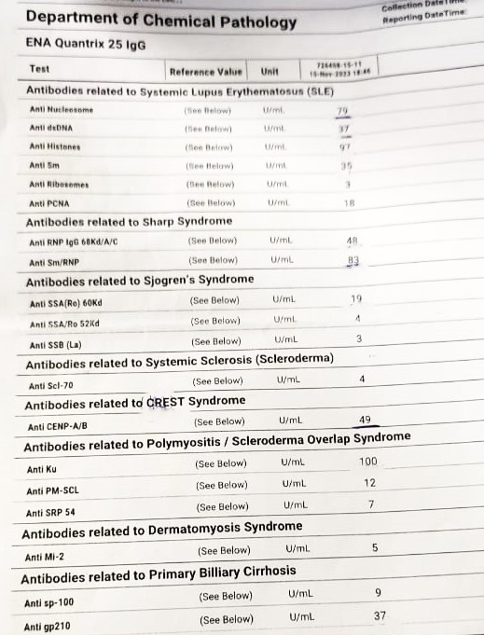
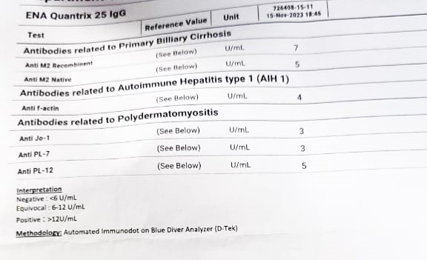
ENA PROFILE
Positive antibodies include
ANA
Anti dsDNA
Anti Histones
Anti Sm
Anti RNP
Anti SSA
Anti CENP
Anti KU
Anti gp210

Slide 31
INVESTIGATIONS:
ULTRASOUND ABD/PELVIS: SPLENOMEGALY(Spleen measuring 14.7cm)
FNAC Right Inguinal Lymph node: Reactive hyperplasia
2D ECHO: Normal study with good LV systolic function, EF=60%
NCS and EMG: Normal study

Slide 32
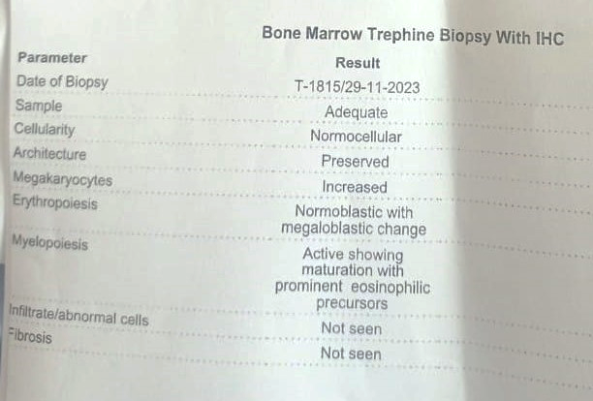
BONE MARROW TREPHINE BIOPSY REPORT

Slide 33
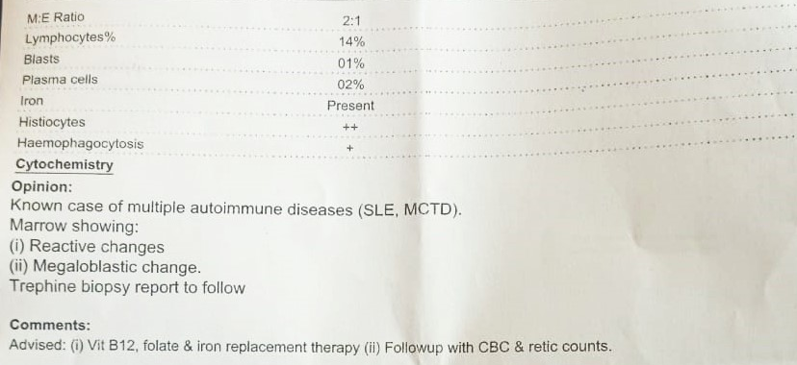
BONE MARROW BIOPSY REPORT

Slide 34
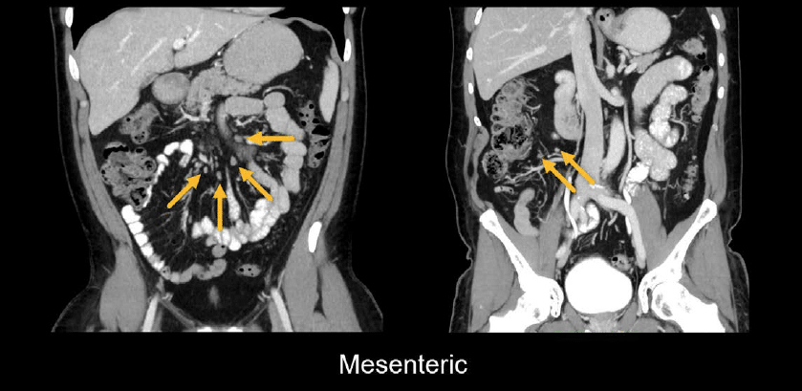
RADIOLOGY REVIEW
Dr Jahangir Khan
Consultant Radiologist
RMU and Allied Hospitals
Rawalpindi

Slide 35
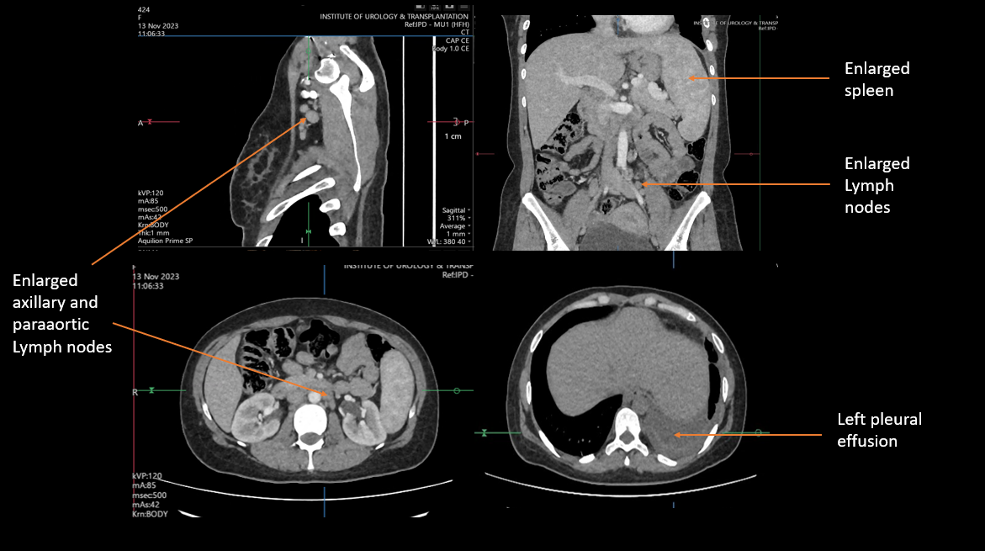
CT SCAN SLIDES /VIDEO

Slide 36
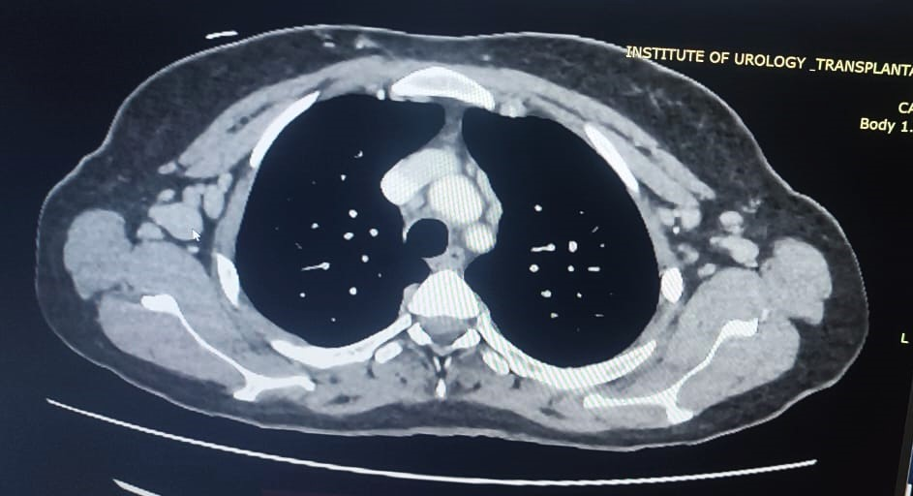

Slide 37
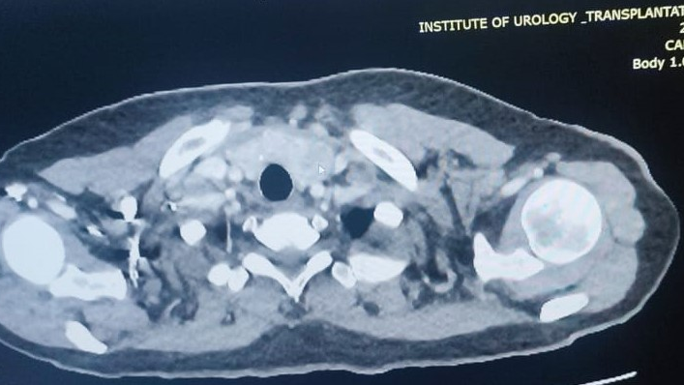

Slide 38
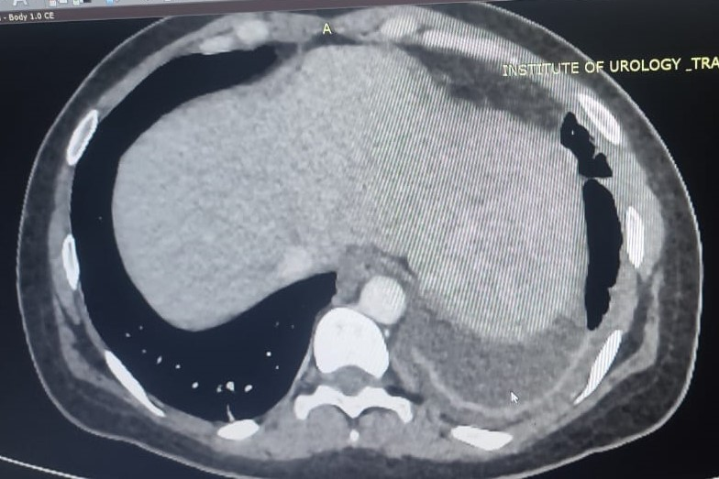

Slide 39
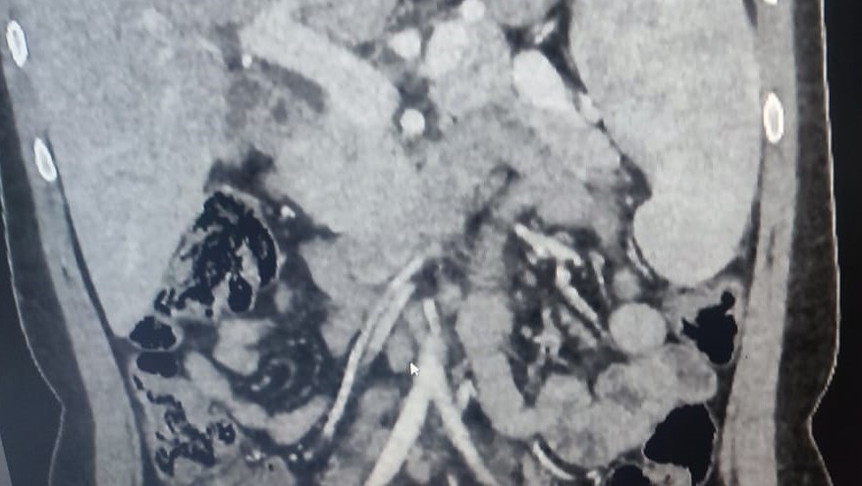

Slide 40
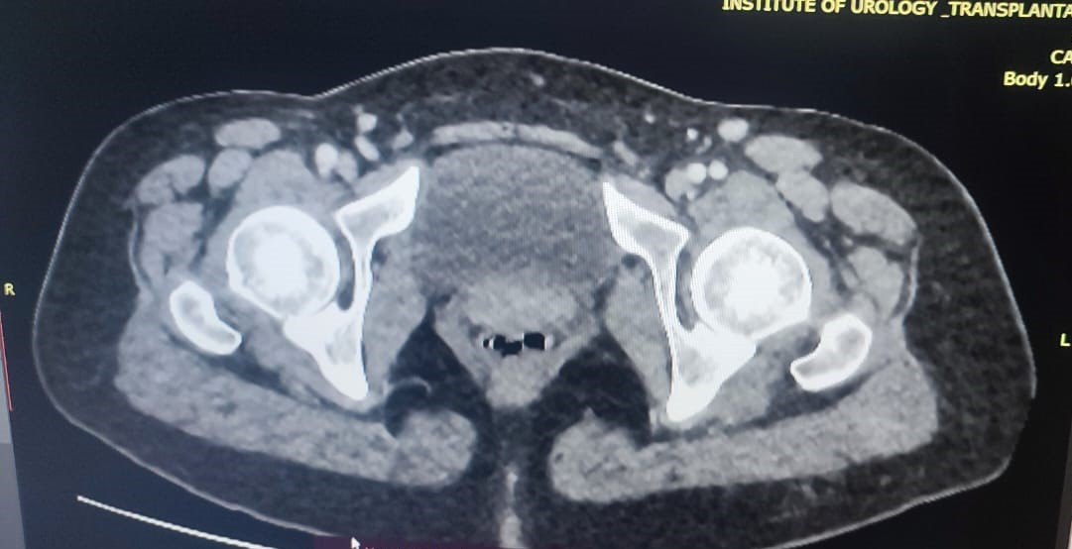

Slide 41
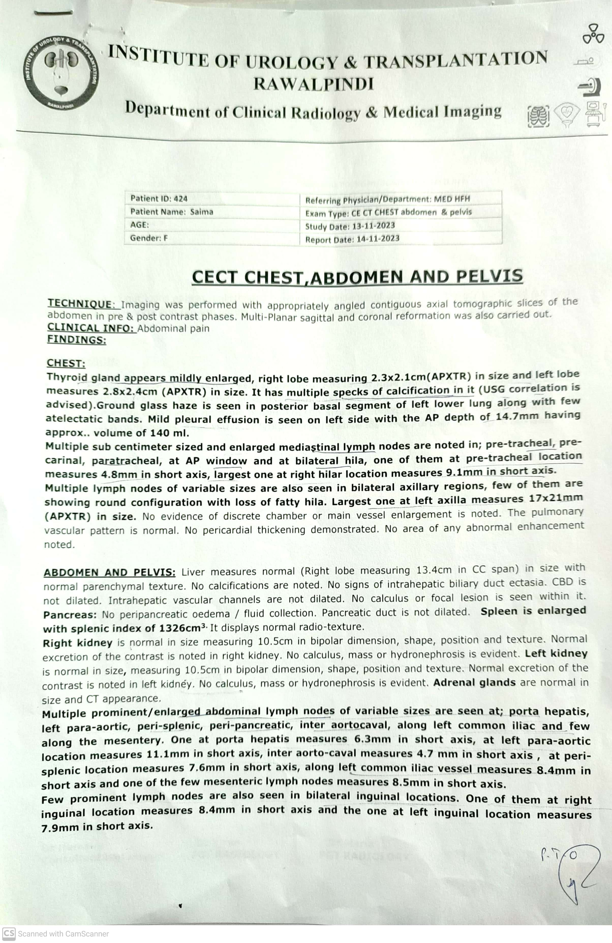

Slide 43
NEPHROLOGY REVIEW
Dr Sana Kifayat
Assistant Professor Nephrology
Benazir Bhutto Hospital Rawalpindi

Slide 44
RENAL BIOPSY
Changes in glomeruli: All glomeruli show mild or thickening of glomerular basement membrane with focal spikes on sliver special stain. No segmental scarring or mesangial cell proliferation is seen. No amyloid deposition or crescents formation is seen
Vessels: No vasculopathy is seen.
Tubules: Minimal focal tubular atrophy is seen.
Interstitium: Minimal focal interstitial inflammation and scarring is seen.
IMMUNOFLUORESCENCE:
IgG - Minimal (+/-) in the peripheral capillary walls and in mesangium
IgA - Minimal (+/-) in the peripheral capillary walls and in mesangium
IgM - Negative
C3 - Negative

Slide 45
RENAL BIOPSY
C4 - Negative
C1Q- Negative
NATIVE RENAL BIOPSY:- MEMBRANOUS GLOMERULONEPHRITIS.
COMMENTS By Pathologist: Keeping in view the clinical history of systemic lupus erythematosus, this may represent class V lupus.

Slide 46
MICROSCOPIC VIEW OF RENAL LUPUS V (MEMBRANOUS)

Slide 48
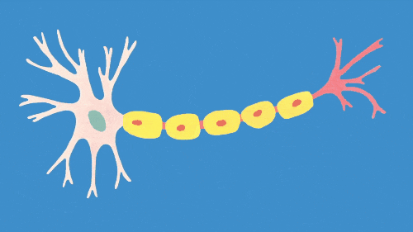
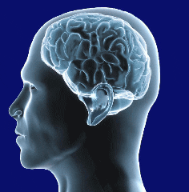
NEUROLOGY REVIEW
Dr Waqas Ahmed
FCPS Neurology
Assistant Professor Neurology
Benazir Bhutto Hospital Rawalpindi

Slide 50
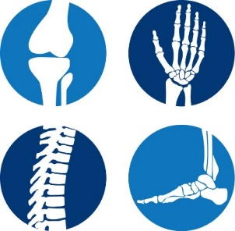
RHEUMATOLOGY REVIEW
Dr Shamaila Mumtaz
MBBS,FCPS(Med),FCPS(Rheumatology)
Consultant Rheumatologist
RTH Rawalpindi

Slide 51
IS IT LUPUS ?
Arthralgias, Photosensitivity, Raynaud’s phenomenon
Serositis
Auto-antibodies, Membranous GN (SLICC)

Slide 52
HOW SEVERE IS DISEASE ?
Lupus Nephritis Class V
NPSLE ??

Slide 53
NEUROPSYCHIATRIC SLE (NPSLE)
ACR – 19 distinct Neuropsychiatric syndromes
(Broad spectrum of severity)
NPSLE – 20 % of lupus patients
(Higher in Pakistani Population)
(Higher in those with Renal involvement)

Slide 54
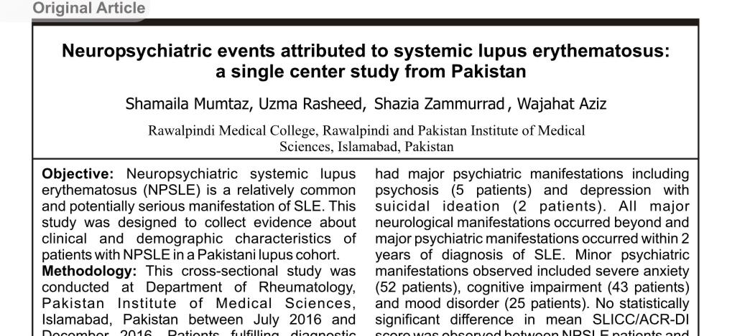

Slide 55
DROOPING DILEMMA - POSSIBILITIES
Indicator of Active Lupus (not necessarily Cerebral Lupus)
Anti-Ku antibody Syndrome
(Sub-set 1: Raised CPK & high risk for ILD
Sub-set 2 : Positive Anti-dsDNA & high risk for nephritis)
Primary Sjogren’s Syndrome (Anti-Ro)

Slide 56
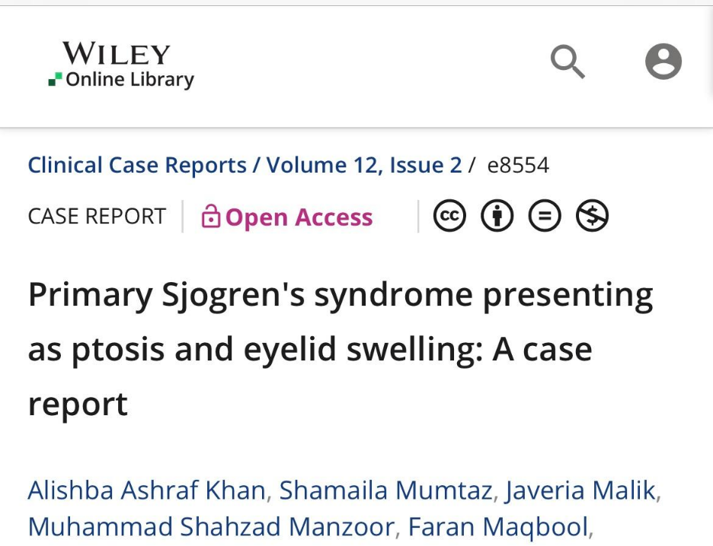
SJOGREN’S SYNDROME

Slide 57
FINAL DIAGNOSIS
SYTEMIC LUPUS ERYTHEMATOSIS WITH OCULAR AND RENAL INVOLVEMENT WITH AUTOIMMUNE THYROIDITIS

Slide 58
MANAGEMENT
Tab Hydroxychloroquine 200mg once per day
Tab Mycophenolate mofetil 500mg twice a day, dose increased to 2g/day upon resolution of cytopenia.
Tab prednisolone 10mg twice daily
Proton pump inhibitor
Iron, Vit B12 and folic acid supplement
Calcium and Vit D supplements
Tab Ramipril 2.5mg once per day to reduce lupus associated proteinuria

Slide 59
FOLLOWUP
On follow up most of the patient’s symptoms had improved including ptosis and chest pain and she reported feeling of general wellbeing.
Menstrual cycles became regular.
Labs showed improvement in cytopenias and decreased ESR.

Slide 60
Pictures taken with patient’s consent
Before treatment
After treatment

Slide 61
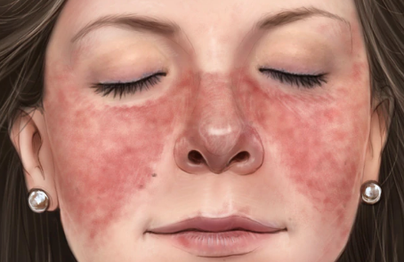
DROOPING DILEMMA Ptosis as an Atypical Manifestation of Systemic Lupus Erythematosus Etiology, Treatment and Literature Review
Iqra Ashraf
MBBS,MRCP(UK),MRCPS (Glasgow),FCPS(Med)
Clinical Supervisor Emergency Med Foundation Program RMU # RCEM
Senior Registrar Medical Unit-1
Holy Family Hospital RWP

Slide 62
LUPUS MEANS WOLF
It has been said that a wolf will devour its own leg to gain freedom from a trap.
Even though, it may die of self-inflicted wound, it is free.
Wolf , the word, in Latin is called Lupus.
Lupus, the disease is an autoimmune disorder in which the immune system attempts to destroy the body it has been designed to protect.

Slide 64
SYSTEMIC LUPUS ERYTHEMATOSIS
Systemic lupus erythematosus (SLE) is a chronic autoimmune disease of unknown cause that can affect virtually any organ of the body. Immunologic abnormalities, especially the production of a numberof antinuclear antibodies (ANA), are a prominent feature of the disease.
Notes:
Patients present with variable clinical features ranging from mild joint and skin involvement to life-threatening kidney, hematologic, or central nervous system involvement. The clinical heterogeneity of SLE and the lack of pathognomonic features or tests pose a diagnostic challenge for the clinician. To complicate matters, patients may present with only a few clinical features of SLE, which can resemble other autoimmune, infectious, or hematologic diseases.

Slide 65
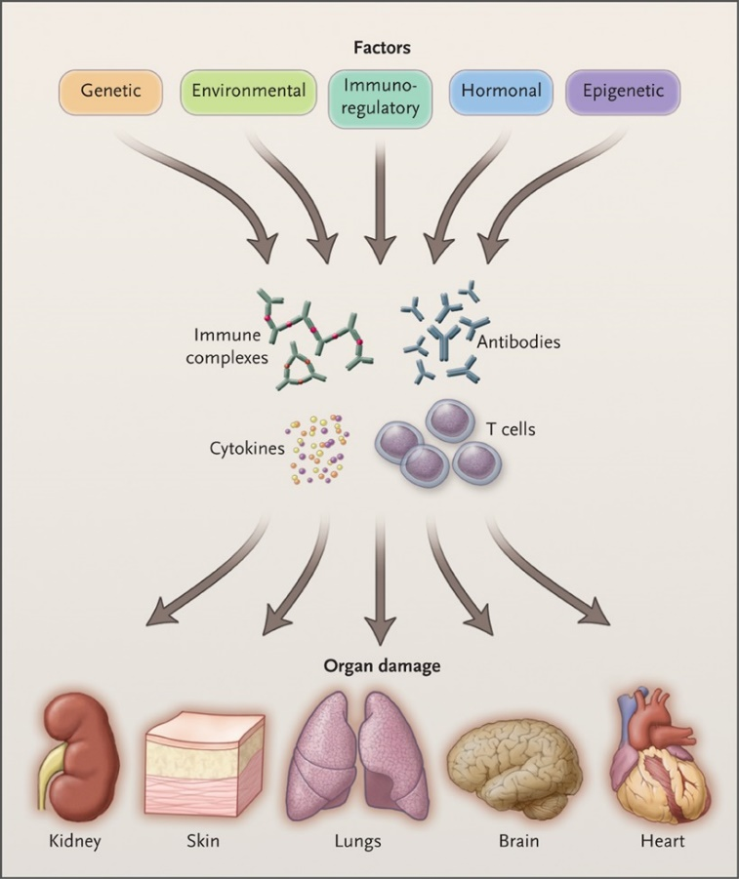
PATHOPHYSIOLOGY OF SLE
Notes:
Genetic, environmental, hormonal, epigenetic, and immunoregulatory factors act either sequentially or simultaneously on the immune system. The action of pathogenic factors results in the generation of autoantibodies, immune complexes, autoreactive or inflammatory T cells, and inflammatory cytokines that may initiate and amplify inflammation and damage to various organs. The target organ affected may be further damaged by local factors.

Slide 66
CLINICAL FEATURES
Constitutional symptoms such as fatigue, fever, and weight loss are present in most patients with systemic lupus erythematosus (SLE) at some point during the course of the disease.
Fatigue – Fatigue is the most common complaint, occurring in 80 to 100 percent of patients
Fever – Fever can be a manifestation of active disease and is seen in over 50 percent of patients with SLE .
Myalgia – Myalgia is also common among patients with SLE
Weight change – Weight changes are frequent in patients with SLE and may be related to the disease or to its treatment.
Arthritis and arthralgias — Arthritis and arthralgias occur in over 90 percent of patients with SLE and are often one of the earliest manifestations.

Slide 67
Mucocutaneous involvement — Most patients develop skin and mucous membrane lesions at some point during the course of their disease. There is tremendous variability in the type of skin involvement in SLE.
Cardiac involvement and vascular manifestations- Cardiac disease among patients with SLE is common and can involve the pericardium, myocardium, valves, conduction system, and coronary arteries. Pericarditis, with or without an effusion, is the most common cardiac manifestation of SLE, occurring in approximately 25 percent of patients at some point during their disease course
Raynaud phenomenon – Raynaud phenomenon in SLE is a vasospastic process induced by cold that occurs in up to 50 percent of patients with SLE.
Vasculitis – Estimates of the prevalence of vasculitis among SLE patients from large cohorts range from 11 to 36 percent . The clinical spectrum of vasculitis in the setting of SLE is broad due to the potential for inflammatory involvement of vessels of all sizes.
Thromboembolic disease – Thromboembolic disease can complicate SLE, particularly in the context of antiphospholipid antibodies.

Slide 68
Kidney involvement — Kidney involvement is clinically apparent in approximately 50 percent of SLE patients and is a significant cause of morbidity and mortality.
Gastrointestinal involvement — Gastrointestinal symptoms are common in SLE patients, occurring in up to 40 percent of patients.
Pulmonary involvement — During the course of their disease, many patients develop symptoms secondary to pulmonary involvement of SLE. Pulmonary manifestations of SLE include pleuritis (with or without effusion), pneumonitis, interstitial lung disease, pulmonary hypertension, shrinking lung syndrome, and alveolar hemorrhage.
Neurologic and neuropsychiatric involvement — Neuropsychiatric involvement of SLE consists of a broad range of neurologic and psychiatric manifestations, including stroke, seizures, cognitive dysfunction, delirium, psychosis, and/or peripheral neuropathies. Other less common problems are movement disorders, cranial neuropathies, myelitis, and meningitis.

Slide 69
Hematologic abnormalities — Hematologic abnormalities are common in SLE, and all three blood cell lines can be affected. Anemia of chronic disease (also called anemia of inflammation and anemia of chronic inflammation) is the most common type of anemia among patients with SLE. Leukopenia is common in SLE patients, occurring in approximately 50 percent of patients . Mild thrombocytopenia is also a common hematologic abnormality.

Slide 70
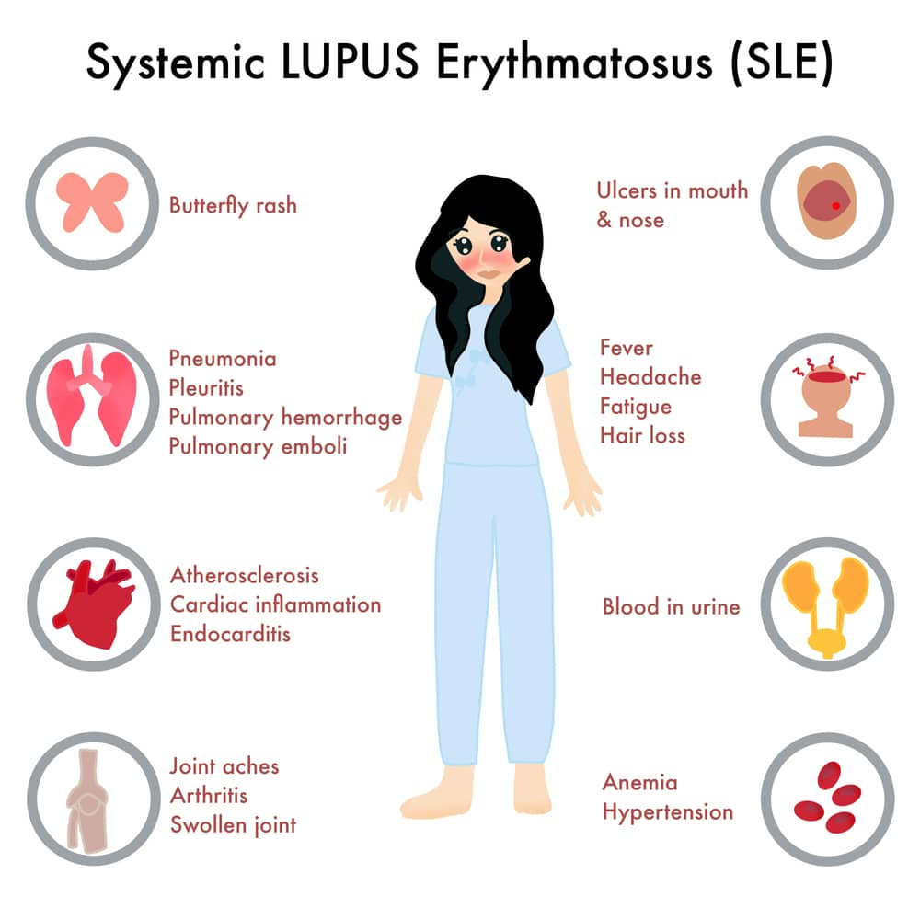

Slide 71
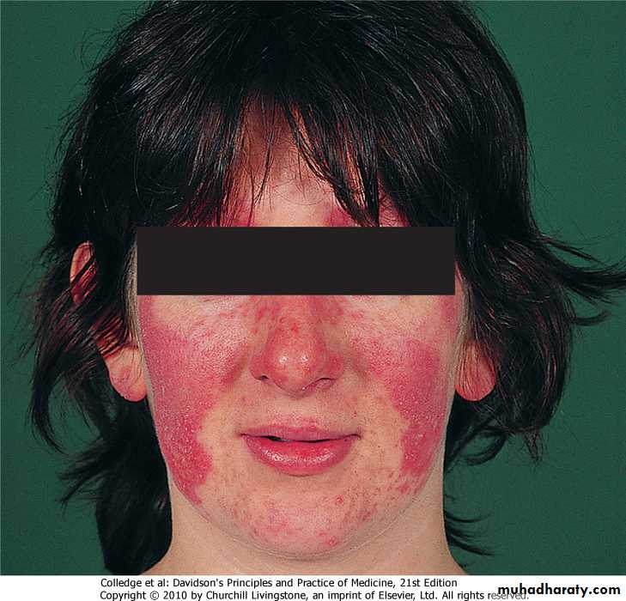
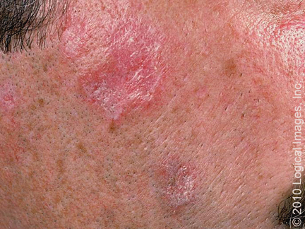
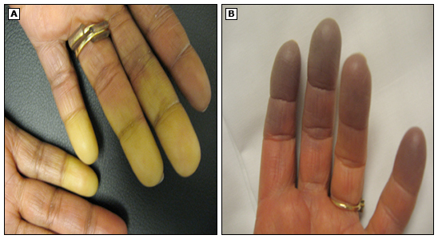
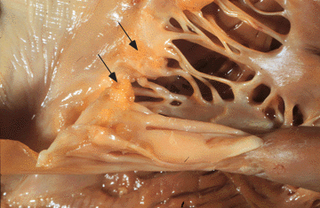

Slide 72
ACR/ EULAR CRITERIA FOR SLE 2019

Slide 76
PATIENT SCORE ACCORDING TO EULAR CRITERIA WAS 34

Slide 77
SLICC CRITERIA (Systemic Lupus International Collaborating Criteria)
The SLICC criteria for SLE classification requires:
1) Fulfillment of at least four criteria, with at least one clinical criterion AND one immunologic criterion
OR
2) Lupus nephritis as the sole clinical criterion in the presence of ANA or anti-dsDNA antibodies.

Slide 78
AIMS OF TREATMENT
Prevent the disease progression and flare ups, achieve remission and low disease activity.
Stop the organ tissue damage
Treat disease complications
Monitor, minimize and treat drug side effects
Improve quality of life

Slide 79
GENERAL MANAGEMENT STEPS
Photoprotection
Sunscreens that block both UV-A and UV-B and have a sun protection factor (SPF) ≥55
Diet and nutrition – conservative approach is to recommend a balanced diet consisting of carbohydrates, proteins, and fats.
The majority of patients with SLE have low serum levels of 25-hydroxyvitamin D (calcidiol) probably due, at least in part, to avoidance of sun exposure and/or use of sunscreen products.
Exercise – isometric and graded exercise.

Slide 80
Smoking cessation – Patients should be counselled against cigarette smoking, since it has been associated with more active disease . Smoking adds to the baseline increased risk of accelerated atherosclerosis with coronary heart disease in those with SLE . There is also evidence to suggest that smoking diminishes the efficacy of hydroxychloroquine.
Immunizations- particulary non alive vaccines

Slide 81
APPROACH TO DRUG THERAPY
The choice of drug therapy for SLE is highly individualized
Depends on the predominant symptoms, organ involvement, response to previous therapy, and disease activity and severity.
Adverse effects of individual therapeutic agents and patient preferences must also be taken into consideration when determining therapy. Family planning is also important to take into account when making treatment decisions.

Slide 82
ORGAN SYSTEM INVOLVED | TREATMENT
CONSTITUTIONAL SYMPTOMS fatigue | LOW DOSE STEROIDS/HCQ
RAYNAUDS PHENOMENA | CALCIUM CHANNEL BLOCKERS/PDE INHIBITOR Smoking cessation
ARTHRITIS AND MUSCULOSKELETAL INVLOVEMENT Non erosive arthritis | HCQ/NSAIDS/LOW DOSE STEROIDS
GI INVOLVEMENT Infectious esophagitis. Peptic ulcer disease, autoimmune pancreatitis, acute pancreatitis | Anti biotics, proton pump inhibitors
RENAL INVOLVEMENT Lupus nephritis | IV STEROIDS + MYCOPHENOLATE/CYCLOPHOSPHAMIDE
HEMATOLOGICAL ABNORMALITIES Pancytopenia , autoimmune hemolytic anemia APLA | Oral steroids +/ immunosuppressants

Slide 83
ORGAN SYSTEM INVOLVED | TREATMENT
CNS MANIFESTATIONS Stroke, seizures, lupus cerebritis, cranial nerve palsies, lupus psychosis, optic neuritis, aseptic meningitis | Steroids +/ immunosuppressants
CUTANEOUS MANIFESTATIONS Butterfly rash, discoid lupus | Topical steroids, topical tacrolimus, hydroxychloroquine
CARDIAC INVOLVEMENT Valvular disease eg MVP, Libman sacks endocarditis, pericarditis ,Myocardial dysfunction Coronary artery disease, cardiac arrythmias | HIGH DOSE ORAL STEROIDS for lupus myocarditis Colchicine / NSAIDS for pericarditis Avoid HCQ for arrythmias
PULMONARY INVOLVEMENT Pleuritis/ acute lupus pneumonitis, pulmonary hemorrhage, ILD, Pulmonary hypertension | STEROIDS IV/ORAL ANTIBIOTICS FOR ENCAPSULATED ORGANISMS High dose steroids/ immunosuppressants for diffuse alveolar hemorrhages

Slide 84
PTOSIS AS AN ATYPICAL MANIFESTATION OF SLE

Slide 88
POSSIBLE MECHANSIM OF PTOSIS IN SLE
Myositis of levator palpebrae superioris
Antibodies against cerebral endothelial cells
Direct injury of intracranial vessels leading to vasculitis
Auto antibodies with activity against neuronal cells
Can be associated with myasthenia gravis as a part of poly-autoimmunity.
Ocular involvement should not be regarded as an indication of cerebral lupus.

Slide 89
PROGNOSIS OF SLE
Ten-year survival rates exceeding 85% are routine.
Mortality in SLE shows a bimodal pattern. In the early years after diagnosis, infections—especially with opportunistic organisms— are the leading cause of death, followed by active SLE, chiefly due to kidney or central nervous system disease.
In later years, accelerated atherosclerosis, linked to chronic inflammation, becomes a major cause of death. Indeed, the incidence of myocardial infarction is five times higher in persons with SLE than in the general population. Therefore, it is especially important for SLE patients to avoid smoking and to minimize other conventional risk factors for atherosclerosis (eg, hypercholesterolemia, hypertension, obesity, and inactivity).
Notes:
In most patients, the illness pursues a relapsing and remitting course. Prednisone, often needed in doses of 40 mg/day orally or more during severe flares, can usually be tapered to low doses (5–10 mg/day) or be discontinued when the disease is inactive. However, there are some in whom the disease pursues a virulent course, leading to serious impairment of vital structures such as lungs, heart, brain, or kidneys, and the disease may lead to death.

Slide 90
SLE AND FERTILITY
Fertility is normal in SLE. Women can pursue pregnancy under close supervision and when SLE is well-controlled and no teratogenic medications are being used. Since SLE patients have a higher risk of developing malignancy (especially lymphoma, lung cancer, and cervical cancer), preventive cancer screening recommendation should be followed assiduously.
Nonetheless, the outlook for most patients with SLE is increasingly favorable.

Slide 91
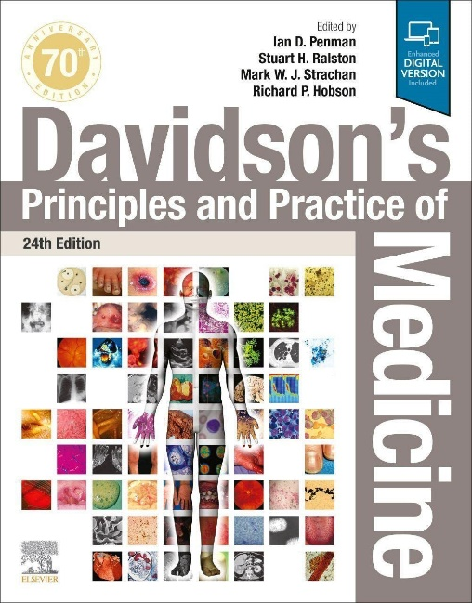
REFERENCES

Slide 92
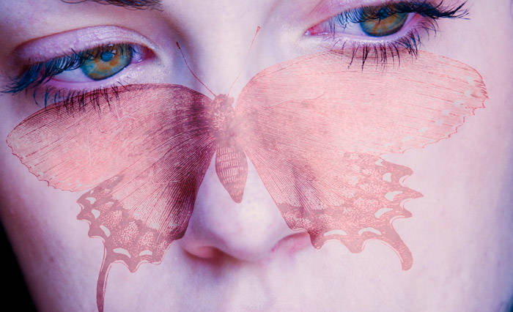
TAKE HOME MESSAGE
LUPUS IS AN UNPREDICATABLE AND MISUNDERSTOOD AUTOIMMUNE DISEASE
IT IS DIFFICULT TO DIAGNOSE, HARD TO LIVE WITH AND A CHALLENGE TO TREAT
IT’S A CRUEL MYSTERY WE ALL MUST SOLVE TOGETHER

Slide 93
THANKYOU

Slide 94
منزل سے آگے بڑھ کر منزل تلاش کر
مل جائے تجھکو دریا تو سمندر تلاش کر
ہر شیشہ ٹوٹ جاتا ہے پتھر کی چوٹ سے
پتھر ہی ٹوٹ جائےوہ شیشہ تلاش کر
سجدوں سے تیرے کیا ہوا صدیاں گزر گئیں
وہ سجدہ تلاش کر دنیا تیری بدل دے

