Slide 1
Clinico-Pathological Conference Diarrhea Decoded: When a common symptom hides an uncommom diagnosis.
Resident: Dr Mohammad Naeem
Senior Registrar: Dr Anum Abbas
Gastroenterology Department
Holy Family Hospital

Slide 5
Demographic Details
Name: ABC
Age/ Gender: 44 / Male.
Marital status: Married for 15 years.
Residence: Kotli, AJK.
Date of admission: 3/07/2024.
Mode of admission: OPD.

Slide 6
Presenting Complaints
Diarrhea - 5 years.
Abdominal pain - 3 months.

Slide 7
History Of Presenting Illness
The patient has been experiencing 4-5 episodes of small-volume, loose, watery stools daily, occasionally mixed with blood. He reports tenesmus, urgency, and bloating but denies any correlation of these episodes with food intake.
Notably, there are no associated symptoms such as fever, vomiting, anorexia, or weight loss.
Recently, he has developed right lower quadrant abdominal pain that has been worsening over the past three months, described as crampy and intermittent, with a pain intensity of 6-7 out of 10. This pain is not related to bowel movements and is partially relieved by analgesics.

Slide 8
History of Presenting Illness
He does not have a history of alcohol or excessive caffeine intake, food intolerances, or allergies and there are no other systemic symptoms present.
Despite seeking treatment at various hospitals in Saudi Arabia and Pakistan, the patient has only received symptomatic relief through antibiotics, proton pump inhibitors, antispasmodics, and probiotics, none of which have fully resolved his symptoms.

Slide 9
Socioeconomic History
The patient is a carpenter from a lower middle-class background, living in good sanitary conditions with access to spring water as his drinking source.

Slide 10
Physical Examination
The patient is a cooperative young male who appears well and is in no acute distress. His vital signs are within normal limits.
Blood pressure 130/90 mmHg.
Pulse: 78 beats per minute.
Respiratory rate 18 breaths per minute.
Temperature 98°F.
BMI 22.5 kg/m².
Upon examination, there are no signs of dehydration, muscle wasting, pallor, jaundice, lymphadenopathy, rash, or any skin lesions.

Slide 11
Systemic Examination
The abdomen was soft and non-distended, with mild tenderness elicited upon deep palpation in the right lower quadrant. The liver and spleen span was within normal limits, and no clinical evidence of ascites.

Slide 12
Differential Diagnosis
Inflammatory bowel disease
Intestinal tuberculosis.
Microscopic Colitis
Irritable bowel syndrome.
Giardiasis
Celiac Disease

Slide 13
Investigations

Slide 14
Investigations | Results | Reference Range
TLC | 4,600 | 4000 – 11000/ul
Hemoglobin | 13.3 | 13 -16gm/dL
platelets | 250,000 | 150,000-300000/ul
LFTs | Normal | -
RFTS & Electrolytes | Normal | -
Anti-HCV | Negative | -
HBsAg | Negative | -
TSH | 1.98 | 0.4-4.1mU/L

Slide 15
Investigations | Results | Reference Range
Anti-TTG (IgA) level | 0.70U/mL | 0-10U/mL
HIV serology | negative | -
C. Difficile toxin | negative | -
Vit.B12 | 150pg/mL | 200-300pg/mL
Folic acid | 2.1ng/mL | 2.5-20ng/mL
Fecal calprotectin. | 453mcg/g | <50mcg/g.

Slide 16
STOOL R/E
Consistency | Semi formed
Color | Brownish
Reaction | Acidic
Mucus | Not present
Blood | Not present
Pus cells | Nil
Ova/cyst | Not seen
RBC | Nil

Slide 17
Chronic inflammatory disease antibodies profile Test (CIBD Profile).
INVESTIGATIONS | RESULTS
ASCA | Positive
ANA | Negative
pANCA | Negative
cANCA | Negative
Anti-rPAg1(CUZD1) | Negative
Anti-rPAg1(GP2) | Negative
Anti-globlet cells antibodies | Negative
Anti-mucous cells antibodies | Negative

Slide 18
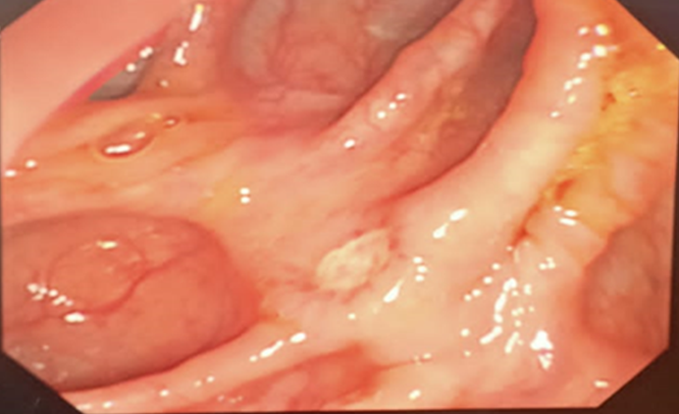
Colonoscopy Findings
Multiple elongated superficial clean based ulcers scattered in terminal ileum, cecum, ascending colon and hepatic flexure with intervening normal mucosa (skip lesion).
Caecum

Slide 19
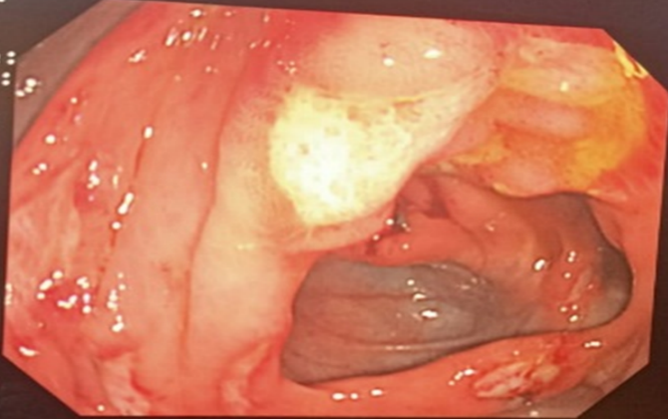
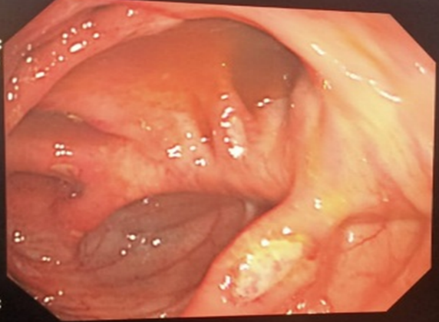
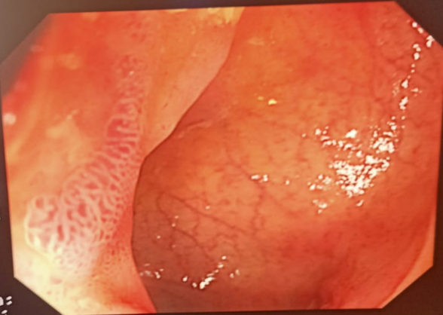
Ascending Colon
Caecum
Caecum
Ileum

Slide 21
Histopathology
FOCAL CHRONIC INFLAMMATION,
MILD CRYTITIS AND CRYPT ABSCESSES.

Slide 22
MR Enterography
Few segmental areas of mild narrowing with trans-mural thickening and progressive delayed mural enhancement, predominantly, involving the proximal and mid jejunal loops, without significant upstream bowel dilatation. No fistulous communication or abscess seen.
Overall findings are of inflammatory bowel disease/CROHN’S DISEASE with suggestion of mild active disease.

Slide 23
Final Diagnosis
Based on chronicity of symptoms, serological markers, supported by colonoscopic, histopathological & radiologic findings, diagnosis of CROHN’s DISEASE was confirmed.

Slide 24
Management Plan
Definitive Treatment:
Tab Budesonide 9 mg daily for 8 weeks.
Dietary Recommendations:
The patient was advised to avoid fast and fatty foods, reduce sugar intake and increase dietary fiber.
Mediterranean diet, rich in olive oil, fish, fruits, vegetables, and whole grains was recommended.
Follow Up:
A follow-up colonoscopy after 8 weeks was advised to assess endoscopic and histologic remission.

Slide 25
Counseling
The patient was counselled about the chronic nature of the disease, potential flare-ups, and complications.
Additionally, the risks of malignancy, the importance of adherence to treatment, and the possible side effects of medications were thoroughly discussed.

Slide 26
CROHN’S DISEASE HISTOPATHOLOGY

Slide 29
Active phase of Crohn disease, numerous neutrophils infiltrate within crypt epithelium (cryptitis) or accumulate in the crypt lumen (crypt abscess)
CRYPTITIS

Slide 30
RADIOLOGICAL MANIFESTATION OF CROHN’S DISEASE
BY
Dr. Anam Zahoor
Assistant Professor Radiology
Holy Family Hospital

Slide 31
RADIOLOGICAL INVESTIGATIONS
Contrast Studies
CT and MR Abdomen / Enterography / Colonography
Disease Activity
Complications

Slide 32
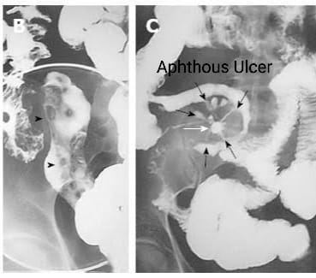
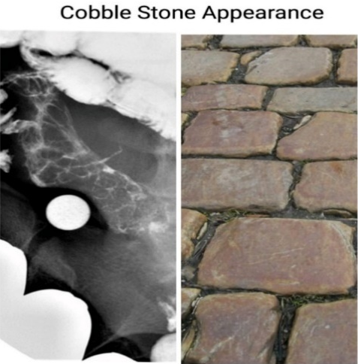
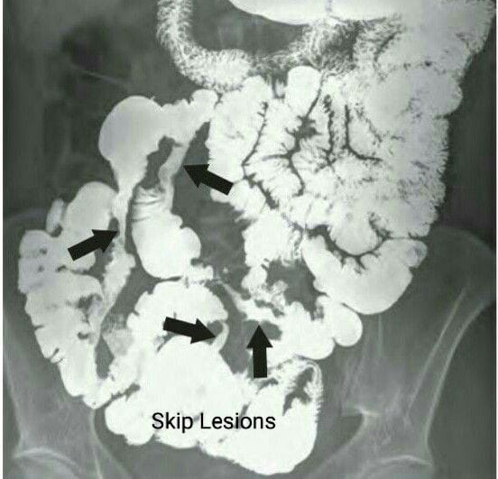
CONTRAST STUDIES

Slide 33
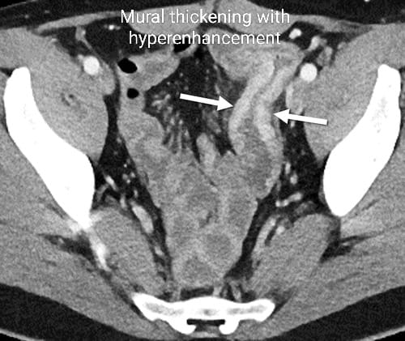
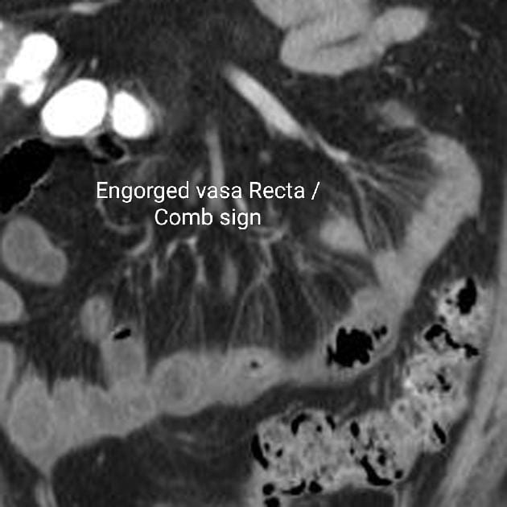
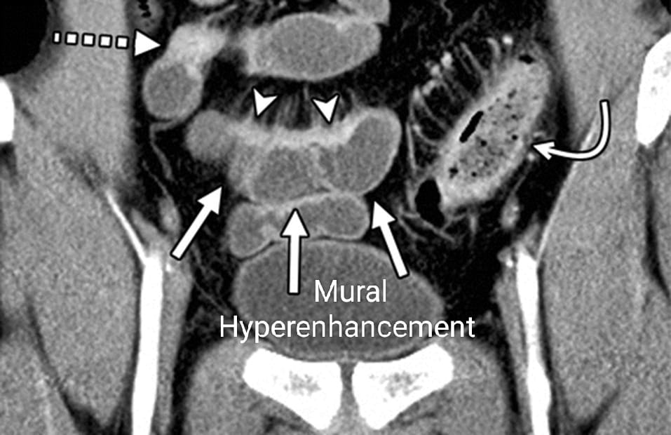
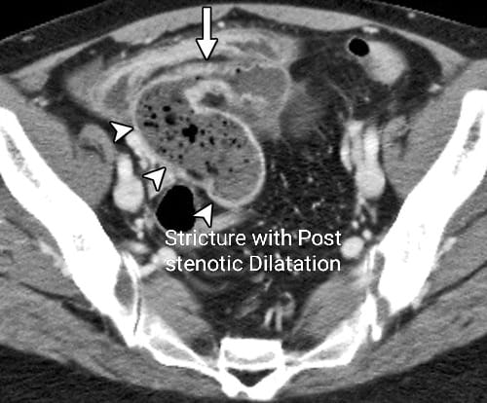
CT SCAN / CT ENTEROGRAPHY

Slide 34
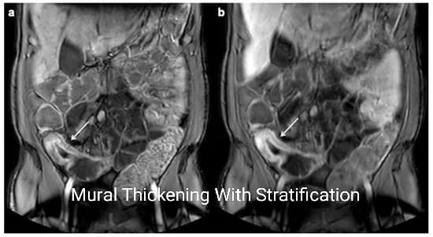
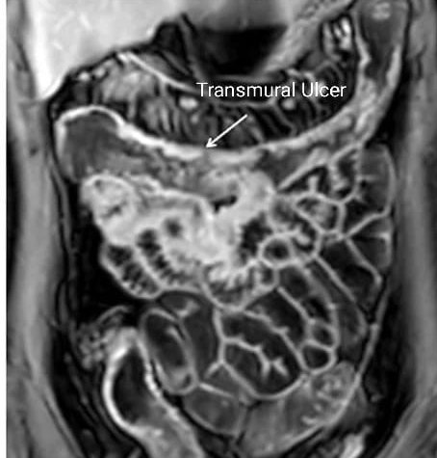
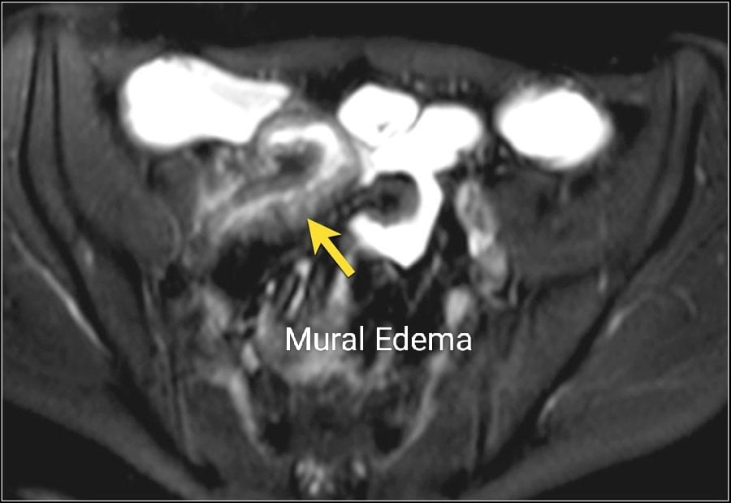
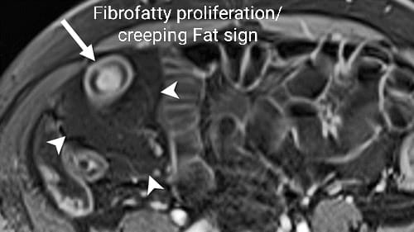
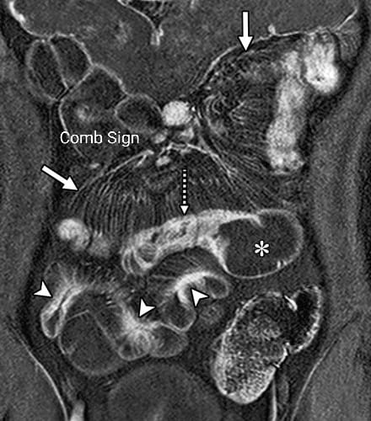
MR Enterography

Slide 35
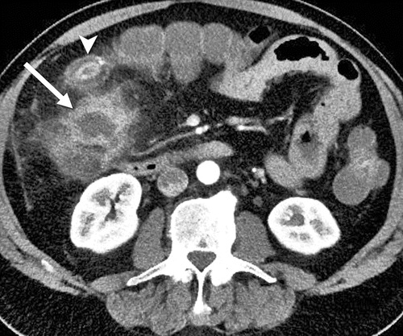
COMPLICATIONS
Entero enteric fistula with
Inflammatory phlegmon
Peri Enteric abscess

Slide 36
Patient’s Follow Up
Clinical Response: After 8 weeks of treatment, there is a complete resolution of symptoms.
Serological Markers for Disease Activity: The fecal calprotectin level has returned to normal

Slide 37
Follow Up Colonoscopy
All ulcers throughout the colon and terminal ileum have completely disappeared.
Caecum
Ascending colon

Slide 38
Ileum
Ileum

Slide 39
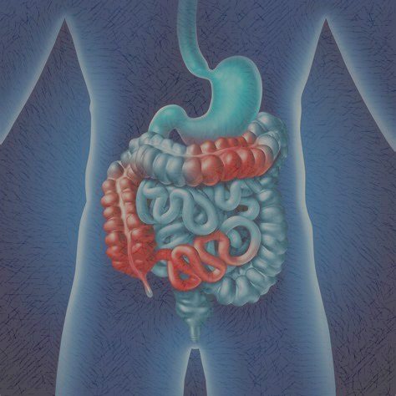
Literature Review of Crohn’s Disease
Dr Anum Abbas
Senior Registrar Gastroenterology
Holy Family Hospital

Slide 40
Crohn’s Disease
Crohn’s disease is a chronic, progressive inflammatory disorder of unknown etiology that affects the gastrointestinal tract, potentially from the mouth to the perianal area.
It is influenced by genetic, immunologic, and environmental factors and is classified into three subtypes:
Non-stricturing/non-penetrating,
Stricturing, and
Penetrating.
Notes:
In 1932 ,Crohn’s disease was first described by three doctors—Burrill Crohn, Leon Ginzberg, and Gordon D. Oppenheimer by collecting data from 14 patients.
e2005 Montreal revision of the Vienna classification includes age of onset, disease location, and disease behavior. A1 refers to disease onset at 16 years of age or younger, A2 disease onset between 17 and 40 years of age, and A3 over 40 years. Disease location is divided into L1 (terminal ileum), L2 (colon), L3 (ileocolonic), and L4 (upper GI involvement). Disease behavior is divided into B1 (nonstricturing, nonpenetrating), B2 (structuring), and B3 (penetrating). Th e letter “p” is appended to the B subtype if there is the presence of perianal fistulizing disease .

Slide 41
Clinical Course of Disease
Population-based cohort studies indicate that 56-80% of patients with Crohn’s disease exhibit inflammatory disease behavior, while 5-25% display stricturing or penetrating patterns.
The cumulative risk of developing intestinal complications in those with inflammatory behavior is 51% within 20 years of diagnosis.
Over extended observation periods, only 20-30% of patients experience a nonprogressive or indolent course.
The 10-year cumulative risk of requiring major abdominal surgery is 40-55%, which decreases to 30% with the introduction of biological agents; a similar reduction in the risk of subsequent abdominal surgeries has also been observed.
Notes:
Young age of onset ,Extensive anatomic involvement , perianal or severe rectal disease, ileal or ileo-colonic involvement , stenosing or pentetrating diseaseand deep ulcerations are risk factors for progression to intestinal complications .

Slide 42
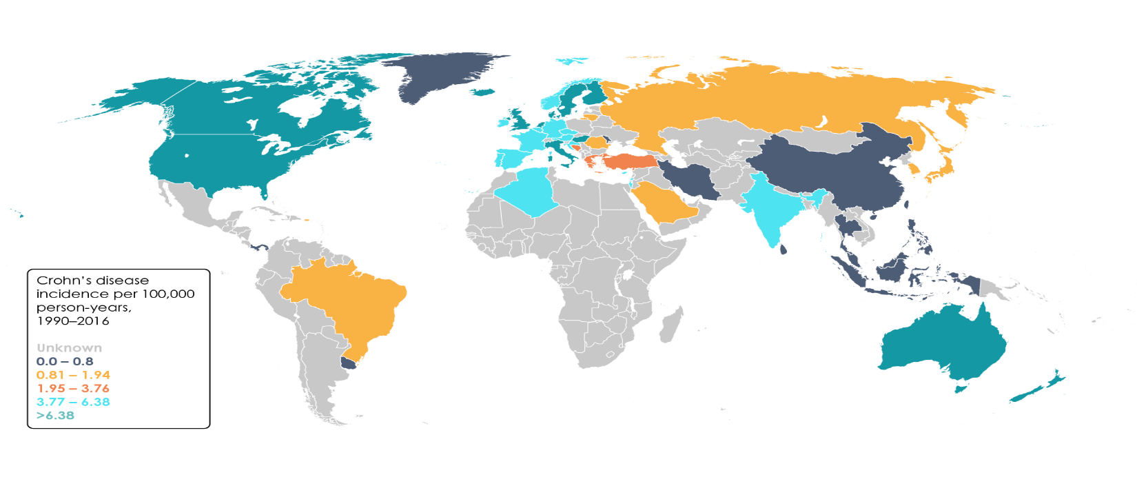
Epidemiology of Crohn’s Disease
The prevalence of CD has an incidence of 3 to 20 cases per 100,000. Crohn disease is more common in the industrialized world, particularly in North America and Western Europe, though the incidence is rising in Asia and South America.

Slide 43
IBD Data From Ibd Clinic CLD HFH
Total IBD Patients = 312
266
23
3

Slide 44
Pathogenesis
ENVIRONMENTAL FACTORS
Smoking, Diet, Exercise, medications, Geography, Socioeconomic Factors
IMMUNE DYSREGULATION
Cytokines, Aberrant immune response, Impaired intestinal barrier function
GUT MICROBIOTA
Dysbiosis, Microbe-immune interaction
IBD
GENETIC PREDISPOSITION
240 genetic variants recognized.
immunity (IL-23R, IL-10, ITGAL, and ICAM1 variants)
autophagy (e.g., ATG16L1 and IRGM)
epithelial barrier (e.g., ECM1),
bacteria recognition (e.g., NOD2)

Slide 45
Symptoms of Crohn’s disease
Intestinal Manifestation
Extra-Intestinal Manifestations
Arthropathy
Skin Manifestations
Constitutional symptoms
Ocular manifestations
Anemia
Thromboembolism
Growth failure in children
Diarrhea
Abdominal pain
Blood in stools
Recurrent fistulas
Notes:
Diarrhea 90% and abdominal pain 77%
Other conditions associated with it are PSE, bronchial asthma, pyoderma gangernosum

Slide 46
DIAGNOSIS OF CROHN’S DISEASE
Clinical Features
Serological Markers (CRP, Stool for calprotectin and lactoferrin)
Radiological Investigations
( CTE, MRE, Barium follow through)
Endoscopic examination
( endoscopy, colonoscopy, VCE, Enteroscopy)
Histological examination
Notes:
CRP has a short half-life (19 hours) so will rise and decrease rapidly at onset and resolution of inflammation.
Calprotectin is a cytoplasmic protein predominantly released from neutrophils that have been recruited to the bowel
Typical endoscopic findings in CD include discontinuous distribution of longitudinal ulcers (defined as ≥4 to 5 cm ulcers in the Japanese criteria), cobblestone appearance, and/or small aphthous ulcerations arranged in a longitudinal fashion .A Korean study reported longitudinal ulcers in 37.2%, cobblestone appearance in 23.9%, and aphthous ulcers in 59.3% of newly diagnosed CD cases. When inflammation worsens and longitudinal ulcers break out throughout the entire colon, it becomes difficult to distinguish Crohn's disease from severe ulcerative colitis; pseudopolyps may also occur in cases of Crohn's disease.
The most used are the CDEIS and Simple Endoscopic Score for Crohn’s Disease in CD

Slide 47
Differentials of Colonic ulcers
Crohn’s disease
Ulcerative Colitis
Intestinal TB
Behcet’s disease
Ischemic Colitis
Infective colitis
Radiation colitis

Slide 48
Differences of Crohn’s Disease vs Intestinal TB
Intestinal TB
Typical endoscopic features of intestinal tuberculosis. (A) Transverse ulcers, (B) deformed and patulous ileocecal valve, (C) pseudopolyps.
Crohn’s Disease
.
Typical endoscopic features of Crohn’s disease. (A) Longitudinal ulcers, (B) cobblestone appearance, (C) aphthous ulcers showing longitudinal array
Notes:
ITB frequently involves the ileocecal area and ascending colon. Endoscopic findings of ITB may include transverse ulcers, nodules with inflammatory changes of surrounding mucosa, pseudopolyps, and/or distorted and strictured ileocecal valves . Mycobacterium tuberculosis from the culture of biopsy specimens can confirm ITB, caseating granuloma findings are present in fewer than 50% of patients . Therefore, acquisition of more than three biopsy samples from the margin and base of ulcers is recommended to increase the diagnostic yield .

Slide 49
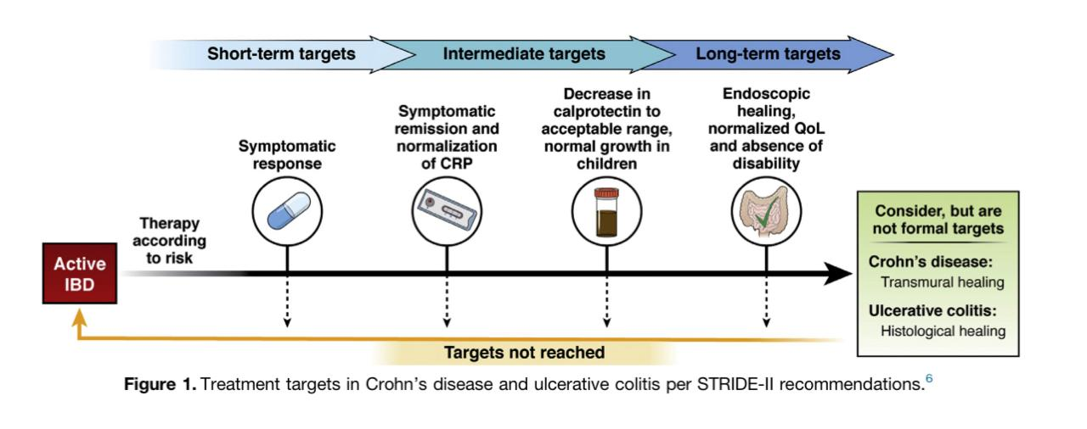
Treatment Aims Of Crohn’s Disease
Notes:
monitoring of IBD should be proactive, not reactive.
Historic treatment strategies have focused on the resolution of symptoms, but there is a clear disconnect between symptoms and active mucosal inflammation in inflammatory bowel disease (IBD). Our ability to predict treatment response or disease course is currently poor. Therefore, robust, and effective monitoring strategies become pivotal in the management of IBD. Definitions of clinical response and remission are proposed and based on symptom scoring systems that include the Harvey Bradshaw Index in CD.

Slide 50
The Step up Approach
Mild
Moderate
Severe

Slide 51
New Treatment Approach
4th
1st
2nd
3rd

Slide 52
Nutrition in Crohn’s Disease

