Slide 1
Literature Review
Dr. Ambreen Gul
Assistant Professor
Ophthalmology department
Benazir Bhutto hospital

Slide 2
"Behind Every Symptom, There's A Story Waiting To Be Told."
Notes:
This case exemplifies how every symptom is s crucial for effective diagnosis and treatmentVisual loss symptoms served as the starting point for uncovering a complex underlying disease. Recurrent oral and genital ulcers, seemingly unrelated to the eye symptoms, added another chapter to his story. patient’s symptoms were just the surface manifestations of underlying vasculitis and immune dysregulation..

Slide 3
Behçet's Disease
Also known as Silk Road disease, a rare chronic, long-term relapsing multisystem inflammatory condition, caused by occlusive vasculitis (blood vessel inflammation), which affects both arteries and veins ¹
DTH (Delayed type hypersensitivity) in early lesions and immune-complex type in late lesions ¹
1. Yazici, H., Yurdakul, S., & Hamuryudan, V. (2001). Behçet disease. Current Opinion in Rheumatology, 13(1), 18-22
Notes:
Recruitment of T cells into tissues to be activated by Antigen presenting cells to produce cytokines that mediate inflammation

Slide 4
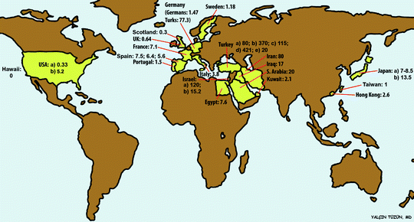
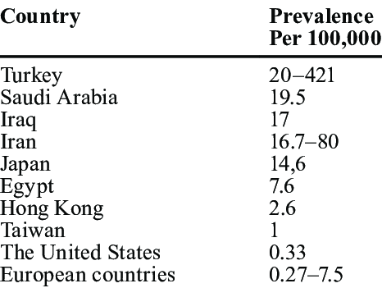
Epidemiology
Most prevalent in middle east and Eastern Asia (silk road region) in populations with high prevalence of HLA-B51 ²
2. Khairallah, M., Accorinti, M., Muccioli, C., Kahloun, R., & Kempen, J. H. (2012). Epidemiology of Behçet disease. Ocular immunology and inflammation, 20(5), 324-335.
Notes:
Mediterranean

Slide 5
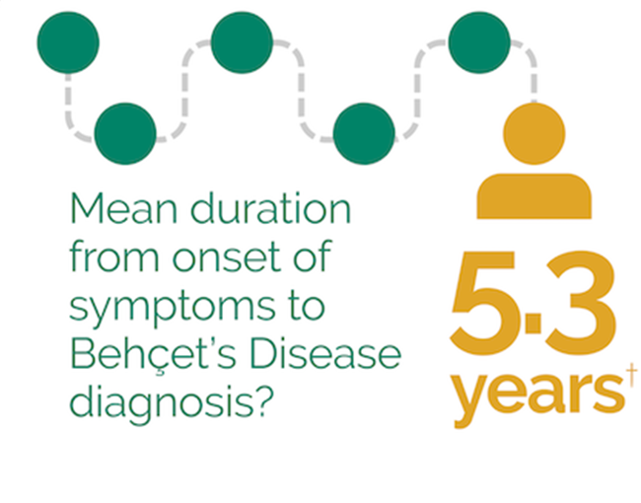
Demographic Features
Typically affects people in their second and third decade¹
Rare in pediatric and geriatric age
No gender predilection, but males tend to be severely affected
1. Yazici, H., Yurdakul, S., & Hamuryudan, V. (2001). Behçet disease. Current Opinion in Rheumatology, 13(1), 18-22

Slide 6
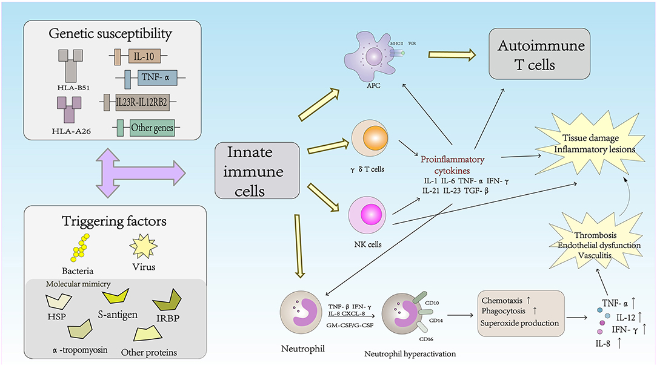
Pathophysiology
Immune-mediated vasculitis affecting both small and large vessels
Genetic predisposition (HLA-B51 association)
1. Yazici, H., Yurdakul, S., & Hamuryudan, V. (2001). Behçet disease. Current Opinion in Rheumatology, 13(1), 18-22
Notes:
Although the pathogenesis of BD is unclear, some studies have shown that immunological aberrations play an important role in the development and progression of BD. Infection-related trigger factors, including antigens and autoantigens, are believed to mediate the development of BD in patients with a genetic predisposition (presence of the HLA-B*51 allele) and subsequently activate the innate and adaptive immune systems, resulting in the production of numerous cytokines and chemokines to combat the infection-related factors. In the innate immune system, NK cells, T cells and neutrophils are the primary cells. CD4⁺ T cells, and related cytokines in the adaptive immune system. Increased macrophage activation, neutrophil chemotaxis, and phagocytosis have been observed

Slide 7
Multisystem Disorder

Slide 8
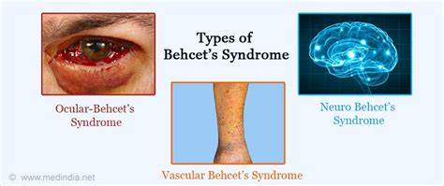
Types of Behçet’s Syndrome
Ocular Behçet's
Neuro Behçet's
Vascular Behçet's
1. Yazici, H., Yurdakul, S., & Hamuryudan, V. (2001). Behçet disease. Current Opinion in Rheumatology, 13(1), 18-22

Slide 9
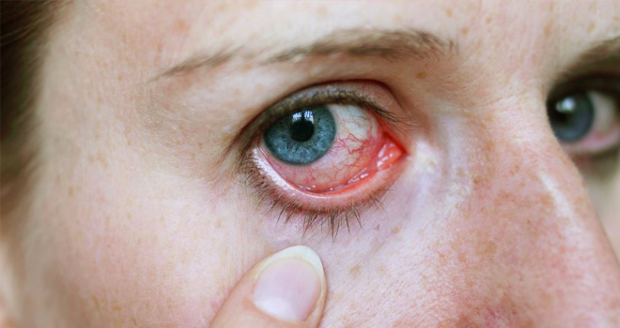
Ocular Behçet's
Behcet uveitis is a distinct entity and Ophthalmologist has a pivotal role in diagnosis
After 3-4 years of onset of oral ulceration
Most commonly involved organ (70%)
25% can have severe visual loss
85% bilateral & Non-granulomatous (100%)
Pan uveitis and Retinal vasculitis
Relapsing remitting course
Tugal-Tutkun, I., Onal, S., Altan-Yaycioglu, R., Altunbas, H. H., & Urgancioglu, M. (2004). Uveitis in Behçet disease: an analysis of 880 patients. American journal of ophthalmology, 138(3), 373-380.
Notes:
If eye lesions are compatible with Behcet uveitis and extraocular manifestations are present, diagnosis is confirmed. However a highly suggestive BD uveitis in absence of extraocular manifestations is isolated Behcet uveitis

Slide 10
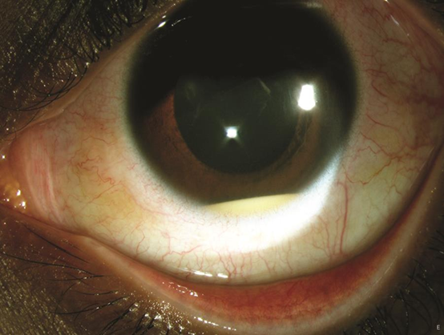
Anterior Segment Manifestations
Non-granulomatous uveitis
Transient mobile hypopyon in 10-35%
Relatively quiet eye
Isolated Anterior Uveitis in 10%
Conjunctivitis, keratitis, episcleritis and scleritis can occur
Tugal-Tutkun, I., Onal, S., Altan-Yaycioglu, R., Altunbas, H. H., & Urgancioglu, M. (2004). Uveitis in Behçet disease: an analysis of 880 patients. American journal of ophthalmology, 138(3), 373-380.
Notes:
Sudden onset and disappears within weeks with or without treatment, can be very small and visible only on gonioscopy,

Slide 11
Posterior Segment Manifestations
More common than anterior uveitis
Sight threatening
Vitritis
Retinitis (superficial multifocal migratory retinitis which heals without scarring)
Occlusive vasculitis involving veins > arteries
Vein occlusion in up to 16%
Fern pattern leakage on FFA
Tugal-Tutkun, I., Onal, S., Altan-Yaycioglu, R., Altunbas, H. H., & Urgancioglu, M. (2004). Uveitis in Behçet disease: an analysis of 880 patients. American journal of ophthalmology, 138(3), 373-380.

Slide 12
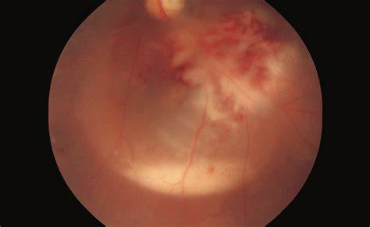
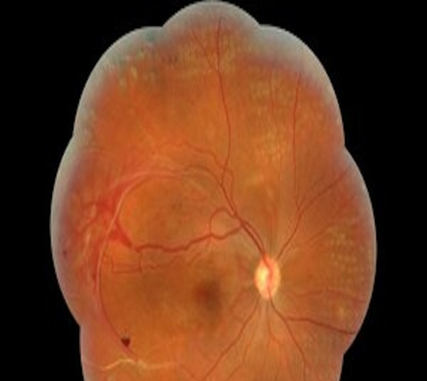
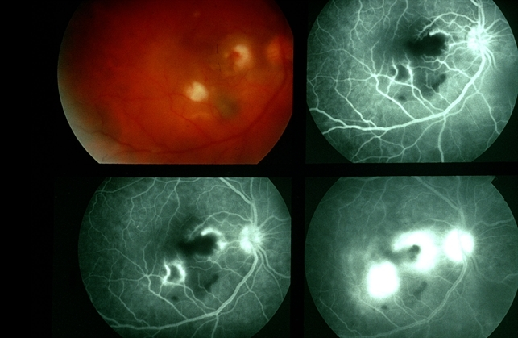
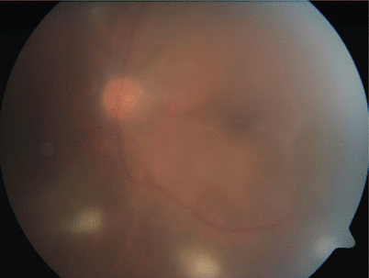
Fundus Features
Tugal-Tutkun, I., Onal, S., Altan-Yaycioglu, R., Altunbas, H. H., & Urgancioglu, M. (2004). Uveitis in Behçet disease: an analysis of 880 patients. American journal of ophthalmology, 138(3), 373-380.
Notes:
Macular edema
Optic atrophy and retinal atrophy, Glaucoma, hypotony

Slide 13
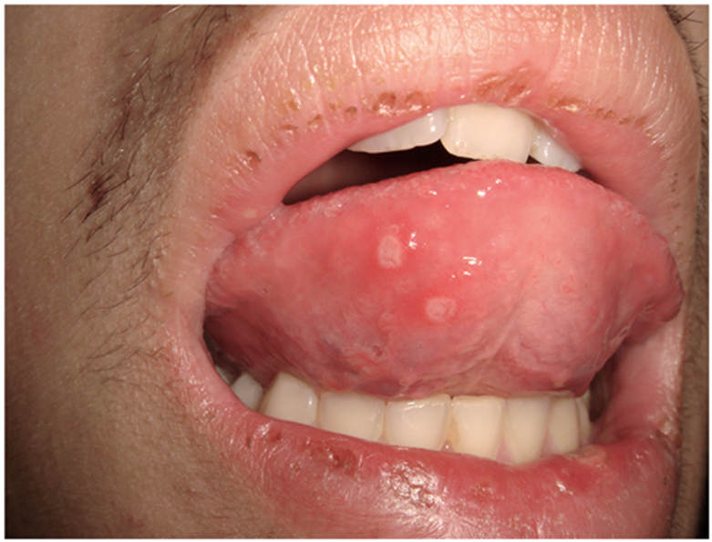
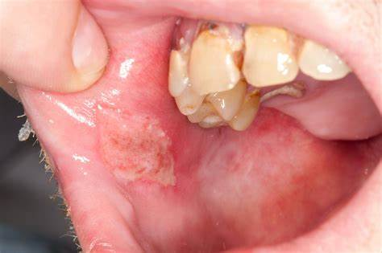
Oral and Genital Manifestations
Recurrent painful aphthous ulcers (most common and earliest manifestation)
Genital ulcers (larger, deeper and heal with scarring
1. Yazici, H., Yurdakul, S., & Hamuryudan, V. (2001). Behçet disease. Current Opinion in Rheumatology, 13(1), 18-22
Notes:
Discrete round white lesions with a red rim, lasts for 7-10 days, heals with minimum scarring

Slide 14
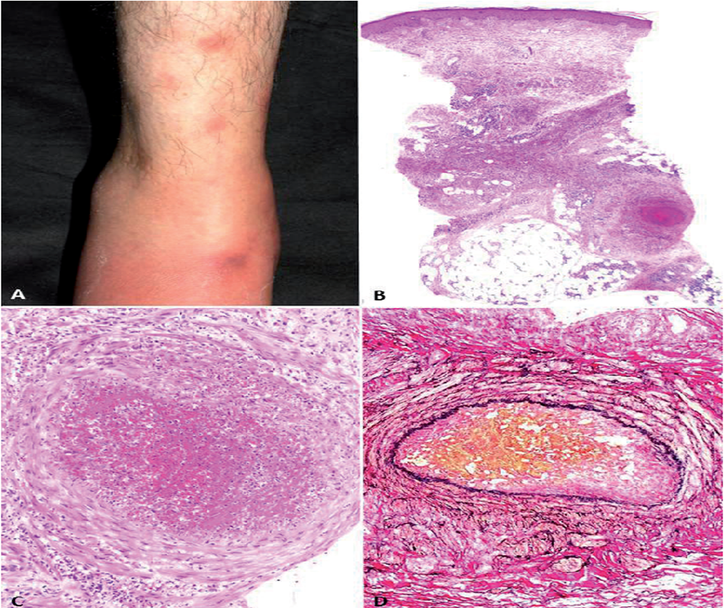
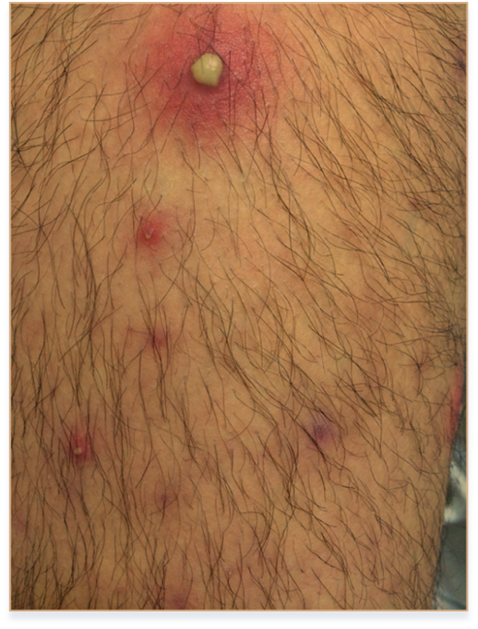
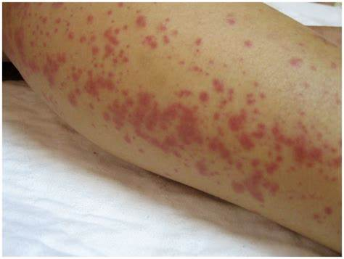
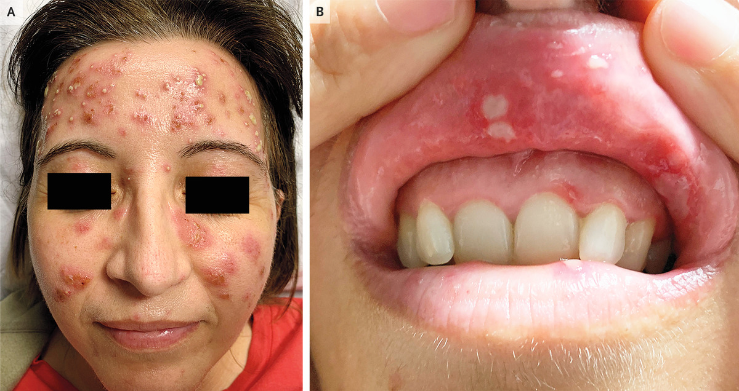
Cutaneous Manifestations
Painful maculopapular or papulopustular rash
Erythema nodosum (Painful red tender nodules on shins, arms, buttocks and face)
1. Yazici, H., Yurdakul, S., & Hamuryudan, V. (2001). Behçet disease. Current Opinion in Rheumatology, 13(1), 18-22

Slide 15
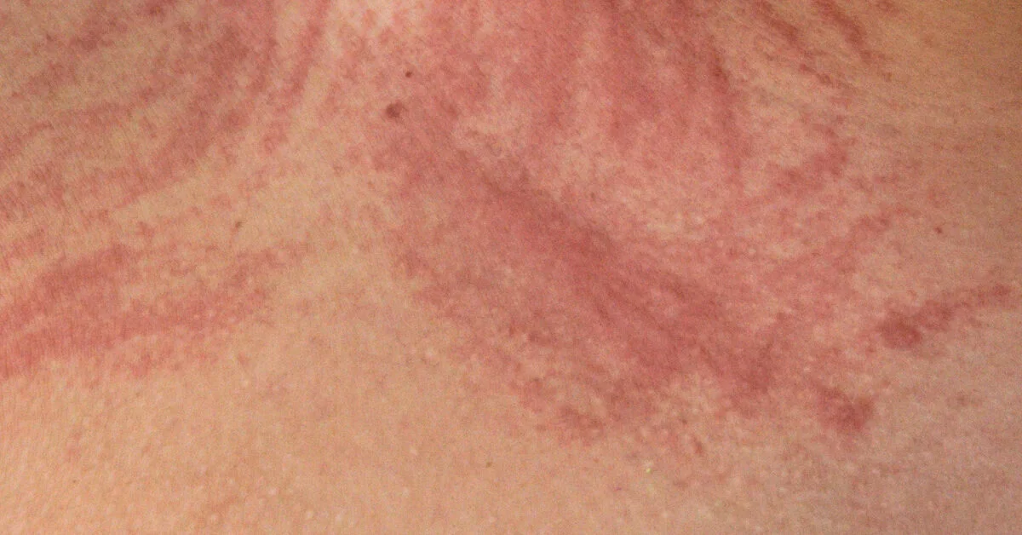
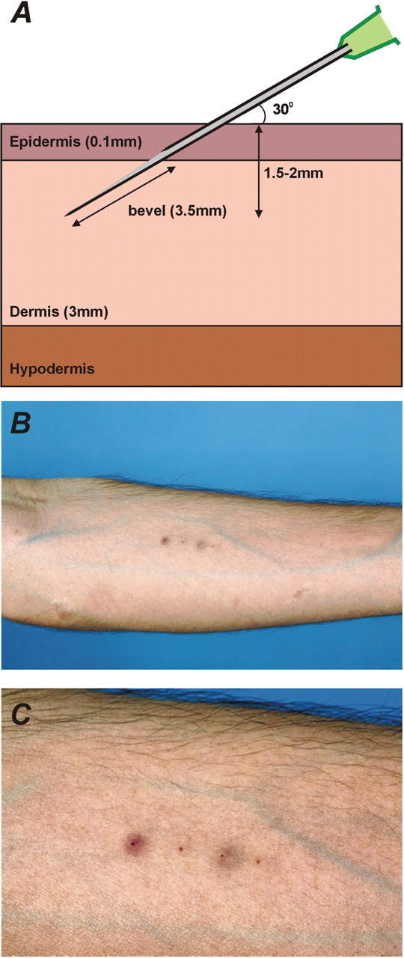
Cont..
Acne vulgaris
Positive pathergy test (Sterile pustule formation at site of venipuncture after 24-48 hours)
Dermatographia (an exaggerated weal and flare response that occurs within minutes of skin being stroked or scratched)
1. Yazici, H., Yurdakul, S., & Hamuryudan, V. (2001). Behçet disease. Current Opinion in Rheumatology, 13(1), 18-22

Slide 16
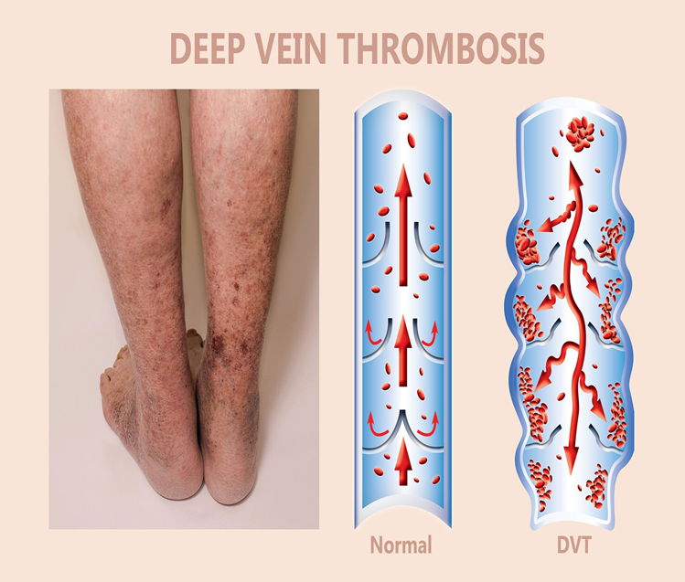
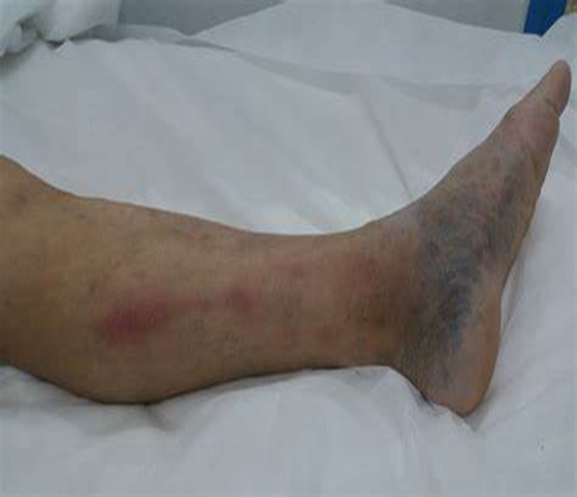
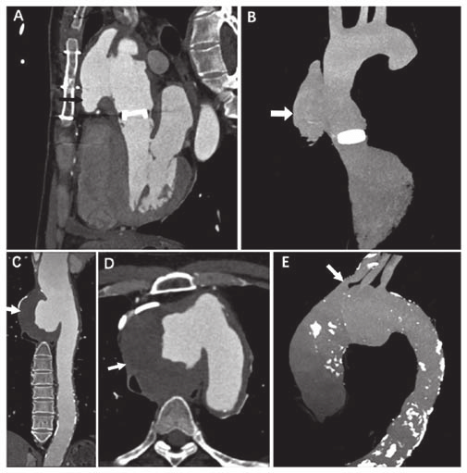
Vascular Manifestations
Systemic vasculitis
Affecting any size of artery and vein
Arterial occlusions and aneurysms
Venous occlusions and varices
Superficial vein thrombosis and deep vein thrombosis
1. Yazici, H., Yurdakul, S., & Hamuryudan, V. (2001). Behçet disease. Current Opinion in Rheumatology, 13(1), 18-22
Notes:
erythematous subcutaneous nodule on the leg. (b) erythematous plaque on the ankle. (c) crusted ulcer on the leg.

Slide 17
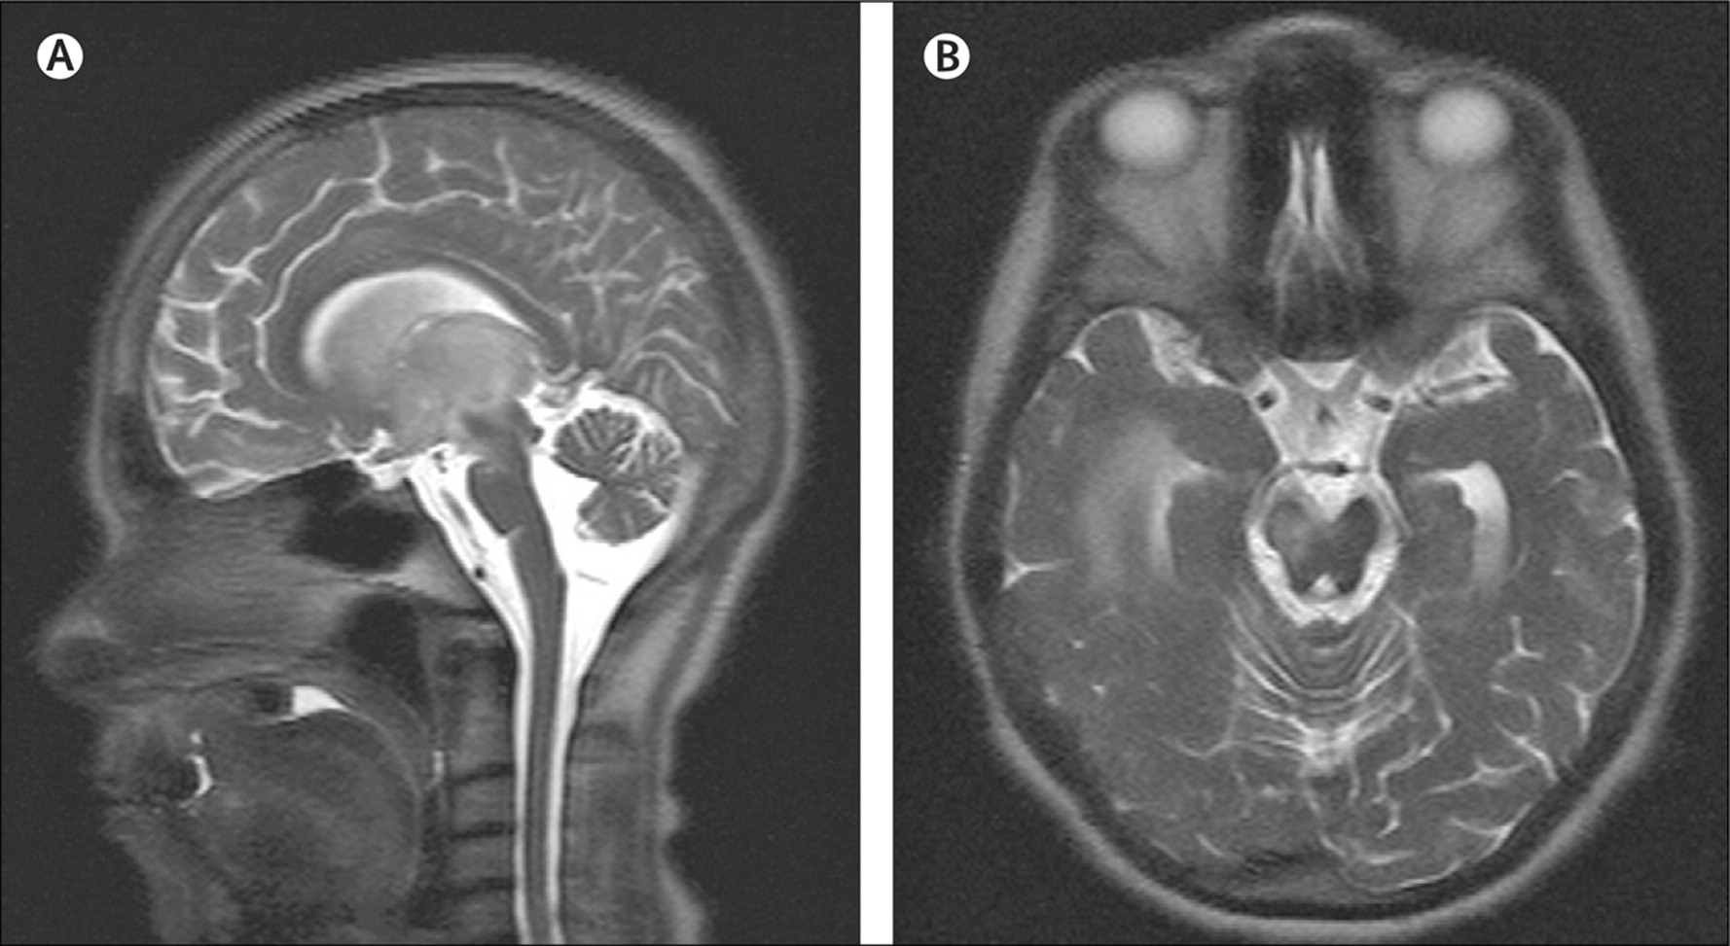
Neuro Manifestations
<20% of patients
Most serious
More common in men
Meningitis or meningoencephalitis
Motor neurologic deficits
Loss of bladder control
Psychiatric symptoms
Dementia in terminal stage
1. Yazici, H., Yurdakul, S., & Hamuryudan, V. (2001). Behçet disease. Current Opinion in Rheumatology, 13(1), 18-22
Notes:
White matter of brain and brainstem, development of an immune-mediated meningoencephalitis, which predominantly involves the brainstem, but can also involve the basal ganglia, thalamus, cortex and white matter, spinal cord, or cranial nervesHeadache, personality changes

Slide 18
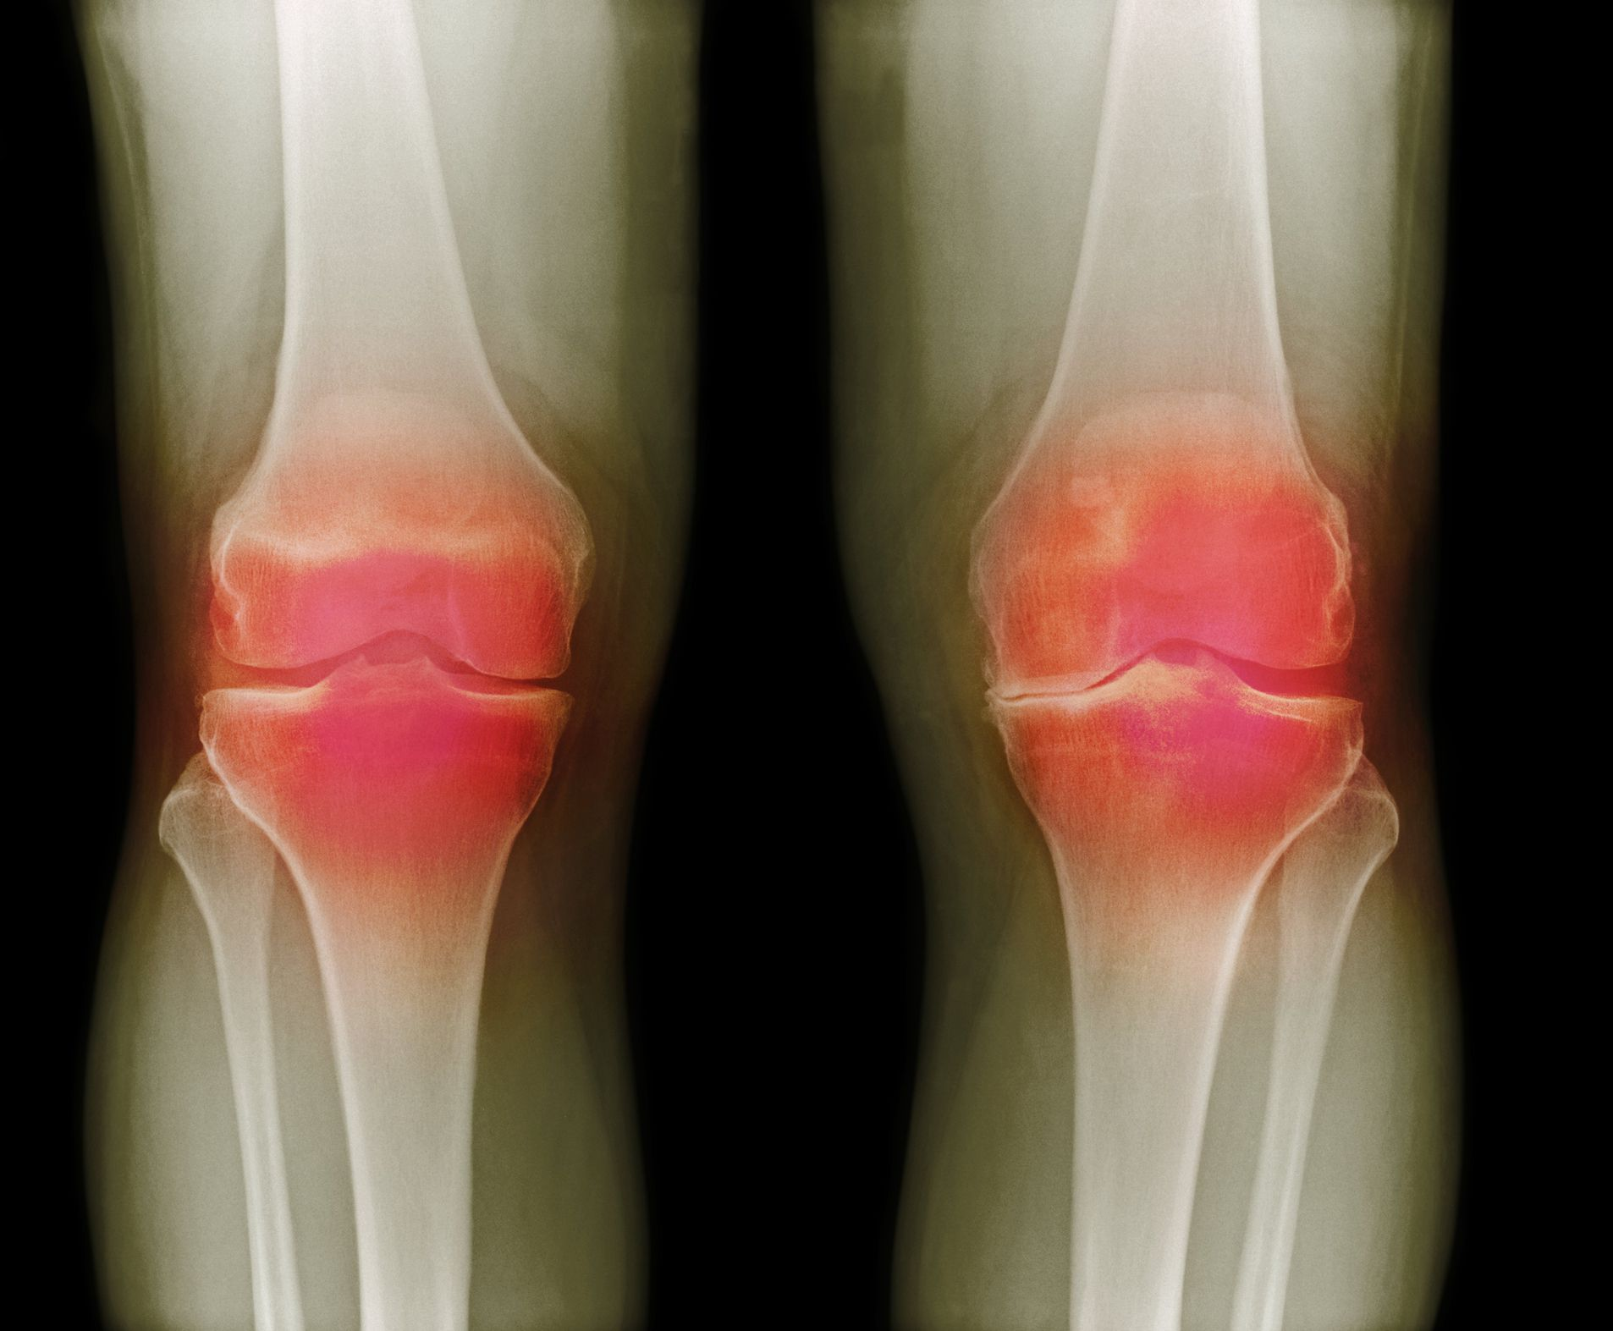
Musculoskeletal Manifestations
Oligo arthritis (symmetric or asymmetric) more common
Polyarthritis and mono arthritis can be seen
Knees most commonly involved joint, followed by ankles, wrists, and elbows
1. Yazici, H., Yurdakul, S., & Hamuryudan, V. (2001). Behçet disease. Current Opinion in Rheumatology, 13(1), 18-22

Slide 19
Diagnostic Criteria
Notes:
The International Team for the Revision of International Criteria for Behçet Disease (ITR-ICBD) revised the established criteria in 2008. The revised criteria are point-based and give 1 point each to oral aphthosis, skin manifestations (pseudofolliculitis, skin aphthosis), vascular lesions (phlebitis, large vein thrombosis, aneurysm, arterial thrombosis), positive pathergy test and 2 points each to genital aphthosis and ocular lesions

Slide 20
Differential diagnosis
Inflammatory Bowel Disease (IBD)
Systemic Lupus Erythematosus (SLE)
Seronegative Arthritis
Herpetic Infections
Sarcoidosis
Other Systemic Vasculitides
Relapsing Polychondritis
Multiple Sclerosis
Notes:
Behcet disease is a clinical diagnosis. However, the other diseases can mimic clinical features seen in Behcet disease, all of which should be ruled out before confirming a diagnosis of Behcet disease. it is challenging to differentiate these two conditions. Colon biopsies may not be adequate. sacroiliitis and axial inflammatory arthritis can be seen in IBD. Posterior uveitis and panuveitis are rare in IBD. SLE can have a very similar presentation to Behcet disease and can involve all the organs similarly involved in Behcet disease. However, inflammatory thrombi are not usually seen in SLE; the SLE-specific autoantibodies can differentiate. posterior uveitis and panuveitis are rare in reactive arthritis, and vascular or CNS involvement is also rare. Sacroiliitis and axial involvement are common in reactive arthritis, while not in Behcet disease. Oral and genital lesions. Depending on organ involvement. For ocular features d/d include all infectious and non infectious non-granulomatous causes of anterior uveitis, intermediate and posterior. CT scan may show bilateral hilar lymphadenopathy.Elevated serum ACE. Granulomatous inflammation

Slide 21
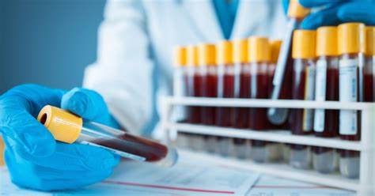
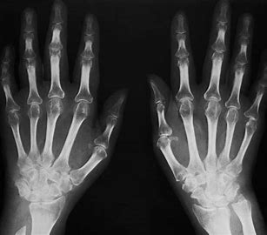
Laboratory Workup
Diagnosis of Behcet is clinical
ESR, CRP, HLA typing
Laboratory testing of little value in ocular disease
Imaging studies X-rays, CT-scan/ MRI (directed at the organ involved)
1. Yazici, H., Yurdakul, S., & Hamuryudan, V. (2001). Behçet disease. Current Opinion in Rheumatology, 13(1), 18-22
Notes:
It can be difficult due to the lack of any pathognomic laboratory findings. No specific diagnostic test
Laboratory findings are usually non-specific, including anemia of chronic disease, leukocytosis, and elevation in markers of inflammation

Slide 22
Workup Cont..
HLA-B51 (high association with Behçet's)
Skin Pathergy test (positive in 40-60% of cases)
Other labs: ANA, Infectious disease screening TB, Syphilis, sarcoidosis
Positive HLA-B51 is not a diagnostic/classification criterion
1. Yazici, H., Yurdakul, S., & Hamuryudan, V. (2001). Behçet disease. Current Opinion in Rheumatology, 13(1), 18-22
Notes:
Positive HLA-B51 is not a diagnostic/classification criterion

Slide 23
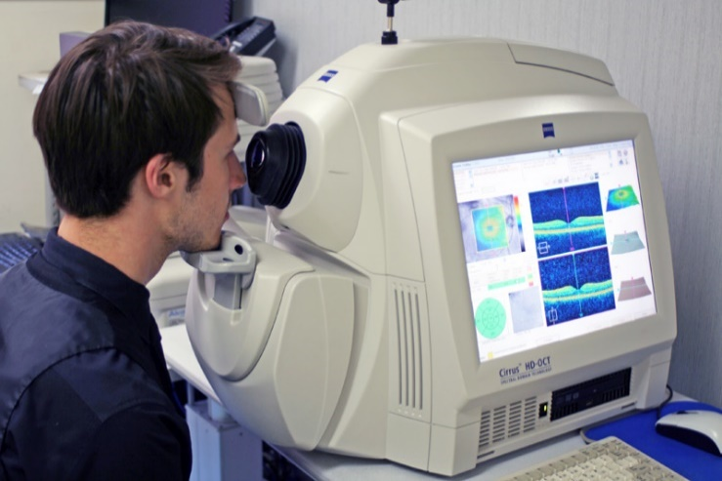
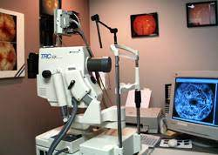
Ocular Imaging
Optical Coherence Tomography OCT (Macular edema)
Fundus Fluorescein Angiography FFA (Retinal ischemia and neovascularization, Macular edema, Perivascular staining, Occlusion and dilatation of capillaries)
OCT
FFA
Tugal-Tutkun, I., Onal, S., Altan-Yaycioglu, R., Altunbas, H. H., & Urgancioglu, M. (2004). Uveitis in Behçet disease: an analysis of 880 patients. American journal of ophthalmology, 138(3), 373-380.

Slide 24
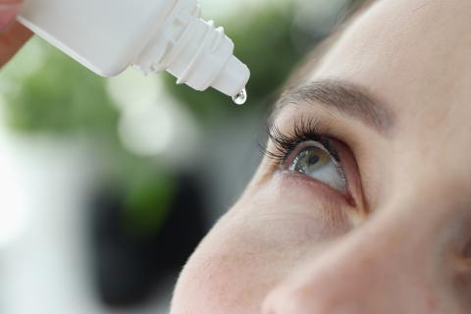
Management
Acute:
High-dose corticosteroids for ocular inflammation
Immunosuppressants: Azathioprine, cyclosporine for long-term control
Posterior segment BD is an absolute indication for prompt initiation of IMT (Immuno-modulative therapy)
Chronic/Refractory:
Biologics: Anti-TNF agents (infliximab, adalimumab) for severe or unresponsive cases
Interferon alpha 2a
Non-Ocular Treatment:
Colchicine for skin and joint involvement
Topical treatments for oral/genital ulcers
Alpsoy, E., Leccese, P., Emmi, G., & Ohno, S. (2021). Treatment of Behçet's Disease: An Algorithmic Multidisciplinary Approach. Frontiers in medicine, 8, 624795. https://doi.org/10.3389/fmed.2021.624795
Notes:
Pulse therapy: In cases of severe inflammation, such as retinal vasculitis, intravenous methylprednisolone (1g/day) may be given for 3 days. Oral prednisone: 0.5–1 mg/kg/day. are tapered gradually over weeks to months after inflammation is controlled. starting dose of azathioprine is 1–2.5 mg/kg/day.For a typical adult, this translates to 100–150 mg/day. Bone marrow suppression hepatotoxicity CBC, LFT, BONE DENSITY
To reduce recurrences and improve long term visual outcome, else severe relapses are likely to occur in tapering of steroids

Slide 25
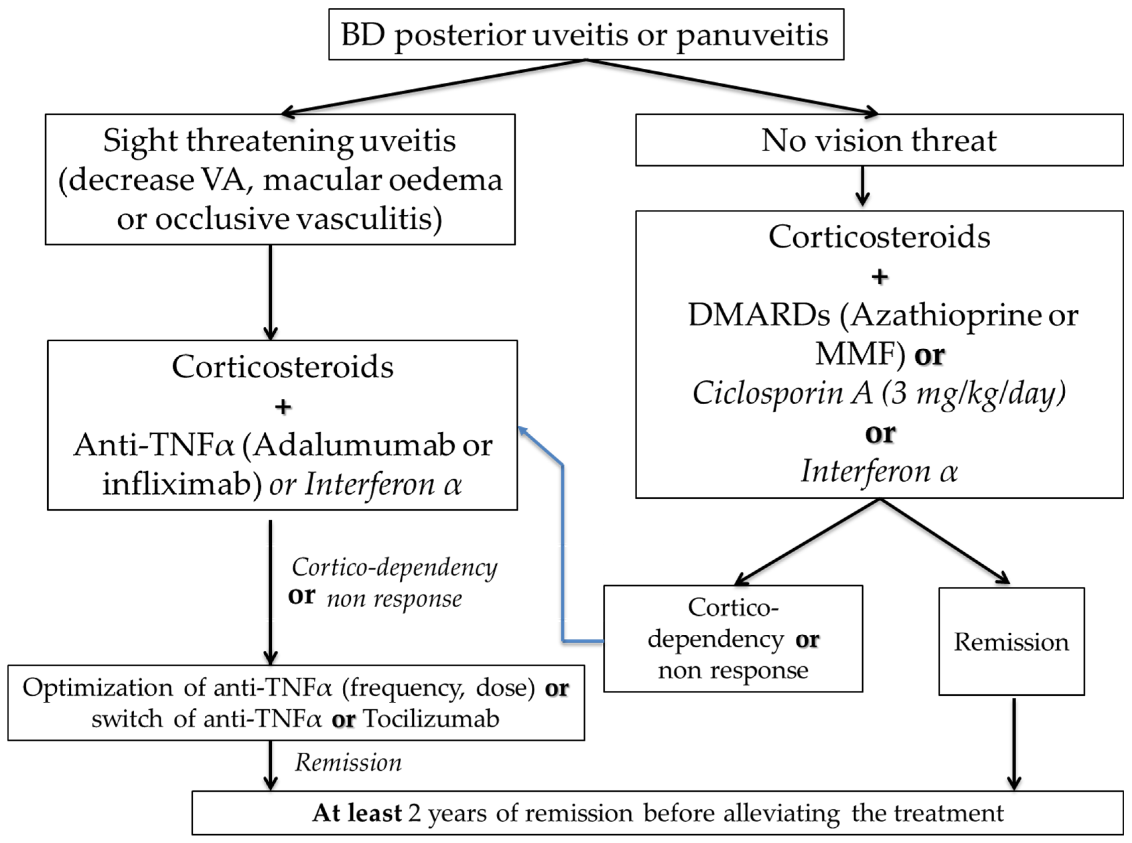
Ocular Behçet's T/M
Alpsoy, E., Leccese, P., Emmi, G., & Ohno, S. (2021). Treatment of Behçet's Disease: An Algorithmic Multidisciplinary Approach. Frontiers in medicine, 8, 624795. https://doi.org/10.3389/fmed.2021.624795
Notes:
Disease modifying anti-rheumatic drugs (immunosuppressive and immunomodulatory agents and are classified as either conventional DMARDs or biologic DMARDs. Commonly used conventional DMARDs include methotrexate) biologic agents include infliximab, adalimumab, Biologic DMARDs are highly specific and target a specific pathway of the immune system. duration of treatment is not known. However, immunosuppressive therapy for at least 18 to 24 months is usually recommended in refractory illness.

Slide 26
Prognosis
Behcet disease has no cure
More than 60% of patients go into remission after passing initial years when disease is most active
Early and aggressive treatment can prevent vision loss and systemic complications
Regular monitoring for disease progression and treatment side effects
Risk of recurrence and flare-ups, especially with ocular involvement
Alpsoy, E., Leccese, P., Emmi, G., & Ohno, S. (2021). Treatment of Behçet's Disease: An Algorithmic Multidisciplinary Approach. Frontiers in medicine, 8, 624795. https://doi.org/10.3389/fmed.2021.624795
Notes:
and is associated with significant morbidity and mortality. Poor prognosis and higher mortality are related to the male sex and younger age of onset. Patient Education symptoms can be controlled significantly with the prescribed drugs. As some drugs may be teratogenic, explained the variety of symptoms they may experience and encouraged to seek immediate medical attention in case any of these symptoms appear

Slide 27
It’s not late to get involved
Notes:
International Behçet’s Awareness Day. This is a special time for spreading awareness about Behçet’s disease among the general public and within the medical community as well. The American Behcet’s Disease Association has put up a calendar of activities and events that can help you get involved in spreading awareness during this time

Slide 28
Take home message
Your eyes can be the windows to your health
Notes:
As we conclude today’s Clinicopathological Conference, I’d like to take a moment to reflect on the key lessons learned from this case.
We began with a young male patient whose initial presentation of gradual vision loss and recurrent ulcers led us down a path of investigation, ultimately revealing a diagnosis of Behçet's disease—a complex, multisystemic vasculitis. This case highlights the importance of considering systemic diseases in patients with ocular symptoms, and the value of a multidisciplinary approach in reaching a diagnosis. Early recognition and aggressive management of Behçet's disease are essential to prevent serious complications like blindness, and this case reinforces the need for vigilance in detecting subtle signs that might indicate a broader systemic condition. Thank you all for your attention and contributions today. I look forward to future discussions and continuing to learn together through these fascinating cases

Slide 29
THANKS

Slide 30
References
Khairallah, M., Accorinti, M., Muccioli, C., Kahloun, R., & Kempen, J. H. (2012). Epidemiology of Behçet disease. Ocular immunology and inflammation, 20(5), 324-335.
Yazici, H., Yurdakul, S., & Hamuryudan, V. (2001). Behçet disease. Current Opinion in Rheumatology, 13(1), 18-22.
Tugal-Tutkun, I., Onal, S., Altan-Yaycioglu, R., Altunbas, H. H., & Urgancioglu, M. (2004). Uveitis in Behçet disease: an analysis of 880 patients. American journal of ophthalmology, 138(3), 373-380.
Alpsoy, E., Leccese, P., Emmi, G., & Ohno, S. (2021). Treatment of Behçet's Disease: An Algorithmic Multidisciplinary Approach. Frontiers in medicine, 8, 624795. https://doi.org/10.3389/fmed.2021.624795

