Slide 1
“Silence to sound: Is hearing loss ever treatable?” Department of ENT,& Head and Neck Surgery Benazir Bhutto Hospital
Presenter: Dr. Muhammad Shuaib
Resident ENT, BBH

Slide 2
Demographic Details
Name: XYZ
Age: 32 years
Sex: Male
Marital status: Unmarried
Occupation: Shopkeeper
Residence: Mandi Bahauddin
Date of admission: Nov 2nd, 2022
Mode of admission: OPD

Slide 3
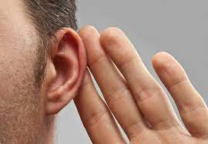
Presenting Complaint
Hearing loss (both ears) for the last 10 years.

Slide 4
History of Presenting Complaint
Hearing loss
Gradual in onset
Progressive
Bilateral
Non episodic
No history of ear trauma

Slide 5
Tinnitus -ve
Vertigo -ve
Ear discharge –ve
Otalgia –ve
Aural fullness -ve

Slide 6
Past Medical History
Not significant
Past Surgical History
History of appendectomy in 2016.
No history of any RTA.

Slide 7
Family History
Mother is hypertensive.
Drug/Allergy History
History of pollen allergy.

Slide 8
Personal History
History of smoking for the last 7 pack years.
Comorbids
Not significant.

Slide 9
Socioeconomic History
Lived in a rented house of 3 rooms with his mother and 2 younger siblings.
Sole bread earner of the family.
Belonged to a lower middle class family.

Slide 10
General Physical Examination
Vitals
BP: 110/70 mmHg
Pulse: 85/min
RR: 18/min
Temp: A/F

Slide 11
Pallor -ve
Jaundice -ve
Clubbing -ve
Koilonychia -ve
Leukonychia -ve
JVP not raised
No cervical lymphadenopathy

Slide 12
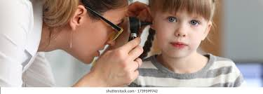
ENT EXAMINATION

Slide 13
Ear Examination
Inspection (bilateral)
No deformity
No scar marks
No pre auricular sinus or any other congenital abnormality

Slide 14
Palpation (bilateral)
No tenderness over tragus, pinna, mastoid area or pre auricular area.
Speculum Examination (bilateral)
External auditory canal of right ear was clear.
In left ear, wax was impacted which was suctioned.

Slide 15
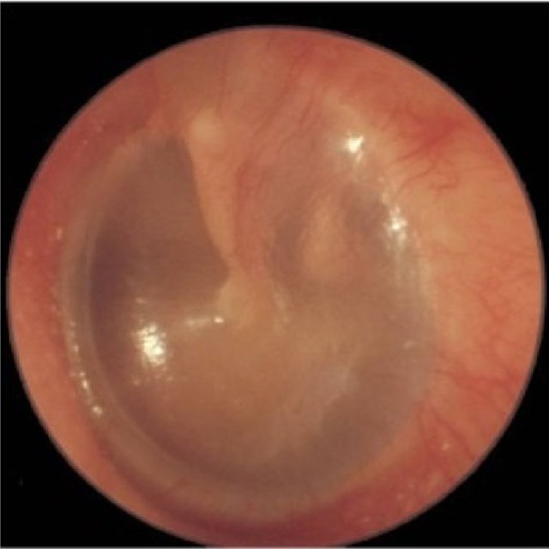
Otoscopy
Tympanic membrane intact bilaterally, pearly, transparent, cone of light seen in the anteroinferior quadrant of both ears.

Slide 16
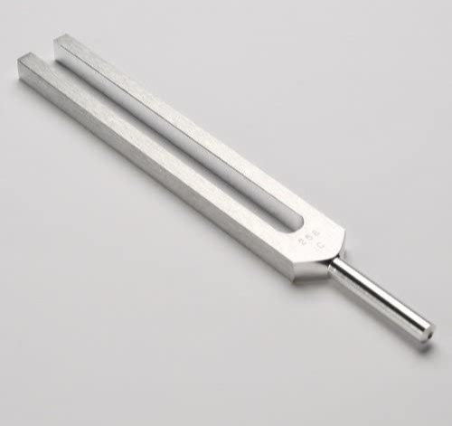
Hearing Tests
Rinne Test
Right ear…BC>AC
Left ear…BC>AC
Weber Test
Central
ABC Test
Same as the examiner

Slide 17
Fistula Test
Negative fistula test
No nystagmus observed
No vertigo
Facial Nerve
Intact

Slide 18
Posterior Rhinoscopy
Unremarkable
Cerebellar Signs
No signs of cerebellar lesion
Lymph Nodes
Not palpable

Slide 19
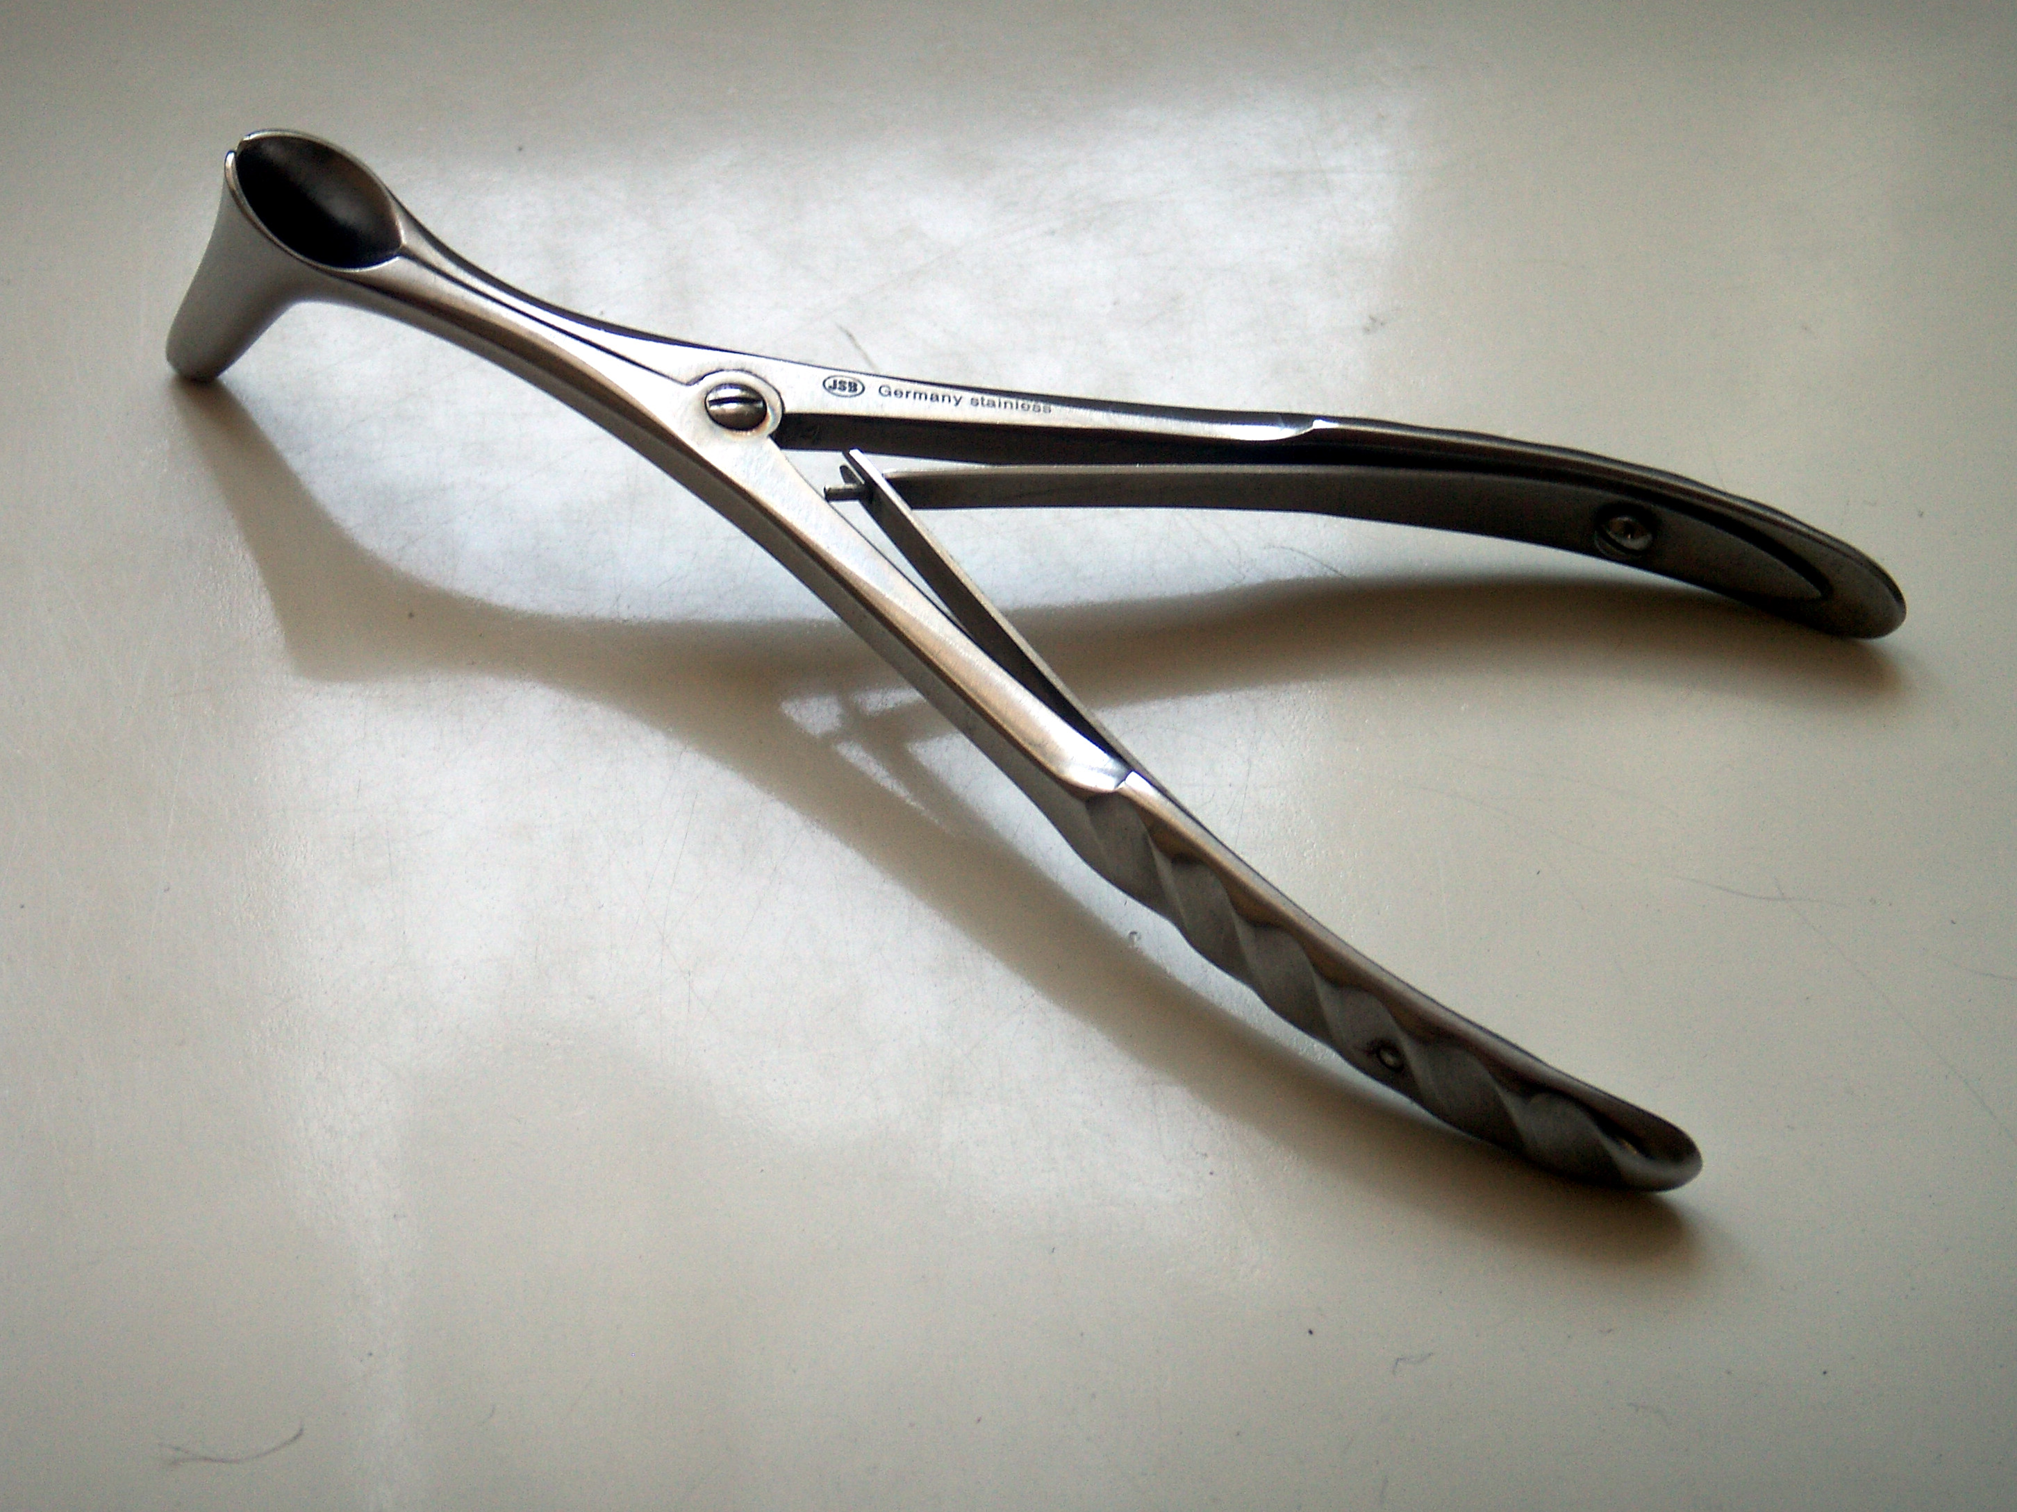
Nose Examination
Inspection
No external nasal deformity
No scar mark
No abnormality in vestibule
Patency Test
Bilaterally patent nostrils

Slide 20
Smell Test
Sense of smell intact bilaterally.
Anterior Rhinoscopy
Septum central.
Nasal mucosa normal.

Slide 21
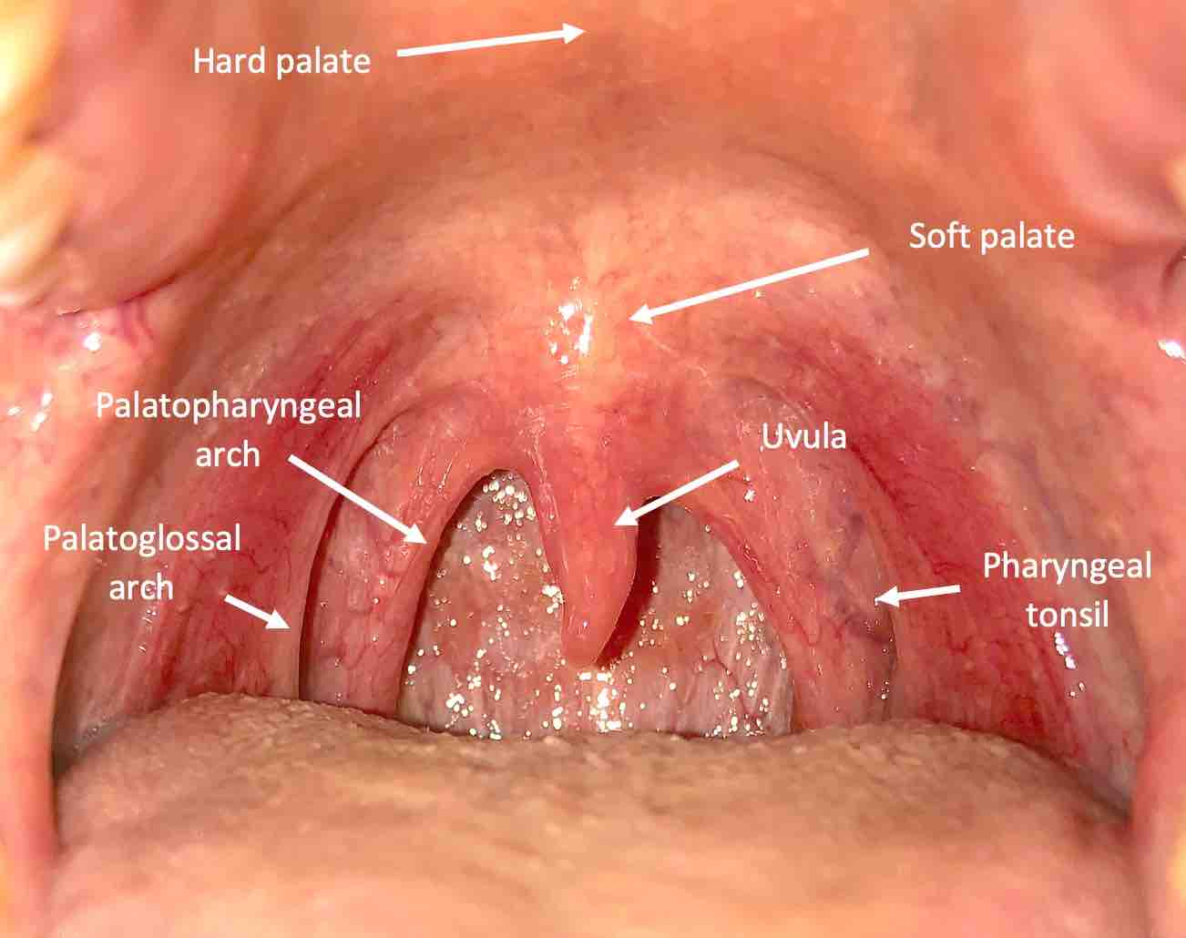
Oral Cavity Examination
Inspection : Unremarkable
Mouth opening : Adequate
Oro-dental hygiene : Satisfactory
Palate : normal movements
Buccal mucosa , ﬂoor of mouth : Normal
Tonsils : Grade 1 tonsils present bilaterally

Slide 22
Throat Examination
Posterior pharyngeal wall healthy ,No congestion or PND seen
Bimanual palpation : no glands palpable
IDL: no congestion or edema seen, both vocal cords mobile, met in midline on phonation.

Slide 23
Systemic Examination
CVS Examination
S1+S2+0
Respiratory examination
Chest B/L clear
No wheeze/ rhonchi/crepts
GIT examination
Abdomen soft, non tender, BS +ve
CNS Examination
-GCS 15/15
-Cranial nerves intact
-Motor and sensory system intact

Slide 24
Investigations

Slide 25
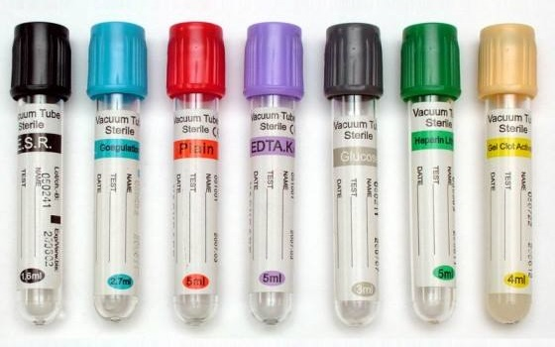
Baselines
Hb: 14 g/dl
WBC count: 9000 cells/ul
Platelets: 250,000 /uI
(All other labs were in normal range.)

Slide 26
Specific Investigations

Slide 27
Pure Tone Audiometry

Slide 28
Pure Tone Audiometry

Slide 29
Tympanometry

Slide 31
Acoustic Reflex

Slide 33
D/Ds
Otosclerosis
Serous otitis media
Adhesive otitis media
Tympanosclerosis
Attic fixation of head of malleus
Congenital stapes fixation

Slide 34
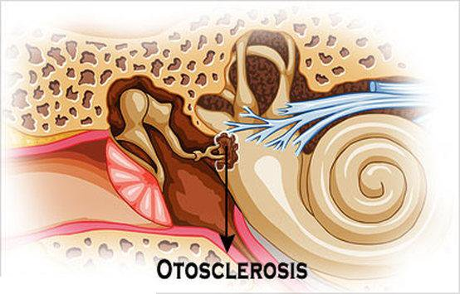
Definitive Diagnosis
Otosclerosis

Slide 35
STAPEDOTOMY

Slide 36
Anesthesia being given.

Slide 37
Tympanomeatal flap is raised.

Slide 38
Middle ear exposed.

Slide 39
Fenestration made in the footplate of stapes and piston inserted.

Slide 40
Operation site closed.

Slide 41
Post Op Scar

Slide 42
Post Operative Audiogram

Slide 44
OTOSCLEROSIS Literature Review
Dr. Fatima Shahid
Resident ENT, BBH

Slide 45
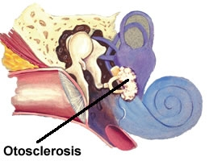
OTOSCLEROSIS
Localized hereditary disorder of bone metabolism.
Involves otic capsule endochondral bone(bony labyrinth inner ear) .
Characterized by disordered resorption and deposition of bone accompanied by vascular proliferation and tissue stroma.

Slide 46
TYPES OF OTOSCLEROSIS
Clinical/ Stapedial
Cochlear
Histological

Slide 47
Clinical
Lesion affect the stapes, stapediovestibular joint or round window membrane
conductive hearing loss.
Cochlear
lesions involving the cochlear endosteum only
Causes pure sensorineural hearing loss
Histological
histopathological lesions that do not affect the stapes, stapediovestibular joint or cochlear endosteum
asymptomatic

Slide 48
Epidemiology
Autosomal Dominant Inheritence
White race
Female >Male
Age of onset
20-30yr
Incidence
Histological 3.4%

Slide 49
Etiology
Virus Induced
(Measles)
Hormonal Factors
(RAAS)
Multifactorial
Cytokines
(TGF-β1 ,BMP)

Slide 50
Pathophysiology
Bony resorption and replacement with spongy bone
Formation of dense sclerotic bone with narrow vasculature
New bone formation at oval window fixing stapes

Slide 51
Symptoms
Hearing Loss (Slow Progressive
Bilateral)
Tinnitus (Rare)
Vertigo(Rare)

Slide 52
EXAMINATION
Otoscopy
Tuning Fork Test
Weber lateralized to poorer ear
Negative Rinne
Schwartz Sign

Slide 53
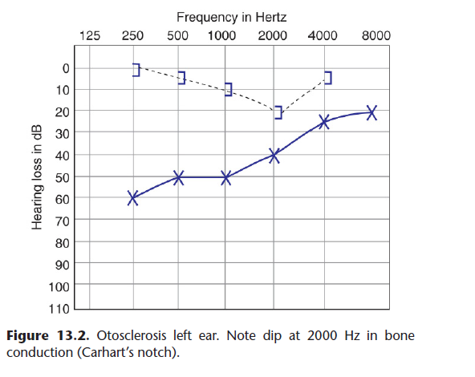
AUDIOLOGICAL TESTS
PTA
Carhart’s Notch
Tympanometry
Ossicular stiffness
Absent stapedial reflex
Air Conduction loss more for lower frequency
Notes:
The 1600-1700 Hz frequency range is affected mostly.
The reason that the Carhart notch is seen audiometrically at 2k Hz is because 2k Hz is the closest frequency tested in atypical hearing thresholds measurement.

Slide 54
Radiological Investigations
High resolution CT scan Temporal Bone
Detect abnormal bone densities within the otic capsule.
Active otosclerosis as hypodense areas within the otic capsule
In case of cochlear involvement it shows “double ring sign”
MRI
If cochlear implantation is contemplated
Excludes retrocochlear pathology

Slide 55
Notes:
lucency anterior to the oval window (arrow) and between the cochlea and the internal auditory canal.

Slide 57
DIFFERENTIAL DIAGNOSIS
Serous otitis media
Adhesive otitis media
Tympanosclerosis
Attic fixation of head of malleus
Ossicular discontinuity
Congenital stapes fixation

Slide 58
TREATMENT
Hearing aid
Medical management
Surgical management

Slide 59
Hearing Aid
Very effective in early stage of disease
Can be used in advance stage, if:
Surgery is contraindicated
Patient refuses the surgery
In far-advance cases it is required, even after stapedotomy

Slide 60
Types of Hearing Aids Used
CONVENTIONAL HEARING AIDS
BONE-ANCHORED HEARING AIDS
DIRECT ACOUSTIC COCHLEAR STIMULATION
COCHLEAR IMPLANTATION
Notes:
Conventional Hearing Aids: Manage conductive hearing impairment
BAHA : only hearing ear with otosclerosis combined with difficulty using a conventional aid, or a post-fenestration cavity
DACS: patients with mixed hearing loss where a successful stapedotomy alone would not allow the patient to manage without a hearing aid
COCHLEAR IMPLANTATION: Patients with FAO (Far Advanced Otosclerosis) or failed stapedotomy

Slide 61
Medical Management
Aim is to Stabilize the disease by
↓Osteoclastic Activity
↑Calcium Deposition in otospongiotic foci
Inhibits cytotoxic proteolytic Enzymes
Sodium Fluoride 20mg BD for 2 years with Calcium & Vitamin D
Not commonly used due to side effects
Notes:
Side effects :Synovitis, gastrointestinal disturbance with pain and vomiting, painful plantar fasciitis and anaemia
Can be used in patients with progressive sensory hearing loss

Slide 62
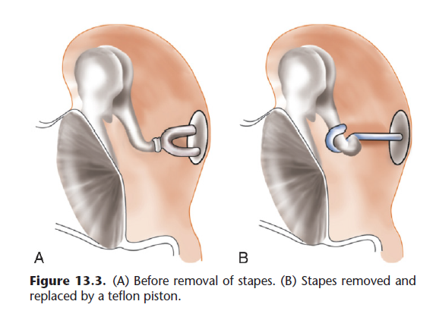
Surgical Management
Stapedectomy/stapedotomy with a placement of prosthesis is the treatment of choice.
Notes:
Creation of a hole in the stapes footplate (stapedotomy) or removal of a part of footplate (stapedectomy).

Slide 63
INDICATIONS OF SURGERY
Progressive conductive hearing loss with absent reflexes
Air-bone gap >20 dB in at least three frequencies
Tympanosclerosis with stapes footplate fixation
Trauma-induced footplate fracture or subluxation

Slide 64
Contraindications to Stapes Surgery
Occupation and leisure activities
Air-bone gap less than 20 dB in at least three frequencies
Meniere disease
Active external or middle ear disease
Only or better hearing ear
Pregnancy
Notes:
Age : Children (risk of congenital middle and inner abnormalities)
Occupation :Commercial air travel, scuba diving, strenuous activities
Meinere Disease: proximity of the distended saccule to the footplate
Diabetes Relative contraindication

Slide 66
Notes:
Steps of Stapedectomy
1. Meatal incision and elevation of the tympanomeatal flap.
2. Exposure of stapes area. This may require removal of posterosuperior bony overhang of the canal.
3. Removal of stapes superstructure.
4. Creation of a hole in the stapes footplate (stapedotomy) or removal of a part of footplate (stapedectomy).
5. Placement of prosthesis.
6. Repositioning the tympanomeatal flap.

Slide 67
Notes:
Steps in stapedotomy. (a) Following disarticulation of the incudostapedial joint, a fixed footplate is confirmed.
(b) Division of the stapedius tendon. (c) Division of the posterior crus of the stapes using crurotomy scissors or a laser followed by
down fracture of the crura. (d) Stapedotomy drilled in posterior third of the footplate. (e) Following insertion of the prosthesis, final
adjustments are made and crimping carried out if required. (f) Packing around the footplate with fat or connective tissue

Slide 68
Complications
Conductive Hearing Impairment
Sensorineural Hearing Impairment
Discomfort to loud sounds
Cholesteatoma
Vertigo
Perilymphatic fistula
Chorda tympani and facial nerve Injury
Reparative granuloma
Notes:
CHL (Displaced Prosthesis, Necrosis of long process of incus, fibrous adhesions, bony regrowth)
SNHL (extensive drilling , floating footplates, perilymph aspiration)
Vertigo (results from serous labyrinthitis)
Perilymphatic fistula(persistent or fluctuating hearing impairment, vertigo, disequilibrium, tinnitus, sense of fullness in the ear)
Reparative granuloma(granulation tissue formation around a stapes prosthesis and the oval window which may extend into the vestibule. Patients present with deterioration in hearing after an initial post-operative improvement, dull red tympanic membrane, particularly in the posterior–superior quadrant
Cholesteatoma(2ndry to skin graft implant)

Slide 69
Post Op Management
Avoid brisk head movements.
Avoid heavy straining/lifting or nose blowing.
Air travel should be avoided.
Follow-up in 1 to 2 weeks for removal of the packing.
Postoperative audiogram is typically done between 1 and 3 months postoperatively.
Appropriate pain control.

Slide 70
THANK YOU!

