Slide 2
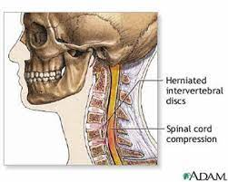
Cervical Disc Disease New Horizon

Slide 3
Anterior Cervical Discectomy Fusion (ACDF) at 2 or More Levels vs Anterior Median Cervical Corpectomy & Fusion (ACCF)
DEPARTMENT OF NEUROSURGERY
HOLY FAMILY HOSPITAL, RAWALPINDI

Slide 4
Outline
Case Presentation
Topic presentation
Discussion
Q and A session

Slide 5
Case Presentation
DEMOGRAPHIC DETAILS
Patient: XYZ
Age : 35 years
Gender: Male
Resident: Kohat
Married with two kids
Laborer by Profession
Presented in Neurosurgical OPD

Slide 6
Presenting Complain
Neck pain radiating to both arms (Right > Left) – 1 year
Numbness Right Arm – 6 months

Slide 7
History of Presenting Illness
My patient was in usual state of health 1 year ago when he started experiencing pain in neck which was gradual in onset, progressive, throbbing in nature , moderate to severe in intensity and radiating to both arms right being greater than left. Pain was aggravated by work and relieved by medicines but for the last one month the pain was continuous and not relieved by any medication . For the last one month he also complained of slight decrease in power of right hand .
It was accompanied by numbness in his right arm and hand.

Slide 8
Treatment history
Taking medicines tab cyclobenzaprine, diclofenac Na and pregabalin off and on for last one year
Undergoing physiotherapy since last 2 months
Cervical collar being worn for last one month

Slide 9
Personal and Socioeconomic History
Married with two children
Labourer by profession
Naswar addict
Belongs to low socioeconomic class

Slide 10
Examination
A young male wearing cervical collar sitting on the bed holding right arm well oriented in time place and person.
Pulse :84/min
BP : 140/80 mm of Hg
GPE: pallor, koilonychia, clubbing , leukonychia -- -ve

Slide 11
Systemic Examination
 | Right |  | Left
 | Upper Limb | Lower Limb | Upper Limb | Lower Limb
Bulk | N | N | N | N
Tone | N | N | N | N
Power | 5/5 in all muscles groups except Hand (4/5) | 5/5 | 5/5 | 5/5
Reflexes | Decreased Biceps & Triceps Jerk | N | N | N
Sensations | Impaired C6 & C7 Dermatomes | N | N | N
CNS

Slide 12
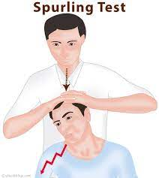
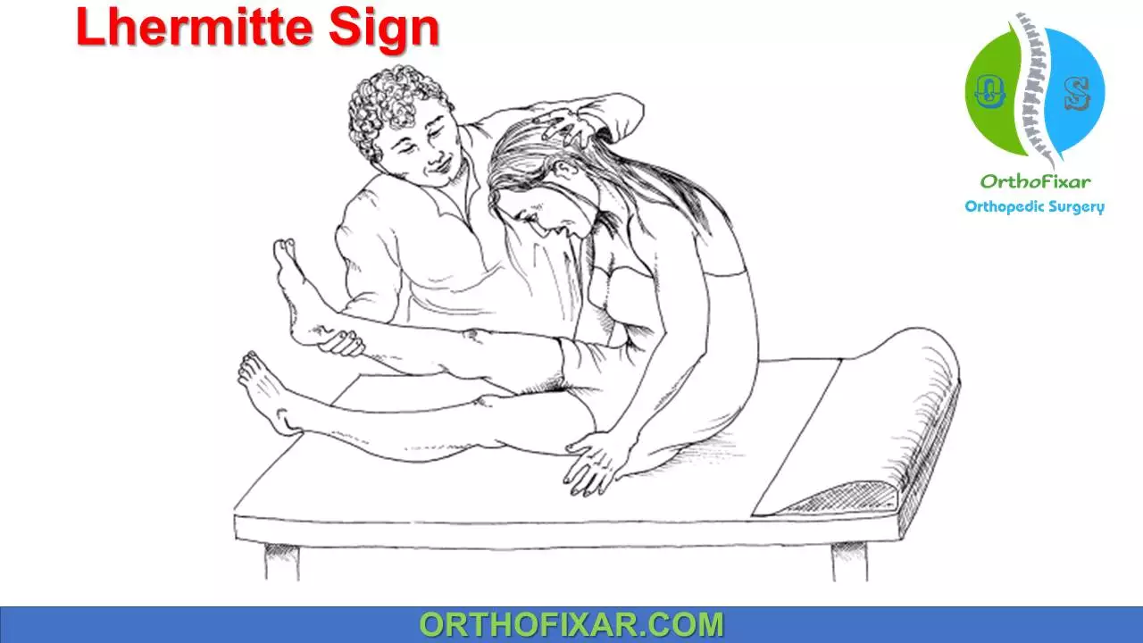
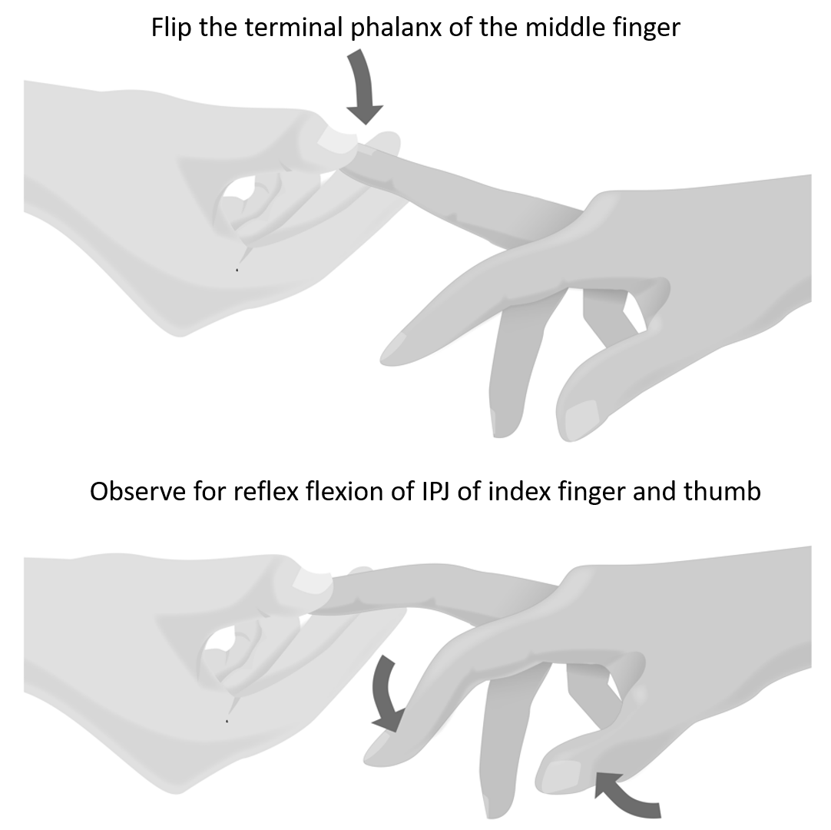
CNS
Spurling’s Sign + ve Right
Lhermitte’s Sign - ve Bilaterally
Hoffman’s Sign - ve Bilaterally
Plantars Bilaterally Down going
Cranial Nerves Intact
Cerebellar Signs: -ve
GCS 15/15
Lobes NA
CVS
Respiratory
GIT
Locomotor
NORMAL
Hoffman`s

Slide 13
Provisional Diagnosis
Cervical Radiculopathy C5-C6, C6-C7 with right brachalgia

Slide 14
Investigations
Xray Cervical Spine (AP & Lateral View)
MRI Cervical Spine (Plain)

Slide 15
X-ray C spine

Slide 16
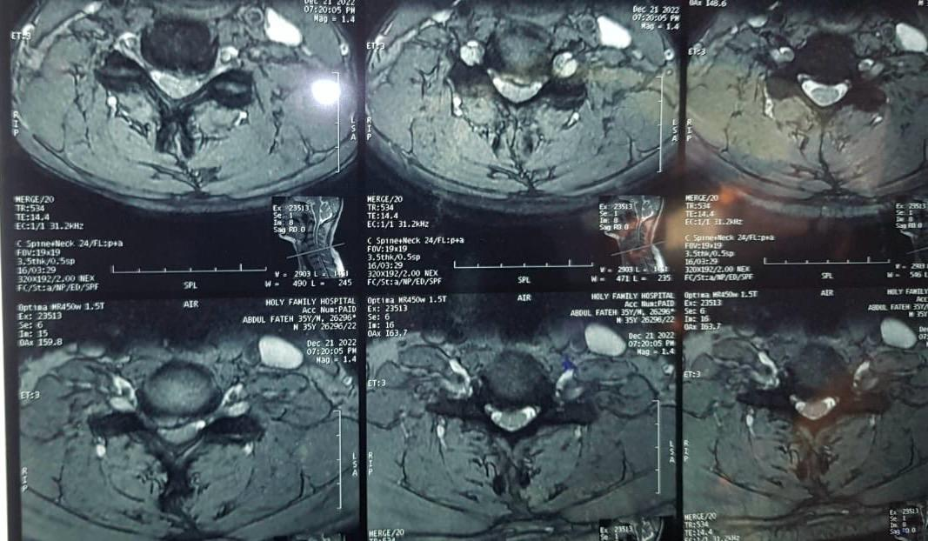
MRI TW1 Axial view

Slide 17
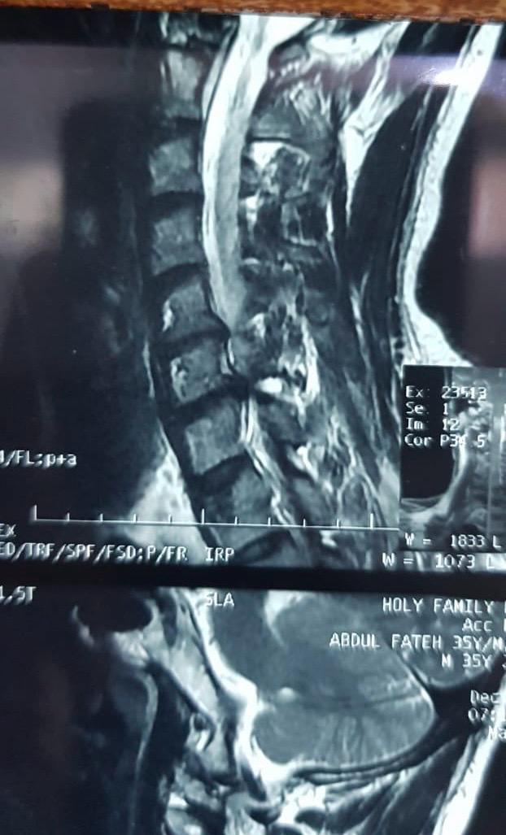
MRI cervical spine T2 sagittal views showing disc bulge at C5.C6,C7

Slide 18
Final Diagnosis
PIVD C5-C6 , C6-C7 with Right Brachalgia

Slide 19
Treatment Plan
Baseline Investigations
Anesthesia Fitness
ACDF Two Levels vs Anterior Median Corpectomy
Pros & Cons Explained to Patient and Attendants
ACDF using Cervical Cage with Integrated Screws Titanium vs PEEK

Slide 20
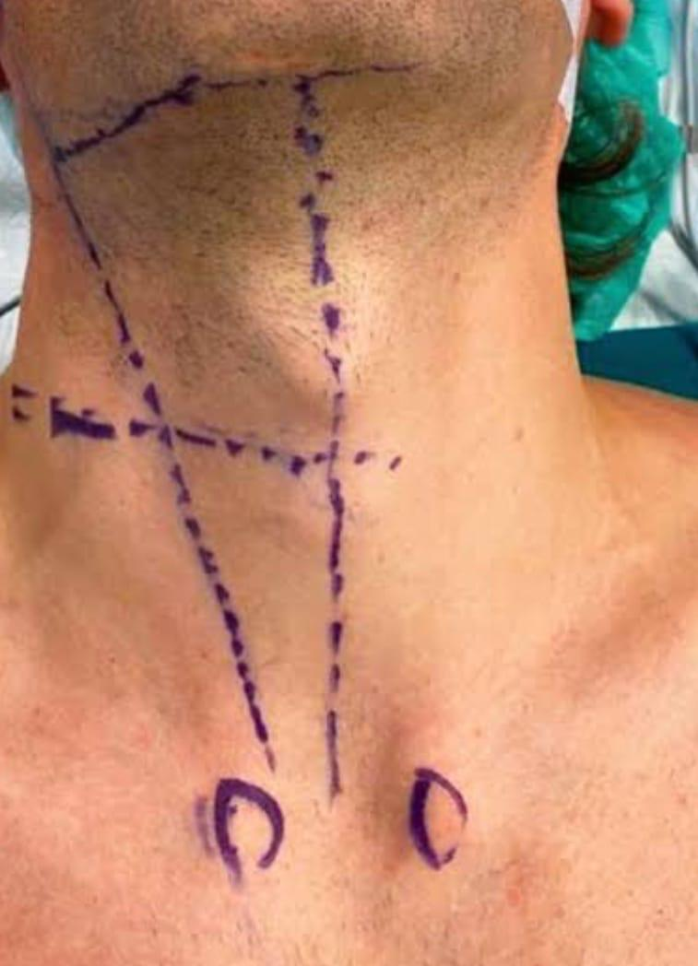
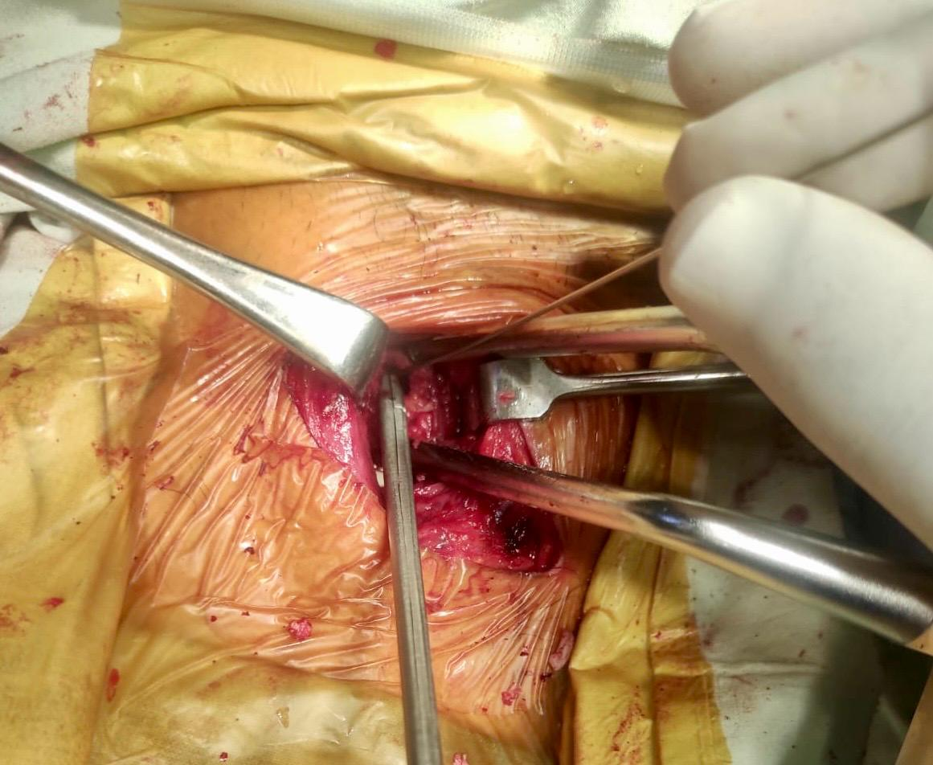

Slide 21
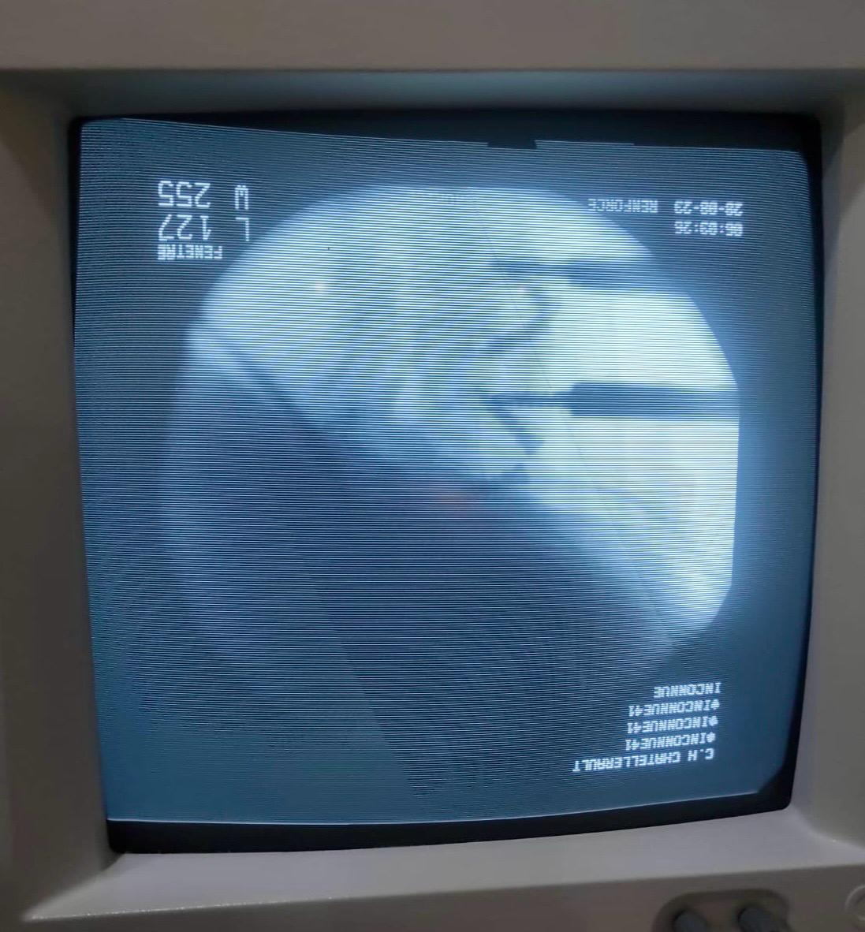
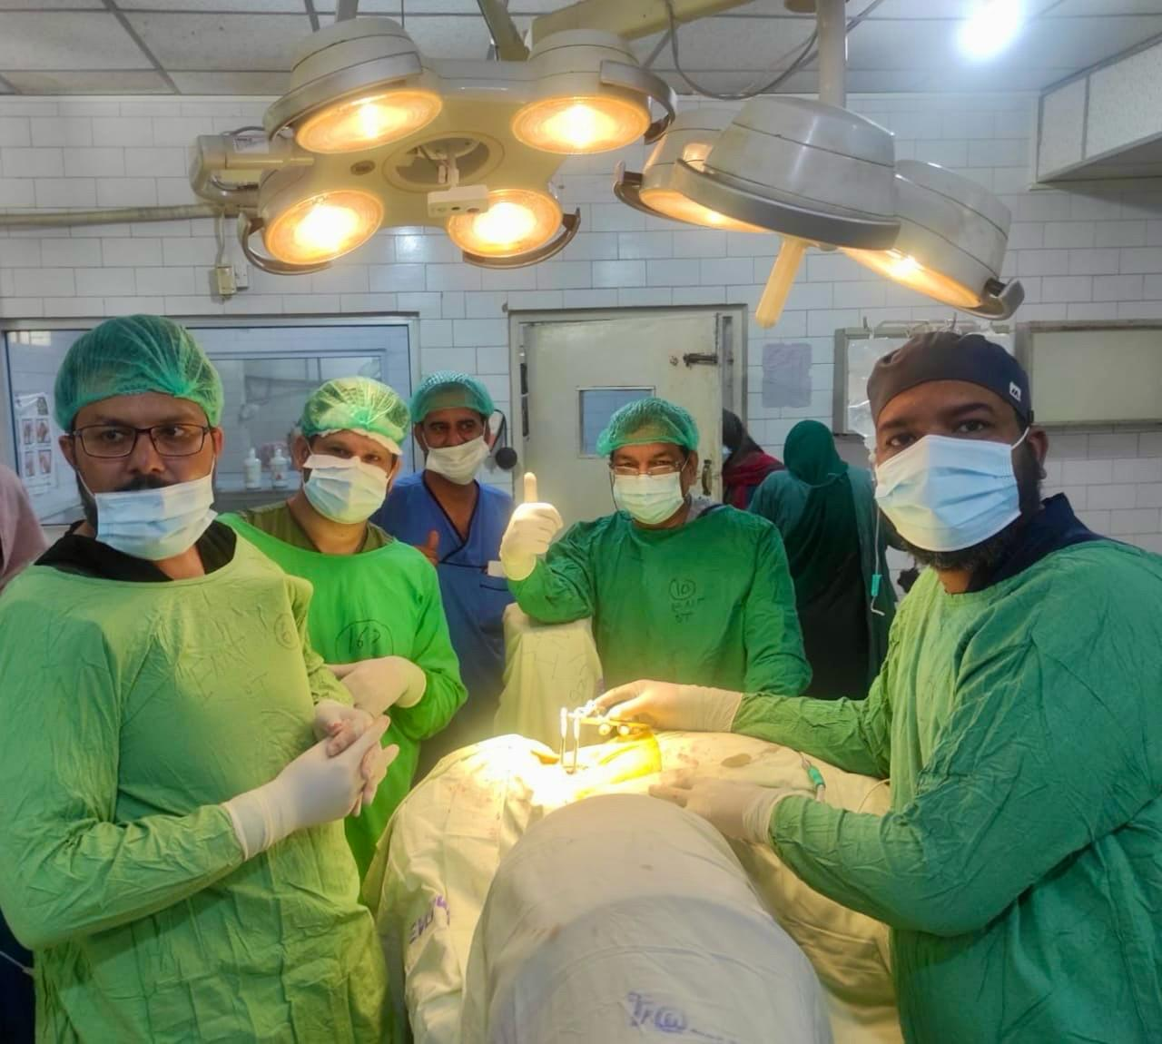

Slide 22
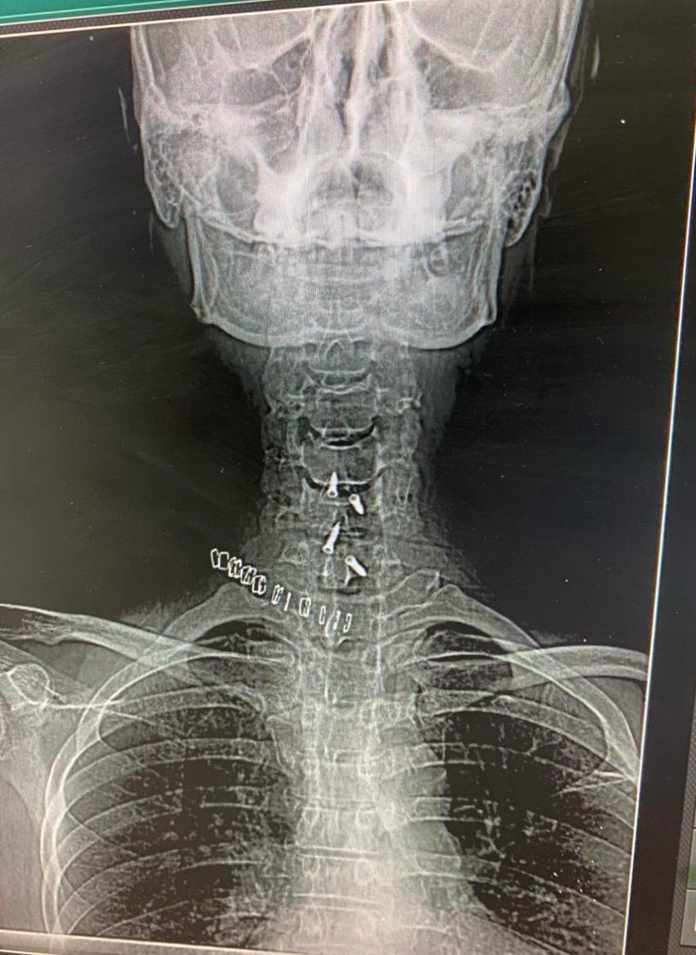
Post op recovery was unremarkable

Slide 23
DISCUSSION
By
DR FRAZ MEHMOOD SR, NEUROSURGERY HOLY FAMILY HOSPITAL

Slide 24
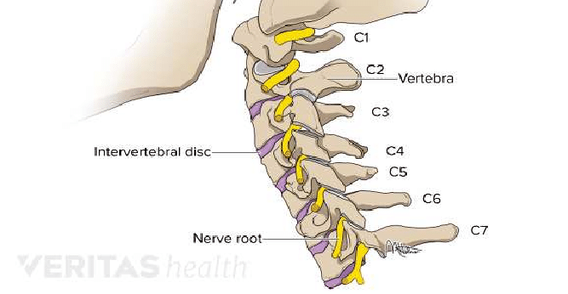
Cervical disc disease
Anatomy of cervical spine : 7 cervical vertebrae
6 Inter vertebral discs
8 pair of exiting nerve roots

Slide 25
Cervical Radiculopathy: In the cervical spine, the most common cause of radiculopathy is foraminal narrowing and impingement onto the spinal nerve.
Cervical Myelopathy: Myelopathy is the result of spinal cord compression, which can be due to spondylosis or ossification of the posterior longitudinal ligament. It can also be caused by an acute problem such as acute disc herniation.

Slide 26
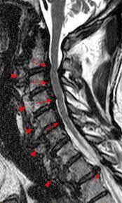
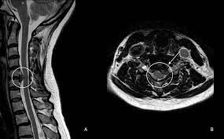
C56 &C67 Disc Bulge With Myelopathy
Left C56 Disc Bulge OPLL

Slide 27
Cervical disc disease
Intervertebral Disc Herniation—Herniated Nucleus Pulpous
Cervical Spondylotic Myelopathy - spinal cord dysfunction accompanying typical age-related degeneration of the cervical spine
Cervical Stenosis – narrowing of spinal canal.
Inflammatory: Rheumatoid Arthritis, Ankylosing Spondylitis

Slide 28
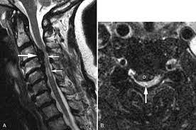

Slide 29
Neoplastic Cervical Spine Disease – Metastatic or Primary
Osteoporosis - characterized by low bone mass and structural deterioration of bone tissue.
Infection – osteomyelitis
Traumatic – Cervical fractures or sublaxation

Slide 30
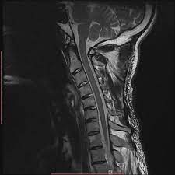
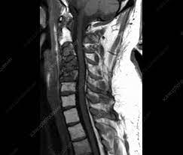

Slide 31
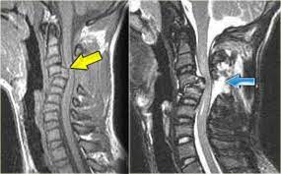

Slide 32
Patient presentation
Symtoms
Pain
Paresthesia
Weakness
Examination
Bulk , Tone ,Power , Reflexes
Sensations , plantars
Signs:
Lhermitte’s
Spurling’s
Hoffman`s

Slide 33
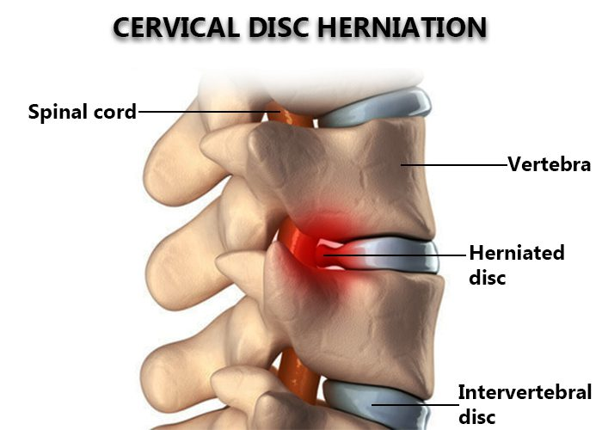
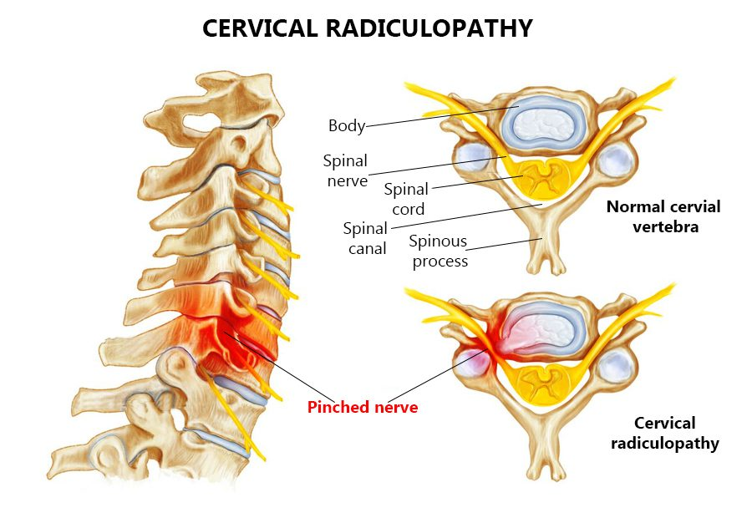
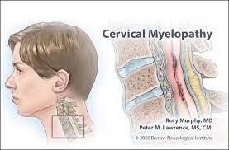
Indications for ACDF + ACCF :
Cervical Spine Trauma And Resulting Instability
Intervertebral Disc Herniation
Cervical Radiculopathy
Cervical Myelopathy

Slide 34
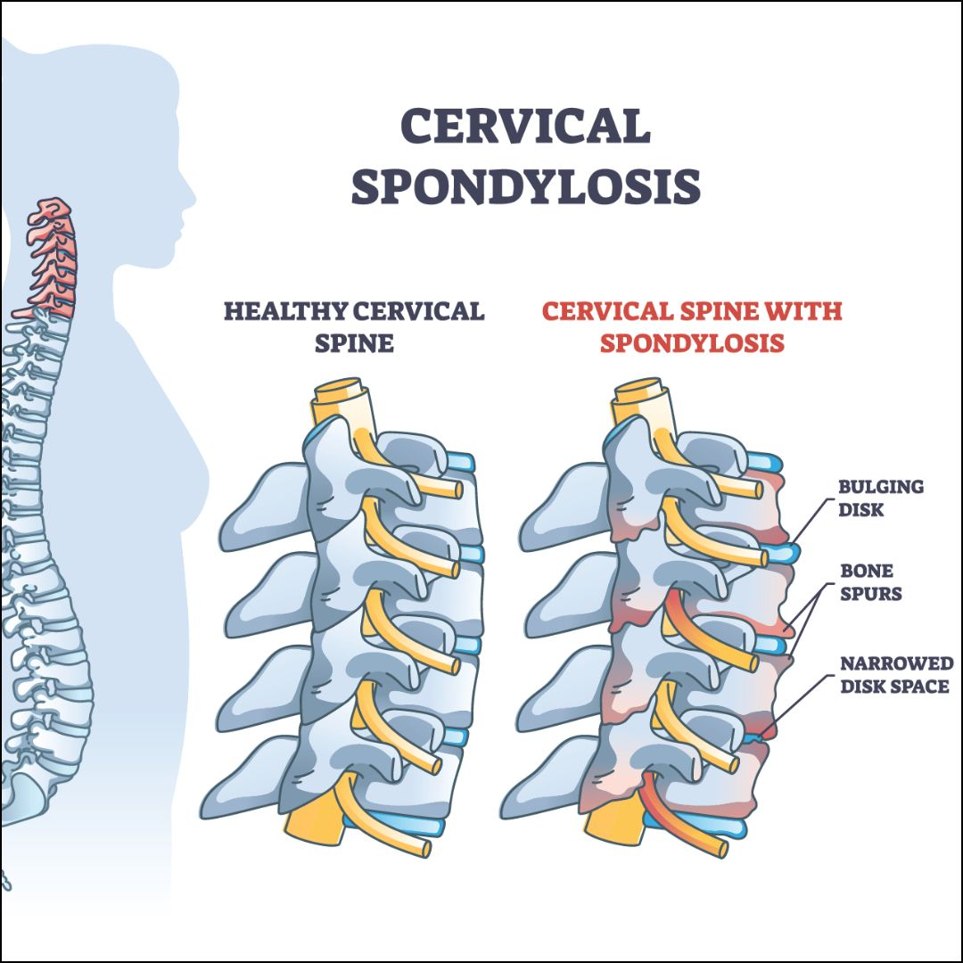
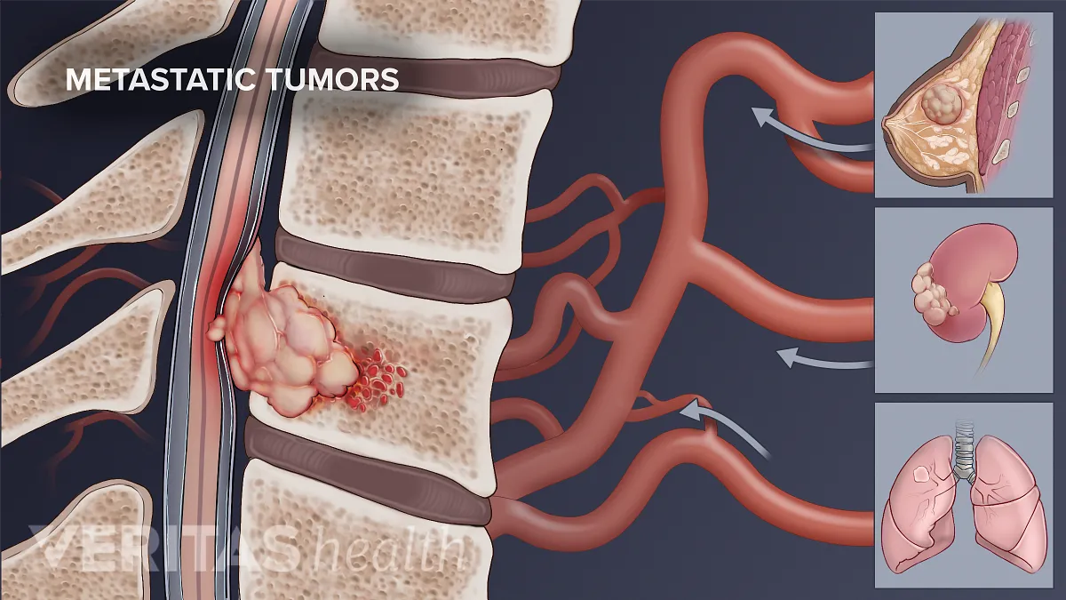
Contd..
Cervical Spondylosis
Vertebral Body Tumors (Primary Or Metastatic)
Opacified Posterior Longitudinal Ligament
Post Laminectomy Kyphosis.
Osteomyelitis

Slide 35
Anterior cervical discectomy and fusion
Discectomy involves removing a damaged disc to relieve pressure on nerve roots . This procedure has two parts:
Anterior cervical discectomy
Fusion

Slide 36
Indication for surgery
• Surgery is indicated for patients with
- (a) persistent signs and symptoms, despite approximately 6 weeks of appropriate nonsurgical treatment or
- (b) progressive motor deficit and in whom there is radiographic correlation

Slide 37
SURGICAL TREATMENT ACDF
Traditionally, an autogenous bone graft is used. This graft typically is harvested from the patient's iliac crest.
Many surgeons now favor the use of interbody fusion devices (e.g., allograft, synthetic spacers, cages)with allograft or other fusion materials.
The patient's length of stay is usually 23 hours or less.

Slide 38
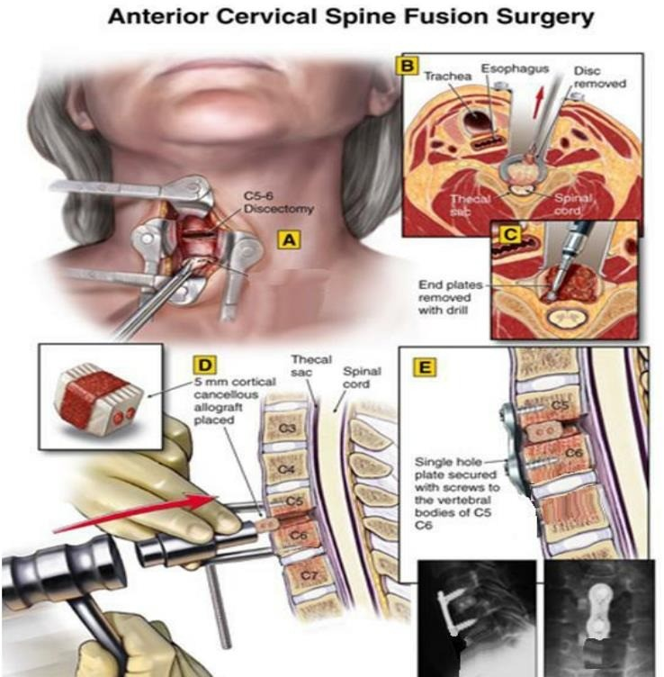

Slide 39
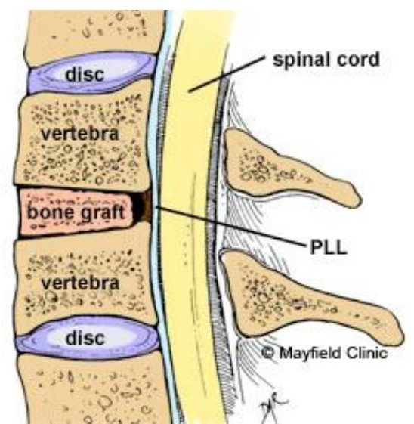
ACD with autologous bone graft

Slide 40
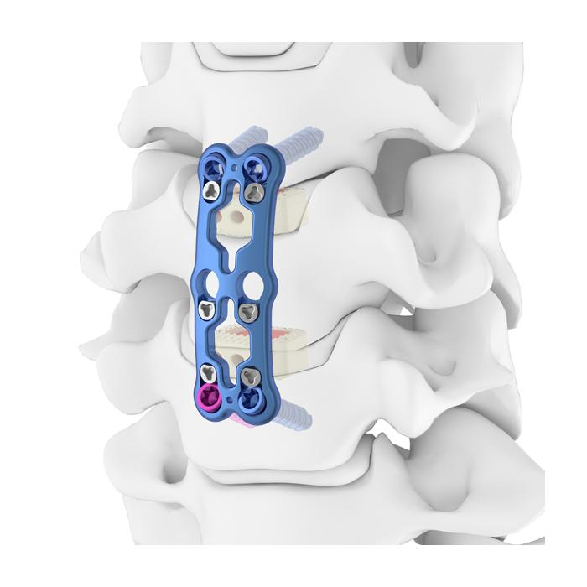
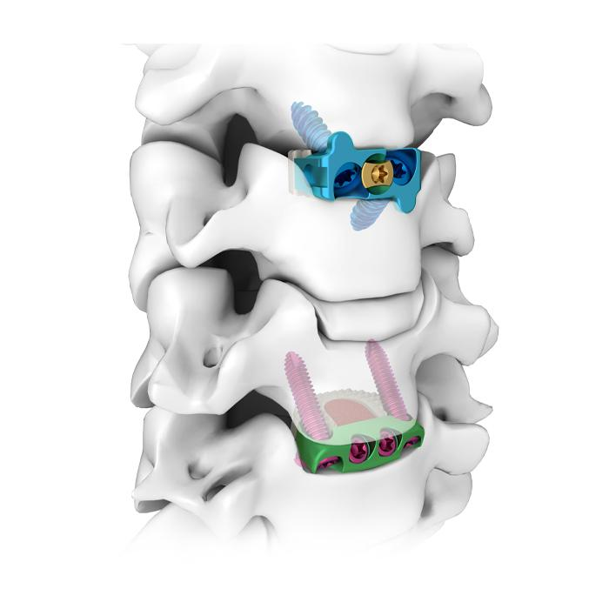
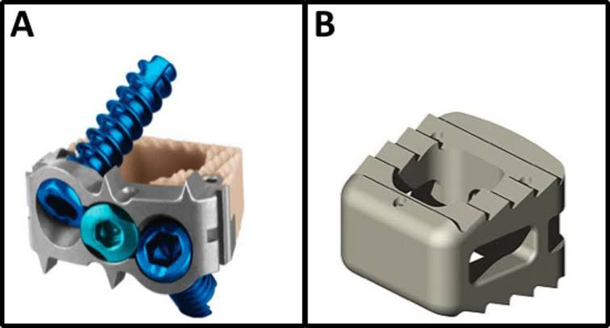
Types of Cervical Cages
Stand alone cage A) with integrated screws B)without screws
Cage fixed with plates and screws
Zero profile cage (spacer) with integrated fixation component

Slide 41
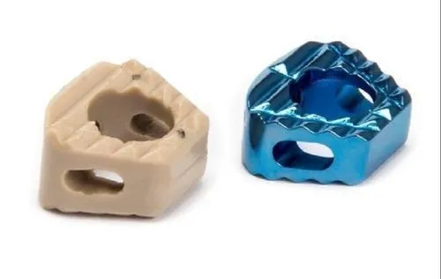
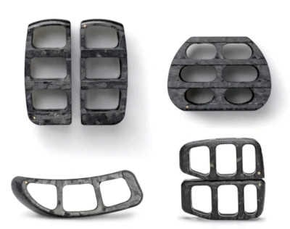
Materials
Titanium*
Carbon Fiber
PEEK (Poly-ethyl Ether Ketone)
* Best Material as better osteoconductive surface

Slide 42
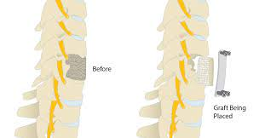
Discectomy vs corpectomy
In a discectomy, only the damaged portion of a disc and bone spurs are removed, whereas, in a corpectomy, the discs, bone spurs as well as vertebral body is removed .A bone graft with or without a metal plate and screws is used to reconstruct the spine and provide stability.

Slide 43
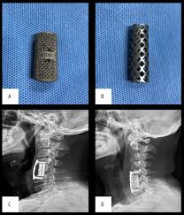
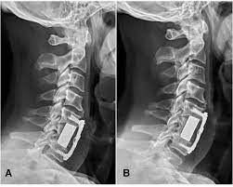

Slide 44
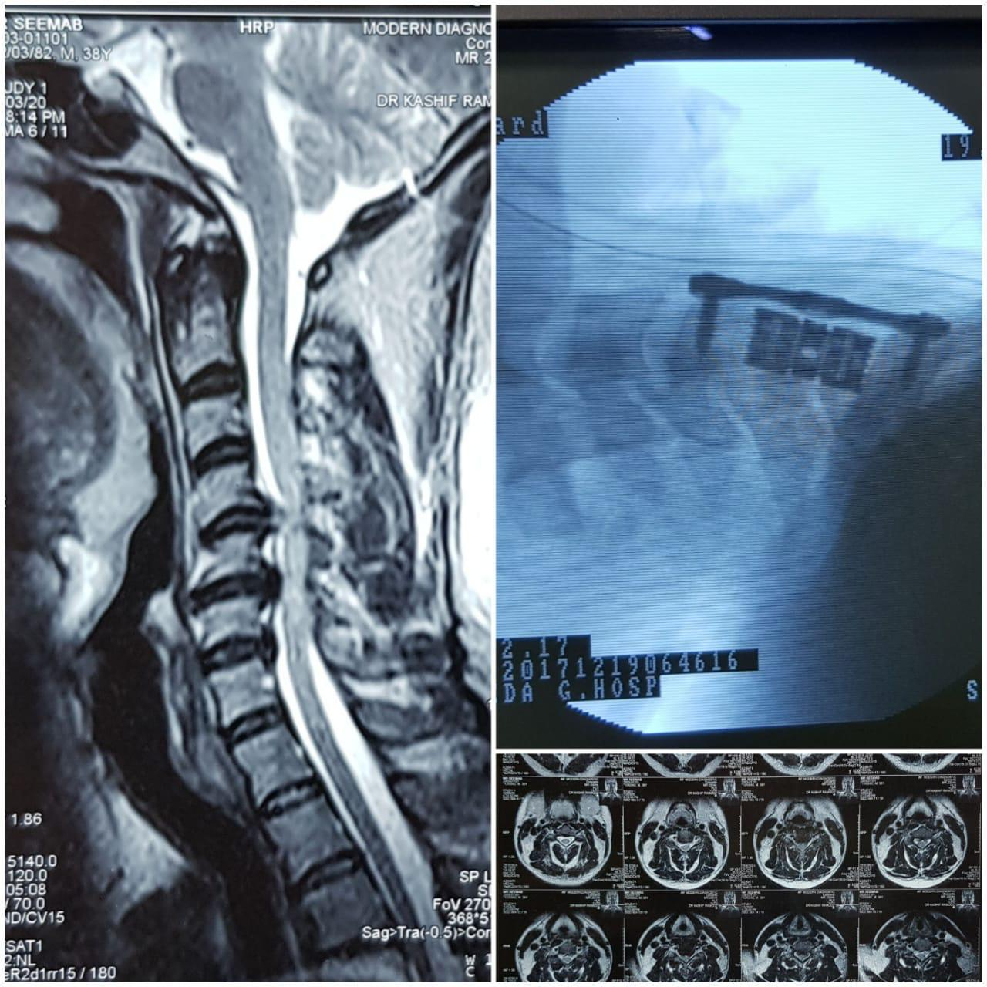

Slide 45
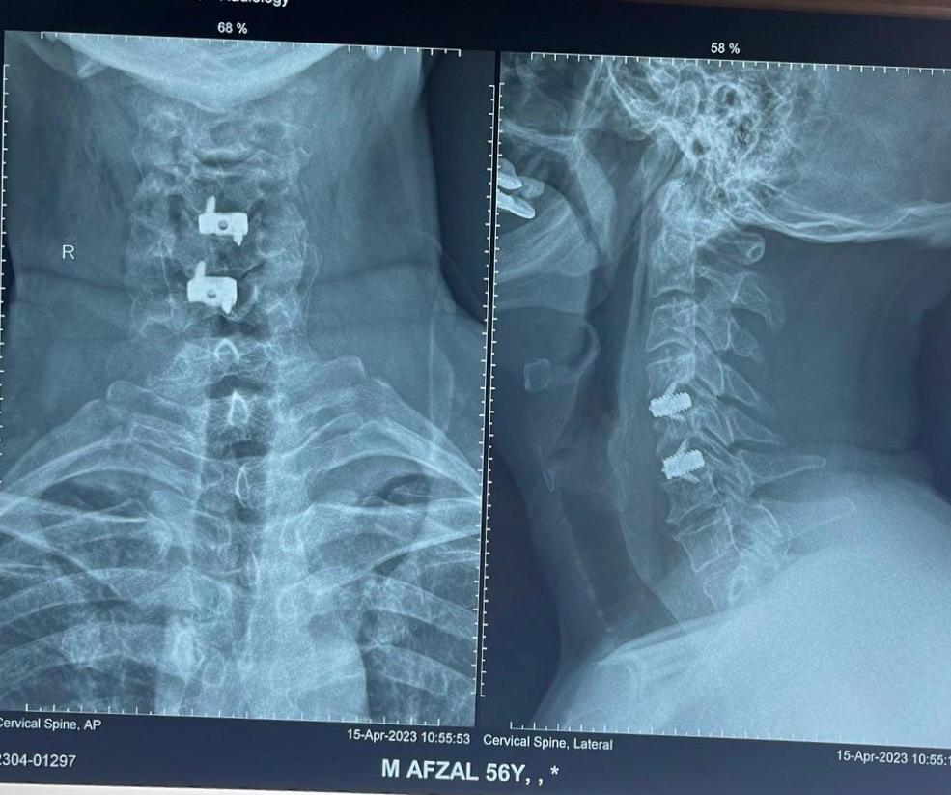

Slide 46
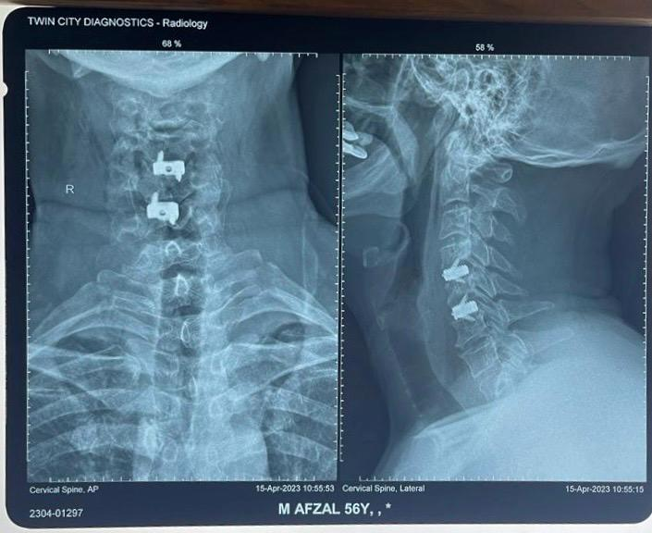

Slide 47
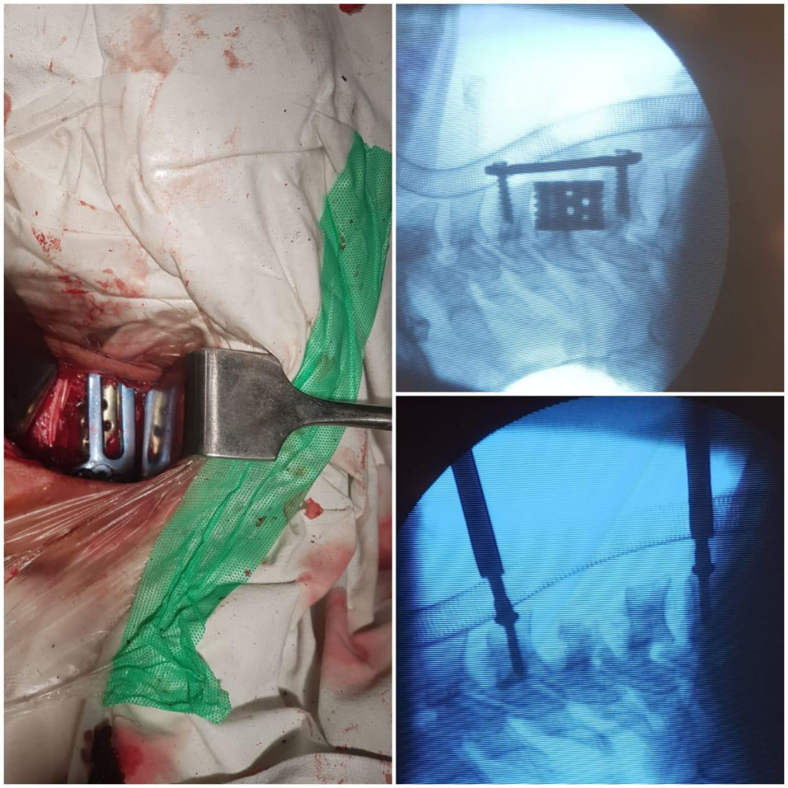

Slide 48
Discussion
1.Comparison of anterior cervical discectomy and fusion versus anterior cervical corpectomy and fusion in the treatment of localized ossification of the posterior longitudinal ligament
Conclusion : Although both options achieved satisfactory primary clinical and radiographic efficacies, ACDF was associated with a shorter surgical procedure, less intraoperative blood loss, better radiologic outcomes, and lower incidence of dysphagia than ACCF.
Chen T, Wang Y, Zhou H, et al. Comparison of anterior cervical discectomy and fusion versus anterior cervical corpectomy and fusion in the treatment of localized ossification of the posterior longitudinal ligament. Journal of Orthopaedic Surgery. 2023;31(1). doi:10.1177/10225536231167704

Slide 49
2.A comparison of anterior cervical discectomy and corpectomy in patients with multilevel cervical spondylotic myelopathy
Conclusion : Surgical managements of 3- or 4-level CSM by ACDF or ACCF showed no significant differences in terms of achieved clinical symptom improvements, with the exception of better postoperative NDI(Neck dysfunction index) scores in ACDF. In addition, ACDF is better than ACCF in terms of blood loss, lordotic curvature improvement and instrumentation and graft related-complication rates, with the exception of operation times.
Lin Q, Zhou X, Wang X, Cao P, Tsai N, Yuan W. A comparison of anterior cervical discectomy and corpectomy in patients with multilevel cervical spondylotic myelopathy. Eur Spine J. 2012 Mar;21(3):474-81. doi: 10.1007/s00586-011-1961-9. Epub 2011 Aug 9. PMID: 21826497; PMCID: PMC3296841.

Slide 50
3.Anterior Cervical Corpectomy and Fusion Versus Anterior Cervical Discectomy and Fusion for Treatment of Multilevel Cervical Spondylotic Myelopathy: Insights from a National Registry
Conslusion : Our study indicates that ACCF is generally associated with increased adverse perioperative and 30-day postoperative outcomes compared with ACDF for patients being treated for multilevel CSM based on analyses from a national database. Although different radiologic and clinical features may compel a surgeon to choose one procedure over the other.
World Neurosurgery Volume 132, December 2019, Pages e852-e861

Slide 51
Q and A session
Dr Ashraf Mahmood
Associate professor
Incharge neurosurgery
Holy family hospital rawalpindi

