Slide 1
Death from starvation, COLD and heat
Dr Filza ali & Dr Sharukh
Forensic Medicine & Toxicology

Slide 2
Motto of RMU

Slide 3
Vision of RMU
The Dream/ Tomorrow
To impart evidence based research oriented medical education
To provide best possible patient care
To inculcate the values of mutual respect and ethical practice of medicine

Slide 4
Prof Umar’s LGIS model

Slide 5
SEQUENCE OF LGIS
Learning Objectives
Core concept 70 %
Horizontal integration related to Pathology and Pharmacology 15 %
Relevant clinical concepts and medico legal application of core knowledge / Vertical integration 10%
Research article relevant to the topic 3%
Ethics and family medicine 2%

Slide 6
LEARNNG OBJECTIVES
Students will be able to:
Define starvation and its types
Enlist its diagnostic postmortem findings and medicolegal importance
Define hypothermia ,mention types of cold injuries ,its S/S, postmortem appearance and medicolegal importance
Define and differentiate various types of heat effects on body
Its postmortem findings and medicolegal importance

Slide 7
DEATH FROM STARVATION
Core Concept
STARVATION
Definition:
It is protein-calorie deficiency resulting from total or partial deprivation of food or using unsuitable food
Acute : due to sudden and complete stoppage of food intake(wilful withholding or accidental)
Chronic: Gradual deficiency in supply of food(concentration camps and famines)

Slide 8
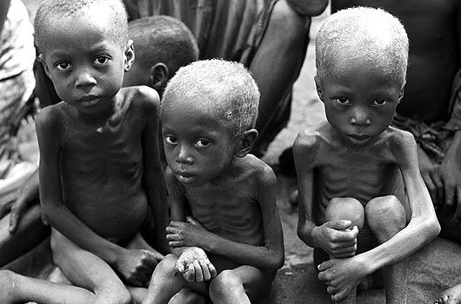
DEATH FROM STARVATION
Core Concept
SYMPTOMS AND SIGNS:
(Acute starvation)
Initial hunger pains relieved on pressure
Intense thirst
Feeble voice
Emaciation, fatigue, apathy

Slide 9
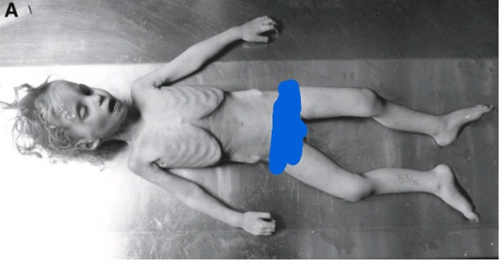
EXTERNAL FINDINGS IN STARVATION
Vertical Integration
Temperature, sub normal, low Bp
Urine scanty,dark,acetonuria Initially constipation the diarrhea
Skin : Pale , thin ,dry, wrinkled ,pigmented,
fissured or ulcerated, parchment like on bony prominences , hollow cheeks(loss of Bichat fat pad)
Nails: Brittle and ridged
Edema
Eyes :sunken
Body :Almost complete disappearance of body fat
scaphoid abdomen , prominent rib cage, broom stick arms and legs
,
Lips:dry,cracked
Hair :dry ,lusterless and brittle

Slide 10
CAUSE OF DEATH:
Acute: Emptiness and circulatory failure ,multiorgan failure
Chronic: Secondary infections and intercurrent diseases
Loss of 40% of body fat leads to death
FATAL PERIOD:
Depends on:Age,health,obesity,weather
With out food and water …7-20 days
With water …2 months

Slide 11
Vertical Integration
POST MORTEM APPEARANCE:
External:
All features of emaciation
Muscular atrophy and flabbiness
Rigor mortis sets earlier
PML not pronounced ?
Decomposition is also early
Rule out all other causes that can be contributory or sole cause of starvation death

Slide 12
Vertical Integration
AUTOPSY FINDINGS IN STARVATION
All organ atrophied( except brain)
Pale and bloodless
Stomach atrophied
Loss of fat of intestinal mesenterium,
small intestines, transparent and thin(diagnostic sign), faecolith
Distended gall bladder, cholilithaiasis
Empty Bladder

Slide 13
Vertical Integration
MEDICOLEGAL IMPORTANCE:
Suicidal: Rare(prisoner and psychiatric persons, hunger strikes)
Homicidal : Illegitimate and battered babies , battered wives , elderly , daughter in law
Accidental: Famine, ship wreck entombment in mines

Slide 14
DEATH FROM COLD
Core Concept
FACTORS AFFECTING EXTENT OF COLD INJURIES:
Local or generalised exposure
Its Intensity and duration(-2.5˚C)
Age, sex, health ,habits, clothing
Atmosphere(moist ,dry)

Slide 15
Core Concept
Cold injury is manifested as:
LOCALISED INJURY:
(Tissue necrosis due to vascular spasm or thrombosis)
Frost bite
Trench foot
Immersion foot
GENERALISED INJURY:
hypothermia

Slide 16
Core Concept
LOCALISED INJURY
FROST BITE:(-2.2˚C)
Occurs by two processes:
Freezing of tissue leading to cellular death
Reperfusion injury during rewarming
Ice crystals endothelial damage Inflammation vascular stasis thrombosis tissue ischemia
S/S:
Patchy redness on exposed parts of body like tip of nose ears, fingers and toes ,bleb formation on rewarming and blackening of skin may occur
numbness
Generalised pallor

Slide 17
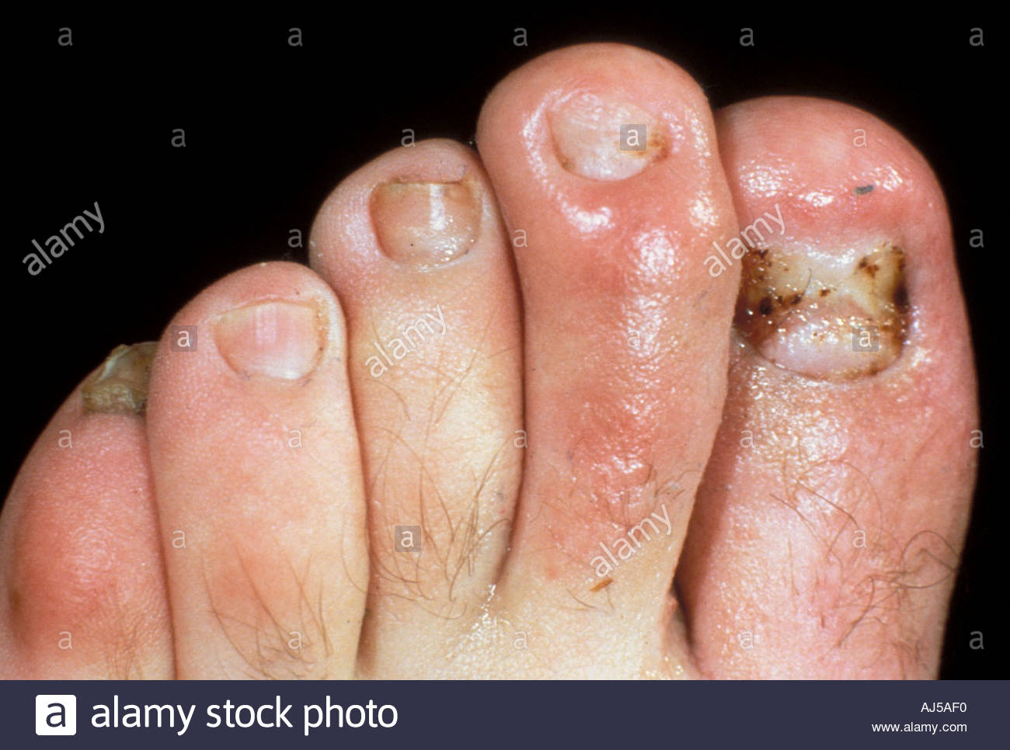
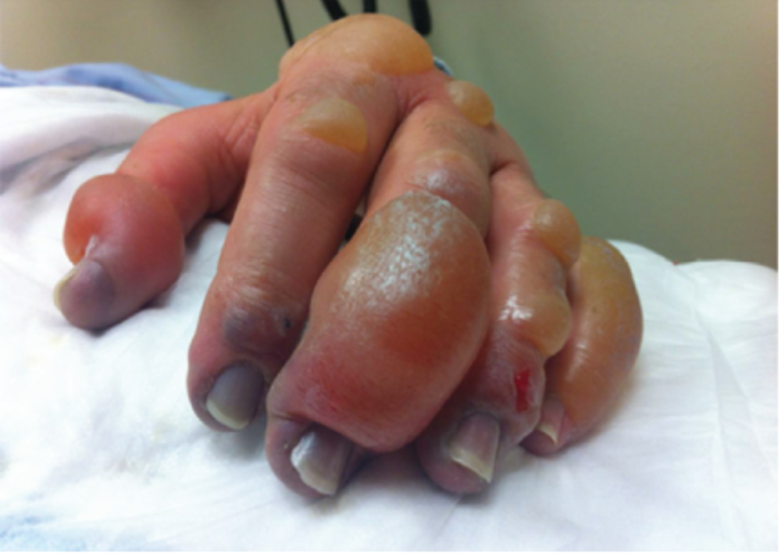
Core Concept
FROST BITE

Slide 18
Core Concept
TRENCH FOOT:
Cold injury to foot due to moist conditions(soldiers at war and trenches)
IMMERSION FOOT:
Foot injury due to cold water (Arctic area and in warfare)

Slide 19
Core Concept
GENERALISED INJURY:
Hypothermia:
Abnormally low body temperature is called hypothermia(35˚C/95˚F)
Death occurs at 21˚C/69˚F
Diagnostic findings:
Icy cold skin
Localised signs of cold injury
Muscle stiffness(cold stiffness d/d ?)
Resp↓,Bp ↓,reflexes ↓
Fatigue , drowsiness,delerium and coma
Suspended animation
Delayed resuscitation is possible

Slide 20
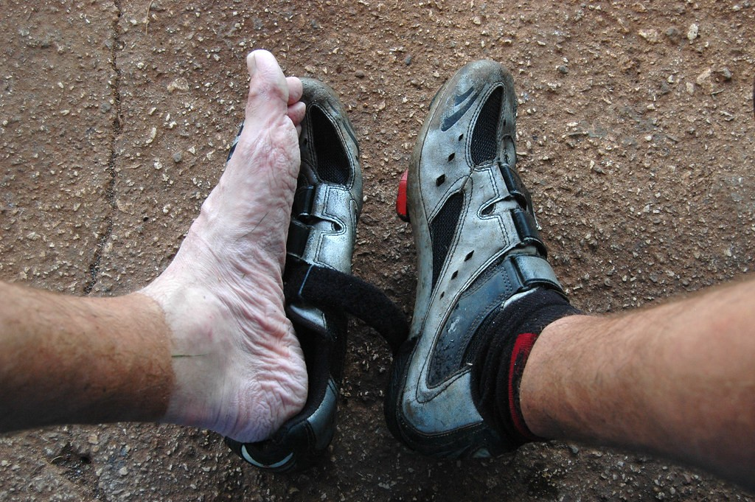
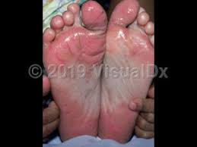
Core Concept
Trench foot
Immersion foot

Slide 21
Core Concept
CAUSE OF DEATH:
Low metabolism(at 21˚C/69.8˚F vital process cease to function)
Pulmonary edema
TREATMENT:
Gradual warmth
Ph and electrolyte balance
Treat inflammation

Slide 22
Vertical Integration
POSTMORTEM APPEARANCE:
Findings are not very characteristic or may be absent
Rule out other causes and infer from circumstances

Slide 23
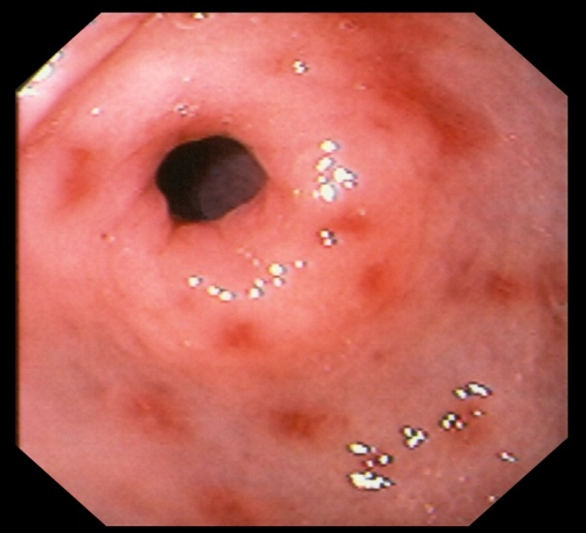
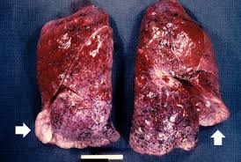
POSTMORTEM FINDINGS IN COLD INJURY
OF PANCREAS
Gastric haemorrhages
(erosions)
High Altitude Pulmonary edema

Slide 24
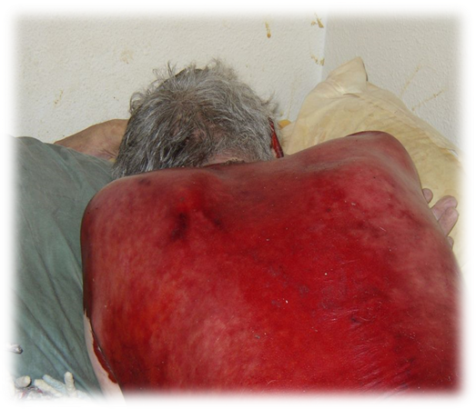
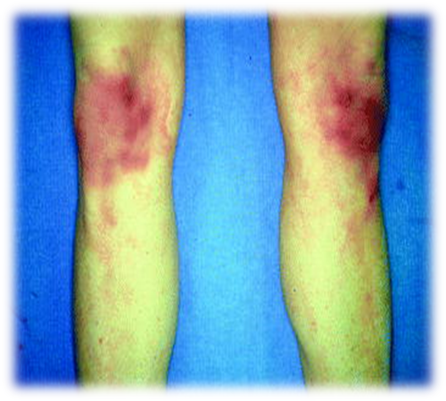

Slide 25
Vertical Integration
MEDICOLEGAL IMPORTANCE:
Accidental usually
Homicidal (illegitimate , battered child or mentally ill)
Suicidal rare
PARADOXICAL UNDRESSING:
Vasodilatation prior to death warmth
undressing hypothermia Death
in case of female ,false suspicion of sexual assault

Slide 26
DEATH FROM HEAT
High temperature cause three clinical manifestations:
Heat cramps(mild)
Heat exhaustion(moderate)
Heat stroke(severe)
FACTORS AFFECTING HEAT INJURY
General habits(diet , sleep, physical activity,alcoholism)
Mental illness
profession

Slide 27
Core Concept
HEAT CRAMPS:
Occurs in people working at furnaces, as stokers or in mines, in hot atmosphere
Hot weather perspiration water and salt loss painful spasm of voluntary muscles(muscle cramps)
Low mortality rate
Treatment:
Move to cool place
Saline water
Sedatives(diazepam) for cramps

Slide 28
Core Concept
HEAT EXHAUSTION:(heat syncope, heat collapse, heat prostration)
It is most common moderate heat illness with heavy sweating and tachycardia leading to cardiac insufficiency
It occurs in persons susceptible to heat

Slide 29
Core Concept
SYMPTOMS/SIGNS:
Sensation of heat
Throbbing temples
Pale, cold clammy skin
Normal body temperature
Hypotension(poor venous return)
Death is unusual
TREATMENT:
Keep in cool place
Glucose saline I/V
I/V Sodium bicarbonate?

Slide 30
Core Concept
HEAT STROKE(Sun stroke ,hyper pyrexia, thermic fever, systemic hyperthermia)
It is life threatening heat illness due to strenuous activity(?) in hot atmosphere(32˚C with 100% humidity?) or prolong exposure to sun and the body temperature reaches upto 40˚C/104˚F leading to CNS dysfunction
Impaired medullary heat regulating mechanism leads to failure of cutaneous circulation and sweating and can result in death(alcoholism can precipitate it ?)
i-e 3 factors impairing thermoregulatory system
One sun burn is enough to bring skin cancer

Slide 31
Core Concept

Slide 32
DEATH FROM HEAT
Core Concept
SYMPTOMS AND SIGN : It is a medical emergency
Sudden onset of prodromal symptoms
Head ache, nausea,vomiting,dizziness,weakness in legs
Excessive desire to micturate ?
Flushed face ,hot and dry skin, contracted pupils
Pulse full and rapid
Respiration stertorous
High grade fever(upto 43˚C/109˚F)
Delirium and convulsions(suspended animation(?) may occur)
FATAL PERIOD
Few minutes to 3 days

Slide 33
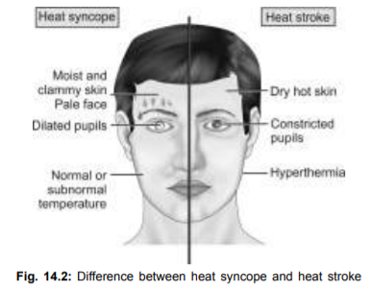
Core Concept

Slide 34
Core Concept
TREATMENT
Move to cool environment, remove unnecessary clothes
Ice cold sponging till temperature is 38˚C
Monitor secondary hyperpyrexia
Blood for alcohol estimation
I/V Fluid to maintain urinary out put >50ml/hr
I/V diazepam 0.1-0.2mg/kg 6hrly for convulsions

Slide 35
POSTMORTEM APPEARANCE
Vertical integration
Not characteristic
High body temperature(post mortem caloricity)
Deeply sunken eyes
Marked lividity
Petechial hemorrhages seen on skin
Rigor mortis sets in and passes early
Rapid putrefaction

Slide 36
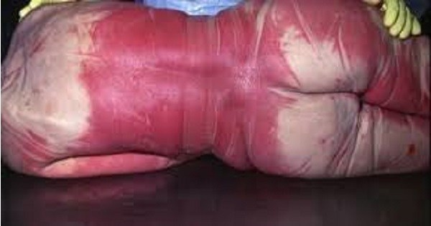
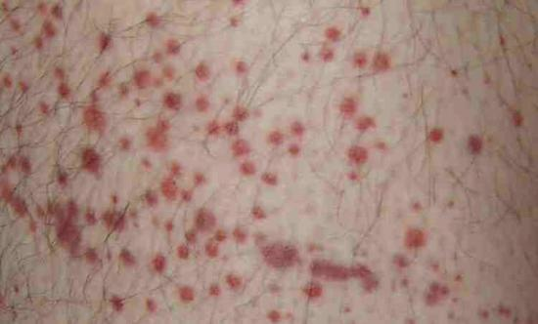
Vertical integration
Skin, Petechial haemorrhages, marked lividity
Petechiae on walls of 3rd and 4th ventricles and aqueduct
Neuronal degeneration (cerebral cortex, cerebellum, basal ganglia)
Congested edematous lungs(and other viscera)

Slide 37
MEDICOLEGAL ASPECTS
Vertical integration
Occupational accidents mostly. Compensations may be claimed for inadequate facilities

Slide 38
CASE SCENARIO
A police party raided a torture cell of gang of criminals . Many prisoners in miserable plight were retrieved .Some fresh dead bodies were also found from their basement.
Body A was of markedly emaciated elderly man. Body B was found near a furnace in a closed small room with deep purple discoloration of body and bluish red spots on some body parts.
A naked Body C was found from a locked deep freezer with its clothes aside. It was all stiff and red . Nose ,cheeks , ears and hands had turned black .

Slide 39
Research
Research
https://www.nature.com/articles/181968a0
https://www.cambridge.org/core/books/abs/medical-jurisprudence/death-by-exposure-to-coldheatlightningstarvation/D6A6954C602170C2686DFDBE995D78CB
https://epgp.inflibnet.ac.in/epgpdata/uploads/epgp_content/S000016FS/P000701/M015738/ET/1464337272FSC_P14_M35_e-text.pdf
https://www.sustainabilitybynumbers.com/p/heat-cold-deaths

Slide 40
BIOMEDICAL ETHICS
ETHICS
Preventing deaths due to starvation, heat, and cold is not just a scientific or logistical challenge—it is an ethical imperative.
Governments, organizations, and individuals must work collectively to uphold the principles of justice, beneficence, and solidarity to ensure that no one suffers due to preventable conditions.
When considering deaths due to starvation, extreme heat, or extreme cold, several key bioethical values come into play.Autonomy,Beneficence, Non-Maleficence ,Solidarity and Compassion

Slide 41
Family Medicine
Family Medicine
Family medicine plays a crucial role in addressing and preventing deaths related to starvation, extreme heat, and extreme cold. As a medical specialty focused on holistic, continuous, and preventive care, family physicians are often the first point of contact for vulnerable individuals facing these risks.
Preventive Care and Early Intervention
Ethical Considerations in Treating Vulnerable Populations
Justice and Equity in Healthcare Access
Non-Maleficence and the Role of Advocacy

Slide 42
How To Access Digital Library
1. Go to the website of HEC National Digital Library.
2. On Home Page, click on the INSTITUTES.
3. A page will appear showing the universities from Public and Private Sector and other Institutes which have access to HEC National Digital Library HNDL.
4. Select your desired Institute.
5. A page will appear showing the resources of the institution
6. Journals and Researches will appear
7. You can find a Journal by clicking on JOURNALS AND DATABASE and enter a keyword to search for your desired journal.

Slide 43
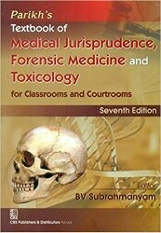
TEXT BOOKS & PRACTICAL NOTEBOOK:
Principles & Practice of Forensic Medicine.
by Nasib R. Awan
Parikh’s Textbook of Medical Jurisprudence,
Forensic Medicine & Toxicology.
Practical Manual Of Forensic Medicine
& Toxicology

Slide 44
THANK YOU

