Slide 1
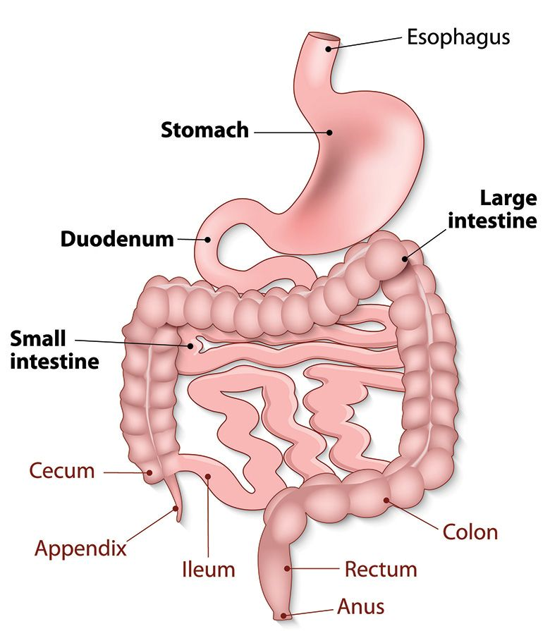
APPROACH TO A PATIENT WITH JAUNDICE
Dr. SHAFAQ FAROOQ
MBBS, FCPS (GASTROENTEROLOGY)
Holy Family Hospital RWP

Slide 3
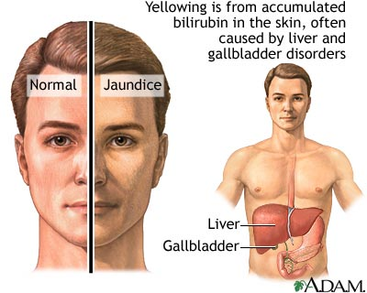

Slide 6
Learning Outcomes
Discuss different symptoms of JAUNDICE and their differential diagnosis.
Discuss relevant questions in history of common presentations in jaundice.
Describe important investigations in jaundice and their interpretation of results.

Slide 7
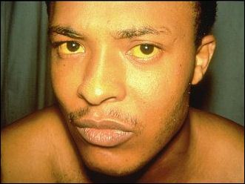
Signs and Symptoms of Jaundice
Common signs and symptoms seen in individuals with jaundice include:
yellow discoloration of the skin
mucous membranes
the whites of the eyes
light-colored stools
dark-colored urine
itching of the skin.
nausea and vomiting
abdominal pain
fever
weakness
loss of appetite
headache
confusion
swelling of the legs and abdomen.

Slide 8
HISTORY QUESTIONS - JAUNDICE
CORE SUBJECT
Duration of jaundice
Associated pain
Previous history of jaundice, liver disease or blood transfusions
Chills, fever , systemic symptoms, weight loss
Itching, urine and stool color
Drugs, biliary surgery, gallstones
Contact with jaundice patient
Water source and hygiene status

Slide 9
SYMPTOMS
*History:* - Onset and duration of jaundice. - Associated symptoms (e.g., fever, abdominal pain, weight loss).
- Risk factors (e.g., alcohol use, drug history, travel, family history).
- *Physical Examination:*
- Assess for pallor, hepatomegaly, splenomegaly, ascites. - Look for signs of chronic liver disease (e.g., spider angiomas, palmar erythema).

Slide 10
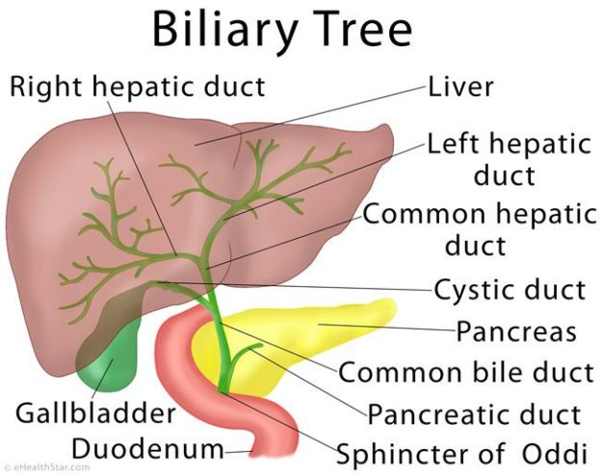
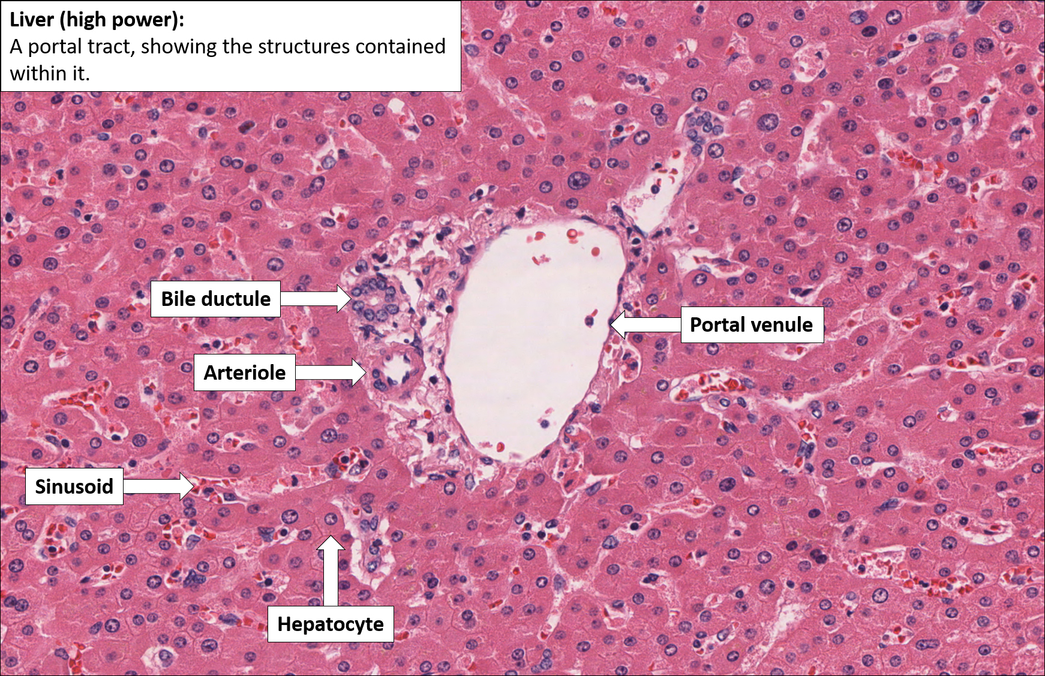
ANATOMY OF LIVER AND BILIARY TRACT
SPIRAL INTEGRATION

Slide 11
CORE SUBJECT

Slide 12
Histology

Slide 14
LIVER LOBULE

Slide 15
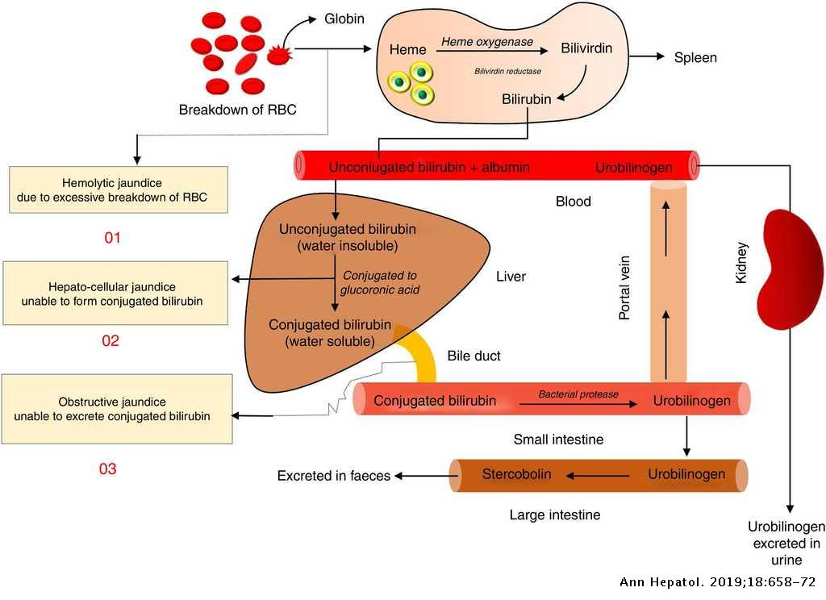
JAUNDICE PATHOPHYSIOLOGY
HORIZONTAL INTEGRATION

Slide 16
PATHOPHYSIOLOGY
Pathophysiology of Jaundice*-
Bilirubin Metabolism:
1. Hemoglobin breakdown → unconjugated bilirubin (indirect). 2. Liver conjugates bilirubin → conjugated bilirubin (direct). 3. Excreted via bile into the intestines.
*Types of Jaundice:*
1. *Pre-hepatic (unconjugated):* Excessive hemolysis (e.g., sickle cell anemia).
2. *Hepatic (mixed):* Liver dysfunction (e.g., hepatitis, cirrhosis).
3. *Post-hepatic (conjugated):* Biliary obstruction (e.g., gallstones, pancreatic cancer).

Slide 17
Heme
Globin
Heme oxygenase
Biliverdin
Biliverdin reductase
LIVER
KIDNEY
Urinary Urobilinogen
Unconjugated bilirubin
UDPGT
Conjugated bilirubin
BILIRUBIN METABOLISM
Intestinal bacteria
INTESTINE
Urobilinogen
Stercobilin

Slide 19
CORE SUBJECT

Slide 20
TYPES OF JAUNDICE
PRE HEPATIC | HEPATIC | POST HEPATIC
Hemolytic Anemia | Hepatitis, cirrhosis, Crigler-Najjar Syndrome, Dubin-Johnson Syndrome, Rotor’s Syndrome | Gallstone, malignancy, inflammation

Slide 21
TYPES OF JAUNDICE
TYPE | PRE HEPATIC | HEPATIC | POST HEPATIC
Urine color | normal | dark | dark
Stool color | normal | normal | acholic
Pruritus | no | No | yes

Slide 22
VERTICAL INTEGRATION
DRUGS CAUSING JAUNDICE
Dose-dependent
Hepatocellular Damage
Acetaminophen
Salicylates
High Dose Tetracyclines
Dose-independent
Hepatocellular Damage
Desulfuran, Isoflurane,
Sevoflurane
Dantrolene
Ketoconazole
Antidepressants
Aminosalicylic Acid
Isoniacid
Pyrizinamide,
Ethambutol

Slide 23
DRUGS CAUSING JAUNDICE
Hemolysis
Methyl Dopa Mefanamic Acid
Cholestasis
Carbimazole
Oral Contraceptives
Sodium Aurothiomalate
Chlorpromazine
Chlorpropamide
Erythromycin Estolate

Slide 24
What causes ↑ bilirubin?
Overproduction by reticuloendothelial system
Failure of hepatocyte uptake
Failure to conjugate or excrete
Obstruction of biliary excretion into intestine
Normal Range of Bilirubin
It is normal to have some bilirubin in your blood. Normal levels are:
Direct (also called conjugated) bilirubin: 0 to 0.3 mg/dL
Total bilirubin: 0.3 to 1.9 mg/dL

Slide 25
CORE SUBJECT
GILBERT SYNDROMEJAUNDICE
Gilbert's Syndrome is a harmless hereditary condition that results in mild
Jaundice. During times of illness or stress, people with Gilbert's Syndrome
will experience low levels of some bilirubin-processing enzymes in their
livers, Once diagnosed, Gilbert's Syndrome does not require further medica ltreatment.
DUBIN-JOHNSON SYNDROME
Autosomal disorder, due to deficiency in transporter protein MRP2 to transport conjugated bilirubin from hepatic cells to gall bladder. This leads to buildup of conjugated bilirubin in hepatic cells. Compensatory mechanism –upregulation of transport mechanism by MRP3 protein that bypasses conjugated bilirubin to blood- passes to kidneys producing even darker urine.

Slide 26
Neonatal Jaundice
Jaundice is clinically detectable in the newborn when the serum bilirubin levels are greater than 85 μmol/L. This occurs in approximately 60% of term infants and 80% of preterm infants.
Neonatal jaundice first becomes visible in the face and forehead. Blanching reveals the underlying colour. Jaundice then gradually becomes visible on the trunk and extremities.

Slide 27
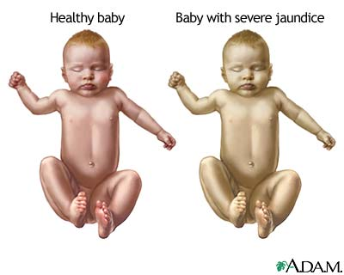
Signs and Symptoms of Neonatal Jaundice
Newborns, as the bilirubin level rises, jaundice will typically progress from the head to the trunk, and then to the hands and feet. Additional signs and symptoms that may be seen in the newborn include:
poor feeding
lethargy
changes in muscle tone
high-pitched crying
seizures.

Slide 28
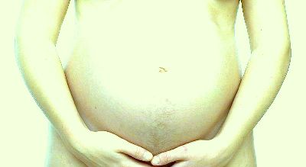
Jaundice in Pregnancy

Slide 29
JAUNDICE IN PREGNANCY
CORE SUBJECT
CHOLESTASISOFPREGNANCY
Cholestasis of pregnancy is an uncommon condition that occurs in pregnant
women during the third trimester. The Cholestasis often is accompanied by
itching but infrequently causes Jaundice. There also is an association
between Cholestasis of pregnancy and Cholestasis caused by oral Estrogens,
and it has been hypothesized that it is the increased estrogens during
pregnancy that are responsible for the Cholestasis of pregnancy
ACUTE FATTY LIVER OF PREGNANCY (AFLP)
It is a very serious complication of pregnancy. It occurs late in pregnancy and
results in failure of the liver. It can almost always be reversed by immediate
delivery of the fetus. There is an increased risk of infant death. Jaundice is
common, but is not always present in AFLP.

Slide 30
Causes of Jaundice
Jaundice occurs when there is:
too much bilirubin being produced for the liver to remove from the blood (for example, patients with hemolytic anemia have an abnormally rapid rate of destruction of their red blood cells that releases large amounts of bilirubin into the blood)
a defect in the liver that prevents bilirubin from being removed from the blood, converted to bilirubin/glucuronic acid (conjugated) or secreted in bile; or

Slide 31
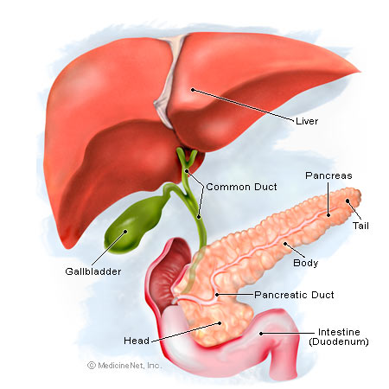
3- blockage of the bile ducts that decreases the flow of bile and bilirubin from the liver into the intestines. For example, the bile ducts can be blocked by cancer, gallstones, or inflammation of the bile ducts. The decreased conjugation, secretion, or flow of bile that can result in jaundice is referred to as cholestasis: however, cholestasis does not always result in jaundice.

Slide 32
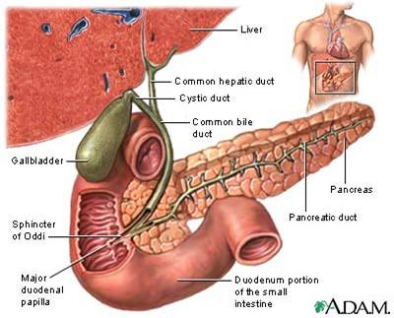
Obstructive Jaundice
Obstructive jaundice is a condition in which there is blockage of the flow of bile out of the liver
INTRAHEPATIC
EXTRAHEPATIC

Slide 33
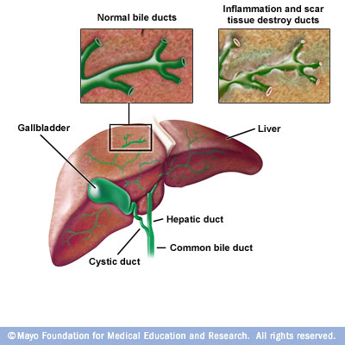
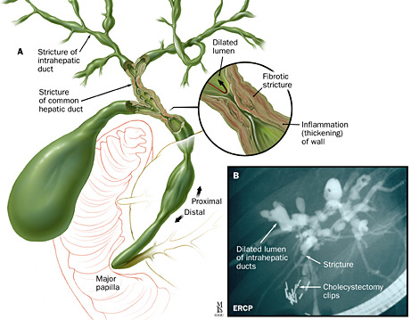
Causes of Obstructive Jaundice: intrahepatic
Primary biliary cirrhosis
Sclerosing cholangitis (Inflammation/scarring)
Primary biliary cirrhosis
Sclerosing cholangitis (Inflammation/scarring)

Slide 34
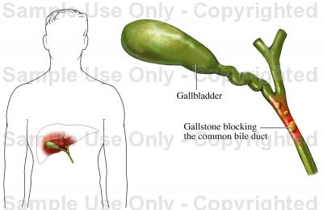
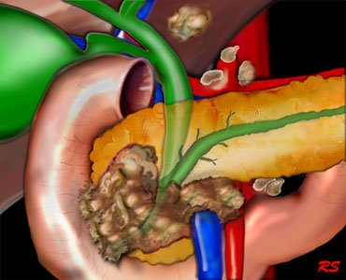
Causes of Obstructive Jaundice: Extrahepatic
Choledocholithiasis
Malignancy : Pancreatic (head of pancreas) carcinoma
Choledocholithiasis
Malignancy : Pancreatic (head of pancreas) carcinoma

Slide 35
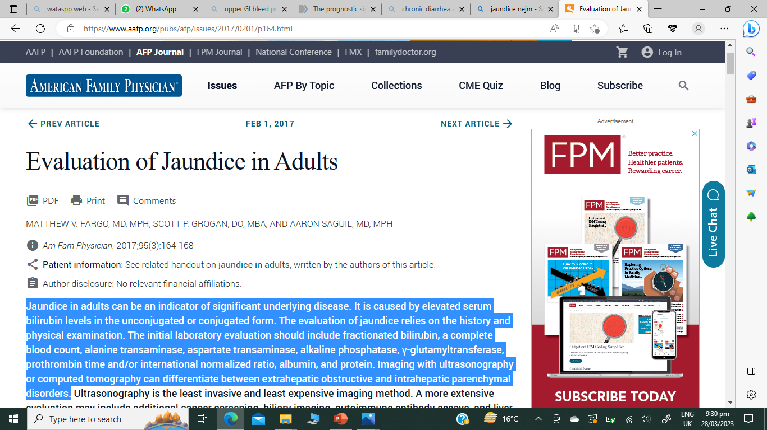
RESEARCH

Slide 36
INVESTIGATION OF JAUNDICE
VERTICAL INTEGRATION

Slide 37
BLOOD TESTS
VERTICAL INTEGRATION
Blood complete picture
Liver function test
Viral serologies
Iron studies
ESR, CRP

Slide 38
Diagnosis of Jaundice
The health care provider will perform a physical exam. This may reveal liver swelling.
A bilirubin blood test will be done.
Other tests vary, but may include:
Hepatitis virus panel to look for infection of the liver
Liver function tests to determine how well the liver is working
Complete blood count to check for low blood count or anemia
Abdominal ultrasound
Abdominal CT scan
Endoscopic retrograde cholangiopancreatography (ERCP)
Percutaneous transhepatic cholangiogram (PTCA)
Liver biopsy
Cholesterol level
Prothrombin time

Slide 39
Table of diagnostic tests
Function test | Pre-hepatic Jaundice | Hepatic Jaundice | Post-hepatic Jaundice
Total bilirubin | Normal / Increased | Increased
Conjugated bilirubin | Normal | Increased | Increased
Unconjugated bilirubin | Normal / Increased | Increased | Normal
Urobilinogen | Normal / Increased | Increased | Decreased / Negative
Urine Color | Normal | Dark (urobilinogen + conjugated bilirubin) | Dark (conjugated bilirubin)
Stool Color | Normal | Normal/Pale | Pale
Alkaline phosphatase levels | Normal | Increased
Alanine transferase and Aspartate transferase levels |  | Increased
Conjugated Bilirubin in Urine | Not Present | Present
Splenomegaly | Present | Present | Absent

Slide 40
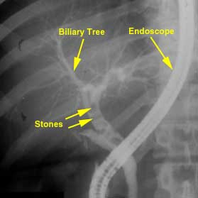
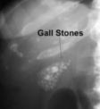
Imaging tests
If intra-hepatic jaundice or post-hepatic jaundice is suspected, it's often possible to confirm the diagnosis using imaging tests to check for any abnormalities inside the liver or bile duct systems

Slide 41
MANAGEMENT

Slide 42
MANAGEMENT
Treatment depends on the cause of the underlying condition leading to Jaundice
and any potential complications related to it. Once a diagnosis is made, treatment
can then be directed to address that particular condition, and it may or may not
require hospitalization.
1. Treatment may consist of expectant management (watchful waiting) at home with rest.
2. Medical treatment with intravenous fluids, medications, antibiotics, or blood transfusions may berequired.
3. If adrug/toxin is the cause,these must bediscontinued.
4. In certain cases of newborn jaundice, exposing the Phototherapy or exchange blood transfusions may be required to decrease elevated bilirubin levels.

Slide 43
TREATMENT
• Supportive care
• IV fluids in cases of dehydration
• Medications for nausea/vomiting and pain
• Antibiotics
• Antiviral medications such as Acyclovir
• Blood transfusions
• For Autoimmune Hepatitis- Steroids ,Immunosuppressants
• For Chronic Hepatitis B And C- Interferon
• For Fulminant Hepatitis And End Stage Liver Failure- Liver transplantation
• Liver Cancer- Chemotherapy /Radiation Therapy
• Neonatal Jaundice- Phototherapy

Slide 44
MANAGEMENT OF OBSTRUCTIVE JAUNDICE
CORE SUBJECT
REMOVAL OF OBSTRUCTIVE JAUNDICE
Non-surgical
ExtracorporealShockwaveLithotripsy
• Non-invasive
• successiveshockwavepressure pulses
– fragment the stones into smaller pieces so they can easily
pass through the duct
EndoscopicRetrogradeCholangiopancreatography
• insertion of the endoscope up into the ducts in a direction
opposite to or against the normal flow of bile down the ducts
(retrograde)

Slide 45
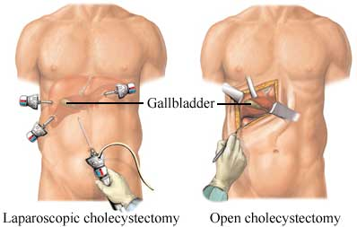
Surgical
Laparoscopic Cholecystectomy
aka minimally invasive surgery (MIS), bandaid surgery, keyhole surgery, or pinhole surgery
small incisions, usually 0.5-1.5 cm
Laparoscope: a telescopic rod lens system, that is usually connected to a video camera.
fiber optic cable system connected to a light source and cannula or trocar for view of the operative field

Slide 46
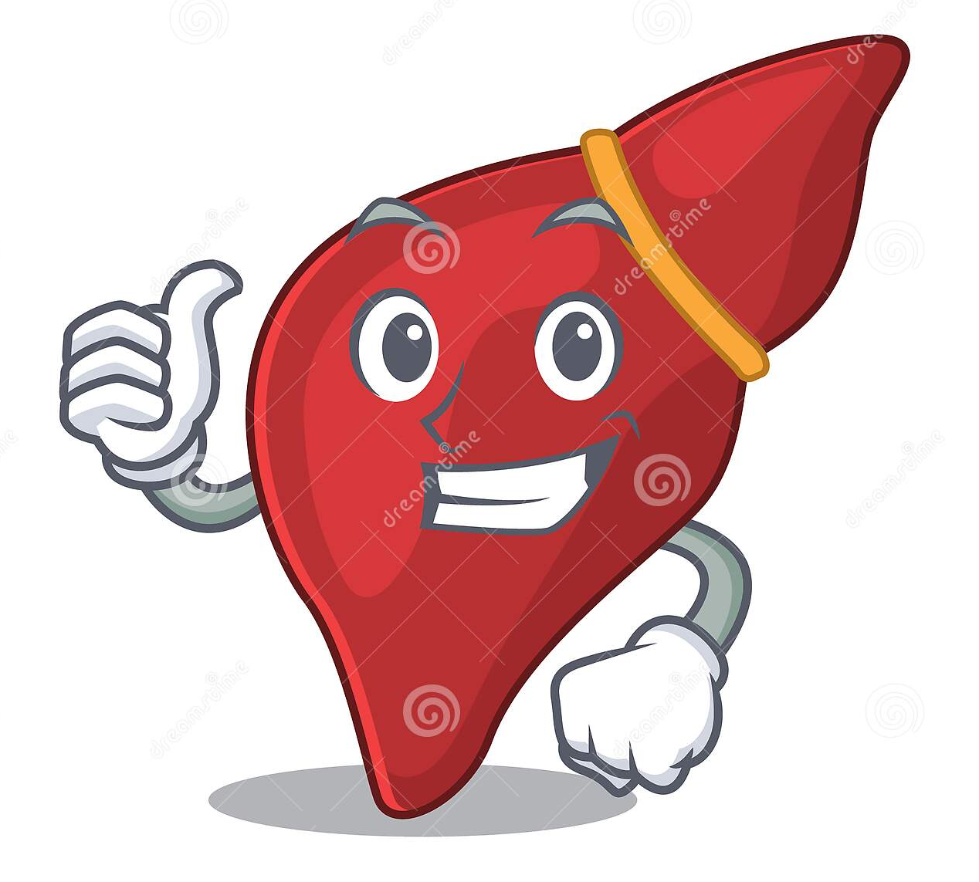
THANKYOU

