Slide 2
RULES

Slide 3
RULES

Slide 4
RULE

Slide 6
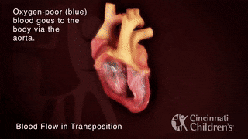
CYANOTIC CONGENITAL HEART DISEASE

Slide 7
Prof. Umar’s Model of Teaching Strategy Self Directed Learning Assessment Program
Objectives:
To cultivate critical thinking, analytical reasoning, and problem solving competencies.
To instill a culture of self-directed learning, fostering lifelong learning habits and autonomy.
HowtoAssess?
➢Ten randomly selected students will be evaluated within the first 10 minutes of the lecture through 10 multiple-choice questions (MCQs) based on the PowerPoint presentation shared on Students Official WhatsApp group, one day before the teaching session.
➢The number of MCQs from the components of the lecture will follow the guidelines outlined in the Prof. Umar model of Integrated Lecture.
Component of LGIS | Core knowledge | Horizontal integration | Vertical integration | spiral integration
No of MCQs | 6-7 | 1-2 | 1 | 1

Slide 8
Final year LGIS paediatrics
core subject – 60% (15-20 )
Horizontal integration – 20% 5- 6 slides
Same year subjects surgery gynaecology
Vertical integration- 7% 2-3 slides
Physiology Anatomy Pathology
Spiral integration – 8 % Research / bioethics- 5%

Slide 9
CASE SCENARIO
4years old has cyanosis of lips since birth and breathlessness since 6 months of age and has episodes of increasing cyanosis since 2-3 months of age, increased in frequency over last 1 year.
Patient is receiving Propranolol 10 mg once a day for last 2 months(irregular). Her weight is 10 kg, Height 95 cm (below 3rd centile).
On examination, she has cyanosis, clubbing with systolic murmur grade 4 best heard at left upper lower sternal border with a soft pulmonary component.
Xray shows decreased pulmonary vascularity and ECG showing right axis deviation

Slide 10
CASE SCENARIO
4years old has cyanosis of lips since birth and breathlessness since 6 months of age and has episodes of increasing cyanosis since 2-3 months of age, increased in frequency over last 1 year.
Patient is receiving Propranolol 10 mg once a day for last 2 months(irregular). Her weight is 10 kg, Height 95 cm (below 3rd centile).
On examination, she has cyanosis, clubbing with systolic murmur grade 4 best heard at left upper lower sternal border with a soft pulmonary component.
Xray shows decreased pulmonary vascularity and ECG showing right axis deviation

Slide 11
DIAGNOSIS

Slide 12
LEARNING OBJECTIVES
DEFINE CYANOTIC CONGENITAL HEART DISEASE AND ITS TYPES
DEFINE TETRALOGY OF FALLOT AND ITS PATHOPHYSIOLOGY
CLINICAL PRESENTATION
INVESTIGATIONS
PLAN OF MANAGEMENT

Slide 13
CYANOTIC CONGENITAL HEART DISEASE
CCHD produces cyanosis when obstruction to right ventricular inflow or outflow causes intracardiac right to left shunting
OR
When complex anatomic defects causes an admixture of pulmonary and systemic venous return in heart

Slide 14
ANATOMY 1 SLIDE

Slide 16
PATHOPHYSIOLOGY 1 SLIDE

Slide 17
Pathophysiology

Slide 18
TYPES OF CYANOTIC CONGENITAL HEART DISEASES

Slide 19
TETRALOGY OF FALLOT
Conotruncal family of heart lesion in which primary defect is an anterior deviation of infundibular septum
P= pulmonary artery stenosis
(obstruction to right ventricular outflow)
R= right ventricular hypertrophy
O= overriding of aorta
V= malaligment type VSD

Slide 20
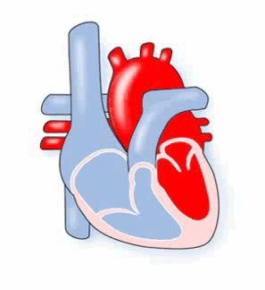
Normal vs TOF

Slide 21
Epidemiology
TOF occurs in 10 % of all CHD with prevalence of 3-6 /1000 births
Factors increase risk includes:
Male
1st degree relative
Teratogens -- Alcohol, Warfarin
Genetics: CHARGE syndrome, DIGEORGE syndrome

Slide 22
Clinical presentation

Slide 24
Continued………….
Mild pink
Asymptomatic until age 1-3 months
Moderate-severe
Cyanosis and respiratory distress at age after 1 week
Extreme
Cyanosis and respiratory distress after birth
Mild disease
Left ventricular pressure > right ( no cyanosis)
Severe disease
Pulmonary stenosis causes Right > Left (cyanosis)

Slide 25
Complications
Polycythemia
Relative anemia
CNS abscess
CNS thromboembolic strokes
Infections
Failure to thrive
Neuro developmental disabilities

Slide 26
Complications….
Left untreated
TOF leads to death in 25% in first year of life
Even post corrective surgery patients are at increased risk of ;
Pulmonary regurgitation
Arrhythmias
Exercise intolerance
Sudden death

Slide 27
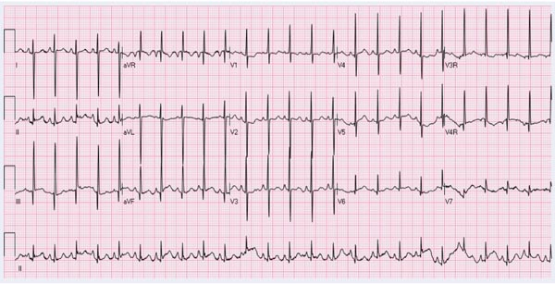
Investigations……
ECG: Right Ventricular Hypertrophy ,Right axis deviation

Slide 28
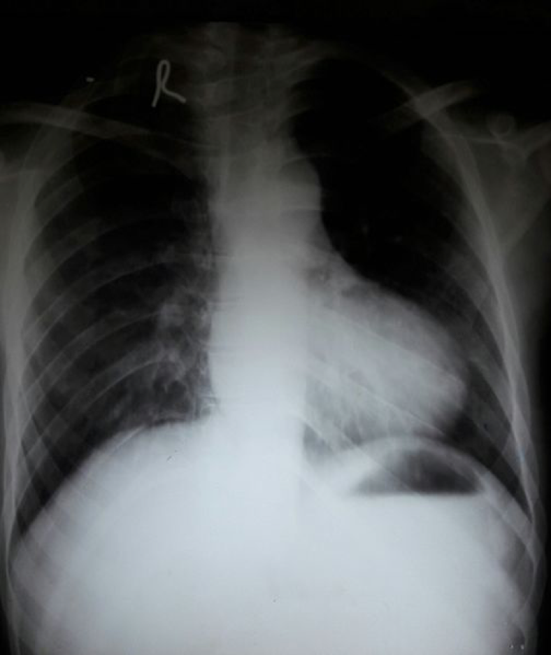
RADIOLOGY:
X Ray
Boot shaped heart
Reduced pulmonary vascular markings
GOLD STANDARD
Shows Pulmonary Stenosis
Ventricular Septal Defect
Angiography
Cardiac catheterization

Slide 30
Management
Medical management
Beta-blocker
Propranolol
Increases systemic resistance
Effective in TET spell
Prophylaxis in moderate severe disease.
Morphine
Reduces respiratory drive .
Surgical Management:
Palliative
Modified Blalock Taussing shunt
Mimic PDA and increases pulmonnary blood flow
Anastomosis of subclavian artery to pulmonary arteries
Definitive
Stenosis resection
VSD patch closure performed
Usually between3 months to 4 years age

Slide 31
Cyanotic spell management
Placement of infant on abdomen in knee chest position
Oxygen inhalation
Morphin subcutaneous 0.2mg/kg
Metabolic acidosis developes when arterial Spo2 <40 mmHg
Rapid correction with intravenous Sodium bicarbonate
Drugs that increase systemic vascular resistance IV Phenylephrine
Intravenous Propranolol (0.1 mg/kg)
Intubation and Anaesthetic sedation

Slide 32
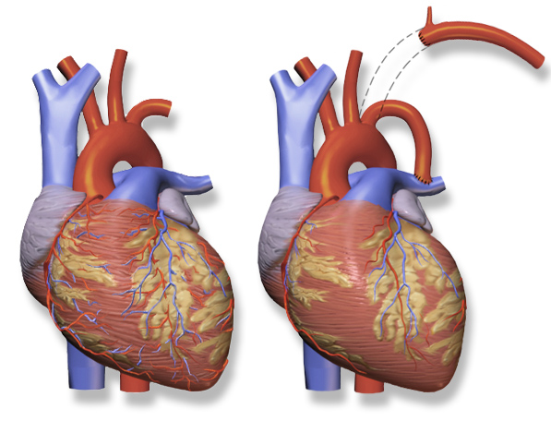
Prognosis: Excellent after surgery. 85% survive to adulthood

Slide 33
Case scenario no.2
1 year old girl admitted with bluish discoloration of lips for 8 days.on examination ,she was cyanotic and normal peripheral pulses and normal respiratory rate. Ascultation indicated both heart sounds with loud s2 at pulmonary area and systolic murmur of grade 4 at left lower sternal border
ECG showed right ventricular hypertrophy and Echocardiogram demonstrated transposition of aorta and pulmonary artery and ventricular septal defect.

Slide 34
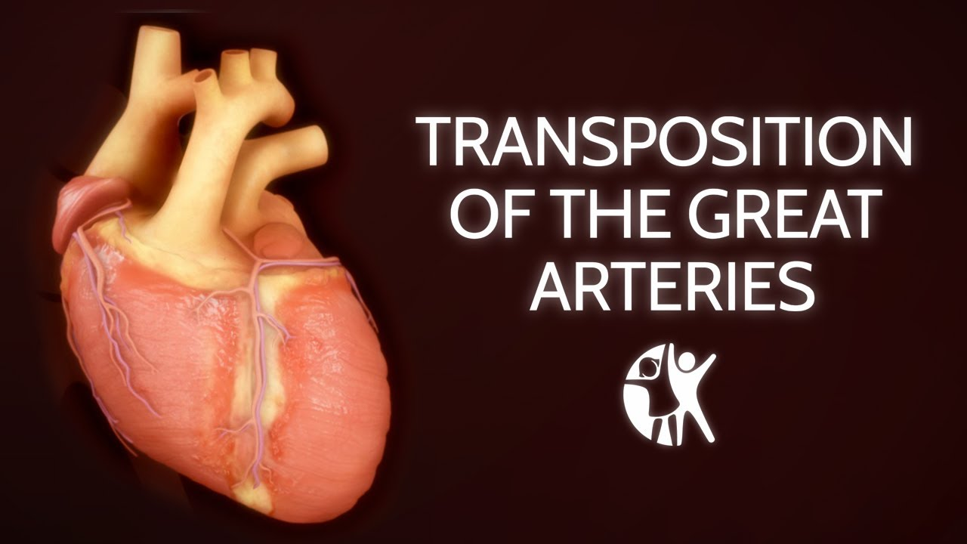

Slide 35
TRANSPOSITION OF GREAT ARTERIES
OBJECTIVES
TGA
PATHOPHYSIOLOGY
CLINICAL FEATURES
DIAGNOSIS
MANAGEMENT
PROGNOSIS

Slide 37
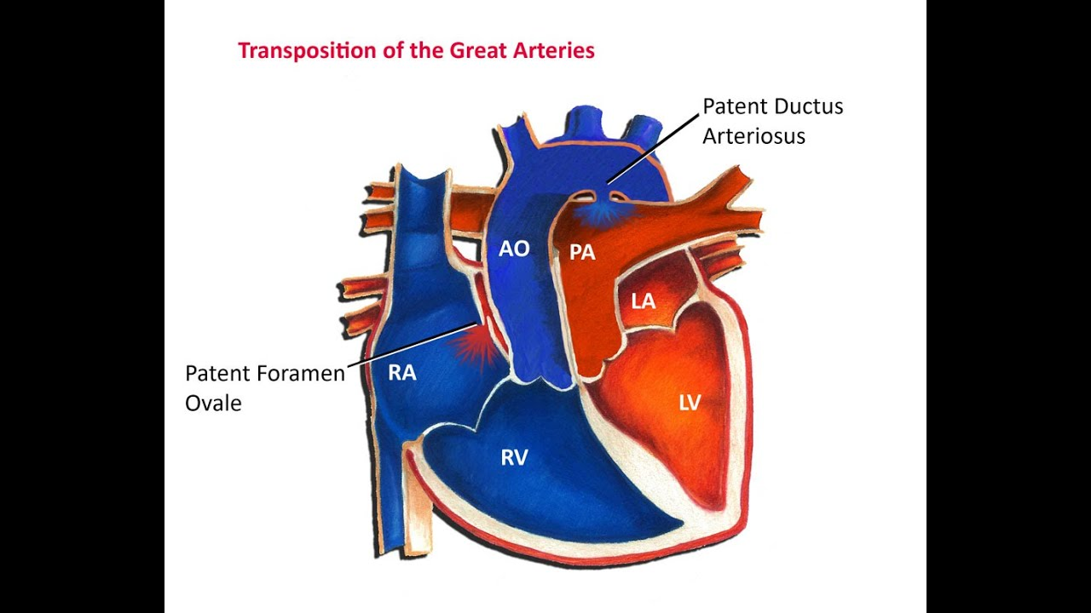

Slide 38
ANATOMY:

Slide 40
SEEN IN 5% OF CYANOTIC CHD
IN TGA,
AORTA ARISES FROM RIGHT VENTRICLE AND
PULMONARY ARTERY ARISES FROM LEFT VENTRICLE
MORE IN MALES AND
IN INFANTS OF DIABETIC MOTHERS

Slide 41
Pathophysiology 1 slide
Desaturated blood from body to right side of heart passes through aorta and back to systemic circulation again
Oxygenated pulmonary venous blood returning to left side of heart is returned directly to the lungs through pulmonary artery
Only means of survival is through mixing of oxygenated and deoxygenated blood by Ductus arteriosus or VSD.

Slide 42
CLINICAL FEATURES
Depends on associated VSD or PDA
TGA with intact ventricular septum
Cyanosis and Tachypnea within first hours and days of life
Untreated vast majority would not survive
TGA WITH VSD
Mild cyanosis in first month of life
Pansystolic murmur
Growth retardation after neonatal period

Slide 44
Diagnosis
Electrocardiogram
Shows normal right sided dominant pattern
Echocardiography
shows anterior –posterior arrangement of the great arteries
arterial blood gases
severe hypoxemia and arterial po2 does not rise after
adminstration of 100% oxygen

Slide 45
Management
Medical management:
Prostaglandin infusion 0.05-0.2ug/kg/min
Correct hypothermia,hypoglycemia and acidosis
Anti - congestives measures digoxin ,diuretics of heart failure
Surgical Management:
corrective surgery offered in favorable conditions by age of 2 weeks
Rashkind procedure or balloon arterial septostomy
Is initial palliation performed by rupturing atrial septum
through fossa ovalis with a balloon catheter

Slide 46
Prognosis
Untreated poor prognosis
30% mortality in first week
50% in first month
90% in first year of life
because of hypoxia,CCF, Pulmonary hypertension
Arterial switch procedure has a survival rate of 90-95% for uncomplicated TGA

Slide 47
REFERENCE BOOKS
BASIS OF PEDIATRICS by PERVAIZ AKBAR
( REVISED 10TH Edition)
Page no.302
Pak J Med Sci. 2013 Jan-Mar; 29(1): 173–176

Slide 48
RESEARCH ………….

Slide 49
MCQS

Slide 50
WHICH OF FOLLOWING HAS GREATEST IMPACT ON THE PHYSIOLOGY OF TOF
SIZE OF ASD
SIZE OF VSD
DEGREE OF PULMONARY STENOSIS
AMOUNT OF AORTIC OVERRRIDINNG

Slide 51
FEATURES ARE TRUE FOR TETRALOGY OF FALLOT,EXCEPT
VENTRICULAR SEPTAL DEFECT
RIGHT VENTRICULAR HYPERTROPHY
ARTERIAL SEPTAL DEFECT
PULMONARY STENOSIS

Slide 52
THANK YOU

