Slide 1
Custodial TORTURE (Death in Custody)
Dr Filza ali Dr Naila

Slide 2
Motto of RMU
Wisdom
Truth
Service

Slide 3
Vision of RMU The Dream/ Tomorrow
To impart evidence based research oriented medical education
To provide best possible patient care
To inculcate the values of mutual respect and ethical practice of medicine

Slide 4
Prof Umar’s LGIS model

Slide 5
SEQUENCE OF LGIS
Learning Objectives
Core concept 70 %
Horizontal integration related to Pathology and Pharmacology 15 %
Relevant clinical concepts and medico legal application of core knowledge / Vertical integration 10%
Research article relevant to the topic 3%
Ethics and family medicine 2%

Slide 6
Learning objectives:
Define custodial torture.
Enlist different objectives of torture
Briefly describe the different ways and means of custodial torture and death.
State the cause of death in custody and medicolegal aspects of custodial torture.

Slide 7
Custodial Torture
Core Concept
Is the act of twisting.
OR
Is a deliberate, systemic or wanton infliction of physical or mental suffering by one or more persons, acting alone or by the order of some authority to force another person to yield information to make a confession of some crime.

Slide 8
Custodial Torture
Core Concept
Abuse of human right
In many of the cases the autopsy findings
Victim is in some forms of detention, police custody or temporarily in the power of some authorities.

Slide 9
Custodial Torture
Core Concept
Motives/ Objectives:
To obtain confession
To obtain information
To punish
Classification/Types
Physical
Psychological
Pharmacological
Sexual

Slide 10
Custodial Torture
Core Concept
PHYSICAL:
It is the infliction of Pain on the body
Beating: Most common form of torture, beating from head to toe by means of fist, show, wooden bars, rods, whips etc.
For example, victim may be suspended upside down and then beaten.
Victim may be beaten in terms of rods or wooden sticks , over the soles of foot, the condition is extremely painful with no signs known as falanga or bastinado.

Slide 11
Custodial Torture
Core Concept
Ear-torture or telefono, repeated and simultaneous slapping of both the ears by open hands of the torturer.
Tram-line bruises over the back and buttocks.
Blows by fist over face and other parts of the body.
Kicking with heavy boots (patterned bruises).
Chepuwa : The thigh of the victim is placed under two wooden rods and pressed.

Slide 12
Custodial Torture
Core Concept
Forcing person in abnormal conditions
For example, prolonged standing on one leg known as El-planton.
Forced standing on a bar known as El-cabellete.
Tied up in an abnormal position for hours known as Hogtie.
Suspension: Victim may be suspended by his wrists, ankles, arms or hairs.

Slide 13
Custodial Torture
Core Concept
Suffocation: (Dry-Submarining) near suffocation may occur by means of Plastic bag placed over the head of the victim.
Drowning/Submarining-Victims head is repeatedly dipped under water or in foul smelling liquid to give victim a sense of drowning known as water torture or sub-marining.
Pulling/ twisting of nail/ hairs/teeth/ genitalia.

Slide 14
Custodial Torture
Core Concept
Electric baton shock
Burns: with hot iron, cigars and cigarettes pressed against the skin, giving patterned burns likewise shape such as inverted triangle, rounded / circular.
Cold-torture: Ice water is poured over the head or over naked body or person is forced to strip naked and stand outside on a winter night or forced to stand out on a snow.

Slide 15
Custodial Torture
Core Concept
Forced feeding: Victim is forcefully feeded a saturated of Salt water, vinegar, liquor, boiling water or urine etc.
Cutting/ Stabbing and Shooting are the means of torture.

Slide 16
Custodial Torture
Core Concept
PSYCHOLOGICAL
To give victim a mental torture:
Deprivtion of sleep, food and water
Coercian methods: Threats, humiliation and sexual torture.
Witness torture: Victims are forced to witness the torture of other persons.

Slide 17
Custodial Torture
Core Concept
PHARMACOLOGICAL
Use of psychotropic drugs/ injections to induce pain and cause compliance with torturer’s goals.
Use of irritating chemicals like chillies which are thrown in to the eyes, poured in to the mouth or rubbed against the skin of breast and genitalia.
Chillie powder: made to rounded balls known as Hyderabadi gollie and is inserted into the vagina or rectum of the victim, extremely irritating and painful.

Slide 18
Custodial Torture
Core Concept
SEXUAL TORTURE
Sexual assault like rape / gang rape / fellatio/ forced masturbation or sodomy.
Undress or paraded naked or photographed in humiliating positions
Pinching or biting off nipples.

Slide 19
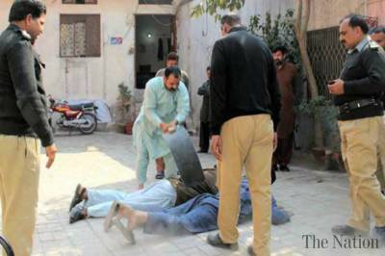

Slide 20
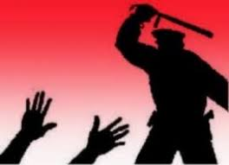

Slide 21
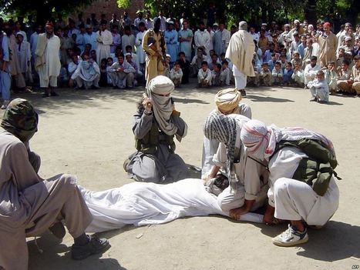

Slide 22
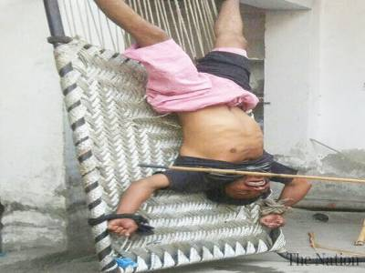

Slide 23
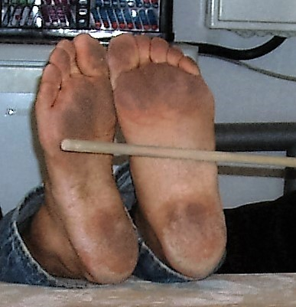
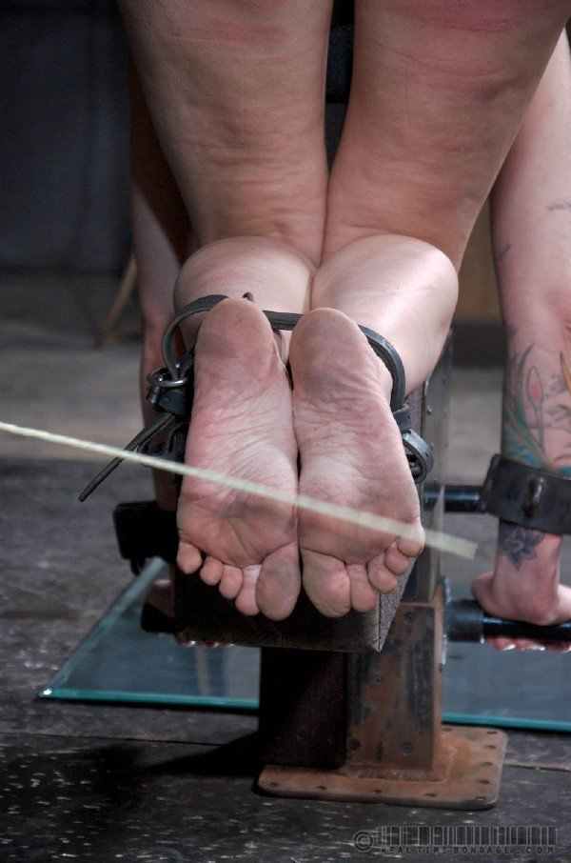

Slide 24
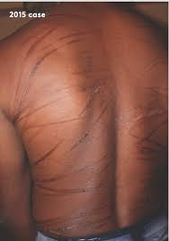
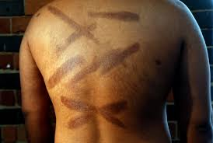

Slide 25
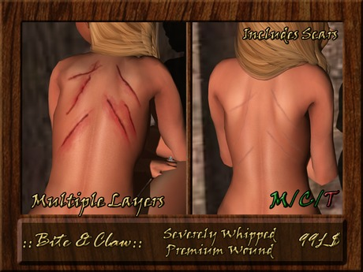

Slide 26
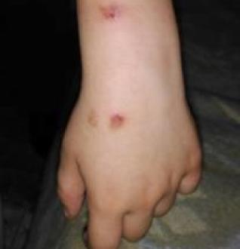
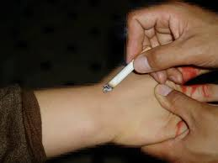

Slide 27
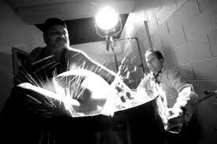

Slide 28
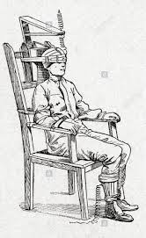
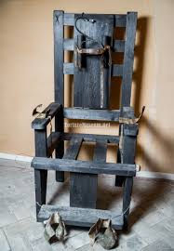
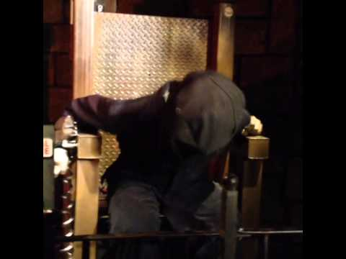

Slide 29
Cause of Death in Custody
Core Concept
Death in custody occur due to following reasons:
Natural causes like cardiac arrest
Emotional leading to suicide
Crush syndrome due to rhabdomyolysis resulting from excessive muscle break down during beating which ultimately results in acute kidney injury.

Slide 30
Medicolegal Aspects
Core Concept
All deaths in custody should be examined with care to ensure that the guardians(police)are cleared of any suspicion of ill treatment.
The torture and custodial deaths are confirmed by circumstantial and corroborative evidence.
The victim is kept in detention after severe torture and deprived of any food or medical care.
Medicolegal Autopsy is must in custodial death
Only Magistrate of that area of jurisdiction can give order for autopsy in that case.
Punishment for torture. Any public official who commits or abets or conspires to commit torture shall be punished with the same punishment as prescribed for the type of harm provided in Chapter XVI of Anti torture Act of the Pakistan Penal Code.

Slide 31
Research
Research
https://www.researchgate.net/publication/335038691_Custodial_Torture_A_Two_Years_Prospective_Study
https://papers.ssrn.com/sol3/papers.cfm?abstract_id=4226400
http://jrmi.pk/article/view/492
https://www.paradigmshift.com.pk/custodial-torture-pakistan/
https://jgmds.org.pk/index.php/JGMDS/article/view/82

Slide 32
Biomedical Ethics
Ethics
Torture is inherently morally wrong because all forms of torture "involve the intentional infliction of extreme physical suffering on some non-consenting and defenceless person", although it does not necessarily follow that torture is wrong in all circumstances.
https://journalofethics.ama-assn.org/article/torture-and-human-rights/2004-09
https://rm.coe.int/prisons-healthcare-and-medical-ethics-eng-2014/16806ab9b5

Slide 33
Family Medicine
Family Medicine
Doctors may assess and treat torture survivors; some may document crucial evidence of torture in medico-legal reports.
Family Clinicians need up-to-date knowledge of the various protocols, skills to ensure their assessments and reports are of the highest standard, and the courage to not turn a blind eye and be complicit, however far removed, from acts of torture by state or non-state organizations.

Slide 34
How to use HEC Digital Library
Go to the website of HEC National Digital Library
http://www.digitallibrary.edu.pk
On Home Page, click on the INSTITUTES.
A page will appear showing the universities from Public and Private Sector and other Institutes which have access to HEC National Digital Library (HNDL).
Select your desired Institute.
A page will appear showing the resources of the institution
Journals and Researches will appear
You can find a Journal by clicking on JOURNALS AND DATABASE and enter a keyword to search for your desired journal

Slide 35
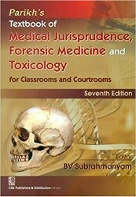
TEXT BOOKS & PRACTICAL NOTEBOOK:
Principles & Practice of Forensic Medicine.
by Nasib R. Awan
Parikh’s Textbook of Medical Jurisprudence,
Forensic Medicine & Toxicology.
Practical Manual Of Forensic Medicine
& Toxicology

Slide 36
THANK YOU!

