Slide 1
CORROSIVES
CARBOLIC & OXALIC ACID
Dr Filza ali & Dr Naila
Forensic Medicine & Toxicology

Slide 2
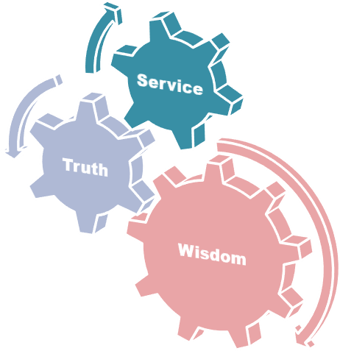
Motto Of RMU

Slide 3
Vision of Rawalpindi Medical University The Dream/ Tomorrow
To impart evidence based research oriented medical
education
To provide best possible patient care
To inculcate the values of mutual respect and ethical practice of medicine

Slide 4
Professor Umar Model of Integrated Lecture
20%
60%
Core subject
Horizontal Integration Physiology Biochemistry
7%
Vertical integration
Clinical integration
8%
Vertical integration
Pathology Pharmacology
5%
Vertical integration Research,
professionalism
Ethics Digital library

Slide 5
SEQUENCE OF LGIS
Learning Objectives
Core concept 70 %
Horizontal integration related to Pathology and Pharmacology 15 %
Relevant clinical concepts and medico legal application of core knowledge / Vertical integration 10%
Research article relevant to the topic 3%
Ethics and family medicine 2%

Slide 6
Learning Objectives:
Classify Corrosives and state its mechanism of actions.
Briefly explain the clinical effects of Carbolic & Oxalic
Acid on human body.
State the fatal dose and management of Carbolic &
Oxalic Acid
Briefly describe the postmortem findings in oxalic acid &
carbolic acid poisoning
State the medico legal importance of throwing of corrosives

Slide 7
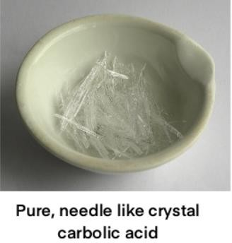
Carbolic Acid
(Phenol) (coal tar derivative)
Core Concept
Colorless
Prismatic
Needle like crystals that turns pink and liquefies when exposed to air

Slide 8
Burning, sweetish
Core Concept
TASTE:
SMELL:
Carbolic or phenolic
Slightly in water
Freely in glycerin, ether, alcohol
SOLUBILITY:

Slide 9
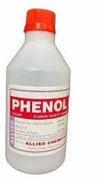
USES:
Core Concept
❑ Antiseptic Disinfectant
Chlorinated phenol (Dettol)
Manufacture of plastic
❑
❑
❑

Slide 10
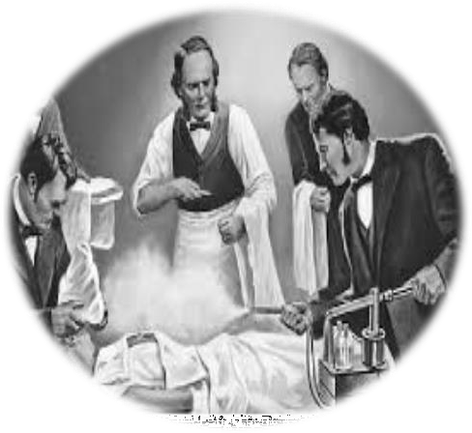
Absorption
Core Concept
GIT
Respiratory tract
Rectum
Vagina
Serous Cavities
Wounds
Skin (intact)

Slide 11
Excretion:
Core Concept
Converted into Hydroquinone + Pyrocatechol and excreted in urine. Traces are excreted by lungs, salivary glands, and skin
Fatal Dose:
1 – 2gm
Fatal Period:
3 – 4 hours

Slide 12
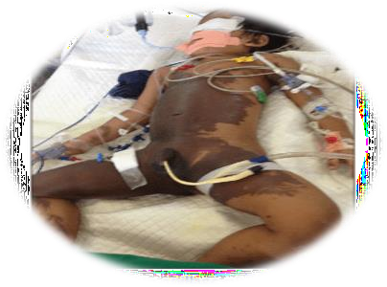
SIGNS & SYMPTOMS
Core Concept
Local
burning pain,
Numbness
tingling anesthesia
corrosion and produce white scar, which falls off in few
days leaving brown stained area

Slide 13
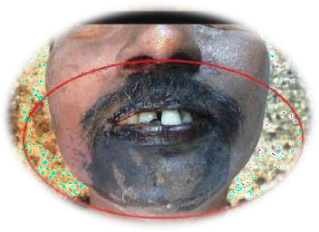
Systemic
Core Concept
GIT: Lips , Mouth , tongue Corroded
Burning pain followed by tingling numbness and anesthesia.
Nausea and vomiting
CNS: Headache,Giddiness,Unconsciousness,Coma

Slide 14
RESPIRATORY TRACT : Breathing Laboured Pulmonary Oedema, Laryngeal Oedema, Bronchitis
Core Concept
,Pneumonia
Pupils
Pulse
Cyanosis
Breath
Contracted
Rapid, feeble, irregular Dusky
Strong odour
Convulsions
Lock jaw

Slide 15
Core Concept
URINE:
Contains
Scanty albumin
Colourless or slightly green
on exposure to air ……. Green or black

Slide 16
TREATMENT
Core Concept
Skin Wash with undiluted polyethylene glycol.
Oxygen/ventilatory support
Intravenous fluids and vasopressors to support blood pressure
Ingestion: Cautious stomach wash with sodium or magnesium sulfate solution
Lidocaine for ventricular arrhythmias
Benzodiazepines for seizures

Slide 17
Post mortem appearance
Vertical Integration
Phenol smell
Corrosion of skin, at angle of mouth, chin.
Corrosions are initially white but turns brown in colour
Splashing may be noted
Tongue – white and swollen
Mucosa of stomach is tough, white or gray, corrugated and arranged in longitudinal folds and looks leathery.

Slide 18
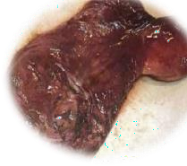
Mucous membrane of mouth throat,lips are sodden whitened or ash gray
Vertical Integration
Oesophagus (mucosa)Tough White or grey Corrugated
Stomach (mucosa) Swollen Covered by opaque, grey or brown mucous membrane Contains reddish fluid mixed with mucous
Kidneys Haemorrhagic Nephritis (delayed death)
Brain Congested Oedematous
Urine on exposure to air turns green.
Stomach

Slide 19
Medico legal Importance
Vertical Integration
Accidental poisoning.
Suicidal ingestion.
Homicide – not possible

Slide 20
OXALIC ACID
Core Concept
ACID OF SUGAR

Slide 21
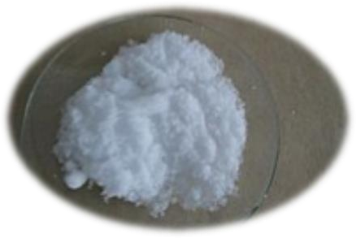
Core Concept
Colourless
transparent
odourless
prismatic crystals resembling the crystals of magnesium sulphate and zinc sulphate

Slide 22
Action: Corrosive Poison
Core Concept
Local– on mucous membrane
Corrosion of mucosa with underlying congestion.
The corroded area is referred as “scalded” in appearance.
Readily corrodes the mucous membrane of digestive tract
.

Slide 23
Core Concept
Systemic
Vomiting and diarrhea
Hypocalcemia (tetany)
Muscle irritability, tenderness, cramps
Convulsion
Shock
Hypocalcaemia
Renal damage

Slide 24
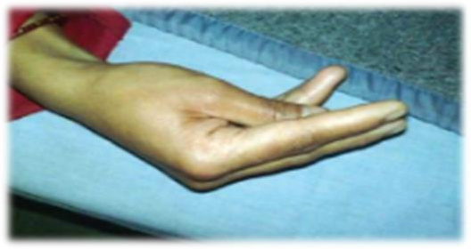
Vomitus(contains altered blood & mucus & has
“coffee ground” appearance)
Core Concept
Accoucher’s hand due to carpopedal spasm

Slide 25
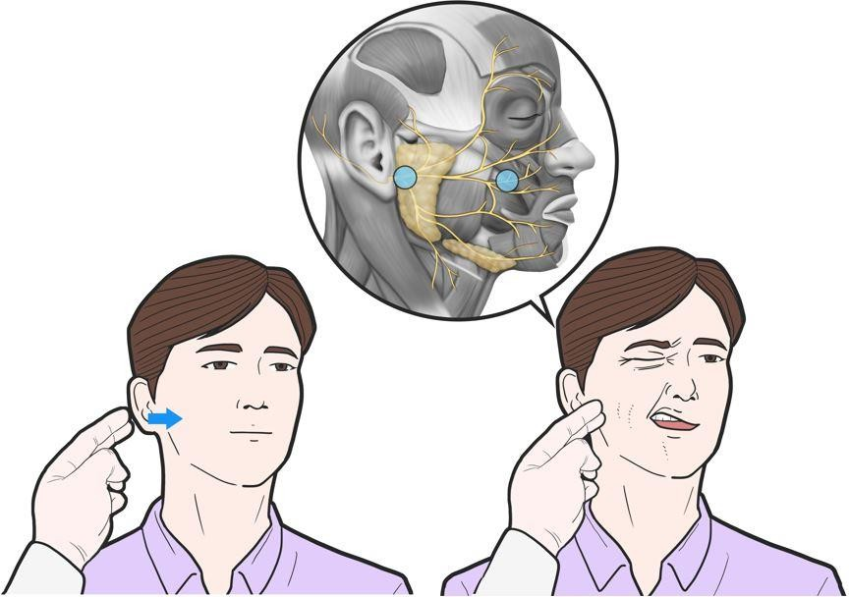
Chavostek’s sign positive.
When tapping is done over facial nerve area, there is spasm of facial muscles
Core Concept

Slide 26
TREATMENT
Core Concept
Local exposure: Wash the affected skin with copious
water
Give milk or suspension of chalk to neutralize- (30 gms of chalk in water or milk will neutralize 20 gms of oxalic acid)
Give 10% Ca gluconate- 10 ml I.V

Slide 27
Core Concept
IV fluids
Maintain urine output record
Demulcent drinks
Symptomatic

Slide 28
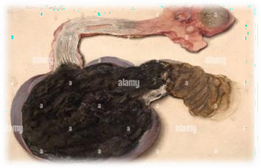
Autopsy Findings
VERTICAL INTEERATION
Scalded mucosa of GIT
Mucous membrane of mouth, tongue, pharynx, esophagus may
be bleached and has scalded appearance
Kidneys show edema, congestion with oxalate crystals in renal
tubules with necrosis of proximal convoluted tubule
tongue, pharynx, esophagus stomach

Slide 29
Medico legal Importance
VERTICAL INTEERATION
Accidental poisoning – common
Suicidal ingestion – rare
Homicide – not possible

Slide 30
Research
Research
https://www.researchgate.net/publication/290443753_Ing estion_of_Phenol_Carbolic_Acid_Leading_to_Ventricula r_Fibrillation
https://epgp.inflibnet.ac.in/epgpdata/uploads/epgp_conte
nt/S000016FS/P000697/M010642/ET/1516252404FSC_
P10_M10_e-text.pdf
https://journals.indexcopernicus.com/search/article?articl
eId=1676721

Slide 31
Biomedical Ethics
Ethics
The principle of beneficence is the obligation of physician to act for the benefit of the patient and supports a number of moral rules to protect and defend the right of others, prevent harm, remove conditions that will cause harm, help persons with disabilities, and rescue persons in danger.
It is worth emphasizing that, the language here
is one of positive requirements. The principle
calls for not just avoiding harm, but also to
benefit patients and to promote their welfare.

Slide 32
Family Medicine
Family Medicine
A successful treatment for any poisoning must do one of
three things:
Empty the stomach before the poison is absorbed.
Prevent the absorption of the poison.
Counteract the systemic effects of the poison.
https://www.sciencedirect.com/topics/medicine-and-
dentistry/toxicity-of-ethanol

Slide 33
How To Access Digital Library
1. Go to the website of HEC National Digital Library.
2. On Home Page, click on the INSTITUTES.
3. A page will appear showing the universities from Public and Private Sector and other Institutes which have access to HEC National Digital Library HNDL.
4. Select your desired Institute.
5. A page will appear showing the resources of the institution
6. Journals and Researches will appear
7. You can find a Journal by clicking on JOURNALS AND DATABASE and enter a keyword to search for your desired journal.

Slide 34
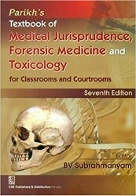
TEXT BOOKS & PRACTICAL NOTEBOOK:
Principles & Practice of Forensic Medicine.
by Nasib R. Awan
Parikh’s Textbook of Medical Jurisprudence,
Forensic Medicine & Toxicology.
Practical Manual Of Forensic Medicine
& Toxicology

Slide 35
Thank you

