Slide 1
CORNEAL DYSTROPHIES & DEGENERATIONS
Dr. Ambreen gul mbbs, fcps, chpe, chr, scholar mhpe assistant professor Ophthalmology dept. BBH, RMU

Slide 2
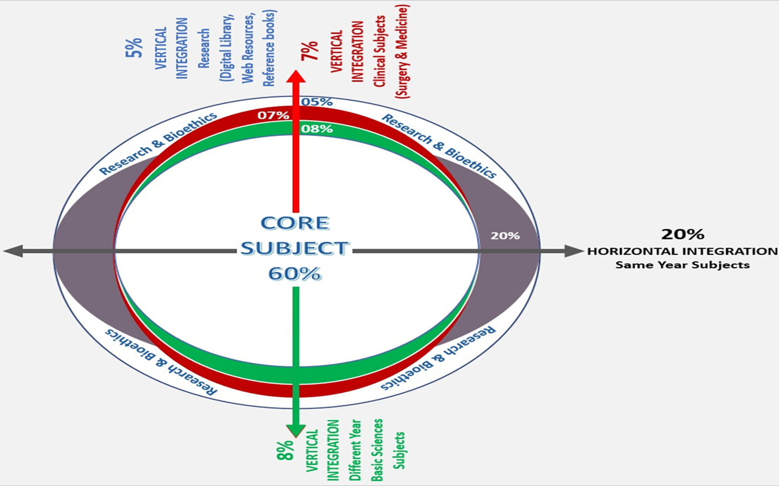
Sequence Of Lecture
Core Subject
Spiral Integration
Horizontal Integration
Vertical integration
EOLA(End of lecture assessment)
Digital Library References
( Research, Bioethics, Artificial Intelligence)

Slide 3
Learning Objectives
At the end of one hour large group interactive session (LGIS) using the PowerPoint , fourth year medical student should be able to
Define corneal dystrophy and degeneration
Differentiate between corneal dystrophy and degeneration
Describe different corneal dystrophies and degenerations

Slide 4
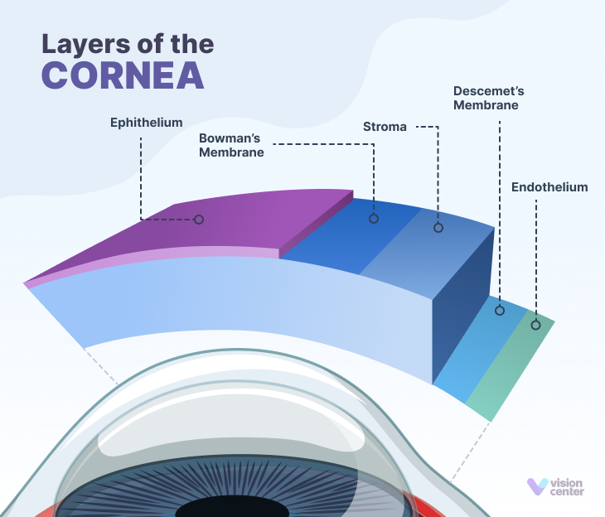
Anatomy Of Cornea
Vertical integration

Slide 5
Physiology
Vertical integration

Slide 6
Community Medicine
Corneal dystrophies (CDs) and degenerations are rare diseases
They cause patients to develop low vision and blindness in the most productive decades of life, with severe impact on quality of life
Corneal dystrophies affect approximately 0.09% of the population.
Horizontal integration

Slide 7
Corneal Dystrophy
Are a group of genetic, non-inflammatory, often progressive, bilateral and symmetrical eye disorders in which abnormal material accumulates in the transparent cornea
Core subject

Slide 8
Subdivisions Of Corneal Dystrophies
Epithelial and Bowman Layer Dystrophies
Endothelial and Descemet membrane Dystrophies
Core subject

Slide 9
Clinical Presentation
May be asymptomatic
Cause recurrent corneal erosions leading to
Discomfort or severe pain,
The sensation of a foreign body in eye
Blurring of vision
Photophobia
Majority are autosomal dominant, few are autosomal recessive
Core subject

Slide 10
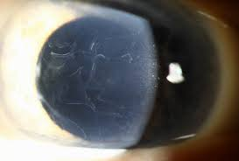
Epithelial Basement Membrane Dystrophy
Common form
Fingerprints on epithelial layer
Also known as map-dot-fingerprint dystrophy
Asymptomatic or recurrent erosions
Core subject

Slide 11
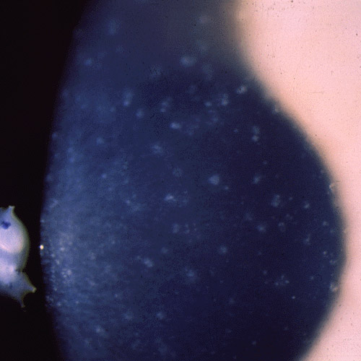
Meesmann Corneal Dystrophy
Extremely rare form
Development of clusters of multiple, small, clear cysts
Core subject

Slide 12
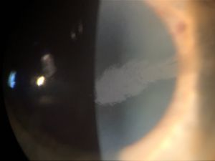
Lisch Corneal Dystrophy
Rare form
Clusters of multiple, tiny cysts or lesions that may be band-shaped or curved or spiraled (whorled)
Core subject

Slide 13
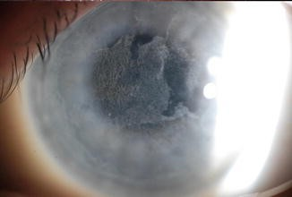
Reis-Buckler Corneal Dystrophy
Affects the bowman membrane
DISORGANIZED
Clouding (opacity) and progressive scarring
Recurrent corneal erosions
Core subject

Slide 14
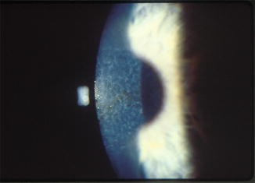
Thiel-Behnke Corneal Dystrophy
Affects the bowman membrane
Recurrent corneal erosions begin during childhood
ORGANIZED, Resemble honeycombs
Core subject

Slide 15
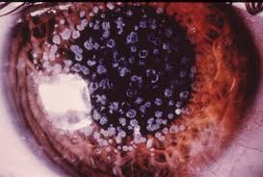
Granular Corneal Dystrophy
Small particles (granules) that resemble breadcrumbs
Lesions slowly grow eventually combining (coalescing) to form larger lesions.
Core subject

Slide 16
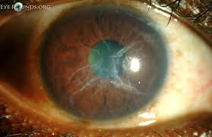
Lattice Corneal Dystrophy
Branching lines that resemble cracked glass or the crisscrossed
Recurrent corneal erosions
Core subject

Slide 17
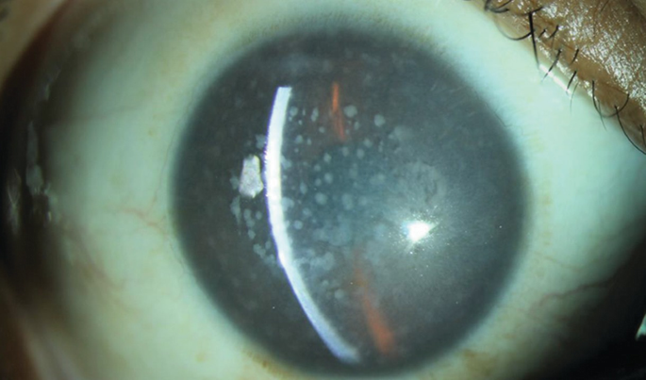
Macular Corneal Dystrophy
Significant vision loss can occur by the second decade
Clouding of the stroma
Painful recurrent corneal erosions
Core subject

Slide 18
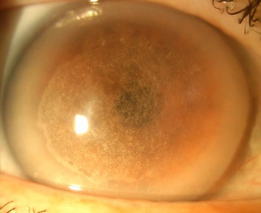
Schnyder Crystalline Corneal Dystrophy
Opaque corneas due to an accumulation of fat or cholesterol within the stroma
Eventually cause clouding, haziness and blurred vision
Core subject

Slide 19
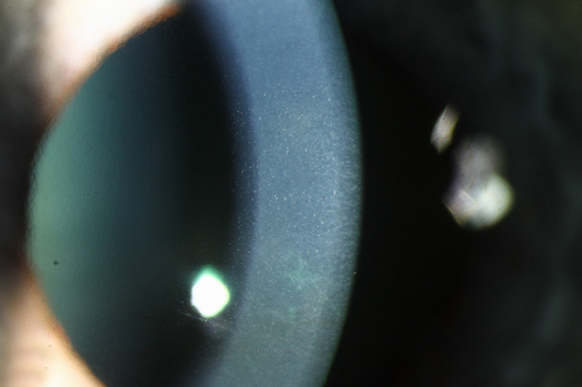
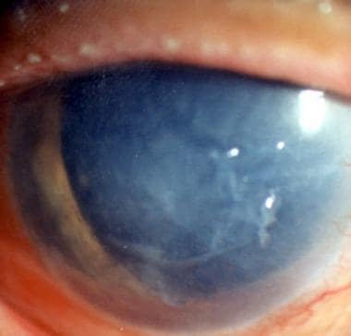
Fuchs Endothelial Dystrophy
Endothelial cells dysfunction
Stromal edema and cloudy cornea
Epithelial bullae rupture causing severe pain and blurred vision
Core subject

Slide 20
Fuchs Endothelial Dystrophy
Core subject

Slide 21
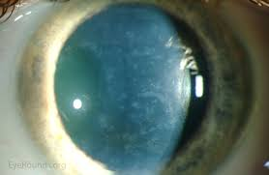
Posterior Polymorphous Dystrophy
May present at birth (with clouding of the cornea) or later during life
Characterized by lesions affecting the endothelium, edema of the stroma
Core subject

Slide 22
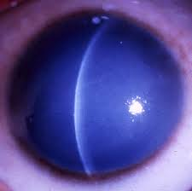
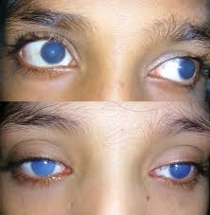
Congenital Hereditary Corneal Dystrophy
Autosomal dominant form (type I) is characterized by pain, swelling (edema) of the cornea that becomes cloudy during early infancy
Autosomal recessive form (type II) by corneal swelling and cloudy corneas at birth.
Core subject

Slide 23
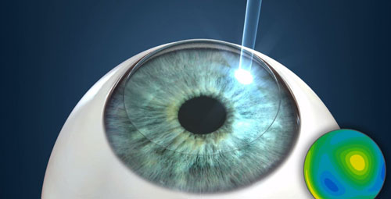
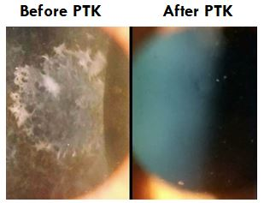
Treatment
For recurrent corneal erosions
Lubricating eye drops, ointments, antibiotics or bandage soft contact lenses.
Corneal scraping or the use of excimer laser therapy ((phototherapeutic keratectomy)
For significant associated visual symptoms
keratoplasty
Core subject

Slide 24
Corneal Degenerations
Characterized by the deposition of a specific material, stromal thinning, and vascularization.
Not hereditary and can be unilateral
Cornea undergoes changes associated with ultraviolet light stimulation and oxidative stress
Core subject

Slide 25
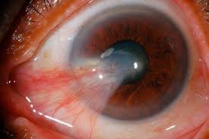
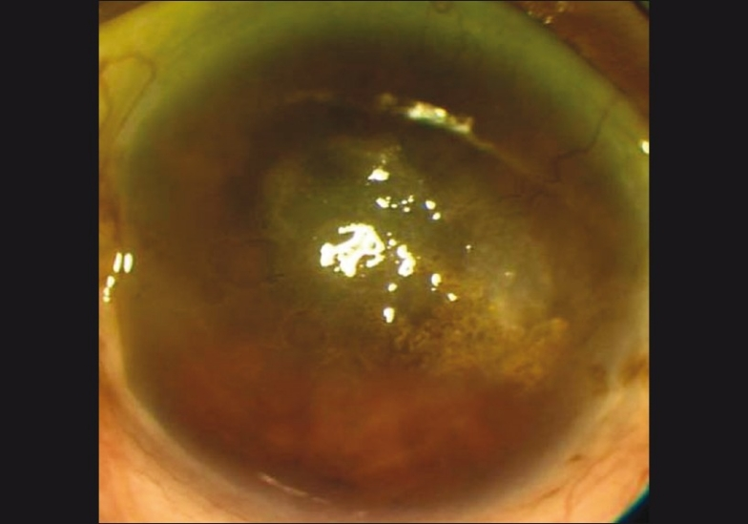
Epithelial And Subepithelial Degenerations
Pterygium
Spheroidal Degeneration
Core subject
Notes:
invades the cornea resulting in loss of Bowman’s layer and epithelial changes, yellowish aggregates that accumulate near the limbus and then progressively extend toward the central part of the cornea within the palpebral fissure. The globular amorphous material is primarily deposited in the area of Bowman’s layer caused by wind, dust, and ultraviolet radiation

Slide 26
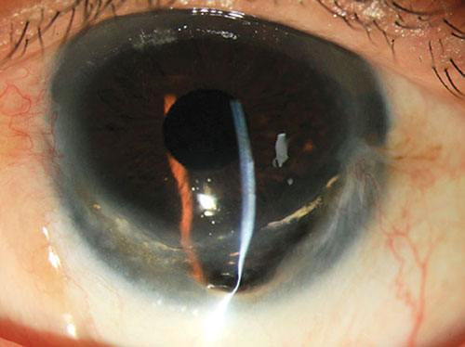
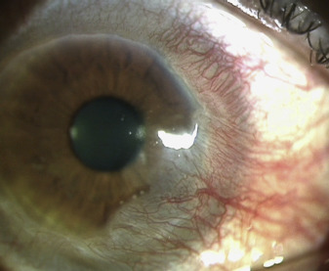
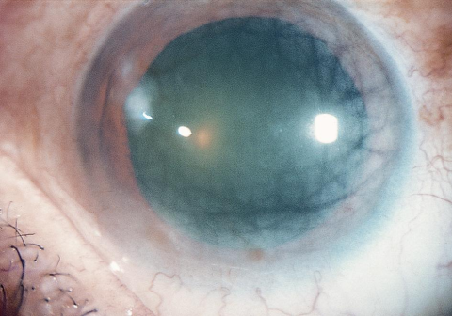
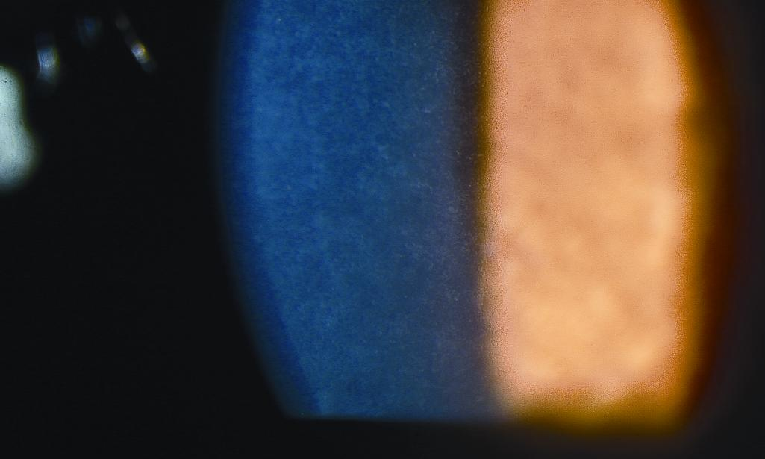
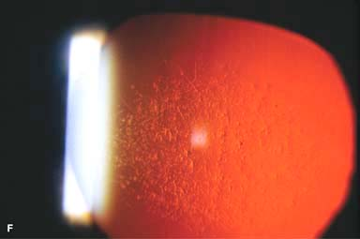
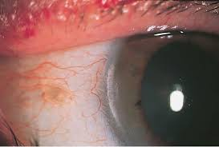
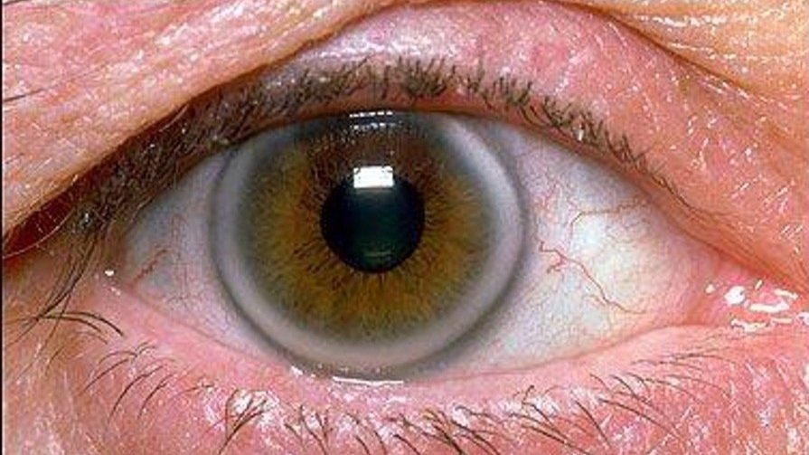
Stromal Degenerations
Stromal (central)
Crocodile shagreen
Cornea farinata
Polymorphic amyloid degeneration
Peripheral stromal
White limbal girdle of Vogt
Corneal arcus
Senile furrow degeneration
Terrien’s marginal degeneration
Core subject

Slide 27
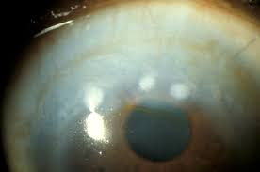
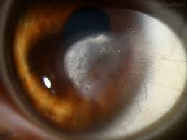
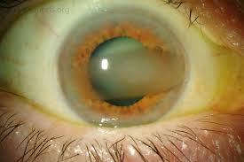
Post-inflammatory Corneal Degenerations
Band-shaped keratopathy
Salzmann’s nodular degeneration
Lipid keratopathy
Core subject
Notes:
calcium deposits within the superficial cornea and Bowman’s layer across the interpalpebral fissure, uveitis
nodular post-inflammatory keratopathy resulting in disruption of Bowman’s layer, subepithelial fibrosis and vascularization

Slide 28
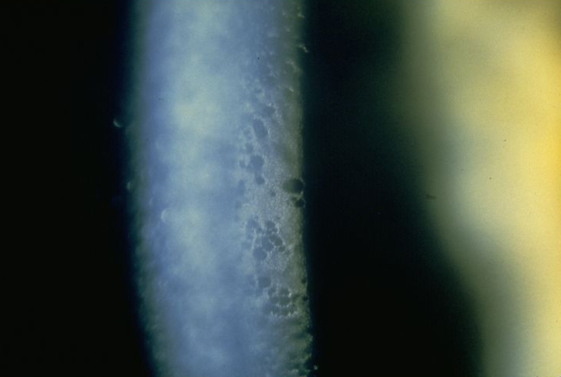
Endothelial Degeneration
Hassall-henle bodies
Drop like excrescences of hyaline material projecting into anterior chamber form corneal periphery
Core subject

Slide 29
Treatment Of Corneal Degenerations
Lubricating eye drops
For progressed conditions affecting vision, corneal transplant surgery
Core subject

Slide 30
Dystrophy Versus Degeneration
Core subject

Slide 31
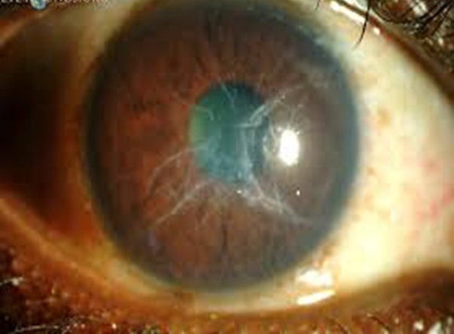
EOLA( End Of Lecture Assessment)
A 40-year-old patient presents with recurrent corneal erosions and blurred vision. Slit-lamp examination reveals grayish-white opacities in the anterior stroma arranged in a cracked glass-like pattern. Which corneal dystrophy is most likely to be diagnosed?
Granular corneal dystrophy
Macular corneal dystrophy
Lattice corneal dystrophy
Reis-Bücklers corneal dystrophy
Thiel Behnke corneal dystrophy
EOLA

Slide 32
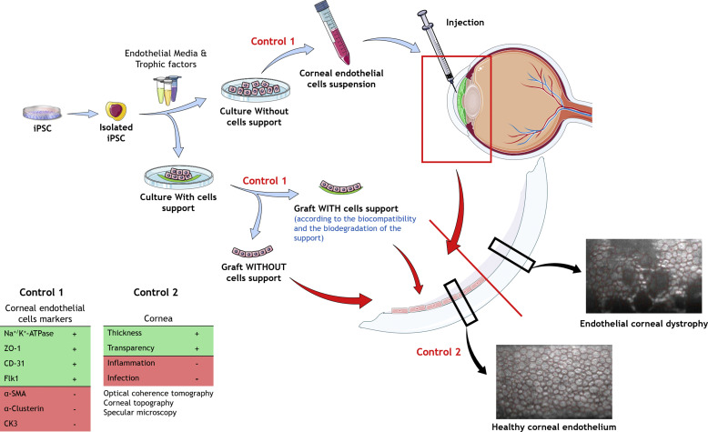
Research And Recent Advances
Cell therapy involving fully differentiated HCECS (human corneal endothelial cells) holds the most immediate promise for patients suffering from corneal dystrophies
Cell therapies involve transplanting healthy cells into the cornea and regenerating and replacing damaged or dysfunctional cells
Research

Slide 33
Bioethics
A 35-year-old woman, has been diagnosed with a rare form of corneal dystrophy that is progressively causing her vision to deteriorate. Despite her doctor recommending a corneal transplant as the best course of treatment to restore her vision, she is hesitant to undergo the procedure due to her personal beliefs.
She is a devout member of a religious community that holds strict beliefs against any form of medical intervention, is torn between her desire to maintain her autonomy and her need for medical care. Her community emphasizes the importance of relying on faith for healing rather than seeking medical intervention.
Bioethics

Slide 34
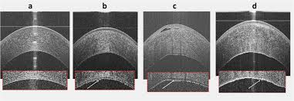
Artificial Intelligence
AI algorithm based on high-definition AS-OCT images has been 99% specific and 98% sensitive in differentiating normal cornea from early or late stages of Fuchs endothelial corneal dystrophy [FECD]
Artificial intelligence

Slide 35
Study Guide Resources
Kanski-Clinical-Ophthalmology-Systematic-Approach
Oxford Handbook of Ophthalmology Book by Philip I. Murray
The Wills Eye Manual: Office and Emergency Room Diagnosis and Treatment of Eye Disease
https://www.forbes.com/sites/williamhaseltine/2024/02/17/novel-treatment-for-damaged-corneas-cell-therapy/#:~:text=More%20recently%2C%20cell%20therapies%20have,replacing%20damaged%20or%20dysfunctional%20cells.

