Slide 1
Lower Urinary Tract:
Congenital Anomalies

Slide 2
University Motto, Vision, Values & Goals
Mission Statement
To impart evidence-based research-oriented health professional education
Best possible patient care
Mutual respect, ethical practice of healthcare and social accountability.
Vision and Values
Highly recognized and accredited centre of excellence in
Medical Education, using evidence-based training techniques for development of highly competent health
professionals, who are lifelong experiential learner and are socially accountable.
Goals
The Undergraduate Integrated Learning Program is geared to provide you with quality medical education in an environment designed to:

Slide 3
SEQUENCE OF LGIS
Learning objectives
Core Subject (70%)
Vertical Integration (10%)
Horizontal Integration (15%)
Research (3%)
Biomedical Ethics (2%)

Slide 4
PROF UMER MODEL OF INTEGRATED LECTURE

Slide 5
LEARNING OBJECTIVES
Understand the embryological development of the lower urinary tract, including the role of the urogenital sinus and mesonephric ducts.
Recognize various congenital anomalies of the lower urinary tract, such as bladder agenesis, duplication anomalies, urachal anomalies, and posterior urethral valves.
Describe the clinical presentation, diagnosis, and complications of anomalies like bladder exstrophy, hypospadias, and prune belly syndrome.
Explain the pathophysiology and management of obstructive conditions such as posterior urethral valves and meatal stenosis.
Interpret imaging and diagnostic modalities (e.g., VCUG, IVP, ultrasound, CT) used for evaluating congenital lower urinary tract anomalies.
Discuss surgical and conservative treatment options, including urinary diversion, reconstructive procedures, and catheterization techniques.

Slide 6
CORE SUBJECT

Slide 7
Congenital Anomalies
A major consideration with congenital abnormalities is that they tend to
be multiple.
All of these anomalies are infrequent or rare, and each condition occurs
in both males and females
Diagnosed in infancy or childhood
Most are discovered in the evaluation of a urinary tract infection or, in the case of urachal anomalies, periumbilical drainage or redness.

Slide 8
Classification
Urinary bladder anomalies are-
bladder diverticula
bladder ears
congenital hypoplasia of the bladder
megacystis
bladder agenesis
duplication anomalies of the bladder
bladder septa
Urachal anomalies are
urachal sinus urachal cyst urachal diverticulum patent urachus

Slide 9
Pathophysiology
The embryologic cause is unknown.
Bladder development occurs during the fifth to seventh
week of gestational development.
Development depends upon many factors
mesenchymal differentiation
mesenchymal growth
urine production
Bladder cycling, the process of sequential expansion and contraction, is important in the anatomic and physiologic development of the normal bladder.

Slide 10
VERTICAL INTEGRATION WITH ANATOMY AND EMBYOLOGY

Slide 11
Anatomy
The urinary bladder is a hollow, muscular, and distensible (or elastic)
organ that sits on the pelvic floor .
It is the organ that collects urine excreted by the kidneys prior to disposal by urination. Urine enters the bladder via the ureters and exits via the urethra.
In males, the base of the bladder lies between the rectum and the pubic symphysis. It is superior to the prostate, and separated from the rectum by the rectovesical pouch.
In females, the bladder sits inferior to the uterus and anterior to the
vagina. It is separated from the uterus by the vesicouterine pouch.

Slide 12
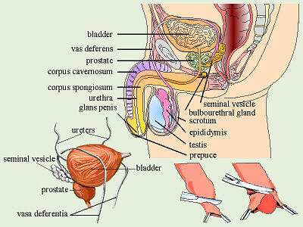
Anatomy……………..

Slide 13
Embryology
The urogenital sinus is formed by the division of the cloaca
by the uro-rectal septum
The uro-genital sinus may be divided into three component parts.
cranial portion which is continuous with the allantois and forms
the bladder proper.
The pelvic part of the sinus forms the prostatic urethra and epithelium as well as the membranous urethra and bulbo urethral glands in the male and the membranous urethra and part of the vagina in females.
the caudal portion forms the penile urethra in males and the
vestibule in females.

Slide 14
Embryology……..
The bladder forms from the cranial end of the urogenital sinus. However, the trigone portion is formed by the caudal ends of the mesonephric ducts. As the bladder expands, the mesonephric ducts begin to become incorporated into the wall of the bladder dragging the ureters along with them. Further growth causes the ureters to eventually have their own opening into the bladder.
The bladder is initially continuous with the allantois. Over time, the allantois degenerates to form a cord-like structure, the urachus. The urachus goes from the umbilicus to the apex of the bladder and forms the median umbilical ligament which can be seen in adults. The medial umbilical ligaments may also be seen in adults on both sides of the median umbilical ligament, these are the vestigial remnants of the umbilical arteries.

Slide 15
Bladder Diverticulum
Bladder diverticula are herniations of the bladder mucosa through
bladder wall musculature (detrusor muscle).
Diverticular size can vary
Diverticula can be wide or narrow mouthed.(The size of diverticular openings has functional implications because narrow- mouthed diverticula often empty poorly).
Stasis of urine within diverticula can also lead to stone formation or epithelial dysplasia.
may cause ureteral obstruction,bladder outlet obstruction or
vesicoureteral reflux

Slide 16
Bladder Diverticulum……………
MC Site lateral and superior to the ureteral orifices. [dome of the bladder, in disorders as bladder outlet obstruction (ie, posterior urethral valves) or Eagle Barrett syndrome (prune belly syndrome)].
Congenital or acquired. Congenital deficiency or weakness in the
Waldeyer fascial sheath has been implicated as a cause.
Solitary
located at the junction of the bladder trigone and detrusor
Congenital diverticula are usually removed surgically

Slide 17
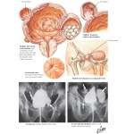
Bladder Diverticula

Slide 18
Bladder ears
lateral protrusions of the bladder through the internal inguinal ring and
into the inguinal canal.
Bladder ears are often observed during voiding cystourethrography (VCUG) or intravenous pyelography (IVP), when the bladder is filled to capacity.
Bladder ears have also been seen on CT body imaging.
No treatment is necessary
Knowledge of this entity is important to surgeons during inguinal herniorrhaphy because occasional reports have been made of partial or near total cystectomy performed under the mistaken notion that this was a large hernia sac.

Slide 19
Bladder agenesis
•
Rare
•
generally incompatible with life.
•
Ureters may enter into the urethra, vagina, Gartner duct cyst
(female), prostatic urethra, rectum, or the patent urachus.
•
Associated hydroureteronephrosis and renal dysplasia (variable) are present.
•
Other associated anomalies include neurologic, orthopedic, hindgut, and other urogenital anomalies, such as renal agenesis and absence of the prostate, vagina, seminal vesicles, epididymis, or penis
This condition requires urinary diversion and subsequent reconstruction

Slide 20
Megacystitis
Megacystitis is an enlarged bladder, believed to be secondary to
overfilling of the fetal bladder during development
Common presentations-
hydronephrosis.
Febrile urinary tract infection
high-grade vesicoureteral reflux
Megacystitis can be observed in other conditions, such as posterior urethral valves, Ehlers-Danlos syndrome, urethral diverticulum, microcolon hypoperistalsis syndrome, sacral meningomyelocele, sacrococcygeal teratoma, and pelvic neuroblastoma.
Clean intermittent catheterization

Slide 21
Bladder duplication
Rare
Complete (2 urethras exist)
Partial (the bladder joins distally into one common urethra)
The 2 halves of the bladder are on either side of the midline, with the corresponding ipsilateral ureter draining each bladder half.
Associated anomalies include duplication of the penis, vagina, uterus, lumbar vertebrae, and hindgut. fistulas may be present between the rectum, vagina, and urethra.

Slide 22
HORIZONTAL INTEGRATION WITH RADIOLOGY

Slide 23
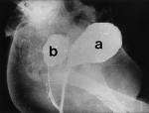
Duplication of Ur. bladder

Slide 24
Urachal cyst
is a fluid-filled structure occurring in between the two obliterated
ends of the urachus.
Most occur in the distal third of the urachus.
More commonly, the urachal cyst is detected in early childhood or
adolescence.
Symptoms -infection ,inflammation,suprapubic mass, fever, pain,
and bladder or irritative voiding symptoms.
(Staphylococcus aureus is the most common bacterial organism).
Death from intra-abdominal rupture has been reported.

Slide 25
Patent urachus
Communication from the umbilicus to the bladder. continuous or
intermittent drainage from the umbilicus.
The tract may become inflamed, resulting in tenderness, periumbilical
swelling, and serosanguinous or purulent discharge.
May be associated with bladder outlet obstruction, such as posterior urethral valves.
Correction of the obstruction may result in the spontaneous resolution
of the patent urachus.

Slide 26
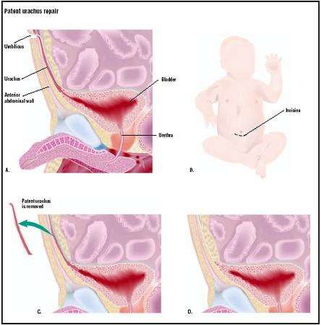
Patent Urachus

Slide 27
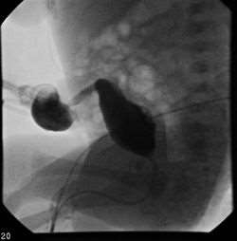
Patent Urachus

Slide 28
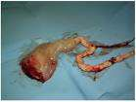
Resected specimen of Urachus

Slide 29
Urachal sinus
derived from a persistently patent urachus
Children may present with periumbilical tenderness wet umbilicus
granulation tissue at the level of the umbilicus
In many instances, these children have undergone multiple sliver nitrate cauterizations under the mistaken notion that this is simply granulation tissue after severance of the remnant umbilical cord.
These can be observed in the first 4-8 weeks of life.

Slide 30
Ectopia Vesicae
open to the outside and turned inside-out, so that its inside is visible at birth,
protruding from the lower abdomen
Symptoms-
Exposed posterior bladder wall
Short lower abdominal wall
Inguinal hernia
Separated pubic rami
Epispadias
Incomplete fusion of genital tubercles

Slide 31
Opening in abdominal wall
Urine excretion through opening in abdominal wall
Incontinence
Dilated ureters
Open pubic arch
Wide-set ischial bones
Constriction between ureter and bladder
Ureteral reflux

Slide 32
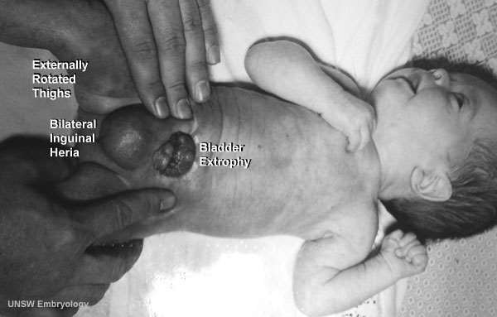
Exostrophy of Urinary bladder

Slide 33
Posterior urethral valves

Slide 34
Renal and urological manifestations

Slide 35
Prune belly syndrome (Triad Syndrome)

Slide 37
Meatal stenosis
Associated with stenosis
When opening is reduced to pinhole there may be chronic retention with back pressure effects and eventually renal failure.
Treatment:
Meatal dilatation, meatotomy or meatoplasty.

Slide 38
Hypospadias
Congenital anomaly in which external urethral opening is located on ventral side of shaft of penis in one or several positions just behind the normal anatomical opening.

Slide 39
Types
Subcoronal: The opening of the urethra is located somewhere near the head of the penis.
Midshaft: The opening of the urethra is located along the shaft of the penis.
Penoscrotal: The opening of the urethra is located where the penis and scrotum meet.

Slide 40
Symptoms
Abnormal urine stream Fertility problems
Psychological and cosmetic issues.
Treatment:
No medical management.
Surgery is the definitive treatment.

Slide 41
Spiral Integration with Family Medicine
Early diagnosis and long-term follow-up of congenital lower urinary tract anomalies in primary care.
Emphasize urinary tract infection (UTI) prevention and bladder function monitoring in children.

Slide 42
Biomedical Ethics
Address ethical dilemmas in prenatal diagnosis and decision-making for severe anomalies.
Discuss the ethical considerations of surgical correction in neonates and children, including parental consent.

Slide 43
Research
Recent advancements in fetal interventions and regenerative medicine for congenital anomalies.
Genetic studies and molecular research related to urinary tract malformations.
https://pmc.ncbi.nlm.nih.gov/articles/PMC5107396/

Slide 44
REFERENCES
Campbells urology 12th edition
Smith and Tanaghos urology 9th edition
EAU 2024 guidelines

