Slide 1
Clinical Scenario: Intermittent Claudication

Slide 2
Case Presentation
Patient History
Name: ABC Age: 65 years
Chief Complaint: Pain in the calves that occurs after walking 200 meters and resolves with rest.
Medical History: Type 2 diabetes mellitus, hypertension, smoker (40 pack-years), hyperlipidemia

Slide 3
Physical Examination
Vital Signs: Blood pressure 150/90 mmHg, heart rate 80 bpm, respiratory rate 16 bpm.
Pulses: Diminished posterior tibial and dorsalis pedis pulses.
Skin: Cool and pale feet, no ulcers or gangrene.
ABI Measurement: 0.75 on the left side, 0.78 on the right side

Slide 4
Diagnostic Approach
Based on the history and ABI values, Mr. Smith's symptoms are consistent with intermittent claudication due to PVD.
Further imaging (e.g., duplex ultrasound) may be performed to evaluate the extent and location of arterial blockage

Slide 5
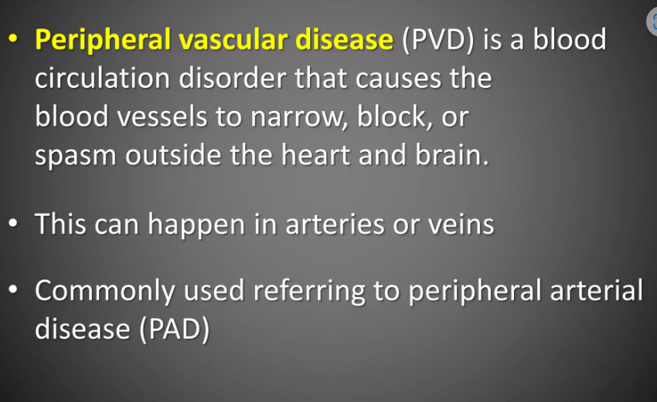

Slide 6
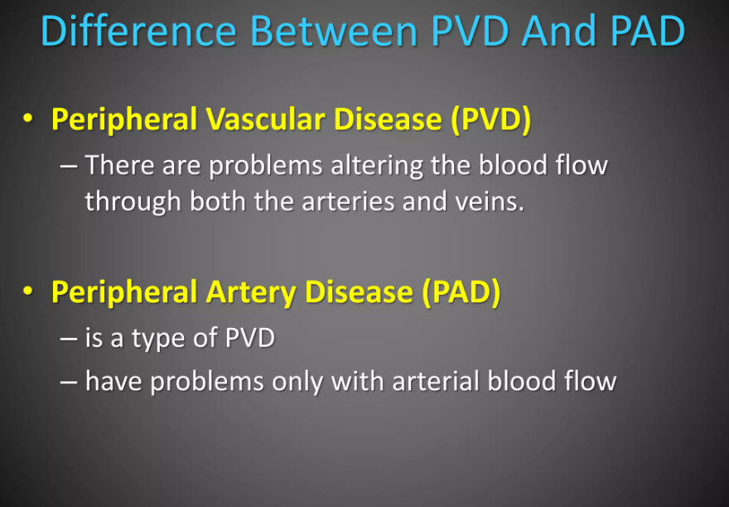

Slide 7
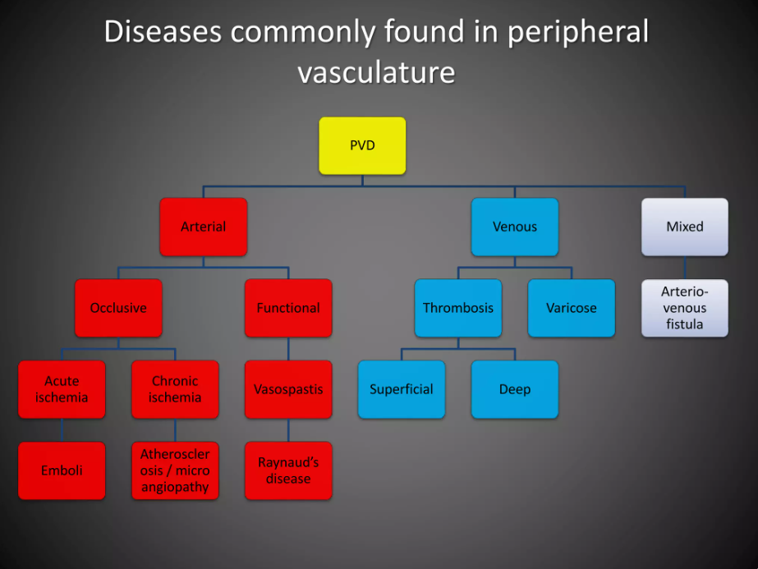

Slide 8
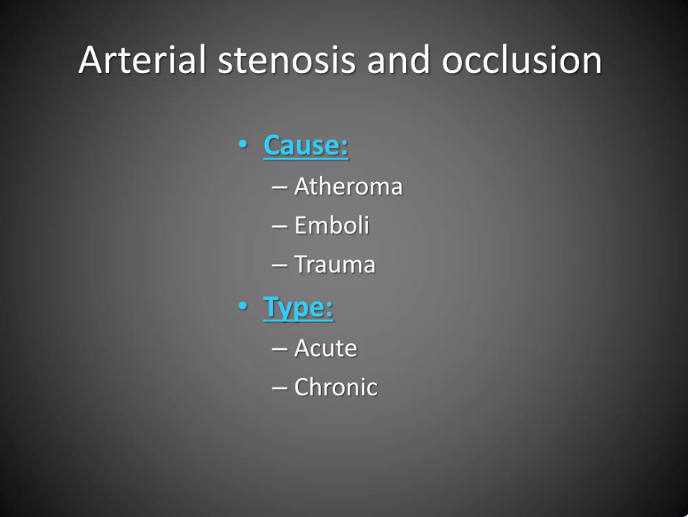

Slide 9
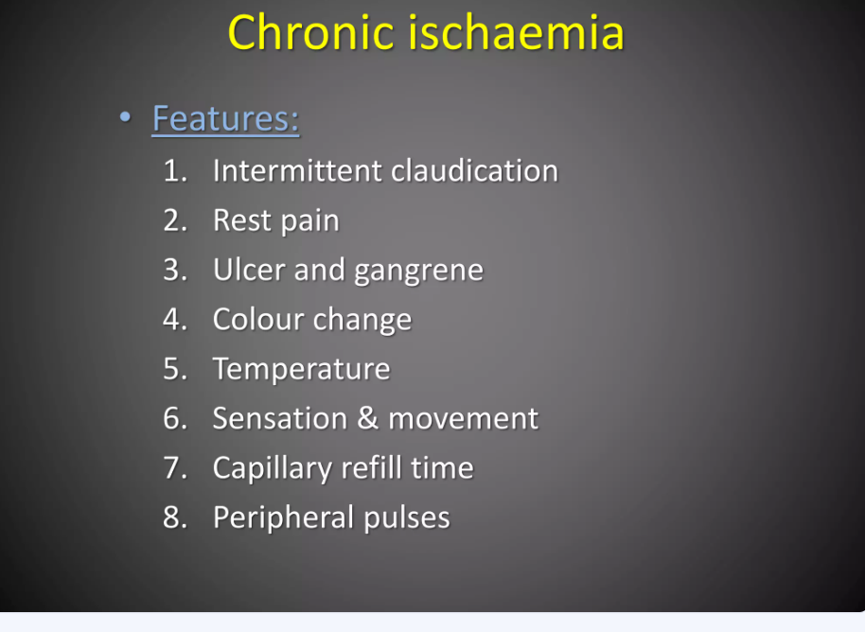

Slide 10
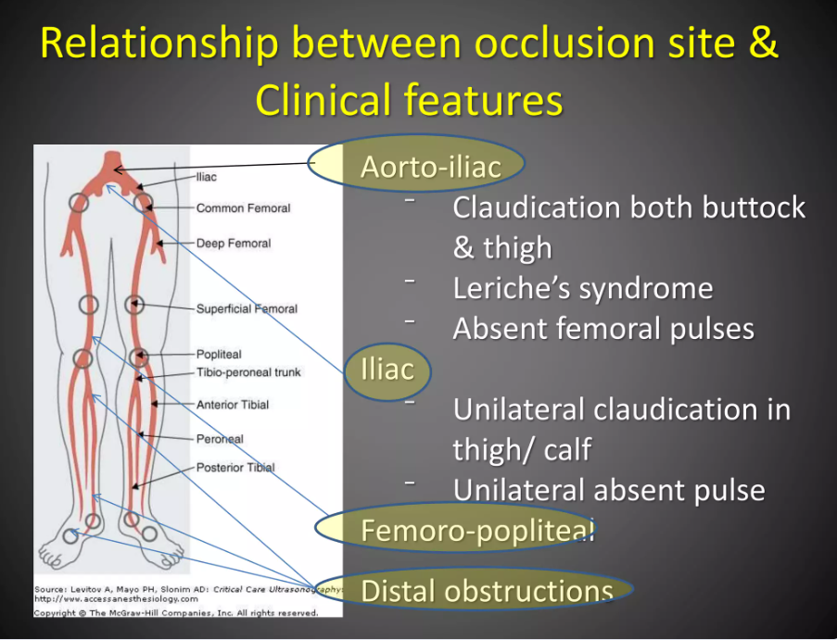

Slide 11
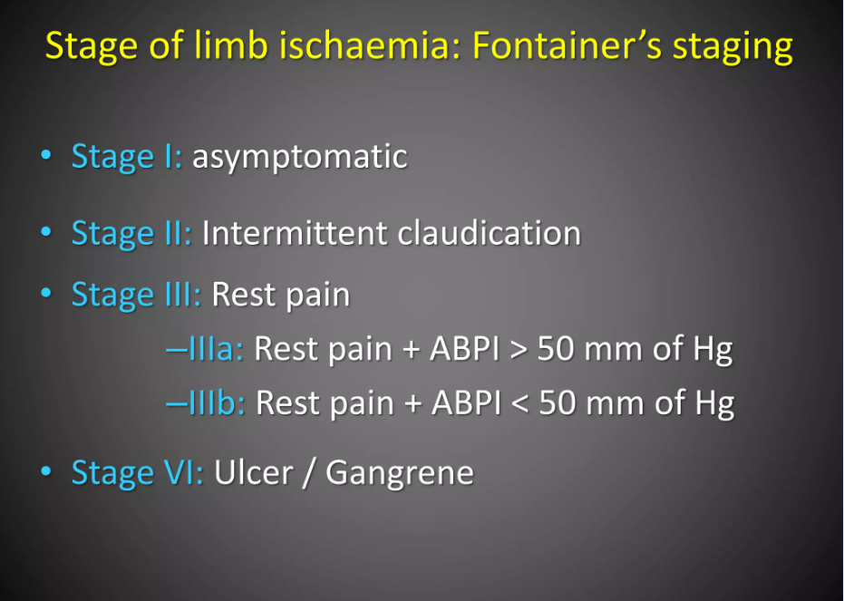

Slide 12
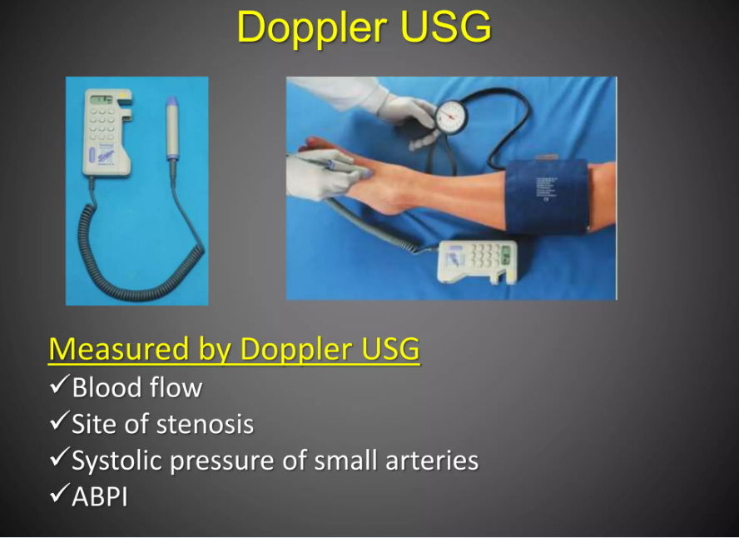

Slide 13
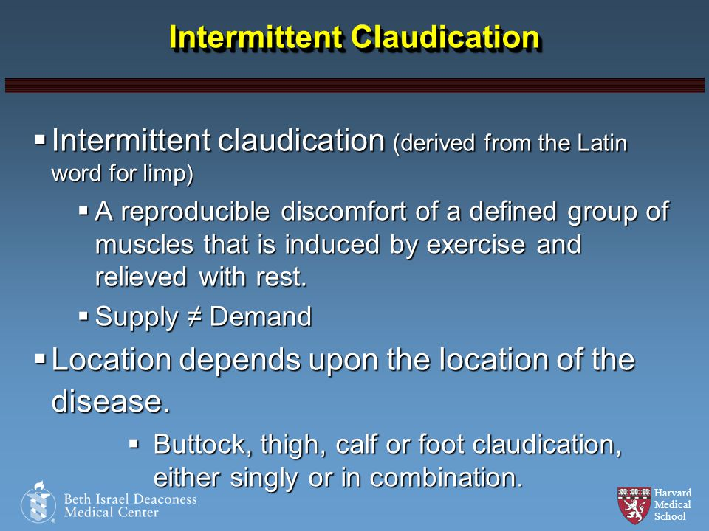

Slide 14
Conclusion
Recap the importance of early diagnosis and management of PVD to prevent progression and complications.
Emphasize the role of a multidisciplinary approach in managing patients with PVD, including lifestyle modifications, pharmacotherapy, and surgical interventions.

Slide 15
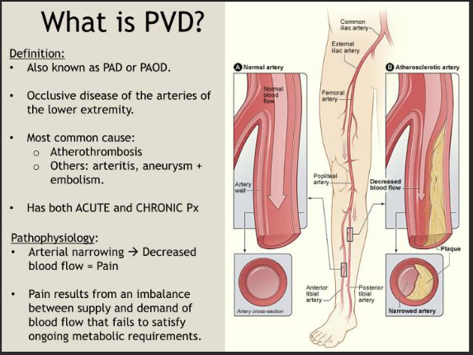

Slide 16
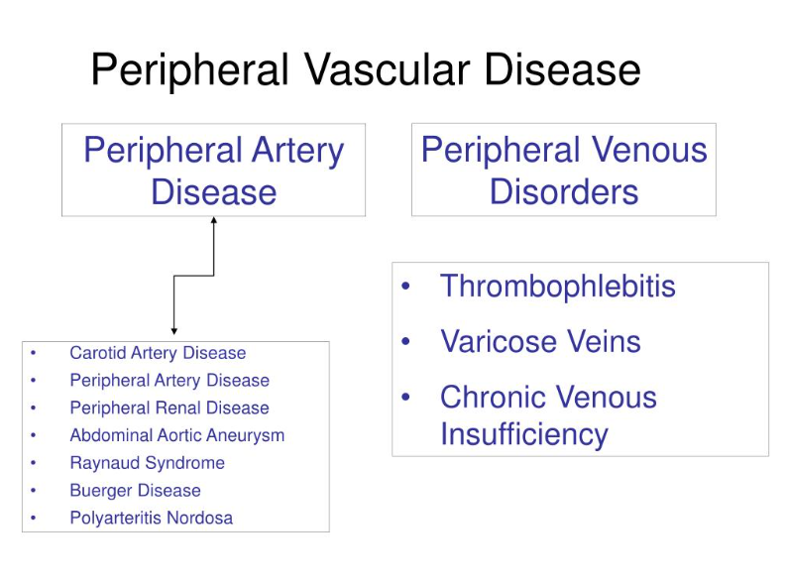

Slide 17
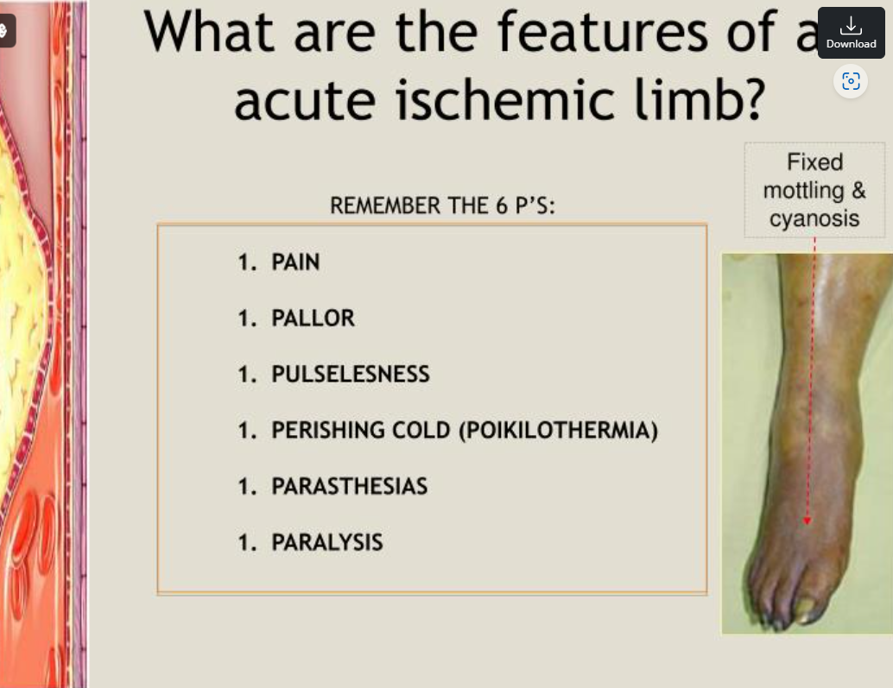

Slide 18
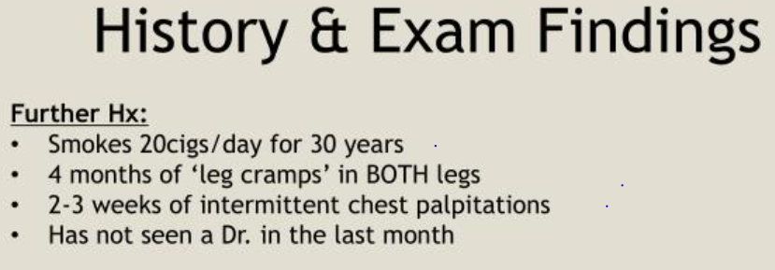

Slide 19
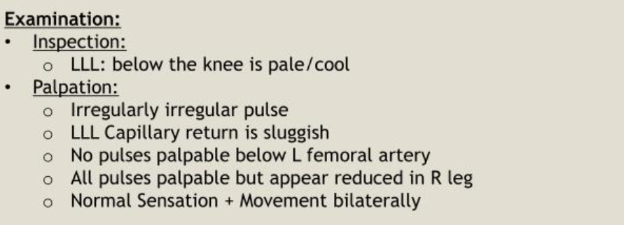

Slide 20
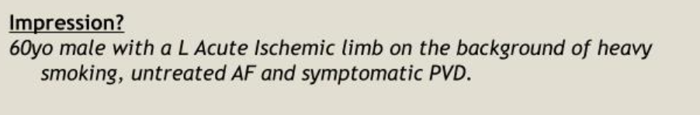

Slide 21
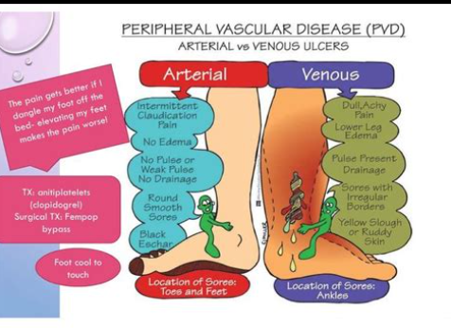

Slide 22
