Slide 2
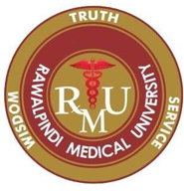
Cholestatic Disease
GASTROINTESTINAL HEPATOBILIARY & PARASITOLOGY II Module
3rd year MBBS
Dr Mudassira Zahid
Prof Mobina Ahsan dodhy
Department of Pathology
Rawalpindi Medical University

Slide 3
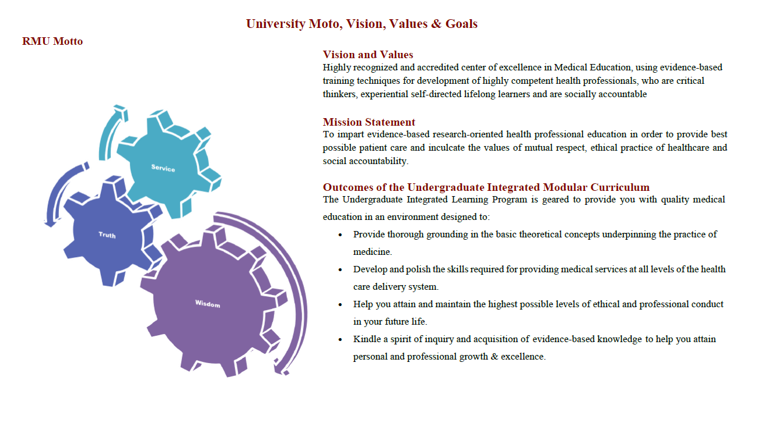

Slide 4
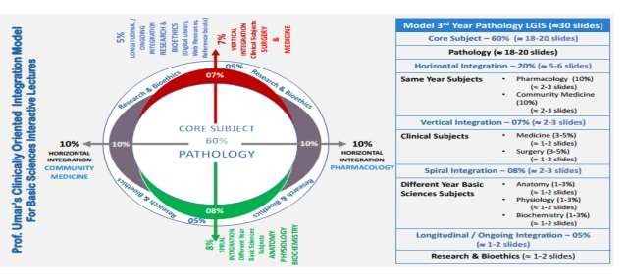

Slide 5
Learning Objectives
Discuss pathophysiology of jaundice, cholestasis, large bile duct obstruction, and autoimmune cholangiopathies.
Differentiate between pathological features of primary biliary cirrhosis (PBC) and primary sclerosing cholangitis (PSC).
Discuss structural anomalies of the biliary tree, including biliary atresia.
Explain portal vein obstruction and hepatic vein thrombosis.
Correlate immunological basis with graft-versus-host disease and liver graft rejection.
Learning Resources: Robbins & Cotran Pathologic Basis Of Disease 10th Edition

Slide 6
Cholestasis
VERTICAL INTEGRATION PHYSIOLOGY
Cholestasis is a decrease in the flow of bile due to:
Impaired secretion by hepatocytes (metabolic)
Obstruction of bile flow through intra- or extrahepatic bile ducts (obstructive).

Slide 7
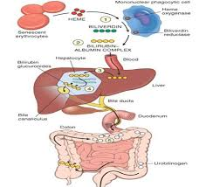
Cholestasis
VERTICAL INTEGRATION BIOCHEMISTRY

Slide 8
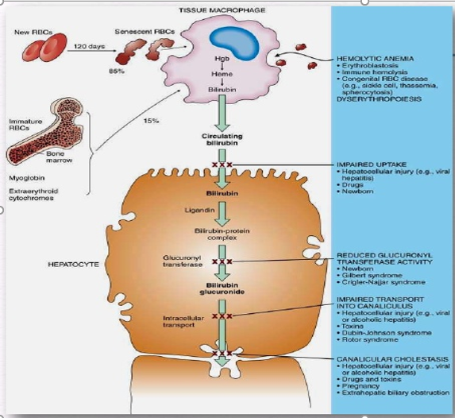
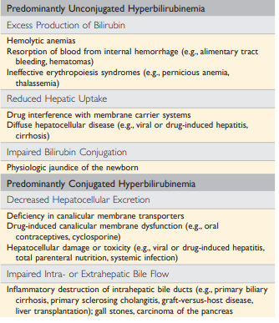
CORE SUBJECT PATHOLOGY

Slide 9
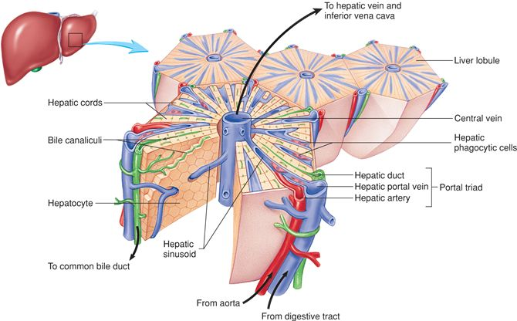
VERTICAL INTEGRATION ANATOMY

Slide 10
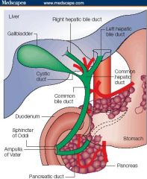
VERTICAL INTEGRATION ANATOMY

Slide 11
Defects In Hepatocellular Bilirubin Metabolism
CORE SUBJECT PATHOLOGY
Two Types:
Neonatal Jaundice
Hereditary Hyperbilirubinemias
Neonatal Jaundice:
Almost every newborn develops transient and mild unconjugated hyperbilirubinemia, termed neonatal jaundice or physiological jaundice of newborn.
Pathophysiology:
The conjugating and excreting bilirubin machinery is not fully developed in newborns.

Slide 12
CORE SUBJECT PATHOLOGY
HEREDITARY HYPERBILIRUBINEMIAS
GILBERT SYNDROME | Decreased hepatic levels of glucuronosyltransferase | Unconjugated hyperbilirubinemia | Not associated with any morbidity
CRIGLER NAJJAR SYNDROME TYPE 1 | Complete deficiency of glucuronosyltransferase | Unconjugated hyperbilirubinemia | Fatal
CRIGLER NAJJAR SYNDROME TYPE 2 | Partial deficiency of glucuronosyltransferase | Unconjugated hyperbilirubinemia | Fatal if untreated
DUBIN JOHNSON SYNDROME | Defect in transport protein for hepatocellular excretion of bilirubin glucronide | conjugated hyperbilirubinemia | Not associated with any morbidity Patients have BLACK liver
ROTOR SYNDROME | Defect in transport protein for hepatocellular excretion of bilirubin glucronide | conjugated hyperbilirubinemia | Not associated with any morbidity

Slide 13
Cholestatic Diseases
CORE SUBJECT PATHOLOGY
Cholestatic Diseases: A condition caused by extrahepatic or intrahepatic obstruction of bile channels or by defects in hepatocyte bile secretion.
Neonatal Cholestasis
Biliary Atresia
Primary Biliary Cirrhosis
Primary Sclerosing Cholangitis

Slide 14
Cholestasis
VERTICAL INTEGRATION MEDICINE
Signs & Symptoms:
Pruritus
Jaundice
Skin xanthomas
Symptoms related to nutritional deficiency of fat-soluble vitamins (A, D, K)
Acholic stools
Dark urine

Slide 15
Cholestasis
CORE SUBJECT PATHOLOGY
Prolonged conjugated hyperbilirubinemia that lasts beyond the first 14 days of life:
Extrahepatic Biliary Atresia
Neonatal Hepatitis

Slide 16
Biliary Atresia
CORE SUBJECT PATHOLOGY
Defined as complete or partial obstruction of the extrahepatic biliary tree with onset before 3 months of life. It comprises 1/3rd of cases of neonatal cholestasis.
Two types:
Fetal form
Perinatal form

Slide 17
Biliary Atresia
CORE SUBJECT PATHOLOGY
Gross:
Atresia limited to common bile duct or right and/or left hepatic duct: Surgically correctable.
Involves all bile ducts at or above the level of the porta hepatis: Not surgically correctable, liver transplant is the only choice.
It includes:
Inflammation and fibrosing stricture of hepatic or common bile ducts.
Inflammation of major intrahepatic bile ducts with progressive destruction of the intrahepatic biliary tree.
Untreated cirrhosis develops.

Slide 18
Neonatal Cholestasis
CORE SUBJECT PATHOLOGY
“Prolonged conjugated hyperbilirubinemia in the neonate”
Common conditions:
Biliary atresia
Neonatal hepatitis

Slide 19
Neonatal Hepatitis
CORE SUBJECT PATHOLOGY
Not a specific entity; not all disorders are inflammatory.
Caused by various toxic, metabolic, and infective liver disorders.
Typical signs/symptoms of cholestasis with hepatomegaly.
Hepatic synthetic defects like hypoprothrombinemia.
Intrahepatic and extrahepatic causes.

Slide 20
Neonatal Hepatitis
CORE SUBJECT PATHOLOGY
Biliary Atresia & Neonatal Hepatitis:
Differentiation between the two is necessary because:
Treatment of atresia is surgery.
Neonatal hepatitis can be adversely affected by surgery, altering the course of the disease.

Slide 21
Etiologies
HORIZONTAL INTEGRATION
COMMUNITY MEDICINE
Metabolic:
Galactosemia
Fructosemia
Tyrosinemia
Infectious:
Bacterial sepsis (E. coli, Listeriosis, Staph. aureus)
TORCH infections
Hepatitis B and C
Metabolic:
Niemann-Pick disease
Gaucher disease
Endocrine Disorders:
Hypothyroidism
Idiopathic hypopituitarism

Slide 22
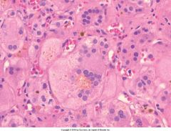
Neonatal Hepatitis
CORE SUBJECT PATHOLOGY
Giant cell transformation of hepatocytes
Lobular disarray
Cholestasis
Ductular reaction and fibrosis

Slide 23
Cholangitis
CORE SUBJECT PATHOLOGY
Primary biliary cholangitis
Primary sclerosing cholangitis
Autoimmune Cholangiopathies

Slide 24
Primary Biliary Cirrhosis-PBC
VERTICAL INTEGRATION MEDICINE
Chronic, progressive, sometimes fatal disease.
Characterized by inflammatory destruction of small and medium-sized intrahepatic bile ducts.
Development of cirrhosis and liver failure over years to decades.

Slide 25
Primary Biliary Cirrhosis
HORIZONTAL INTEGRATION
COMMUNITY MEDICINE
Female 40-50 years
M:F ratio: 1:6
Family members are at an increased risk of developing the disease
Cirrhosis doesn't always develop
Insidious onset
Asymptomatic
May be associated with:
Sjogren syndrome
Scleroderma
Thyroiditis
Rheumatoid arthritis (RA)
Raynaud’s phenomenon
Celiac disease

Slide 26
PBC- Pathogenesis
CORE SUBJECT PATHOLOGY
Immune mediated:
Initiating agent unknown
Anti-mitochondrial antibodies
Aberrant expression of MHC Class II molecules on bile duct epithelial cells
Autoreactive T cells around bile ducts
Frequent presence of other autoantibodies (ANA, ANCA)

Slide 27
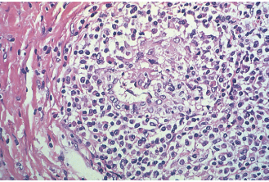
PBC- Morphology
CORE SUBJECT PATHOLOGY
Pre-cirrhotic lesion include:
Active destruction of bile ducts by lymphocytic and plasmacytic inflammation, with or without granulomas (the florid duct lesion).
Bile ductular proliferation and necrosis of adjacent portal parenchyma.
This leads to the development of portal-portal septal fibrosis.

Slide 28
PBC
CORE SUBJECT PATHOLOGY
Two pathways to end-stage liver disease:
Nodular regenerative hyperplasia:
Due to portal hypertension leading to widespread nodularity without surrounding scar tissue.
Early hepatomegaly occurs due to little hepatocyte loss.
Chronic cholestasis:
Periportal/periseptal bile accumulation with feathery degeneration (swollen bile-stained hepatocytes, sometimes with prominent Mallory-Denk bodies), leading to cirrhosis.

Slide 29
Primary Sclerosing Cholangitis
VERTICAL INTEGRATION MEDICINE
Chronic cholestatic disorder:
Characterized by inflammation and obliterative fibrosis of extrahepatic and intrahepatic bile ducts of medium and large sizes.
Cholangiography, performed endoscopically or with MRI, shows beading in the biliary tree because changes in the ducts are patchy.
Commonly associated with IBD, especially ulcerative colitis.

Slide 30
VERTICAL INTEGRATION RADIOLOGY

Slide 31
Primary Sclerosing Cholangitis
HORIZONTAL INTEGRATION
COMMUNITY MEDICINE
3rd-4th decade of life, Male to female ratio: 2:1
Asymptomatic or acute presentation with fever, right upper quadrant tenderness, and acute on set jaundice.
Patients presenting late show progressive fatigue, pruritis
10-15% of PSC cases transform into cholangiocarcinoma in about 5 years.
Most likely immune-mediated injury of bile ducts due to:
Association with ulcerative colitis
T-cell mediated injury
Linkage with certain HLA-B8 and other MHC alleles
Presence of autoantibodies, including antinuclear cytoplasmic antibodies with perinuclear localization.

Slide 32
Primary Sclerosing Cholangitis
CORE SUBJECT PATHOLOGY
Morphology differs in extrahepatic and large bile ducts versus smaller ducts:
Large ducts:
Show chronic inflammation with superimposed acute inflammation.
Edema, inflammation, or subsequent scarring leads to narrowing of duct lumen.
Smaller ducts:
Show circumferential fibrosis known as onion skinning around an atrophic duct lumen.
The lumen eventually disappears, leaving a tombstone scar.

Slide 33
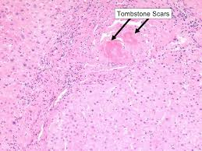
Primary Sclerosing Cholangitis
CORE SUBJECT PATHOLOGY
Smaller ducts:
Show circumferential fibrosis known as onion skinning around an atrophic duct lumen.
The lumen eventually disappears, leaving a tombstone scar.

Slide 34
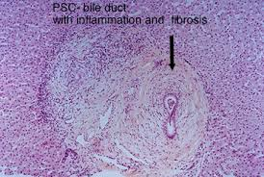
Primary Sclerosing Cholangitis
CORE SUBJECT PATHOLOGY
Diagnosis depends on radiological imaging as the probability of finding such hallmarks on biopsy is very low.
Due to duct loss, there is bile ductular proliferation, portal-portal septal fibrosis, and cirrhosis.
The end-stage liver is cirrhotic with biliary intraepithelial neoplasia.

Slide 35
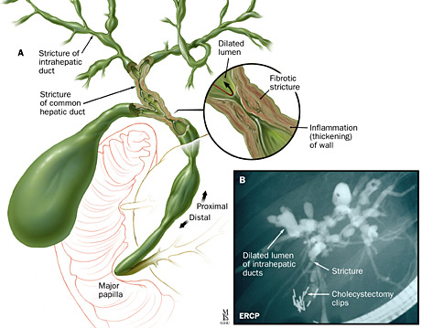
Primary Sclerosing Cholangitis
CORE SUBJECT PATHOLOGY

Slide 36
CORE SUBJECT PATHOLOGY
Parameter | PBC | PSC
Age | Avg 50 yrs (30-70) | Avg 30 yrs
Gender | 90% females | 70% males
Clinical course | Progressive | Unpredictable but progressive
Associated conditions | Sjogren syndrome, scleroderma, thyroid disease | IBD, pancreatitis, idiopathic fibrosing disease
Serology | 95% AMA, 20% ANA, 40% ANCA positive | 0-5%AMA, 6% ANA, 65% ANCA positive
Radiology | Normal | Beading of large bile ducts, pruning of smaller ducts
Duct lesions | Florid duct lesion, loss of small ducts only | Inflammatory destruction of extrahepatic and large intrahepatic ducts, fibrotic obliteration of medium and small intrahepatic ducts
Diagnosis | Antimitochondrial antibodies, liver biopsy | Cholangiography, liver biopsy

Slide 37
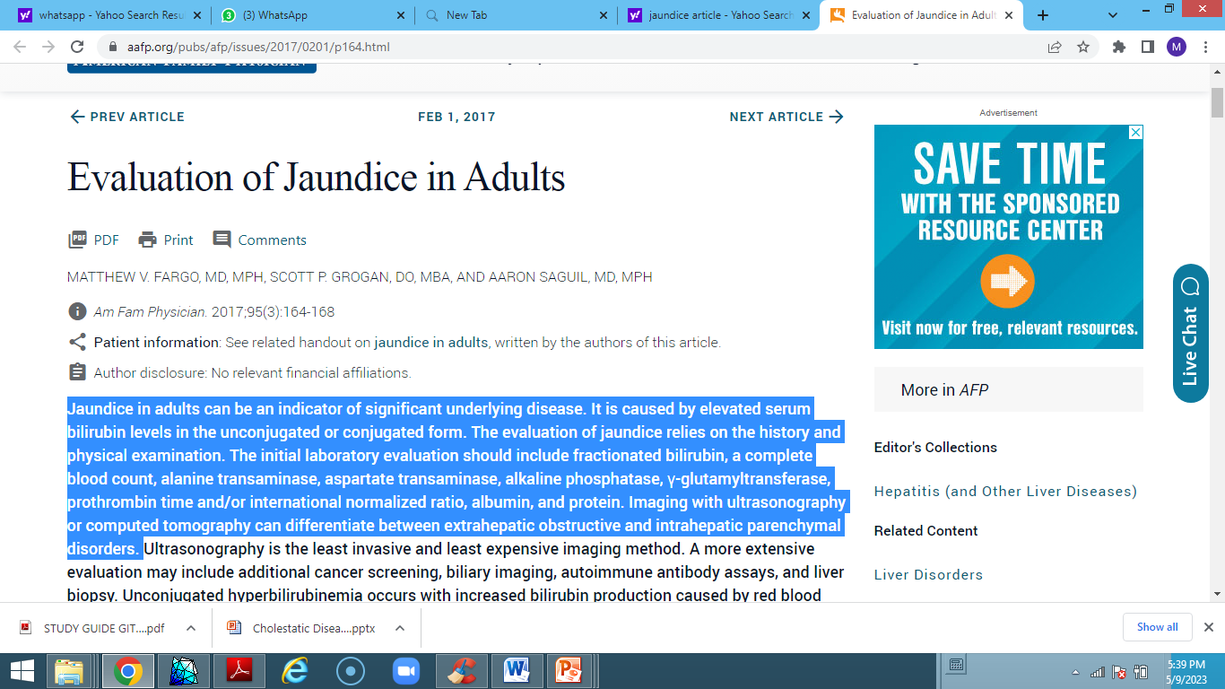
Research
RESEARCH

Slide 38
Biomedical Ethics
ETHICS

Slide 39
Family Medicine
FAMILY MEDICINE
Treatment:
Treatment will depend on the underlying cause of jaundice.
Pruritus (itching) caused by jaundice can be managed with:
Warm baths containing oatmeal.
Antihistamines for mild pruritus.
For moderate to severe pruritus, a healthcare professional may prescribe medications such as cholestyramine or colestipol.
If jaundice indicates liver damage, a liver transplant may be necessary, depending on the severity of the injury.

