Slide 1


Slide 2


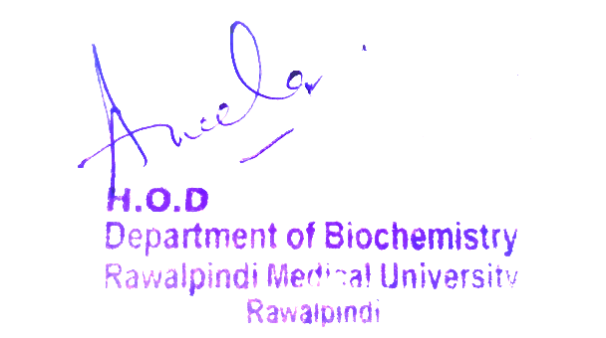
Foundation Module
1st Year MBBS(LGIS)
Large Group Interactive Session (LGIS)
Chemistry of Nucleic Acid I
Presenter: Dr. Uzma Zafar Date: 23-01-25
(Biochemistry Department)

Slide 3
Motto, Vision, Dream
To impart evidence based research oriented medical education
To provide best possible patient care
To inculcate the values of mutual respect and ethical practice of medicine
Wisdom
Truth
Service

Slide 4
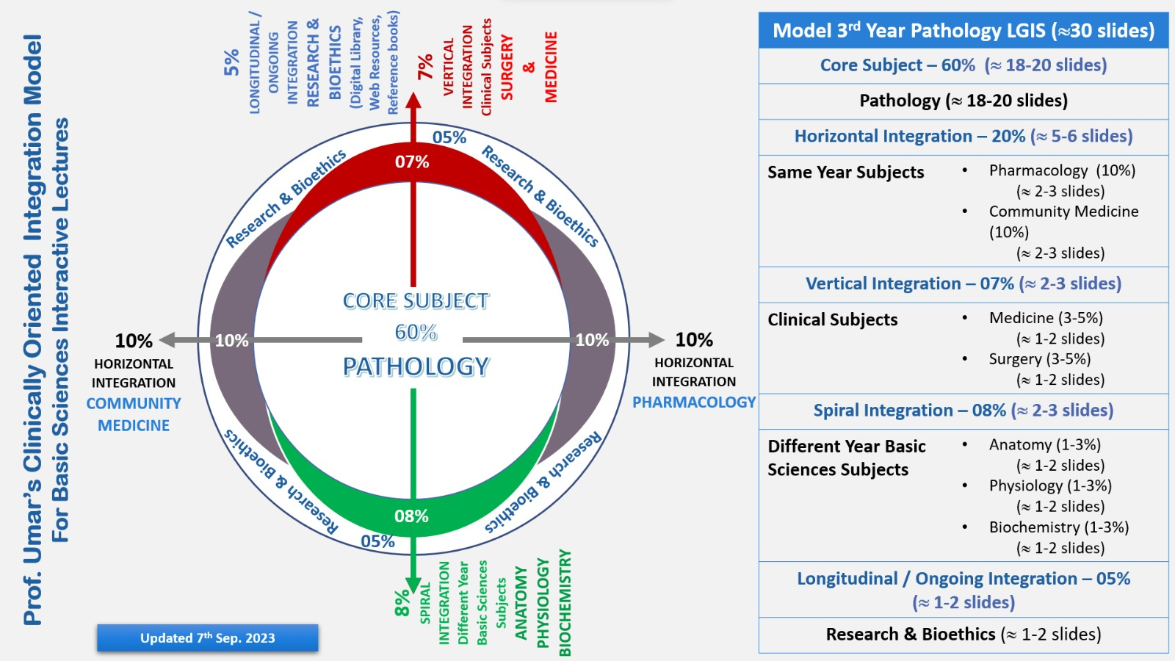
Professor Umar Model of Integrated Lecture

Slide 5
Learning Objectives
At the end of the lecture, students will be able to
Describe types of nucleic acid
Describe components of nucleic acid
Describe structure of DNA
Describe types of DNA

Slide 6
Interactive Session
A 6-month-old infant is brought to the family physician by his parents due to poor feeding, lethargy, developmental delay, and episodic vomiting. The child has a history of failure to thrive and seizure-like episodes. On examination, the infant has hypotonia and signs of metabolic acidosis. Laboratory investigations reveal lactic acidosis, hyperammonemia, and hypoglycemia. Urine organic acid analysis shows elevated lactate, alanine, and ketone bodies. The infant is referred to a biochemical geneticist for confirmatory enzyme assays and genetic testing.

Slide 7
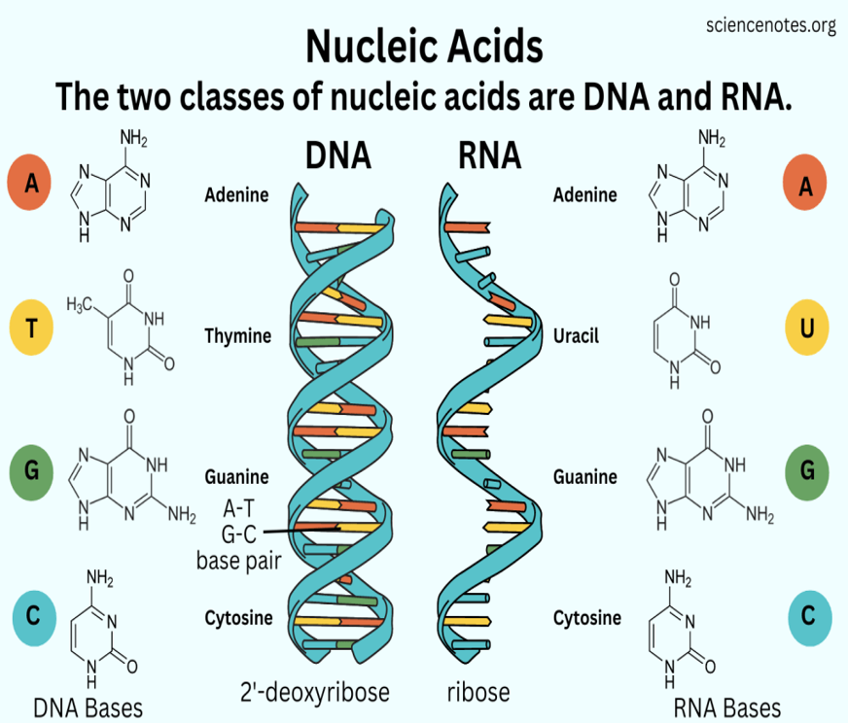

Slide 8
Physiology of Nucleic Acids
Nucleic acids, deoxyribonucleic acid (DNA) and ribonucleic acid (RNA), carry genetic information which is read in cells to make the RNA and proteins by which living things function. The well-known structure of the DNA double helix allows this information to be copied and passed on to the next generation.

Slide 9
Nucleic Acids
Nucleic acids were first discovered in
Nucleic of pus cells 1868 Friedrich
Sperm heads 1872 Miescher
They can reproduce
They can under go mutations

Slide 10
Biomedical Importance
They are carriers of genetic information
DNA- almost all organisms
RNA- viruses e.g. Tobacco mosaic virus
Influenza virus
2. Mutations are primarily changes in the structure of DNA.
They are important in evolution of new varieties and species.
Many mutations are harmful and produce diseases.

Slide 11
All viruses are nucleoproteins and contain DNA or RNA as genetic material.
DNA – Bacterial and Animal viruses
Vaccinia virus
Herpes simplex virus
RNA – All plant viruses
Bacterial and animal viruses Poliomyelitis
Influenza
Human immunodeficiency syndrome
virus (HIV) (AIDs)

Slide 12
Nucleic acids direct the synthesis of proteins including enzymes.
Single gene controls the synthesis of single poly peptide chain
5. Cancer research involves an extensive study of nucleic acids.
6. Disease like Gout and Orotic- aciduria are inborn errors of Purine and Pyramidine metabolism respectively.

Slide 13
7.. By advanced techniques called Genetic engineering and DNA recombinant technology genes can be synthesized and incorporated into the genome of selected host cells, which starts producing specific proteins under direction of the newly incorporated genes

Slide 14
Defective genes are localized in DNA before birth by studies on fetal cells which are obtained from amniotic fluid.
9. Genomic libraries have been prepared - DNA finger printing (Blood, Seminal fluid)
10. Gene therapy for genetic disorders.

Slide 15
Nitrogenous bases
1.Purines
Adenine A
Guanine G
2. Pyrimidines
(i) Cytosine C
(ii) Uracil U
(iii) Thymine T

Slide 16
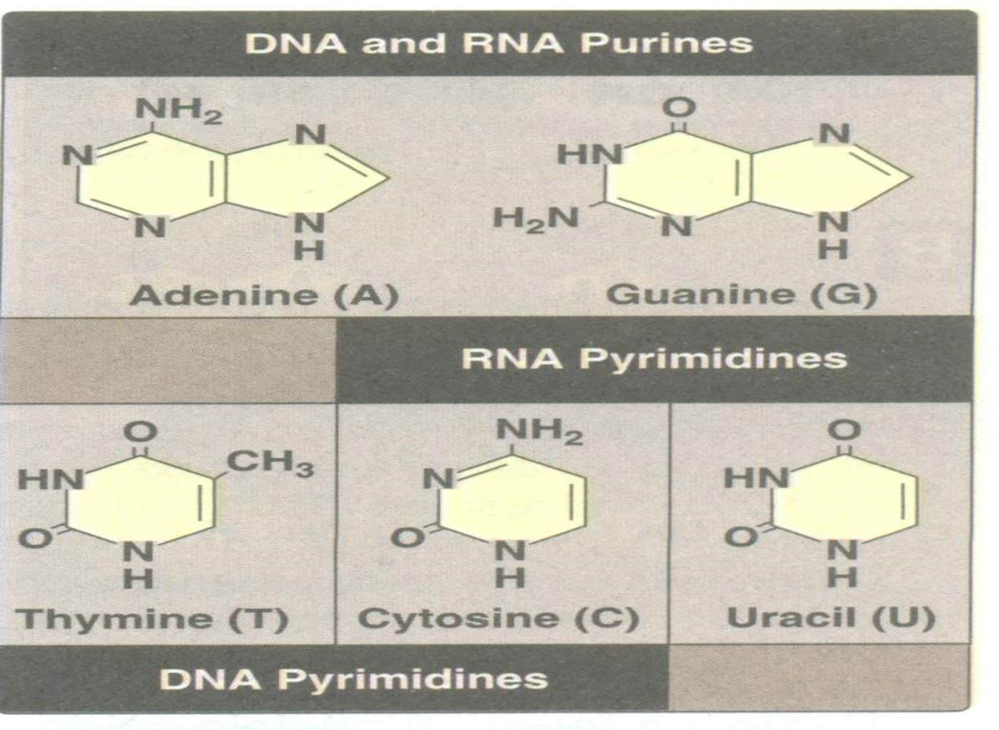

Slide 17
Sugar
Ribose
Deoxy ribose

Slide 18
Nucleoside
Combination of nitrogenous base with a sugar is known as Nucleoside
Ribonucleoside ------ Ribose
Deoxyribonucleoside ---------Deoxyribose

Slide 19
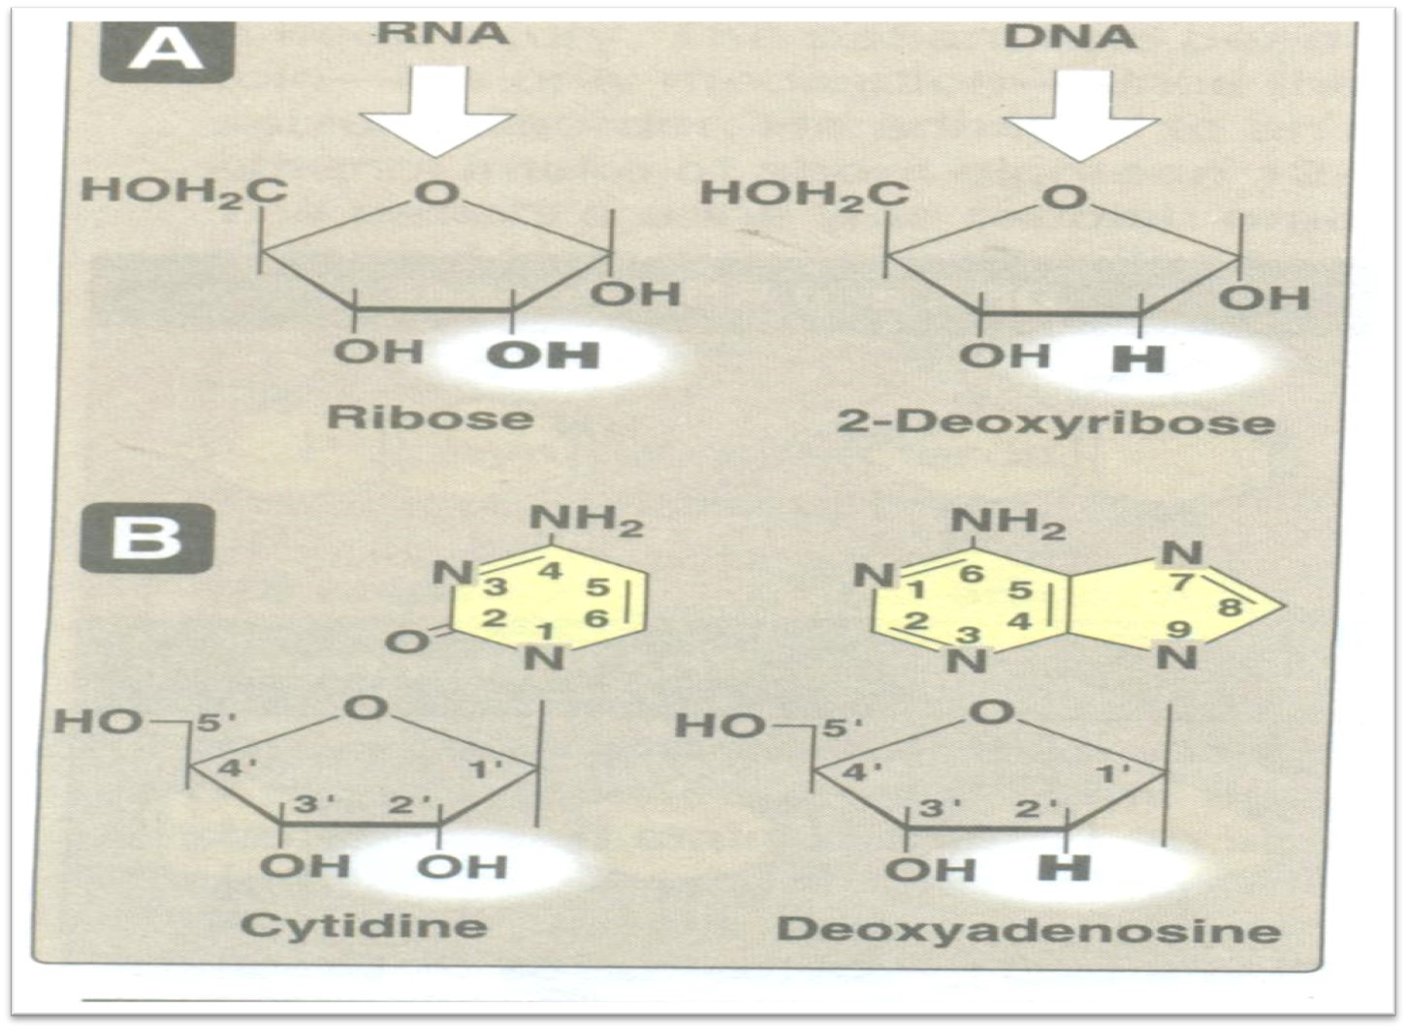

Slide 20
Adenine, Guanine and Cytosine can combine with ribose as well as deoxyribose
Uracil only combines with ribose
3. Thymine only combines with deoxyribose

Slide 21
DNA-Deoxyribo Nucleic Acid
It is a Polynucleotide having a thread like structure
Contains the genetic information that gives rise to chemical and physical properties of living organisms
DNA is responsible for Heredity-----1944

Slide 22
The size of DNA molecule show great variations
Size Base pairs
Simian virus-40 1.7µm 5243
E.coli 1.7mm 4639221
Human 2 m 3.2x10⁹

Slide 23
Shape of DNA molecule
It is present in form of a Double helix –
Watson and Crick 1953
Also known as coil of life
It is a spiral stair case wound around a cylindrical axis
The bases are on inside of the helix and deoxy ribose and phosphates on the out side

Slide 24
2 strands of DNA are wound on each other to form a double helix
The bases are separated by 0.34 nm
Each base is rotated 36º in relation to the previous base.
The helical structure repeats at intervals of 3.4 nm and there are 10 base pairs in each completed helix.
The helix is 2 nm in diameter.

Slide 25
Grooves
The molecule shows a minor and a major groove
These grooves wind along the DNA molecule parallel to the phospho diester backbones
These grooves serve to accommodate proteins which bind with specific nucleotide sequences without disturbing the basic pairing of the double helical DNA molecule
These proteins are concerned with expression of specific genes
The bases are inclined 20º from horizontal plane

Slide 26
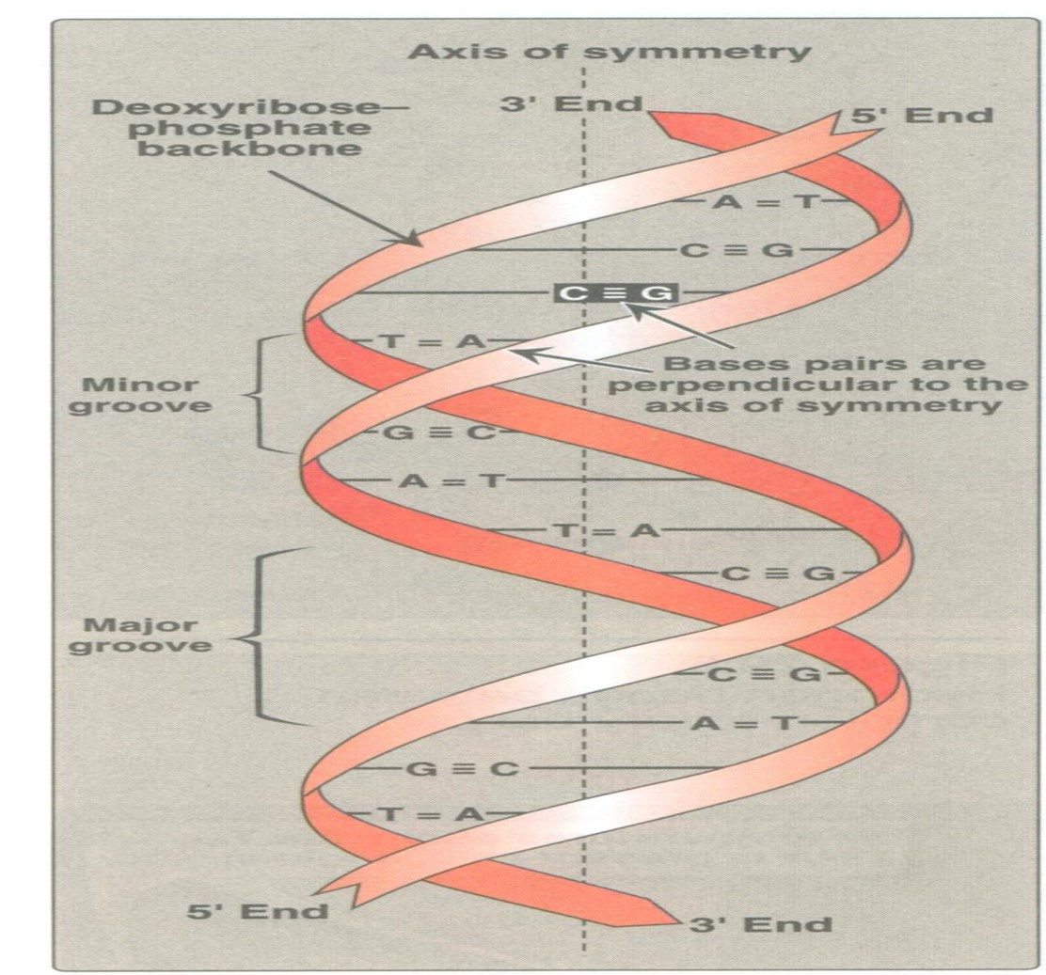

Slide 27
The two strands of DNA are anti parallel to each other.
Two strands are joined to each other by H-bonds which are formed between nitrogenous bases.
Sequence of bases represents Primary structure of DNA.
Helical structure is called Secondary structure of DNA.
The nitrogenous bases are on the inside of helix and deoxy ribose PO₄ on the outside

Slide 28
The chromosomal DNA may be linear or circular but the molecule do not exist in an extended form in either case.
Both rod and circle portions are twisted forming super circles or super coils or coiled coils.
The super coiling of DNA is an intrinsic property of DNA - Tertiary structure.
The super coiling enables a several thousand fold condensation of the DNA in a chromosome or the head of a virus.

Slide 29
The DNA molecule can be visualized as a staircase
The steps of which are made up of complementary bases and sides are made up of phospho diester backbone .
The sequence of bases which are attached to sugar phosphate backbone determines the information content of the DNA.

Slide 30
Family Medicine
Family Medicine plays important role in
diagnosis of diseases related to genetic disorder
in following manner:
1.It helps in diagnosis and treatment of wide range of diseases
2.It helps to promote preventive care and well being

Slide 31
Artificial Intelligence
Artificial Intelligence can be useful in following ways:
1.AI algorithms can analyze large amount of data
2.Identify patterns and mutations using machine learning techniques
3.For example AI can analyze DNA sequencing data to identify genetic variations that contribute to cancer development

Slide 32
Biomedical Ethics
Biomedical Ethics plays a crucial role in field of nucleic acid chemistry it involves:
Addressing ethical considerations and dilemmas that arise from the use of nucleic acid
Safeguard the sensitive data is essential to protect individuals from discrimination or stigmatization

Slide 33
Suggested Research Article
Link:annualreviews.org
Journal Name:Annual Review of Biochemistry
Title:In Vitro Selection Of Functional Nucleic Acids
Author Name:David S.Wilson and Jack W.Szostak
Latest Research Article
Abstract:
Invitro selection allows rare functional RNA or DNA molecules to be isolated from pools of over 1015 different sequences. This approach has been used to identify RNA and DNA ligands for numerous small molecules, and recent three-dimensional structure solutions have revealed the basis for ligand recognition in several cases. By selecting high-affinity and -specificity nucleic acid ligands for proteins, promising new therapeutic and diagnostic reagents have been identified. Selection experiments have also been carried out to identify ribozymes that catalyze a variety of chemical transformations, including RNA cleavage, ligation, and synthesis, as well as alkylation and acyl-transfer reactions and N-glycosidic and peptide bond formation. The existence of such RNA enzymes supports the notion that ribozymes could have directed a primitive metabolism before the evolution of protein synthesis. New in vitro protein selection techniques should allow for a direct comparison of the frequency of ligand binding and catalytic structures in pools of random sequence polynucleotides versus polypeptides.

Slide 34
How To Access Digital Library
Steps to Access HEC Digital Library
Go to the website of HEC National Digital Library.
On Home Page, click on the INSTITUTES.
A page will appear showing the universities from Public and Private Sector and other Institutes which have access to HEC National Digital Library HNDL.
Select your desired Institute.
A page will appear showing the resources of the institution
6. Journals and Researches will appear
7. You can find a Journal by clicking on JOURNALS AND DATABASE and enter a keyword to search for your desired journal.

Slide 35
Learning Resources
Lippincott , Biochemistry (Eight Edition)
Chapter 30, pg#459
Google scholar
Google images

Slide 36
THANK YOU

