Slide 1
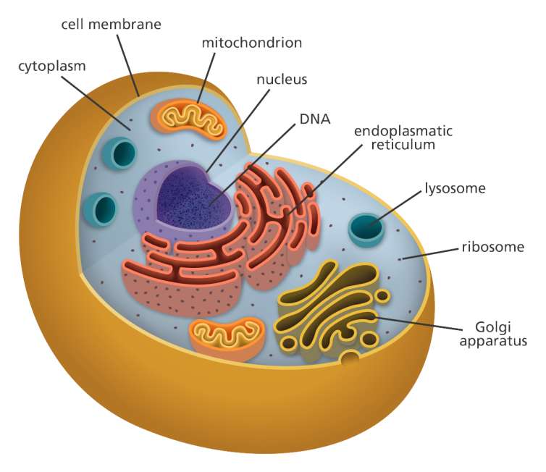
Foundation Module 1st year MBBS(SGD) Cells and Tissues
Presenter: Dr. Ali Raza Date: 22.2.2025
(Senior Demonstrator)

Slide 2
Motto, Vision, Dream
To impart evidence based research oriented medical education
To provide best possible patient care
To inculcate the values of mutual respect and ethical practice of medicine
Wisdom
Truth
Service

Slide 3
Professor Umar Model of Integrated Lecture

Slide 4
Learning Objectives
Define cell.
Define tissue.
Describe the basic tissues of the human body.
Practice principles of bioethics.
Apply the strategic use of artificial intelligence in healthcare.
Understand the curative and preventive healthcare services.
Read a relevant research article.
Use the digital library.

Slide 5
Core Concept
No of Slides - 22

Slide 6
Cell
A cell is the basic structural and functional unit of life.
It is the smallest unit of an organism that is capable of performing all the functions necessary for life, including metabolism, growth, and reproduction.
Cells contain various organelles, each with specific functions, and are organized into tissues, organs, and systems to carry out complex biological processes.
Understanding the structure and function of cells is fundamental to comprehending the anatomy, physiology, and pathology of living organisms, including humans.

Slide 8
Components of Cell
Cell membrane/plasma membrane
Cytoplasm
Nucleus
Cytoplasmic organelles
Mitochondria
Endoplasmic reticulum
Ribosomes
Golgi apparatus
Lysosomes
Centrioles

Slide 9
Cell Membrane
Two layers of phospholipids with protein molecules embedded in it (fluid mosaic model)
2 main types of proteins
Transmembrane proteins -- run through the entire thickness
Surface membrane proteins -- penetrate partly
The outer surface is covered by a layer of glycoprotein - glycocalyx ( the tissue antigens as major histocompatibility antigens )

Slide 10
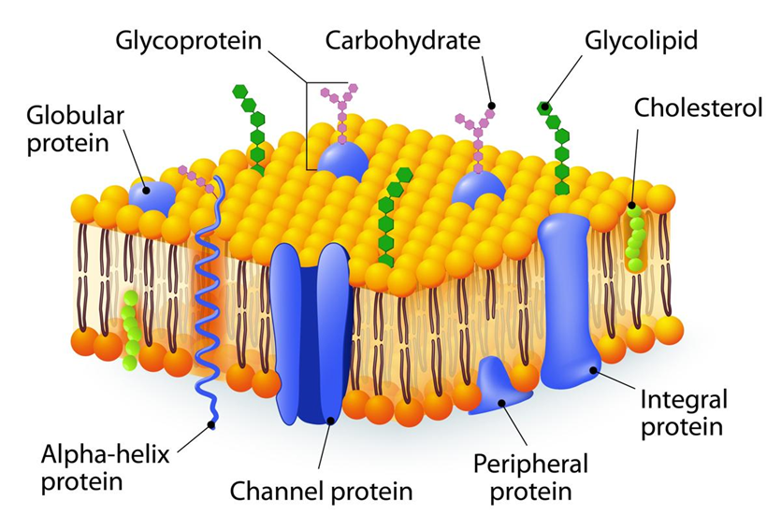

Slide 11
Functions of Cell Membrane
Provides Immunological identity
Receptors for hormones and chemical stimuli
Mechanical Structure.
Selective Permeability
Transportation across the membrane.
Bulk Transport: Exocytosis & Endocytosis
Active transport
Metabolic Activities

Slide 12
Nucleus
Large, spheroid body
It is surrounded by the same but more permeable membrane
Nucleoplasm ( material within the nucleus) Contains genetic material
Deoxyribonucleic acid & histone proteins.
DNA + HISTONES – form a network of thread “chromatin”

Slide 13
Cytoplasmic Organelles
Mitochondria
Power house of the cells
Aerobic respiration and atp breakdown to provide free energy
More mitochondria at more metabolically active sites as liver cells and muscle cells
Ribosomes
Tiny electron-dense granules (appearing dark)
Composed of RNA and 80 different proteins
Synthetizes proteins

Slide 14
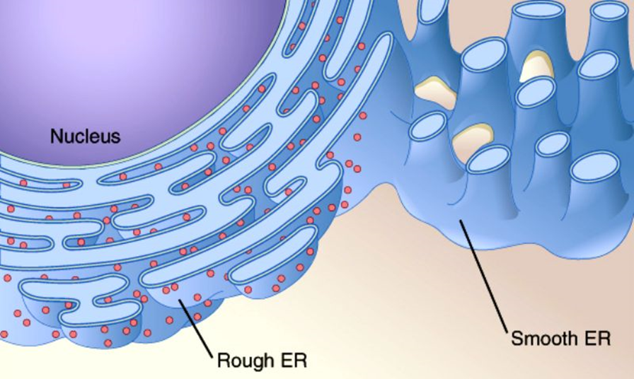
Cont.
Endoplasmic Reticulum
Series of inter-connecting membranous canals
2 types 1. rough 2. smooth
SER –Synthesis of phospholipids, glycogen, and steroid hormones
Detoxification of drugs like alcohol and barbiturates

Slide 15
Cont.
RER – studded with ribosomes
Synthesis of hormones & enzymes
Pancreatic Acinar Cells
Fibroblasts
Plasma Cells

Slide 16
Cont.
Golgi Apparatus
Stacks of closely folded flattened membranous sacs
Site for protein processing & packaging
Proteins from rer ->golgi apparatus -> secretory granules (small membrane-bound vesicles)
Lysosomes
Membrane-bound vesicles having hydrolytic enzymes for intra-cytoplasmic digestion
More in cells with phagocytic activity like macrophages and leukocytes

Slide 17
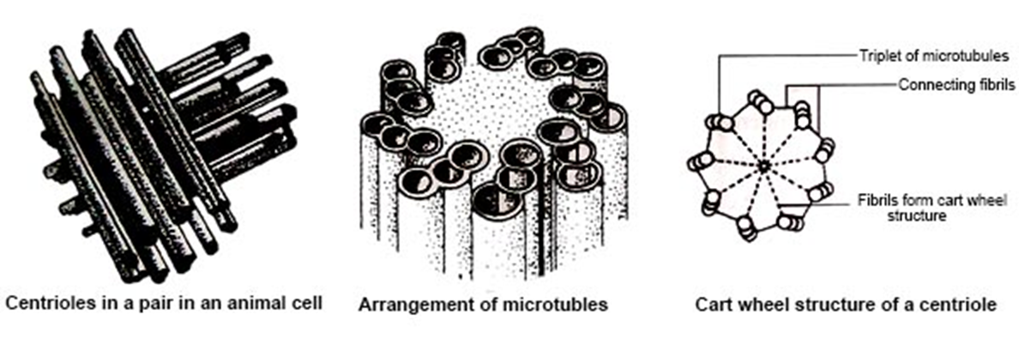
Cont.
Centrioles
Cells contain 2 centrioles in the dense region called the centrosome
2 cylindrical bodies, placed at right angles to each other
27 microtubules arranged in nine bundles

Slide 18
Types of Cells
1. Somatic cells
For growth, development, regeneration and maintenance
46 in no. Arranged in 23 pairs (diploid) One set is derived from the mother and the other from the father.
Twenty-two (22) pairs look alike (homologous) 23rd pair is the sex chromosome. (Females XX, Males XY)
2. Germ cells
Essential for the production of gametes.
Gametes contain 23 chromosomes i.e a single set of chromosomes (haploid)
Functions of cell
Cell division, growth, differentiation, maturation, and programmed cell death (apoptosis).

Slide 19
Types of Cells
Blood cells
Stem cells
Neurons (Nerve cells)
Epithelial cells

Slide 20
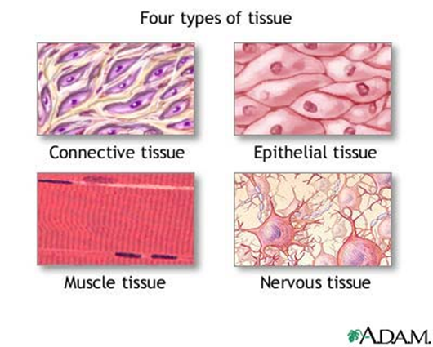
Tissues
Collection of cells irrespective of common morphological and functional characteristics
4 types
Epithelial tissue
Connective tissue
Muscle tissue
Nervous tissue

Slide 21
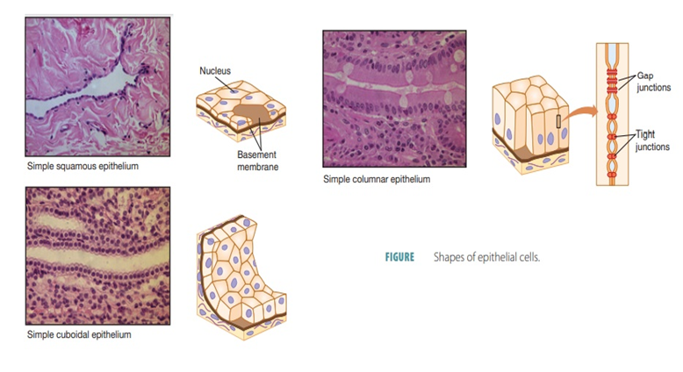
Epithelial Tissue
Scanty absent intercellular material
Covers /lines the cavities and glands

Slide 22
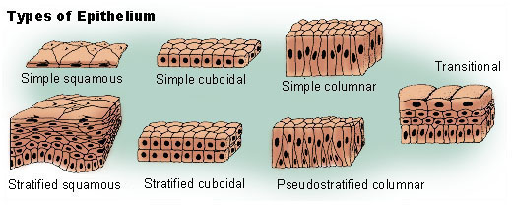

Slide 23
Connective Tissue
Rich in inter cellular material
connects / binds cells
Types
Dense irregular
Dense regular
Loose connective tissue

Slide 24
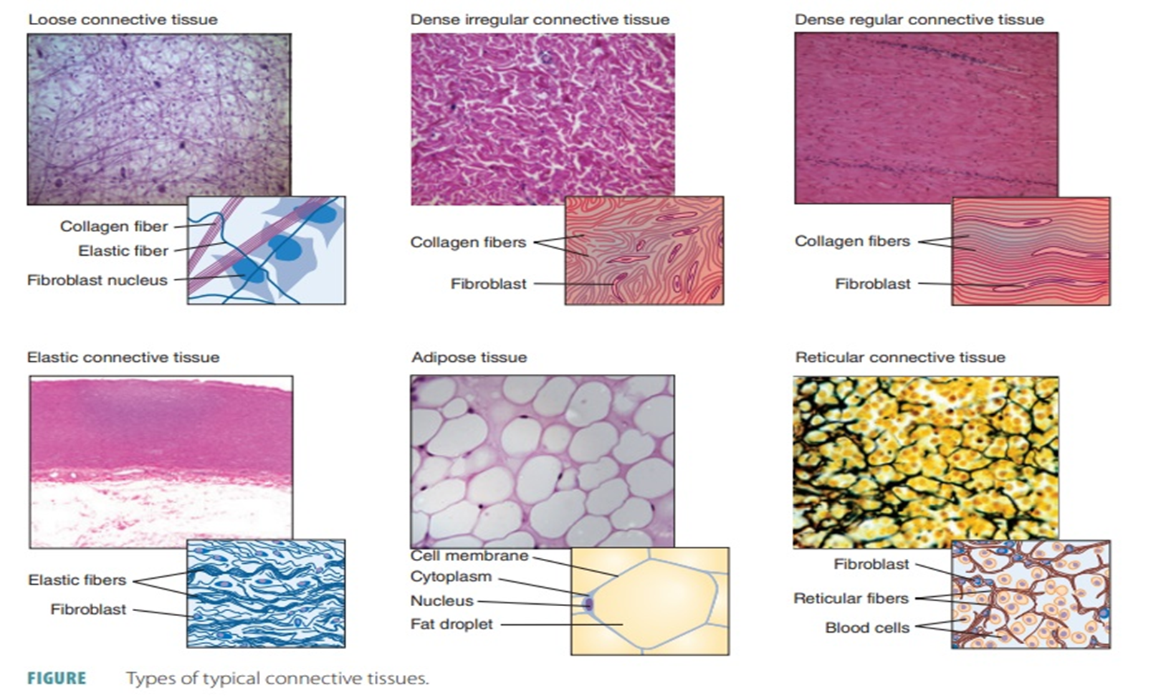

Slide 25
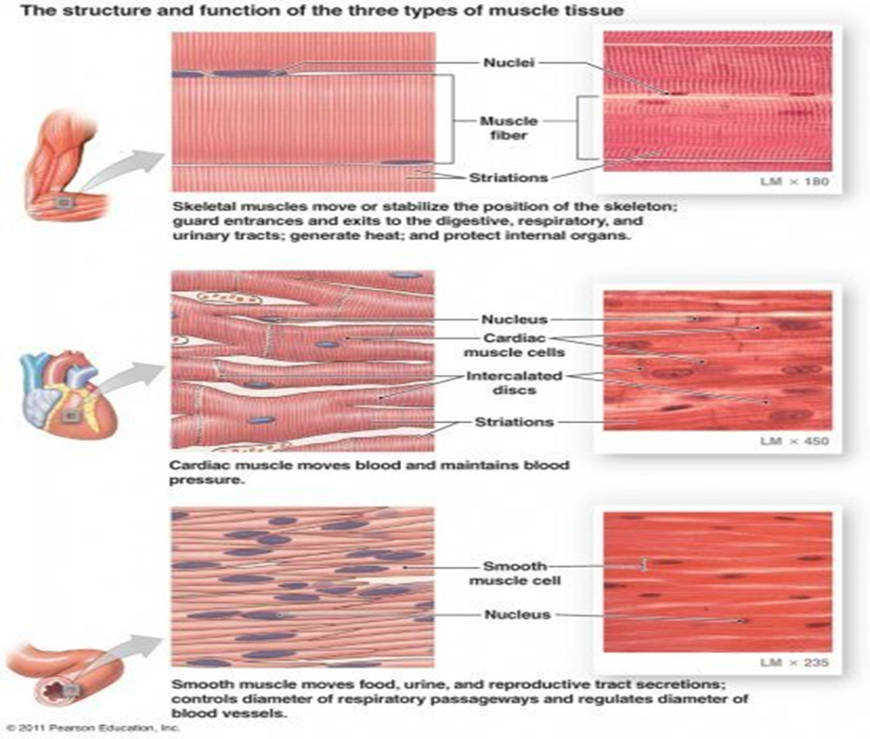
Muscular Tissue
Elongated cells
Contractile, elastic

Slide 26
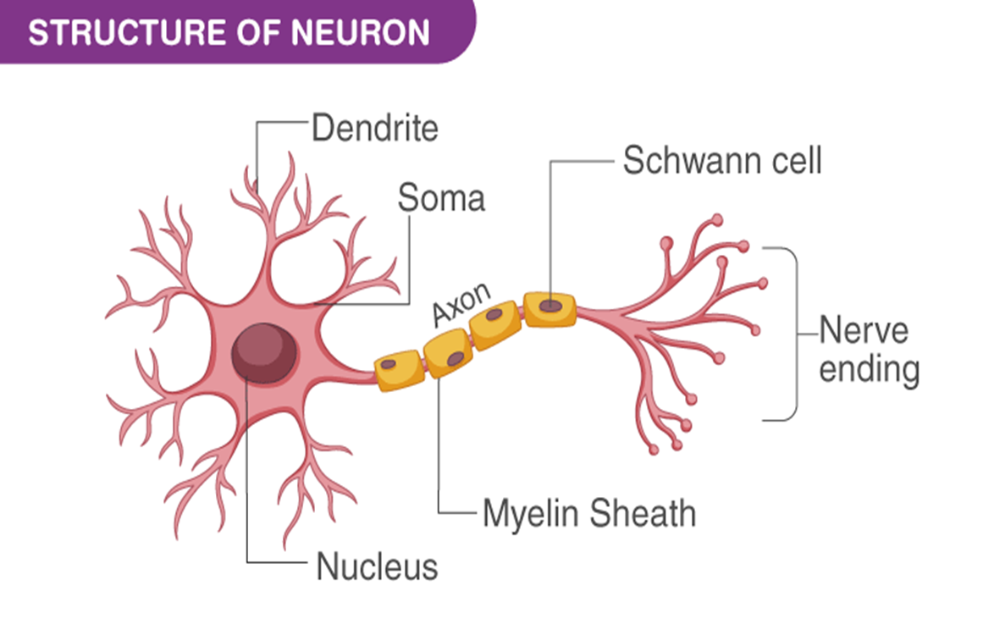
Nervous Tissue
Elongated processes axons
Reception, integration transformation, and transmission

Slide 27
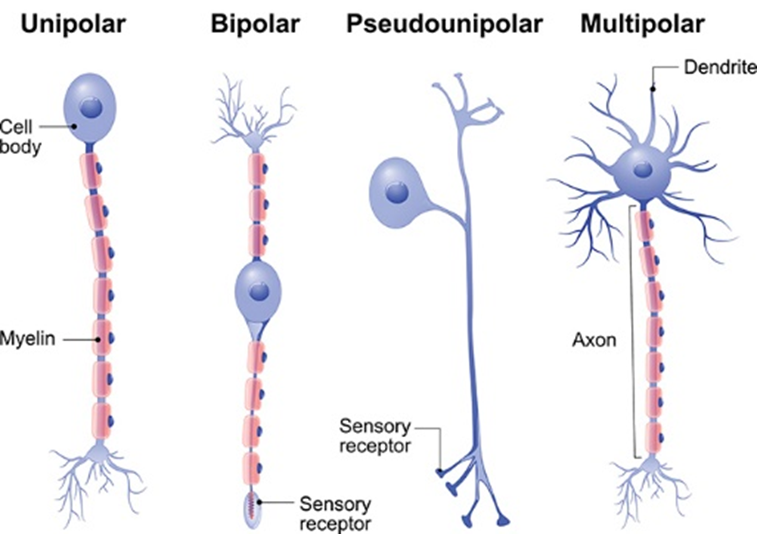

Slide 28
Horizontal Integration

Slide 29
Functions of Human Cell
A cell performs major functions essential for the growth and development of the human body. Important functions of human cells are as follows:
Provides Support and Structure
Facilitate Growth Mitosis
Allows Transport of Substances
Energy Production
Aids in Reproduction

Slide 30
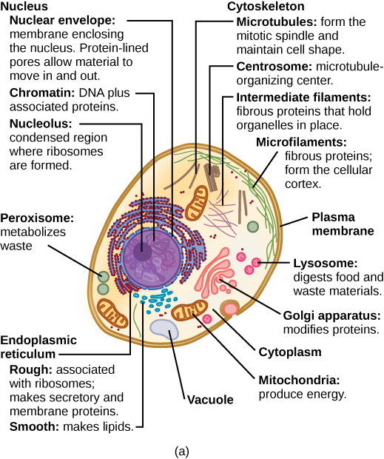

Slide 31
Vertical Integration

Slide 32
Diseases Related to Human Cells
Cancer: A group of diseases characterized by the uncontrolled growth and spread of abnormal cells.
Leukemia: A type of cancer that affects the blood-forming tissues, such as the bone marrow and lymphatic system, resulting in the overproduction of abnormal white blood cells.
Sickle cell disease: A genetic disorder that affects red blood cells, causing them to become rigid and sickle-shaped, leading to various complications including pain, anemia, and organ damage.
Alzheimer's disease: A neurodegenerative disorder characterized by the progressive loss of brain cells, leading to memory loss, cognitive decline, and changes in behavior.

Slide 33
Cont.
Parkinson's disease: A progressive neurological disorder caused by the degeneration of dopamine-producing cells in the brain, resulting in movement difficulties, tremors, and other symptoms.
Cystic fibrosis: A genetic disorder that affects the cells lining the respiratory and digestive systems, leading to the production of thick, sticky mucus that can clog the airways and obstruct the pancreas.
Diabetes mellitus: A metabolic disorder characterized by high blood sugar levels due to inadequate insulin production or insulin resistance, affecting cells' ability to utilize glucose for energy.

Slide 34
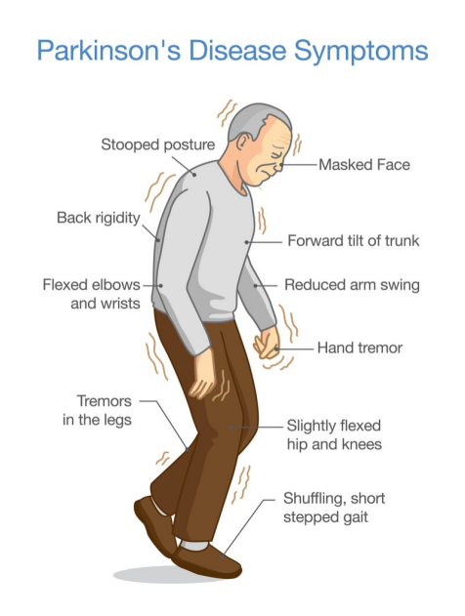

Slide 35
Spiral Integration

Slide 36
Biomedical Ethics

Slide 37
Family Medicine

Slide 38
Artificial Intelligence
Image Analysis
Pattern Recognition
Disease Prediction and Risk Assessment
Drug Discovery and Development
Personalized Medicine
Virtual Health Assistants and Chatbots

Slide 39
Research Article
Topic: The Human Cell Count and Size Distribution
Authors: Ian A. Hatton, Eric D. Galbraith, et al.
Date: July 24, 2023
https://www.pnas.org/doi/10.1073/pnas.2303077120

Slide 40
Assessment
Q: Lysosomes are known as “suicidal bags” because
Parasitic activity
Presence of food vacuole
Hydrolytic activity
Catalytic activity
Q: Collagen is
carbohydrate
lipid
fibrous protein
globular protein
Q: The tip of the nose and external ears have
areolar tissue
ligament
cartilage
Bone
Q : Adipocytes are
fat storage cells
carbohydrate storage cells
hydrolytic cells
protein storage cells

Slide 41
Key
Q: Lysosomes are known as “suicidal bags” because
Parasitic activity
Presence of food vacuole
Hydrolytic activity
Catalytic activity
Q: Collagen is
carbohydrate
lipid
fibrous protein
globular protein
Q: The tip of the nose and external ears have
areolar tissue
ligament
cartilage
Bone
Q: Adipocytes are
fat storage cells
carbohydrate storage cells
hydrolytic cells
protein storage cells

Slide 42
Learning Resources
1.Clinically Oriented Anatomy by Keith Moore 9th edition.
2.Cunningham’s Manual of Practical Anatomy by G.J. Romanes, 16th edition, Vol-I, II and III
3. http://www.anatomyzone.com 3D anatomy
https://teachmeanatomy.info

Slide 43
Use of Digital Library
1. Go to the website of HEC National Digital Library.
2. On the Home Page, click on the INSTITUTES.
3. A page will appear showing the universities from the Public and Private Sector and other Institutes that have access to HEC National Digital Library HNDL.
4. Select your desired Institute.
5. A page will appear showing the resources of the institution
6. Journals and Research will appear
7. You can find a Journal by clicking on JOURNALS AND DATABASE and entering a keyword to search for your desired journal.

Slide 44
Thank You!

