Slide 2
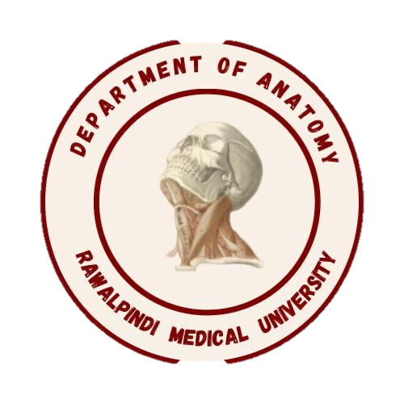
CVS Module 1st Year MBBS(SGD)Heteropolysaccharide
Presenter: Dr Uzma Zafar Date: 01-02-25
Dept of Biochemistry
RMU

Slide 3
Motto, Vision, Dream
To impart evidence based research oriented medical education
To provide best possible patient care
To inculcate the values of mutual respect and ethical practice of medicine
Wisdom
Truth
Service

Slide 4
Professor Umar Model of Integrated Lecture

Slide 5
Learning Objectives
At the end of this session students should be able to
Define and classify Polysaccharides along with their biomedical importance
Explain Structure and chemical properties of biologically important heteropolysaccharides. Definition and classification of polysaccharides
Structure and chemical properties of biologically important homo- and heteropolysaccharides
Biomedical importance of homo and heteropolysaccharides

Slide 6
Heteropolysaccharides
Heteropolysaccharides are polymers composed of two or more than two sugar monomers linked by glycosidic bond.
HETEROPOLYSACCHARIDES
GAGs Gluco-conjugates Mucilages
Heparin * proteoglycans *Agar
Hyaluronic acid *glycoproteins *Vegetable gums
Keratan sulphate * Pectins
Dermatan sulphate
Heparan sulphate
Chondroitin sulphate
*hyaluronic acid is non sulfated
CORE CONCEPT

Slide 7
Structure OF GAGs
Repeating disaccharide units consist of amino sugar and acid sugar.
Acid Sugar: Uronic acid(D-glucuronic
acid and its C-5 epimer,
Iduronic acid)
Amino Sugar: N-acetylglucosamine
N-acetylgalactosamine
CORE CONCEPT

Slide 8
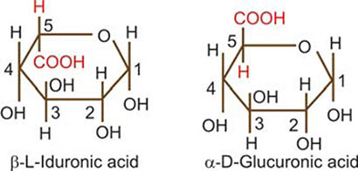
Structure OF GAGs
CORE CONCEPT

Slide 9
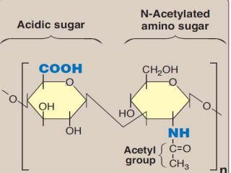
Structure OF GAGs
STRUCTURE OF GAGs
CORE CONCEPT

Slide 10
CORE CONCEPT

Slide 11
CHONDROITIN SULPHATE
Widely distributed in bone , cartilage and tendon
In cartilage it binds collagen and hold fibers in a tight strong network.
Role in compressibility of cartilage in weight bearing along with hyaluronic acid
Uses in the treatment of osteoarthritis.
2 types of chondroitin sulphate
Sulfated at C4 or C6
CORE CONCEPT

Slide 12
CORE CONCEPT

Slide 13
DERMATAN SULPHATE
Present in skin, blood vessel and heart valves
They not only are important structural substances but also bind to a variety of cytokines, growth factors, cell surface receptors, adhesion molecules, enzymes
Dermatan sulfate is thought to be involved in wound repair, regulation of blood coagulation and the response to infection
CORE CONCEPT

Slide 14
CORE CONCEPT

Slide 15
HYALURONIC ACID
Non-sulfated, non covalently attached to protein
Present in animal tissues as well as in bacteria
Found in synovial fluid joints, vitreous humor of the eye, umbilical cords, loose connective tissues and cartilage
CORE CONCEPT

Slide 16
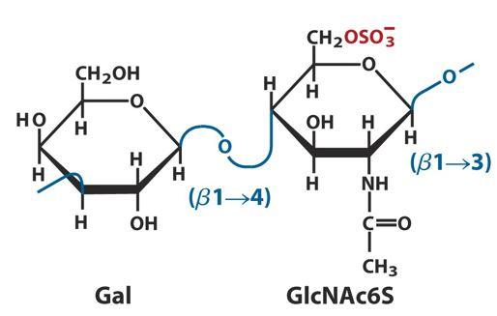
KERATAN SULPHATE
CORE CONCEPT

Slide 17
KERATAN SULFATES
Disaccharide unit
N-acetylglucoseamines with sulfate attach to the 6 position and galactose
KS I present in cornea
KS II present in connective tissue along with the chondroitin sulfate attached to hyaluronic acid
CORE CONCEPT

Slide 18
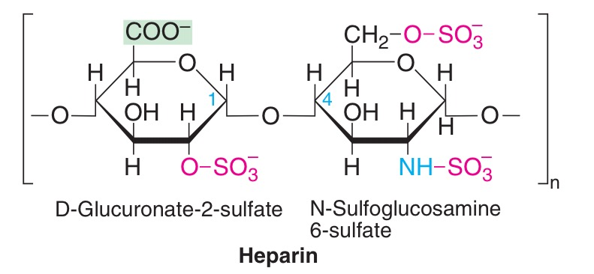
HEPARIN
CORE CONCEPT

Slide 19
HEPARIN
Intracellular GAG
Glucosamine and glucuronic acid or L-iduronic acid
Most of amino group are of GluN are N-sulfated but few are acetylated
90% IdUA present
Proteoglycan consists exclusively of serine and glycine.
Present in mast cell, liver, lung and skin
Serve as anti-cogulant
CORE CONCEPT

Slide 20
HEPARAN SULFATE
Same as heparin except some glucosamines are acetylated and there are few sulfate groups
Predominent uronic acid is GlUA
Extracellular GAG, found in basement membrane
Act as filtration barrier, repel negatively charge
Present on many cell surface (cell to cell interaction, regulate cell signaling)
CORE CONCEPT

Slide 21
PROTEOGLYCANS
Proteoglycans are proteins that covalently bound to GAG’s called core protein except hyaluronic acid.
The amount of carbohydrates(95%) in proteoglycan is much greater than is found in glycoprotein.
There are 30 proteoglycan present on cell membrane or in extracellular matrix.
CORE CONCEPT

Slide 22
FUNCTIONS OF PROTEOGLYCANS
Found in every tissue of body specially in the ECM or ground substance.
Proteoglycans criss-crossed by collagen and elastin giving strength to the ECM.
They act as tissues organizers.
They are the major component of cartilage.
Role in cell migration.
Act as anticoagulant.
Maintain the shape of eye and corneal
transparency.
CORE CONCEPT

Slide 23
Core Knowledge

Slide 24
Core Knowledge

Slide 25
Core Knowledge

Slide 26
Core Knowledge

Slide 27
Core Knowledge

Slide 28
Core Knowledge

Slide 29
Core Knowledge

Slide 30
Core Knowledge

Slide 31
Core Knowledge

Slide 32
Core
Knowledge

Slide 33
Core
Knowledge

Slide 34
Core Knowledge

Slide 35
Core Knowledge

Slide 36
Horizontal Integration

Slide 37
Vertical Integration
Clinical Correlates

Slide 38
Biochemical changes
Notes:
Thickening of the superficial layer of the epithelium due to increased keratinization.
Destruction or atrophy of the finger-like projections on the dorsal surface of the tongue.
Increased proliferation of epithelial cells in response to the inflammatory process.
Invasion of fungal elements, such as hyphae and spores, within the superficial layers of the epithelium.

Slide 39
Spiral Integration
Family Medicine
Management of (Make Changes)
Lifestyle: Maintain a low-salt diet, manage weight and abstain from alcohol.
Medications: Diuretics for ascites, beta-blockers for variceal bleeding, lactulose for hepatic encephalopathy.
Surveillance: Regular screening for varices, liver function, and hepatocellular carcinoma.
Complications: Manage ascites (paracentesis), SBP (antibiotics), and consider liver transplant.
Patient Education: Inform about complication signs and the importance of adherence to treatment.

Slide 40
Spiral Integration
Bioethics
Ethical Considerations
From an ethical standpoint, the scenario raises considerations regarding patient autonomy, informed consent, and confidentiality
The physician must ensure that patient fully understands her diagnosis, treatment options, and potential implications
Discuss the necessity of a healthy lifestyle & treatment plan. This requires clear communication and understanding of risks and benefits.
Additionally, the physician must respect patient’s privacy and confidentiality throughout the diagnostic and treatment process

Slide 41
Spiral Integration
Artificial Intelligence
Role of AI in (The Disease) Management
AI can potentially aid in enhancing diagnostic accuracy and efficiency.
AI-powered decision support systems can also help clinicians in selecting appropriate treatment modalities
AI-driven predictive models may help anticipate the risk of complications of the Disease in susceptible populations

Slide 42
Liver cirrhosis: An Overview (Make Changes)
Spiral Integration
Research Article
Nadia Moustafa, Manal Abdul-Hamid Mohamed, Rasha Rashad Ahmed, Rehab Nady
July 2016 Merit Research Journal of Medicine and Medical Sciences 4(7):329-343
Identification and characterization of cell populations contributing to the myofibroblastic pool and production of extracellular matrix (ECM) in liver fibrosis, as well as the increasing knowledge about natural course, many of the intricate cellular and molecular mechanisms underlying liver fibrogenesis and its progression, and contributions of the genetic regulation, inflammatory and immuno-mediators, neuroendocrine factors, and oxidative stress, have provided important data upon which the design of effective and targeted antifibrotic pharmacological strategies, aiming at halting the progression to decompensated cirrhosis or even reversing the liver fibrogenesis, can be based.

Slide 43
How To Access Digital Library
Steps to Access HEC Digital Library
Go to the website of HEC National Digital Library
On Home Page, click on the INSTITUTES
A page will appear showing the universities from Public and Private Sector and other Institutes which have access to HEC National Digital Library HNDL
Select your desired Institute
A page will appear showing the resources of the institution
Journals and Researches will appear
You can find a Journal by clicking on JOURNALS AND DATABASE and enter a keyword to search for your desired journal

Slide 44
Learning Resources
Lippincott Illustrated Reviews 8th Edition, Chap , pages -
Harper’s Illustrated Biochemistry 32nd Edition, Chap , pages –
Google images

Slide 45
THANK YOU

