Slide 2
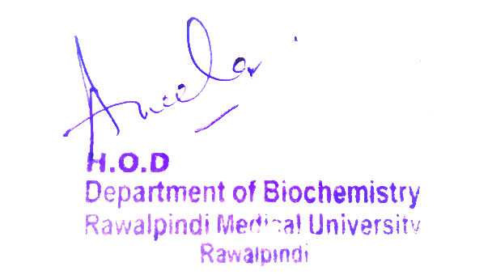
CVS Module 1st Year MBBS(LGIS) Classification of carbohydrates& Lipids
Presenter: Dr Uzma Zafar Date: 01-02-25
Dept of Biochemistry
RMU

Slide 3
Motto, Vision, Dream
To impart evidence based research oriented medical education
To provide best possible patient care
To inculcate the values of mutual respect and ethical practice of medicine
Wisdom
Truth
Service

Slide 4
Professor Umar Model of Integrated Lecture

Slide 5
Learning Objectives
At the end of the session, students will be able to:
Explain classification of carbohydrates.
Discuss classification of Lipids.

Slide 6
Carbohydrates : Definition

Slide 7
Classification of Carbohydrates

Slide 8
Classification of Carbohydrates

Slide 9
Classification of Carbohydrates

Slide 10
Classification of Carbohydrates

Slide 11
Classification of Carbohydrates

Slide 12
Lipids :Definition

Slide 13
Classification of Lipids

Slide 14
Classification of Lipids

Slide 15
Classification of Lipids

Slide 16
Classification of Lipids

Slide 17
Anatomy of Cell Membrane

Slide 18
Physiology of cell Membrane
Selective Permeability
Protection and Support
Transport
Cell Recognition
Endocytosis and Exocytosis

Slide 19
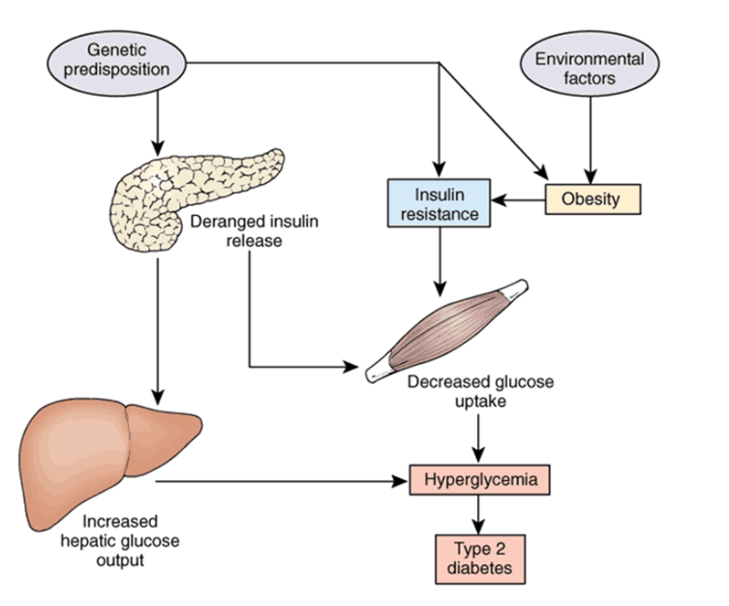
Diabetes Mellitus

Slide 20
Family Medicine
Family Medicine plays important role in following manner:
Diagnosis
Education & Counselling
Dietary Guidance
Monitoring
Refer to Specialists

Slide 21
Spiral Integration
Bioethics
Ethical Considerations
From an ethical standpoint, the scenario raises considerations regarding patient autonomy, informed consent, and confidentiality
The physician must ensure that patient fully understands her diagnosis, treatment options, and potential implications
Discuss the necessity of a healthy lifestyle & treatment plan. This requires clear communication and understanding of risks and benefits.
Additionally, the physician must respect patient’s privacy and confidentiality throughout the diagnostic and treatment process

Slide 22
Spiral Integration
Artificial Intelligence
Role of AI in Management
AI can potentially aid in enhancing diagnostic accuracy and efficiency.
AI-powered decision support systems can also help clinicians in selecting appropriate treatment modalities
AI-driven predictive models may help anticipate the risk of complications of the Disease in susceptible populations

Slide 23
Suggested Research Article
Link: https://www.nature.com/
Journal Name:
Title:
Dietary iron intake predicts all-cause and cardiovascular mortality in patients with diabetes
Author Name: Chenchen Yang,
Tingting
Introduction
Diabetes mellitus is a prevalent global health concern, with approximately 451 million individuals affected in 2017. Projections from the International Diabetes Federation indicate that this number is expected to rise significantly, reaching an estimated 693 million individuals by 2045 [1]. Diabetes has been linked to a heightened risk of both all-cause mortality and cardiovascular mortality [2]. It is of great significance to identify factors to delay the progress of diabetes and reduce mortality.
In this study, we aimed to investigate the relationship between dietary iron intake and all-cause or cause-specific mortality in diabetic individuals.

Slide 24
Assessment
1. A 35-year-old biochemistry student is studying the classification of monosaccharides and encounters a new compound in the lab. The compound has a structure with a five-carbon backbone and contains a ketone group. Based on this information, which of the following classifications correctly describes this monosaccharide?
A) Aldohexose
B) Aldopentose
C) Ketotetrose
D) Ketopentose
E) Aldoheptose
2.A researcher is analyzing a polysaccharide isolated from the cell walls of a plant. The polysaccharide is known to consist of repeating units of galactose, glucose, and xylose, linked together in a complex branched structure. Based on this information, which of the following classifications most accurately describes this heterosaccharide?
A) Homopolymer of glucose
B) Heteropolysaccharide with a backbone of glucose
C) Homopolymer of galactose
D) Heteropolysaccharide with a backbone of galactose
E) Heteropolysaccharide with a backbone of xylose

Slide 25
Assessment
3.A biochemist is studying a lipid that is found to be a major component of cell membranes in a marine organism. The lipid consists of two long fatty acid chains esterified to a glycerol backbone and a phosphate group. Additionally, it contains a choline group attached to the phosphate. Based on this information, which of the following classifications best describes this lipid?
A) Sphingolipid
B) Glycolipid
C) Phospholipid
D) Triacylglycerol
E) Steroid
4. A researcher is analyzing a substance secreted by a plant for its role in protecting the plant’s surface from water loss. The substance is found to be a long-chain fatty acid esterified to a long-chain alcohol. The researcher identifies this substance as a component of the plant's protective coating. Based on this information, which of the following classifications most accurately describes this substance?
A) Phospholipid
B) Glycolipid
C) Sphingolipid
D) Wax
E) Triacylglycerol

Slide 26
Assessment
5. A 52-year-old patient presents to the clinic with elevated levels of total cholesterol and low-density lipoprotein (LDL) cholesterol in their blood. The patient has a family history of cardiovascular disease and is concerned about their risk. The physician decides to assess the patient's lipid profile further and recommends lifestyle modifications and medication. Based on the lipid profile findings, which of the following lipid classifications is most relevant to the patient’s cardiovascular risk management?
A) Triglycerides
B) High-Density Lipoprotein (HDL) Cholesterol
C) Low-Density Lipoprotein (LDL) Cholesterol
D) Very-Low-Density Lipoprotein (VLDL) Cholesterol
E) Phospholipids

Slide 27
Key
1.D
2.B
3.C
4.D
5.C

Slide 28
How To Access Digital Library
Steps to Access HEC Digital Library
Go to the website of HEC National Digital Library.
On Home Page, click on the INSTITUTES.
A page will appear showing the universities from Public and Private Sector and other Institutes which have access to HEC National Digital Library HNDL.
Select your desired Institute.
A page will appear showing the resources of the institution
6. Journals and Researches will appear
7. You can find a Journal by clicking on JOURNALS AND DATABASE and enter a keyword to search for your desired journal.

Slide 29
Learning Resources
Text Book of Biochemistry, Lippincott 8th edition, chapter no. 7 page no. 92-94
Text Book of Harper 32nd Edition chapter# 15 Page #143-148 chapter #21 page #196
First Aid for USMLE step 1 page #350
Google scholar
Google images

Slide 31
Spiral Integration
Research Article

Slide 32
How To Access Digital Library
Steps to Access HEC Digital Library
Go to the website of HEC National Digital Library
On Home Page, click on the INSTITUTES
A page will appear showing the universities from Public and Private Sector and other Institutes which have access to HEC National Digital Library HNDL
Select your desired Institute
A page will appear showing the resources of the institution
Journals and Researches will appear
You can find a Journal by clicking on JOURNALS AND DATABASE and enter a keyword to search for your desired journal

Slide 33
Learning Resources
Lippincott Illustrated Reviews 8th Edition, Chap , pages -
Harper’s Illustrated Biochemistry 32nd Edition, Chap , pages –
Google images

Slide 34
THANK YOU

