Slide 1
CRANIAL NERVE PALSIES/ PUPPILARY ABNORMALITIES

Slide 2
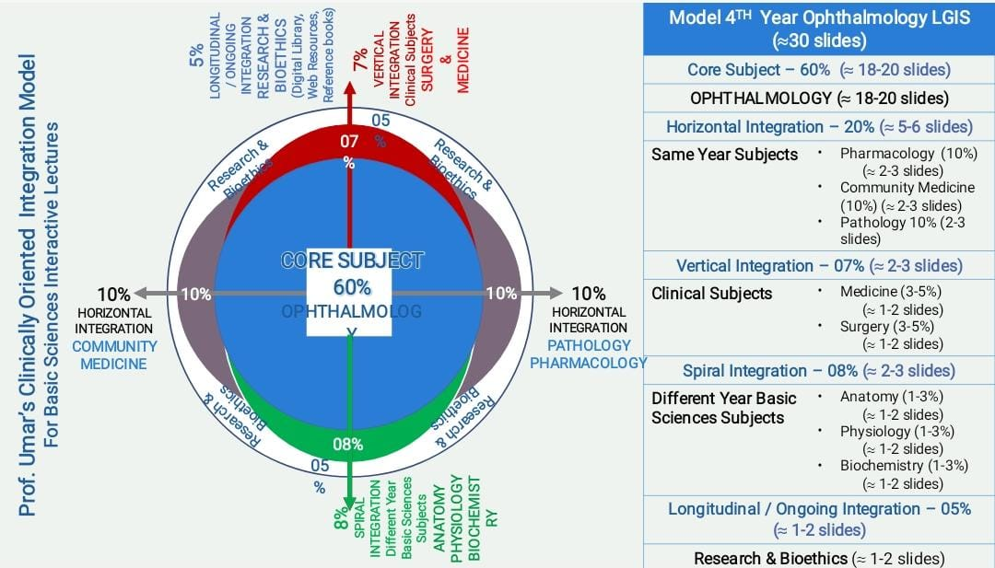
SEQUENCE OF LECTURE
VERTICAL INTEGRATION
HORIZONTAL INTEGRATION
CORE SUBJECT
EOLA (END OF LECTURE ASSESSMENT)
DIGITAL LIBRARY REFERENCES (RESEARCH, BIOETHICS, ARTIFICIAL INTELLIGENCE.)

Slide 3
LEARNING OBJECTIVES
AT THE END OF THIS SESSION, STUDENTS SHOULD BE ABLE TO
RECALL ANATOMY AND PATHWAY OF OPTIC NERVE
DESCRIBE THE CLINICAL FEATURES OF C.N PALSIES AND FACIAL SPASM
DESCRIBE OCULAR MOTALITY AND RELATED NEURONAL PATHWAY
DISCUSS THE TYPICAL FEATURES AND EVALUATION AND MANAGEMNET OF THE MOST COMMON OCULAR MOTOR NEUROPATHY (III, IV AND V)

Slide 4
Neuroanatomy
Vertical Integration

Slide 5
Horizontal Integration

Slide 6
Horizontal Integration

Slide 7
Core Subject

Slide 8
Core Subject

Slide 9
Core Subject

Slide 10
Core Subject

Slide 11
Core Subject

Slide 12
Core Subject

Slide 13
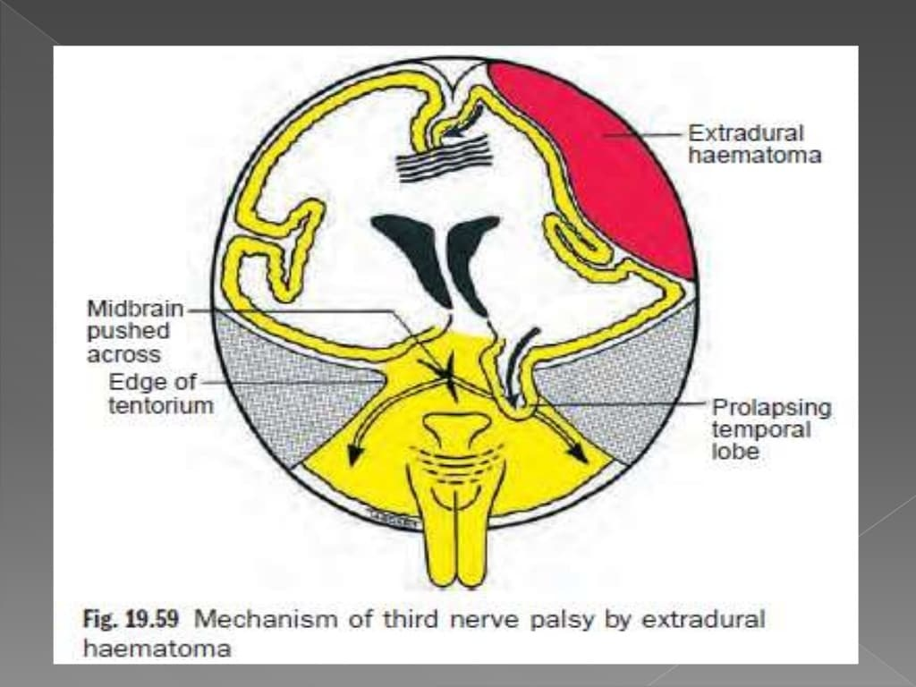
Core Subject

Slide 14
Core Subject

Slide 15
Core Subject

Slide 16
Core Subject

Slide 17
Core Subject

Slide 18
Core Subject

Slide 19
Core Subject

Slide 20
Core Subject

Slide 21
Core Subject

Slide 22
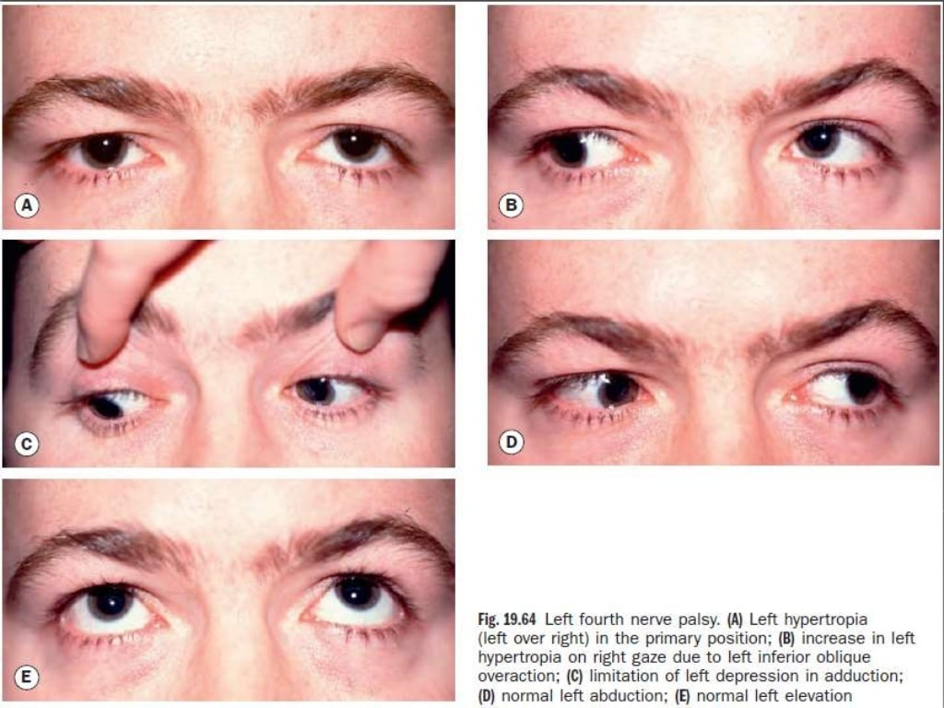
Core Subject

Slide 23
Core Subject

Slide 24
Core Subject

Slide 25
Core Subject

Slide 26
Core Subject

Slide 27
Core Subject

Slide 28
Core Subject

Slide 29
Core Subject

Slide 30
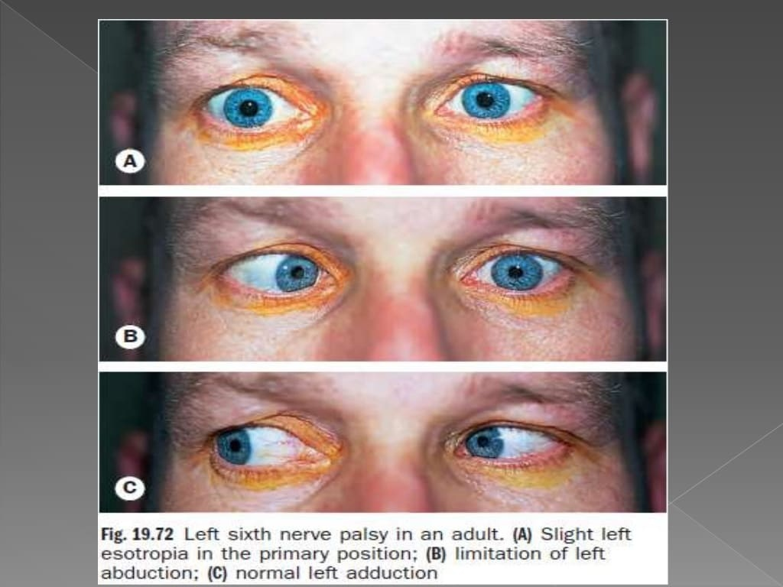
Core Subject

Slide 31
Core Subject

Slide 32
Core Subject

Slide 33
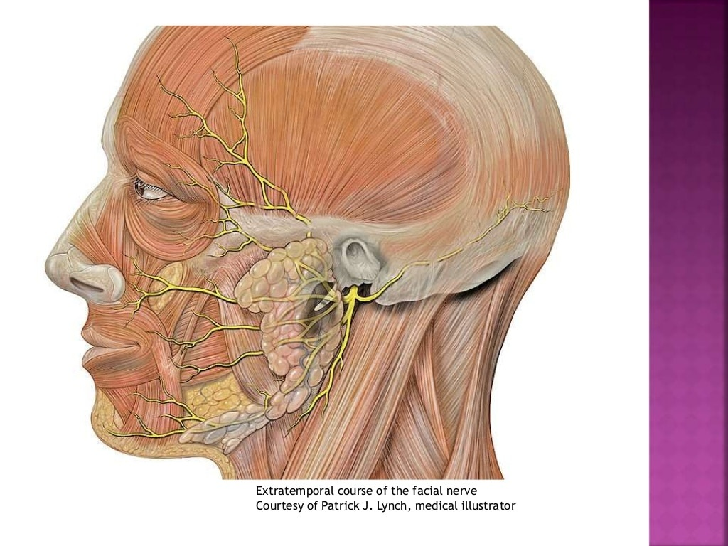

Slide 34
Core Subject

Slide 35
Core Subject

Slide 36
Core Subject

Slide 37
Core Subject

Slide 38
END OF LECTURE ASSESSMENT
A 60 year old male known diabetic for last 30 years presented in eye opd with complain of drooping of Rt upper eyelid for 1 day. He also complains of diplopia in the same eye. On examination visual acquity in both eyes is 6/12 and extraocular movement were restricted in all quadrants of Rt eye except in dextrodepression. Pupils were round regular and reactive.
What is your differential diagnosis?
How will you investigate this case?
How will you counsel the patient?

Slide 39
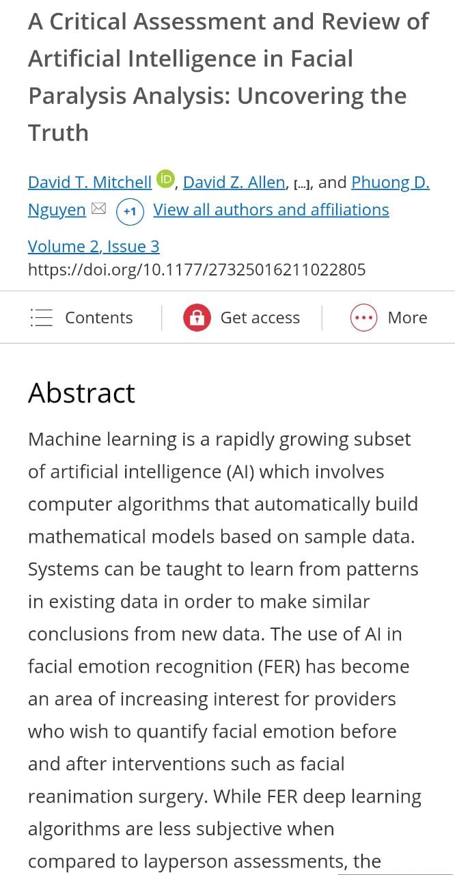
ETHICS AND RESEARCH
https://www.sciencedirect.com/science/article/abs/pii/S1529183906005975
ARTIFICIAL INTELLIGENCE
https://journals.sagepub.com/doi/10.1177/27325016211022805

Slide 40
REFERENCES
AAO, NEURO-OPHTHALMOLOGY, BCSC 2016-2017
OPHTHALMOLOGY AT A GLANCE 2015
KANSKI’S CLINICAL OPHTHALMOLOGY 9TH EDITION

