Slide 2
Clinico-Pathological Conference Medical Unit 1
Benazir Bhutto Hospital
Rawalpindi Medical University

Slide 4
Lost Steps, Faded Vision, Unable to Eat:
A Young Woman’s unexplained Ordeal
Dr Afshan Idrees
Postgraduate Resident
MU-I, BBH

Slide 5
Demographic Profile
Name: Miss XYZ
Age: 21 years old
Gender: Female
Address: Rawalpindi
Marital status: Single
Date of Admission: 13-02-2024
Mode of Admission: OPD

Slide 6
Presenting Complaints
Persistent vomiting ---- 10 days
Walking difficulty --- 2 days

Slide 7
History of Present illness
Vomiting:
Sudden in onset
Non-projectile
After every meal
Containing mostly food particles
No blood in vomitus
No retching, nausea, bloating, abdominal pain, abdominal distension or yellowish discoloration of eyes.

Slide 8
Walking Difficulty:
Due to sudden weakness of Right Lower Limb
Rapidly progressed to involve the Right Upper Limb within 24 hours.
Associated with numbness in both lower limbs.
Also developed urinary Retention, relieved by urinary catheterization.
Patient was wheelchair bound when she presented to OPD, needing support of two attendants to stand and walk.

Slide 9
No associated headache, backache or neck pain.
No episode of altered consciousness, fits, memory disturbance, facial deviation or weakness of any other part of body.
No speech or swallowing difficulty
No identifiable relieving or aggravating factors for these complaints.
There was no history of fever, weight loss, joints or bone pains, rash, oral ulcers or photosensitivity.

Slide 10
Patient was admitted two months back in eye department from 6-12-2023 to 9-12-2023, for the LOSS OF VISION in LEFT EYE for 3 days.
Sudden In Onset
Progressive
Painless
No Involvement Of Right Eye
Patient was diagnosed as a case of optic neuritis at that time and was given IV methylprednisolone pulse therapy for 3 days, after which her vision improved completely and she was subsequently discharged.

Slide 11
Systemic Inquiry
GENERAL | No history of fever, weight loss, lumps or bumps on body, changes in appetite or sleep disturbance
CARDIOVASCULAR | No history of chest pain, orthopnea , paroxysmal nocturnal dyspnea , palpitations , pedal edema.
RESPIRATORY | No history of cough, sputum production, shortness of breath, pleuritic chest pain.
GENITOURINARY | No history of burning micturition, dysuria , hematuria, frothy urine, lumbar pain or loin to groin pain

Slide 12
Medical History:
No history of diabetes, hypertension, tuberculosis, cardiovascular diseases or autoimmune disorders
Surgical history:
Unremarkable
Gynecological/Obstetric History:
Patient had menarche at age of 14
Menstrual cycle was regular

Slide 13
Family History:
No history of diabetes mellitus, hypertension, tuberculosis, cerebrovascular accident or autoimmune disorders.
Personal History:
Education: Intermediate
No history of recreational drug use or substance abuse.
Adequate nutritional intake from meat sources
Socioeconomic History:
Lives in a rented house with two bedrooms. Her father works on daily wages and is the sole earner of the family.

Slide 14
Clinical Examination

Slide 15
General Physical Examination
A young thin, lean lady lying on bed of average height and medium built.
Patient was conscious, oriented in time, place and person with vitals of
B.P: 100/70
Pulse: 82/min, regular good volume
R.R: 18/min
Temperature 98.6F
Saturation: 98 % on ambient air
BSR: 102 mg/dl

Slide 16
On Examination
No pallor
No clubbing, koilonychia, leukonychia, jaundice, neck swelling
No rash on body
No axillary or cervical lymph nodes palpable
No pedal edema

Slide 17
Higher Mental Functions
Patient was
Conscious
Oriented
Speech --- normal
Memory --- intact
Obeying commands

Slide 18
Eye Examination
Pupil: Regular, Bilaterally Reactive to light, No Relative Afferent Pupillary Defect (RAPD)
Visual Acuity --- 6/6 in both eyes
Extraocular movements --- Intact
Visual Field ---- Normal in both eyes
Fundus: Clear margins of optic disc with normal cup disc ratio. Clearly visible retinal vessels.no evidence of papilledema.
Remaining cranial nerve examination was also unremarkable

Slide 19
Motor System Examination
 | Right Upper and Lower Limb | Left Upper and lower Limb
Inspection
No muscle wasting, fasciculations, or visible deformity
No muscle wasting,
fasciculations, or visible deformity
Tone
Normal
Normal
Power
Upper Limb
Proximal: 2/5
Distal: 3/5
Lower Limb
Proximal: 2/5
Distal: 2/5
5/5
Deep Tendon Reflexes
Hyper-reflexia
Normal
Plantar reflex
Upgoing
Nonspecific

Slide 20
Sensory Examination
Sensory level
There was impaired pinprick, light touch & proprioception sensation in lower limbs up to T1 level.
Joint position and vibration sensation ---- Intact

Slide 21
Cerebellar Examination
Cerebellar examination was UNREMARKABLE

Slide 22
Localization of Lesion

Slide 23
Recurrent Multi focal disease
Persistent Vomiting
Dorsal Medullary Area Postrema
Hemiparesis and Sensory Loss
Cervical Cord Lesion predominantly left side
Optic Neuritis
Optic Nerve

Slide 24
Differential Diagnosis

Slide 25
Relapsing and Remitting Multiple Sclerosis
Neuromyelitis Optica with Spectrum Disorder
Chronic Infective etiology --- TB
Autoimmune disorder --- SLE
Vitamin B12 deficiency

Slide 26
Investigations

Slide 27
Blood Complete Picture
WBC Count | 6.7
RBC Count | 4.98
Hemoglobin | 15.5
HCT | 43.7
MCV | 87.8
MCH | 31.1
MCHC | 35.5
Platelets | 309

Slide 28
Electrolytes
Sodium | 132 mEq/L
Potassium | 3.90 mEq/L
Chloride | 97 mEq/L
Liver Function Tests
Bilirubin Total | 1.0 mg/dl
Alkaline Phosphate | 61.9 U/L
ALT | 14. 2 U/L
Renal Function Tests
Serum Creatinine | 0.4 mg/dl
Serum Urea | 18.69 mg/dl
Erythrocyte Sedimentation Rate
ESR | 5 mm/hr

Slide 29
Radiological Investigations Dr Hina Hanif HOD, Radiology Department, BBH

Slide 30
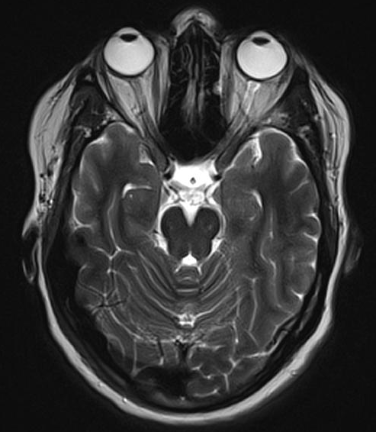

Slide 31
MRI Brain T1W1+ Contrast

Slide 32
MRI Brain T1W1

Slide 33
MRI SPINE T2W1 SAGITTAL

Slide 34
MRI SPINE T2W1 SAGITTAL

Slide 35
MRI Spine T2W1 SAGITTAL

Slide 36
MRI Spine T2W1 AXIAL

Slide 37
MRI Spine T2W1
AXIAL

Slide 38
Further Investigations

Slide 39
Cerebrospinal Fluid Examination
 | Patients’ Value | Normal Values
Appearance | Clear watery
Xanthochromia | Negative
LDH | 22 U/L | 0-40 U/L
Glucose | 59mg/dl | 40-74 mg/dl
Protein | 76.6mg/dl | 20-45mg/dl
RBCs | 02/cmm | /cmm
WBCs | 10/cmm | /cmm
Lymphocytes | 100% | %
No Oligoclonal bands seen on CSF

Slide 40
Relevant Investigations
 | Patients’ Value | Normal Range
HIV by ELISA | Negative
VDRL | Negative
Serum ANA | Negative
B12 levels | 450pg/mm | 190-950pg/mm

Slide 41
Serum Level
Anti Aquaporin 4 Ab --- POSITIVE

Slide 42
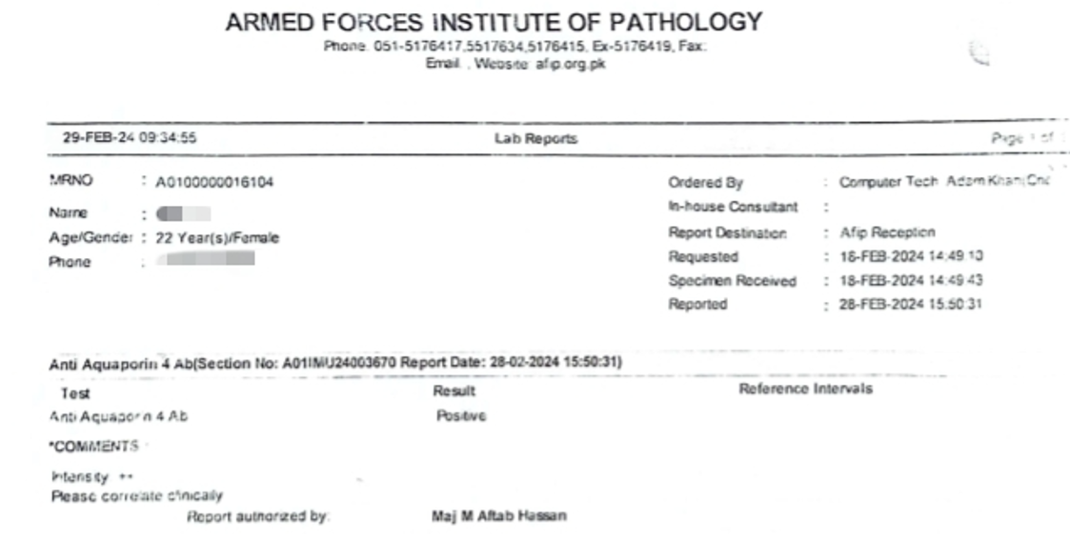

Slide 43
Diagnosis

Slide 44
MacDonald Criteria --- NOT fulfilled
No lesions in MRI Brain
No oligoclonal bands on CSF R/E
Multiple Sclerosis
No history of Fever, weight loss or TB Contact
ESR --- Normal
CSF R/E --- No finding suggestive of TB
Chronic Infective Etiology--- TB

Slide 45
No clinical history suggestive of SLE
No lesions on MRI Brain
ANA --- Negative
Autoimmune disorders --- SLE
Adequate dietary intake
No anemia
Vitamin B12 Level --- Normal
Vitamin B12 Deficiency

Slide 46
Differential Diagnosis
Differential Diagnosis
Final Diagnosis
DIFFERENTIAL DIAGNOSIS

Slide 47
Diagnosis
Neuromyelitis Optica with Spectrum Disorder
(Optic Neuritis, Longitudinally Extensive Transverse Myelitis, Area Postrema Syndrome)

Slide 48
Management

Slide 49
Patient was admitted to Medical ward
STEROID PULSE THERAPY
Injection methylprednisolone 1 gm once daily for 5 days followed by oral prednisolone
Injection omeprazole 40mg OD and Injection Ondansetron 8mg BD
Patient remained admitted for 13 days during which her weakness improved to 5/5

Slide 50
Oral Prednisolone 5mg
3 in morning
2 at night
Oral Prednisolone 5mg
2 in morning
2 at night
AFTER 2 WEEKS
Discharged on Medication
Oral Azathioprine 50mg
Twice a day
Follow up after 2 weeks advised

Slide 51
Follow Up Visit
Vomiting was settled
There was NO residual lower limb weakness
Patient was able to walk without assistance
Power was 5/5 in all limbs
Current medication was continued

Slide 52
Future Plan
Injection Rituximab

Slide 53
Literature Review Neuromyelitis Optica Spectrum Disorder (NMOSD) Dr Sana Ahmed (MBBS, MRCP (UK), FCPS Medicine, CHPE) SR Medicine Unit 1, BBH

Slide 54
Introduction:
NMOSD, also known as Devic’s disease, is an inflammatory disorder of the CNS.
Severe, immune-mediated demyelination and axonal damage.
Predominantly affects the:
optic nerves (optic neuritis) and
spinal cord (transverse myelitis)
https://rarediseases.org/rare-diseases/neuromyelitis-optica/
Notes:
According to the NORD,

Slide 55
Brief History:
First described over a century ago by Devic and Gault.
Previously considered a variant of multiple sclerosis(MS).
Discovery of disease-specific serum NMO-IgG antibody (anti-AQP4) led to its recognition as a distinct entity from classic relapsing-remitting multiple sclerosis.
Notes:
First described by Devic and Gault
It was previously believed that NMOSD and multiple sclerosis represented one disease entity with variable phenotypes and expression.
However, the discovery of a disease-specific serum NMO-immunoglobulin G (IgG) antibody that selectively binds aquaporin-4 (AQP4) has led to increased understanding that NMOSD is distinct from classic relapsing-remitting multiple sclerosis with respect to pathogenesis, imaging features, biomarkers, neuropathology, and treatment.

Slide 56
Epidemiology
Prevalence
0.37-10 per 100,000 adults (Papp et al., 2021)
Demographics
Female: male incidence ratio up to 10:1
Geographic/ Ethnic Distribution:
Asian/Black patients vs. White patients:
Median age of onset: 32-41 years
Higher prevalence of brain and brainstem involvement (Kim et al., 2018)
Younger mean age of onset
(Kim et al., 2018)
Risk Factors
Usually sporadic; few familial cases
Associated with other autoimmune conditions (SLE, Sjögren's, Myasthenia gravis)
Papp, V. et al. (2021) ‘Worldwide incidence and prevalence of neuromyelitis optica’, Neurology, 96(2), pp. 59–77. doi:10.1212/wnl.0000000000011153.
Kim, S.-H. et al. (2018) ‘Racial differences in neuromyelitis Optica Spectrum disorder’, Neurology, 91(22). doi:10.1212/wnl.0000000000006574.
Notes:
The prevalence of NMOSD in adults in various studies ranges from 0.37 to 10 per 100,000
The reported incidence of AQP4-antibody seropositive NMOSD in females is up to 10 times higher than in males Ethnic, geographic, and sex-based disparities are recognized
The median age of onset for NMOSD is 32 to 41 years
NMOSD is usually sporadic, though a few familial cases have been reported
Patients with autoimmune conditions including systemic lupus erythematosus, Sjögren's disease, and myasthenia gravis may have an increased risk of developing NMOSD

Slide 57
Clinical Features:
Hallmark Features:
Acute bilateral or sequential optic neuritis (severe visual loss, eye pain).
Transverse myelitis (limb weakness, sensory loss, bladder dysfunction).
With a typically relapsing course.
Attacks most often occur over days, with variable degrees of recovery over weeks to months (Ghezzi et al., 2004 , Kim et al., 2012)
Ghezzi, A. et al. (2004) ‘Clinical characteristics, course and prognosis of relapsing Devic?s neuromyelitis optica’, Journal of Neurology, 251(1), pp. 47–52. doi:10.1007/s00415-004-0271-0.
Kim SH, Kim W, Li XF, et al. Clinical spectrum of CNS aquaporin-4 autoimmunity. Neurology 2012; 78:1179
Notes:
Hallmark features of NMOSD include acute attacks of bilateral or rapidly sequential optic neuritis (leading to severe visual loss) or transverse myelitis (often causing limb weakness, sensory loss, and bladder dysfunction) with a typically relapsing course.
Attacks most often occur over days, with variable degrees of recovery over weeks to months

Slide 58
Clinical Features:
Brain and Brainstem Syndromes: (Tan, 2016)
Area postrema syndrome: nausea, vomiting, hiccups.
Hypothalamic: narcolepsy, sleepiness, obesity, autonomic issues.
Hyponatremia: SIADH or cerebral salt-wasting.
Other symptoms:
Muscle: autoimmune myopathy, hyper-CKemia.
Pain: 75-80% of patients, trunk/legs.
Tan, C.T. (2016) ‘International consensus diagnostic criteria for Neuromyelitis Optica Spectrum Disorders’, Neurology, 86(5), pp. 491–492. doi:10.1212/wnl.0000000000002366.
Notes:
In addition to optic neuritis, and transverse myelitis, other Brain and Brainstem Syndromes can develop
muscle may be a target of attacks in rare cases.
Pain is a common symptom

Slide 59
Investigations:
MRI, with and without contrast, of the brain and spinal cord
Cerebrospinal fluid (CSF) analysis
Serum for AQP4-IgG antibody
The detection of AQP4-IgG antibodies is
specific for confirming the diagnosis in appropriate clinical settings (Tan, 2016)
Tan, C.T. (2016) ‘International consensus diagnostic criteria for Neuromyelitis Optica Spectrum Disorders’, Neurology, 86(5), pp. 491–492. doi:10.1212/wnl.0000000000002366.
Notes:
The evaluation of suspected NMOSD entails the following investigations:
is used to distinguish from other entities such as multiple sclerosis, since for example oligoclonal bands are not usually present in NMOSD, unlike multiple sclerosis

Slide 60
Treatment: Acute Attacks
Initial treatment: High-dose IV methylprednisolone (1g daily for 3-5 days)
For severe symptoms or poor response: Add plasma exchange
Up to 7 exchanges every other day
More effective if started early with glucocorticoids
Limited data on IV immunoglobulin use (Sellner et al., 2011)
Sellner, J. et al. (2011) ‘Diagnosis and management of Neuromyelitis Optica’, European Handbook of Neurological Management, pp. 287–307. doi:10.1002/9781444346268.ch20.
Notes:
There are two aspects to the treatment of NMOSD
….
therapeutic plasma exchange is the suggested concomitant or rescue treatment

Slide 61
Long Term Attack Prevention:
Recommended agents for AQP4-IgG seropositive NMOSD: Eculizumab Inebilizumab
Satralizumab Ravulizumab
Rituximab(Sellner et al., 2011)
- Off-label options: Tocilizumab, azathioprine, mycophenolate mofetil
Duration: At least 5 years for AQP4-IgG seropositive patients (Many experts suggest lifelong therapy).
Sellner J, Boggild M, Clanet M, et al. EFNS guidelines on diagnosis and management of neuromyelitis optica. Eur J Neurol 2010; 17:1019
Notes:
Indicated as soon as NMOSD diagnosis is made

Slide 62
Prognosis:
90% have relapses, leading to significant disability
Within the first year: 60% of cases.
Within 3 years: 90% of cases
Stepwise deterioration from recurrent attacks.
Rare secondary progressive phase.
Mortality rates: 25-50% (Sellner et al., 2011)
Sellner, J. et al. (2011) ‘Diagnosis and management of Neuromyelitis Optica’, European Handbook of Neurological Management, pp. 287–307. doi:10.1002/9781444346268.ch20.

Slide 63
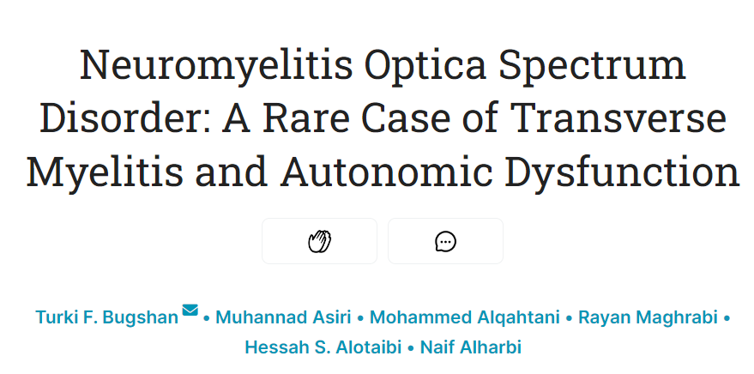

Slide 64
Neurological Perspective Neuromyelitis Optica Spectrum Disorder (NMOSD) Dr Waqas Ahmed Assistant Professor of Neurology Rawalpindi Medical University

