Slide 2
Chronic Obstructive Pulmonary Disease (COPD)
DR ABRAR AKBAR
ASSOCIATE PROF, MICU, HFH

Slide 3
UNIVERSITY MOTTO, VISION, VALUES & GOALS
MISSION STATEMENT
To impart evidence-based research-oriented health professional
education
Best possible patient care
Mutual respect, ethical practice of healthcare and social
accountability.
VISION AND VALUES
Highly recognized and accredited centre of excellence in
Medical Education,Using evidence-based training techniques
for development of highly Competent health professionals,
who are lifelong experiential learner and are Socially accountable.

Slide 4
GOALS
The Undergraduate Integrated Learning Program is geared
to Provide you with quality medical education.
Provide thorough grounding in the basic theoretical
concepts underpinning the practice of medicine.
Develop and polish the skills required for providing medical
services at all levels of the Health care delivery system.
Help you attain and maintain the highest possible levels of
ethical and professional conduct in your future life.
Kindle a spirit of inquiry and acquisition of knowledge to help
you attain personal and professional growth & excellence.

Slide 5
SEQUENCE OF LGIS
Learning objectives
Definition
Integration with pathophysiology
Types and risk factors of COPD
Related Clinical Features
Complications
Investigations
Management
Research articles related to topic
Ethics

Slide 6
LEARNING OBJECTIVES
AT THE END OF THIS LECTURE STUDENTS SHALL BE ABLE TO LEARN:
Definition and causes of COPD
Classification of COPD
Pathophysiology of COPD
Signs and symptoms of COPD
Investigations
Medical management
Recent advances
Ethics

Slide 8
DEFINITION
“A common preventable and treatable disease, is characterized by persistent airflow limitation that is usually progressive and associated with an enhanced inflammatory response in the airways and the lungs to noxious particles or gases.”
Exacerbations and co morbidities contributes to the overall severity in individual patients.

Slide 9
RISK FACTORS
SMOKING (ACTIVE / PASSIVE)
OCCUPATIONAL EXPOSURE
POLLUTION
POOR NUTRITION
SOCIOECONOMIC STATUS
ALCOHAL
AGE/ GENDER
FAMILIAL / INHERITED
MUCOUS HYPERSECRETION / AIRWAY HYPERRESPONSIVENES

Slide 10
BURDEN OF DISEASE
COPD was the 6th leading cause of death in the world in 1990.
Third leading cause by 2020.
4th leading cause by 2030.
Physical impairment, debility, reduced quality of life, and death.
High resource utilization due to acute exacerbations, and chronic therapy (eg, long-term oxygen therapy, medication)

Slide 14
PATHOPHYSIOLOGY

Slide 15
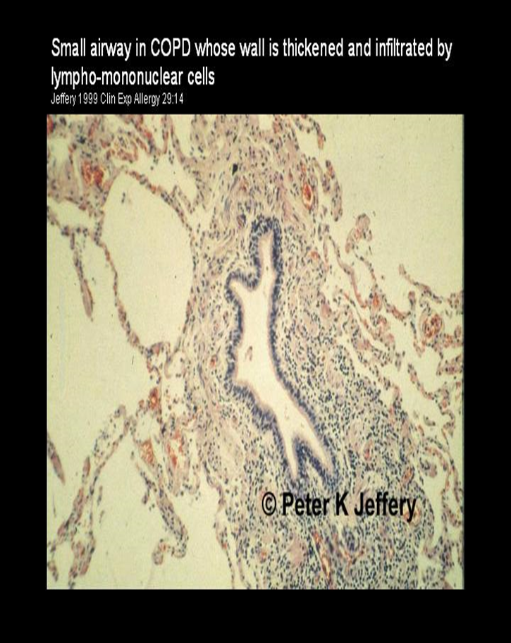
SMALL AIRWAYS: NORMAL & CH. BRONCHITIS

Slide 17
TWO CLASSICAL PHENOTYPES:
Chronic Bronchitis
Presence of cough and sputum for at least 3 months in each of 2 consecutive years.
Not necessary to have airflow limitations.
Emphysema
abnormal permanent enlargement of air spaces distal to the terminal bronchioles, accompanied by the destruction of alveolar walls and without obvious fibrosis.

Slide 18
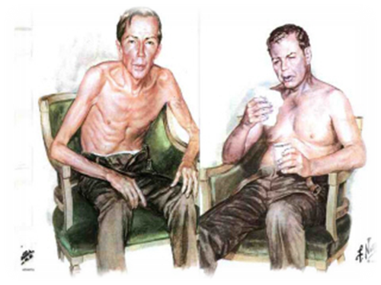
DIFFERENCES b/w EMPHYSEMA AND BRONCHITIS

Slide 19
CLINICAL FEATURES
Chronic cough
Sputum production
Chest tightness
Fever
Wheezing

Slide 20
ASSOCIATIONS OF DISEASE
Obesity
OSA
HTN
DM
Osteoporosis
Metabolic problems
Depression

Slide 21
HALLAMRK OF COPD
Limitation of expiratory airflow;
Progressive and irreversible
Accompanied by Systemic Signs

Slide 22
INVESTIGATIONS
CXR
Spirometry / PFTs
ABGs/oximetry
CBC
Sputum examination
ECG
HRCT chest
MMRC

Slide 23
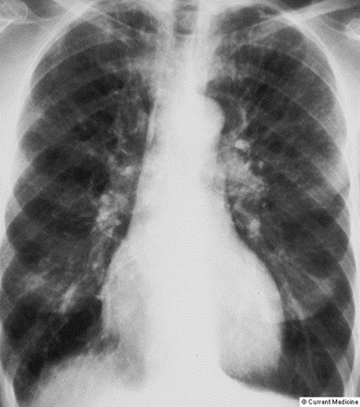
RADIOLOGY
CXR

Slide 24
SPIROMETRY
Spirometry is the gold standard.
Post bronchodilator FEV1/FVC < 0.70
Low FEV1 more than FVC
Ratio is also less than 0.7

Slide 25
DIAGNOSTIC STANDARD
Clinical diagnosis
Spirometry low FEV1 and ratio of FEV1/FVC is less than 0.7

Slide 26
Severity OF COPD…..GOLD

Slide 27
New ABCD classification

Slide 28
Treatment Goals
To improve the quality of life
To avoid exacerbation
To control the associated complications

Slide 29
Treatment
LABA/LAMA
LABA/ICS
Antibiotics
Oral/i.v steroids
LABA/LAMA/ICS
Diuretics
Oxygen
Methylxanthine

Slide 30
According to GOLD/ABCD

Slide 32
Complications of COPD
Frequent exacerbations
Respiratory failure
Cor pulmonale
Osteoporosis
Recurrent infections
Sec. polycythemia
Pneumothorax
Pulmonary cachexia

Slide 33
Non pharmacological treatment
Vaccination (pneumococcal and flu)
Pulmonary Rehabilitation
Vitamin supplementation
Smoking cessation
Oxygen

Slide 34
Oxygen: Indications
PaO2<59, >55 but PaCo2>45
PaO2<55
Acute exacerbation

Slide 35
Role of surgery
Bullectomy
Stapling and pleurodesis for pneumothorax
Lung transplantation

Slide 36
Acute Exacerbation of COPD
“Changes in symptom and sign of a COPD Patient that leads to changes in treatment”.
Worsening of SOB
Increase in quantity of sputum
Increase in purulence of sputum

Slide 37
Precipitating factors
Infection
Non compliant to treatment
Improper inhaler technique
Pneumothorax
Old age
Sepsis

Slide 38
Treatment of AECOPD
Antibiotics
i.v/Oral corticosteroids
SABA/SAMA/ICS
LABA/LAMA/ICS
Controlled oxygen via venturi
BiPAP
Invasive ventilation
DVT prophylaxis

Slide 39
FOLLOW UP
Inhaler technique
Compliance to treatment
Smoking cessation
Vaccination
Diet
Rehabilitation

Slide 40
COUNSELLING
Smoking cessation
Make sure compliance to Rx
Vaccination
Healthy life style

Slide 41
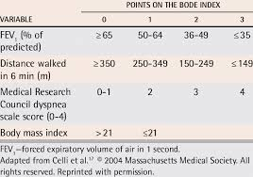
PROGNOSIS …BODE index

Slide 42
RESEARCH
Aaron SD, Vandemheen KL, Whitmore GA, Bergeron C, Boulet LP, Côté A, McIvor RA, Penz E, Field SK, Lemière C, Mayers I. Early diagnosis and treatment of COPD and asthma—a randomized, controlled trial. New England Journal of Medicine. 2024 Jun 13;390(22):2061-73.

Slide 43
ETHICS
Before doing any medical treatment, informed consent must be taken
Prognosis should be explained to patients and attendants

Slide 44
Thank you

