Slide 2
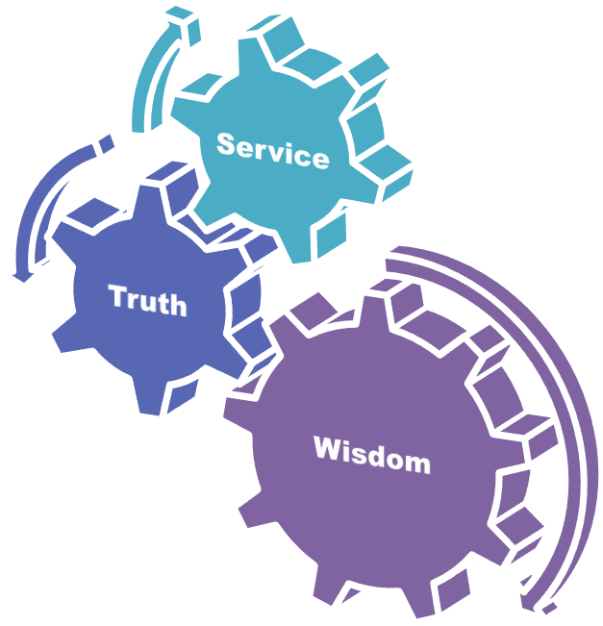
University Motto, Vision, Values & Goals
Mission Statement
To impart evidence-based research-oriented health professional education
Best possible patient care
Mutual respect, ethical practice of healthcare and social accountability.
Vision and Values
Highly recognized and accredited centre of excellence in
Medical Education, using evidence-based training techniques for development of highly competent health
professionals, who are lifelong experiential learner and are socially accountable.
Goals
The Undergraduate Integrated Learning Program is geared to provide you with quality medical education in an environment designed to:

Slide 3
SEQUENCE OF LGIS
Learning objectives
Core Subject (70%)
Vertical Integration (10%)
Horizontal Integration (15%)
Research (3%)
Biomedical Ethics (2%)

Slide 4
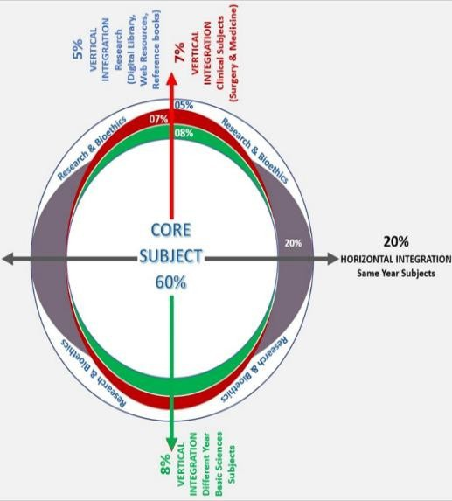
PROF UMER MODEL OF INTEGRATED LECTURE

Slide 5
CORE SUBJECT

Slide 6
Congenital Anomalies of Upper Urinary Tract
Structural or functional abnormalities of the kidneys, ureters, or their embryological derivatives that arise due to developmental defects during fetal life. These anomalies can affect renal formation, migration, differentiation, or fusion and may lead to complications such as hydronephrosis, recurrent urinary tract infections, hypertension, or renal failure.

Slide 7
Classification
Renal Agenesis & Hypoplasia – Absence (agenesis) or underdevelopment (hypoplasia) of one or both kidneys.
Renal Dysplasia & Polycystic Kidney Disease – Abnormal differentiation leading to cystic or dysplastic kidneys.
Fusion Anomalies – Conditions like horseshoe kidney, where kidneys are abnormally joined.
Ectopic Kidney – Kidney located outside its normal anatomical position (e.g., pelvic kidney).
Ureteral Anomalies – Includes duplex ureter, ureterocele, and vesicoureteral reflux (VUR) affecting urine drainage.
Obstructive Anomalies – Conditions like pelviureteric junction obstruction (PUJO) leading to hydronephrosis.

Slide 8
VERTICAL INTEGRATION WITH EMBRYOLOGY

Slide 9
EMBRYOLOGY
Upper renal tract is derived from three structures
Metanephros (mature form)
Mesonephros
Pronephros (most immature form)
Development begins at 4 weeks and completed by 36 weeks
antenatally.

Slide 10
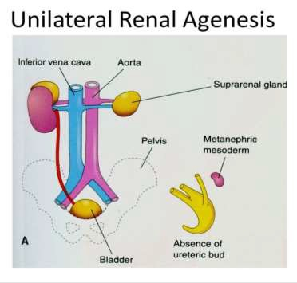
RENAL AGENESIS
It is defined as absence of kidneys
Mostly it is due to failure of mesonephric duct to bud.
It can be unilateral or bilateral.

Slide 11
RENAL DYSPLASIA
It is abnormal metanephric differentiation
It may result in cartilage/cystic structure.
Most common cystic anomaly is adult polycystic kidney disease which is common in adults
Other is multicystic dysplastic kidney disease which is incompatible with life.

Slide 12
ADULT POLYCYSTIC KIDNEY DISEASE(APKD)
Autosomal dominant inherited disorder
95% occur in both kidneys
Symptoms occur by 30 yrs
Had association with berry aneurysms.
Clinically patient presents with pain, hematuria, infection,
hypertension and in late stages uremia.

Slide 13
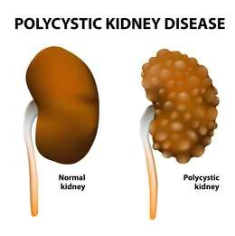
Diagnosis is by USG , CT SCAN
Treatment involves low protein diet , adequate fluid.
Infection and hypertension to be treated accordingly.
Renal transplantation in late stages.

Slide 14
HORSE SHOE KIDNEY
Incidence 1 in 400-800 live births
Commonest fusion anomaly of kidney
Kidneys are fused together at lower pole and lie at level of L3-L4 vertebrae.
It is due to arrest of ascent of isthmus by inferior mesenteric kidney.

Slide 15
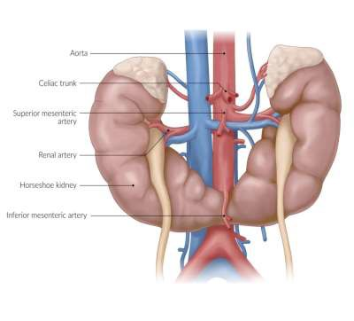
Diagnosis is by USG and IVU.
Kidneys are malrotated with pelvis facing anteriorly.
Surgery is indicated when there is infection/stones formation.

Slide 16
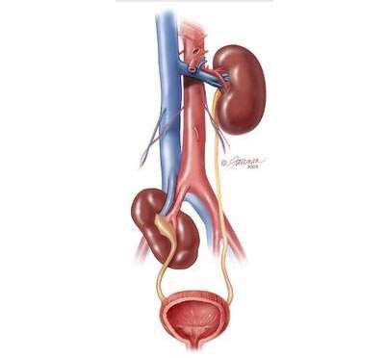
RENAL ECTOPIA
Presence of kidney in any other location other than its
normal position.
Most common location is in pelvis.

Slide 17
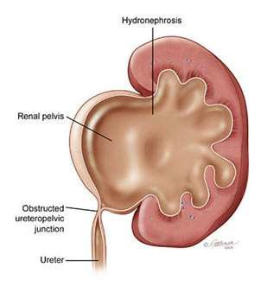
PELVIURETERIC JUNCTION OBSTRUCTION

Slide 18
PELVIURETERIC JUNCTION OBSTRUCTION
It is defined as obstruction at junction of renal pelvis and
proximal ureteric aspect.
It is most common cause of hydronephrosis in neonates
it can be primary(congenital) or secondary(acquired)
Congenital causes may include extrinsic or intrinsic factors
In extrinsic cause most common is crossing of aberrant vessels at lower pole of kidney
Intrinsic cause is due to abnormal musculature in PUJ junction.

Slide 19
Clinically patient may present with flank pain , vomiting
induced by increase fluid intake.
Investigations include Antenatal and postnatal USG.
MCUG is done to rule out VUR
Renal scan is done to rule out renal scarring
Treatment involves conservative treatment in mild hydronephrosis.
Surgical treatment in symptomatic obstruction
Procedure of choice is ANDERSON HYNES DISMEMBERED PYELOPLASTY.

Slide 20
URETERIC DUPLICATION
WEIGERT MEYER RULE
It states that 2 ureters arise from kidney
Upper pole moiety drains into bladder inferiorly and medially hence obstructing in nature
Lower pole moiety drains into bladder superiorly and laterally hence refluxing in nature.

Slide 21
VERTICAL INTEGRATION WITH RADIOLOGY

Slide 22
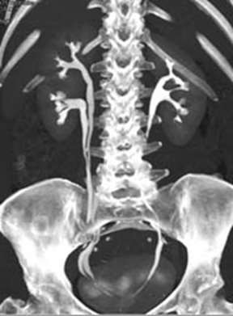
CTU showing duplex ureter

Slide 23
VESICOURETERIC REFLUX(VUR)
It is defined as retrograde flow of urine from bladder in
ureters and kidneys.
Divided into 5 grades
Grade 1 reflux into nondilated/normal ureter
Grade 2 reflux into nondilated/normal ureter and kidney
Grade 3 mild dilatation of ureter and kidney
Grade 4 moderate dilatation of ureter and kidney
Grade 5 gross dilatation, clubbing of kidney and tortuisity of ureter

Slide 24
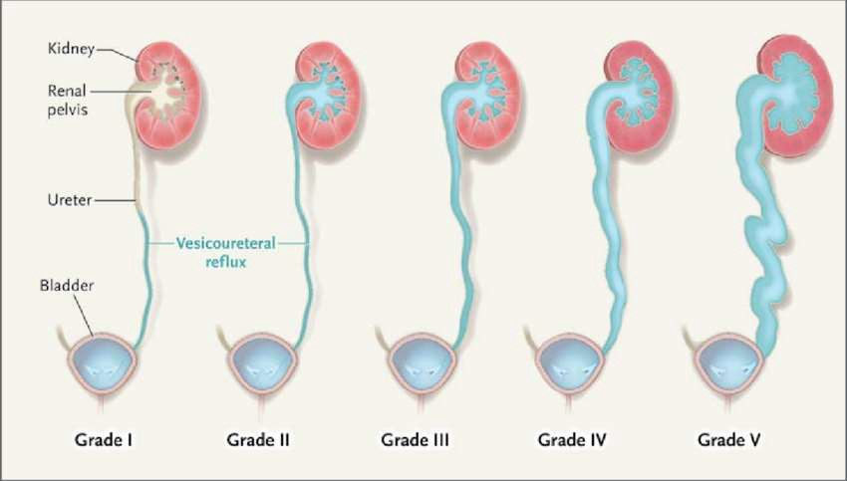

Slide 25
It can be primary or secondary
Primary occurs when intramural length of ureter is too
short( length to diameter ratio is less than 1:5)
Secondary causes include BOO,PUV,BPH and neurogenic
bladder
Clinically patient presents with flank pain,recurrent UTI or renal failure in late stages
Investigations include MCUG, USG and DMSA renal scan for renal function.

Slide 26
Treatment involves prolonged antibiotic therapy
If renal function comromise then endoscopic injection of deflux can be given and ureteric implantation is also another option.
Deflux is a gel that is used to inject around ureteral opening.

Slide 27
URETEROCELE
It is a cystic dilatation of distal part of ureter as it enters the
bladder.
Females are more prone to it.
It occurs with upper moiety of duplex kidney.
Investigation involves IVU
Classical cobra head appearance is seen.
Endoscopic puncture of cyst if symptomatic.

Slide 28
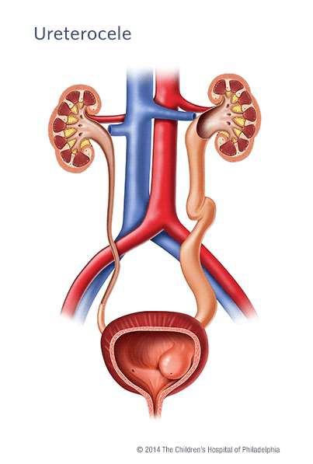
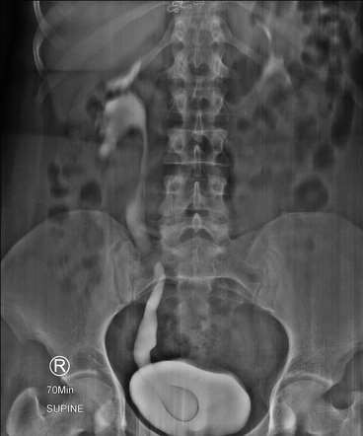

Slide 29
Spiral Integration with Family Medicine:
Emphasize early detection and long-term follow-up of congenital renal anomalies in primary care settings.
Role of general practitioners in monitoring renal function and preventing complications.

Slide 30
Spiral Integration with Biomedical Ethics:
Ethical considerations in prenatal diagnosis and genetic counseling for hereditary renal diseases.
Discuss the decision-making process for interventions, especially in conditions incompatible with life.

Slide 31
Research:
Recent advances in genetic studies related to congenital renal anomalies.
Emerging diagnostic and surgical techniques, such as minimally invasive pyeloplasty and tissue engineering in urology.
https://pubs.rsna.org/doi/full/10.1148/rg.2021200078

Slide 32
REFERENCES
Campbells urology 12th edition
Smith and Tanaghos urology 9th edition
EAU 2024 guidelines

