Slide 1
Congenital anomalies of upper renal tract
Renal Module
4th Year MBBS
Dr. Kiran Fatima
Pathology Department
Rawalpindi Medical University

Slide 2

MOTTO OF RMU
Wisdom
Truth
Service

Slide 3
VISION OF RMU
THE DREAM/ TOMORROW
To impart evidence based research oriented medical education
To provide best possible patient care
To inculcate the values of mutual respect and ethical practice of medicine

Slide 4
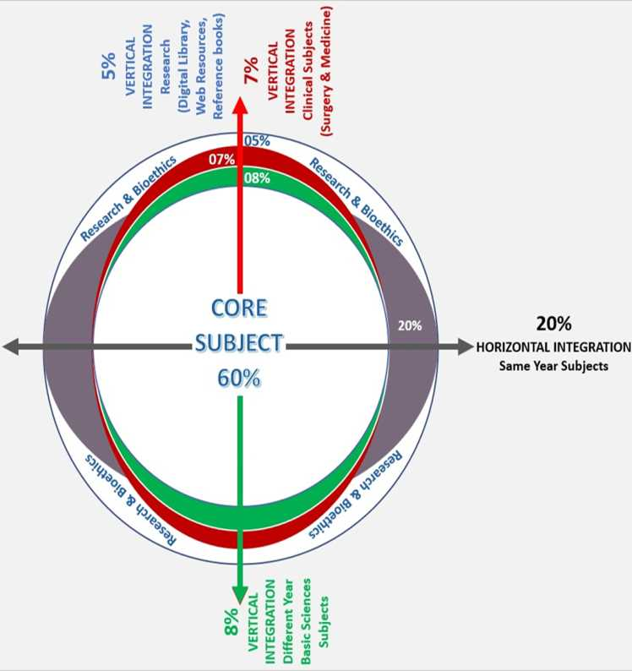
PROF UMAR’S LGIS MODEL

Slide 5
How to use HEC Digital Library
Steps to Access HEC Digital Library
Go to the website of HEC National Digital Library.
On Home Page, click on the INSTITUTES.
A page will appear showing the universities from Public and Private Sector and other Institutes which have access to HEC National Digital Library (HNDL).

Slide 6
How to use HEC Digital Library
Steps to Access HEC Digital Library
Go to the website of HEC National Digital Library.
On Home Page, click on the INSTITUTES.
A page will appear showing the universities from Public and Private Sector and other Institutes which have access to HEC National Digital Library (HNDL).

Slide 7
4. Select your desired Institute.
5. A page will appear showing the resources of the institution
6. Journals and Researches will appear
7. You can find a Journal by clicking on JOURNALS AND DATABASE and enter a keyword to search for your desired journal.

Slide 8
Learning objectives
Identifying the different types of congenital anomalies affecting the kidneys and ureters.
Understanding the embryological basis and developmental mechanisms leading to these anomalies.
Recognizing the clinical presentations and associated symptoms of these anomalies.
Learning about the diagnostic approaches used to detect and evaluate these anomalies.

Slide 9
Embryology
Core Content
Upper renal tract is derived from three structures
Metanephros (mature form)
Mesonephros
Pronephros (most immature form)
Development begins at 4 weeks and completed by 36 weeks antenatally.

Slide 10
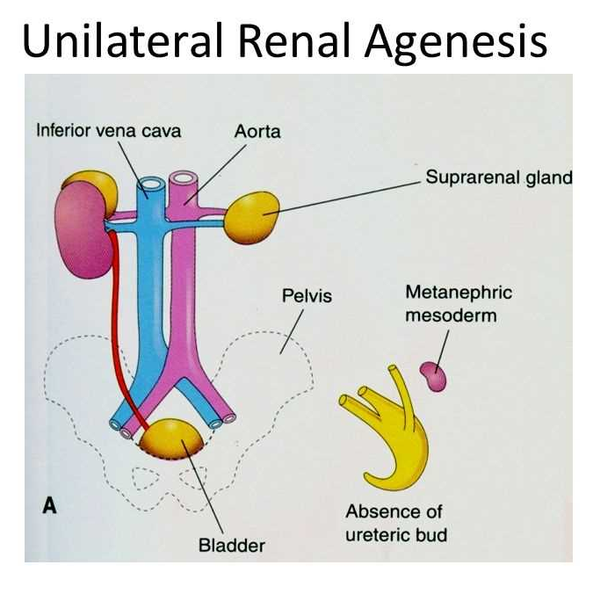
Renal agenesis
Core Content
It is defined as absence of kidneys
Mostly it is due to failure of mesonephric duct to bud.
It can be unilateral or bilateral.

Slide 11
Renal dysplasia
Core Content
It is abnormal metanephric differentiation
It may result in cartilage/cystic structure.
Most common cystic anomaly is adult polycystic kidney disease which is common in adults
Other is multicystic dysplastic kidney disease which is incompatible with life.

Slide 12
Adult polycystic kidney disease(apkd)
Core Content
Autosomal dominant inherited disorder
95% occur in both kidneys
Symptoms occur by 30 yrs
Had association with berry aneurysms.
Clinically patient presents with pain, hematuria, infection, hypertension and in late stages uremia.

Slide 13
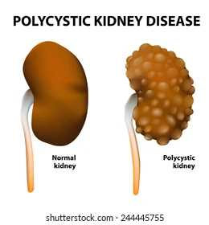
Core Content
Diagnosis is by USG , CT SCAN
Treatment involves low protein diet , adequate fluid.
Infection and hypertension to be treated accordingly.
Renal transplantation in late stages.

Slide 14
Horse shoe kidney
Core Content
Incidence 1 in 400-800 live births
Commonest fusion anomaly of kidney
Kidneys are fused together at lower pole and lie at level of L3-L4 vertebrae.
It is due to arrest of ascent of isthmus by inferior mesenteric kidney.

Slide 15
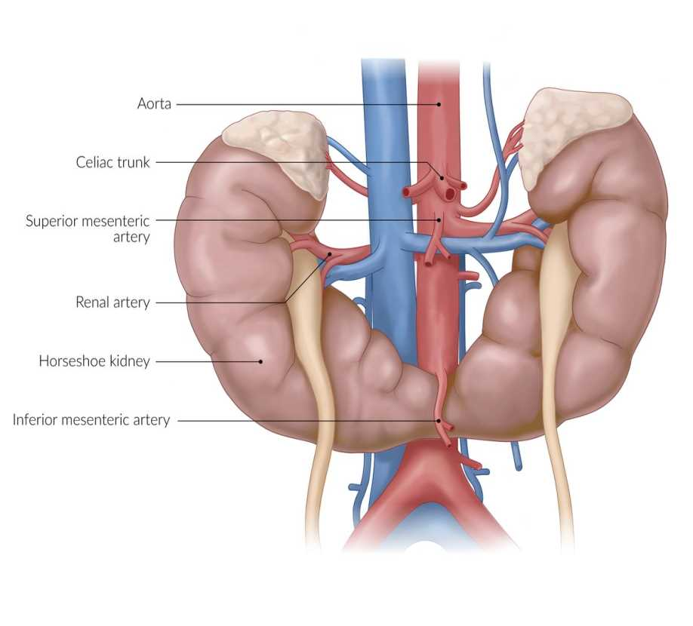
Core Content
Diagnosis is by USG and IVU.
Kidnys aere malrotated with pelvis facing anteriorly.
Surgery is indicated when there is infection/stones formation.

Slide 16
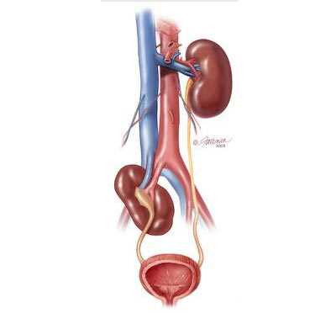
Renal ectopia
Core Content
Presence of kidney in any other location other than its normal position.
Most common location is in pelvis.

Slide 17
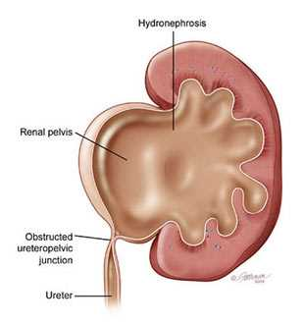
Pelviureteric Junction Obstruction
Core Content

Slide 18
Pelviureteric junction obstruction
Core Content
It is defined as obstruction at junction of renal pelvis and proximal ureteric aspect.
It is most common cause of hydronephrosis in neonates
it can be primary(congenital) or secondary(acquired)
Congenital causes may include extrinsic or intrinsic factors
In extrinsic cause most common is crossing of aberrant vessels at lower pole of kidney
Intrinsic cause is due to abnormal musculature in PUJ junction.

Slide 19
Core Content
Clinically patient may present with flank pain , vomiting induced by increase fluid intake.
Investigations include Antenatal and postnatal USG.
MCUG is done to rule out VUR
Renal scan is done to rule out renal scarring
Treatment involves conservative treatment in mild hydronephrosis.
Surgical treatment in symptomatic obstruction
Procedure of choice is Anderson Hynes Dismembered Pyeloplasty.

Slide 20
Ureteric duplication
Core Content
Weigert meyer rule
It states that 2 ureters arise from kidney
Upper pole moiety drains into bladder inferiorly and medially hence obstructing in nature
Lower pole moiety drains into bladder superiorly and laterally hence refluxing in nature.

Slide 21
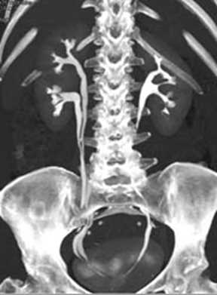
CTU showing duplex ureter

Slide 22
Vesicoureteric reflux(VUR)
Core Content
It is defined as retrograde flow of urine from bladder in ureters and kidneys.
Divided into 5 grades
Grade 1 reflux into nondilated/normal ureter
Grade 2 reflux into nondilated/normal ureter and kidney
Grade 3 mild dilatation of ureter and kidney
Grade 4 moderate dilatation of ureter and kidney
Grade 5 gross dilatation, clubbing of kidney and tortuisity of ureter

Slide 23
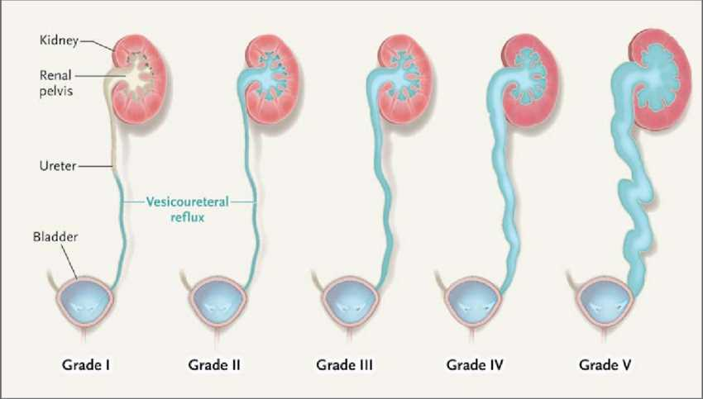

Slide 24
Core Content
It can be primary or secondary
Primary occurs when intramural length of ureter is too short( length to diameter ratio is less than 1:5)
Secondary causes include BOO,PUV,BPH and neurogenic bladder
Clinically patient presents with flank pain,recurrent UTI or renal failure in late stages
Investigations include MCUG, USG and DMSA renal scan for renal function.

Slide 25
Integration Horizontal
Treatment involves prolonged antibiotic therapy
If renal function comromise then endoscopic injection of deflux can be given and ureteric implantation is also another option.
Deflux is a gel that is used to inject around ureteral opening.

Slide 26
Ureterocele
Core Content
It is a cystic dilatation of distal part of ureter as it enters the bladder.
Females are more prone to it.
It occurs with upper moiety of duplex kidney.
Investigation involves IVU
Classical cobra head appearance is seen.
Endoscopic puncture of cyst if symptomatic.

Slide 27
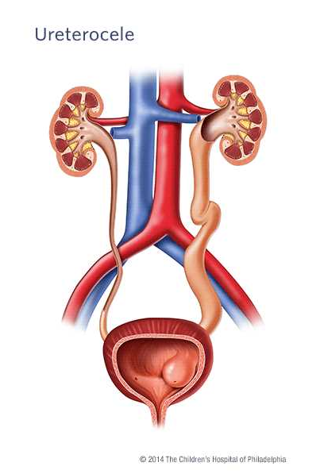
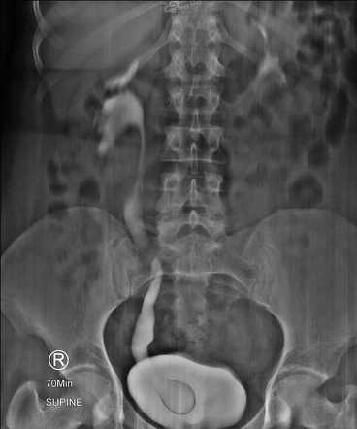

Slide 28
Family medicine
A 5-year-old child presents with recurrent urinary tract infections and daytime wetting. An ultrasound reveals hydronephrosis (swelling of the kidney due to a blockage of urine flow) on the right side.
What is the most likely underlying cause of this child's hydronephrosis?
Posterior urethral valves
b) Ureteropelvic junction obstruction
c) Vesicoureteral reflux
d) Renal calculi (kidney stones)

Slide 29
Research
https://pubmed.ncbi.nlm.nih.gov/33513074/
Congenital Anomalies of the Upper Urinary Tract: A Comprehensive Review
Abdallah P Houat ¹, Cassia T S Guimarães ¹, Marcelo S Takahashi ¹, Gustavo P Rodi ¹, Taísa P D Gasparetto ¹, Roberto Blasbalg ¹, Fernanda G Velloni ¹
Affiliations
PMID: 33513074
DOI: 10.1148/rg.2021200078
Erratum in
Congenital Anomalies of the Upper Urinary Tract: A Comprehensive Review.
Houat AP, Guimarães CTS, Takahashi MS, Rodi GP, Gasparetto TPD, Blasbalg R, Velloni FG.Radiographics. 2021 Sep-Oct;41(5):E165. doi: 10.1148/rg.2021219009.PMID: 34469224 No abstract available.
Abstract
The upper urinary tract is the most common human system affected by congenital anomalies. Congenital anomalies of the kidneys and ureters comprise a wide spectrum of disorders ranging from simple variants with no clinical significance to complex anomalies that may lead to severe complications and end-stage renal disease. They may be classified as anomalies of renal form, which are subclassified as structural anomalies (eg, persistent fetal lobulation, hypertrophied column of Bertin, and dromedary hump) and fusion anomalies (eg, horseshoe kidney and pancake kidney); anomalies of renal position (eg, renal malrotation, simple renal ectopia, and crossed renal ectopia) and renal number (eg, renal agenesis and supernumerary kidney); and abnormalities in development of the urinary collecting system (eg, pyelocaliceal diverticulum, megacalycosis, ureteropelvic junction obstruction, duplex collecting system, megaureter, ectopic ureter, and ureterocele). US is usually the first imaging modality used because of its low cost, wide availability, and absence of ionizing radiation. Intravenous urography and voiding cystourethrography are also useful, mainly for characterization of the collecting system and vesicoureteral reflux. However, intravenous urography has been replaced by CT urography and MR urography. These imaging methods not only allow direct visualization of the collecting system but also demonstrate the function of the kidneys, the vascular anatomy, adjacent structures, and complications. Comprehension of congenital anomalies of the upper urinary tract is crucial for an accurate diagnosis and correct management. The authors discuss the spectrum of these anomalies, with emphasis on embryologic development, imaging findings, clinical manifestations, and complications. Online supplemental material is available for this article. ©RSNA, 2021.

Slide 30
Take home message
These anomalies involve structural or functional abnormalities of the kidneys, ureters, or renal pelvis present at birth.
They can range from asymptomatic variations to severe conditions causing kidney damage or failure.
Common examples include renal agenesis (absence of a kidney), multicystic dysplastic kidney (abnormal kidney development), and ureteropelvic junction obstruction (blockage where the ureter joins the kidney).

Slide 31


