Slide 1
بسم الله الرحمن الرحيم

Slide 2
CO POISONING AND CORROSIVE INTAKE
Dr Shahzad Manzoor
Professor of Medicine
BBH Hospital Rwp.

Slide 3
Professor Umar’s Model of Integrated Lecture

Slide 4
MISSION AND VISION
MISSION To impart evidence-based research-oriented health professional education Best possible patient care Mutual respect, ethical practice of healthcare and social accountability. Vision and Values Highly recognized and accredited centre of excellence in Medical Education, using evidence-based training techniques for development of highly competent health professionals, who are lifelong experiential learner and are socially accountable. Goals The Undergraduate Integrated Learning Program is geared to provide you with quality medical education in an environment designed to learn an grow.

Slide 5
LEARNING OBJECTIVES
By the end of this lecture, all final year MBBS students should be able to
Diagnose case of carbon monoxide poisoning.
Describe the management of CO poisoning.

Slide 6
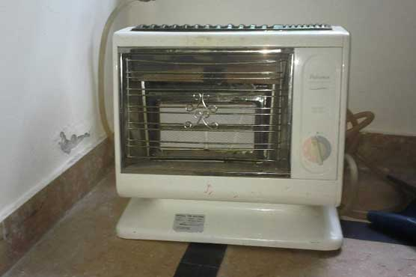
CARBON MONOXIDE POISONING

Slide 7
NEWS PAPER

Slide 8
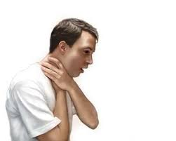
SUFFOCATION

Slide 9
CO POISONING CORE CONCEPT
Only 3% of the O₂ in the blood is dissolved, the remaining 97% is transported in combination with Hb.
The O₂ bound to Hb does not contribute to the PO₂ of the blood (Dissolved oxygen).
CO has a very strong affinity for Hemoglobin, even at a very low concentration its readily binds with Hb and displaces oxygen from Hb.

Slide 10
CARBON MONOXIDE-HEMOGLOBIN DISSOCIATION CURVE

Slide 11
CO POISONING CORE CONCEPT
PO2 of blood Maybe Normal as CO doesn’t affect the dissolved oxygen level. So, no signs of Hypoxemia.
Feedback Mechanism to hypoxia is Absent and the patient shows no symptoms of any struggle.
Disorientation & Unconsciousness occurs before becoming aware

Slide 12
TREATMENT VERTICAL INTEGRATION
Pure oxygen
Hyperbarric Oxygen therapy which Displaces CO
5 % CO₂
stimulates the respiratory center and causes 10 times rapid removal of CO from blood.

Slide 13
CORROSIVE INTAKE

Slide 14
CASE REPORT CORE CONCEPT
A 35 Years old male shopkeeper by profession arrived at DHQ emergency with a history of ingestion of washroom cleaner after a dispute with his spouse. On examination, his pulse rate was 200 beats per minute. His B.P was 80/50mmHg. He was immediately resuscitated.

Slide 15
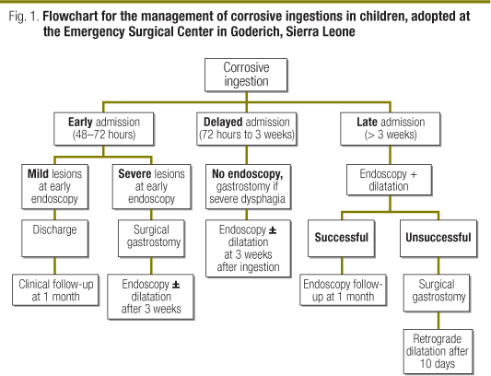
VERTICAL INTEGRATION

Slide 16
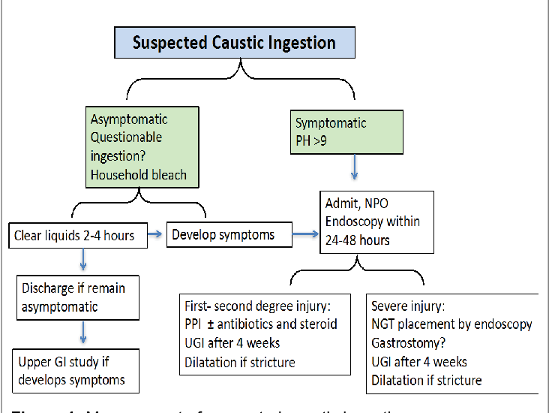
HORIZONTAL INTEGRATION

Slide 17
References
Fucili, G., Brauzzi, M. Tips for avoiding common mistakes in out-of-hospital diagnosis of carbon monoxide poisoning. J Anesth Analg Crit Care 2, 14 (2022).
ROSE JJ, WANG L, XU Q, et al. Carbon Monoxide Poisoning: Pathogenesis, Management, and Future Directions of Therapy. Am J Respir Crit Care Med. 2017;195(5):596-606.
YANAGIHA K, ISHII K, TAMAOKA A. Acetylcholinesterase inhibitor treatment alleviated cognitive impairment caused by delayed encephalopathy due to carbon monoxide poisoning: two case reports and a review of the literature. Medicine (Baltimore). 2017;96(8):e6125.
BANO D, ANKARCRONA M. Beyond the critical point: An overview of excitotoxicity, calcium overload and the downstream consequences. Neurosci Lett. 2018;663:79-85.
ZHAO N, LIANG P, ZHUO X, et al. After treatment with methylene blue is effective against delayed encephalopathy after acute carbon monoxide poisoning. Basic Clin Pharmacol Toxicol. 2018;122(5):470-480.
ZHANG W, YU J, GUO M, et al. Dexmedtomidine attenuats glutamate-induced cytotoxicity by inhibiting the mitochondrial mediated apptotic pathway. Med Sci Monit. 2020;26:922139.

Slide 18
THANK YOU !!!!!

